Slide 1

Family Study
By
Dr. Swati Khan

Slide 2
LEARNING OBJECTIVES
To know about physical & social environment of family
To know regarding salient features of Index case
To know about health interventions that can be done

Slide 3
FAMILY BIODATA (HOUSE NO – 137)
Religion – Hindu
Caste – Schedule Caste (Dhobi)
Type of Family – Nuclear
Name | Relationship with HOF | Age/sex | Marital status | Education | Occupation
Joga Singh | Self | 40 yrs/M | Married | Illiterate | Farmer
Rajwinder Kumari | Wife | 33 yrs/F | Married | 10th Class | Housewife
Sandeep Kumari | Daughter | 12yrs/F | Unmarried | 12th Class | Student
Sajan Singh | Son | 8 yrs/M | Unmarried | 9th Class | Student
Shammi Kumari | Daughter | 5 yrs/F | Unmarried | 6th Class | Student
Charanjit Singh | Son | 2 yrs/M | Unmarried | 1st Class | Student

Slide 4
Salient Features
SE status
  KS scale – Upper lower (10)
Physical Environment
  House – katcha–pacca
  Kitchen – Separate & Closed (use Cow Dung)
  No cross ventilation
  Insect breeding places - Present

Slide 5
  Over Crowding
    Person per room – Present ( 2 rooms)
    Floor Space – Present ( total floor area – 270 square feet)
    Sex separation – Present
Water
  Submersible pump (Depth – 120 meters)
  Contamination Source – 500 meters ( Chappar)
Sanitation
  Toilets – Absent (open defecation)
  Cattles – 1, cow shed present (10 m away)
  Waste disposal - Rudi

Slide 6
INDEX CASE UNDER 5
Demographic details
  Name, Age, Sex
Birth History
  Date of Birth
  Place : Institutional / home
  Delivery done by: Skilled / Unskilled
  Type of delivery : Normal Vaginal / Assisted Vaginal / Caesarian

Slide 7
NUTRITIONAL ASSESSMENT
Dietary Assessment
Anthropometry
  Growth Chart
Developmental milestone

Slide 8
DIETARY SURVEY
Less than 6 months
  Taking mother milk
  Initiation of breast feeding: time after birth
  Type of breast feeding: Exclusive / complementary
  Attachment, positioning, suckling, number of breast feeding
  Urine output / stool output

Slide 9
DIETARY SURVEY
More than 6 months
  Start of complementary feeding
  Type of complementary feeding
  Continuation of breast feeding

Slide 10
ASSESSMENT OF NUTRITIONAL STATUS ANTHROPOMETRY
Age Dependent parameters
  Weight
  Height or length(for Infants)
  Head circumference
  Chest circumference
Age Independent parameters
  Mid upper arm circumference
  Hip circumference
  Waist circumference
  Skin fold thickness
  Weight to height ratio

Slide 11
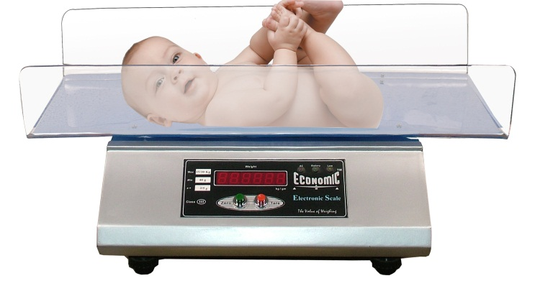
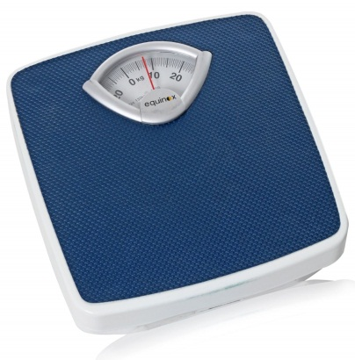
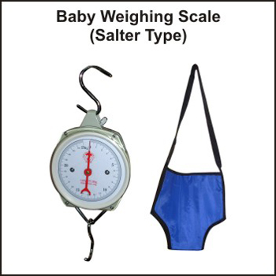
WEIGHT
Most reliable criteria of assessment of health and nutritional status of children
The weight can be recorded using a :
  Beam type weighing balance
  Electronic weighing scales for infants and children
  Bathroom type of mechanical scale (very unreliable)
  Salter spring machine (in field conditions)
Notes:
Monitoring the weight is helpful in diagnosing malnutrition at early stage

Slide 14
WEIGHT GAIN
0-4 months 1.0kg/month(30g/day)
5-8 months 0.75kg/month(20gm/day)
9-12 months 0.50kg/month(15g/day)
1-3 years 2.25kg/yr
4-9 years 2.75 kg/yr
10-18 years 5.0-6.0kg/yr(0.5kg/month)
B. Weight at 4-5 months 2 x birth weight
Weight at 1 year 3 x birth weight
Weight at 2 years 4 x birth weight
Weight at 7 years 7 x birth weight

Slide 15
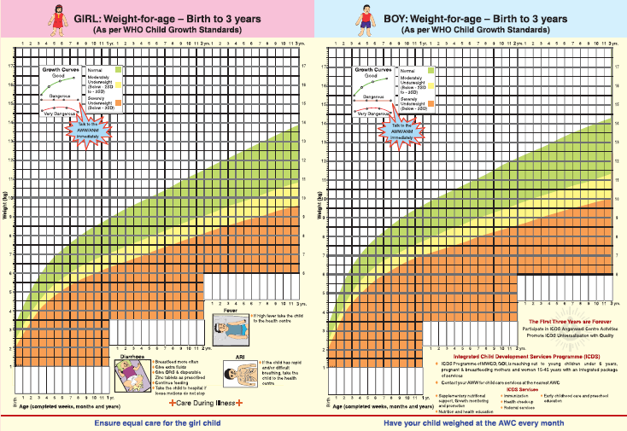
NEW WHO GROWTH CHART

Slide 16

CHIEF COMPLAINTS
Cough- 3 days
Fever- 3 days

Slide 17



HISTORY OF PRESENT ILLNESS - COUGH
No precipitating factor
Aggravating factor- lying down
Relieving factor –sitting
,drinking water
No diurnal variation
Accompanied with running nose.
No associated pain
Duration 3 days
Gradual onset
Brassy in character
No whooping
Productive in nature
progressive increase in frequency and severity
Initially 5-6 times a day throughout the day.

Slide 18



HISTORY OF PRESENT ILLNESS - COUGH
Sputum
yellow in colour
Amount scanty
No foul taste or odour
No blood present

Slide 19



HISTORY OF PRESENT
ILLNESS cont.
FEVER-
Duration 3 days
Acute in onset
Remittent in character
Frequency 1-2 times a day
Progressive increase in intensity
Initially mild now moderate (101F)
Accompanied with rigours
No chills
Relieved on medication

Slide 20

PAST HISTORY
Similar episodes of fever and cough in past
No history of – Pneumonia, Tuberculosis, Malaria, Kala-azar, Jaundice, Asthma
No past surgical history

Slide 21


PERINATAL HISTORY
Birth Date- 7 September 2010 Pregnancy was not booked
ANC
No antenatal care was given.
No IFA tablets taken
TT vaccine administered
Indiscriminate use of drugs for headache ,vomiting etc
No USG
no radiation exposure

Slide 22
PERINATAL HISTORY
First trimester- suffered from hyperemesis gravidarum
Rest trimesters uneventful
Labour was uneventful
Normal vaginal, term delivery at PHC, RHTC, RMCH, Bareilly ON 7TH SEPTEMBER 2010

Slide 23

DEVELOPMENTAL
MIESTONEs

Slide 24
GROSS MOTOR MILESTONES
Started sitting at age of 6 months(6-8months )
Climbed upstairs at age of 9months (10 months )
Started walking at age of 13 month (12-15 month )
started jumping and walking with both legs at age around 2year(2year)
Started hopping and skipping step on coming downstairs at age of 4year

Slide 25
FINE MOTOR MILESTONE
Started holding objects at age of 4month(3 month)
Stated holding objects with thumb at age of 9 month (7-12 month)
Started eating by it self at age of 17 month
(15 month )
Started over writing at age of 2years(2year )
Self dressing at age of 3year (3year)
Button unbutton copy square cross at age of 4 year

Slide 26
SOCIAL AND ADAPTIVE MILESTONES
Started giving social and interactive smile at 2.5 months(2 months)
Hand regard ; recognising mother at 3months(3 months)
Spoke monosyllables at 7 months(6 months)
Spoke disyllables at 8.5 months(9 months)
Could make small sentences 2 years(normal)
Normal speech ,asking questions at 3 years(normal)
Could tell story ,recite poem at 4 years(normal)

Slide 27

DIETARY HISTORY
Child was exclusively breast fed till 6 months of age
Complementary feeding started after 6 months
Daily calorie requirement for child= 1350 kcal
Daily protein requirement for child= 20.1 g

Slide 28




DIETARY HISTORY CONT….
Calorie deficit= 1350-1132.5
=217.5 kcal
Total protein intake= 29.15 gram

Slide 29

DIETARY PLAN
TIME | FOOD ITEM | AMOUNT | CALORIES IN KCal | PROTEIN IN GRAMS
6 30 am | Roti Boiled egg | 1 1/4 | 85 22.5 | 2.95 3.25
7 am | Tea bread | 1 cup 1 slice | 75 85 | 0.9 2.95
8 am | Rice dal | ½ katori each | 85 100 | 1.7 2.5
12 30 pm | Rice dal | ½ katori each | 85 100 | 1.7 2.5
2 00 pm | Mango sattu | 1(medium) 1 tablespoon | 160 90 | 2.0 5.0
3 30 pm | rice | ½ katori | 85 | 1.7
5 ;30 pm | Potato chips Lays classic | 1 five rs pack | 160 | 2
TOTAL |  |  | 1132.5 | 29.15

Slide 30

FAMILY HISTORY
No history of any stillbirth, miscarriage or childhood death in
family
No history of tuberculosis in family
grandfather, grandmother and father suffer from filariasis.

Slide 31
 |  | Given (Yes / No)
At birth | BCG Hepatitis B Polio
6 weeks | F - IPV OPV Pentavalent PCV Rotavirus
10 weeks | OPV Pentavalent Rotavirus

Slide 32
14 weeks | F - IPV OPV Pentavalent PCV Rotavirus
9 months | MR JE PCV
1.5 years | DPT MR JE OPV
5 years | DPT MR JE OPV

Slide 33
10 years | dT
16 years

Slide 34
FAMILY HISTORY
No history of any stillbirth, miscarriage or childhood death in family
No history of tuberculosis in family
grandfather, grandmother and father suffer from filariasis.

Slide 35

PERSONAL HISTORY
Mixed Diet
Normal sleep pattern (8-10 hr)
Normal bladder & bowel habit
No history of blood transfusion
No known drug allergy

Slide 36


GENERAL APPEARANCE(SUBJECTIVE)
Appears to be acutely ill
Able to speak a normal-length sentence without stopping to take a breath
Character of cry – hoarse
Activity level - moderate
Mental status -well oriented to time, place, and person
Emotional reaction towards parent was positive and towards examiner was negative
Hygiene –inadequate

Slide 37


GENERAL EXAMINATION
Afebrile
Pulse -130/ min ,regular , Adequate in volume, synchronous
Pallor- present
Icterus- absent
Cyanosis- absent
No clubbing
No pedal edema
No thyroid enlargement.

Slide 38

REPIRATORY SYSTEM
INSPECTION-
  shape of chest –circular
  Bilaterally symmetrical
  Trachea central in position
  Trail sign absent
  No drooping of shoulders
  No localised bulge/retraction
  Movement- abdominothoracic
  Symmetrical range of movements on both sides
  No suprasternal ,intercostal or subcostal recessions

Slide 39

Palpation
No tenderness
Tracheal position - midline
Chest wall not tender
Crepitus – absent
Spinal abnormality- absent
Nodes (axillary, supraclavicular, cervical)- not palpable
No masses felt
apical beat- in 4th inter costal space along midclavicular line

Slide 40

Percussion
•
comparable notes on all palpable areas on both sides
Liver dullness started on 7th inercoastal space

Slide 41

Auscultation
Normal vesicular sound heard over chest
Intensity of breath sounds normal
Vocal resonance- symmetrical on both sides
No pleural rub
No added sound

Slide 42

SYSTEMIC EXAMINATION
CIRCULATORY SYSTEM-
S1 and S2 heard , no added sound , no murmur
ABDOMINAL-
scaphoid in shape umbilicus was central in position ;everted , soft, non tender , no palpable mass ,no palpable organomegaly.

Slide 43

ANTHROPOMETRIC ASSESSMENT
WEIGHT
Weight of child=18.3 kg
Weight for age= (Age in yrs x 2) + 8 kg
= (5 x 2) + 8 =18 kg
HEIGHT
Height of child=102cm
Height for age=(age in years x 6)+77
= (5 x 6)+77 =107 cm
102/107 x100=95.32%

Slide 44
ANTHROPOMETRIC ASSESSMENT
Head circumference=49cm
(Normal for age- 48.5-51.5 cm)
Mid upper arm circumference =17cm
(Normal for age- 17cm)

Slide 45

DIAGNOSIS
A 5yr old girl is suffering from cough and fever since 3 days. This is probably a case of URTI.

Slide 46

CONCLUSION
MEDICAL PROBLEMS:
Cough
Fever
filariasis in grandfather , grandmother and father.

Slide 47
LIVING CONDITIONS
NO bathroom; toilet; kitchen
Defaecation in open space
Natural ventilation- inadequate
Natural lighting- inadequate
General cleanliness of rooms- inadequate
Overcrowding –present

Slide 48
source of water supply- hand pump(35feet)
storage utensils- uncovered
REFUSE DISPOSAL:-
Thrown near the house
Water logging in nearby areas & open drains personal
PERSONEL HYGEINE
Nails-unclean
Hand washing practices: After defecation-ash/mud
No handwashing Before cooking or taking meal

Slide 49
SOCIAL AND REPRODUCTIVE
Lack of family planning.
Alcohol and tobacco addiction of father .
Domestic violence due to desire for a male child
lack of awareness about antinatal care

Slide 50

CURE AND REMEDIES
MEDICAL
treatment for the current medical conditions of sughandha and other family members.
LIVING CONDITIONS
toilet should be constructed.in house.
Correction of ventilation and lighting.
General cleanliness of rooms should be ensured.
correction of overcrowding.

Slide 51
source of clean water should be ensured.
storage utensils should be kept covered. REFUSE DISPOSAL:-
Should be disposed off properly.
Correction of Water logging
PERSONEL HYGEINE
Proper cutting of nails
Hand washing practices: should be followed.

Slide 52
SOCIAL AND REPRODUCTIVE
family planning should be ensured,if not proper ANC should be ensured in subsequent pregnancy.
De addiction of father .
Counselling about desire of a male child.

Slide 53

TRAIL SIGN
In a child with marked tracheal displacement ,clavicular head of the sternomastoid muscle is pushed forward as a visible swelling on the displaced side.

Slide 54

HEAD CIRCUMFERENCE TO AGE
Age | Circumference (in cms)
1 month | 32-35.5
6month | 40-43.5
1year | 43.5-46.5
2year | 45.5-49.5
3year | 46.8-5
4year | 47.5-50.5
5year | 48.1-51.5

