Slide 1
Deviated nasal septum
DR SHRADHA CHANDRA
Assistant Professor

Slide 2
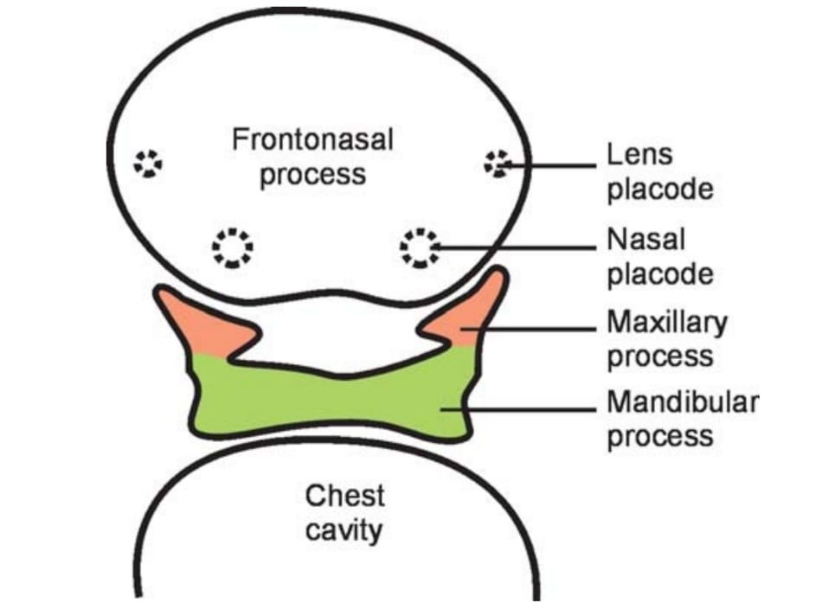
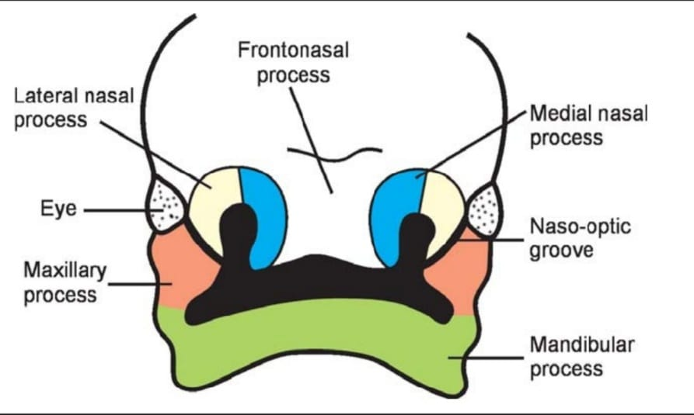
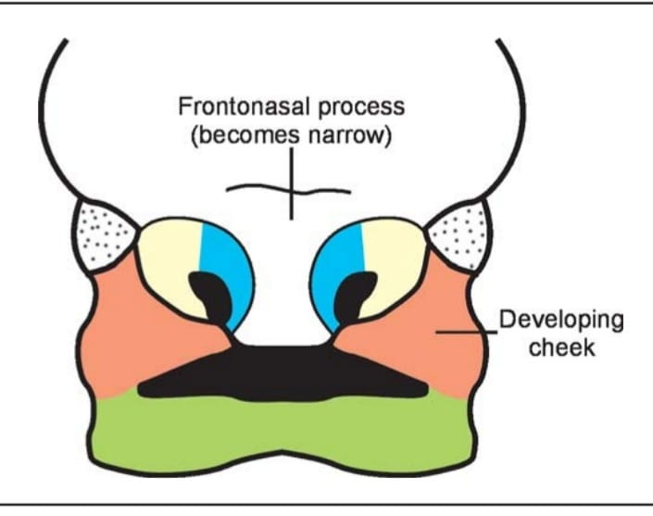
Development of nasal septum

Slide 3
Anatomy
Divided into 3 parts : columellar septum, membranous septum and septum proper.
Columellar septum : can be moved from side to side.
Covered by skin.
Contains medial crura of lower lateral cartilages, which are joined together with fibrous tissue.
Membranous septum : lies between the columella and caudal border of septal cartilage.
Septum proper : covered with mucus membrane.
Osteocartilagenous
Made up of – a) perpendicular plate of ethmoid
b) vomer
c) septal cartilage

Slide 4
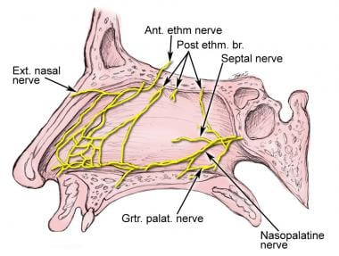
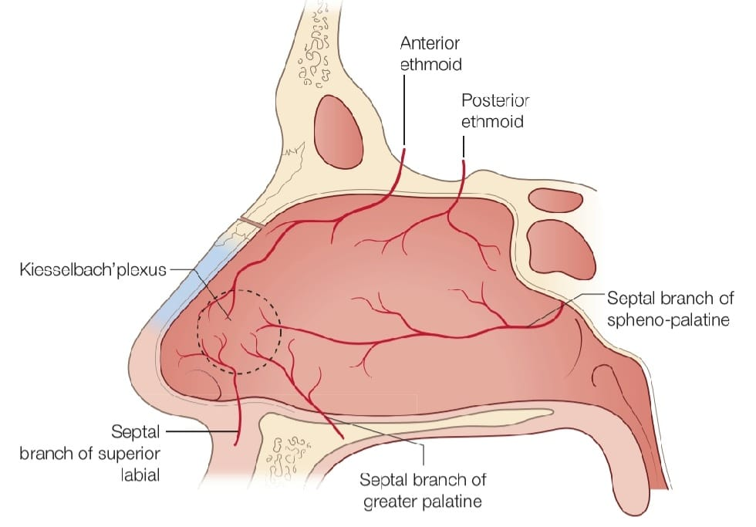
Anatomy
Blood supply
Nerve supply

Slide 5
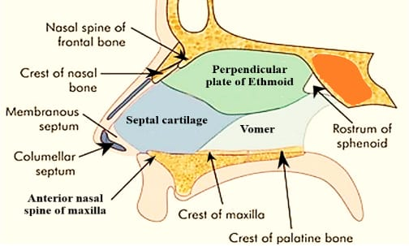
Anatomy : osseocartilaginous framework

Slide 6
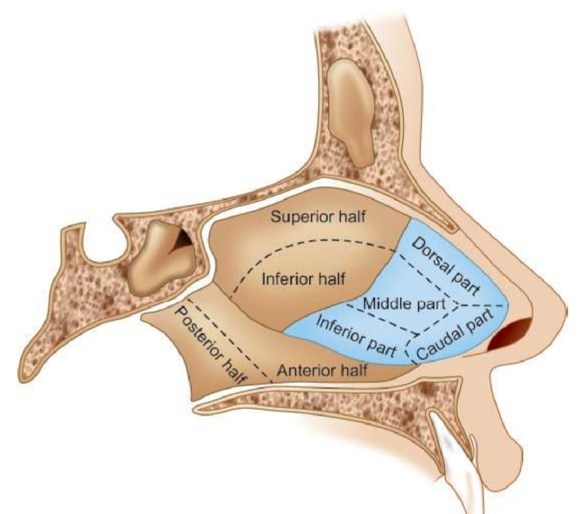
Deviated Nasal Septum
AETIOLOGY
Developmental error
Secondary to trauma
Racial factor – Caucasians are affected more than black Americans
Hereditary factor

Slide 7
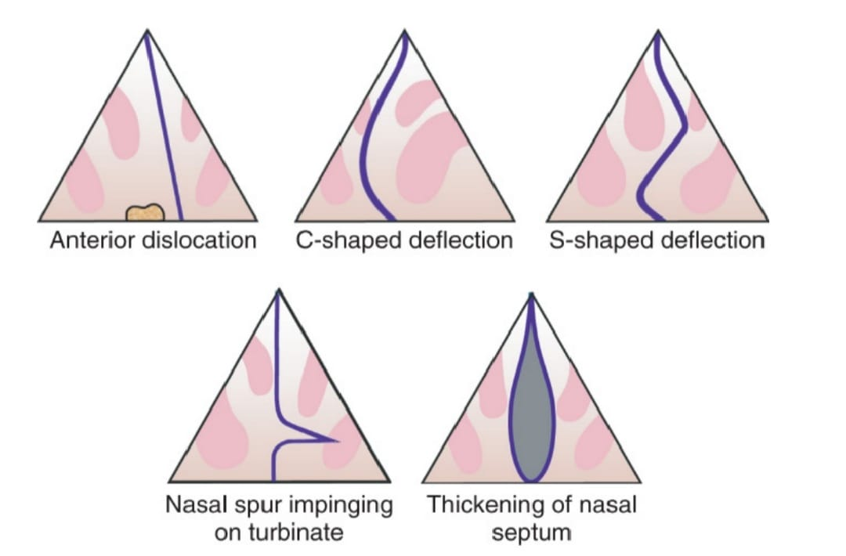
TYPES

Slide 8
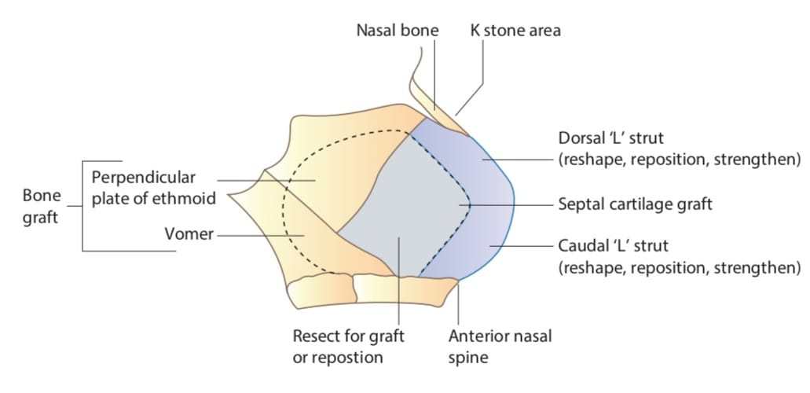
DIAGNOSIS

Slide 9
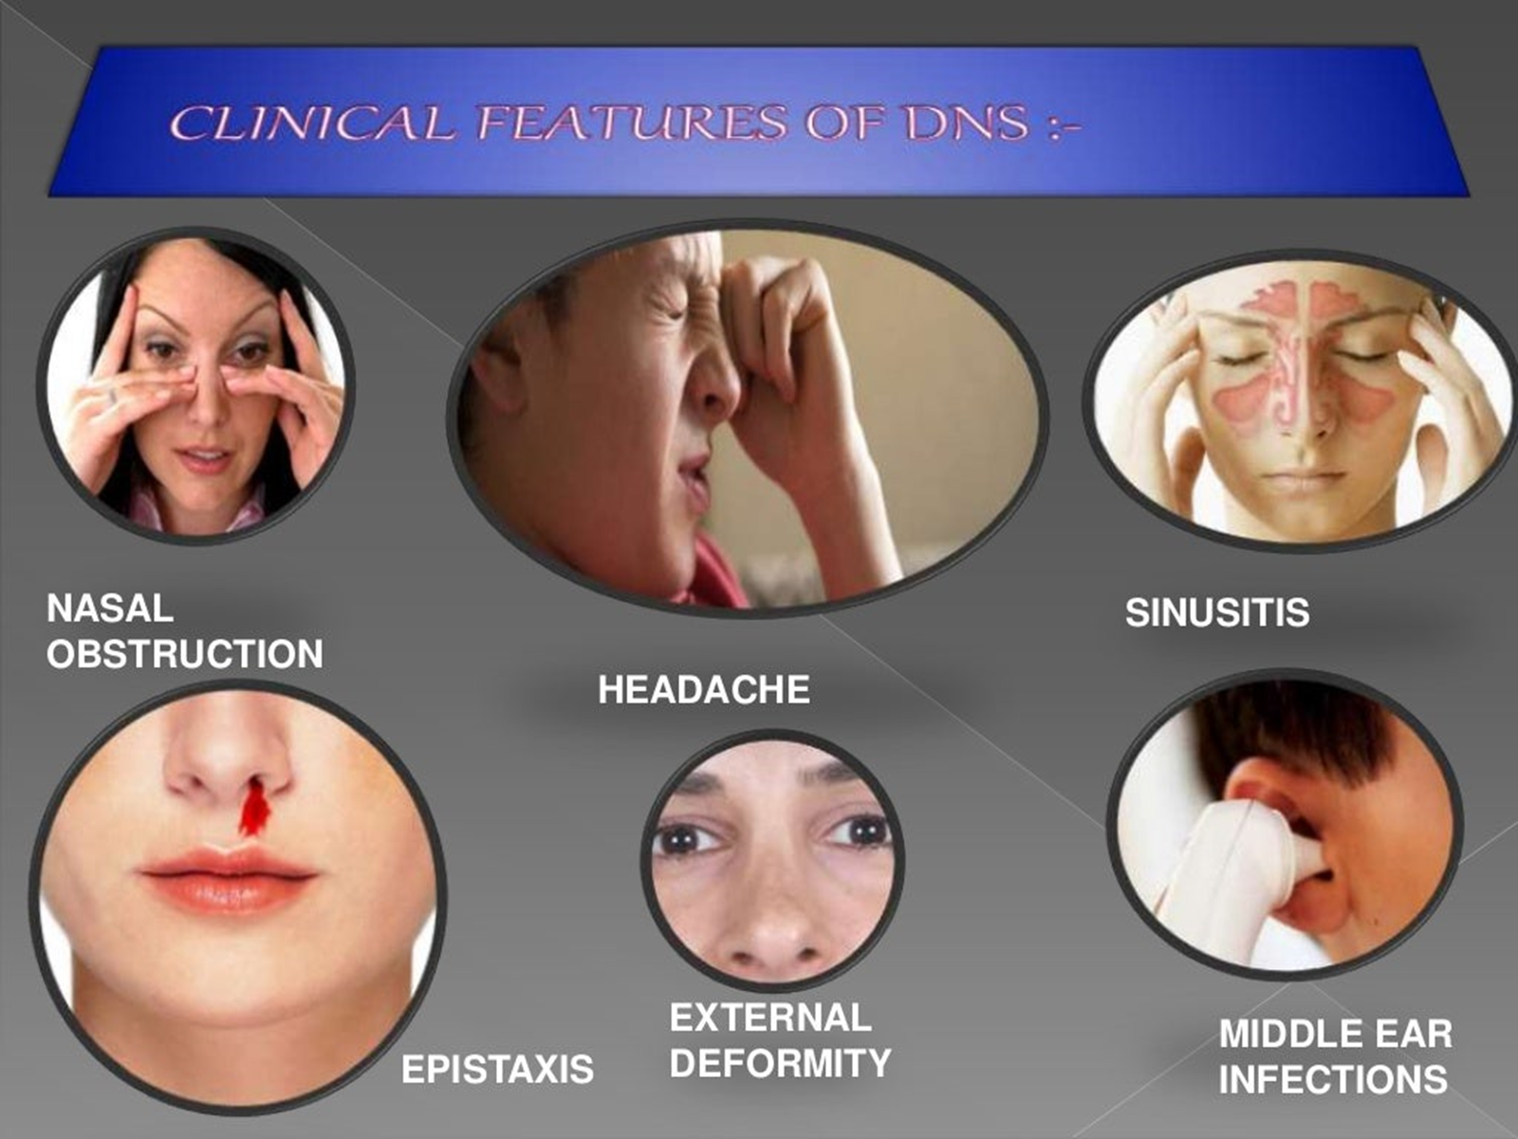
Symptoms and sign

Slide 10
DIAGNOSIS
During inspection, the position of deviation should be mapped in relation to L-strut.
Nasendoscopy will allow inspection of basic anatomy and variation
Nasal airflow can be demonstrated by misting of tongue spatula.
Absence or reduction in mist formation can be suggestive of structural blockage
Patients who have undergone septal surgery in past, gentle palpation of the septum with an applicator (eg. Jobson horne probe) might indicate areas deficient of cartilage.

Slide 11
DIAGNOSIS
History of continuous nasal obstruction – suggestive of anatomical blockage
And intermittent obstruction – indicates more towards the mucosal elements
Significant improvement in nasal obstruction after topical decongestants indicate mucosal elements in nasal obstruction

Slide 12
Treatment
SUBMUCOSAL RESECTION
Killian incision is useful for this procedure.
Killian incision is placed about 1 cm cephalad from the caudal end of the septum.
At this point, flap can be raised more easily as the perichondrium is less adherent.
The deviated part is freed from its peripheral bony and cartilagenous attachment
The in-situ bony deviation can be fractured to put the bony septum in midline or it can be excised conservatively

Slide 13
SUBMUCOSAL RESECTION
Bony septum can be used as graft material for septal reconstruction
Or, it can be straightened and re-inserted in its place
It can be secured to the remaining septum by sutures to avoid displacement

Slide 14
Septoplasty
INDICATION –
DNS causing nasal obstruction
For cosmesis in case of external deformity
Recurrent epistaxis
For approach to middle meatus in FESS when dns obstructs access to the areas
Septal deviation causing sleep apnoea
Contraindications –
Acute sinus infection
Untreated diabetes
Hypertension
Bleeding diathesis

Slide 15
septoplasty
Anaesthesia and analgesia
Use of topical and local vasoconstrictive anaesthetic for not only the analgesic qualities but also for the vasoconstrictive effects.
Anaesthesia of choice is 1% xylocaine with 1 : 100,000 epinephrine used with a maximum suggested dose of 4 to 7 mg/kg
The injection is started at the caudal end of the septum, and secondary injections are performed more posteriorly, until the mucosa is well blanched.
The contralateral membrane should also be injected and also the area of the nasal floor around the maxillary crest.
After the injection is performed, waiting at least 10 minutes ensures maximum vasoconstriction

Slide 16
septoplasty
Incisions
Killians incision - is created approximately 1 to 2 cm posterior to the caudal septal margin.
Its greatest downfall is in its relative inaccessibility to the caudal septal edge and the higher potential for membrane tearing
Hemitransfixion or transfixion incision – made at the caudal border of the septum
allows access to the deviated caudal septum and any posterior deflection.
The incision is created within the squamous epithelium of the vestibule and hence has less of a tendency to tear under stress.

Slide 17
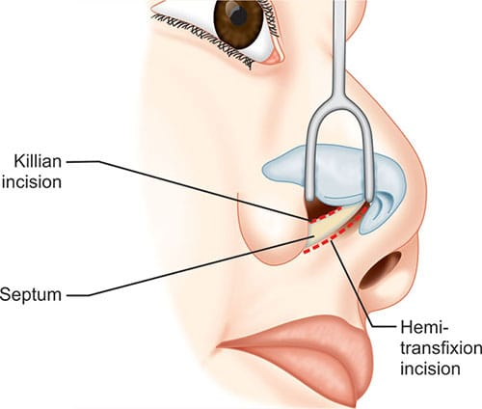
septoplasty
Incisions
Full-transfixion incision - accomplished by incising completely through to the opposite membrane.
Marginal and transcolumellar incisions – for open rhinoplasty approach
In the open approach to the septum, after a trans-columellar skin incision is made, the medial crura are separated, and the caudal septum is then identified

Slide 18
septoplasty
In most cases, septal L–strut is involved
Hemitransfixion incision provides access to the whole septum including caudal L-strut
This incision in placed at the caudal edge of the septum
The length of the incision depends on the access required
If access is required to the floor of the nasal cavity then an extended hemitransfixion incision is used.

Slide 19
Raising the flap on the concave side helps to –
To allow access for ecision of septal cartilage and bone
To detach septal osseocartilaginous junction
To score on the concave side
Reduces chance of septal perforation by keeping the opposite mucosa intact
If the flap is raised at the correct plane, minimal or no bleeding occurs
The flap is raised anteriorly as far cephalically as possible.

Slide 20
When osseocartilaginous junction is reached, it is disarticulated to gain access to the opposite side of bony septum.
Care must be taken not to perforate mucosa on the other side
Often, disarticulation is not enough for septum to return to midline, then a sliver of bone or cartilage needs to be removed.
Disarticulation of septal cartilage from the maxillary crest is required to allow the septum to move to midline (often a sliver of bone or cartilage needs to be removed)
The 1 cm of bony cartilaginous junction at the L-strut is left undisturbed if possible.

Slide 21
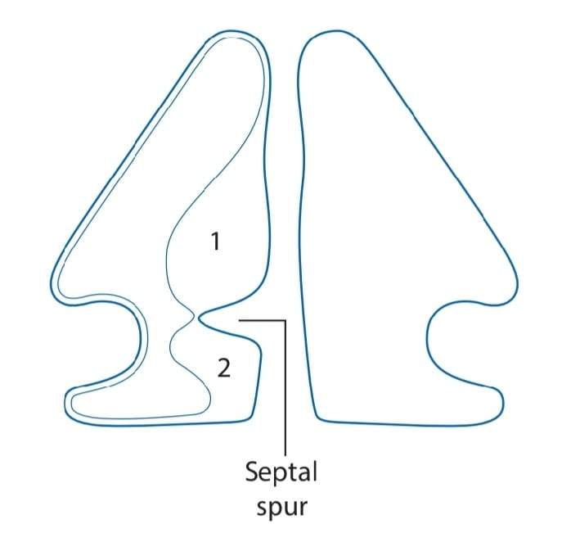
If access is required to the floor of the nasal cavity then an extended hemitransfixion incision is applied
It allows raising a tunnel underneath the septal spur which reduces the chance of mucosal tear over the spur.

Slide 22
Septoplasty techniques
The deviated septum can be addressed by –
Cutting technique
Grafting technique
Suturing technique
Relocating technique
Techniques can be used alone or in combination

Slide 23
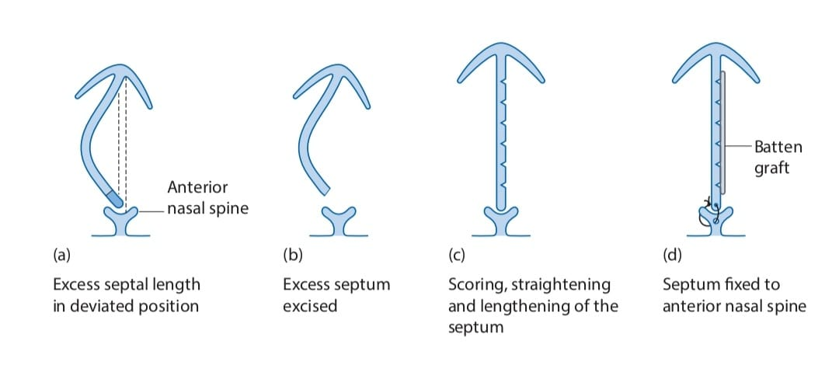
Cutting technique
Scoring is done on the concave side, allows the septum to become straight eliminating the deviation
In S-shaped deformity, scoring need to be done on both concave side, hence there is need to raise the mucoperichondrial flaps on both the sides
Caudal septal deviation is managed by swinging door technique -

Slide 24
Grafting technique
The deviated septum can be kept in a straight line if it is splinted against a graft.
A suitable piece of perpendicular plate of ethmoid is harvested, which is thinned out and splinted against the concave side of the septum.
A fine absorbable or non-absorbable suture is used to secure the graft to the septum.
This technique is more reliable as it eliminates chance of residual deviation or over correction due to underscoring or overscoring.

Slide 25
Suturing technique
In this, the septum is 1st scored just enough to make it pliable so it can be shaped and kept in shape by fine sutures
The entrance and exit sutures are placed on the convex side
A fine non-absorbable suture is used and B/L mucoperichondrial flaps are raised so that the suture is covered by the septal mucosa.

Slide 26
Relocating techniques
Used when the septum is dislocated off the midline and requires reinsertion into the maxillary crest
Achieved by suturing the septum either onto the periosteum of the anterior nasal spine or to the actual bone by drilling a hole onto it.

Slide 27
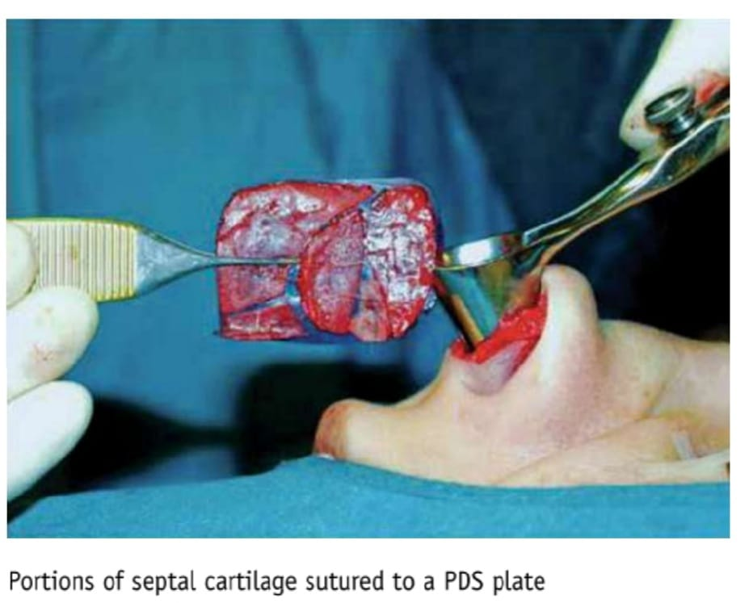
Polydioxanone plates
Use of resorbable PDS to nasal septum reconstruction helps to support cartilage fragments during healing
Degraded by hydrolysis that is completely absorbed by the body
Available in various sizes and thickness

Slide 28
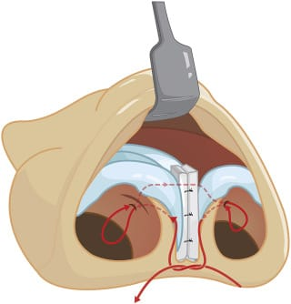
Columellar strut
Used for minor caudal septal deviations in which the base of the nose is well supported by the medial crura along with a favourable alar-columellar relationship, a sutured-in-place columellar strut can effectively stabilize the base
This graft is placed into a pocket dissected between the medial crura

Slide 29
SMR
septoplasty
extensive dissection of septum removing all deformed part leaving only a caudal and dorsal strut
Not done before 17 years of age
Mucoperichondrial and mucoperiosteal flaps are raised on both sides of septum
More chances of complications
Re-operation is difficult
Removing minimal cartilage and bone, deformed parts are corrected and reimplanted
Can be done in children
Flaps are raised only on one side and limited elevation on the other side
Deformed cartilage is corrected by scoring, cross-hatching realigning in the groove
Less chances of complications
Re-operation is easier

Slide 30
Post op care
At the conclusion of septal surgery, a light nasal pack is placed to prevent large clot accumulation and to prevent bleeding
Some surgeon disagree with this practice; packing has a tendency to adhere to mucosa, cause pain, and create bleeding when removed
Suturing is adequate for preventing the formation of a septal hematoma
After the nasal packs are removed, a regimen of saline flushing of the nose 4 times a day is initiated.
Start the instillation of antibiotic and saline drops into each vestibule.
Strenuous exercise is discouraged for a total of 6 weeks.

Slide 31
complications
Most common septoplasty complication is persistence in the subjective complaint of nasal obstruction
Septal hematoma
Septal perforations
Nasal shape changes (e.g., Tip deformity, dorsal nasal saddling) may result from over-resection of the caudal septum or loss of dorsal nasal support.
Infection is rare
Synechiae can develop between the septum and the turbinate or lateral nasal wall secondary to traumatic techniques of suturing

Slide 32
THANK YOU

