Slide 1
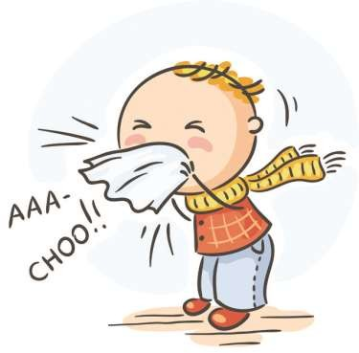
Allergic Rhinitis
Dr. Baeth Al-Rawashdeh

Slide 2


OUTLINE
Definition.
Classification of allergic rhinitis
Epidemiology.
Risk factors
Pathophysiology
Diagnosis
Investigation
Treatment.

Slide 3
Introduction
Rhinitis is broadly defined as inflammation of the nasal mucosa.
It is a common disorder that affects up to 40% of the population .
Allergic rhinitis is the most common type of chronic rhinitis, affecting 10–20% of the population

Slide 4
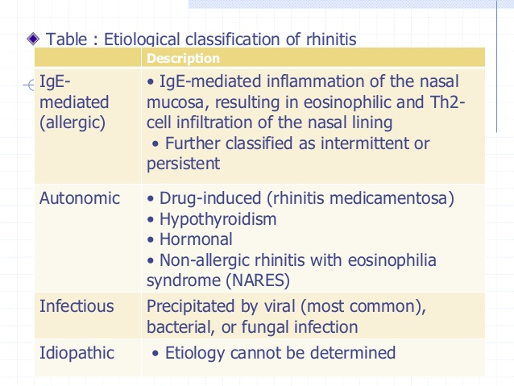

Slide 5
Definition of Allergic Rhinitis
IgE – mediated immunologic response of nasal mucosa to air-borne allergens.
type I hypersensitivity reaction
mast cell–mediated immune reaction, whereby the release of mast cell or basophil mediators creates responses to sensitizing allergens.

Slide 6
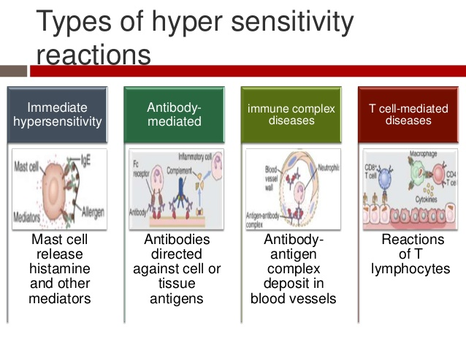
Notes:
Anaphylaxix
Nephritis
Vasculitis
Tb , contact dermatitis

Slide 7
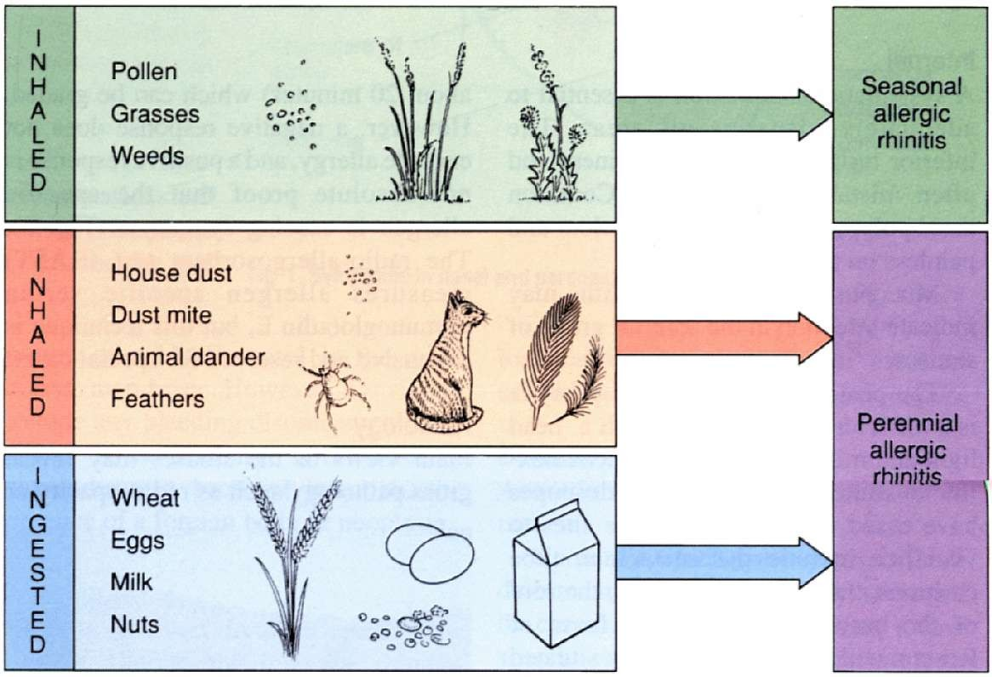

Classification of Allergic Rhinitis
Notes:
Traditionally, allergic rhinitis has been categorized as
Classification of allergic rhinitis is seasonal, perennial, or episodic .
Seasonal allergic rhinitis is defined by symptoms that occur during exposure to seasonal allergens
Perennial allergic rhinitis, defined as nasal symptoms for more than 2 hours per day for more than 9 months of the year.
Episodic rhinitis refers to symptoms on exposure to allergens that are not normally present in the environment.
However, not all patients fit into this classification scheme. For example, some allergic triggers, such as pollen, may be seasonal in cooler climates, but perennial in warmer climates, and patients with multiple “seasonal” allergies may have symptoms throughout most of the year [4]. Therefore, allergic rhinitis is now classified according to symptom duration (intermittent or persistent) and severity (mild, moderate or severe)

Slide 8
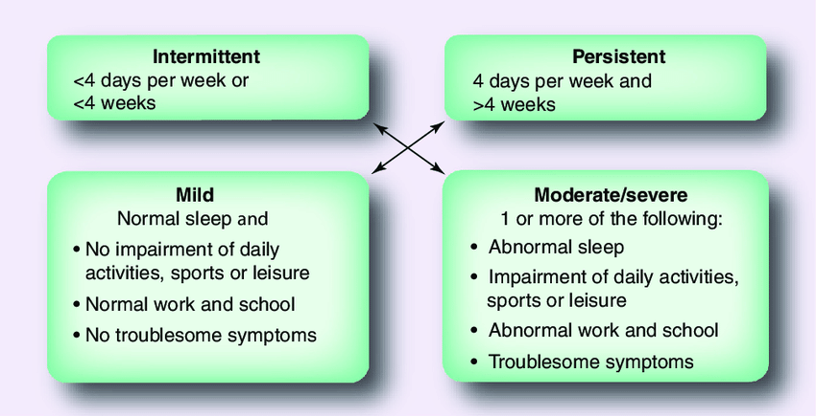
Allergic Rhinitis and its Impact on Asthma
(ARIA ) classification
Notes:
Allergic Rhinitis and its Impact on Asthma
The ARIA classification is
used to suggest a treatment algorithm, whereas the traditional classification
is used to help define the offending antigens.
It is important to classify the severity and duration of symptoms as this will guide the management approach for individual patients

Slide 9
Epidemiology
Allergic rhinitis is common, affecting 10 to 30 percent of children and adults in the United States and other industrialized countries
higher in children and adolescents than in adults.
The overall prevalence of rhinoconjunctivitis in children aged 6 to 7 years and 13 to 14 years was 8.5 and 14.6 percent, respectively.

Slide 10
rarely occurs in children younger than 2 years
Most patients with allergic rhinitis have symptoms before age 20 y
In childhood, boys outnumber girls; the gender ratio becomes approximately equal in adults.
Notes:
Because individuals require low-dose exposure to an offending allergen over many years before development of symptoms, seasonal rhinitis

Slide 11
The severity of the disease remains relatively constant throughout childhood and early adulthood, usually improves in middle age, and is seldom a problem in the elderly

Slide 12
Pathophysiology of Allergic Rhinitis

Slide 13
The reaction can be considered in four phase:
Sensitization
Early phase reaction
Late phase reaction
Systemic activation

Slide 14
1.Sensitization
Initial stage :
low-dose exposure production of
specific IgE antibodies

Slide 15
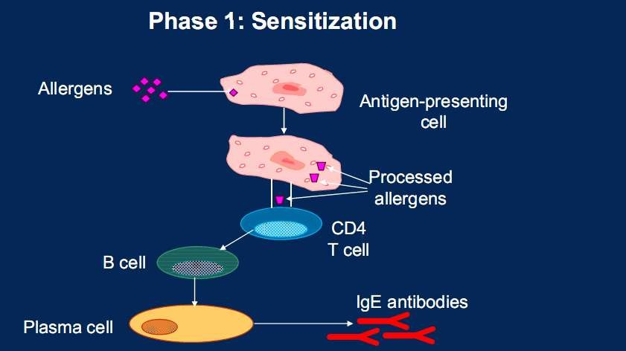
Notes:
1388

Slide 16
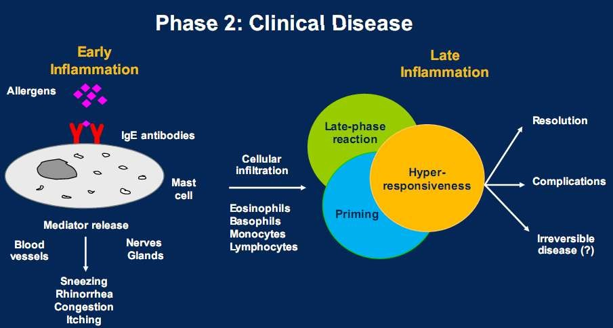

Slide 17
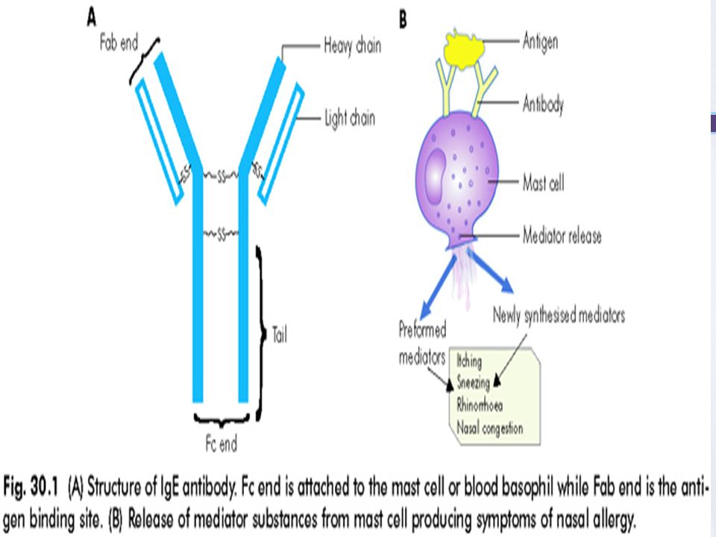

Slide 18
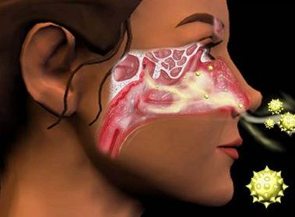
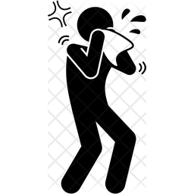
2.Early Response to Antigen
Within minutes after exposure of an allergic patient to antigen.
The patient first senses tingling and itching, followed by sneezing, rhinorrhea, and, last, nasal congestion.
increases are noted in the levels of several mediators, including histamine, kinins, tryptase, PGD2, leukotriene C4 (LTC4), leukotriene B4 (LTB4), major basic protein (MBP) and platelet-activating factor (PAF).
Notes:
Histamine provocation, for
example, produces rhinorrhea, congestion, pruritus,
and sneezing by stimulating receptors on sensory
nerves and blood vessels.60
Instillation of serotonin
produces sneezing,61
whereas PGD2
62 and kinins63 all
produce nasal congestion.

Slide 19

How are the symptoms caused?
Irritation of free
nerve endings ----
Itching and sneezing
Increased
mucus production ------
Rhinorrhoea
Vasodilation -------- Congestion
Increased
vascular permeability----
Oedema

Slide 20
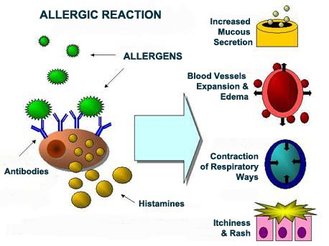
Histamine
The major mediator of the early phase reaction.
Notes:
Action on sensory nerves induces itching and sneezing, its action on endothelial cells and blood vessels results in vasodilatation, plasma exudation and oedema.
It is probably the major mediator of the early phase reaction, but is also relevant in the late phase, when it probably emanates mainly from basophils.
Upregulation of adhesion molecules on vascular endothelial cells, increased production of cytokines IL-6 and IL-8 by endothelial cells and activation of epithelial cells with consequent ICAM 1 expression and cytokine production.
Histamine is preformed in Granules
Histamine causes rhinorrhea (By action on vascular endothelial cells and glandular secretions), sneezing, pruritis (By action on sensory nerves) and nasal obstruction (Not marked and of short duration)
The major mediator of the early phase reaction.
Histamine also possesses proinflammatory and immunomodulatory properties

Slide 21
3.Late phase reaction
Hours after antigen challenge, some patients experience a recurrence of symptoms, most notably nasal congestion.
striking characteristic of the late-phase response is cellular inflammation.
suggesting that nasal secretions and the nasal mucosa are two separate compartments with different inflammatory cellular predominance during allergic inflammation.
Notes:
such as eosinophils, basophils, mast cells, T lymphocytes, neutrophils and macrophages into the local reaction site.

Slide 22
polymorphonuclear cells and eosinophils predominating in nasal secretions
mononuclear cells predominating in the nasal mucosa.
Notes:
These are mostly
of the T-helper category, as evidenced by positive
staining with antibodies against CD4, and a portion
of them are activated, as documented by IL-2 receptor
expression (CD25+).71,72 These T lymphocytes
have been shown to express messenger ribonucleic
acid (mRNA) for TH2-type cytokines.
Typically, a slight initial increase in eosinophils in nasal secretions
is observed within 1 to 2 hours of challenge and is usually followed by
a peak 6 to 8 hours later.238 MBP, a mediator secreted by eosinophils,
is also recovered in nasal lavages hours after antigen provocation, and
its levels correlate with the number of eosinophils, suggesting that these
cells flow into nasal secretions and release inflammatory mediators.189
Basophils constitute 1% of the recovered cells. Their number correlates
significantly with levels of histamine recovered in nasal secretions
during the late phase response, suggesting that these cells are the source
of the late rise in histamine

Slide 23
4.Systemic activation
- There is evidence of upregulation of production and release of eosinophil and basophil precursors from the bone marrow in response to allergen contact in the nose or lung.
- The resultant circulating precursors are attracted to the reaction site and to other parts of the respiratory tract by selectins and adhesion molecules and infiltrate the tissue, where they mature.
- This process is also evident in nasal polyposis and may be responsible for some of the notable rhinitis/asthma link
Notes:
Although allergic rhinitis appears to be a local phenomenon

Slide 24
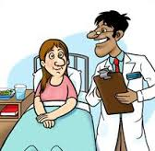
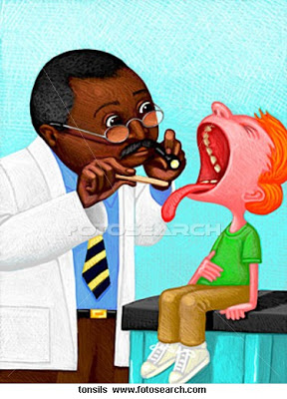
Diagnosis
Notes:
A
A thorough history and physical examination are the cornerstones of establishing the diagnosis of allergic rhinitis
llergic rhinitis is usually a long-standing condition that often goes undetected in the primary-care setting

Slide 25

History
The classic symptoms of seasonal allergic rhinitis are recurrent episodes of sneezing, pruritus, rhinorrhea, nasal congestion, and lacrimation that occur after exposure to the offending allergen.
Itching is the symptom most suggestive of an allergic etiology and involves not only the nose but also the palate, throat, eyes, and ears.

Slide 26
The environmental history
Systemic symptoms and comorbidities that may accompany allergic rhinitis include asthma , snoring, sleep problems , otitis media .
family history of allergic diseases such as allergic rhinitis, asthma, and atopic dermatitis.
the impact of symptoms on quality of life
Notes:
including pollens, furred animals, textile flooring/upholstery, tobacco smoke, humidity levels at home, as well as other potential noxious substances

Slide 27
Physical Examination
Examination of the face
allergic shiners .
Adenoid facies
allergic salute .
Injection of bulbar conjunctiva
Notes:
allergic shiners : puffiness of the eyelids and periorbital cyanosis, usually due to venous stasis secondary to chronic nasal obstruction.
Adenoid facies : elongated facies, open mouth, flattened malar eminences, pinched nostrils, raised upper lips, high arched palate, and retracted jaws.
allergic salute : A supra tip creaseat the junction of the upper and lower lateral cartilages is a result of frequent pushing upward of the nasal tip
Dinnie’s lines: fine horizontal lines in the lower eyelids due to spasms of muller’s muscles in the lids

Slide 28
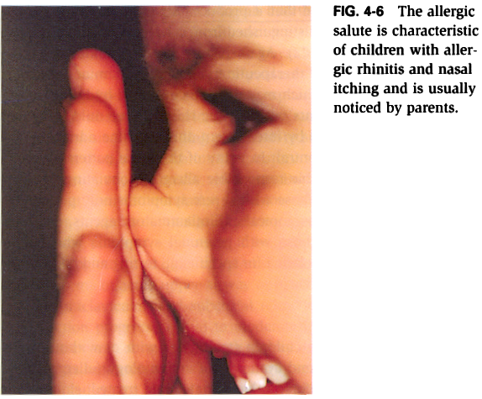
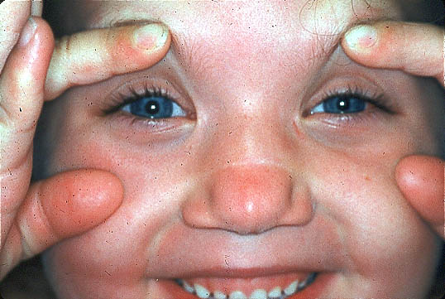

Slide 29
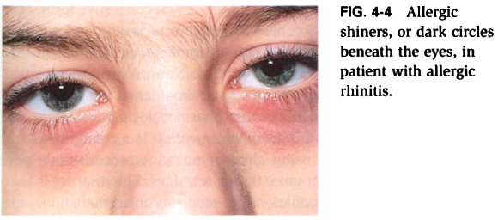

Slide 30
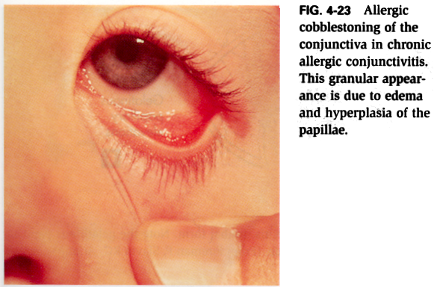

Slide 31
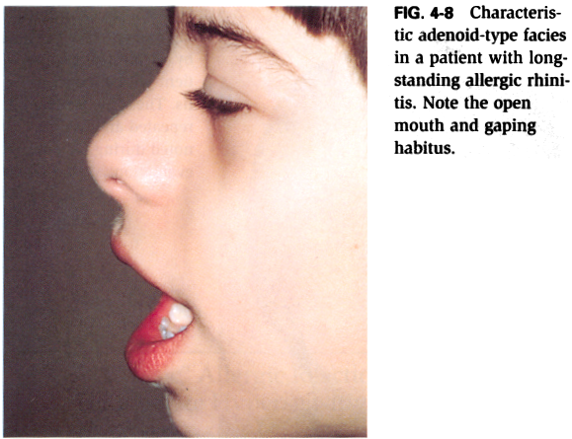

Slide 32
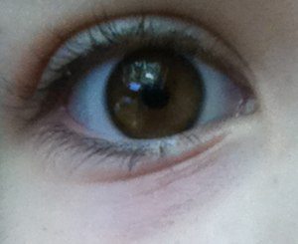
Notes:
Dennie–Morgan line or an infraorbital fold

Slide 33
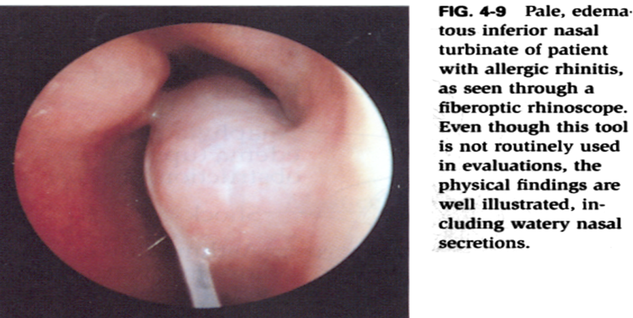
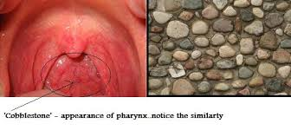
Nose and throat
Inferior turbinate Mucosal edema, pale, bluish, and edematous, and coated with thin, clear secretions.
Cobblestoning of posterior pharyngeal wall

Slide 34
Ears … OME
conjunctivitis
the chest and skin should be examined carefully for signs of concurrent asthma (e.g., wheezing) or dermatitis

Slide 35
Investigations

Slide 36
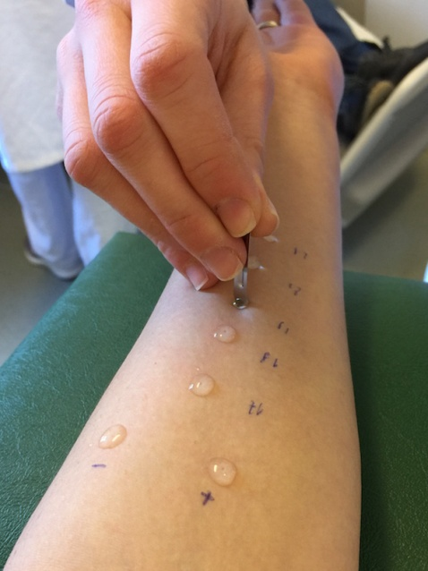
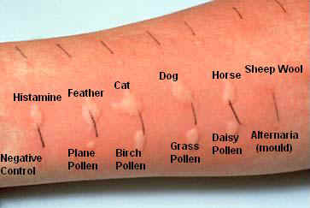
Allergy skin prick testing (SPT)
Reactions greater than 2 mm in under fives and 3 mm in older subjects are regarded as positive
Notes:
A drop of a standardized allergen extract is placed on the volar aspect of the forearm and then pricked into the skin using a lancet
The wheal size does relate to the amount of IgE, although the relationship is not linear.
relevant plant allergens vary in different parts of the world and so local sensitivity patterns need to be checked. Other possible allergens include animals to which the patient has been exposed, moulds and occupational allergens such as latex.

Slide 37
Sensitivity and specificity of SPT
A positive skin prick test is not indicative of clinical allergy unless supported by the relevant history.
Positive skin prick tests occur in 25-30 percent of adults, only 10-15 percent develop symptoms.
The risk of clinical allergy increases with the size of the skin reaction.

Slide 38
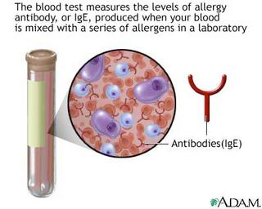
Specific IgE (RAST study)
Radioallergosorbent Test
more expensive
delayed
take longer
no more sensitive or specific than skin prick tests.
Notes:
They should be used where there are contraindications to skin prick tests, where skin prick tests are unavailable or difficult to interpret.

Slide 39
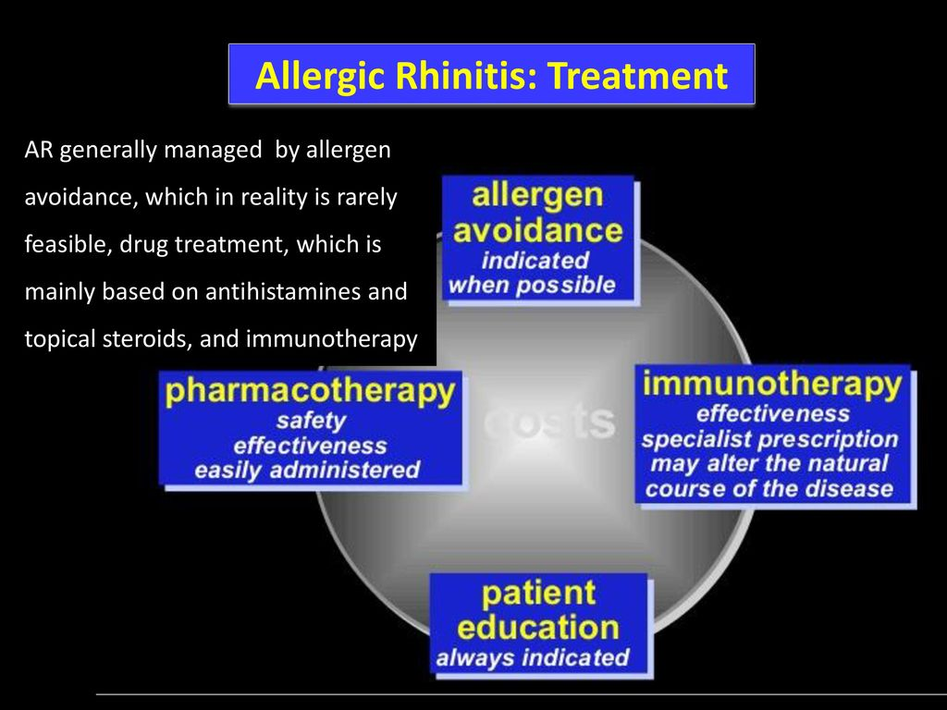

Slide 40
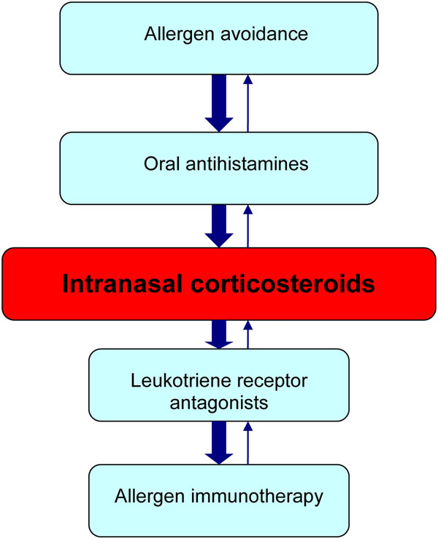

Slide 41
Allergen avoidance and environmental control
Primary prevention
Early uses of antibiotics and vaccinations (↑)
High allergenic foods during early life (↑)
Smoking during pregnancy (↑)
Notes:
Primary prevention programs, designed to limit the incidence of asthma among atopic families, have not been successful
Obsessional house dust mite avoidance measures are associated with improvement in lung function at three years, although, paradoxically, an increase in mite sensitization as determined by skin testing was observed.
Allergens represent major provoking factors in allergic rhinitis in atopic, exposed and sensitized individuals. Major indoor allergens include house dust mite, domestic pets, cockroach and moulds. Seasonal rhinitis results from exposure to pollens, which vary dependent on geography and time of year. In northern Europe, tree pollens are prevalent in March-May, grass pollens in May-July, weed pollen throughout the summer and mould spores during summer until late autumn. In sensitized symptomatic individuals, allergen avoidance is desirable and should be regarded as complementary to usual pharmacotherapy with antihistamines and topical intranasal corticosteroids. However, allergen avoidance measures are frequently expensive, time-consuming, impracticable or, in the case of pollens, not feasible.
Theoretical approaches to house dust mite avoidance/reduction are summarized below: [Grade D]
• encase mattress and pillows in plastic covers or special allergen-proof fabric;
• hot wash bedding (55°C) and damp wipe mite-proof covers every one to two weeks;
• remove objects that accumulate dust or place in a cabinet;
• store clothing in drawers and remove unused clothing from the bedroom;
• remove upholstered furniture and replace with leather, plastic or vinyl furniture;
• remove carpets, replace with washable rugs, install hardwood floors;
• treat carpets with acaricide, 3 % tannic acid, vacuum regularly (ideally not patient)
• use washable curtains or venetian blinds, clean every two weeks;
• replace or wash air filters on air cinditioners every month to remove debris
Patients with allergic rhinitis with or without asthma who are sensitive to cats and dogs should be advised to remove the animals or, failing this, not to replace them.
Avoidance of pollen is frequently not possible. Simple measures include keeping windows in cars and buildings tight shut. Cars may be fitted with a pollen filter. Patients should be recommended to avoid grassy open spaces. Paradoxically, pollen counts are highest in the late afternoon and evening when lower temperatures result in pollen counts falling to ground level. Recently, individual intranasal filters have demonstrated efficacy.
Food allergy almost never causes isolated nasal symptoms, although rhinitis may occur with other organ involvement including the mouth, upper and lower airways, gastrointestinal tract and skin. Provoking foods include peanuts, tree nuts, fish, shellfish and fruit. Milk and egg allergy are common in young children and usually resolve by four to eight years of age

Slide 42
Secondary measures
Major indoor allergens include house dust mite, domestic pets, cockroach and moulds.
However, allergen avoidance measures are frequently expensive, time-consuming, impracticable or, in the case of pollens, not feasible
Notes:
Secondary prevention, which aims at favoring disease control in allergic rhinitis or allergic asthmatic patients, has led to contradictory results.

Slide 43
Food allergy almost never causes isolated nasal symptoms
Provoking foods include peanuts, tree nuts, fish, shellfish and fruit. Milk and egg allergy are common in young children and usually resolve by four to eight years of age

Slide 44
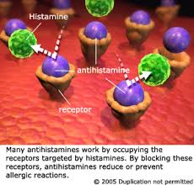
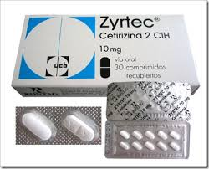
Antihistamines
These rapidly relieve running, itching and sneezing, but have little or no effect on blockage
Notes:
nor should they be used in patients on antiarrhythmics, those with low potassium or a congenital prolonged QTc interval
They appear to be more effective if used regularly rather than interrnittently and may reduce allergic progression in children.
mild, intermittent allergic rhinitis can generally be managed effectively with avoidance measures and oral antihistamines. However, as mentioned earlier, most patients presenting with allergic rhinitis have moderate-to-severe symptoms and, therefore, will require a trial of intranasal corticosteroids.

Slide 45
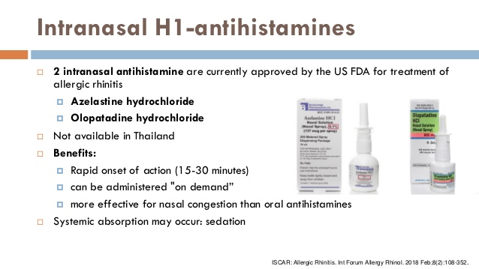

Slide 46
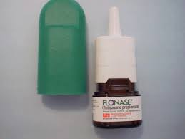
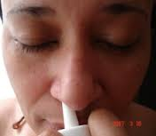
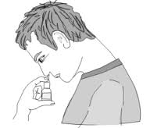
Topical Glucocorticosteroids
first-line therapeutic options for patients with mild persistent or moderate/severe symptoms and they can be used alone or in combination with oral antihistamines
These are the most effective treatment for rhinitis, especially if started prior to allergen exposure. Regular treatment is necessary.
Notes:
first-line therapeutic options for patients with mild persistent or moderate/severe symptoms and they can be used alone or in combination with oral antihistamines
mild, intermittent allergic rhinitis can generally be managed effectively with avoidance measures and oral antihistamines. However, as mentioned earlier, most patients presenting with allergic rhinitis have moderate-to-severe symptoms and, therefore, will require a trial of intranasal corticosteroids.

Slide 47
Nasal steroids reduce inflammation and consequent hyperreactivity, reduce nasal symptoms, eye symptoms and improve the sense of smell.
reduce lower airway symptoms in patients with concurrent asthma and allergic rhinitis
Notes:
to antihistamines and leukotriene receptor antagonists in controlling

Slide 48
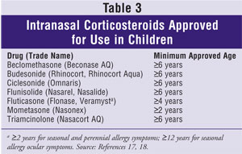

Slide 49
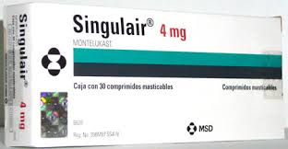
Antileukotriens
Montelukast and Zafirlukast
They are effective against congestion and mucus production, with efficacy similar to that of loratadine, but less than topical corticosteroids.
Combination of an antileukotriene plus an antihistamine was superior to either alone in one study, but in a second study did not show much clinically significant added benefit.
Notes:
Although one short-term study found the combination of LTRAs and antihistamines to be as effective as intranasal corticosteroids [38], longer-term studies have found intranasal corticosteroids to be more effective than the combination for reducing nighttime and nasal symptoms

Slide 50
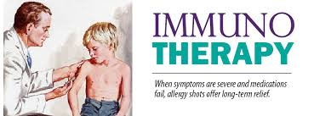
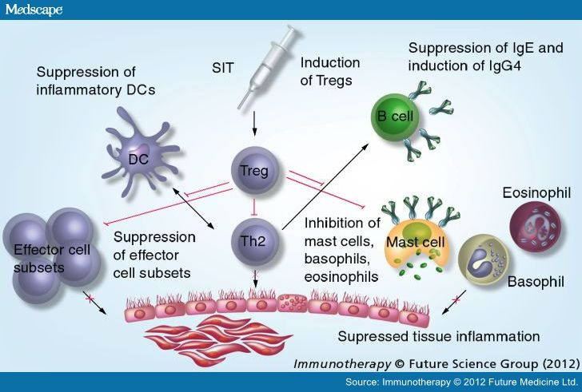
Immunotherapy
repeated administration of an allergen extract in order to induce a state of immunological tolerance.
for patients with severe symptoms in whom optimal avoidance measures and pharmacotherapy are insufficient to control symptoms or are not well tolerated
  Immunotherapy is more effective in patients with a limited spectrum of allergies.
Notes:
the subcutaneous administration of gradually increasing quantities of the patient’s relevant allergens until a dose is reached that is effective in inducing immunologic tolerance to the allergen

Slide 51
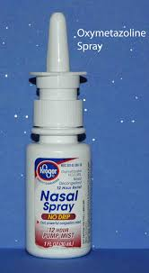
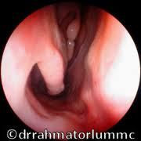
Decongestants
Used topically, these reduce nasal obstruction, but increase rhinorrhoea.
Regular use for more than a few days can result in rhinitis medicamentosa
Very short-term use (for flying, OME, and rhinosinusitis) is therefore recommended.
Systemic decongestants (pseudoephedrine, phenylephrine) are relatively ineffective and have side effects such as hyperactivity and insomnia in children and hypertension in adults.
Notes:
Regular use for more than a few days can result in rhinitis medicamentosa with abrogation of the normal response to alpha stimulation by the sympathetic nervous system as well as to the drug
contraindicated in patients with uncontrolled hypertension and severe coronary artery disease

Slide 52
Salaine nasal irrigation
using isotonic solution can be recommended as complementary therapy in AR. It is well tolerated, inexpensive
May reduce disease severity compared with no saline irrigation at up to three months

Slide 53
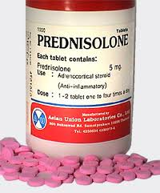
Systemic Corticosteroids
These can be used to unblock the nose at the start of treatment or provided for very severe symptoms during the hayfever season.
Regular use is associated with significant systemic side effects and therefore only occasional intermittent use for a few days at a time is sensible.
They should be combined with topical corticosteroid and the usual precautions apply.
Notes:
Depot-injected preparations are not recommended because they are not removable if side effects occur.
Injection of depot steroid into turbinates and polyps has been associate with blindness and is not recommended.

Slide 54
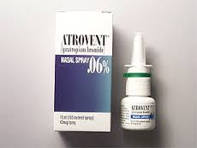
Ipratropium Bromide
This atropine-like nasal spray is useful against watery rhinorrhoea and may, if regularly used, be curative.
Occasionally it is helpful in patients with allergic rhinitis who do not respond to topical corticosteroids alone.
Side effects can include worsening of glaucoma or prostatism and dry mouth and eyes.

Slide 55
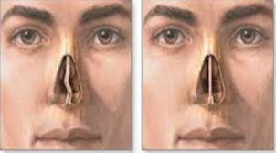
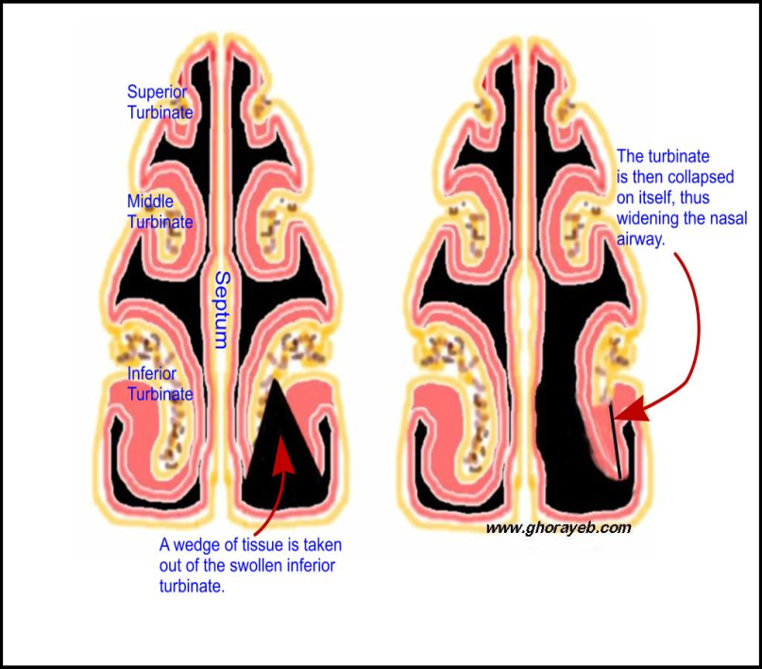
Surgery
Nasal surgery may be needed where there is a marked septal deviation or bony turbinate enlargement which makes topical nasal sprays usage difficult.
Mucosal hypertrophy is preferably dealt with medically if possible, since after surgery the problem tends to recur within months.
Endoscopic sinus surgery may also be needed to relieve symptoms of rhino sinusitis

Slide 56
