Slide 1
NASAL POYPS
Dr.Satguru Saran Singh
Assistant Professor
Department of ENT

Slide 2

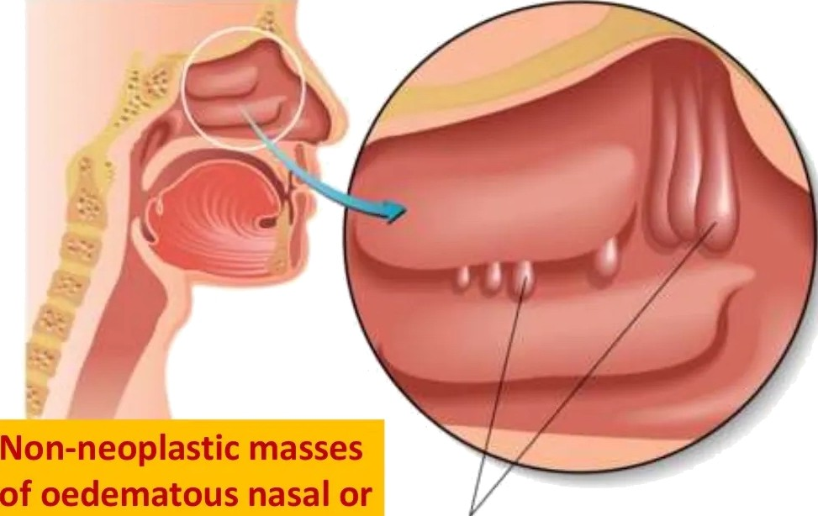

sinus mucosa

Slide 3



TYPES
NASAL POLYPS
BILATERAL ETHMOIDAL POLYP
ANTROCHOANAL POLYP

Slide 4
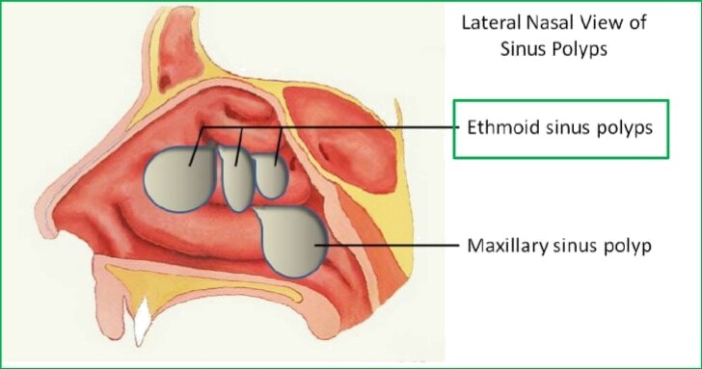
BILATERAL ETHMOIDAL POLYP

Slide 5


ETI LOGY
Inflammatory conditions of nasal mucosa
Rhinosinusitis
Disorders of ciliary motility
Kartagener's syndrome
Abnormal composition of nasal mucus
Cystic fibrosis

Slide 6


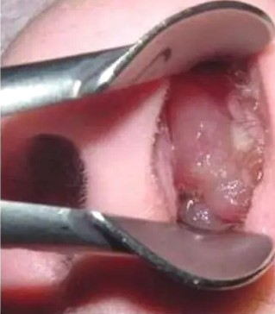
ETI LOGY
Various disease associated with the formation of nasal polyps are:
Chronic rhinosinusitis Kartagener syndrome Cystic fibrosis Asthma
Aspirin tolerance Allergic fungal sinusitis Young syndrome
Churg-Strauss syndrome Nasal mastocytosis

Slide 7



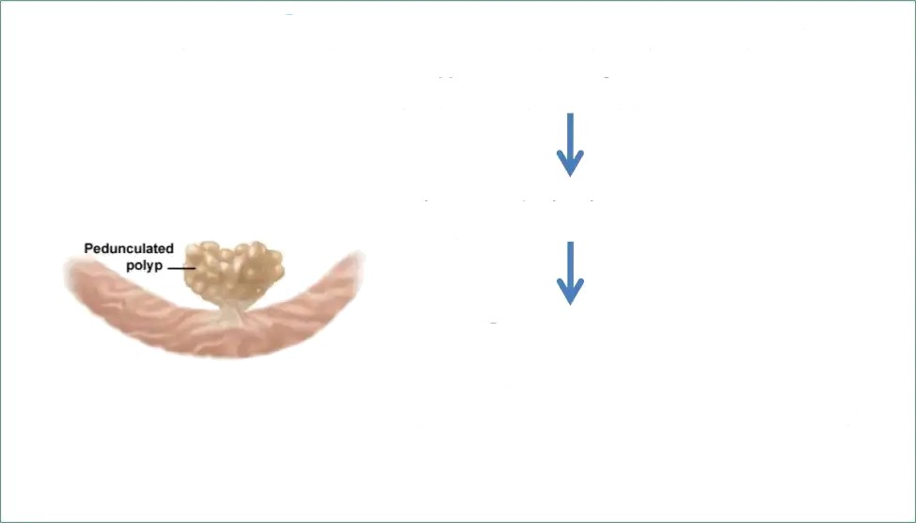
PATH ESI
Nasal mucosa
becomes edematous due to
collection of ECF
polypoidal change
Sessile to pedunculated
(due to gravity and excessive sneezing)

Slide 8

PATH LOGY
Early stage Nasal polyp (surface covered
ciliated columnar epithelium)
Metaplastic change in exposure to atmospheric irritation
Transitional squamous epithelium large ICS filled with serous fluid
+ infiltration with eosinophils and round cells
Submucosa

Slide 9




ITE I I
ultiple nasal polyps always arise from the lateral wall of nose, usual from the middle meatus
Common sites:
Uncinateprocess Bulla ethmoidalis Ostia of sinuses Medial surface
edge of middle turbinate

Slide 10


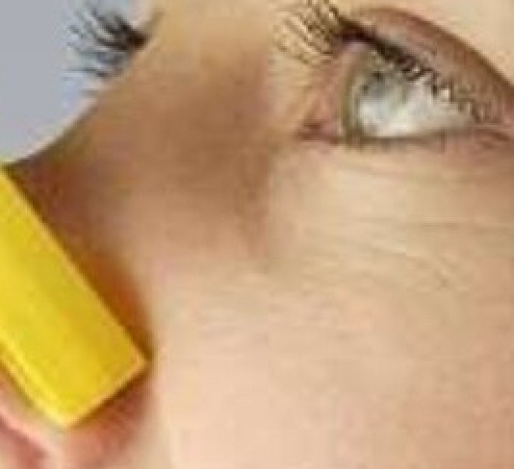
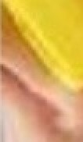
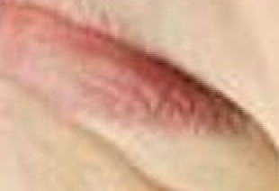
SYMPTOMS
Mostly seen in adults
Nasal stuffiness leading to total nasal obstruction
Partial/total loss of smell
Headache (associated sinusitis)
Sneezing and watery nasal discharge (associated allergy)
Protruding mass
,
“

Slide 11
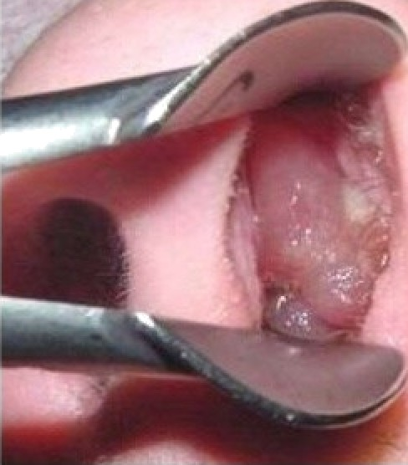
SIGNS
On anterior rhinoscopy, polyps appear as
  Smooth, glistening
  Grape-like masses
  Often pale in color
  May be sessile or pedunculated
  Insensitive to probing
  Do not bleed on touch
  Often multiple and bilateral
Broadening of nose
Increase intercanthal distance
long standing case
May protrude from the nostril and appear pink and vascular, simulating neoplasm
Purulent discharge (associated sinusitis)

Slide 12


IAG OSI
Clinical examination
CT scan of paranasal sinuses
exclude neoplasia plan surgery
Histological examination
especial in people >40 years

Slide 13
TREATM NT
CONSERVATIVE
Antihistaminics control of allergy may revert early polypoidal changes with oedematous mucosa to normal
Short course steroids
in people who cannot tolerate antihistaminics or with asthma

Slide 14
TREATM NT
Polypectomy
Intranasal ethmoidectomy
Extranasal ethmoidectomy
Transantral ethmoidectomy
Endoscopic sinus surgery

Slide 15
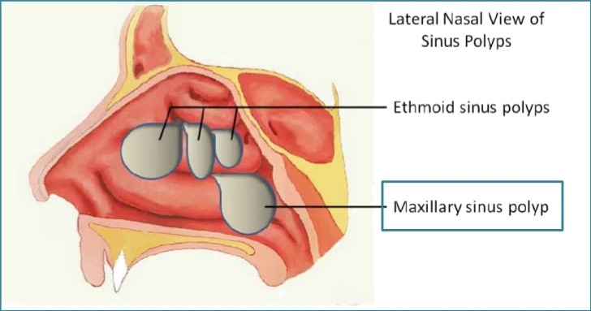
ANTROCHOANAL POLYP

Slide 16
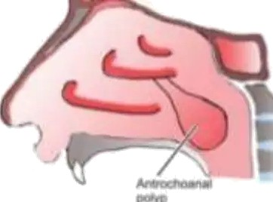

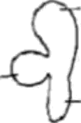

SITE OF ORIGIN
Arise from the mucosa of maxillary antrum near its accessory ostium, comes out of it, and grows in the choana
a nasal cavity
Thus, it has arts:
Antral: thin stalk
Choanal: round and globular
Nasal: flat from side to side
I

Slide 17


ETI LOGY
Exact cause is unknown
Nasal allergy coupled with sinus infection is
incriminated
Seen in children and adults
Usual single and unilateral

Slide 18
SYMPTOMS
Unilateral nasal obstruction
Bilateral nasal obstruction
when polyp grows into the nasopharynx starts obstructing the opposite choana
Thick and dull voice hyponasality
Nasal discharge mostly mucoid

Slide 19
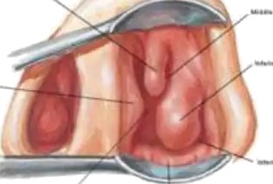
ON EXAMINATION
Anterior rhinoscopy may be missed as it grows posteriorly
Large, smooth, pale mass covered with nasal discharge
Soft, can be moved up and
down with the probe, insensitive to touch and does not bleed on probing
May protrude from nostril
shows pink, congested loop

Slide 20
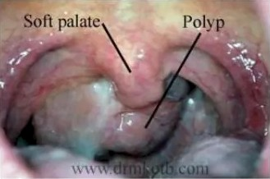
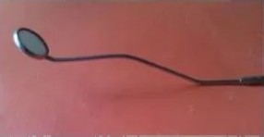
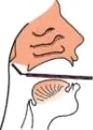
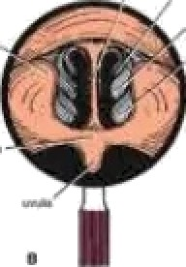
ON EXAMINATION
Posterior rhinoscopy
lar mass filling the choana or the nasopharynx
A large polyp may hang down behind soft palate
and present in oropharynx
— ......

Slide 21
INVESTIGATIONS
Nasal endoscopy
  May reveal choanal or antrochoanal polyp hidden posteriorly in the nasal cavity
Xrays of paranasal sinuses
  May show opacity of the involved antrum
Lateral view
  globular swelling in postnasal space
  column of air behind the polyp

Slide 22
DIFFERENTIAL DIAGNOSIS
A blob of mucus
  disappear on blowing nose
Hypertrophied middle turbinate
  pink appearance
  hard feel of bone on probe testing
Angiofibroma
  history of profuse recurrent epistaxis
  firm in consistency
  easily bleed on touch
Neoplasms
  fleshy pink appearance
  friable nature
  tendency to bleed)

Slide 23
TREATM NT
Avulsion nasal/oral route
Recurrence is uncommon after complete removal
In case of reccurence, Caldwell-Luc operation
Complete removal of polyp from site of origin
Endoscopic sinus surgery is now preferred

Slide 24
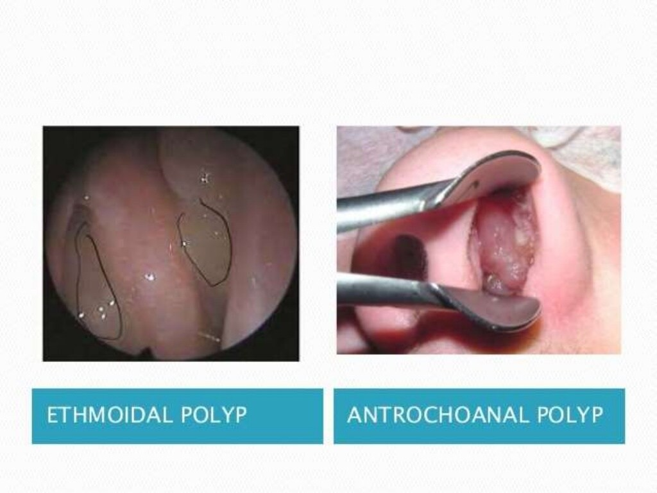

Slide 25

Common in adults
Age
Common in children
Etiology
Allergy or multifocal
Infection
Number
Multiple
Solitary
Laterality
Bilateral
Unilateral
Origin
Ethmoidal sinuses
Maxillary sinus near ostium
Backwards to choana, may hang down behind soft palate
Growth
Mostly anteriorly & may present at the nares
Size & shape
Usually small & grape-like masses
Trilobed (antral, nasal,
choanal part)
Recurrence
Uncommon if removed completely
Treatment
Polypectomy, endoscopic surgery or ethmoidectomy
Polypectomy, endoscopic
removal

Slide 26


