Slide 1
Acute and Chronic Sinusitis
By:-
Dr.SATGURU SARAN SINGH
Department of ENT&HNS
Rohilkhand Medical College & Hospital

Slide 2
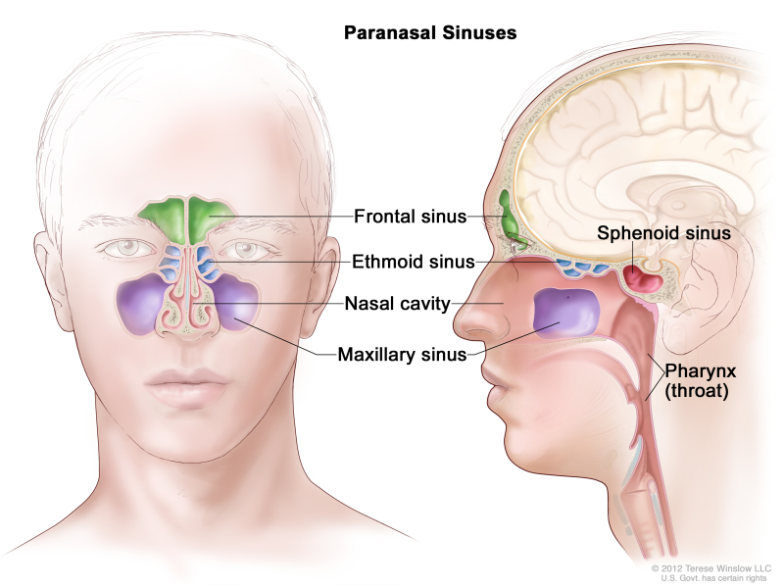
OVERVIEW OF ANATOMY OF PARANASAL SINUSES

Slide 3
ACUTE SINUSITIS
Acute inflammation of sinus mucosa is called ACUTE SINUSITIS.
Symptoms resolves in <12 weeks
Most common sinus involved :- (Maxillary)>Ethmoid>Frontal>Sphenoid
Sinusitis:- 1)Multisinusitis (more than one sinus is infectd)
2) Pansinusitis (all sinuses of one or both sides are involved
simultaneously).
Depending on whether inflammatory products of sinus cavity drain into nasal cavity through natural ostia or not , sinusitis is of 2 types:-
1) Open type
2) Closed type

Slide 4
CAUSES OF SINUSITIS
EXCITNG CAUSES:-
1)Nasal infections:- viral rhinitis followed by bacterial invasion.
2)Swimming and diving
3)Trauma:- compound fractures or penetrating injuries of
sinuses( Frontal,Maxillary,Ethmoid).
4)Dental infections (molar or premolar teeth)
BACTERIOLOGY:-
Streptococcus pyogenes & Streptococcus pneumoniae
Haemophilus inluenzae , Moraxella catarrhalis
Staphylococcus aureus , Kleibsella pneumoniae
Anaerobic organizms & mixed infections seen in sinusitis of dental
origin.

Slide 5
PREDISPOSING CAUSES
A. LOCAL :-
1)Obstruction to sinus ventilation and drainage ( nasal packing , deviated septum , nasal polyp , hypertrophy turbinates , structural abnormality of ethmoidal cells , oedema of sinus ostia due to vasomotor rhinitis or allergy , Benign or malignant neoplasm).
2)Stasis of secretions in nasal cavity ( cystic fibrosis,enlarged adenoids ,choanal atresia)
3) Previous attacks of sinusitis
B. GENERAL:-
1) Enviornment (cold and wet climate, atmospheric polluion, smoke
dust and overcrowding)
2)Poor general health(recurrent attacks of exanthematous fever, diabetes, immunodeficiency syndromes , nutritional deficiencies)

Slide 6
PATHOLOGY OF SINUSITS
Acute inflammation of sinus mucosa
Hyperaemia,exudation of fluid,pouring out of polymorphonuclear cells
Increased activity of serous and mucous glands
Depending on virulence of organizms,defence of host and capability of sinus ostia to drain exudates the disease may be:-
mild( Non suppurative) severe( Suppurative )
cause destrction of mucosal lining

Slide 7
1.Acute Maxillary Sinusitis
Causes:- 1)MOST COMMON(Viral rhinitis followed by bacterial
invasion).
2)Diving and swimming
3)Dental infections (because roots of premolar and molar
teeth are realated to floor of sinus and may be seprated by
thin layer of mucosal covering).
4)Trauma( penetrating injuries or compound fractures)
C/F:-
1) Constitutional symptoms:- fever,malaise,bodyache
2) Headache(confined to forehead)
3) Pain(over upper jaw,may be refferred to gums or teeth, aggravated on
coughing or chewing, may be refferred to ipsilateral supraorbital
region).

Slide 8
4) Tenderness( pressure over anterior wall of antrum produces pain)
5) Redness and edema of cheek( lower lid becomes puffy )
6) Nasal discharge ( pus or mucopus in middle maetus)
7) Post nasal discharge( may be seen on upper soft palae on posterior
endoscopy)
Postural test :- if no pus seen in middle maetus,it is decongested
with pledget of cotton soaked with vasoconstrictor and
patient is asked to sit with the affected sinus turned up.
examination done after 10-15 min may show discharge
middle maetus.
Diagnosis:-
1) Transillumination test:-Affected sinus will be found opaque.
2) X-Rays(water’s view):-shows opacity or fluid level in affected sinus
3) CT Scan

Slide 9
TREATMENT:-
MEDICAL
Antimicrobial drugs:-Ampicillin and amoxicillin are quite effective and cover a wide range of organizms.
Erythromycin or doxycycline or cotrimoxazole are equally effective and can be given to those who are sensitive to penicillin.
β- lactamase producing strains of H. influenzae and M. catarrhalis may
use amoxicillin/ clavulanic acid or cefuroxime axetil.
2.Nasal decongestant drops:- One per cent ephedrine or 0.1% xylo- or oxymetazoline
3.Steam inhalation:- Steam inhalation alone or medicated with menthol or Tr. Benzoin Co. provides symptomatic relief and encourages sinus drainage.
4.Analgesics:- Paracetamol or any other suitable analgesic should be given for relief of pain and headache.

Slide 10
5.Hot fomentation
SURGICAL
1) Antral lavage.:- Lavage is rarely necessary. It is done only when
medical treatment has failed.
Complications:-
1)Acute maxillary sinusitis may change to subacute or chronic sinusitis
2) Frontal sinusitis
3) Osteitis or osteomyelitis of the maxilla
4)Orbital cellulitis or abscess. Infection spreads to the orbit because of oedema either directly from the roof of maxillary sinus or indirectly, after involvement of ethmoid sinuses.

Slide 11
2. Acute ethmoid sinusitis
Assosiated with infection of other sinuses
Ethmoid sinuses oftenly involved in infants and young children.
C/f:-
1) Pain:-over bridge of nose, medial and deep to eye,aggravated by
movements of eyeball.
2)Oedema of lids (both eyelids become puffy and swollen)
3)Nasal discharge (seen on superior or middle maetus)
4)Swelling of middle turbinate
Treatment:;
1) Medical treatment
2) Visual deteioration and exophthalmos indicates abscess in the
posterior orbit and may require drainage of ethmoid sinuses
through external ethmoidectomy.

Slide 12
Complications:-
1. Orbital cellulitis and abscess.
2. Visual deterioration and blindness due to involvement of optic
nerve.
3. Cavernous sinus thrombosis.
4. Extradural abscess, meningitis or brain abscess.

Slide 13
3. Acute Frontal Sinusitis
C/f:-
1) Frontal headache:- Usually severe and localized over the
affected sinus .It shows characteristic periodicity, i.e.comes up on waking, gradually increases and reaches its peak by about mid day and then starts subsiding. It is also called “office headache” because of its presence only during the office hours.
2) Tenderness:- Pressure upwards on the floor of frontal sinus, just above the medial canthus, causes exquisite pain.
3) Oedema of upper eyelid with suffused conjunctiva and photophobia.
4) Nasal discharge:- A vertical streak of mucopus is seen high up in the anterior part of the middle meatus.
Diagnosis:-1)X-Rays( both water’s and lateral view)
2)CT Scan

Slide 14
Treatment:-
1) MEDICAL :- same as for acute maxillary sinusitis, i.e. antimicrobials, decongestion of the sinus ostium or drainage and analgesics.
Placing a pledget of cotton soaked in a vasoconstrictor in the middle meatus, once or twice daily, helps to relieve ostial oedema.If patient shows response to medical treatment and pain is relieved, treatment is continued for full 10 days to 2 weeks.
2) SURGICAL :-Trephination of frontal sinus:- If there is persistence or exacerbation of pain or pyrexia in spite of medical treatment for 48 h, or if the lid swelling is increasing and threatening orbital cellulitis, frontal sinus is drained externally.
2cm long horizontal incision is made in superomedial aspect of the orbit below the eyebrow
Floor of frontal sinus is exposed and hole drilled with a burr
Pus taken for c/s . Plastic tube inserted and fixed

Slide 15
Sinus can now be irrigated with normal saline two or three times daily until frontonasal duct become patent which can be detrmined by adding few drops of methylene blue to the irrigating fluid and its exit may be seen through nose.
Drainage tube is removed when frontonasal duct becomes patent
Complications:-
1) Orbital cellulitis.
2) Osteomyelitis of frontal bone and fistula formation
3) Meningitis, extradural abscess or frontal lobe abscess.
4) Chronic frontal sinusitis

Slide 16
4. Acute Sphenoid Sinusitis
Isolated involvement is rare.
Often a part of pansinusitis or assosiated with infection of posterior ethmoid sinuses.
C/F:-
1)Headache(localized to occiput or vertex or may be reffered to mastoid region.
2)Post Nasal discharge:- streak of pus may be seen on roof or posterior wall of nasopharynx or above posterior end of middle turbinate.
Diagnosis:- 1)X Ray lateral view in supine or prone position to
demonstrate fluid level.
2)CT Scan

Slide 17
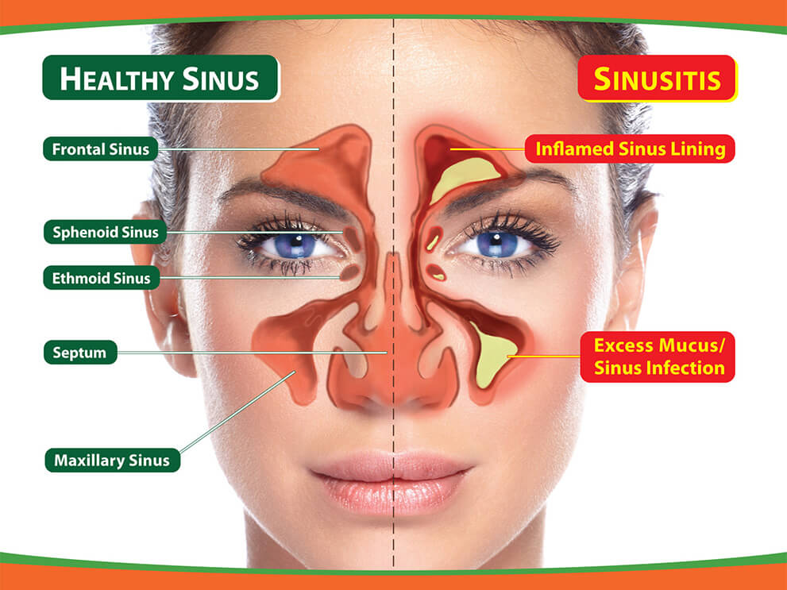
Chronic sinusitis
Sinus infection lasting for months or years (>12 weeks)

Slide 18
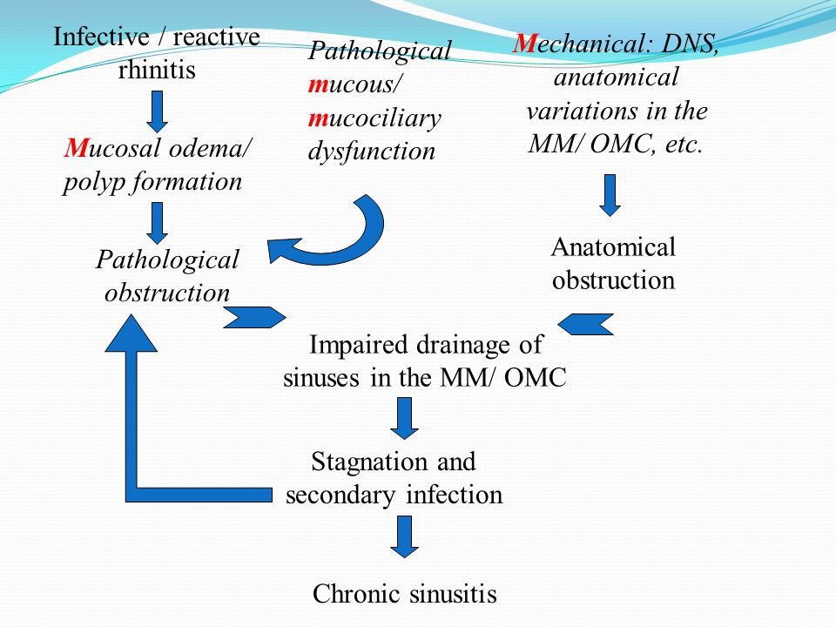
Pathophysiology and causes of chronic sinusitis

Slide 19
Pathology of chronic sinusitis
In chronic infections, process of destruction and attempts at healing proceed simultaneously.
Sinus mucosa becomes thick and polypoidal (hypertrophic sinusitis) or undergoes atrophy (atrophic sinusitis).
Surface epithelium may show desquamation, regeneration or metaplasia.
Submucosa is infiltrated with lymphocytes and plasma cells and may show microabscesses, granulations, fibrosis or polyp formation.

Slide 20
C/f of chronic sinusitis :-
1)are often vague and similar to those of acute sinusitis but of lesser severity.
2)M/C complain Purulent nasal discharge
3)Foul-smelling discharge suggests anaerobic infection.
4)Local pain and headache are often not marked except in acute exacerbations.
5)nasal stuffiness and anosmia
Diagnosis:-
1) X-ray of the involved sinus may show mucosal thickening or opacity.
2)X-rays after injection of contrast material may show soft tissue changes in the sinus mucosa.
3)CT scan is particularly useful in ethmoid and sphenoid sinus infections.
4)Aspiration and irrigation:- Finding of pus in the sinus is confirmatory.

Slide 21
Treatment of chronic sinusitis
Initially t/t is conservative :- antibiotics,decongestants,antihistaminics
and sinus irrigations.
Surgical t/t for chronic sinusitis :-
1) Chronic maxillary sinusitis:-
Antral puncture and irrigation (sinus cavity is irrigated with a cannula passed through inferior maetus).
Intranasal antrostomy(a window is created in inferior maetus to provide aeration to sinus).
Caldwell- luc operation(antrum is entered through its anterior wall by a sublabial incision and a window is created b/w inferior maetus and antrum).

Slide 22
2) Chronic frontal sinusitis:-
Intranasal drainage operations(correction of deviated septum , removal of ployp, intranasal ethmoidectomy provide drainage through frontonasal duct).
Trephination of frontal sinus
External frontoethmoidectomy or howarth’s or lynch operation (frontal sinus is entered through its floor by curvilinear incision round the inner margin of orbit . Diseased mucosa is removed , ethmoid cells exenterated and new frontonasal duct created ).
Osteopalstic flap operation ( a coronal or brow incision is given. Anterior wall of sinus reflected as osteoplastic flap,based inferiorly)
3) Chronic ethmoid sinusitis:-
Intranasal ethmoidectomy(for chronic ethmoiditis with polyp formation)
External ethmoidectomy (ethmoid sinus approached via medial orbital incision).

Slide 23
4)Chronic sphenoiditis:-
Sphenoidotomy (Access to the sphenoid sinus can be obtained by removal of its anterior wall and it is accomplished by external ethmoidectomy or trans- septal approach).

Slide 24
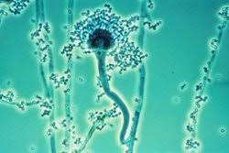
Fungal infection of sinuses
M/C species (Aspergillus, Alternaria , Rhizopus , Mucor)

Slide 25
Varieties of fugal infection of sinuses
Fungal ball
Allergic fungal sinusitis
Chronic invasive snusitis
Fulminant fungal sinusitis

Slide 26
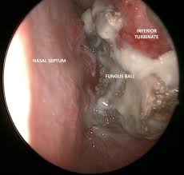
1.Fungal Ball:-
Due to implantation of fungus in the healthy sinus.
M/C sinus involved Maxillary sinus.
CT scan shows hyperdense area with no bone erosion.
T/t:- 1)Surgical removal of fungal ball
2)Adequate drainage of sinus
3)No antifungal therapy

Slide 27
2.Allergic fungal sinusitis
Due to allergic reaction to causative fungus.
Presents with mucin or sinonasal polyposis (contains RBCs, charcot laden crystals and fungal hyphae).
CT Scan shows:- Hyperdense area with mucosa thickening
Bone erosion may be seen due to pressure.
No fungal invasion in sinus mucosa.
T/t:-1)Endoscopic clearance of sinus with provision of ventilaton and drainage.
2) Pre and Post-op steroids

Slide 28
3.Chronic Invasive Sinusitis
Fungus invades sinus mucosa.
Presents with chronic sinusitis
CT Scan :-1)Bone erosion
2)Thickened mucosa with opacification of sinus
3)Intracranial or Intraorbital invasion
4)Invasion of submucosa
T/t:-surgical removal of involved bone, mucosa and soft tissue
F/b by anti fungal therapy with i.v amphotericin B(2-3g)
F/b itraconazole therapy for 12 months or more monitored by serial CT or MRI scans.

Slide 29
4.Fulminant fungal sinusitis(commonly seen in immunocompromised or diabetics)
Mucur
Aspergillus
Cause rhinicerebral disease
Invasion of blood vessels cause ischaemic necrosis .
Presents as black ESCHAR.
Involves skull base, brain,face,eye,palate and inferior turbinate.
T/T:-Surgical debribement of necrotic tissue and i.v amphotericin B.
Cause acute fulminant sinusitis.
Tissue invasion
Presents with acute sinusitis and sepsis.
T/T:-Antifungal therapy and surgery.

