Slide 1
VIRAL infections
Dr pooja
Senior resident
29/05/2024

Slide 2
CONTENTS
Classification
Etiopathogenesis
Molluscum contagiosum
Human papilloma virus infection
Herpes simplex infection
Herpes zoster infection
Epstein Barr virus infection
Other herpes infection
Viral exanthem
Uncommon viral infection of skin
MCQs
Photo quiz

Slide 3
Classification of virus
DNA VIRUS
Enveloped (double stranded)
        Herpesviridae
        Hepadnaviridae
        Non-enveloped (double stranded)
        Papillomaviridae
        Polyomaviridae
        Adenoviridae
        Single stranded (non-enveloped)
        Parvoviridae
        Poxviridae
        RNA Virus
        Flaviviridae
        Togaviridae
        Retroviridae
        Coronaviridae
        Picornaviridae
        Calciviridae
        Orthomyxoviridae
        Paramyxoviridae
        Rhabdoviridae
        Arenaviridae
        Reoviridae

Slide 4
Etiopathogenesis
Cell lysis (Herpes)
Cell proliferation (Pox, HPV)
Carcinogenesis (Cervical Ca, Hepatoma)
Exanthemata - Viraemia, Type 3 hypersensitivity (Arthus) reaction, virus lodged in dermal capillaries and replicate in epidermis.
Persistent infection: Periods of latency and reactivation (HSV, VZV)

Slide 5
Molluscum Contagiosum
Caused by molluscum contagiosum virus , a DNA virus of Poxviridae family.
Commonly affects children and sexually active adults.
Most easily transmitted by direct skin to skin contact.
Incubation period varies from 2 weeks to 6 months.
Typical lesions are discrete, dome shaped, umbilicated papules.
D/D: Cryptococcosis, Histoplasmosis, Penicillinosis

Slide 6
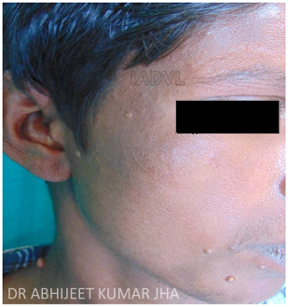
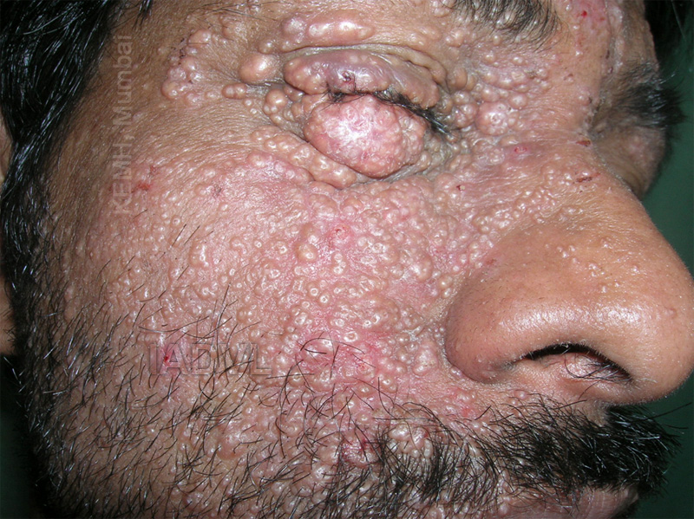
Molluscum Contagiosum
Molluscum In HIV

Slide 7
Diagnosis and treatment
Direct examination of expressed material when clinical diagnosis is doubtful.
On histopathology-Henderson-Paterson bodies (molluscum bodies).
Enucleation, Cryotherapy using liquid nitrogen, Curettage or diathermy
Pulsed dye laser.
Application of phenol or 40 % silver nitrate.
10 % KOH, 0.5 % podophyllotoxin, Imiquimod cream.
1 -3 % cidofovir ointment or cream, 0.9 % cantharidin.
Povidone iodine with 15 – 20 % salicylic acid.
Systemic : Levamisole, Cimetidine.

Slide 8
Human Papilloma Virus
More than 100 types of HPV
Genome of HPV-Early genes (E1-E7), Late genes (L1-L2)
Transmission : direct or indirect contact (nail biters, shaving, occupational, swimming pool)
Sexual transmission : genital / perianal wart
Autoinoculation

Slide 9
Clinical Types
Non genital :
Verruca vulgaris (Common warts)
Verruca Plana (Plane warts)
Filiform
Digitate
Palmoplantar
Periungual
Genital :
Condyloma Acuminata

Slide 10
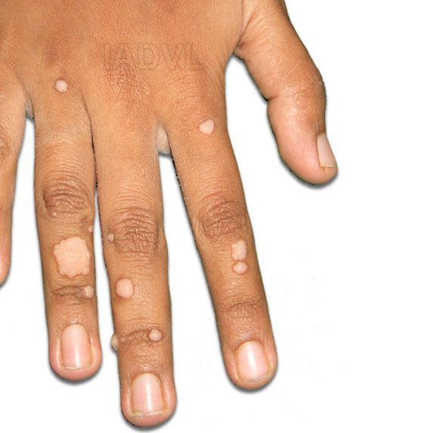
Common Wart
HPV types-1,2,4,27 and 57
Commonly seen in young children and adults.
Meat butchers, frequent immersion of hand in water are risk factors
Papules with verrucous surface.
Commonest site-Hands
(Fingers and palms)
Warts do not have dermatoglyphics

Slide 11
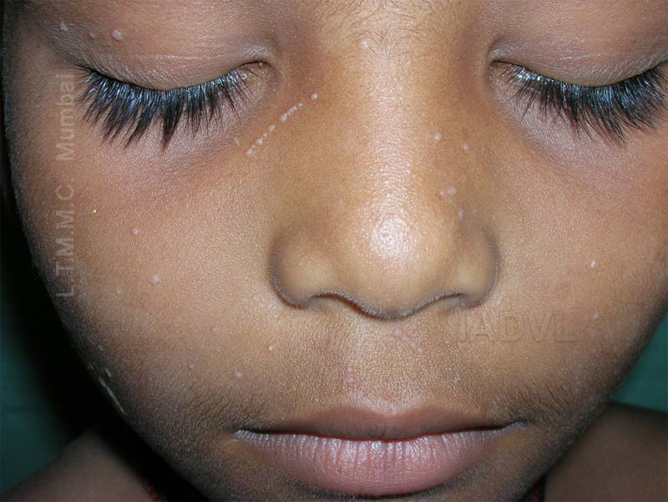
Verruca Plana
HPV types-3,10,28 and 41
Risk factors-sun exposure, swimmers
Common sites-Face, lower legs
Few milimetres brown or skin coloured flat topped papules
Koebnerisation seen

Slide 12
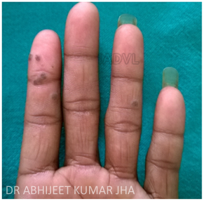
Palmo-Plantar warts
HPV types-1, 2, 4, 27
Seen at pressure points
If paring is done-multiple small black points seen (dilated capillary loops)
Myrmecia
Mosaic type
Differentiate from corn and callosity

Slide 13
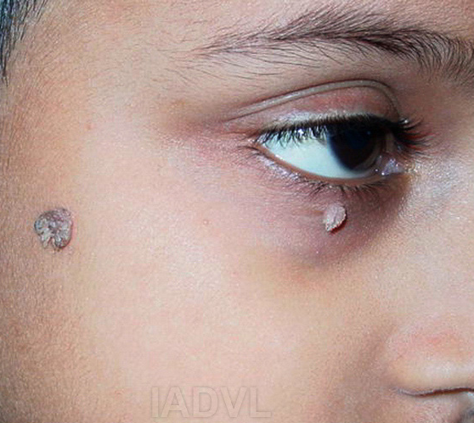
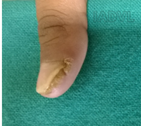
Filiform and digitate warts
Finger like projection
Periungual warts
Seen in nail biters
Recalcitrant to treatment

Slide 14
Genital Warts
Low risk genital HPV types-6 and 11
High risk genital HPV types-16 and 18
Condyloma acuminata
Few mm to cms in size
Lobulated papules usually multifocal, cauliflower like mass may be seen in moist occluded areas
Sites- intraurethral in men, mucosal surface of cervix or vulva, perianal skin, vulva
Giant Condyloma acuminata (Buschke Lowenstein tumor)
Verrucous carcinoma, may invade and metastasize to LN

Slide 15
Genital Warts
Bowenoid paulosis
Hyperpigmented papules or flat surface
HPV types-16,18
Sites- Penis, Perianal area, vulva
Diagnosis
Clinically
Histopathology-Papillomatosis, acanthosis
DNA hybridisation, Immunohistochemistry

Slide 16
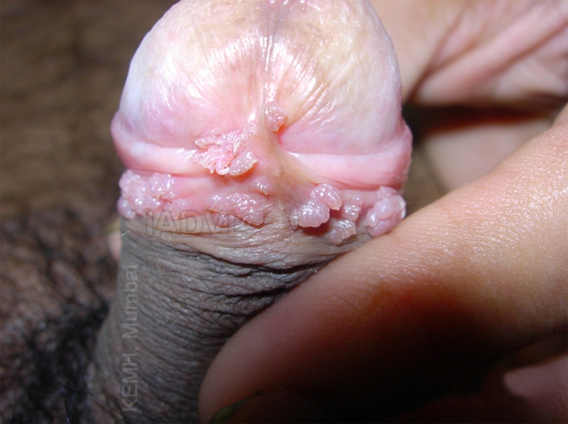
Genital Wart

Slide 17
Treatment
Salicylic Acid, Lactic acid / Salicylic Acid combination
Chemical cautery : Podophyllin, TCA (35%-85%)
Imiquimod, Green Tea Extract (Sinecatechins), 5FU
Cryotherapy
Electrocautery
Radiosurgery
CO2 Laser
Newer therapies - Mycobacterium W vaccine, MMR vaccine

Slide 18
Human Herpes Virus
Human Herpes virus 1 (Herpes simplex virus 1 (HSV 1))
Human Herpes virus 2 (Herpes simplex virus 2 (HSV 2))
Human Herpes virus 3 (Varicella-Zoster virus (VZV))
Human Herpes virus 4 (Epstein Barr virus (EBV))
Human Herpes virus 5 (Cytomegalovirus (CMV))
Human Herpes virus 6 (HHV 6)
Human Herpes virus 7 (HHV 7)
Human Herpes virus 8 ( Kaposi’s sarcoma associated Herpes Virus (KSV)(HHV 8))

Slide 19
Herpes Virus
Herpes Simplex Virus I :
Herpes Labialis, Herpetic Gingivostomatitis, Herpetic whitlow, Herpetic gladiatorum, Herpes sycosis, Keratoconjunctivitis
Herpes Simplex Virus II :
Herpes progenitalis, Herpetic vulvovaginitis
Complicated :
Eczema herpeticum, Disseminated HSV
Herpes Simplex Virus in HIV :
Chronic, recurrent, ulcer, eschar formation and dissemination

Slide 20
Herpes simplex infections
Primarily involve the skin and mucous surfaces
Can be disseminated in neonates and immunocompromised hosts
Produces primary infection - enters a latent or dormant stage, residing in the sensory ganglia - can be reactivated at any time
HSV-1 : >90% of primary infections caused by HSV-1 are subclinical; more common
HSV-2- usually the genital pathogen and usual pathogen of neonatal herpes

Slide 21
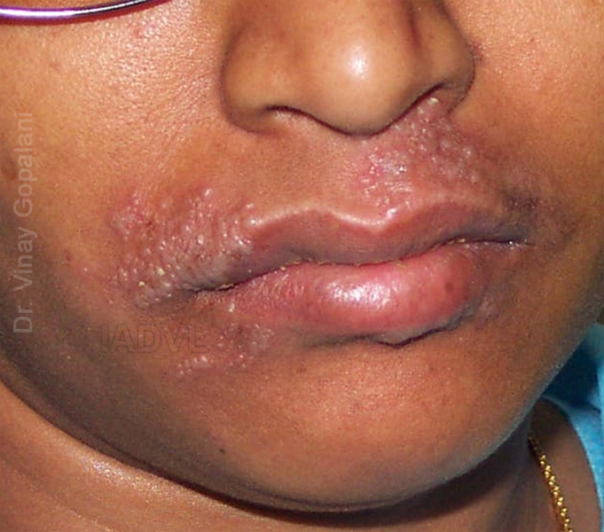
Orolabial Herpes
95 % HSV – 1
Presentation :
Grouped vesicles on an erythematous base.
  Often prodrome of tingling or itching.
  Variable severity of recurrent lesions.
  Mild flu like symptoms may be present.

Slide 22
Herpetic Gingivostomatitis
High fever, irritability, anorexia, mouth pain, drooling
Gingivae becomes intensely erythematous, edematous, friable and tends to bleed
Symptoms last 5-14 days, but virus can be shed for weeks following resolution

Slide 23
Differential diagnosis
Aphthous ulcer
Herpangina
Stevens Johnson Syndrome
Syphilis

Slide 24
Diagnosis
Tzanck smear-
  Method-scraping base of freshly ruptured vesicle
  Staining with Giemsa or Wright stain
  Look for multinucleated giant cells
HSV antibody titre : IgG/IgM
Immunofluoroscence, PCR-most sensitive

Slide 25
Herpetic Infections ( contd)
Herpetic Sycosis
Shaving after facial herpes induces a slowly spreading folliculitis of the beard with few isolated vesicles.
Herpes Gladiatorum
Herpetic whitlow
Herpetic infection of the fingers.
Children (thumb sucking)
Adults : 2/3 cases HSV-2, Children nearly 100% HSV-1

Slide 26
Genital Herpes
Infection of HSV-2 in majority of cases.
Spread by Skin to Skin contact
Active lesions are infective
Asymptomatic shedding accounts for the majority of transmission.
Prior HSV-1 infection does not protect from HSV-2 infection but may lessen severity of first outbreak.
Primary infection:
Grouped vesicles which appear for 7-14 days.
Fever, Flu like symptoms, inguinal lymphadenopathy, proctitis if rectal involvement.
Recurrent lesions with typical prodrome of burning/itching followed by outbreak which is less severe than the primary infection healing in 6-10 days.

Slide 27
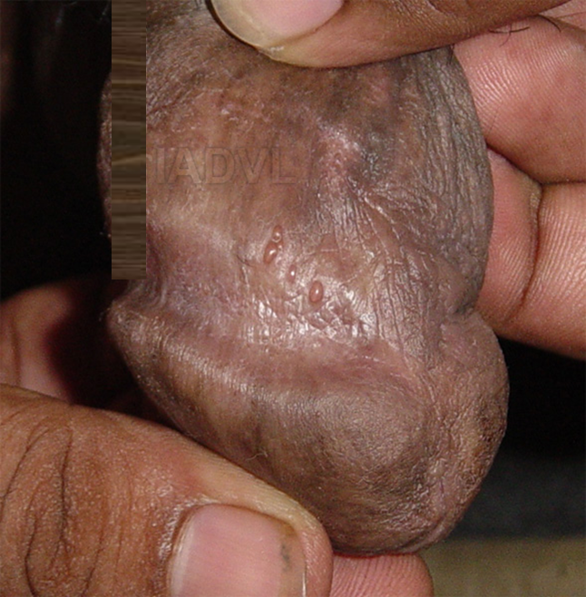
Genital Herpes simplex infection

Slide 28
Treatment
Symptomatic
Topical : Acyclovir, Penciclovir, Cidofovir
Systemic :
Antiviral | Primary (10 days) | Recurrence (5 days) | Suppressive 6 months - 1yr
Acyclovir | 200 mg 5 times / day | 400 mg tid | 400 mg bd
Valaciclovir | 1 gm bd | 500 mg bd | 500-1000 mg bd
Famciclovir | 250 mg tid | 125 mg bd | 250 mg bd

Slide 29
Intrauterine and Neonatal Herpes
Extent of initial involvement predicts outcome:
Localized : rarely fatal
Disseminated disease fatal
Presentations in newborns
Majority present with vesicles.
Disseminated herpes with CNS involvement may occur without skin involvement.
Few cases never have vesicles.
Treatment: Acyclovir 250 mg/(m)2 q8 hours x7 days

Slide 30
Eczema herpeticum
(Kaposi’s varicelliform eruption)
Multiple crops can appear over 7-10 days (like varicella)
Can be mild or fulminant,
If area of involvement is large, can be lots of fluid loss and potentially fatal
Onset of high fever, irritability, and discomfort
Lesions appear in crops in areas of currently or recently affected skin (for those with atopic eczema or chronic dermatitis)
Lesions begin as pustules, then rupture and crust over the course of a couple of days
Lesions can become hemorrhagic.
Risk of secondary bacterial infections

Slide 31
Varicella (chicken pox)
Acute and highly contagious exanthem that occurs mostly in children.
Rash begins on face, scalp and spreads to trunk.
Lesions scattered than clustered and progress from rose colored macules to papules, vesicles, pustules and crust.
Individuals are infectious 4 days before and 5 days after exanthem appears.

Slide 32
Varicella
Secondary bacterial infection may result in scarring.
Other complications :
Pneumonia : neonates and adults (1/400)
Reyes syndrome: encephalitis, hepatitis with aspirin use.
Thrombocytopenia
Purpura Fulminans : DIC with low proteins C and S
Treatment :
Acyclovir (800mg 5 times a day/1week) for severe cases, high risk individuals and adults (>13 years).
No Aspirin
Isolate from immunocompromised.

Slide 33
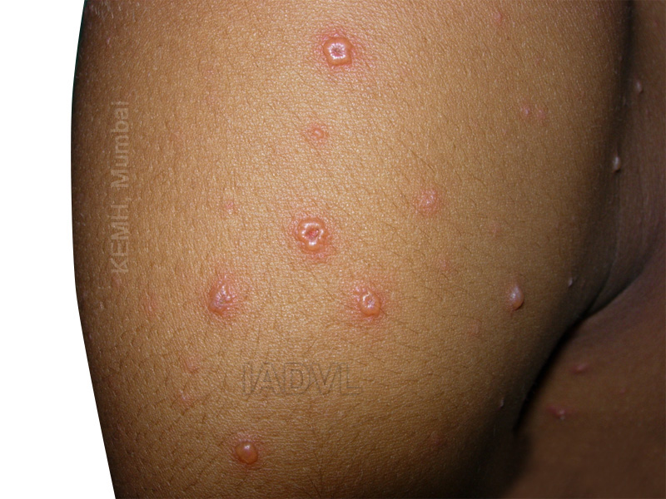
Varicella

Slide 34
Prevention
Varicella Vaccine
Live attenuated virus
At present immunity appears to be lasting.
Modified Varicella-like syndrome (MLSV)
15 days after exposure to varicella virus.
35-50 macules and papules, few vesicles.
Mild, afebrile course lasting 5 days

Slide 35
Varicella in Pregnancy
Increased risk of spontaneous abortion (3% by 20 wks), congenital varicella syndrome and fetal death. Possible increase in pre-term labor.
Mother at increased risk for varicella pneumonia.
Congenital Varicella Syndrome
Hypoplastic limbs, scars, ocular and CNS disease.
F > M
1-2% risk, highest between weeks 13 and 20.

Slide 36
Herpes Zoster
Reactivation of latent herpes zoster infection from the dorsal root ganglia
Over 1-5 days new lesions develop, these become pustular and crust.
Typically along a dermatome at times involving adjacent dermatomes.
Preceded by pain, itching
Duration of the lesion is dependent on age
Young 2-3weeks, Elderly 5-6 weeks
Severity of lesions, immunosuppression
Incidence of H.Z. increases with age (>50 yrs) and immunosuppression.

Slide 37
Herpes Zoster
Heals without scaring in young.
Increased incidence of scarring in elderly and severe eruptions.
Disseminated Zoster
Defined as >20 vesicles outside dermatome.
Chiefly elderly or Immunocompromised
Hemorrhagic/gangrenous lesions with outlying vesicles or bullae.
Systemic symptoms include fever, meningeal irritation.

Slide 38
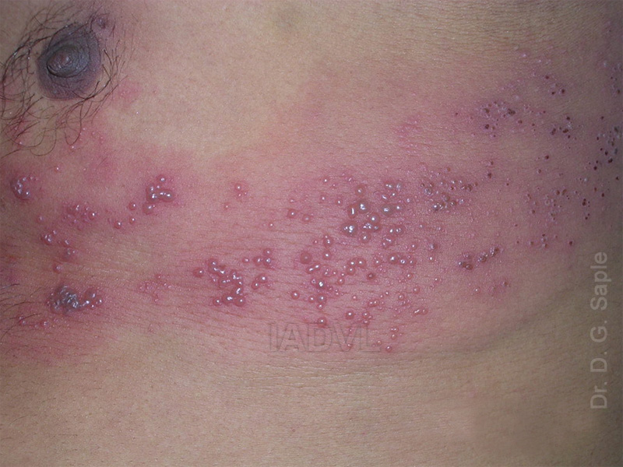
Herpes Zoster

Slide 39
Herpes Zoster Ophthalmicus
Involvement of fifth cranial nerve, ophthalmic branch
Lesion location on tip/side of nose- ‘Hutchinson’s sign’
Ocular complications
Uveitis , Keratitis
Less common: glaucoma, optic neuritis
Encephalitis

Slide 40
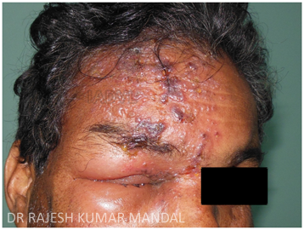
Herpes Zoster Ophthalmicus

Slide 41
Ramsay Hunt syndrome
Facial and auditory nerve involvement with inflammation of geniculate ganglion
Zoster of external ear or TM, herpes auricularis, with ipsilateral facial paralysis
Herpes auricularis, facial paralysis and auditory symptoms.

Slide 42
Diagnosis and Treatment
Diagnosis : Tzanck, direct fluorescent antibody, culture, PCR.
Symptomatic treatment
Antivirals :
Acyclovir 800mg x 5times/day for 1 week (may lessen severity of symptoms in acute outbreak. May lessen incidence of PHN).
Famciclovir 250-500 mg TDS
Valaciclovir 1gm TDS
Duration : 1week in immunocompetent
2 weeks in immunosuppressed

Slide 43
Post Herpetic Neuralgia
Postherpetic neuralgia- nerve pain due to damage caused by VZ virus.
Constant burning pain, intermittent stabbing pain or shooting pain, stimulus evoked pain including Allodynia.
Risk factors : prodromal pain, severe pain during acute phase, greater rash severity, opthalmic zoster.
Treatment
Topical : Capsaicin, topical lidocaine.
Oral :analgesics ( NSAIDS), tricyclic antidepressants (amitryptiline), anticonvulsants : gabapentin
Injectable : lidocaine / steroids

Slide 44
Epstein Barr Virus
Infectious mononucleosis
After 3-7 wk incubation period
Bilateral enlargement of cervical and other lymph glands
High grade fever, malaise, splenomegaly.
Pharyngitis with hyperplasia of lymphoid tissue are the most frequent signs.
Ampicillin triggers maculopapular eruption.
Macular or morbilliform rash.
Mucous membranes with 5-20 pinhead sized petechiae at junction of soft palate with hard. (Forscheimer spots)
Atypical lymphocytosis with more than 10 % atypical cells.

Slide 45
Epstein Barr Virus
Lab findings :
WBC count 10,000 to 40,000.
Abnormal large lymphocytes (Downey cells) are 10% of total leukocyte count.
Heterophile antibodies 1:160 of higher
EBV is associated with lymphoma esp. Hodgkin's disease.
Treatment : supportive.

Slide 46
Oral Hairy Leukoplakia
Associated with chronic shedding of EBV in the oral cavity.
Presentation: Poorly demarcated, corrugated, white plaques on lateral aspect of tongue.
Unlike thrush, cannot be removed by scraping.
Occurs with immunosuppression (esp AIDS) and warrants HIV workup.
Treatment
Not required
Podophyllin and tretinoin are used but lesions recur

Slide 47
Human Herpes virus 6
HHV 6A causes multiple sclerosis and HHV 6B causes Exanthem subitum or Roseola Infantum.
Roseola Infantum (sixth disease) presents as abrupt fever, inflammed tympanic membrane, periorbital edema, hematuria and maculopapular rash.
Complications : seizures, thrombocytopenia, intussusception, hemophagocytic syndrome and fatal hepatitis.

Slide 48
Human Herpesvirus 7
HHV 7 has been associated with febrile illness in children, exanthem subitum and questionably pityriais rosea.
There is persistent infection in salivary glands and is believed to be the mode of infection.
HHV 7 infection can reactivate HHV6 from latency.

Slide 49
Human Herpesvirus 8
Three proliferative diseases are associated with HHV 8: Kaposi sarcoma, Primary effusion lymphoma and Castelman’s disease.
Kaposi’s Sarcoma
Includes AIDs, African and Mediterranean cases.
Seroprevalence correlates with prevalence of KS in a given population.
Infection predicts and precedes subsequent development of KS.
HHV 8 is found in KS lesions, saliva, blood and semen of infected individuals.

Slide 50
Viral Exanthems
Macular :
Rubella
EBV (infectious mononucleosis)
Human herpesvirus 6 (roseola)
Human herpesvirus 7
Maculopapular :
Togavirus
Measles
Human parvovirus B19 (erythema infectiosum)

Slide 51
Viral Exanthems
Maculopapular - vesicular :
Coxsackie A (5, 9, 10,16)
Echovirus (4, 9, 11)
Maculopapular – petechial :
Togavirus (Chikungunya)
Bunyavirus haemorrhagic fever (Lassa)
Urticarial :
Coxsackie A9 and Hepatitis B

Slide 52
Uncommon Viral Infections of the Skin
Pox Viruses :
Cowpox, Orf, Milker’s nodule
Epstein Barr Virus :
Infectious Mononucleousis, OHL, Gianotti Crosti,
Lymphomas
Viral insect-borne and haemorrhagic fevers:
(Toga, Flavi, Arena, Filo, Bunya)
Chikungunya, Dengue, Kyasanur Forest Disease, Lassa
Picorna Viruses :
Herpangina, hand, foot and mouth disease.

Slide 53
MCQ’S
Q.1) Henderson-Paterson bodies is seen in
Wart
Herpes simplex
Molluscum Contagiosum
EBV
Q.2) The following diseases are associated with Epstein-Barr virus infection, except :
Infectious mononucleosis
Bowenoid papulosis
Nasopharyngeal carcinoma
Oral hairy leukoplakia
Notes:
Answer to MCQ – 1] C 2] B

Slide 54
MCQ’S
Q.3) Kaposi’s Sarcoma is associated with
HHV 6
HHV 7
HHV 8
HHV 3
Q.4) All are differential diagnosis of plantar wart except -
Corn
Callosities
Punctate Keratoderma
Plantar psoriasis
Notes:
Answer to MCQ – 3] C , 4] D

Slide 55
MCQ’S
Q.5) HPV is responsible for cancer of
Brain
Lung
Cervix
Prostate
Notes:
Answer to MCQ – 5] C

Slide 56
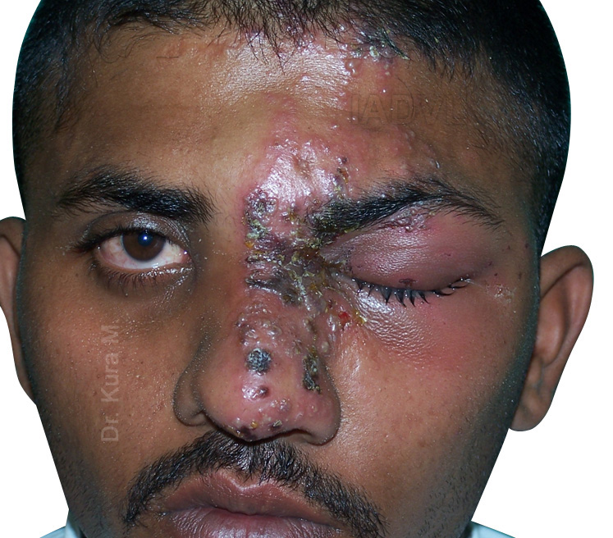
Photo Quiz
Q. Diagnose and describe the lesions
Notes:
Ans : Herpes Zoster Ophthalmicus, unilateral grouped vesicles involving the trigeminal nerve ( ophthalmic) with positive Hutchinson’s sign

Slide 57
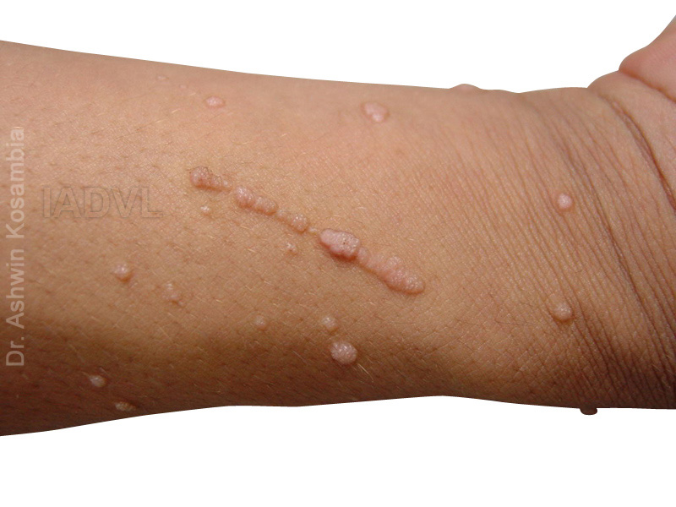
Photo Quiz
Q. Identify the Phenomenon and describe the condition where it is seen
Notes:
Ans : Psuedokoebnerisation, warts, molluscum

Slide 58
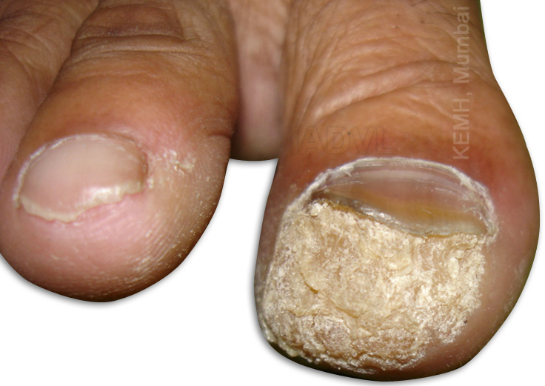
Photo Quiz
Q. Identify the condition and the causative organism?
Notes:
Ans : Peri-ungual wart, Human Papilloma Virus

Slide 59
Thank You!

