Slide 1
Urticaria and angioedema
Dr ashima
Sr

Slide 2
CONTENTS
Introduction
Pathogenesis
Classification
Clinical Features
Differential diagnosis
Investigations
Provocative test
Treatment

Slide 3
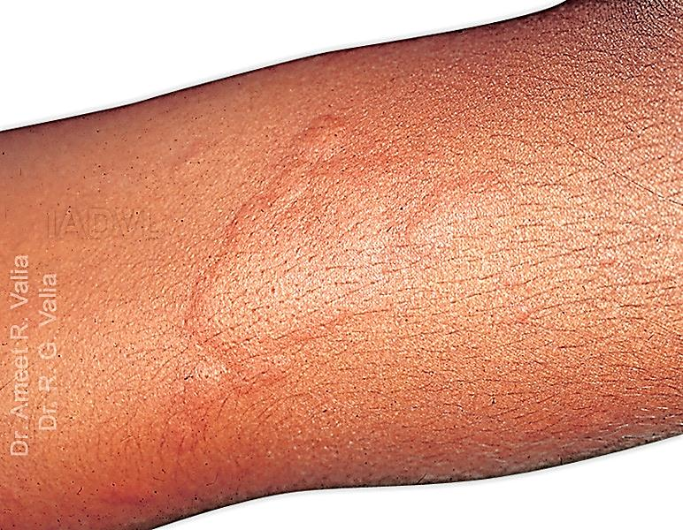
Introduction
Urticaria is derived from Latin word “Urtica” meaning stinging nettle.
It is a cutaneous reaction pattern consisting of transient, dermal swellings in form of wheals or angioedema.
Individual wheals are pruritic , pink or pale swellings of superficial dermis that have red flare around them and usually subside within 24 hours.
Wheal

Slide 4
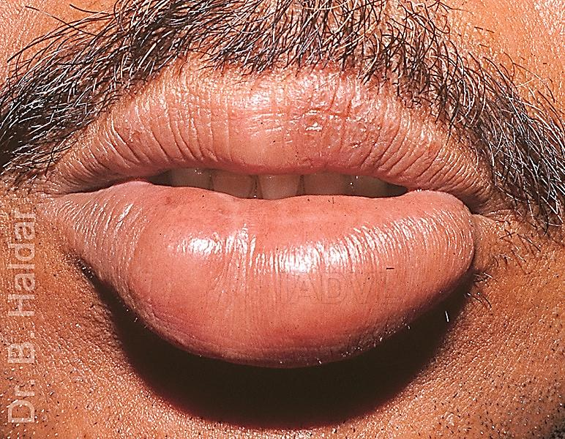
In angioedema, the swelling is
Deeper
Less well defined
Painful rather than itchy
Less erythematous
Involves deeper tissues such as hypodermis and submucosa and
Takes longer than 24 hours to resolve.

Slide 5
Pathogenesis
For urticaria / angioedema to happen, vasodilatation and plasma leakage is required.
Most commonly, this is brought about by histamine (usually released by mast cells).
But many other chemicals like sorbic acid, benzoic acid and bradykinin can also cause it (not released by mast cells).

Slide 6
Thus urticaria can be
IgE Dependent
Mast cell dependent
Non IgE Dependent
or
Mast cell independent
Mast cell dependent is more common
Ig E +Allergen
Mast cell
Degranulation

Slide 7
In some instances, mast cells are directly activated by molecules such as substance P, morphine, codeine, complement 5a.
This activation is independent of IgE.
Such activation is referred to as non immunological activation.

Slide 8
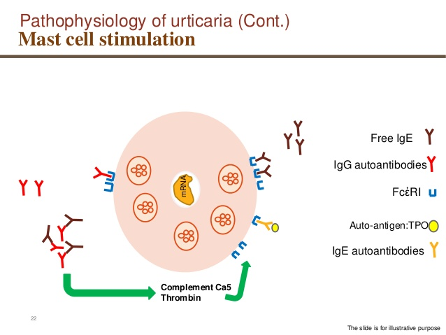

Slide 9
Mast cell stimulation (Immune-mediated urticaria )
Free IgE
IgG autoantibodies
mRNA
FcἐRI
Auto-antigen:TPO
IgE autoantibodies
Complement Ca5
Thrombin
The slide is for illustrative purpose

Slide 10
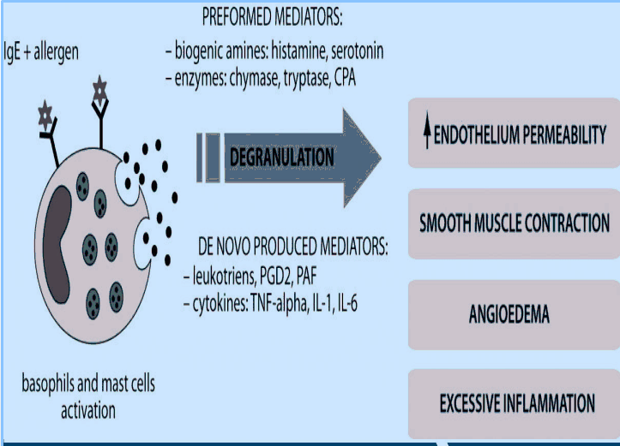

Slide 11
Mediators released by human dermal mast cell degranulation
Preformed mediators
Histamine
Heparin
Proteases like tryptase
New synthesis of mediators
Prostaglandin D2
Leukotrienes C4, D4, E4
Platelet activating factor

Slide 12
Mast cell independent urticaria
Vasoactive stimuli (sorbic acid etc)
Bradykinin mediated
C1 inhibitor deficiency
Hereditary
Acquired
ACE inhibitor induced urticaria

Slide 13
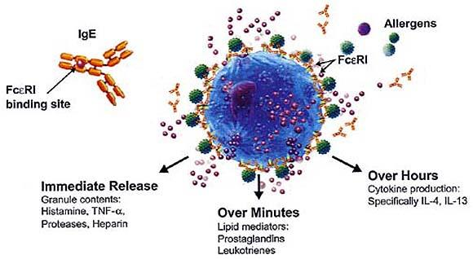

Slide 14
Allergens and autoantibodies against IgE (immunological)
Substance P, morphine, codeine, complement 5a (non-immunological)
Sorbic acid, benzoic acid, food additives and bradykinin (HAE)
Mast cell dependent
Mast cell independent
Histamine and leukotrienes
Vasodilation and increased permeability
Wheal, angioedema

Slide 15
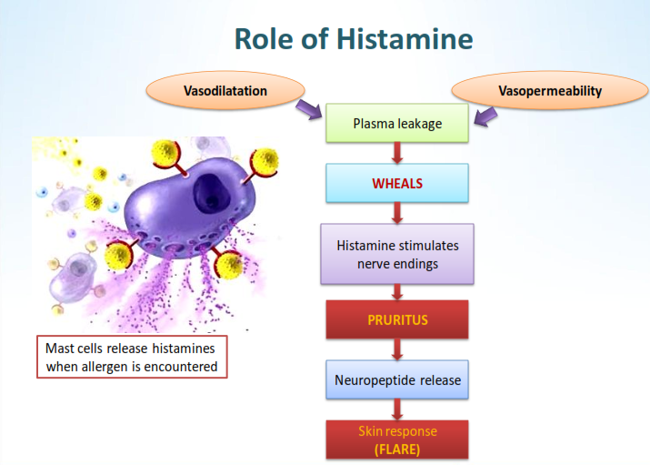

Slide 16
Histamine
Blood vessels
Erythema
Edema
Nerve endings
Pruritus
Axon reflex and flare
Lewis triple response – erythema, flare and wheal.

Slide 17
CLASSIFICATION AND CAUSES OF URTICARIA
Acute urticaria | Chronic urticaria
Duration less than 6 weeks. Infections (40%) Drugs(9%) Food items (1%) Idiopathic (50%) | Daily or almost daily for more than 6 weeks. Chronic spontaneous urticaria (autoimmune, pseudoallergic, infection and idiopathic) (65%) Physical/ inducible urticaria (35%) Urticarial vasculitis (5%)

Slide 18
CLASSIFICATION OF ANGIOEDEMA
Angioedema with wheals | Angioedema without wheals
Associated with urticaria | Hereditary angioedema ACE inhibitor associated angioedema
Urticaria rarely progresses to anaphylaxis, but it is often a feature of anaphylaxis.
50% of chronic urticaria patients have angioedema.

Slide 19
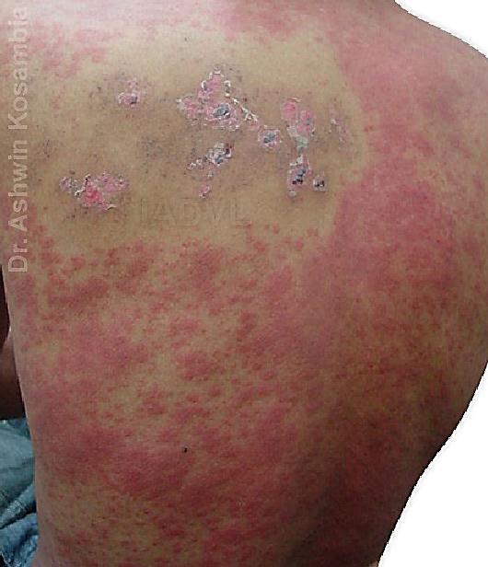
Causes
Exogenous (Allergens and Pseudoallergens)
Inhalants : pollens, house dust, fungi, dander.
Ingestants : fish, egg, brinjal , soy, milk, chocolate, nuts, (pseudoallergens - food additives, dyes, preservatives, flavors).
Drugs : NSAIDs, Polymyxin, Vancomycin, Morphine, codeine, Penicillins, Cephalosporins

Slide 20
Food likely to cause urticaria
Acute urticaria | Chronic urticaria
Nuts, fish, chocolates, spices Act through type I hypersensitivity (IgE mediated) | Food additives such as sodium benzoate, salicylates Act by pseudoallergic mechanism, direct mast cell activators.

Slide 21
Endogenous
Infections :
Gastrointestinal, respiratory, urinary tract infections
Bacterial, protozoal, helminthic, viral (CMV, EBV, HSV)
Systemic diseases :
Hashimoto’s thyroiditis
Systemic lupus erythematosus
Chronic active hepatitis
Malignancies

Slide 22
Physical urticaria
Urticaria factitia / dermographism (most common type, red, itchy, linear wheal appearing immediately after light stroking of the skin) | Eliciting factor : mechanical sheering forces (weals arising within 1-5 minutes)
Cold contact urticaria | Eliciting factor : cold objects, air, fluids, wind
Heat contact urticaria | Eliciting factor : localized heat
Solar urticaria | Eliciting factor : UV and / or visible light.
Delayed pressure urticaria (appear at site of pressure on the skin , painful rather than itchy last for more than 24 hrs, poor prognosis) | Eliciting factor : vertical pressure (weals arising with 3 - 12 hrs. latency)

Slide 23
Physical urticaria
Vibratory urticaria / angioedema | Eliciting factor : vibratory forces
Aquagenic urticaria | Eliciting factor : water
Cholinergic urticaria (small (2-4mm) erythematous papules surrounded by a pink flare, most commonly on trunk and proximal limbs) | Eliciting factor : increase in core body temperature, by exercise or spicy food.
Contact urticaria [Can be IgE dependent or independent (immunologic or non-immunologic)] | Eliciting factor : contact with urticariogenic substance
Exercise induced urticaria / anaphylaxis | Eliciting factor : physical exercise

Slide 24
Clinical features and differentials
Symptoms :
Pruritus
Signs :
Pale pink well defined swellings (Hives or wheals) Spreads with scratching and coalesce to form large lesions.
Course of Lesions :
Lesions last 90 minutes to 24 hours

Slide 25
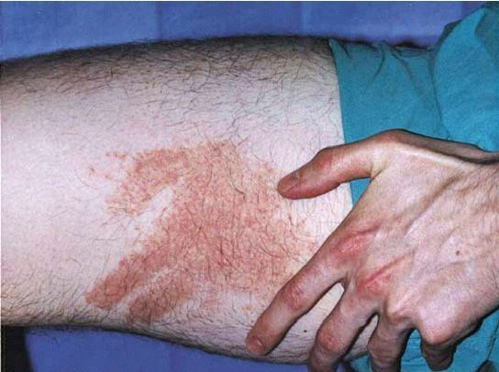
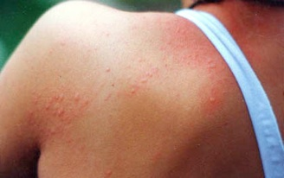
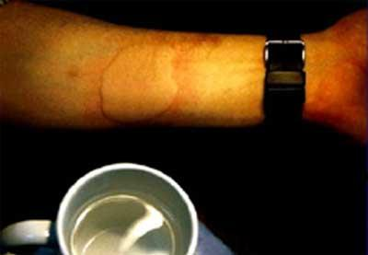
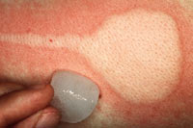

Slide 26
Differential diagnoses
Important to differentiate urticaria from urticarial dermatoses which are :
Urticarial vasculitis
Eosinophilic cellulitis
Bullous pemphigoid
Urticarial drug eruptions
These last more than 24 hours (may be days)

Slide 27
Difference between urticaria and urticarial vasculitis
Urticaria | Urticarial vasculitis
Generalized body involvement Individual lesions last less than 24 hours Itchy Don’t leave post inflammatory pigmentation Rare systemic symptoms Biopsy does not reveal vasculitis | Trunk and proximal limbs Individual lesion last more than 24 hours Associated with burning and pain Have purpuric centre and leave post inflammatory pigmentation Systemic symptoms, fever, arthralgia present

Slide 28
Differential diagnosis (contd..)
Anaphylaxis has urticaria has one of the component, but it has several other components like bronchoconstriction, hypotension and flushing.
Normal / ordinary urticaria almost never progresses to anaphylaxis.
Familial cold auto-inflammatory syndromes and paraneoplastic syndromes also present with urticarial lesions, e.g. Muckle-Wells syndrome, Schnitzler syndrome.
But these lesions are non itchy and are associated with systemic symptoms, and usually arise in infancy / childhood.

Slide 29
Chronic urticaria
Chronic urticaria can be physical urticaria or spontaneous urticaria.
Depending upon duration of wheals, some inference can be drawn regarding etiology;
<1 hour – physical urticaria
<2 hours – contact urticaria
1-24 hours – spontaneous urticaria and delayed pressure urticaria
>24 hours – urticarial vasculitis

Slide 30
Associations of chronic urticaria
Thyroid disease
Atopic disorders
Vitiligo
Pernicious anemia
Rheumatoid arthritis

Slide 31
Workup in a patient of urticaria
Careful History
Travel and work history
Ingestion of foods, medications, herbals, vitamins
Recent infection
Known allergies / atopy
Family History of allergy or thyroid disease

Slide 32
Urticaria Activity Score 7
Score | Weals | Pruritus
0 | None | None
1 | Mild (<20 wheals / 24 hours) | Mild (present but not troublesome)
2 | Moderate (20-50 wheals / 24 hours) | Moderate (troublesome but does not interfere with sleep)
3 | Severe (>50 wheals / 24 hours) | Severe (sufficiently troublesome to interfere with normal daily activity and sleep)
Scores of both the parameters i.e. number of wheals and severity of the pruritus are to be added to get UAS for last 24 hours which will range between 0 to 6.
Sum of score : 0–6 for each day is summarized over one week (maximum 42).

Slide 33
Investigations
Hb, TLC/DLC
Urine analysis
Stool analysis
ESR
Liver Function Tests
TSH / anti TPO
ANA
IgE levels
Autologous serum /plasma skin test
Skin biopsy if lesion present >24 hrs, consider urticarial vasculitis

Slide 34
Provocation tests for physical urticaria
Dermographism | Stroking of skin by blunt object
Delayed pressure urticaria | Locally applied weight for 20 min.
Cold urticaria | Cold contact (ice cube for 20 min.)
Cholinergic urticaria | Physical exercise/hot bath
Aquagenic urticaria | Contact with water of any temperature
Exercise anaphylaxis | Supervised exercise (shortly after meal)
Solar urticaria | Phototesting

Slide 35
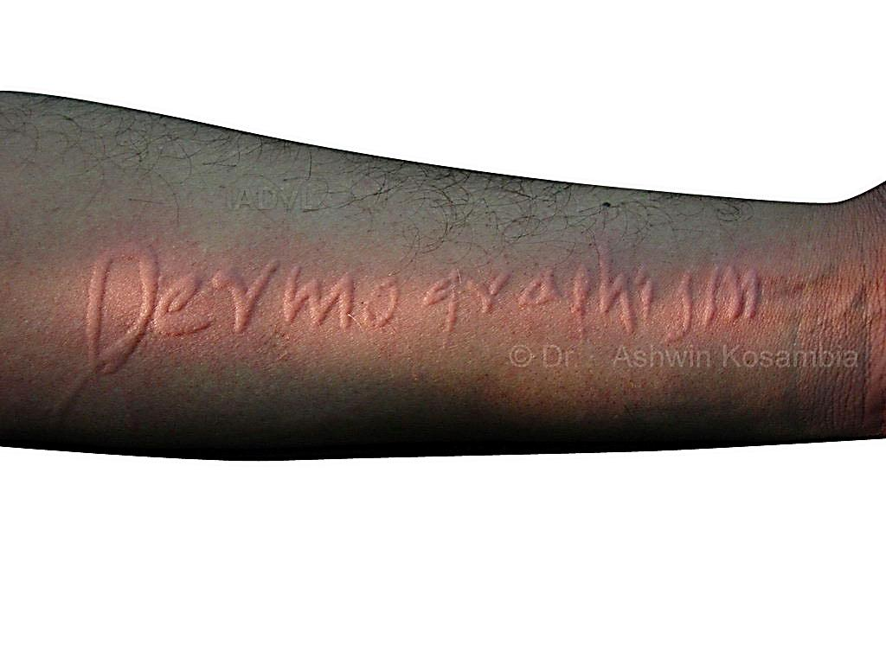
Dermatographism

Slide 36
Hereditary angioedema
Recurrent laryngeal edema or colicky abdominal pain, skin swellings especially on distal limbs.
May be preceded by reticular erythema.
Family history present (autosomal dominant).
Trauma and estrogens are triggers.
These individuals lack C1 esterase/C1 inhibitor and over-activity of C1 results in generation of kallikrein, which converts kininogen to bradykinin.
Bradykinin acts on vasculature and results in angioedema attacks.
Attacks can be life threatening and are associated with arthralgia too.

Slide 37
Diagnosis of hereditary angioedema
Detection of low serum level of C4 is very sensitive, but non specific screening test.
Acquired angioedema due to lymphomas and SLE etc. has low C1q levels along with low C4 levels.

Slide 38
Treatment
General
  Rule out Anaphylaxis
  Discontinue offending drugs, food, or behavior
  Offer Reassurance
Discuss idiopathic nature of chronic urticaria and possibility of inability to identify a specific cause.

Slide 39
European academy of allergy and clinical immunology) guidelines (EAACI )
First use second generation antihistamines in baseline dose.
Second step in non responsive patients is to increase the dose by four folds.
Third step in antihistamine refractory patients is to use omalizumab, cyclosporine and addition of monteleukast.
Fourth step is Dapsone, Colchicine, HCQs, Ranitidine, Methotrexate, Azathioprine.

Slide 40
Modern second generation H1 antihistamines in standard dosages
1-2 weeks
Four fold increased dosages of same antihistamines
2-4 weeks
Add omalizumab, cyclosporine, monteleukast, first generation antihistamines at bed time
Dapsone, colchicine, HCQS, ranitidine, methotrexate, azathioprine, phototherapy, plasmapheresis etc

Slide 41
Antihistamines
Second generation H1 antihistamines are the cornerstone of treatment for urticaria.
Commonly used drugs are (Baseline Dose)
Cetirizine (10mg/day)
Levocetirizine 5 mg
Fexofenadine (180mg/day)
Loratidine (10mg/day)
Desloratidine (5mg/day)

Slide 42
H1 receptor antagonist
NON- SEDATING 2ND GENERATION
Cetrizine
Loratadine
Acrivastine
Mizolastine
Newer 2nd generation
Levocitrizine
Desloratidine
Fexofenadine
SEDATING
Chlorpheniramine
Hydroxyzine
Diphenhydramine
doxepin

Slide 43
Antihistamines
H2 antihistamines
Ranitidine, 150 mg twice daily
Famotidine, 20 mg twice daily
Cimetidine, 400 mg twice daily
Leukotriene-receptor antagonist
Montelukast, 10 mg once daily
Zafirlukast, 20 mg twice daily

Slide 44
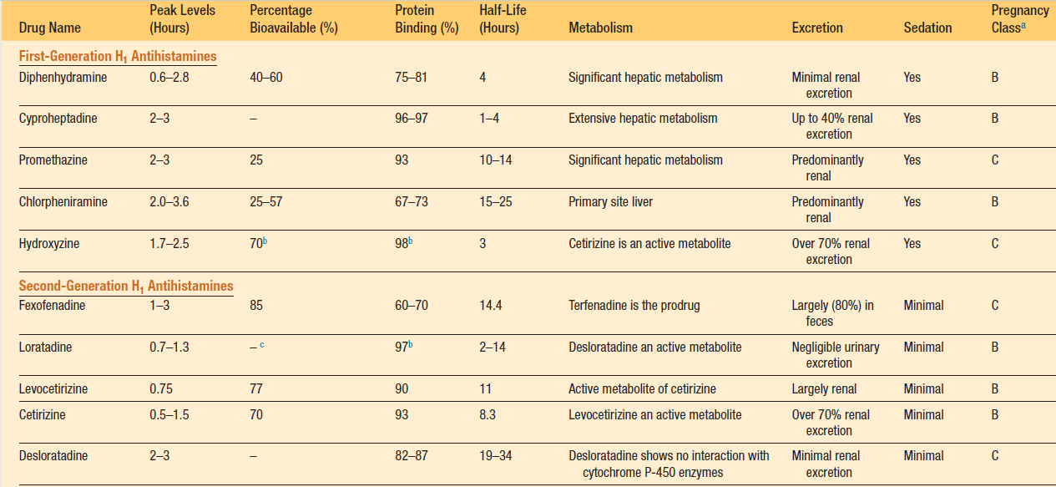

Slide 45
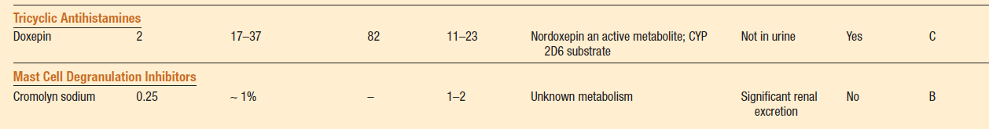

Slide 46
Oral steroids
Oral corticosteroids (short courses for 10 days) are useful in
Acute severe exacerbations of chronic urticaria
Severe angioedema
Delayed pressure urticaria
Urticarial vasculitis

Slide 47
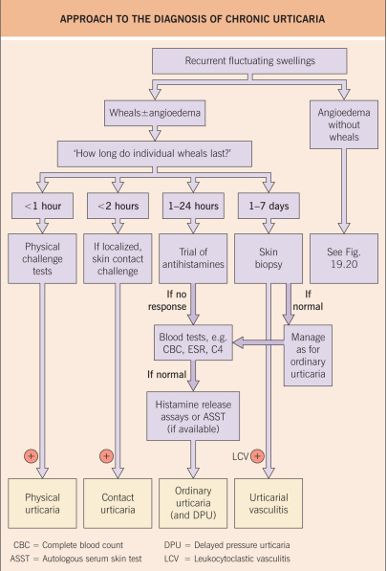

Slide 48
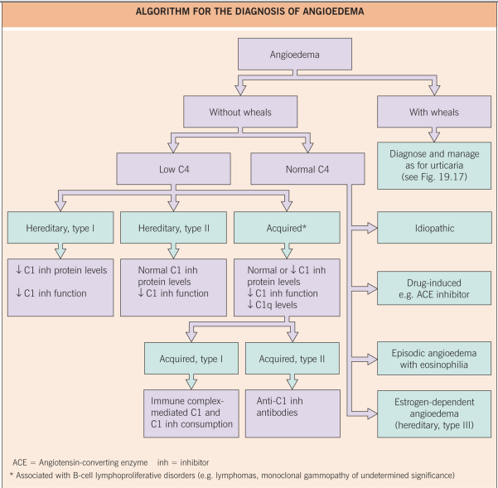

Slide 49
Thank You!

