Slide 1
syphilis

Slide 2
Learning points
INTRODUCTION
ETIOLOGY
MICROBIOLOGY
PATHOGENESIS
CLASSIFICATION
PRIMARY SYPHILIS
SCONDARY SYPHILIS
TERTIARY SYPHILIS
CONGENITAL SYPHILIS
LAB DIAGNOSIS AND TREATMENT

Slide 3
Spirochetes
Family spirochates
Genera treponema…. borrelia …..leptospira
Pathogenic
T.palladium ssp pertunue (yaws)
T.palladium ssp endemicum ( endemic syphilis)
T. palladium ssp palladium ( syphilis )

Slide 4
Introduction
“Great Imitator”
Sexually transmitted disease - spirochaete bacterium Treponema pallidum
Chronic systemic infectious disease - may affect any organ during its course..life threatening consequences in the CVS & CNS.

Slide 5
Name derived from a poem “syphilis sive morbus gallicus” written by a physician Girolamo Fracastoro,
….. syphilis happens to be the name of a shepherd who suffered this disease as a curse for insulting the god Apollo.

Slide 6
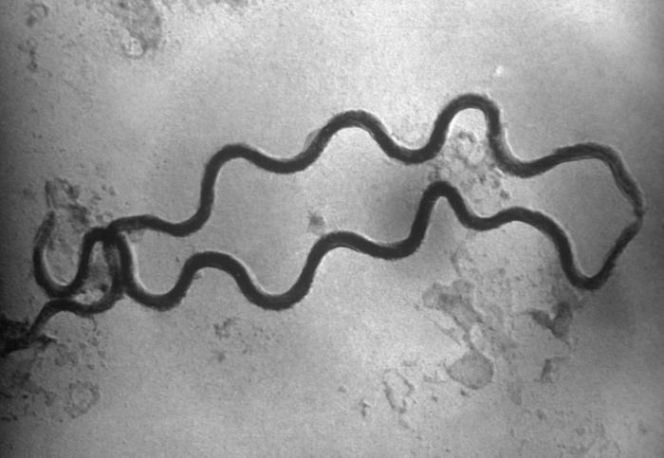
ETIOLOGY
TREPONEMA PALLIDUM
(Trepos – turn & Nema – thread
Pallidum = refers to its pale
staining)
Nichol first isolated in 1912
Closely coiled, slender, spiral spirochaetes
Pointed or rounded ends, 8-20 regular coils
Length –8 -16 micrometer; width0.1 – 0.15 micrometer
Identified by negative staining with Indian Ink

Slide 7
Morphology & motility – DARK GROUND MICROSCOPY
Virulent strain (Nichol’ s strain) – not cultured
Non virulent strain (Reiter’s strain)- Thioglycolate medium

Slide 8
RISK FACTORS AND HIGH RISK GROUP
Sexual promiscuity and prostitution – twin around which revolve others risk factors
Population explosion, migration of people from rural to urban areas seeking work, over crowding and low standards of living, low moral standards, ignorance and lack of sex education account for spread of disease.

Slide 9
TRANSMISSION OF SYPHILIS
Direct sexual contact with an infected person
Vertical transmission from infected mother to fetus
Transfusion of infected blood – prenatal syphilis
Contact with exudates from chancre (highly contagious)

Slide 10
STAGES OF SYPHILIS
Contact (1/3 become infected)
↓ 10-90 days
Primary (chancre)
↓ 3-12 wks
Secondary syphilis
↓ 4-12 wks
Early latent → Relapsing (25%)
(1 yr from contact)
↓
Late latent (more than 1 yr)
Remission (2/3) Tertiary (1/3)
- Late benign (16%)
- Cardiovascular (9.6%)
- Neurosyphilis (6.5%)

Slide 11
CLASSIFICATION
Acquired syphilis:
Early syphilis (Infectious phase) <2yr
Primary syphilis
Secondary syphilis
Early latent syphilis
Late Syphilis (non infectious phase) >2yr
Late latent syphilis
Tertiary syphilis
  Benign tertiary
  Cardiovascular syphilis
  Neurosyphilis

Slide 12
Prenatal syphilis
Early phase <2yr
Analogous to secondary syphilis
Late phase >2 yr
Analogous to tertiary syphilis
Stigmata
Scars and deformities

Slide 13
PRIMARY SYPHILIS
After an IP of 10-90 days, a primary chancre develops at the site of inoculation (avg 21 days)
500-1000 organism
Small dull red macule →papule→ ulcerates (Chancre)- classical lesion of primary syphilis
The classic hunterian chancre is a single, painless, indurated ulcer, round to oval in shape, clearly defined with rolled borders

Slide 14
and ham coloured smooth base but sometimes may be covered with greyish slough or slightly haemorrhagic curst.
Size of the chancre - 0.3 to 3cm

Slide 15
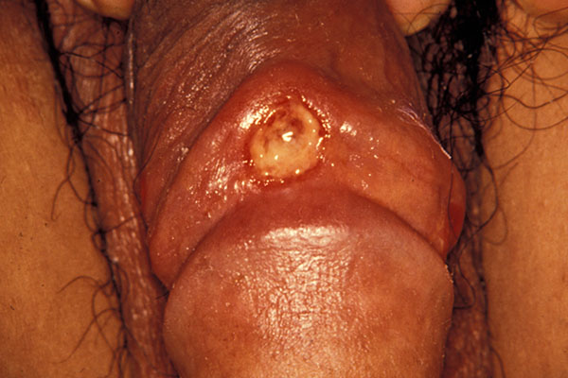

Slide 16
In men, the chancre on the genitalia is seen on the coronal sulcus (35%), glans (29%), shaft (22%) prepuce (19%) frenulum (10%) and urinary meatus (1%)
In women, the genital chancres are seen on the vulva, vagina or cervix
Extragenital chancres occur in 12-14% of the patients.
Related to oral / anal sex, 2/3 occur above neck ,½ on lips, perianal area or oral cavity .

Slide 17
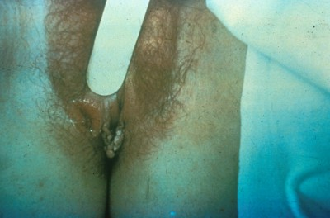
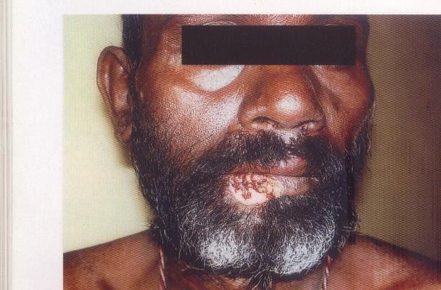
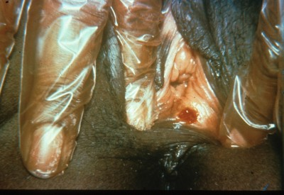

Slide 18
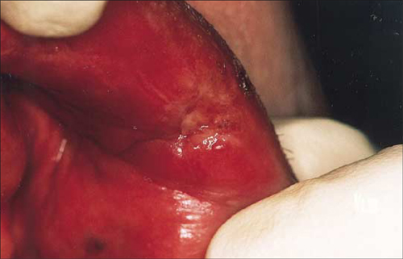
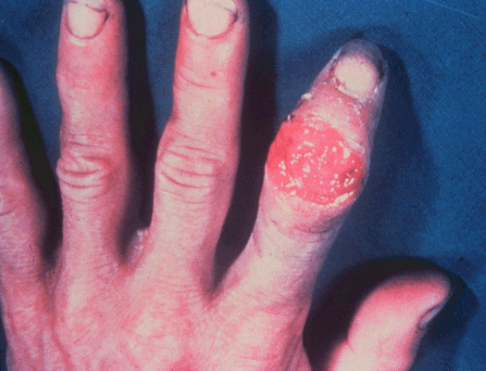

Slide 19
COMPLICATIONS
Oedema
Phimosis
Erosive balanitis
Lymphangitis
Thrombophlebitis of the dorsal vein
Phagedenic chancre – due to co- infection with fusospirochaetes, characterized by necrotising perforation of prepuce, or gangrene

Slide 20
DIFFERENTIAL DIAGNOSIS
Chancroid
Genital herpes
Granuloma inguinale
Traumatic ulcer
LGV
Behcet’s disease
Squamous cell carcinoma
Fixed drug eruption
Erosive candidial balanitis or vulvitis.

Slide 21
treatment
A single dose of benzathine penicillin G, 2.4 million units i.m
(1.2 million units i.m on each buttock)
Given after intradermal test dose.
Alternate:
Procaine penicillin G 1.2million units / day i.m X 10 days
PENICILLIN ALLERGY
Doxycycline 100 mg orally BD x 2 wks.
Tetracycline 500 mg orally QID x 2 wks.

Slide 22
SECONDARY SYPHILIS
The signs and symptoms of secondary syphilis usually develop 6-8 weeks after the appearance of the primary chancre
In 10-40% of the patients - chancre may persist even after appearance of the secondary rash
Constitutional symptoms like fever, malaise, headache, stiff neck, myalgia, arthralgia, wt loss may preceede or accompany the lesions

Slide 23
Cutaneous manifestations
The cutaneous lesions may be macular, papular, maculopapular, papulosquamous, psoriasiform, annular, pustular or follicular.
Macular or maculopapular rash- commonest ( 50% of the pts)
The rash is usually distributed bilaterally and symmetrically

Slide 24
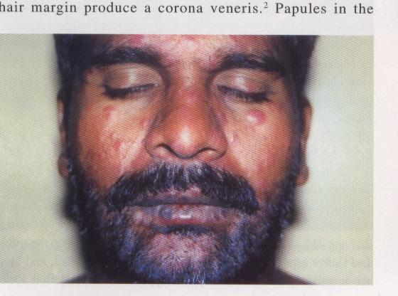
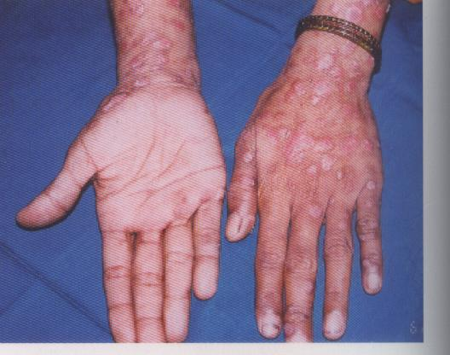

Slide 25
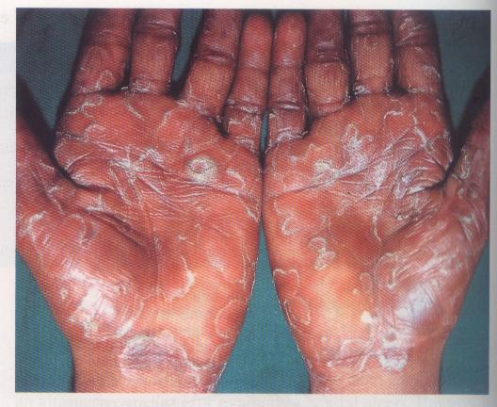
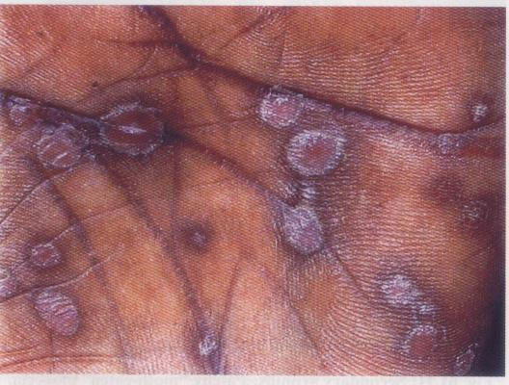

Slide 26
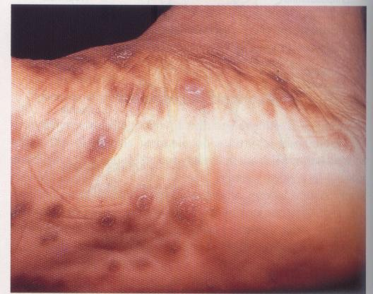
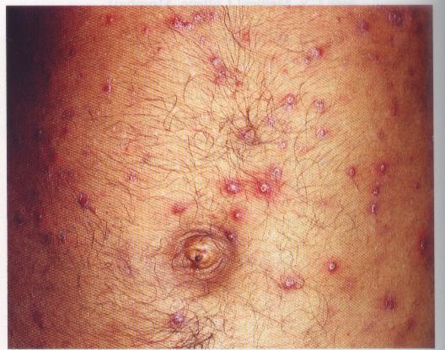
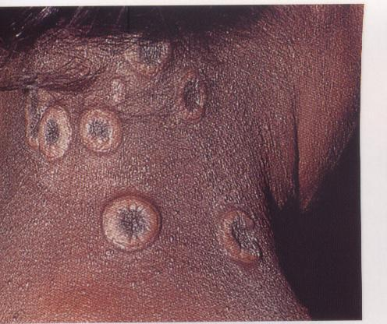

Slide 27
Condyloma lata – pale, elevated, moist, oozy sharply demarcated with flat surfaces which develop in warm and moist areas of the body such as genitals, perineum, perianal region, under breasts, axillae, groin.
It is highly infectious and seen in 25-60% of pts with secondary shyphilis.
At labial commissures and nosolabial folds, these lesions become elevated and fissured and are called “spilt papules”

Slide 28
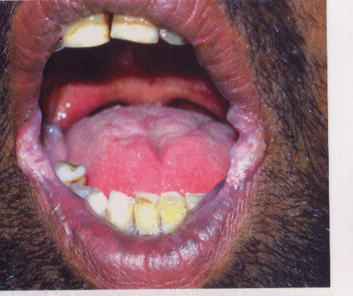
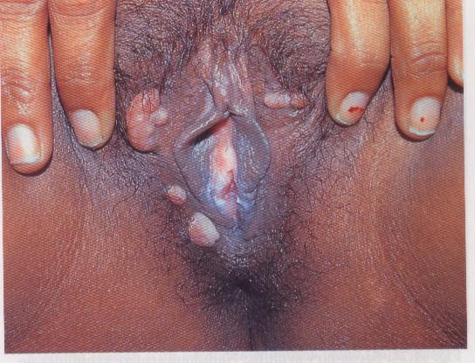

Slide 29
Mucous membrane involvement – mucous patches are painless, shallow lesions covered with gray macerated scaling that may appear anywhere in the mouth, more frequent along tongue and lips
Mucosal lesions are in the form of serpiginous ulcers- “snail track” ulcers, superficial erosions, papules, plaques.
The oral mucosa, tongue, lips palate, pharynx, larynx, tonsils, epiglottis may be affected.

Slide 30
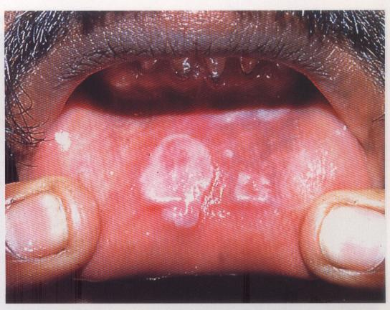
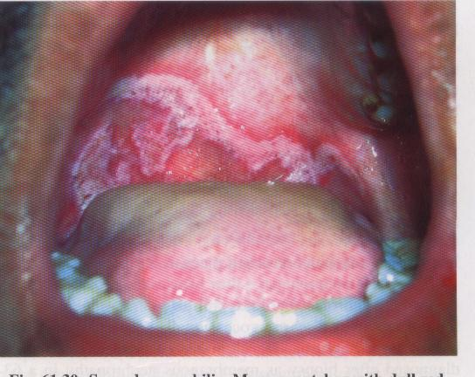
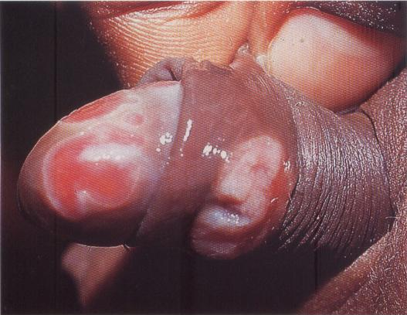

Slide 31
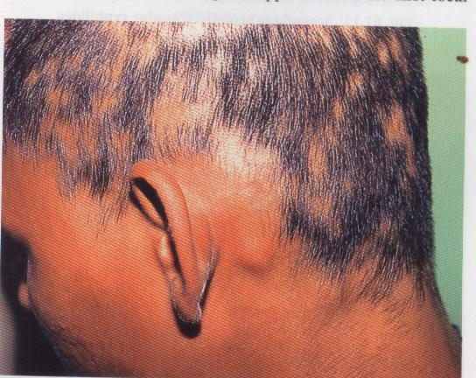
Follicular rash on the scalp may give rise to 2 patterns of hair loss.
Irregular non-scarring
patchy alopecia –
“moth eaten alopecia”
It usually occurs at the margins of the scalp or rarely in the beard area, eyebrows

Slide 32
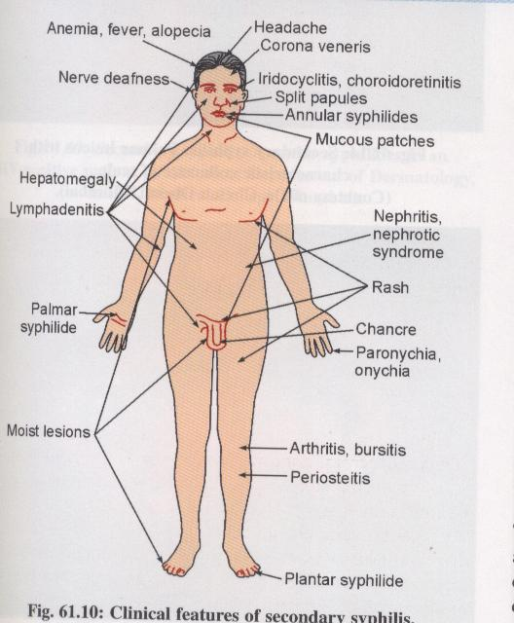

Slide 33
DIFFERENTIAL DIAGNOSIS:
Macular – drug rash, P. versicolor, EM ,measles rubella
Papular – drug rash, LP ,acne vulgaris, papular urticaria
Papulosquamous – Psoriasis, seborrhoeic dermatitis
Annular – annular LP, granuloma annulare, impetigo, dermatophyte infection
Pustular – Acne vulgaris, ecthyma, eruptions due to bromides and iodides

Slide 34
Follicular – Lichen scrofulosorum, PRP, lichen spinulosus
Alopecia – Alopecia areata, T.capitis
Leukoderma syphiliticum – P. versicolor
Condyloma lata – condyloma accuminata
Mucosal lesions over throat and tonsils – vincent’s angina, tonsillitis, diphtheria

Slide 35
treatment
A single dose of benzathine penicillin G, 2.4 million units i.m
(1.2 million units i.m on each buttock)
Given after intradermal test dose.
Alternate:
Procaine penicillin G 1.2million units / day i.m X 10 days
PENICILLIN ALLERGY
Doxycycline 100 mg orally BD x 2 wks.
Tetracycline 500 mg orally QID x 2 wks.

Slide 36
LATENT STAGE
Diagnosis depends on positive blood tests
Absence of clinical evidence – asymptomatic state – latency
Diagnosis:
Routine reagin test- VDRL slide test
Specific test – TPI, FTA –A BS, TPHA
Treatment :
Benzathine pencillin G 2.4 million units 1M single dose

Slide 37
Tertiary syphilis
Three forms-
Benign tertiary syphilis
Cardiovascular syphilis
Neurosyphilis

Slide 38
LATE BENIGN SYPHILIS
(GUMMATOUS SYPHILIS)
First lesions seen – 3 – 10 yrs after primary & secondary stages
Painless nodules which ulcerates
Involves:Covering structures – skin, mucous membrane, subcutaneous & submucous tissues
Supporting structures – bones, joints, muscles ligaments
Viscera-Liver, stomach, lungs, testis

Slide 39
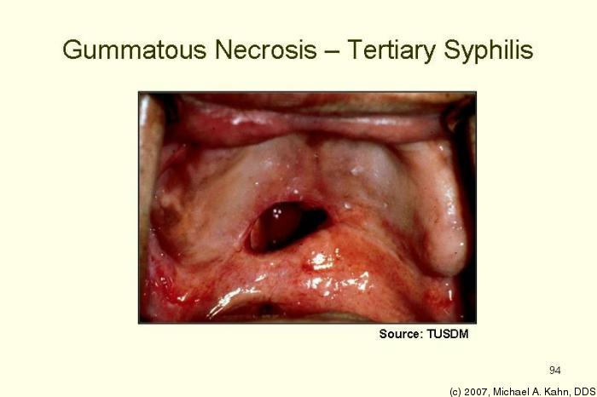
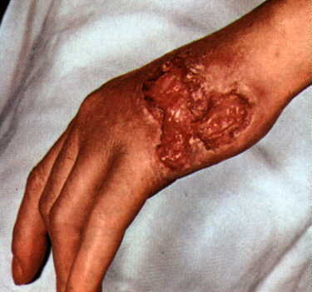
Treatment
Benzathine penicillin G, 2.4 million units 1 wk apart for 3 doses.
PENICILLIN ALLERGY
doxycycline, 100 mg orally BD x 4 wks.

Slide 40
Cardiovascular syphilis
Manifestations include:
Aneurysms of the aorta
Aortic insuffuciency
Coronary stenosis
myocarditis

Slide 41
NEUROSYPHILIS
CLASSIFICATION
1.Asymptomatic neurosyphilis
  Early
  Late
2. Meningeal neurosyphylis
  Acute syphilitic meningitis
  Spinal syphilitic pachymeningitis
3. Meningovascular neurosyphilis
  Cerebral form
  Spinal form

Slide 42
4. Parenchymatous neurosyphilis
  General paresis
  Tabes dorsalis
  Taboparesis (mixed)
  Optic atrophy
5. Gummatous neurosyphilis
  Cerebral form
  Spinal form

Slide 43
Congenital syphilis
Resemble secondary and tertiary syphilis
Vesicular or bullous lesions (syphilitic pemphigus)
Generalised papulosquamous eruptions
Palmoplantar eruptions
Perioral and perianal rhagades
Paronychias
Patchy alopecia
Nasal snuffles, saddle nose
Osteochondritis, periostitis, dactylitis, pseudoparalysis

Slide 44
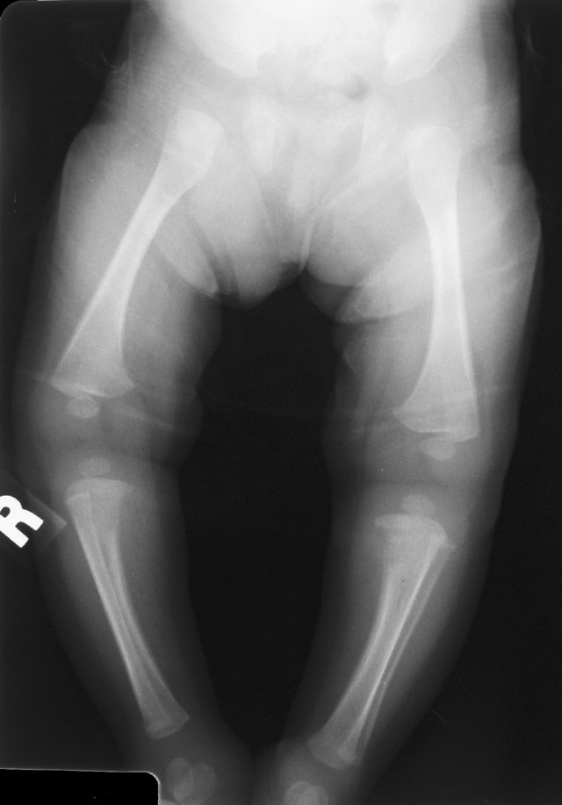
Wimberg’s sign or Cat Bite Sign : loss of density over the medial aspect of upper tibia. usually B/L

Slide 45
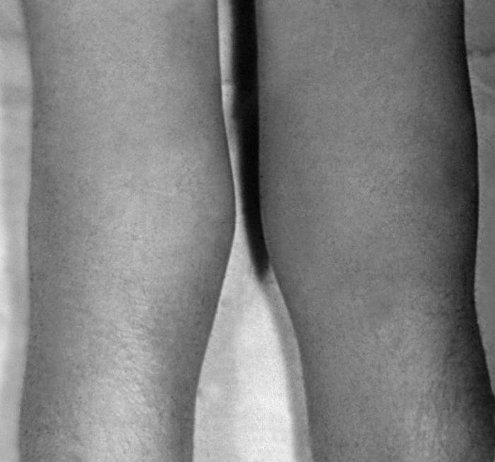
LESIONS OF JOINTS :
Clutton joints – symmetrical, non-tender swelling of both knees which often follow trauma & hydrarthrosis.
X-ray shows enlargement of joint spaces.
Due to hypersensitivity reaction.

Slide 46
Systemic features – hepatosplenomegaly, lymphadenopathy, pneumonitis, anaemia, uveitis
Clinical manifestations in late prenatal stage (> 2yrs) are interstitial keratitis, deafness and hutchinson’s teeth - - hutchinson’s triad

Slide 47
LAB diagnosis of syphilis
1)Direct microscopic identification of T. pallidum
3)Direct Ag detection
2)Serological tests to detect Ig G Abs
4) Detection of treponemal Ig M Abs
Non treponemal tests
Treponemal tests

Slide 48
Specific tests:-
Microhaemagglutination test for T. pallidum
T. pallidum haemagglutination
T. pallidum immobilisation test
Fluorescent treponemal antbody absorption tests
Non specific tests:-
VDRL
RPR

Slide 49
Interpretation of serological tests
VDRL | TPHA | IgM | Diagnosis
- | - | - | No syphilis or incubating syphilis
- | - | + | Early primary syphilis
+ | + | + | Primary or secondary syphilis
+ | + | - | Late secondary or latent syphilis
+ | - | - | Biologic false-positive, late syphilis
- | + | - | Late infection, treated syphilis, or false-positive treponemal test
↑ | + | ↑ | Re-infection, relapse

Slide 50
Summary
PRIMARY History & chancre
early stage
detection by dark field microscopy/DFA-TP ,
2 wks after chancre→ VDRL → FTA-Abs
SECONDARY
All tests +ve
Titer<1:8 → NTT repeated→ confirmed by TT

Slide 51
LATENT
All tests reactive in early latency
TPHA/FTA Abs- test of choice in late stage
LP recommended in all pts
TERTIARY
TT →-ve →PCR
CONGENITAL
Prenatal :detection of maternal infn
Demonstration of treponemes, detection of IgM Abs

Slide 52
STAGE | 1st LINE | ALTERNATIVE
INFECTIOUS | INJ. Benzathine penicillin, 2.4 million units IM (single dose) OR Inj. Procaine penicilline, 1.2 million units IM for 10 DAYS | Tetracycline 500 mg TID ,14 d Doxycycline 100mg BD,14d Erythro 500mg TID,14d Azithro 500mg OD,10 d Ceftrioxone 250-500mg IM OD,10d
LATE LATENT /LATE BENIGN/CVS | INJ.Benzathine penicillin, 2.4 million units IM at weekly interval for 3 weeks OR Inj. Procaine penicillin, 1.2 milion units IM for 20DAYS | Tetracycline 500 mg TID,28-30d Doxycycline 100mg BD,21- 30d Erythro 500mg TID,28d
NEURO/OCULAR SYPHILIS | Aqueous crystalline Penicillin G 18-24 million units per day administered as 3-4 million units IV every 4 hours or as continuous infusionfor 10-14 days OR Inj Procaine penicillin,2.4 million units IM daily for 14 days along with Probenecid,500mg orally QID, for 10-14 days | Doxy, 200mg,BD orally for28-30d OR Amox 3g BD and Probenecid 500mg BD for 21 dOR Inj ceftrioxone 2g IM/IV for 10 – 14 d

Slide 53
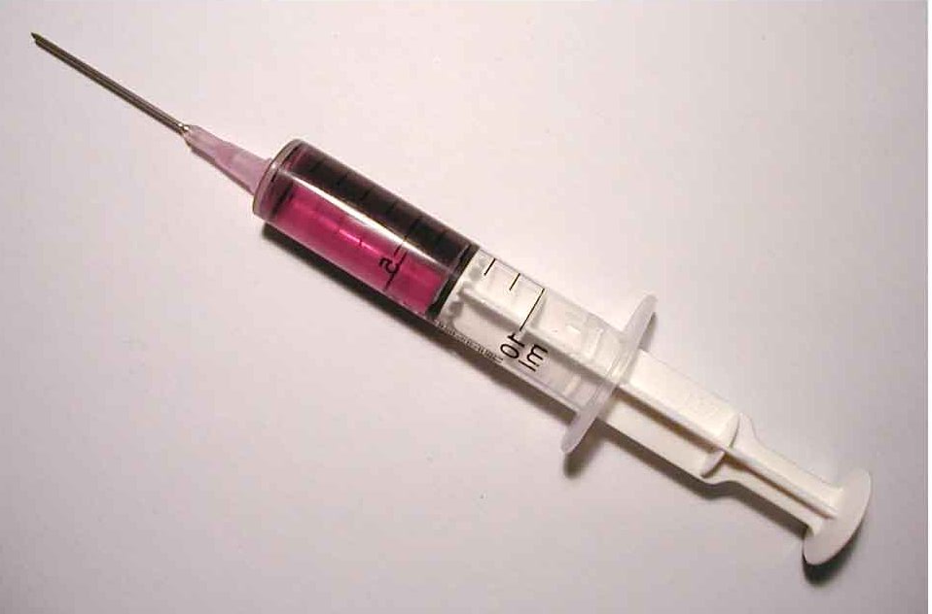
Treatment of syphilis

Slide 54
History
Until early 20th century ….., MERCURY and ARSENIC were the only drugs available.
But its highly toxic nature limited its use.
Later..
Different forms of ARSENIC, “EHRLICH’S SOLUTION” & i.v. NEOARSPHENAMINE along with Bismuth were used for 9- 15 months.
POTASSIUM IODIDE – gummatous lesions

Slide 55
FEVER induced by mechanical means or by inoculation of infective agents eg: malaria has also been used
1943 PENICILLIN first used by MAHONEY, ARNOLD & HARRIS in Rx of syphilis.
Penicillin – G, F, X, K.

Slide 56
Parenteral penicillin is the treatment of choice for all stages of syphilis
Parenteral penicillin is the only treatment with documented efficacy in neurosyphilis, HIV infection, and pregnancy.

Slide 57
Introduction of penicillin has simplified the management.
Parenteral penicillin is the preferred drug for treating all stages of syphilis.
Only drug efficacious for neurosyphilis and syphilis in pregnancy.
After >60yrs experience, results continue to be excellent, with no signs of resistance.

Slide 58
MECHANISM OF ACTION
Bind irreversibly to transpeptidase enzymes req for biosynthesis of outer envelope
Prevent closure of gaps in envelope lattice
↑ osmotic pressure within the protoplasm
Bulging of inner membrane
bursting

Slide 59
Complications of treatment
Jarisch Herxheimer reaction
Therapeutic paradox
Hoigne syndrome (pseudoanaphylactic reaction)
Anaphylaxis

Slide 60
Jarisch Herxheimer reaction
Clinical syndrome consisting of fever, headache, flare of mucocutaneous lesions, tender lymphadenopathy, pharyngitis, malaise, myalgias, and leukocytosis
Endotoxemia caused by the release of lipopolysaccharides from degenerating treponemes
Occurs within 24 hours of instituting therapy and subsides in 12-24 hours
The fever peaks in 6 to 8 hours usually around 39°C, but can go as high as 42°C
Patient should be warned about this reaction
Treatment
  Bed rest
  Aspirin, Corticosteroids

Slide 61
Therapeutic paradox
Deterioration of tertiary syphilis after therapy
Results from rapid decomposition of gummatous tissue
Worsening of the aortic insufficiency murmur has been reported from this complication

Slide 62
Hoigne syndrome
Complication associated with IM procaine penicillin treatment (1 case per 1000)secondary to crystals of procaine penicillin
Due to microembolism in brain
Reaction occurs immediately after the injection
  Tachycardia, elevated BP, fear of imminent death, anxiety, violent combativeness, unusual taste sensation, auditory or visual hallucinations, neuromuscular twitching, occasional seizures, and even loss of consciousness
Does not last more than 30 minutes
Treatment
  Observation
  Sedatives or anticonvulsants

Slide 63
Treatment of sex partners
Examine the exposed person and do a serologic test
Treat the contact if there is clinical or serologic evidence of disease
Treat prophylactically for primary syphilis if
  The exposure occurred within 90 days preceding the sex partner's diagnosis of early syphilis
  The exposure occurred more than 90 days before the sex partner's diagnosis of early syphilis, but serologic tests are not immediately available, and reliability is uncertain
  The evaluation of a long-term sex partner of a person with latent syphilis demonstrates possible transmission serologically or clinically

Slide 64
Epidemiological treatment
Treat contacts prophylactically for primary syphilis if
  The exposure occurred within 90 days preceding the sex partner's diagnosis of early syphilis
  Living conditions are favourable to the spread of the disease
  The patient will not return
  The contact has evidence of infectious syphilis
  The female partner is pregnant

Slide 65
Follow up of patients
Treatment is incomplete if the patient is not followed up
VDRL/TPHA recommended at 1, 3, and 6 months after treatment
Then at every 6 months
  For 2 years in early syphilis
  For 3 years in late syphilis
If HIV infected then follow up is done every 3 months
Evaluation of sexual partners is necessary

Slide 66
Penicillin allergy / Anaphylaxis
Penicillins are low molecular weight compounds that covalently bind to tissue carrier proteins and form drug-protein complexes or haptens which makes them immunogenic.
95% of tissue bound penicillin is haptenated as BENZYL PENICILLOYL – ‘’MAJOR ANTIGENIC DETERMINANT.’’
Remaining 5% molecules are termed as “minor antigenic determinants”
BENZYL PENICILLIN
BENZYLPENICILLOATE
BENZYL PENILLOATE
BENZYL PENILLOIC ACID

Slide 67
Skin testing with both major and minor antigenic determinants is gold standard for detecting penicillin allergy.
In USA the major antigenic determinants are commercially available as “BENZYL PENILLOYL POLYLYSINE” (PPL).
Many researches use penicillin G at a concentration of 10,000 U/ml as a partial source of minor determinants.

Slide 68
A commercial kit containing both these determinants – available in Europe (ALLERGOPEN) withdrawn from market in 2005.
New kit with both major and minor determinants is commercialized in Spain for skin testing (DIATER labs, Madrid, Spain)

Slide 69
PRICK TEST (EPICUTANEOUS)
Duplicate drops of reagents for skin testing are placed on volar aspect of forearm, underlying epidermis is pierced with 26G needle. Reading is taken after 15mins.
POSITIVE- >4mm

Slide 70
Treatment of penicillin allergic reactions/anaphylaxis
Acute reactions
Inj adrenaline 0.6ml of 1:1000 solution IM
Inj Hydrocortisone 250mg followed by 1000mg during succeeding 24 hours.
Inj amynophilline 250mg in 10ml strile water to relieve bronchospasm.
Delayed reactions
Antihistaminics or steroids

Slide 71
Retreatment
Serologies generally
  Decrease fourfold at 3 months
  Eightfold at 6 months
  Return to normal
    Within 6 to 12 months of treatment of primary syphilis
    Within 12 to 18 months of treatment of secondary syphilis
  Small proportion of patients will remain seropositive lifelong at a low titer – serofast state

Slide 72
Retreatment
Retreatment (same treatment as for syphilis of >1 year duration) should be considered if
  Clinical disease continues or recurs
  The quantitative serologic titer measured at 3-month intervals does not decrease at least fourfold (two tube dilutions) within 1 year
  The quantitative serologic titer increases fourfold (two tube dilutions), representing either relapse or reinfection

Slide 73
Summary
Syphilis is a complex disease with various stages
Serological tests play an important role in diagnosis of the disease
Penicillin still remains the treatment of choice today

Slide 74
Exercise:-
Moth eaten alopecia is seen in :
Primary syphilis
Secondary syphilis
Tertiary syphilis
Latent syphilis
Hutchinson’s triad includes all, except
Notched incisions
Nerve deafness
Interstitial keratits
Charcot’s joint

Slide 75
A 24 yr old male had an ulcer of size 0.2 x 2 cm over shaft of penis, painless, well circumscribed, round and indurated, with no tender inguinal lymphadenopathy. You suspect:
Syphilitic chancre
Chancroid
Herpes genitalis
LGV

