Slide 1
Syndromic management of STI’S
Dr. POOJA
SR DEPT. OF DVL
19/06/2024

Slide 2
INTRODUCTION
Sexually transmitted infections (STIs) are among the most common causes of illness in the world and have far reaching health, social and economic consequences.
As their name implies, the main mode of transmission of STI is through unprotected sexual intercourse.
Other modes of transmission include:
  Mother-to-child, blood transfusions
  Contact with blood or blood products.

Slide 3
There are 3 approaches to diagnose and treat STIs
Aetilogical diagnosis
Clinical diagnosis
Syndromic approach

Slide 4
Syndromic approach
Syndromic management is based on the identification of a group of symptoms and easily recognized signs associated with infection with well-defined pathogens.
Treatment for each syndrome is directed against the main organisms within that geographical setting responsible for the syndrome.
The syndromic approach has been shown to be highly effective for the management of majority of the STI.

Slide 5
Advantages
Complete STI care offered at first visit
No special tests are necessary to make a diagnosis
Simple, rapid and inexpensive
Patients can be provided with effective care without delay
Accessible to a broad range of health workers
Curtails unnecessary referral to hospitals

Slide 6
disadvantages
Risk of over-treatment
Requires prior research to determine the common causes of particular syndromes
Asymptomatic infections are missed
Has low specificity and positive predictive value for detecting cervical infections in women presenting with vaginal discharge.

Slide 7
The commonly encountered STI syndromes are:
Urethral discharge
Genital ulcer
Vaginal discharge
Lower abdominal pain in women
Inguinal bubo
Scrotal swelling
Neonatal conjunctivitis.

Slide 8
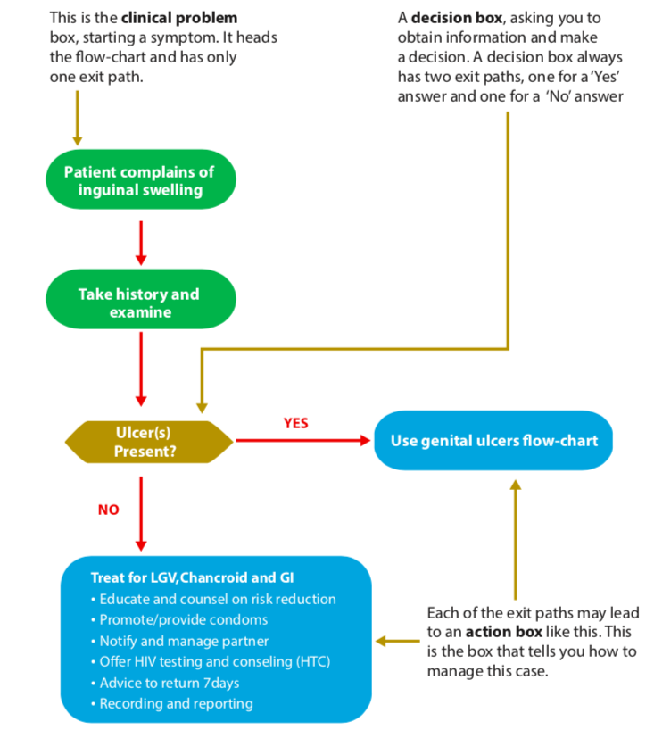

Slide 9
URETHRAL DISCHARGE SYNDROME

Slide 10
Presence of abnormal secretions from the distal part of the urethra and it is the characteristic manifestation of urethritis.
Two most common causative agents of the syndrome are Neisseria gonorrhea and Chlamydia trachomatis
Other causative micro-organisms are mycoplasma genitalium, Trichomonas vaginalis, and Ureaplasma urealyticum
N. gonorrhea has usually an acute onset with profuse and purulent discharge
C. trachomatis has sub-acute onset with scanty mucopurulent discharge
Notes:
Urethritis is usually due to sexually transmitted infections although urinary tract infections may produce similar symptoms
Usually urethral discharge is accompanied by burning sensations (dysuria) during micturition. Person with urethral discharge can also have increased frequency and urgency of urination and itching sensation of urethra.

Slide 11
  History
  Onset
  History of unprotected casual sex
  Amount of discharge.
  Examination
Look for
Urethral meatus for redness and swelling
No urethral discharge → massage from the ventral part of the penis towards the meatus → thick, creamy greenish-yellow or mucoid discharge

Slide 13
Laboratory investigations
Gram stain – gram negative intra-cellular diplococci in case of gonorrohea
> 5 neutrophils per oil immersion field or >10 neutrophils per high power field in the sediments of the first void urine in case of non gonococcal urethritis

Slide 14
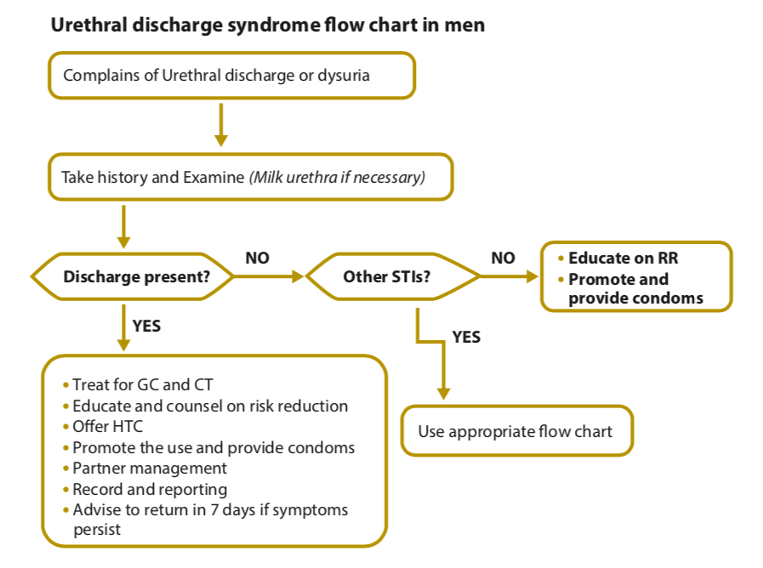
The algorithm of syndromic case management of urethral discharge syndrome
Notes:
RR- risk reduction

Slide 15
Recommended regimen for uncomplicated Gonorrhoea + Chlamydia
Tab Cefixime 400 mg P.O single dose
+
Tab Azithromycin 1g P.O single dose
Advice to return after 7 days of start of therapy.
Symptom persist or recur-Trichomonas vaginalis
Discharge /only dysuria persist after 7 days
  Tab Secnidazole 2 gm P.O, single dose
Symptoms persist- refer to higher center
Notes:
Symptom persist or recur after adequate treatment for gonorrhea and chlamydia in the index client and the partner should be treated for T.vaginalis
Secnidazole- nitroimadazoles

Slide 16
Management of pregnant partner
Per speculum and per vaginal examination- Gonococcal + Chlamydial infection
Cephaloporins – safe and effective in pregnancy
  Tab cefixime 400 mg orally , single dose
  or
  Inj Ceftriaxone 125 mg IM
  +
  Tab Erythromycin 500 mg QID x 7 days
  or
  Cap Amoxicillin 500 mg TID x 7 days
  Quinilones(ofloxacin, ciprofloxacin), doxycycline are contraindicated in pregnant women
Notes:
Pregnant partner of male clients with urethral discharge should be examined by doing a Per speculum and per vaginal examination and should be treated for Gonococcal as well as Chlamydial infection

Slide 17
Follow up
After 7 days
To see reports of test done for HIV, Syphilis, and Hepatitis B
If symptoms persist, to assess whether it is due to treatment failure or re-infection

Slide 18
Genital ulcer

Slide 19
Genital ulcer is an open sore or a break in the continuity of the skin or mucous membrane of the genitalia as a result of sexually acquired infections.
ETIOLOGY OF GENITAL ULCER SYNDROME
Treponema pallidum (syphilis)
Haemophilius ducreyia (chancroid)
Chlamydia trachomatis (LGV)
Klebsiella granulomatis (Granuloma inguinale)
Herpes simplex virus (Genital herpes)
Notes:
Genital ulcer facilitates transmission of HIV more than other sexually transmitted infections because it disrupts continuity of skins and mucous membranes significantly.
Commonly genital ulcer is caused by bacteria and viruses.

Slide 20
CLINICAL MANIFESTATION
History
Genital ulcer/vesicles
Burning sensation
Sexual exposure of either partner to high risk practices including orogenital sex
Examination
Presence of vesicles
Presence of genital ulcer- single or multiple
Ass. Inguinal lymph node swelling

Slide 21
Ulcer characteristics:
Painful vesicles/ulcers, single or multiple- Herpes simplex
Painless ulcer with shotty lymph node- Syphilis
Painless ulcer, no inguinal lymph node- Granuloma inguinale
Painful ulcer usually single- chancroid ass with painful bubo

Slide 22
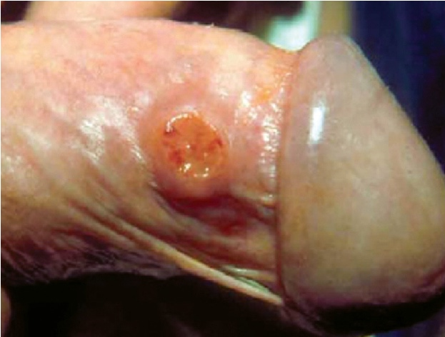

Slide 23
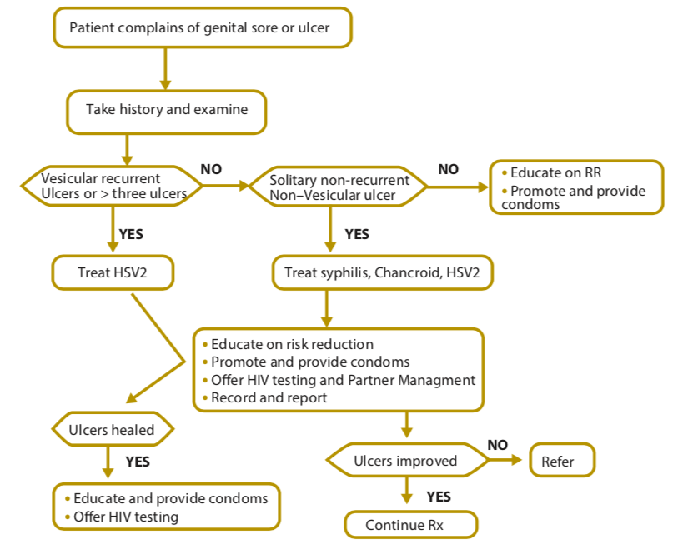
THE ALGORITHM OF SYNDROMIC CASE MANAGEMENT OF GENITAL ULCER SYNDROME

Slide 24
Treatment
Vesicles or multiple painful ulcers- Herpes
    Tab Acyclovir 400 mg P.O TID x 7 days
Only ulcer is seen – Syphilis, Chancroid and counsel on Herpes genitalis
To cover syphilis
    Benzathine penicillin 2.4 million units IM after test dose in two divided doses /Doxycycline(in penicillin allergy) 100mg BID for 14 days
    +
    Ciprofloxacin 500mg bid orally for 3 days /Azithromycin 1g Single dose, P.O
Notes:
Treatment should be extended beyond 7 days if ulcers have not epithelialized i.e formed a new layer of the skin over the sore.

Slide 25
Management of pregnant women
Quinolones (ofloxacin,Ciprofloxacin), doxycycline , and sulfonamides are contraindicated in pregnancy.
Inj Benzathine Pencillin 2.4 million IU IM after test dose
Second dose should be administered 1 week after the initial dose for women who have primary , secondary or latent syphilis
Allergy to penicillin→ erythromycin 500 mg QID for 15 days and neonate should be treated for syphilis after delivery
Oral Acyclovir-first episode or recurrent genital herpes.
Notes:
All pregnant women should be asked for history genital herpes and examined carefully for herpetic lesions
Vaginal delivery is preferred for women without symptoms or no signs of genital herpes.

Slide 26
Vaginal discharge

Slide 27
Abnormal vaginal discharge which is STI related is abnormal in color, odor and amount
ETIOLOGY OF VAGINAL DISCHARGE SYNDROME
Neisseria gonorrhea
Chlamydia trachomatis
Trichomonas vaginalis
Gardnerella vaginalis, Mycoplasma
Candida albicans
Notes:
In another word abnormal vaginal discharge is there when a women notices a change in color, odor and amount accompanied by pruritus.
Gardnerella vaginalis, Mycoplasma causing bacterial vaginitis

Slide 28
CLINICAL MANIFESTATION
History
Menstrual history – to rule out pregnancy
Nature and type of discharge(amount, smell, consistency)
Genital itching
Burning while passing urine, increased frequency
Presence of any ulcer, swelling on the vulval or inguinal region
Low backache

Slide 29
Examination- Per speculum to differentiate b/w vaginitis and cervicitis
Vaginitis
Trichomoniasis- Greenish frothy discharge
Candidiasis- curdy white discharge
Bacterial vaginosis- adherent discharge
Mixed infections- presents with atypical discharge
Cervicitis
Cervical erosion/ cervical ulcer/ mucopurulent cervical discharge
Bimanual pelvic examination to rule out pelvic inflammatory disease

Slide 31
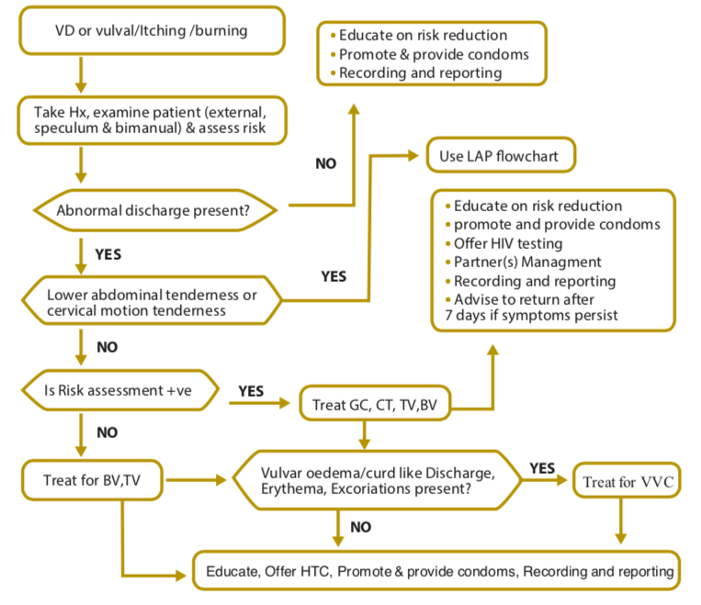
THE ALGORITHM OF SYNDROMIC CASE MANAGEMENT OF VAGINAL DISCHARGE SYNDROME

Slide 32
Treatment
Vaginitis(TC+BV+Candida)
Tab Secnidazole 2 gm P.O single dose OR
  Tab Tinidazole 500 mg P.O BID x 5 days
  Tab Metoclopramide 30 mins before Tab Secnidazole to prevent gastric intolerance
Candidiasis- Tab Fluconazole 150 mg P.O single dose
OR
Clotrimazole 500 mg vaginal pessaries once

Slide 33
Cervicitis(Chlamydia and gonorrhoea)
Tab Cefixim 400 mg P.O single dose
+
Tab Azithromycin 1 gram, 1 hour before lunch
If vaginitis and cervicitis are present treat for both
Avoid douching
Pregnancy, diabetes, HIV should be considered in recurrent infections
Follow up after 1 week
Notes:
Tab Azithromycin 1 gram, 1 hour before lunch if vomiting within 1 hour , give anti emetic and repeat

Slide 34
Management of pregnant women
Vaginitis (TV+BV+Candida)
1st trimester of pregnancy
  Clotrimazole vaginal pessary/ cream – candidiasis
  Metronidazole pessaries/ cream intravaginally – Trichomoniasis or BV is suspected
2nd & 3rd trimester
  Tab Secnidaole 2 gm P.O single dose OR
  Tab Tinidazole 500 mg P.O twice daily x 5 days
Notes:
Per speculum examination should be done to rule out pregnancy complications like abortion, premature rupture of membranes

Slide 35
Lower abdominal pain in women

Slide 36
Pelvic inflammatory disease (PID) refers to a clinical syndrome resulting from ascending infection from the cervix and/or vagina.
Endometritis, salpingitis, tubo-ovarian abscess and pelvic peritonitis
ETIOLOGY
  Chlamydia trachomatis
  Neisseria gonorrhoea.
  Mycoplasma, Gardnerella,
  E. coli
  H. influenza
  Streptococcus
Notes:
Comprises a spectrum of inflammatory disorders of the upper female genital tract, including any combination of endometritis, salpingitis, tubo-ovarian abscess and pelvic peritonitis
PID is frequently poly-microbial
The commonest pathogens associated with PID, which are transmitted sexually, are C. trachomatis and N. gonorrhoea.

Slide 37
History
  Onset
  Type of pain, radiation, severity
  Presence of vaginal discharge
  Last menstrual period
  Systemic symptoms like fever, nausea and vomiting

Slide 38
Examination
P.S examination-vaginal/cervical discharge
P.A examination-lower abdominal tenderness, cervical movement tenderness
Pelvic- uterine and adnexal tenderness, cervical movement tenderness

Slide 39
CLINICAL MANIFESTATION
Lower abdominal pain
Abnormal vaginal discharge
Inter-menstrual or post coital bleeding
Dysuria
Backache
Fever, nausea and vomiting
Adnexal tenderness
Rebound tenderness
Adnexal mass

Slide 40
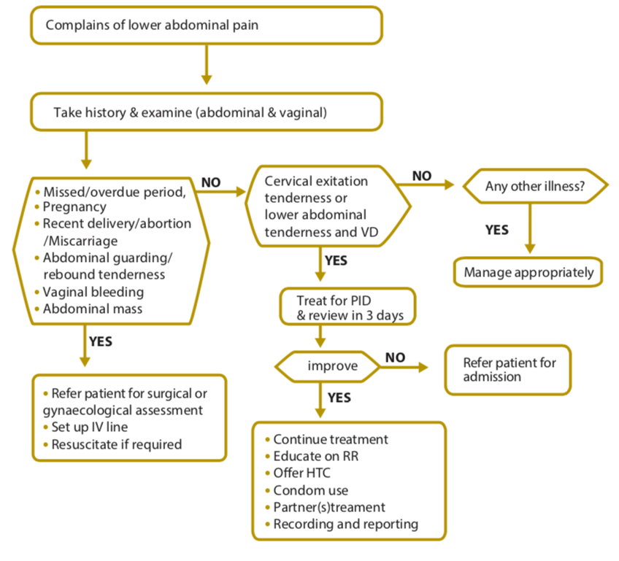
THE ALGORITHM OF SYNDROMIC CASE MANAGEMENT OF LOWER ABDOMINAL PAIN SYNDROME

Slide 41
Treatment
Mild or moderate PID
Tab cefixim 400 mg P.O BID x 7 days +
Tab Metronidazole 400 mg P.O BID x 14 days
+
Tab Doxycycline 100 mg P.O twice daily x 2 weeks(Chlamydial infection)
Tab Ibuprofen 400 mg P.O TID x 3-5 days
Advice abstinence during the course of treatment
Notes:
Advice abstinence during the course of treatment and educate on correct and consistent use of condoms

Slide 42
Hospitalization of clients with acute PID should be considered when
Diagnosis is uncertain
Surgical emergencies
Pelvic abscess is suspected
Woman is pregnant
Notes:
Surgical emergencies like appendicitis or ectopic pregnancies
Management of pregnant woman- Though PID is rare in pregnancy. Any pregnant woman suspected to have PID should be reffered to district hospital for hospitalization and treated with parenteral regimen.

Slide 43
Inguinal bubo

Slide 44
Inguinal bubo is defined as swelling of inguinal lymph nodes as a result of STIs.
ETIOLOGY
Chlamydia trachomatis (L1, L2 and L3)
Klebsiella granulomatis (donovanosis)
Treponema pallidum
Haemophilius ducreyi

Slide 45
Clinical manifestations
Constitutional symptoms of fever, headache and pain
Tender unilateral or bilateral lymphadenopathy forms a classical “groove sign” in the inguinal area
Fluctuant abscess formation which form a coalesce mass (bubo)
Sometimes concomitantly occur with genital ulcer

Slide 47
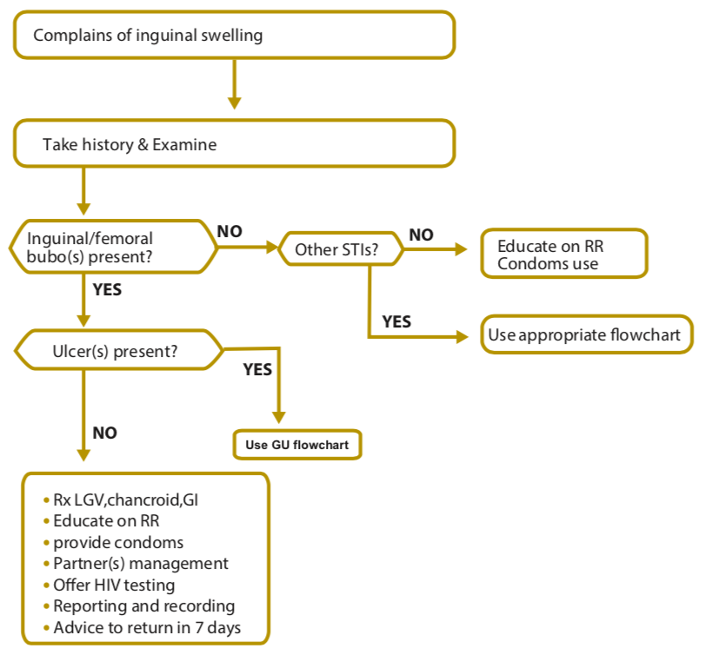
THE ALGORITHM OF SYNDROMIC CASE MANAGEMENT OF INGUINAL BUBO SYNDROME

Slide 48
Treatment
Cap. Doxycycline 100 mg orally twice daily x 21 days
+
Tab Azithromycin 1gm P.O single dose OR
Tab Ciprofloxacin 500 mg P.O BID x 3 days

Slide 49
Management of pregnant women
Tab Erythromycin 500 mg orally QID x 21 days
Quinolones( ofloxacin, ciprofloxacin), Doxycycline, Sulfonamides, Erythromycin estolate are contraindicated in pregnant women

Slide 50
Scrotal swelling

Slide 51
Scrotal swelling can be caused by trauma, tumor, and torsion of the testis or inflammation of the epididymis.
Mostly the inflammation of the epididymis is caused by sexually transmitted diseases
ETIOLOGY SCROTAL SWELLING SYNDROME
N. gonorrhea
C. trachomatis
T. pallidum
M. tuberculosis
Pseudomonas aeruginosa

Slide 52
CLINICAL MANIFESTATIONS
Scrotal swelling can manifest itself with different signs and symptoms. Some of them are:
  Pain and swelling of the scrotum
  Tender and hot scrotum on palpation
  Erythema of the scrotum
  Dysuria
  Sometimes frequency and urethral discharge can be there
Notes:
It is important to exclude other causes of scrotal swelling like testicular torsion, trauma, and incarcerated inguinal hernia

Slide 54
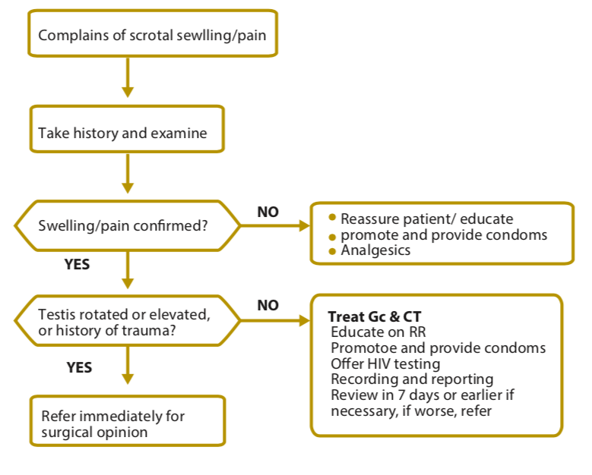
THE ALGORITHM OF SYNDROMIC CASE MANAGEMENT OF SCROTAL SWELLING SYNDROME

Slide 55
Treatment
Treat for both gonococcal and chlamydial infections
Tab cefixime 400 mg orally BD x 7 days
+
Doxycycline 100mg P.O BD for 14 days

Slide 56
NEONATAL CONJUNCTIVITIS

Slide 57
Is an ocular redness, swelling and drainage which can be sometimes purulent due to pathogenic agents or irritant chemicals occurring in infants less than 4 weeks of age.
The neonates get the infections from their infected mothers.
ETIOLOGY OF NEONATAL CONJUNCTIVITIS
N. gonorrhea
C. trachomatis
S. pneumoniae
H. influenzae
S. aureus
The commonest irritant- silver nitrate solution
Notes:
The commonest irritant chemical that causes neonatal conjunctivitis is silver nitrate solution

Slide 58
RISK FACTORS OF NEONATAL CONJUNCTIVITIS
Maternal infection with STI
Exposure of the infant to infectious organisms
Inadequacy of ocular prophylaxis immediately after birth
Premature rupture of membrane
Ocular trauma during delivery
Mechanical ventilation
Prematurity

Slide 59
CLINICAL MANIFESTATIONS
Red and edematous conjunctiva
Edematous eye lid
Discharge which may be purulent
Orbital cellulitis in more serious cases

Slide 61
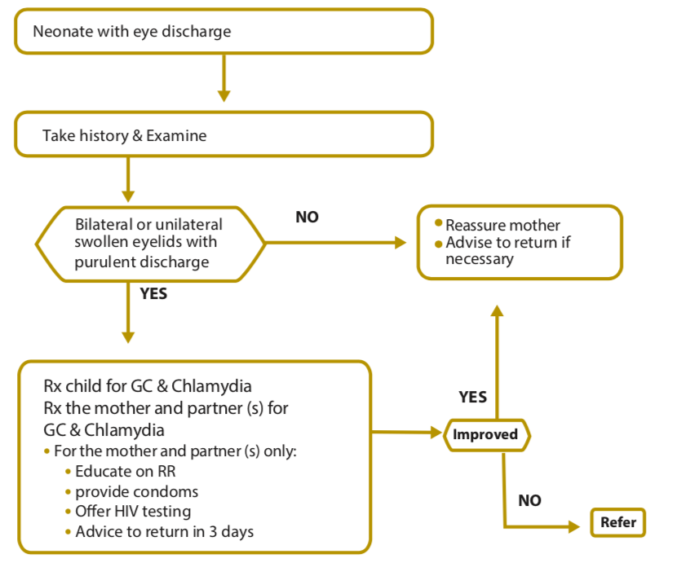
THE ALGORITHM OF SYNDROMIC CASE MANAGEMENT OF NEONATAL CONJUNCTIVITIS SYNDROME

Slide 62
TREATMENT
Ceftriaxone 50mg/kg IM stat maximum dose 125 OR
Spectinomycin 25 mg/kg IM stat maximum dose 75mg
+
Erythromycin 50mg/kg P.O in four divided dosesx14 days

Slide 63
Syndrome specific guidelines for partner management
Treat all recent partners
Treat female partners(for gonorrhea and chlamydia) on the same lines after ruling out pregnancy and history of allergies
Advice sexual abstinence during the course of treatment
Provide condoms, educate on correct and consistent use
Refer for voluntary counselling and testing for HIV, syphilis and hepatitis B
Schedule return visit after 7 days and 21 days

Slide 64
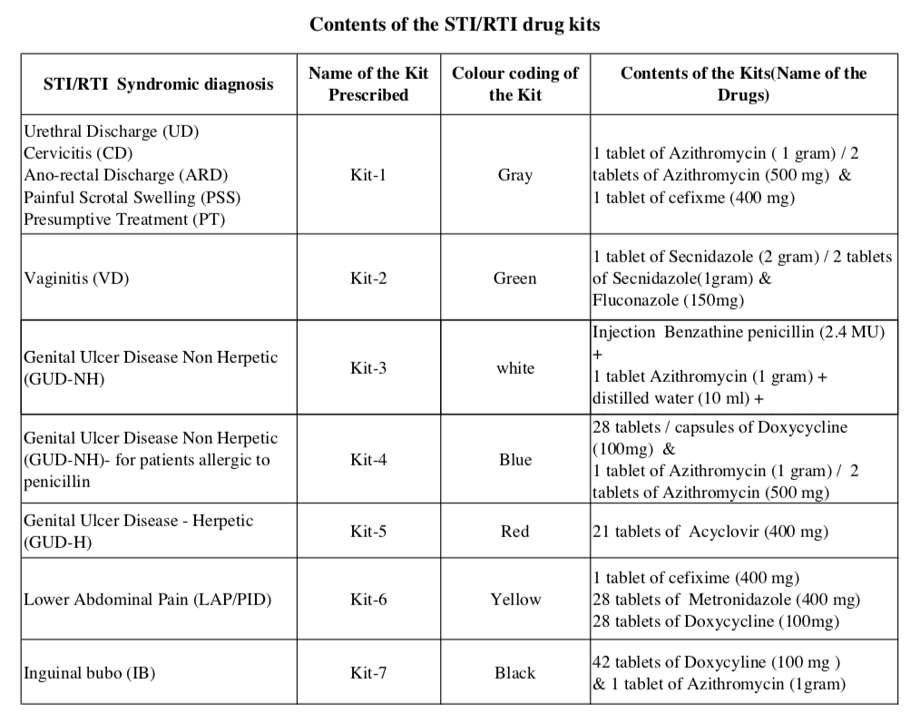

Slide 65
references
NATIONAL GUIDELINES FOR THE MANAGEMENT OF SEXUALLY TRANSMITTED INFECTIONS USING SYNDROMIC APPROACH,
NACO, MOHFW, Govt. of India. Operational Guidelines for Programme managers and Service Providers for strengthening STI/RTI Services, NACO, New Delhi; Oct 2012.
VK Sharma 2nd edition
Internet sources.

Slide 66
QUESTIONS

Slide 67
A male patient complains that he has pain on his penis. Patient gives h/o fluid filled lesions. Upon examination, you can see no discharge, but there are multiple ulcers on the penis. There is history of 2 similar episodes in the past. What is the colour of the kit that should be used?
Grey
Blue
Red
White

Slide 68
RED

Slide 69
A young woman complains of a pain in her stomach, low down. You take her history and examine her. She tells you that her periods are normal and she has never been pregnant. She has no rebound tenderness but clearly feels pain when you palpate her abdomen. Syndromic management would include…?
Cap. Doxycycline ,Tab Azithromycin
Tab cefixime, Tab Metronidazole, Tab Doxycycline and Tab Ibuprofen
Tab Secnidazole
Tab Fluconazole, Tab Secnidazole, Tab Cefixim, Tab Azithromycin

Slide 70
B
Mild or moderate PID
Tab cefixim 400 mg P.O BID x 7 days +
Tab Metronidazole 400 mg P.O BID x 14 days
+
Tab Doxycycline 100 mg P.O twice daily x 2 weeks(Chlamydial infection)
Tab Ibuprofen 400 mg P.O TID x 3-5 days
Advice abstinence during the course of treatment
Notes:
Advice abstinence during the course of treatment and educate on correct and consistent use of condoms

Slide 71
A middle-aged man tells you that he has felt pain in his groin for a week or so. Upon examination, you confirm that he has a painful fluctuating mass in the right groin. The patient winces when the mass is touched. There are no ulcers on his penis. What medications would the kit for this syndrome include?
Cap. Doxycycline ,Tab Azithromycin
Tab cefixime, Tab Metronidazole, Tab Doxycycline
Tab Secnidazole

Slide 72
Cap. Doxycycline ,Tab Azithromycin

Slide 73
Tab erythromycin is contraindicated in pregnancy.
True
False

Slide 74
false

