Slide 1
SCABIES
BY,
Dr . PRAVEEN KUMAR
HOUSE SURGEON
DEPT OF DERMATOLOGY
DR.B.R.AMCH

Slide 2
INTRODUCTION
Scabies is caused by Sarcoptes scabiei var. hominis.
Physiological variants of the same species cause ‘mange’ in other mammals, like dogs, cats, cattle, rabbits, pigs and horses. Mites of one animal do not cause established infestations on other animals or humans. Humans may contract animal scabies but the infestation is mild and dies out spontaneously.
The size of the male and female mites are about 0.2mm and 0.4mm respectively. Oval in shape, they are ventrally flattened and have a convex dorsal surface.

Slide 3
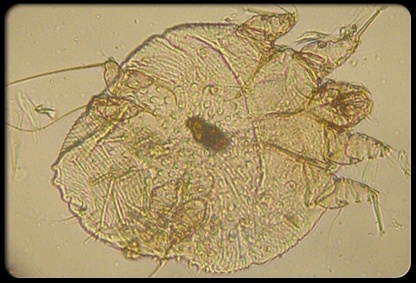
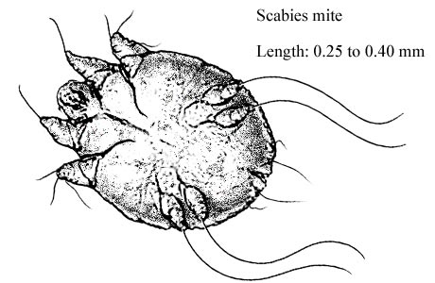
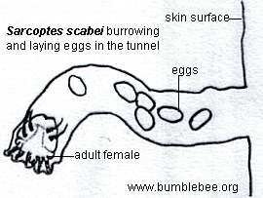

Slide 4
A newly fertilized female is usually the initiator of the infestation.
The female mite immediately starts digging a tunnel in the stratum corneum and remains in the burrow for the rest of its life thriving on the host lymph and lysed tissue.
The female mites lay eggs at the rate of 2 to 3 eggs per day for 6 to 8 weeks.

Slide 5
The eggs hatch out in 3-4 days , pierce the roof of the burrow and after the larval and a few molts in the nymphal stage , becomes adult.
Mating takes place on the surface of the skin and the male dies.
It takes about two weeks for an egg to develop into a graved female.

Slide 6
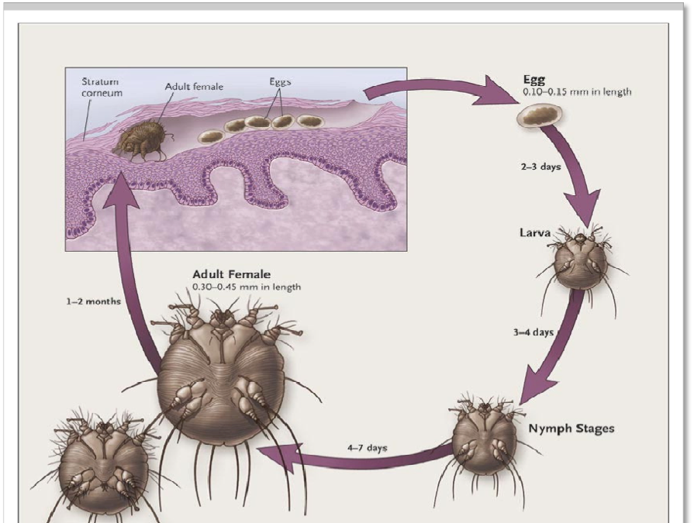

Slide 7
An affected host harbors about 11 to 12 gravid female mites.
A delayed hypersensitivity reaction (type IV) to the mites, their eggs or feces develops approximately 4 weeks after the infestation.
This is responsible for the intense itching. A person with a past history of scabies can develop immediate pruritus on re-infestation.

Slide 8
How to spread
The disease is spread from an infested person to another by close personal and prolonged contact, including sexual transmission.
Overcrowding and associated poverty and poor hygiene helps transmission.
Transmissions through fomites (clothing, linens towels) may occur but are not considered significant modes of spread.

Slide 9
CLINICAL FEATURES

Slide 10
Scabies occurs in all populations. It is particularly prevalent in the developing countries.
Children younger than 15 years of age have the highest prevalence.
After an incubation period of about 4 weeks the disease manifests itself with its most characteristic symptom: severe itching with nocturnal exacerbation.
The patient may present with extensive pyoderma or infective eczema.

Slide 11
The pathognomonic lesion of scabies is the burrow: short, straight or curved, slightly elevated lesion which often has a vesicle at its end . Burrows are typically found on the finger webs, front of the wrists, axillae and genitalia.
Intensly itchy papular and vesicular lesions soon develop due to hypersensitivity and these lesions may be generalized with predilections for the nipple and areola in females, umbilical regions, buttocks, groins and thighs.

Slide 12
Site:-(circle of hebra)
Finger web, flexor aspect of wrist , ulnar border of forearm , antecubital region , axilla , breast n nipple ( in females ) , in umbilical region , gluteal folds , involvement of back (in old age), genital region , feet.

Slide 13
The scalp, face and the palms and soles are usually spared sites in the usual cases.
The lesions are readily infected with bacteria and impetigo, folliculitis, oozing and crusting are very commonly seen as localized or extensive infective eczema.

Slide 14
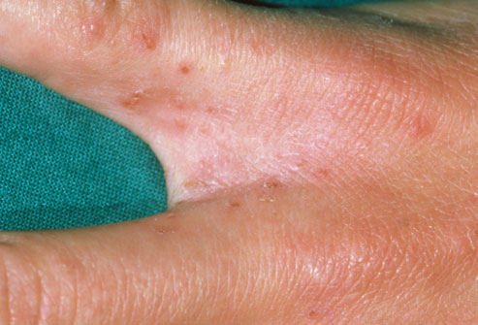
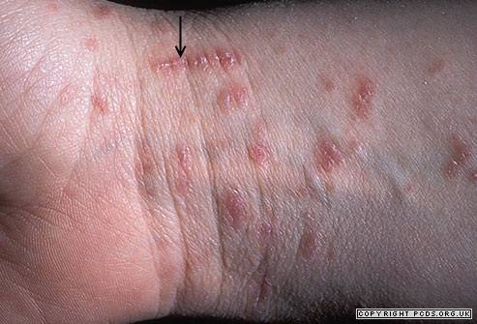
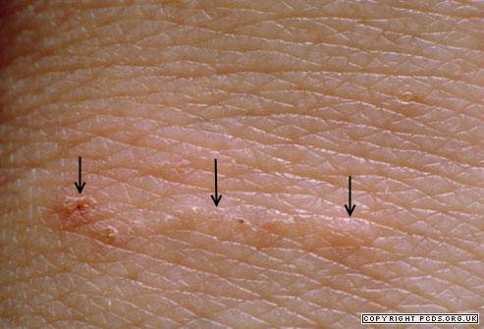
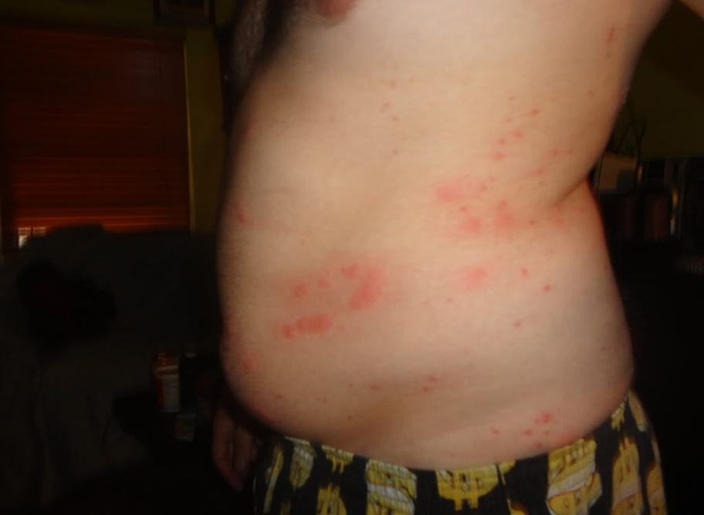

Slide 15
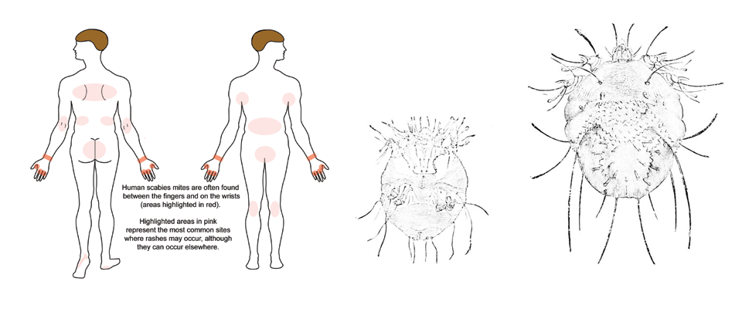

Slide 16
ATYPICAL FORMS

Slide 17
Norwegian or crusted scabies:
This is an unusually severe and extensive variety of scabies that occurs in immunocompromised individuals ( HIV infection, steroid therapy, malignancies), mentally retarded persons ( particularly Down’s syndrome) , and in old debilitated persons unable to respond to the infestation by scratching.
Crusted scabies is characterized by thick scaling and crusted lesions on the sites of preference of the mites. In contrast to the more usual variety of the disease, the palms and soles may be affected and the nails may be thickened and dystrophic. Facial involvement may also occur. The condition may give rise to a generalized erythroderma. Thousand, even millions of mites may be present in a patient.

Slide 18
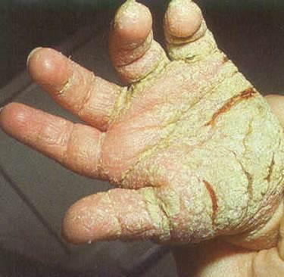
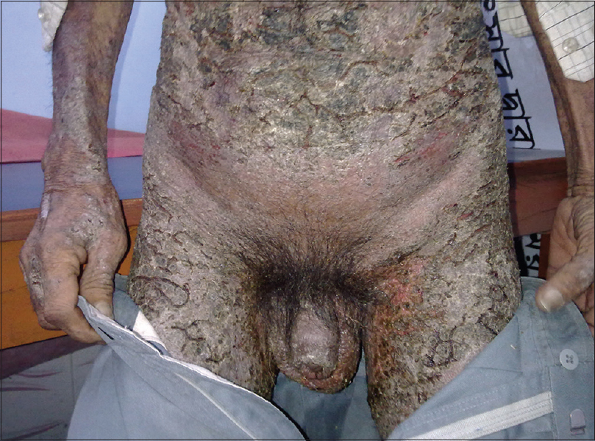

Slide 19
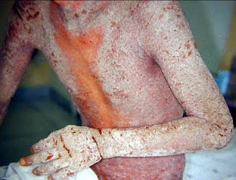
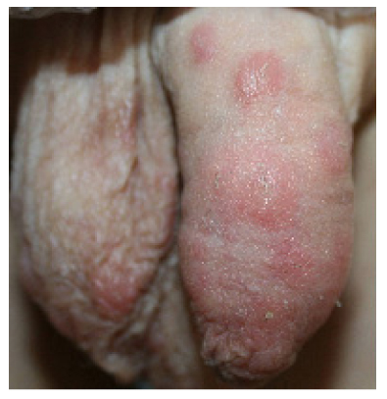

Slide 20
Nodular scabies:
Genital scabies in males may give rise to persistent papules and nodules despite successful treatment of the infestation. Histologically, the nodules may mimic a lymphoma.
Bullous scabies: bullae may occur in infants and immunocompromised people.
Animal scabies: is characterized by absence of burrows since the animal mites cannot adapt themselves to human skin.

Slide 21
Scabies in infants and in the very old: infantile scabies shows involvement of palms and soles as well as the face and scalp. In the very old, the trunk may be more severely infested.
Scabies incognito: inadvertent application of topical steroid may modify the clinical picture of scabies.
Scabies in very clean individuals may show few lesions, thus confusion may arise as to the true nature of the itch.

Slide 22
Diagnosis
Typical clinical features of itching with nocturnal exacerbation and finding the burrows and papules and vesicles in the sites of preference. History of scabies in close contacts is an important diagnostic feature.
The diagnosis may be confirmed by finding the mites, their eggs or feces by scraping the burrows and examining under a microscope.

Slide 23
Visualization of the burrow may be aided by applying marker pen ink and washing the excess with alcohol, or painting with tetracycline solution which is retained on the burrow and examining under Wood’s light : the burrows will fluoresce.
HPE
PCR
Raised IgE with eosinophilia
Dermatoscopy

Slide 24
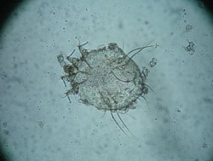

Slide 25
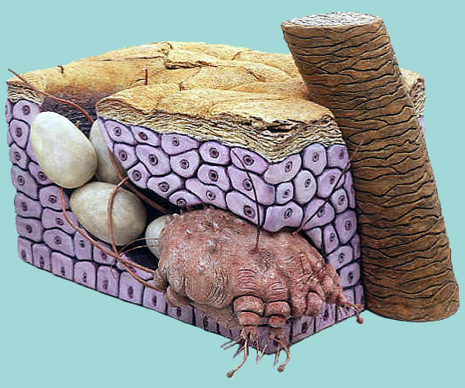
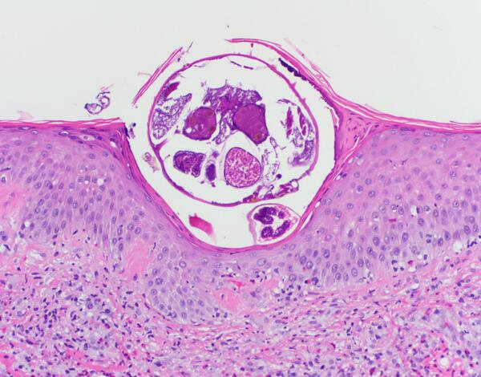

Slide 26
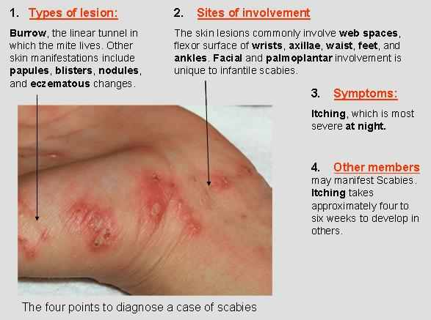

Slide 27
DIFFERENTIAL DIAGNOSIS

Slide 28
Insect bite
Papular urticaria
Dermatitis herpetiformis
Atopic dermatitis
Contact dermatitis
Pyoderma

Slide 29
COMPLICATIONS
Secondary pyogenic infection. Streptococcal pyoderma may in turn be complicated by glomerulonephritis.
Infective eczema
Persistent nodules
Crusted or Norwegian scabies
Erythroderma from crusted scabies

Slide 30
TREATMENT

Slide 31
GENERAL ADVICES
Avoidance of contact with infested persons. In crusted scabies isolation of the patient is very important.
Treatment of all close contacts.(Blanket therapy)
Maintenance of good personal hygiene-washing of clothes in hot water and drying it. Items that cannot be washed should be isolated from use for at least 3 days.
Nail clipping is must.
Improvement of socio-economic conditions is associated with lowered prevalence of scabies.

Slide 32
TOPICAL ANTISCABICIDAL DRUGS

Slide 33
DRUGS | CONC. | MOA | DIRECTION | INDICATIONS & C/I | S/E | COMMENTS
Sulphur | 6% ointment | suppresses mite proliferation | After a preliminary bath, the sulphur ointment is applied and thoroughly rubbed into the skin over the whole body for two or three consecutive nights. | used only in situations where adults cannot tolerate lindane, permethrin, or ivermectin C/I - HYPERSENSITIVITY | ICD | messy, malodourous, stains clothes CHEAP Safe alternative in infants, children, and pregnant
Benzyl benzoate | 25% emulsion 12.5%. Benzyl benzoate – for children | Unknown | Benzyl benzoate should be applied below the neck three times within 24 hours without an intervening bath or on successive days, or separated by intervals of a week | Effective in permethrin resistant crusted scabies. Combination with ivermectin in Patients with relapses after a single treatment with ivermectin C/I - pregnant and lactating women, infants, and young children less than 2 years of age. | ICD , ACD, CNS toxicity | CHEAP

Slide 34
Crotamiton | 10% cream or lotion | Unknown | applied twice daily for five consecutive days after bathing and changing clothes | ICD | antipruritic properties
Lindane ( ϒ-BHC) | 1% cream or lotion | Primarily acting on nerve cell Na channel - leads to increased excitability, convulsions, and death of mite | A single six hour application | CNS toxicity - headache, nausea, dizziness, vomiting, restlessness, tremors, disorientation, weakness, twitching of eyelids convulsions, aplastic anaemia, Thrombocytopenia and pancytopenia | maximum single dose is 20 g for adults. 3-day or more interval is given if used with ivermectin.
Permethrin | 5% Cream Or Lotion | Primarily acting on nerve cell Na channel - leads to increased excitability, convulsions, and death of mite | applied overnight once a week for two weeks to the entire body, including the head in infants. The contact period is about eight hours | Contact dermatitis | Low toxicity rapidly metabolised by skin esterases, and excreted in urine

Slide 35
SYSTEMIC ANTISCABICIDAL
IVERMECTIN – In crusted scabies , In epidemic , Nodular, If hypersensitive to permithrin , In patients with plaster cast.
dosage:200 microgms/kg/bw.
2 doses with interval of 14 days.
Acts by interrupting glutamate and aminobutyric acid induced neurotransmission in parasites leading to paralysis and death .
Other systemic drugs – Thiabendazole, Flubendazole ,

Slide 36
Adjunct therapy
Antibacterials for pyoderma and topical steroid for Eczematization.
Antihistaminics for pruritus.
Intralesional/topical steroids may be needed for the treatment of nodular scabies

Slide 37
PEDICULOSIS
Notes:
37

Slide 38
Pediculus Humanus:
  PH Capitis (head louse).
  PH Corporis (body louse).
Pthirus Pubis (Pubic or crab louse).
Notes:
38

Slide 39
Pediculi are ectoparasites, they live on top of their hosts instead of inside of them.
They are small, six-legged insects with claws adapted to clinging onto their host's hairs or clothes.
Pediculi mouth-parts are adapted to sucking the host's blood, and in the case of capitis, they are also adapted to eating dermal parts of the host's scalp, neck and eyelids.
Notes:
39

Slide 40
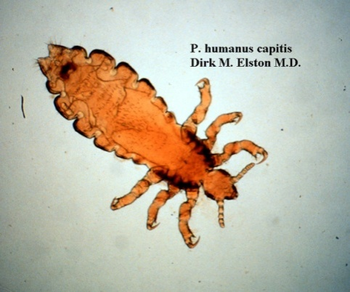
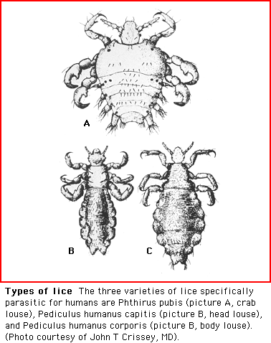
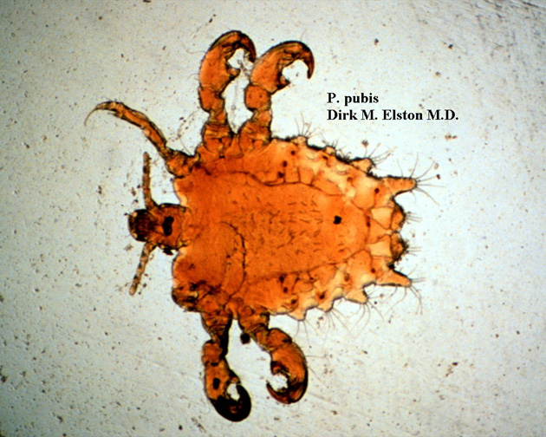
Notes:
40

Slide 41
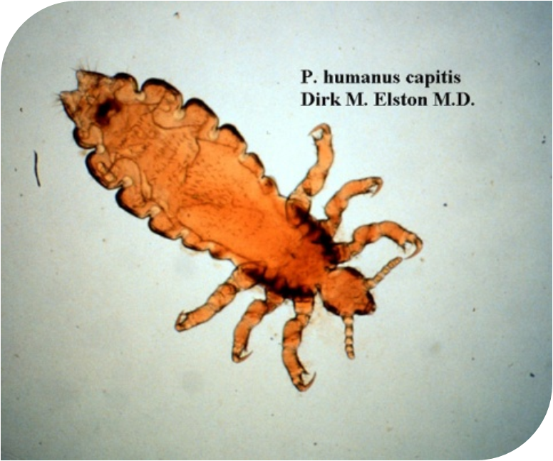
Pediculosis capitis
Notes:
41

Slide 42
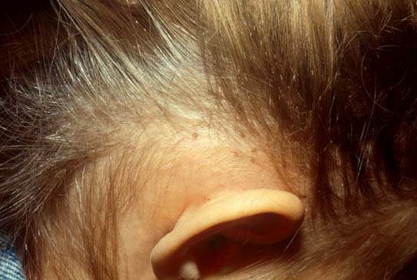
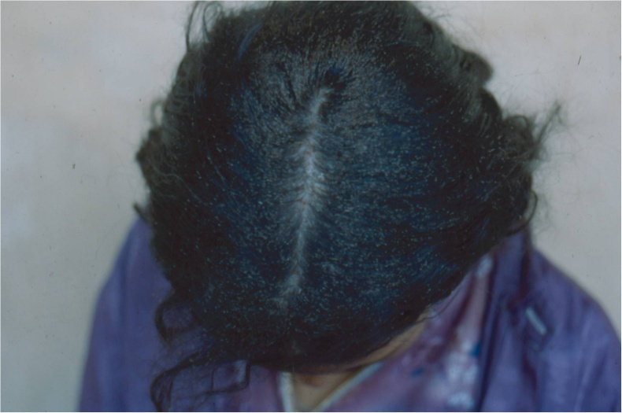
Clinical Picture
Symptoms that may appear are itchiness of the neck, scalp and ears.
In more severe cases secondary bacterial infections can develop which may lead to febrile episodes as well as enlargement of the cervical and nucal lymph nodes.
Notes:
42

Slide 43
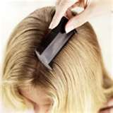
Human to human transmission is the only way pediculosis is transmitted.
Diagnosis is by Identification of louse and nits.
Notes:
43

Slide 44
Treatment
Permethrin 1%: the drug of choice 10 min. and washed off.
Malathion 0.5%: applied for 12 hrs.
Gamma benzene hexachloride 1% shampoo: washed off after 10 min.
Crotamiton 10%:applied for 30 min.
Fine-toothed comb for remaining nits.
Antiobiotics for 2ry infection.
Notes:
44

Slide 45
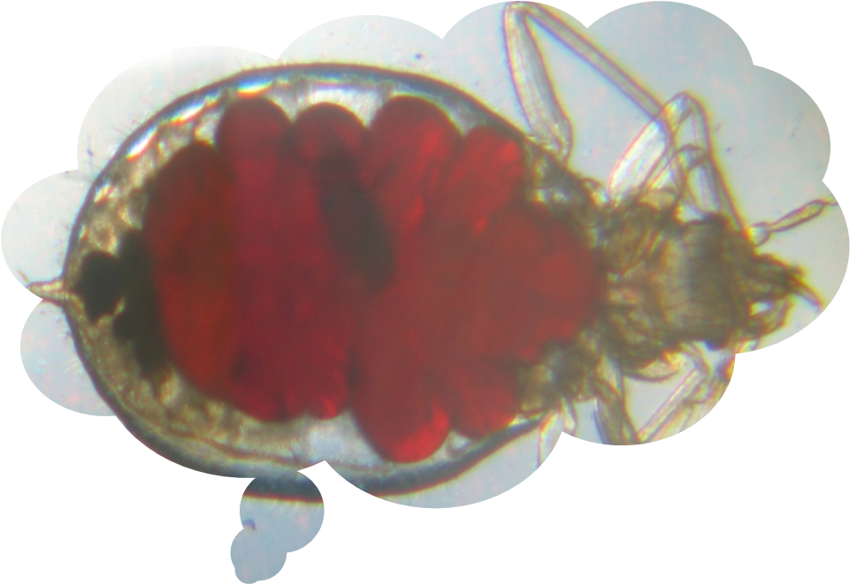
Pediculosis Corporis
Notes:
45

Slide 46
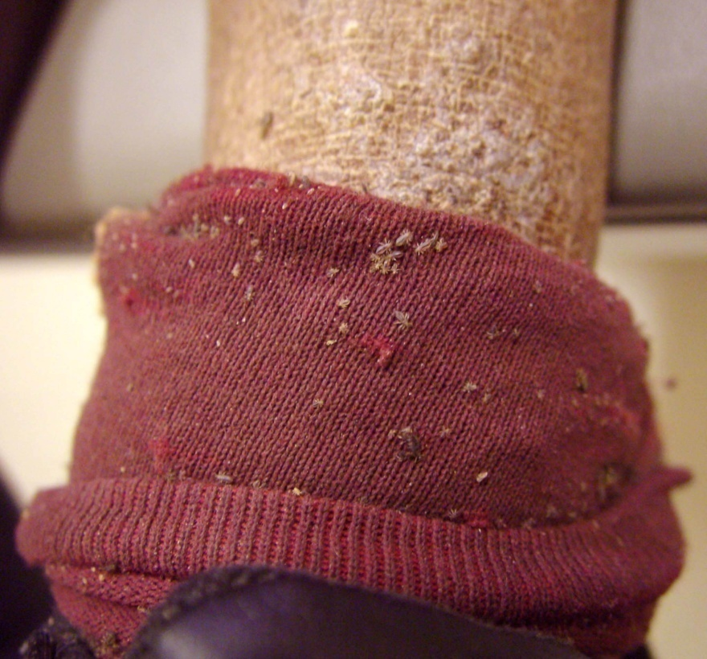
Body lice infest the seams of clothing and take blood meals at night.
Nits are found in the seams, not on human hairs.
Maculae ceruleae, the hemosiderin-stained purpuric spots where lice have fed, suggest the diagnosis of body louse infestation.
Notes:
46

Slide 47
Treatment
Destruction of lice by boiling or ironing of clothes and bedding.
Malathion or DDT dusting powder for clothes.
Frequent bath.
Notes:
47

Slide 48
Pediculosis Pubis (Crab)
Notes:
48

Slide 49
Pubic lice and nits generally are plainly visible throughout the pubic hair, extending onto adjacent hairy areas of the body.
Eyelash nits are a manifestation of pubic louse infestation, not head louse infestation.
Notes:
49

Slide 50
Transmission is by sexual contact mainly and to less extent from bedding.
Itching is the main symptom, 2ry infection is common.
Treatment:
  Permethrin 1%: 10 min and washed off
  Gamma benzene hexachloride 1% applied for 8 hrs
Notes:
50

Slide 51
Thank you

