Slide 1
Nutrition defiencies and skin

Slide 2
CONTENTS
Basics of nutrition
Nutritional deficiencies
Fat soluble vs Water soluble Vitamins
Vit A deficiency
Vit D deficiency
Vit B1 deficiency
Vit B2 deficiency
Vit B3 deficiency
Vit B6 deficiency
Vit B12 deficiency
Vit B9 (Folic acid) deficiency
Vit C deficiency
Zinc deficiency
Iron deficiency
Protein energy malnutrition
Marasmus
Kwashiorkor
MCQs
Photo Quiz

Slide 3
Introduction
Nutrition : Dynamic process concerned with ingestion, digestion, absorption and assimilation of food for nourishment.
Nutrients : Constituents of food necessary to sustain the normal function of the body.
Macronutrients : Carbohydrates, protein, fat
Micronutrients : Vitamins, minerals
Malnutrition : Imbalance in nutrient supply and demand, characterized by inadequate intake, absorption or utilization of key nutrients.

Slide 4
Etiology : Nutritional deficiencies
Decreased intake
Poverty
Ignorance
Food faddism
Crash diets
Anorexia nervosa
Increased requirement
During growth
Pregnancy
Lactation
Fever
Hyperthyroidism

Slide 5
Nutritional deficiencies
Fat soluble vitamins (A,D,E,K)
Water soluble vitamins
(B-complex, Niacin, Pantothenic acid, Biotin, Vit C)
Minerals
Trace elements (Zinc, Iron)
Essential fatty acids (EFA)
PEM (Protein energy malnutrition)

Slide 6
Fat soluble vs Water soluble vitamins
Vitamins | Fat Soluble | Water soluble
Chemical property | Lipophilic | Hydrophilic
Absorption | Needs lipids and bile salts | Simple (Except for Vit B12)
Carrier proteins | Present | Absent (Except for Vit B12)
Storage | Liver | Not stored (Except for Vit B12)
Deficiency manifestations | Faster onset | Slower onset
Toxicity | More common | Less common (Excess is excreted)

Slide 7
Vitamin A
Active forms : Retinal, retinol and retinoic acid
Storage form : Retinyl ester
Rich source : Animal fats, fish liver oils, milk, butter, eggs, liver
Provitamin A (Beta carotene) : Spinach, drum sticks, pumpkin,
carrots, tomato, fruits like mango and papaya
Functions:
Vision : Dark adaptation (Rhodopsin synthesis)
Epithelium : Maintenance and integrity
Immunomodulation, antinflammatory action

Slide 8
Clinical features : Vitamin A deficiency : Skin
Earliest manifestation: Asteatosis (Dryness)
Phrynoderma (Toad skin)
Mixed deficiencies of Vit. A, Vit. E, B - complex, Vit. C and EFA
Grouped, hyperkeratotic and pointed follicular papules with central keratotic horn spines,
Distribution : Elbows, knees, anterolateral thighs, posterolateral arms

Slide 9
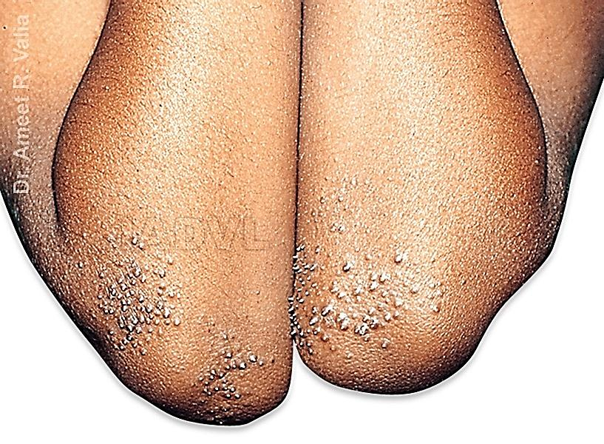
Phrynoderma

Slide 10
Clinical features
Eye Manifestations :
Common cause of blindness in developing countries.
Earliest symptoms:
Delayed adaptation to dark
Nyctalopia (night blindness)
Xerophthalmia:
Conjunctival xerosis, Bitot’s spots
Corneal xerosis, Corneal ulceration ,Keratomalacia
Phthisis bulbi, scarring, blindness

Slide 11
Treatment
RDA of allowance of vitamin A :
Infants : 300 - 400 µg, Children : 400 - 600 µg
Adolescents : 750 µg
Treatment of Vitamin A deficiency :
Oral Vitamin A : < 6 months : 50000 IU
6 -12 months : 1,00,000 IU, > 1 year : 2,00,000 IU
Repeat the dosage next day and 4 days later
Treatment of underlying cause (Protein and zinc deficiency)
Prophylactic Treatment :
Vit. A (2 lacs IU) every 6 months to pre-school children
(Orally retinyl palmitate in oil)

Slide 12
Vitamin D
Vit. D is a group of antirachitic sterol derivatives, considered as a hormone.
Skin : Role in synthesis, storage and release of Vit. D.
Function :
Maintenance of calcium and phosphorus homeostasis.
Influences the level of serum alkaline phosphatase.

Slide 13
Source of Vit. D and Chemistry
  Plants Ergosterol Ergocalciferol (Vit D2)
  Animal and dairy products (Eggs, liver, butter, codliver oil)
  Vitamin D metabolism
  7 dehydrocholesterol (human skin)
  UVB (Temperature dependent)
  Cholecalciferol (Vit. D3)
  Liver (25 Hydroxylase)
  25 hydroxy cholecalciferol
  Kidney (1 α Hydroxylase)
  1, 25 di-hydroxy cholecalciferol (Calcitriol)

Slide 14
Clinical features, Lab diagnosis, treatment
Children : Rickets, Tetany
Adults :
Osteomalacia
Type I Vit.D dependent rickets : No skin lesions
Type II Vit.D resistant rickets : Progressive alopecia
Lab diagnosis :
Serum 25 (OH) vitamin D3 < 5 ng/ml indicate deficiency
Treatment :
Normal daily requirement: 200 IU (infants) 400 IU (children)
In rickets : 5000 IU oral Vit D for 3 to 5 weeks
Exposure to sunlight

Slide 15
Vitamin B1 (Thiamine, Aneurin)
Sources : Yeast (richest source), unmilled cereals, pulses, nuts
Function : Thiamine pyrophosphate (Active form)
Functions as cocarboxylase in carbohydrate metabolism and in numerous other enzyme systems.
Dry Beriberi
Peripheral neuropathy, atrophic skin, red burning tongue
Korsakoff's psychosis,Wernicke's encephalopathy
Wet Beriberi
Peripheral edema, high output cardiac failure
Skin is warm before CCF and cold, edematous, cracked later

Slide 16
Diagnosis and treatment
Diagnosis
Urinary excretion of < 50 mcg of thiamine after 1 mg injection.
Treatment :
Dietary requirement: 0.4 mg /1000 kcal, 0.5 to 2 mg
Mild Beriberi: Thiamine 5 mg / day
Severely ill: Thiamine 10mg IV twice daily

Slide 17
Vit. B2 (Riboflavin)
Riboflavin : Flavoprotein widely distributed in plants
Sources of Vit. B2:
Milk, milk products, eggs, liver, cereals, pulses, green leafy vegetables
Deficiency of Vit.B2 affects metabolism of free fatty acids, tryptophan, folic acid
Function:
Role in intracellular oxidation-reduction reactions
(Flavin adenine mono and dinucleotide)

Slide 18
Clinical features : Vit B2 deficiency
Onset : 3-5 months of inadequate diet.
Oral manifestations :
Angular stomatitis (perleche) with maceration.
Cheilosis : Lip involvement with vertical fissuring.
Glossitis : Smooth, magenta coloured tongue, atrophic filiform papillae, enlarged fungiform papillae.

Slide 19
Clinical features: Vit B2 deficiency: Skin
Seborrheic dermatitis like rash :
Nasolabial folds, alae nasi, nasal bridge
(Nasolabial dyssebacea)
Forehead, cheeks, post auricular, eyelids, scrotum, vulva (Oro-oculo-genital syndrome)
Involved areas : Red, greasy, sometimes hyperpigmented (Dyssebacea or shark skin)
Dysriboflavinosis : Dyskeratotic follicular papules with scaly erythema, patchy alopecia, scalp and eyebrow scaling

Slide 20
Vit B2 deficiency: Extra cutaneous
Eyes :
Photophobia, lacrimation, blepharospasm, conjunctivitis, decrease in visual acuity, corneal vascularization
CNS : Psychomotor, intellectual development impaired in children.

Slide 21
Diagnosis and treatment
Diagnosis : Markers of deficiency
RBC glutathione reductase activity coefficient > 1.2
Urinary excretion < 30 mcg of vit.B2 / gm of creatinine
Treatment :
Normal requirement : 1-2 mg / day
Therapeutic dose: Infants : 1-3 mg , Adults : 10-30 mg/day
Correct the associated tryptophan, FA, EFA deficiency

Slide 22
Vitamin B3 (Nicotinic acid, Nicotinamide, Niacin)
Pellagra (deficiency of Niacin)
Italian word pelle - skin, agra - rough
Niacinamide (active form) NAD, NADP (coenzymes)
Function : Plays a vital role in cell, fatty acid, carbohydrate metabolism.
Sources :
Meat, fish, eggs, milk, cheese
Cereals, grains, legumes, coffee and tea
Endogenous production :
60 mg of tryptophan 1mg of niacin

Slide 23
Etiology of Vit B3 deficiency
Staple diet of maize and jowar with less animal proteins
Maize : Poor source of nicotinic acid and tryptophan, niacin is present but not bio-available
Jowar : High content of leucine (Inhibits tryptophan uptake)
Imbalance in leucine and isoleucine inhibition of NAD
Tryptophan Niacin
Chronic alcoholics : Unbalanced diet
Hartnup disease : Impaired reabsorption of tryptophan
Carcinoid Syndrome : 60% dietary tryptophan Serotonin
Drugs : Isoniazid, azathioprine, anticonvulsants

Slide 24
Clinical features
Characteristic 4 “D’s” :
Dermatitis, Diarrhoea, Dementia, Death
Skin :
Distribution : “Photo exposed areas”
Acute : Well-demarcated patches of erythema with pruritus, burning and pain resembling sunburn
Redness and maceration in the intertriginous areas
Chronic : Reddish brown, rough, scaly, thickened, and pigmented skin lesions

Slide 25
Clinical features
Pellagrins nose :
Dull erythema, butterfly rash with scaling on bridge of nose
Casal's necklace :
Sharply demarcated lesion on upper central chest, neck
Cravat :
Anterior continuation of necklace on chest
Scrotal erythema :
Symmetrical lesions, clear line of demarcation

Slide 26
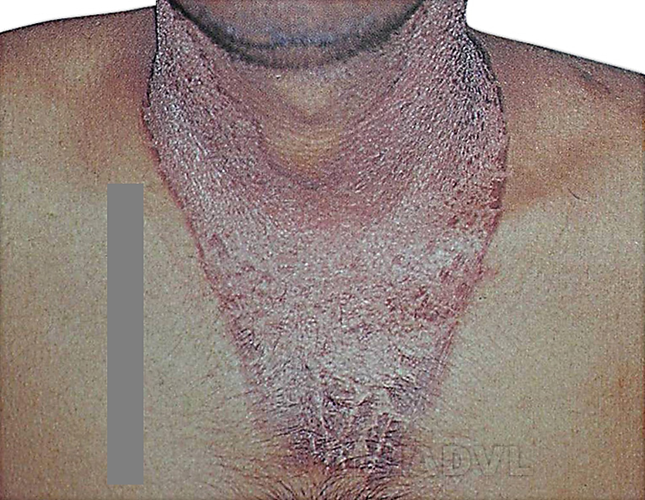
Pellagra

Slide 27
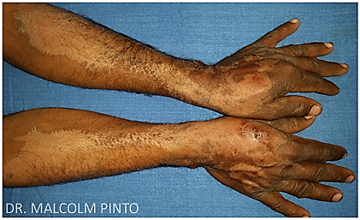
Pellagra

Slide 28
Clinical features
Mucous membrane
Angular stomatitis, cheilitis
Scarlet glossitis with imprint of teeth
Tongue is red, smooth, atrophy of filiform papillae, erosions, ulcerations, fissures
GIT : Anorexia, nausea, vomiting, abdominal pain, bloody diarrhoea
CNS : Depression, psychosis

Slide 29
Treatment
Daily requirement : 10 - 20 mg / day
Therapeutic dose :
300 - 500 mg niacinamide orally or intramuscular in divided doses (Niacin precipitate flushing, itching, burning)
Supplement with B complex, animal proteins eggs, milk
Balanced diet
Reduce alcohol

Slide 30
Vitamin B6 (Pyridoxine)
Animal sources : Liver, egg yolk, meat
Vegetable sources : Pulses, cereals, peas, soya beans
Drugs producing Vit B6 deficiency : INH, Hydralazine, Cycloserine, Penicillamine
Function :
Coenzyme in transaminase and decarboxylase reactions and in the metabolism of cysteine, tryptophan and EFA

Slide 31
Clinical features (Vit B6 deficiency)
Children : Anaemia, convulsion
Adults :
Seborrheic dermatitis like rash
Cheilitis, angular stomatitis, glossitis, peripheral neuritis
Chinese restaurant syndrome
Inability to metabolize monosodium glutamate
Headache, sensation of pressure in chest, palpitation, feeling of warmth, tingling, numbness

Slide 32
Diagnosis and treatment
Diagnosis :
Serum Pyridoxal phosphate levels < 20 µg / ml
Treatment :
Daily requirement : 1.5 - 2.5 mg
Therapeutic dose : 30 - 100 mg /day orally

Slide 33
Vit B12: Cobalamin, Cyanocobalamin
Forms : Cyanocobalamin, Deoxyadenosyl cobalamin, Methylcobalamin
Sources :
Liver, kidney, heart , meat, fish, cheese, eggs, milk
Vegetables, fruits, legumes – nil
Absorption : Specific receptor mediated process in the ileum involving glycoprotein (Intrinsic factor)
Function :
Nucleoprotein synthesis, Maturation of red cells
DNA synthesis and methyl group transfer

Slide 34
Etiology: Vit.B12 deficiency
Strict vegetarian diet
Gastric atrophy (achlorhydria) and decreased intrinsic factor (pernicious anemia)
Diphyllobothrium latum infestation
Malabsorption syndromes (Coeliac sprue, intestinal TB, Whipple’s disease)
Elderly individuals, chronic alcoholism

Slide 35
Clinical features : Vit.B12 deficiency
Skin : Symmetrical generalized hyperpigmentation (Flexures, palmar creases, soles, knuckles)
Mucous membrane : Hyperpigmentation, cheilitis, glossitis with beefy red tongue, glossodynia, aphthae like lesions
Nails : Pigmented streaks
Hair : Premature graying, canities
Other manifestations : Peripheral neuritis, impaired memory

Slide 36
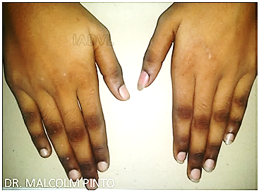
Vit.B12 deficiency

Slide 37
Diagnosis and treatment
Diagnosis :
Serum Vit. B12 <150 pg/ml
Hemogram, Bone marrow examination
Schilling’s test : Detects malabsorption
Treatment :
Daily requirement : 1 mcg
Dose : 1000 mcg / week for 1 month;
1000 mcg / month thereafter
Supplement folic acid 1 - 5 mg
Course : Cutaneous changes improve within 1 year

Slide 38
Vit B9 (Folic acid, Pteroylglutamic acid)
Sources :
Liver, meat, green leafy vegetables, milk
Produced by colonic bacteria (inadequate)
Active form :
Folic Acid Folinic acid
Function :
Coenzyme for normal RNA and DNA Synthesis
Neurotransmitter production (Serotonin)
Reduction in blood homocysteine levels
Vit C

Slide 39
Clinical features: Folic acid deficiency
Skin :
Diffuse hyperpigmentation
Mucous membrane :
Glossitis, superficial erosions, cheilitis
Others :
Megaloblastic anemia (Fatigue, tiredness)

Slide 40
Diagnosis and treatment
Diagnosis
Serum folate < 3 ng/ml (normal > 6 ng/ml)
Treatment :
Daily requirement : 50 - 100 mcg
In pregnancy : 400 mcg
Therapeutic dose : 1 - 5 mg / day
Correct concomitant Vit. B12 deficiency

Slide 41
Vitamin C (Ascorbic acid)
Scurvy : Deficiency of Vitamin C
Sources :
Fresh fruits - oranges, grapes, lemons
Fresh vegetables - Green leafy vegetables, potatoes, cabbage
Functions :
Antioxidant, Reducing agent
Role in collagen and ground substance formation, wound healing, immune response
Required for iron absorption

Slide 42
Etiology : Vit C Deficiency
Diet poor in Vitamin C (Elderly men, alcoholics)
Gastro-intestinal diseases
Malnourished children with scurvy (Barlow's disease)
Cigarette smokers

Slide 43
Clinical features
Skin :
Follicular hyperkeratosis :
Earliest change, cork screw hair (swan neck deformity) -
due to reduced disulfide bonds
Perifollicular purpura, hemorrhage
Sites : Upper arms, buttocks, shins, trunk, thighs
Petechiae, echhymosis
“Woody” edema of legs
Delayed wound healing

Slide 44
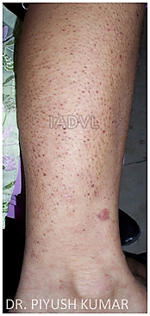
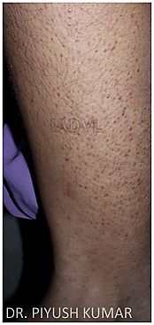
Scurvy

Slide 45
Vitamin C (Ascorbic acid)
Oral Cavity :
Hemorrhagic gingivitis (Spongy gums)
Loosened teeth, foul odour
Internal hemorrhage :
Hematuria, epistaxis, malena, hematemesis
In infants :
Excessive crying
Pseudo paralysis
Scorbutic rosary

Slide 46
Diagnosis and Treatment
Diagnosis :
Capillary fragility test : Positive
Serum Vitamin C assay < 0.1 mg/dl
Serum Vitamin C leukocyte assay < 7 mg/dl
Treatment :
Daily requirement : Adult: 50 mg, Children: 25 mg
Therapeutic dose : 100- 300 mg / day

Slide 47
Minerals and Trace elements : Zinc
Zinc :
Component of metalloenzymes for carbohydrate, protein, lipid and nucleic acid metabolism
Role in immunological functions and wound healing
Sources :
Shellfish, legumes, nuts, whole grains, green leafy vegetables
Zinc deficiency :
Genetic : Acrodermatitis enteropathica
Acquired : Acquired zinc deficiency

Slide 48
Acrodermatitis enteropathica
Inheritance : Autosomal recessive
First description : Danbolt and Class in 1943
Etiology :
Defect in intestinal zinc transporter : ZIP4 protein
Genetic locus on chromosome : 8q

Slide 49
Clinical features: Acrodermatitis enteropathica
Classical presentation : During infancy on weaning from breast milk to formula or cereal
Triad : Dermatitis, alopecia, diarrhea
Dermatitis :
Acute phase : Eczematous, erosive dermatitis favoring acral areas : perioral, periocular, anogenital, hands, feet
Chronic deficiency : Psoriasiform dermatitis
Oral Cavity: Angular stomatitis, glossitis, Superadded candidiasis
Nails : paronychia, leukonychia
Hair : alopecia
Eyes : photophobia, conjunctivitis
Diarrhoea, lethargy, growth failure

Slide 50
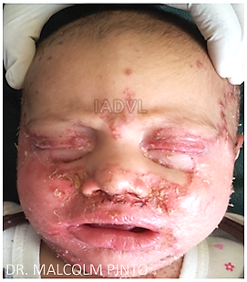
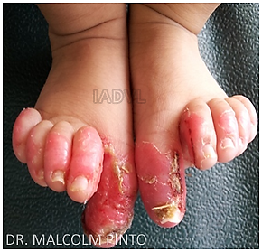
Acrodermatitis enteropathica

Slide 51
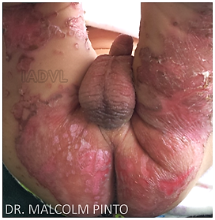
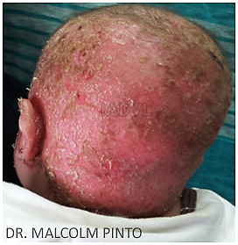
Acrodermatitis enteropathica

Slide 52
Diagnosis and treatment
Diagnosis
Serum zinc levels <80 mcg/dl (80 - 120 mcg/dl)
Treatment :
Daily requirement:
< 6months : 3 mg
6months - 1yr : 5 mg
1 - 7 yrs : 10 mg
7 yrs, adults : 16 mg
Pregnant and lactating mothers : 20 - 25 mg

Slide 53
Treatment
Dose
Oral zinc : 2mg/kg/day for 1- 2 weeks
30 to 55 mg of elemental Zn for 1-2 weeks
(220 mg ZnSo4 = 55 mg of elemental Zn)
Hereditary type requires life long treatment

Slide 54
Iron deficiency
Sources :
Green leafy vegetables, pulses, meat products
Vitamin C rich foods improve absorption; tea and tamarind inhibits absorption
Clinical features :
Generalized pruritus, increased hair loss, koilonychia
Angular stomatitis, cheilitis, glossitis
Hypochromic microcytic anemia
Plummer-Vinson syndrome

Slide 55
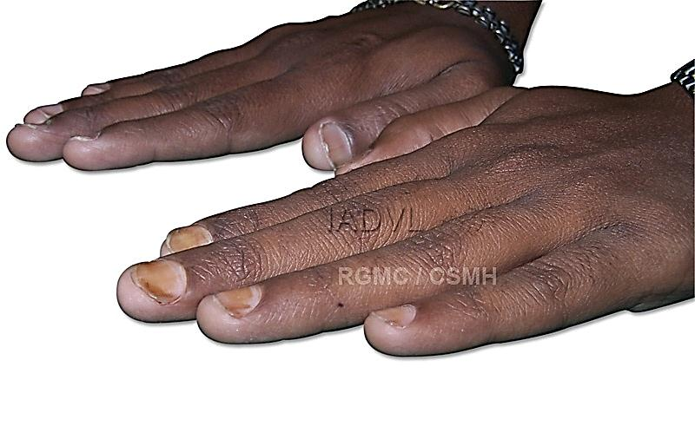
Iron deficiency : Koilonychia

Slide 56
Treatment
Therapeutic dose :
Ferrous sulphate or gluconate 300mg thrice daily
Treat underlying cause : chronic blood loss, parasitic infestations, malaria
Supplementation with Vitamin C
Supplementation during pregnancy

Slide 57
Protein Energy Malnutrition (PEM)
PEM is most common form of malnutrition.
Age: 1-3 years
Commonly seen during weaning and post weaning period.
Marasmus :
Patient with 60% of expected body weight without edema.
Kwashiorkor :
Patient who weighs 60 - 80 % of expected body weight for that age with severe protein malnutrition with relative carbohydrate excess.

Slide 58
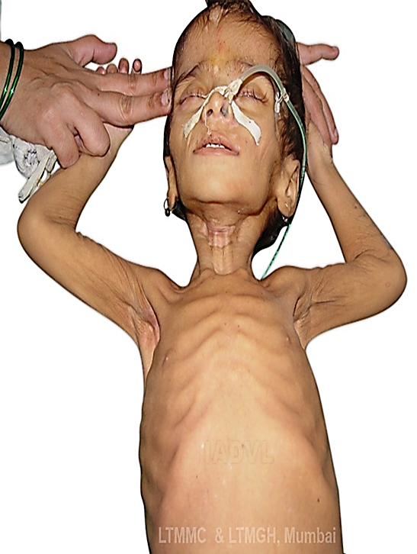
Marasmus : Clinical features
Skin :
Dry, inelastic, thin, wrinkled, loose
Follicular hyperkeratosis (adults)
Hair :
Slow growth, lustreless
Growth of lanugo hair occurs
Nails :
Fissured
Facies:
“Monkey facies”- wrinkled skin with loss of buccal fat pad
Child is alert

Slide 59
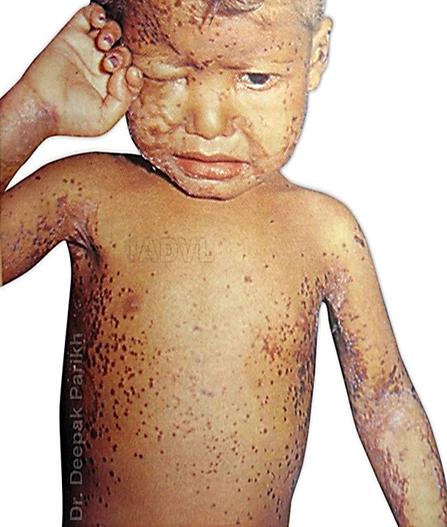
Kwashiorkor : Clinical features
Skin :
“Flaky paint” or “crazy pavement” dermatoses, extensive peeling of skin with erosions
“Enamel paint” dermatoses
Sites: Pressure sites
Sharply demarcated hyperpigmented plaques with burnt out appearance and waxy feel (spares feet and dorsa of hands in contrast to pellagra)

Slide 60
Clinical features
Mucosa :
Angular stomatitis, glossitis
Cheilitis with fissuring on lips
Nails : Soft and thin
Hair :
Sparse, thin, brittle, easy pluckable
Dyschromotrichia : golden, blonde, rust
Flag sign: Alternating bands of pale and dark hair corresponding to periods of poor nutrition interspersed with good nutrition
Eyelashes : broomstick appearance

Slide 61
Treatment
High protein, high caloric diet
Topical zinc paste, oral zinc supplements
Correction of other associated deficiency
Treatment of infection and infestation

Slide 62
MCQ’S
  Q.1) The typical sites of affection in riboflavin deficiency are :
  Sun exposed areas
  Frictional sites
  Seborrhoeic areas
  Flexural sites
  Q.2) Cork screw hairs with perifollicular purpura are features resulting from deficiency of
  Vitamin A
  Vitamin D
  Vitamin E
  Vitamin C
Notes:
Ans : Q. 1 - C, Q. 2 - D

Slide 63
MCQ’S
Q.3) Hair changes, such as alopecia and decreased hair pigmentation, can be seen with which nutritional dermatoses?
Scurvy
Kwashiorkor
Beriberi
Marasmus
Notes:
Ans : Q. 3 - B

Slide 64
MCQ’S
Q.4) A 50yr old male, chronic alcoholic presented with pruritic, sharply demarcated, erythematous rash over the anterior chest and forearms. The most likely vitamin deficiency implicated in this patient :
Niacin
Riboflavin
Vitamin
Biotin
Q.5) Which of the following is a common micronutrient deficiency found in patients with eating disorders?
Vitamin C
Zinc
Vitamin A
Vitamin B12
Notes:
Ans : Q. 4 - A, Q. 5 - B

Slide 65

Photo Quiz
Q. Identify the condition?
Notes:
Ans : Phrynoderma

Slide 66
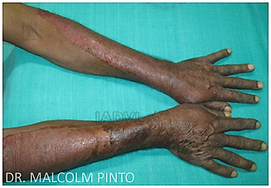
Photo Quiz
Q. Identify the condition?
Notes:
Ans : Pellagra

Slide 67
Photo Quiz
Q. Identify the distribution of lesions in this image
Notes:
Ans : Peri-orificial

Slide 68
Thank You!

