Slide 1

LICHEN PLANUS
Dr. pooja
Senior resident
Dept. of dvl
01/05/2024

Slide 2
CONTENTS
LICHEN PLANUS
Definition
Epidemiology
Etiology and pathogenesis
Triggers
Clinical features
Clinical types
Histopathology
Differential diagnosis
Prognosis
Treatment

Slide 3
Lichen Planus
Definition :
Lichen planus (lp) is a chronic inflammatory disease of unknown etiology affecting skin and mucous membranes,hair and nail.
Clinically characterized by pruritic, pink, polygonal, violaceous, flat topped, papular lesions.

Slide 4
Epidemiology
Incidence – 0.2% - 1%
No racial predilection
Seen in all age groups and both sexes
More common in 30-60 years age group
Familial cases are reported

Slide 5
Etiology & pathogenesis
Lichen planus represents :
T-cell mediated autoimmune damage to basal keratinocytes.
An increased association with other autoimmune disorders like ulcerative colitis, myasthenia gravis, lupus erythematosus, alopecia areata and diabetes.
Exact nature of lp antigen is unknown.
Increased frequency of hla-b27,hla-b51,hla-bw57,hla-dr1,hla-dr4,hla-dr6.
In genetically predisposed person, the antigen can be self peptide or various exogenous agents like drugs, contact allergens, viruses or bacteria and mechanical trauma.

Slide 6
Triggers
Common drugs implicated in the pathogenesis of lichen planus :
Antimicrobials – INH, ethambutol, griseofulvin, streptomycin, sulfonamides, tetracyclines
Antihypertensives – captopril, enalapril, labetalol, methyldopa, propranolol.
Antimalarials
Nsaids
Antidepressants and antipsychotics
Anticonvulsants
Diuretics
Gold salts
Tnfα inhibitors – etanercept, infliximab
Hypoglycemic agents

Slide 7
Other exogenous antigens
Viruses – hepatitis C (hcv)-common in oral LP
human herpes virus (HHV-6)
Vaccinations – HBV, killed influenza, MMR,DPT
Helicobacter. Pylori
Contact allergens – dental amalgams(mercury),copper and gold

Slide 8
Pathogenesis
Neo-antigen (self peptide or induced by systemic drugs, contact
allergens, mechanical trauma, infection)
Processed by the antigen presenting cell and presented to the t-lymphocytes
Production of ifn-ᵧ and intercellular adhesion molecules (icam-1)
Facilitates the interaction between lymphocytes and keratinocytes
Results in band like infiltration of lymphocytes close to the dermo-epidermal junction
Activated cd8⁺ lymphocytes undergo clonal expansion
contd.

Slide 9
Activated CD8+ lymphocytes undergo clonal proliferation
Cross linking of Fas ligand on cytotoxic T lymphocytes and a death receptor(Fas) on the target keratinocyte
Cytotoxic molecules, such as perforin and granzyme B
Release of MMP’s altering extracellular matrix protein
Perforin induces hole in the host cell membrane, Granzyme B induces a direct cytotoxic damage on keratinocyte
Activation of proteolytic enzyme catalase
Basement membrane disruption,subepidermal cleft formation
Target cell apoptosis & lyses
Colloid bodies
Ref: IADVL textbook 4th edi. 2015

Slide 10
Clinical Features
Mild to severe pruritus.
Small polygonal, violaceous, flat topped, papules.
The surface is transparent with a network of fine white striations (criss-cross lines).
These lines are called “wickham’s striae”
These papules are widespread as clusters or coalesce into large plaques.
Koebner’s phenomenon is commonly seen. Development of lesions along the lines of trauma over the normal skin.
Common sites – flexor surface of wrists, forearms, hands, legs, neck and sacral areas.
Other sites – oral mucosa, genitalia, scalp and nails.

Slide 11
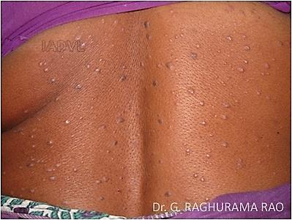
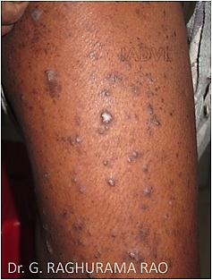
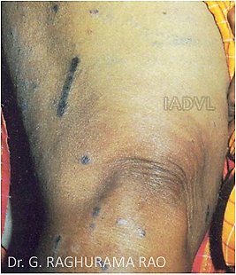
Multiple violaceous papules
LP with Koebner’s
Phenomenon
LP with Wickham’s striae

Slide 12
Clinical Types
Acute lichen planus – wide spread eruptions over the trunk, forearms, wrists and legs.
Annular lp
Atrophic LP
Hypertrophic LP
Inverse LP – lesions appear in axillae, inguinal and inframammary folds.
Bullous lp – bullous lesions develop within pre-existing lp lesions.
LP pemphigoides – bullous lesions develop within uninvolved skin
LP pigmentosus – brown to gray brown macules over the face and neck
Lichen planopilaris – multiple violaceous follicular papules over the scalp (cicatricial alopecia) and legs
Linear LP

Slide 13
Lichen planopilaris – multiple violaceous follicular papules over the scalp (cicatricial alopecia) and legs
Linear LP

Slide 14
Nail lichen planus
10% of cases
Lateral thinning, longitudinal ridging and fissuring.
Pterygium formation - fixation of proximal nail fold to the nail bed.
Yellow discoloration, onycholysis and subungual hyperkeratosis.
Twenty nail dystrophy – common in children

Slide 15
Oral lichen planus
Prevalence 0.5% - 2.2%.
Oral lesions occur in 70% - 77% with cutaneous LP lesions.
Reticular - whitish linear lines in a lace like pattern –buccal mucosa
Erosive(ulcerative)
Atrophic
Bullous
Papular
Plaques
Pigmented
These lesions are seen on buccal mucosa and tongue. Gingival involvement is also common.

Slide 16
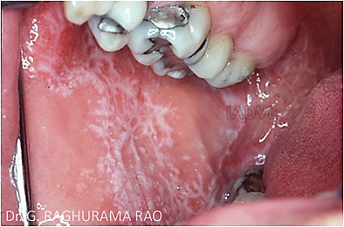
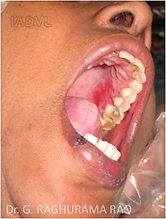
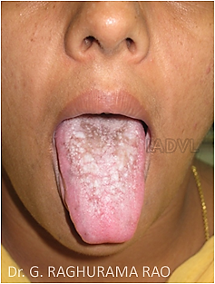
White streaks in Lacy pattern
on the buccal mucosa
Whitish Plaques over the tongue
Erosive LP lesions

Slide 17
Mucosal involvement in lichen planus

Slide 18


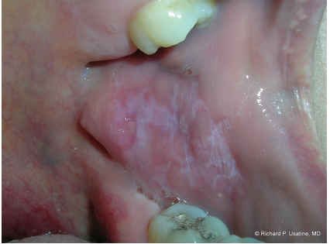
Oral lichen planus with Wickham striae on buccal mucosa.

Slide 19
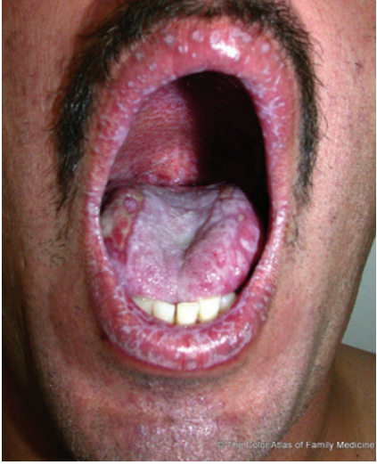
Oral lichen planus with erosions on the lips, tongue, and palate.

Slide 20
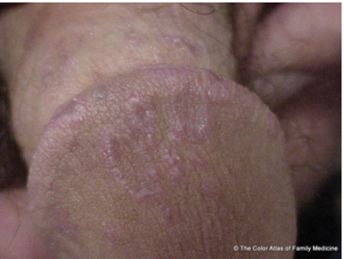
Lichen planus on the penis showing a lacy, white, annular pattern.

Slide 21
Genital lichen planus
Common in men
Annular lesions over the glans penis
Erosive lesions over the vagina
Association with oral lesions is common

Slide 22
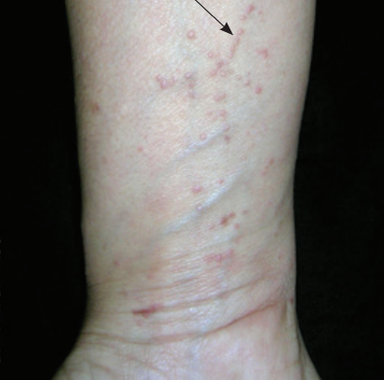
Identify & distinguish lichen planus lesions from other causes:

Slide 23
Classic:
Psoriasis, lichenoid drug eruption, lichen simplex chronicus,
Chronic cutaneous lupus, graft-versus-host disease, secondary syphilis, pityriasis rosea, mycosis fungoides

Slide 24
Annular: Granuloma annulare, tinea corporis
Linear: Nevus unius lateris, lichen striatus, linear epidermal nevus,psoriasis, darier disease
Hypertrophic: Lichen simplex chronicus, prurigo nodularis, lichen amyloidosis, kaposi sarcoma, squamous cell carcinoma, psoriasis

Slide 25
Atrophic: Lichen sclerosus, cutaneous lupus erythematosus, Poikiloderma, mycosis fungoides, morphea
Vesiculobullous: Lichen planus pemphigoides, epidermolysis bullosa pruriginosa, pemphigus vulgaris, bullous pemphigoid, bullous amyloidosis

Slide 26
Follicular: Lichen nitidus, lichen spinulosa, follicular psoriasis, pityriasis rubra pilaris
Childhood: Lichen nitidus, lichen striatus, pityriasis lichenoides, papular acrodermatitis of childhood, annular lichenoid dermatitis of youth, mycosis fungoides, frictional lichenoid eruption

Slide 27
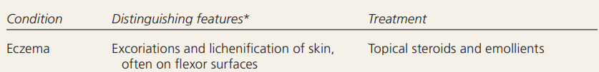
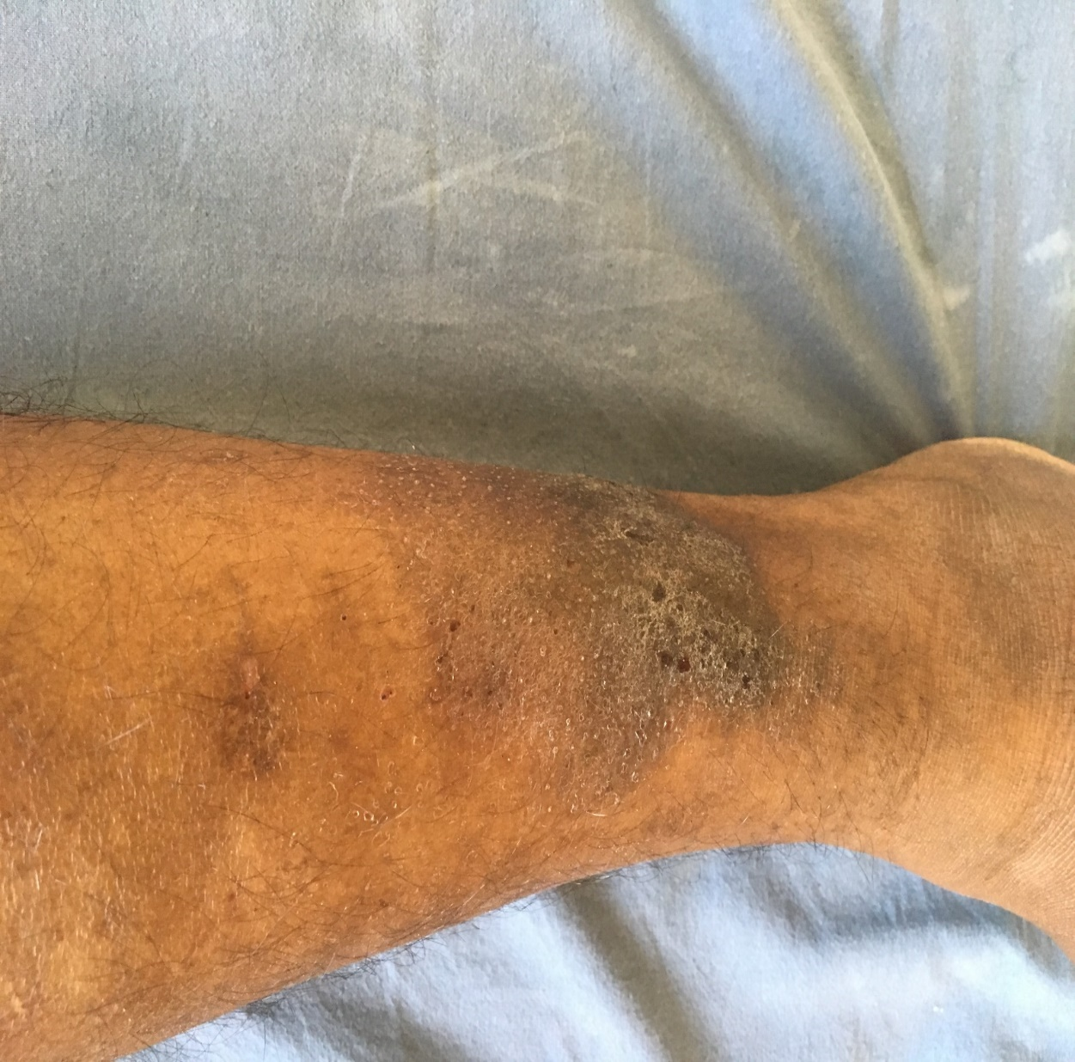

Slide 28
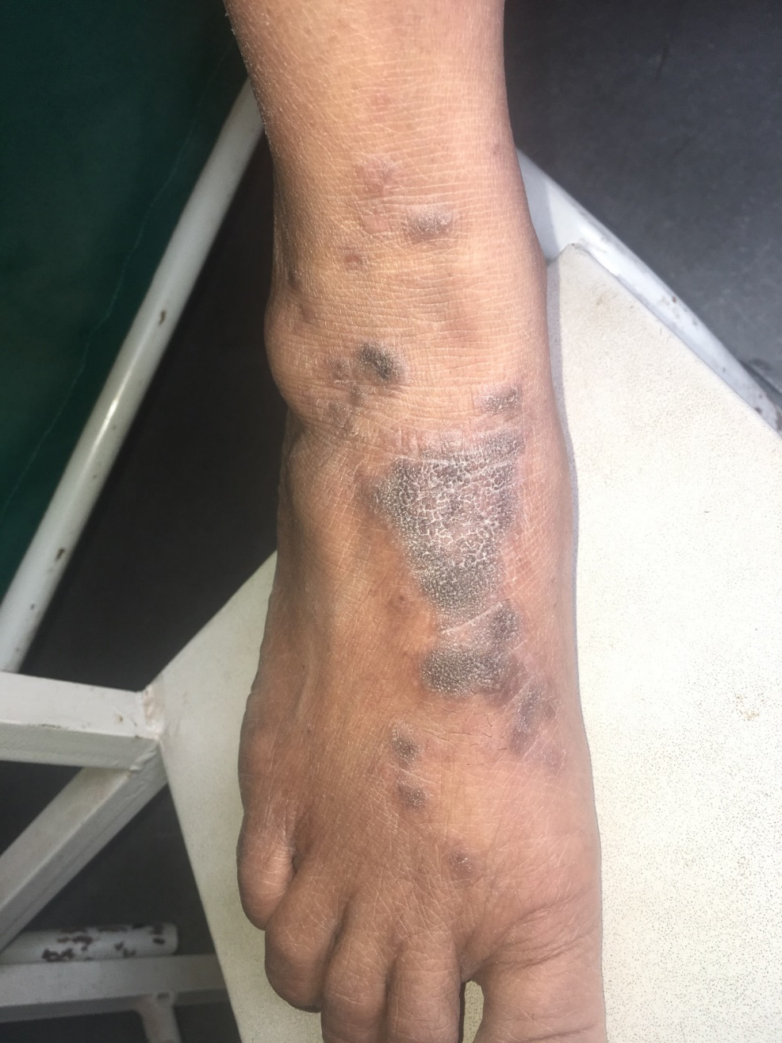

Slide 29
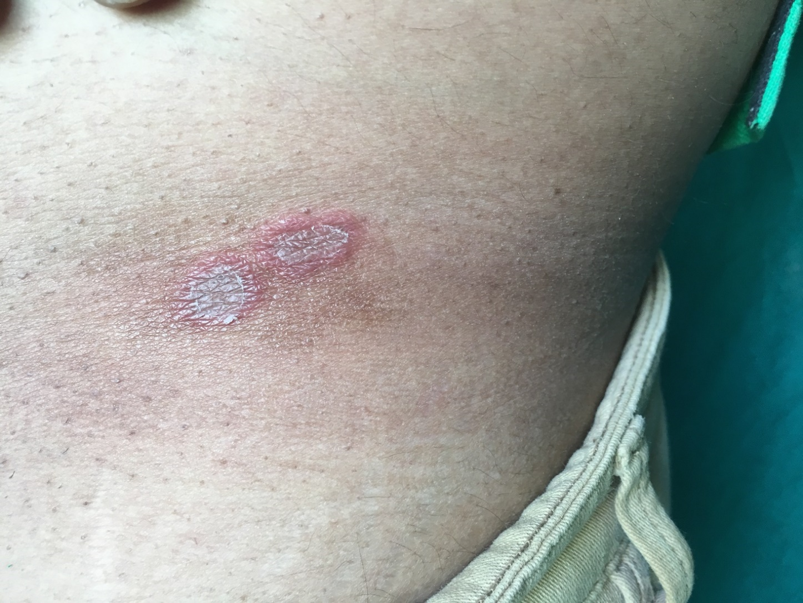

Slide 30
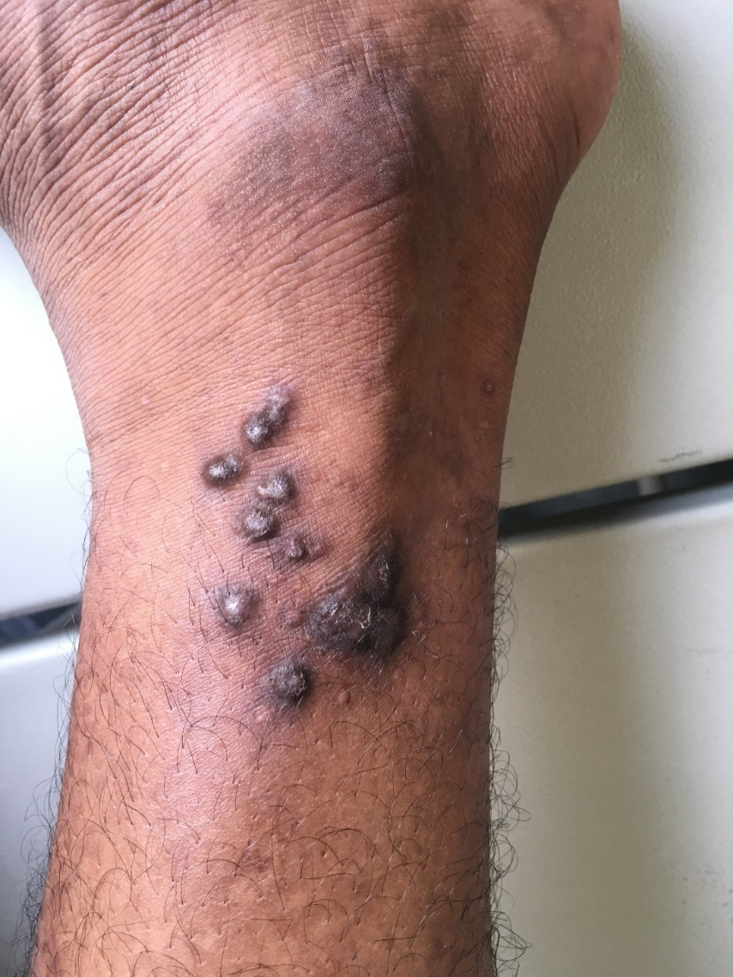
Pruritic nodules with central depigmentation and rim of hyperpigmentation

Slide 31
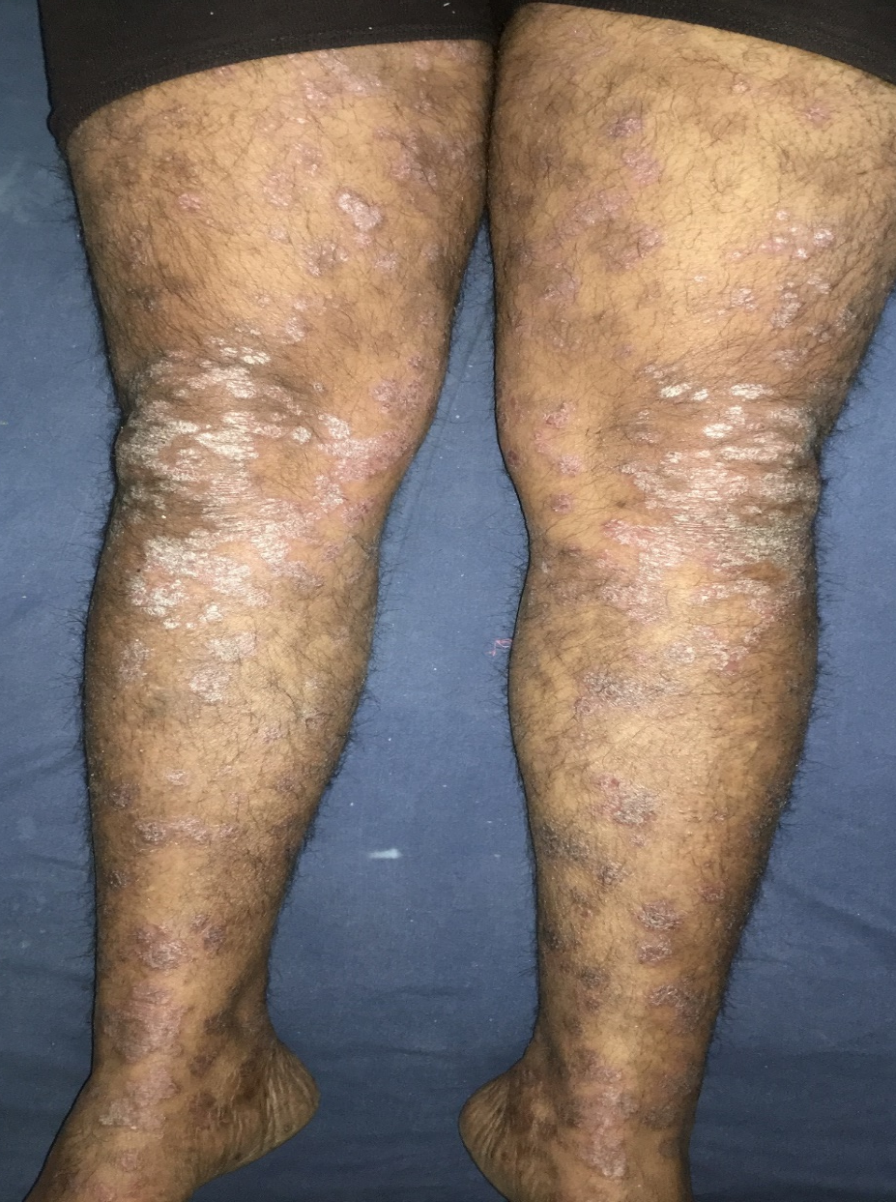
Plaque with silvery white scaling present over the extensor aspect of extrimities.

Slide 32
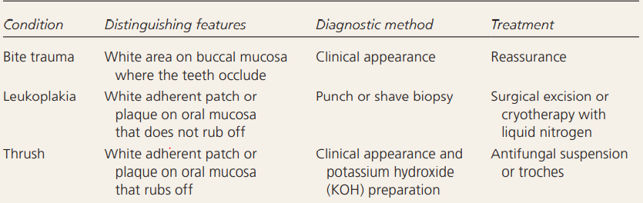
DIFFERENTIAL DIAGNOSIS OF ORAL LICHEN PLANUS

Slide 33
ENUMERATE & DESCRIBE THE TREATMENT MODALITIES FOR LICHEN PLANUS:

Slide 34
GENERAL MEASURES:
Avoidance of exacerbating drugs unless necessary
Minimising trauma to skin and mucosal tissues are routinely recommended
Replacement of amalgum or gold dental restoration with composite material

Slide 35
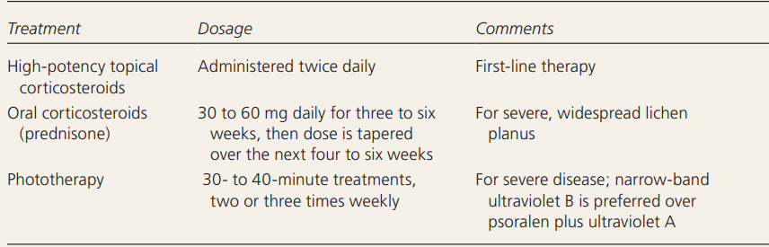
Treatment of Nongenital Cutaneous Lichen Planus Lesions

Slide 36
IMMUNOSUPPRESSIVE AGENTS:
1. Systemic cyclosporine
Indication: Recalcitrant LP
Dosage: 3-10mg/kg/d
Pruritus disappears in 1-2 wks, clearance of the rash seen in 4-6wks
2. Indication of Azathioprine:
Recalcitrant generalised cutaneous LP and LP pemphigoides

Slide 37
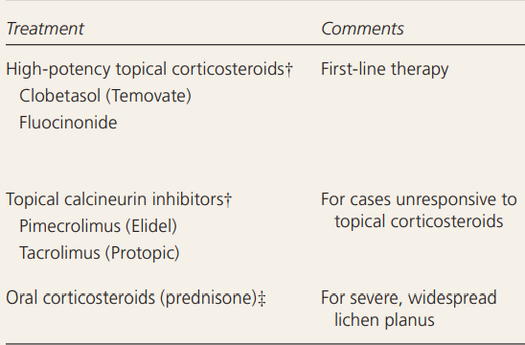
Treatment of Oral Lichen Planus

Slide 38
PROGNOSIS
Lichen planus is usually not harmful and may get better with treatment.
It usually clears up within 18 months.
However it may last for weeks to months, and may come and go for years.
If lichen planus is caused by a medication, the rash should go away once the medicine is stopped.

Slide 39
CASE SCENARIOS

Slide 40
1.
A 14-year-old female presented with multiple hyper pigmented, pruritic lesions on both the legs of duration of 5 months.
On examination, multiple violaceous, pruritic, papules to plaques of varying sizes (1cm - 5cm) were present on the extensor aspects of both legs and dorsum of feet bilaterally with few erythematous papules over the wrist area.
On examination of oral cavity, no lesion were noticed

Slide 41
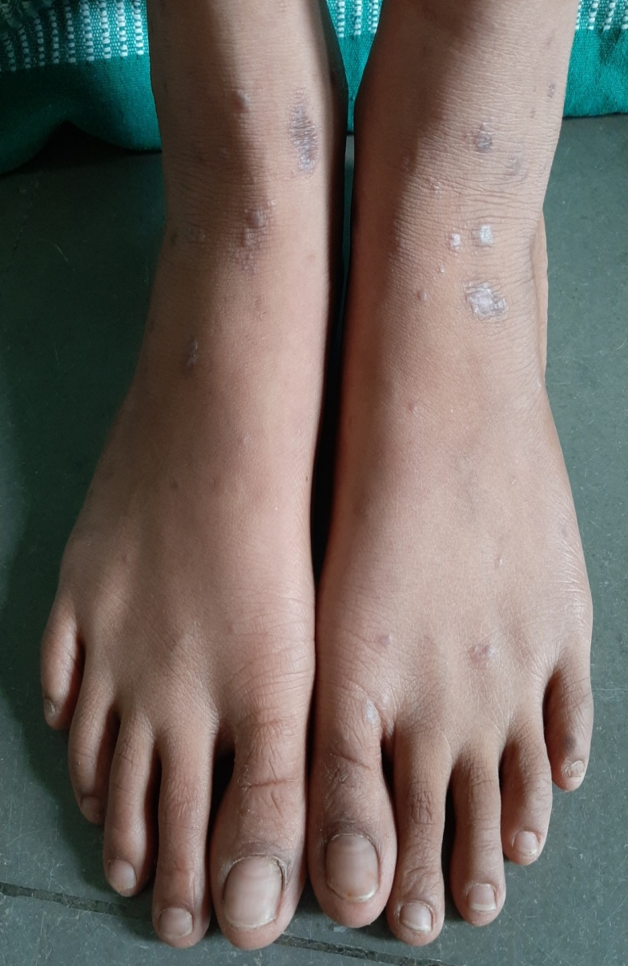
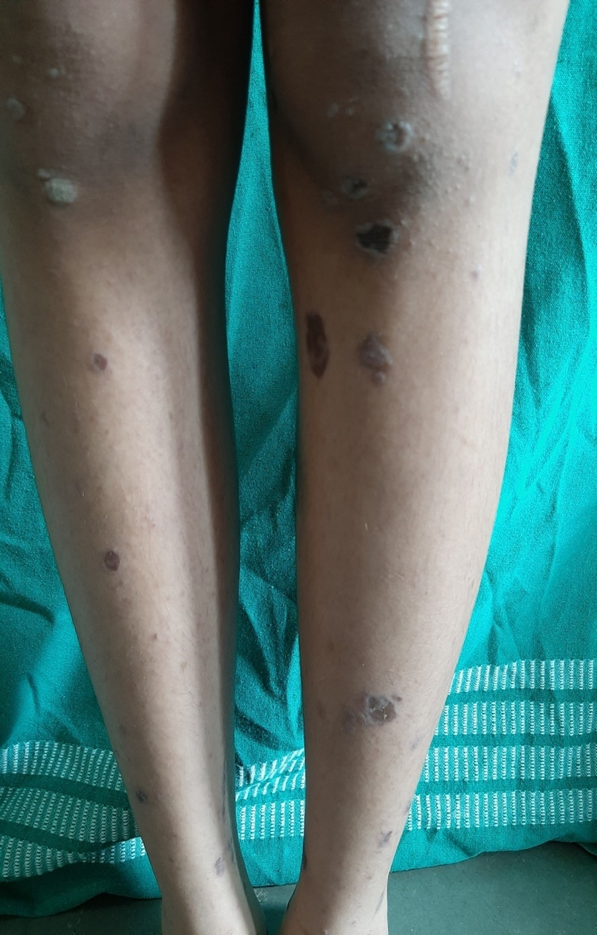
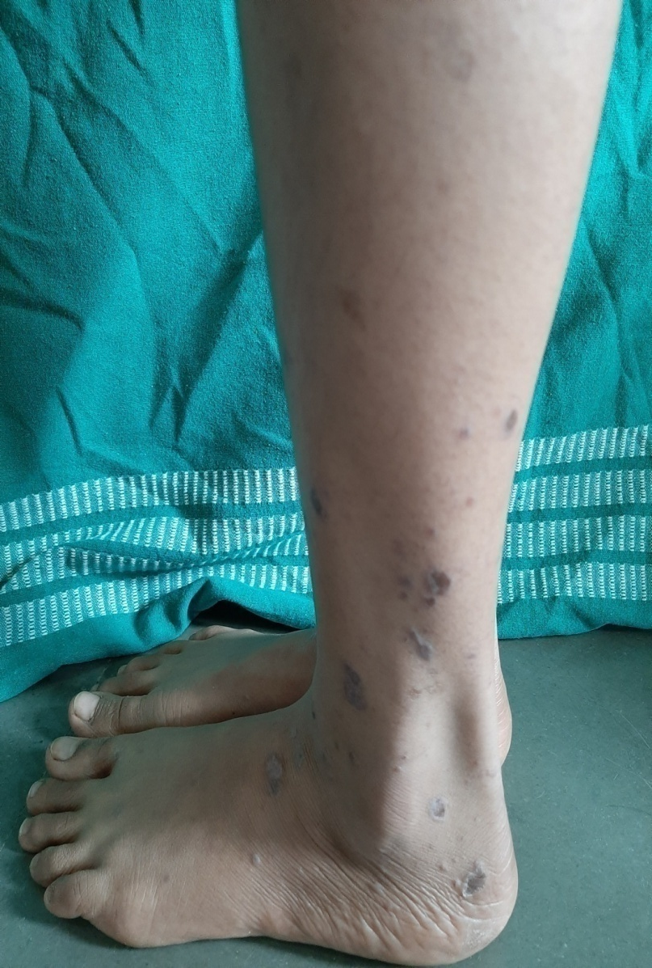

Slide 42
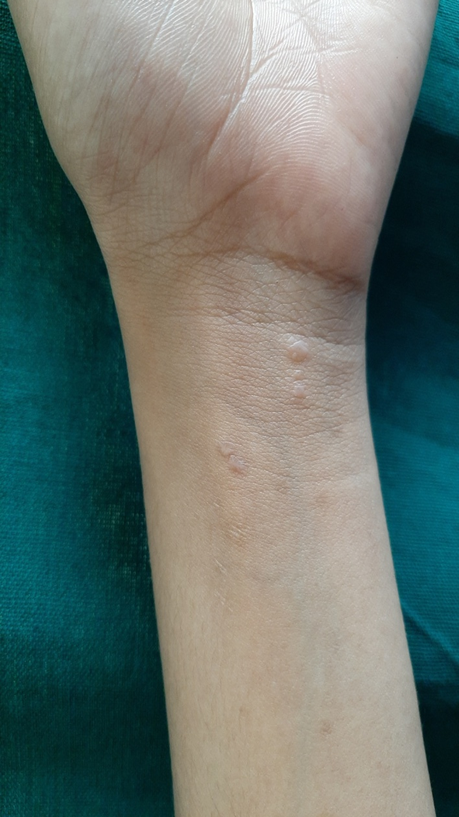

Slide 43
2.
A 47-year-old housewife presented with itchy warty growths on the sides of the heels, rapidly growing and spreading to other parts of the foot. They appeared on the front of the right lower leg 2-3 years later, at the site of a previous skin injury. There were no relatives with a similar disorder.

Slide 44
A 35-year-old male patient, reported to the department with the chief complaint of burning sensation for past one month. Patient was apparently normal a month back when he noticed white patch on the upper lip and irregular white lines on the buccal mucosa bilaterally associated with mild burning sensation on taking hot and spicy foods.
No history of pruritus or drug intake present. Patient was a non smoker and non tobacco chewer.
Intra oral examination revealed non scrapable white patch involving upper lip and commissure on right side.
3.

Slide 45
Also multiple nonscrapable lace like radiating white lines noticed on right and left buccal mucosa, retromolar area and buccal gingival margins of giving a reticular appearance.
Few erythematous areas interspersed between reticular areas are also present. White striae are seen involving right and left retromolar region and gingiva on buccal aspect of molar region.

Slide 46
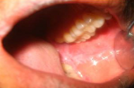
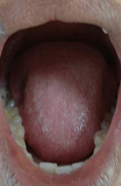
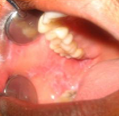

Slide 47
THANK YOU…

