Slide 1
HANSEN’S DISEASE
Dr Ashwin charaniya
A.P dept of DVL
05/06/2024

Slide 2
Structure

Slide 3
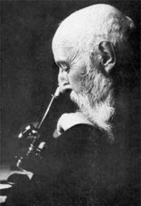
The causative agent is Mycobacterium lepraemacid-fast bacteria) first identified in 1873 by the Norwegian physician,
Gerhard Henrik Armauer Hansen

Slide 4
History
The earliest description of leprosy comes from India around 600 BC.
It was then described in the Far East around 400 BC
The word "leprosy" derives from the ancient Greek words lepros, a scale, and lepein, to peel.
M.Leprae is oldest known pathogenic bacterium to man

Slide 5
MODE OF TRANSMISSION:
SKIN
Direct skin to skin contact or
RESP. TRACT:
Infected droplets discharged into the atmosphere in the act of talking, sneezing or coughing.
Increased in poor living condition and overcrowding
Naturally acquired leprosy has been reported in the armadillo, the chimpanzee and mangabay monkey

Slide 6
FACTORS RESPONSIBLE FOR SPREAD
Bad housing conditions
Inadequate food
Overcrowding
Undernourishment

Slide 7
STRUCTURE OF M. LEPRAE
M.leprae is a straight rod about 1-8mm long by 0.3mm in diameter.
In infected time the rods are often stacked or clumped together in globi

Slide 8
Obligatory intracellular parasite found within macrophages
- Schwann cells of nerves
- Muscle cells
- Endothelial cells of blood vessels
- Melanocytes of skin
- Chondrocytes of cartilage

Slide 9
‘Acid fast’ – Refers to the capacity of the bacillus when stained with carbol fuschin to retain its red colour when treated with acid.
Mycolic acid is responsible for the acid fastness.

Slide 10
Electron Microscopy
Capsule
Outer layer of wall
Inner layer of wall
Cytoplasm
Membrane

Slide 11
CAPSULE –
Electron transparent zone of foamy material
composed of 2 lipids:
  Phthioceroldimycoserosate
  Phenolic glycolipid PGL

Slide 12
2. CELL WALL –
Two layers:
Outer layer – electron transparent and contains lipopolysaccharide composed of arabinogalactan esterified with mycolic acids.
Inner Wall – composed of peptigodoglycan carbohydrate linked by peptides

Slide 13
3. MEMBRANE –
Under the cell wall and attached to it
Concerned with the transport of molecules into and out of the organism
Composed of lipid and proteins
4. CYTOPLASM –
Contain storage granules, DNA & ribosome

Slide 14
ANTIGENS OF M. LEPRAE
PGL 1 – specific for M. leprae
Other mycosides
Lipoarabinomannan
Peptidoglycan
Proteins
65 kd
36 kd
28 kd
18 kd
12 kd

Slide 15
Pathogenesis

Slide 16
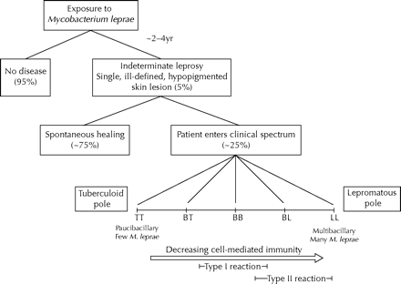

Slide 17
RIDLEY JOPLING CLASSIFICATION
TT – Tuberculoid Type
BT – Borderline Type
BB – Mild Borderline
BL – Borderline lepromatous
LT – Lepromatous Type
TT – associated with severe large N. damage.
LL – chronicity and long term complications
Polar forms of the disease tend to be immunologically stable.
Borderline disease is unstable and may move either way along the spectrum.

Slide 18
CLINICAL FEATURES
Incubation Period – 2-4 yrs.
CARDINAL SIGNS –
1. Anaesthetic lesions
2. Nerve enlargement
3. M. Leprae in smear

Slide 19
INDETERMINATE LEPROSY
One or a few slightly hypopigmented macules
Few cms in diameter with ill defined margins
Lesions seen commonly on the extensor surface of the limbs or buttocks or on the face
There will rarely be any reduction of sensitivity (hypo-aesthesia).

Slide 20
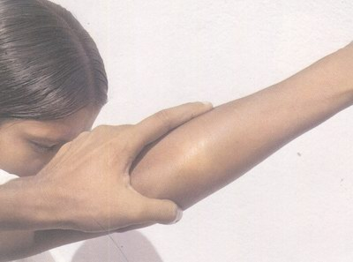
INDETERMINATE LEPROSY…

Slide 21
INDETERMINATE LEPROSY…..
Bacilli are practically never found in this lesion.
After the initial lesion there is evolution towards recovery or towards one of the forms in the spectrum TT – LL, which usually occurs within 2 years.
Approximately 75% of indeterminate leprosy cases recover spontaneously.
This indeterminate stage is often not diagnosed. diagnosis is often only possible via histology

Slide 22
TUBERCULOID LEPROSY
only one, or a few, asymmetrical skin spots
They are sharply delineated, sometimes with a slightly elevated border and central healing.
The lesion is rather hypopigmentation on dark skin or erythematous (on white skin)

Slide 23
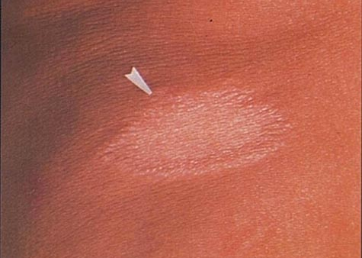
TUBERCULOID LEPROSY…

Slide 24
TUBERCULOID LEPROSY…
There is loss of sensitivity.
First the sensitivity to temperature decreases, then the sense of touch, then pain and finally deep sensitivity.
There is hair loss and the skin is dry.
One or two peripheral nerves are affected (thickened).
The consequences of neural dysfunction appear early (muscle weakness and atrophy,).

Slide 25
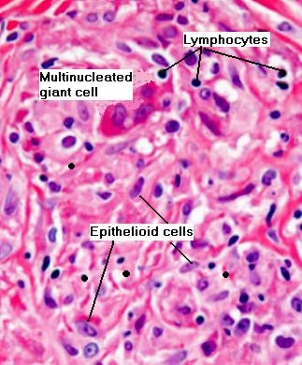
TUBERCULOID LEPROSY…
AFB absent
Lepromin reaction strongly positive
Histology – foci of lymphocytes, epithelioid cells & giant cells invading papillary zone & sometimes eroding epidermis.

Slide 26
BORDERLINE
Combines features of both tuberculoid and lepromatous leprosy.
Few to many bacilli in skin smears
Many skin patches, raised or flat with well-marked, often irregular edges, and some anaesthesia;
Patches about the same on both sides of the body (symmetry)

Slide 27
BORDERLINE…
Depending on where it falls along the line between the two extremes, borderline leprosy is divided into:
  Borderline tuberculoid (bt),
  Borderline (bb), and
  Borderline lepromatous

Slide 28
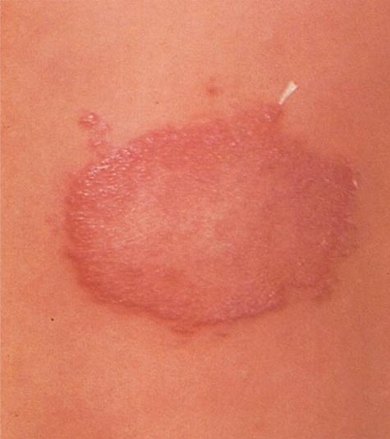
BORDERLINE TUBERCULOID
Well defined lesions
Nerve involvement+
Anaesthesia+
SATELLITE LESIONS
Lepromin test +
Smear –
H/P: tuberculoid reaction more diffuse than TT

Slide 29
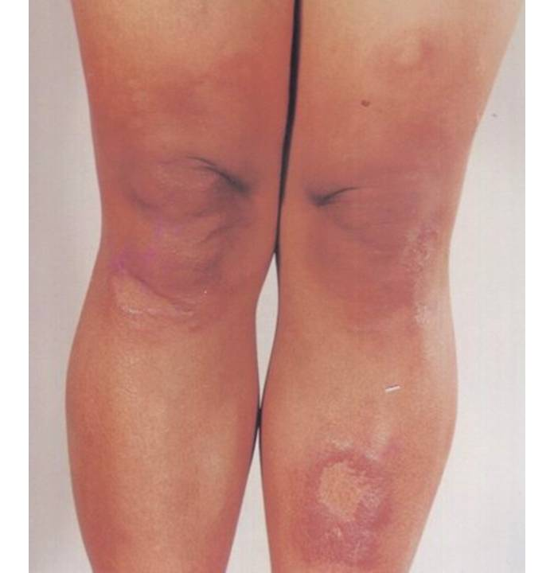
MIDBORDERLINE
Cross midline
Characteristic lesion-ill defined, sloping outer margin & a punched out centre with well demarcated edge
Nerve damage is variable
Lepromin test is doubtful \ negative
H/P: diffuse epithelioid cell granuloma

Slide 30
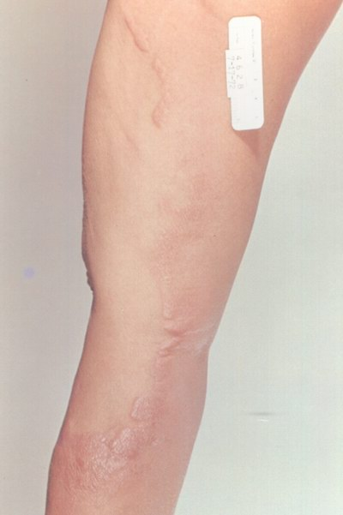
MIDBORDERLINE…

Slide 31
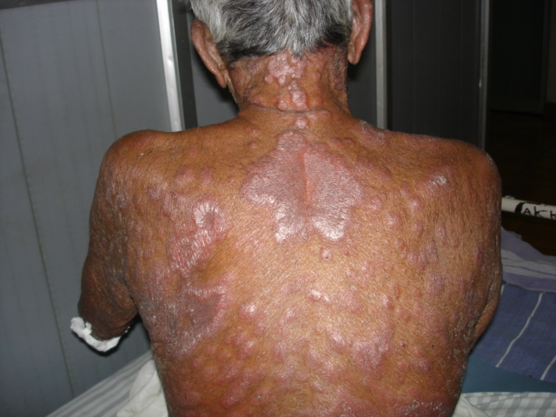
BORDERLINE LEPROMATOUS
Starts with macules not so perfectly symmetrical
As disease progressess macule become infiltrated usually at centre

Slide 32
BORDERLINE LEPROMATOUS….
Signs of nerve damage/enlargement is wide spread , starts sooner than LL
Nerves are less tender than BT
Anesthesia over extensor surface of hands & feet develop late
No signs\symptoms referable to nose/mouth/eyes
Madarosis is less marked
H/P: granuloma composed of macrophages with lymphocytes in dense clumps.

Slide 33
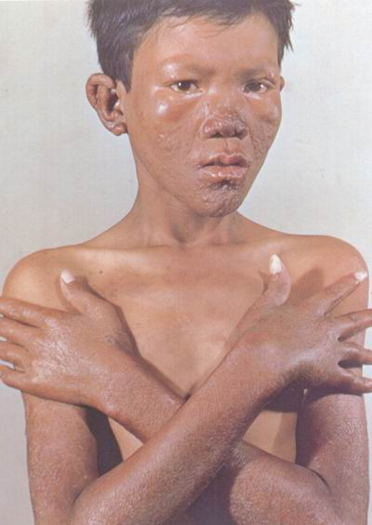
LEPROMATOUS
Persons with little/no specific resistance
Bacilli multiply freely & are wide spread in skin , nerves, lymph nodes, mucosa & internal organs

Slide 34
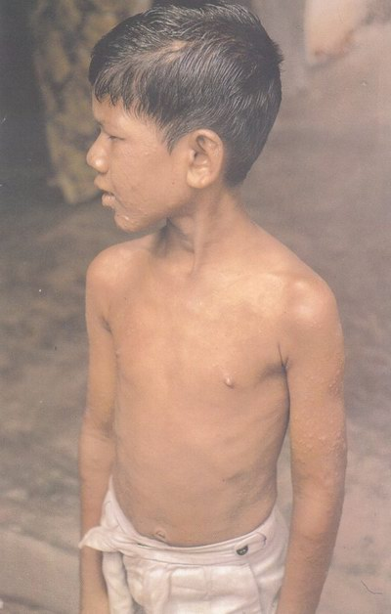
Symptoms are mainly by skin & mucous membrane lesions
Nerve involvement is late in the course of disease
Smears from skin & nasal mucosa strongly positive –open case ie infectious
Lepromin reaction is negative

Slide 35
SKIN LESIONS IN LL
Wide spread, generalised, blurred outlines & symmetrical
Marked on face, ears, back, buttock, knee, elbow & dorsal aspect of hands
SKIN LESIONS ARE
  DIFFUSE INFILTRATION
  MACULES
  PLAQUES
  NODULES
  ULCERS

Slide 36
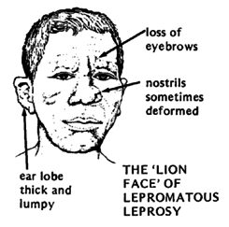
MILD-MOD INFILTRATION
Loss of hair over eye brows
Defined infiltration & thickening of ear lobes

Slide 37
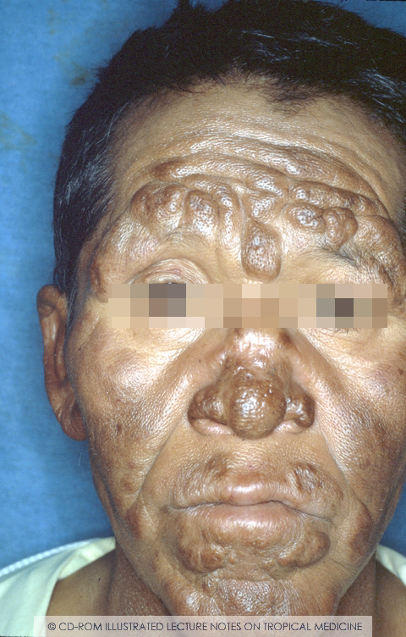
SEVERE INFILTRATION
Marked thickening , puckered appearance like orange peel
Produces corrugation of skin on forehead, thickening of nose & enlarged ears resulting in LEONINE FACIES
As disease progress facial skin losses elasticity becomes lax pt looks older

Slide 38
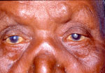
MADAROSIS

Slide 39
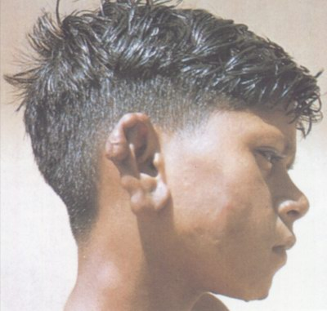
EARS
Thickening and nodulation of both ears

Slide 40
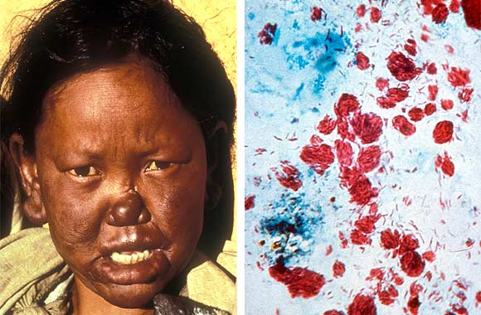
NOSE
Swollen and broadened
Nasal stuffiness
Blood stained discharge
Anosmia
O/E:
Crusting with irregular and thickened mucosa bathed in nasal discharge
Perforation of nasal septum, and destruction of nasal cartilage causes nasal collapse.

Slide 41
ORAL CAVITY
Palatal nodules which may ulcerate and cause perforation of hand palate.
Upper teeth loose and missing ‘facies leprosa’
Larynx – fibrous nodulation, thickening & ulceration of vocal cords leading to hoarseness.

Slide 42
EYES
Eyebrows thinned (superciliary madarosis)
Eyelashes (ciliary madarosis)

Slide 43
Superficial punctate keratitis
Military lepromata – white spots on the upper part of each cornea resembling grains of chalk
These are basically aggregations of leprosy bacilli and are accompanied by pannus formation
Iris pearls – deposits of tightly packed bacilli within swollen macrophages.
Acute Iritis – red & painful eyes – manifestation of lepra reaction

Slide 44
Other ophthalmic complications – secondary cataract, secondary glaucoma, herniation of the ciliary body corneal anaesthesia due to damage to 5th cranial N.
Lagophthalmos – damage to 7th cranial N leading to exposure keratitis & later blindness.

Slide 45
Bones
Distal phalanges undergo slow atrophy & absorption – finger shortening
Cysts on X-Ray
Concentric bone atrophy – pencilling or ‘sucked candy stick appearance’
Factors responsible:
Repeated trauma due to absence of pain
Impaired blood supply to bones
Impaired nerve supply
Depositions of leprosy bacilli in bones
In males- generalized osteoporosis due to testicular atrophy
Osteomyelitis complicating chronic ulceration

Slide 46
Testes:
Testicular atrophy sterility,
impotence &
gynaecomastia
Kidney :
Renal Amyloidosis
Glomeruconephritis
Muscles – palpable nodules

Slide 47
Chronic edema of legs
Damage to motor nerves – muscle weakness
Facial N – facial palsy
Ulnar N (claw hand)
Median N - ape hand
Lat. Popliteal N – foot drop
Nails – Dry, lusterless, shrunken, narrowed & longitudinally ridged

Slide 48
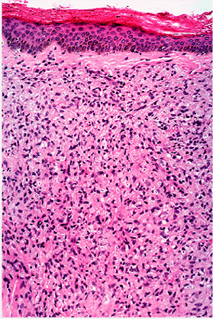
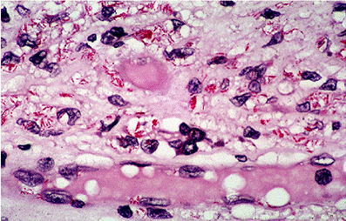
Histopathology of LL
Thinned epidermis & flattened rete ridges.
Diffuse leproma of foamy macrophages with few lymphocytes & plasma cells.
GRENZ ZONE

Slide 49
OBSERVATION | TT | BT | BB | BL | LL
NO OF LESION | Single usually | Single or few | Several | Many | Very many
SIZE | Variable | Variable | Variable | Variable | Small
SURFACE | Very dry | Dry | Slightly shiny | Shiny | Shiny
SENSATION | Absent | Markedly diminished | Moderately diminished | Slightly diminished | Not affected
HAIR GROWTH | Absent | Markedly diminished | Moderately diminished | Slightly diminished | Not affected
AFB | Nil | Nil/scanty | Moderate | Many | Very many
AFB IN NASAL SCRAPPING | Nil | Nil | Nil | Usually nil | Very many (plus globi)
LEPROMIN TEST | Strongly +++ | Weakly+/++ | Negative | Negative | Negative

Slide 50
Rare presentations
LUCIO LEPROSY
(Lepra Bonita - Beautiful leprosy)
Polar form of LL
Occurs in Mexico
Diffuse generalized infiltration of skin with waxy & shiny appearance
Numbness of hands/feet, stuffy nose, hoarse voice, edema of feet
Thick eyelids – sad sleepy appearance

Slide 51
Sensation is impaired
Loss of hair – eye brows , eye lashes
Reaction a/w infarction of skin – Lucio phenomenon
Lepromin test- intense local response in 4- 6 hrs

Slide 52
LAZARINE LEPROSY
Severe ulcerations ,usually in tuberculoid end a/w underlying malnutrition / debilitating illness.
Slow healing ulcers preceded by edema/blisters

Slide 53
HISTOID LEPROSY
Described by wade 1963
Cutaneous or s/c nodules & plaques on apparently normal skin
Extensor aspect of extremities, back, buttocks & face / bony prominences
Histologically resemble tumor developed from single spindle shaped tissue element
Variant of nodular LL

Slide 54
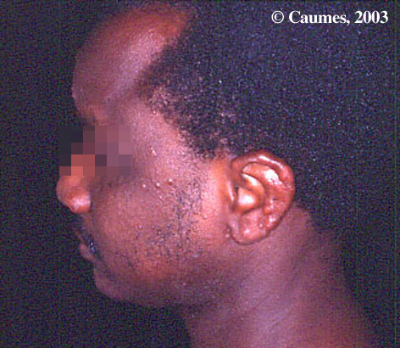
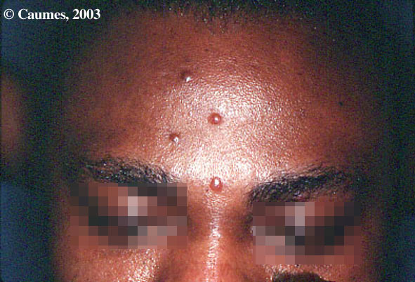

Slide 55
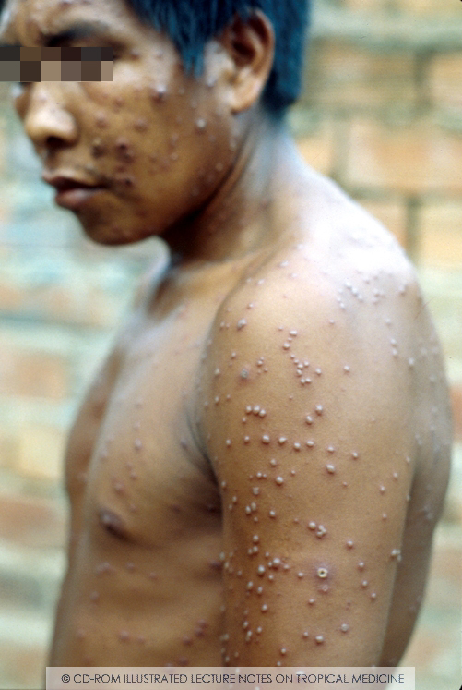

Slide 56
Pure Nueritic Leprosy
Male Patients of 20 – 40 yrs
Sensory impairment, nerve pain /deformity, nerve abscess
Majority – mononeuritic.
Skin lesions are absent

Slide 57
Localized LL/ BL - single nodule / plaque, shiny with sloping margins
Spontaneous ulcers
Tenosinovitis
Silent or invisible LL
-No skin infiltration
- Peripheral anaesthesia / nasal symptoms/ Type 2 Rn

Slide 58
COMPLICATIONS OF LEPROSY

Slide 59
LEPROSY REACTIONS
Hypersensitive response to the presence of M. leprae or their components
Type I
Two types of reactions
Type II

Slide 60
Type I
Seen in borderline leprosy
Coombs & gel Type IV
Rapid change of CMI
Occurs within 6 months of treatment

Slide 61
C/F:
Inflammatory signs in the pre-existing leprosy lesions
New lesions
Neuritis-⬆intraneural pressure from oedema & granuloma
Oedema of hands and feet
No constitutional symptoms / minimal
TREATMENT:
Corticosteroids – Prednisolone (40-60mg/day)

Slide 62
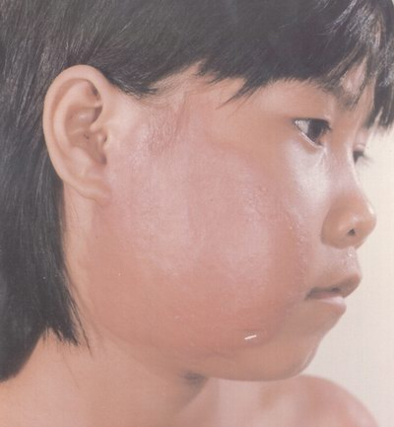
Type 1 lepra reaction

Slide 63
Type II
Immune complex mediated
Occur in LL, BL
No change in the lesions
Occurs after 6 months of treatment
Type III hypersensitivity reaction

Slide 64
C/F:
ENL – Erythematous tender nodules
    Bilaterally symmetrical
    Evanescent (last for 2-3 days)
Fever, malaise,pain & swelling of the joint,
iritis, epididymoorchitis,
neuritis,
hepatosplenomegaly,
lymphadenopathy, albuminuria
TREATMENT:
Thalidomide – (100mg tabs 3-4 tab/day)
Clofazamine – anti-inflammatory action 200 – 300mg daily

Slide 65
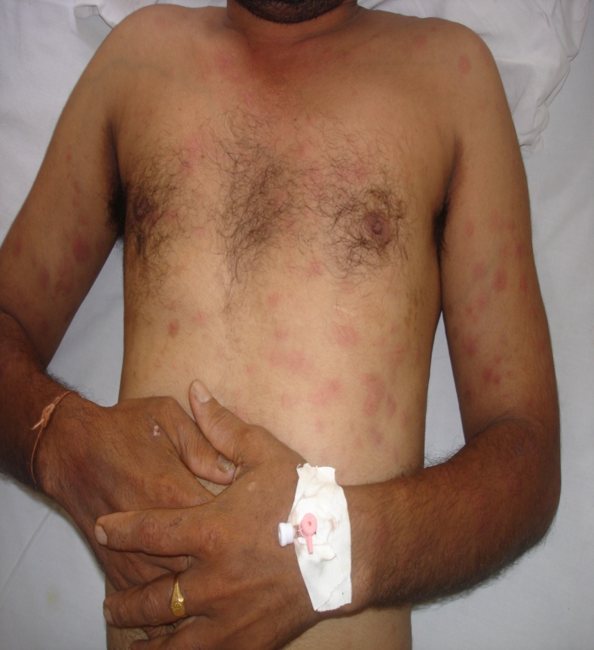
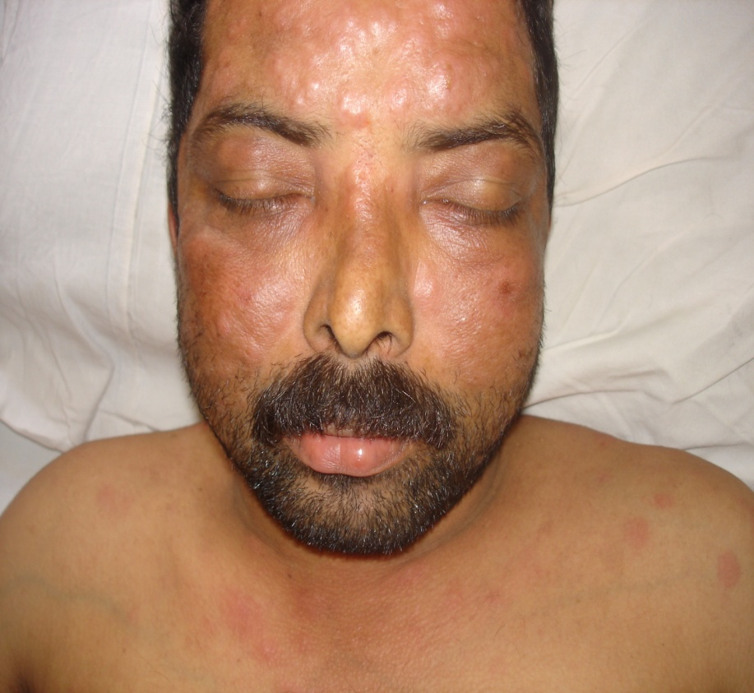

Slide 66
Deformities and disabilities in Leprosy:
Deformity -
An alteration in the form, shape or appearance of the affected part of the body
Disability -
Deterioration of one’s ability to perform a function

Slide 67
Grading – Hands & feet
Grade 0 – no anaesthesia, no visible deformity or damage
Grade 1 – anaesthesia present, but no deformity or damage
Grade 2 – visible deformity or damage present
Damage – ulceration, shortening, stiffens, loss of part

Slide 68
Grading – Eyes
Grade 0 – no eye problems due to leprosy,
no evidence of visual loss
Grade 1 – eye problem due to leprosy present,
but vision is not affected
Grade 2 – severe visual impairment
Eye problems –
corneal anaesthesia, lagophthalmos, iridocyclitis

Slide 69
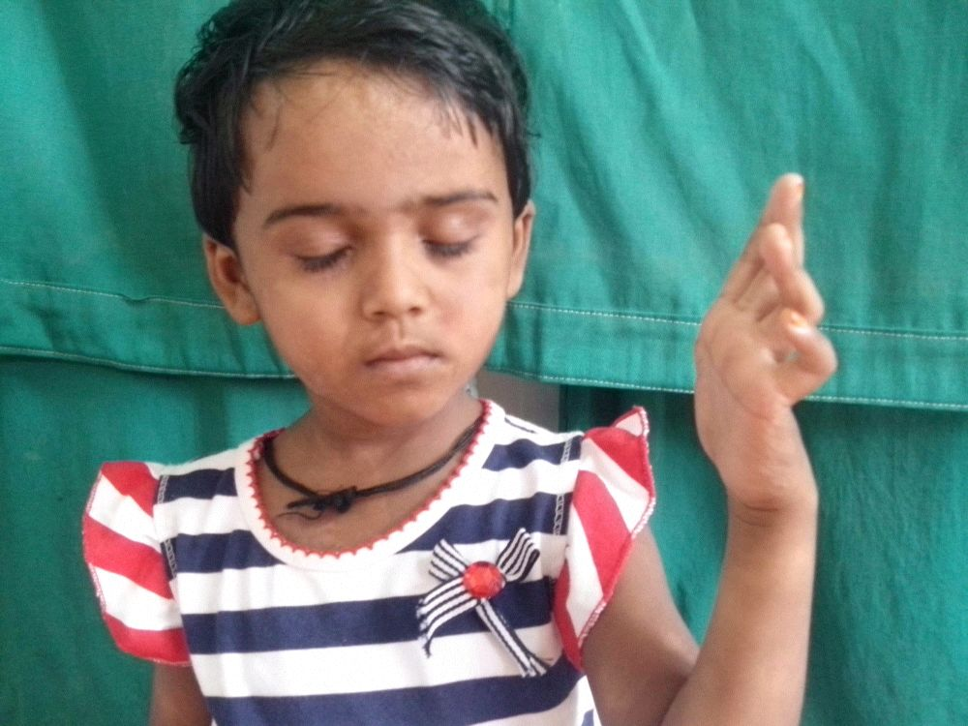
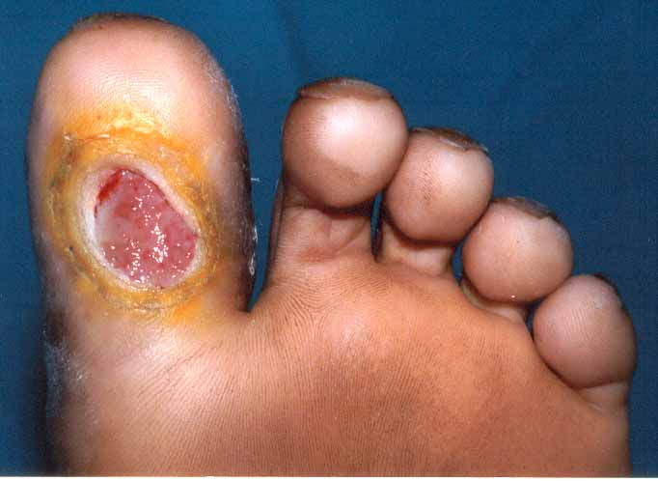
Primary
Deformities
Secondary
Primary – Direct effects of the disease
Damage to peripheral nerves – motor & sensory loss, bone destruction
Secondary – Results from anaesthesia, paralysis
Anaesthetic deformity – injuries, infection trophic ulcers

Slide 70
Prevention & Control :
Health education
Early diagnosis & treatment
Rehabilitation – already having deformity

Slide 71
INVESTIGATIONS
Skin smears:
Ziehl - Neelsen staining method
SITES:
  Right ear lobe,
  left forehead,
  right chin,
  left buttock (in men) or in front of left thigh (in women).

Slide 72
ZIEHL –NEELSEN STAINING
A 5mm long & 2mm deep material of skin is taken and the material is smeared on a clean slide with circular motion to make smear about 8mm in diameter.
The slide with the smear is flooded with carbol fuschin.
Heat gently by passing a spirit lamp along the underside of the slide until a faint cloud of steam rises. Avoid boiling.
Allow it to cool. Wash in tap water.
Pour acid alcohol mixture (1% hydrochloric acid in 70% alcohol) & leave for 3-5 seconds.
Flood with methylene blue for 10 seconds
Wash with tap water

Slide 73
BACTERIAL INDICES
A. Bacteriological index (BI) :
the density of bacilli in smears.
Includes both living and dead bacilli
  6+ many clumps of bacilli in an average field
  5+ 100-1000 bacilli in an average field
  4+ 10-100 in an average field
  3+ 1-10 in an average field
  2+ 1-10 in 10 fields
  1+ 1-10 in 100 fields

Slide 74
B. Morphological index (MI) –
It is the percentage of solid stained bacilli calculated after examining 200 red staining elements lying singly.
Gives an idea
1. If a patient’s leprosy is active or not
2. Response to treatment
3. Bacterial resistance to chemotherapy
4. Defaulting on treatment

Slide 75
Other indices are
SFG index
Biopsy index
Dharmendra index
Not commonly used

Slide 76
2. Skin Biopsy:
Helpful in diagnosis & correct classification
3. Nerve Biopsy:
Done in pure neural leprosy
Pure sensory nerve used
Nerves used commonly are
  Supraorbital br. Of V CN
  Supraclavicular N
  Great auricular N in the neck
  Radial N at the wrist
  Cutaneous N of forearm/ thigh
  Sural N
  Superficial peroneal N

Slide 77
4. Histamine test:
Histamine when injected ID
Bright red flare
Capillary dilatation
5. Sweating test:
Anhidrosis in T.T.
0.2ml of 1 in 1000 solution of pilocarpine nitrate pain with tincture iodine & dust with starch powder
6. PGL – 1 : to detect subclinical cases
7. PCR
Specific and sensitive
Useful in early leprosy
Persisting bacilli after treatment
Studies & subclinical infection

Slide 78
8. Lepromin Test
Non specific test
Not used as a diagnostic test
Useful in classification
Delayed type of hypersensitivity reaction
Antigens used:
  Mitsuda lepromin
  Lepromin A- from armadillo
  Lepromin H – from human tissue
  Bacillary lepromin: Purified bacillus suspension
  Leprolins – soluble bacterial proteins
  Dharmendra Ag
0.1ml i.d. Inj on Inner aspect of arm/forearm
Reactions – 2 types
Early Fernandez reaction (24-48 hrs)
Late mitsuda reaction (> 3-4 wks)

Slide 79
Early reaction :
Tuberculin type of reaction
Erythema + oedema + thickening
Late reaction:
Nodule develops in positive cases
Central necrosis + ulcer in severe cases
  Negative (-) → Nothing to see/fell
  Doubtful (±) → ≤ 3cm papule
  One plus (+) → An erythematous papule 4-7 mm in diameter without ulceration
  Two Plus (++) → An erythematous papule > 7mm & upto 10mm in diameter without ulceration
  Three plus (+++) → An erythematous nodule >10mm/one in any size with ulceration

Slide 80
TREATMENT:

Slide 81
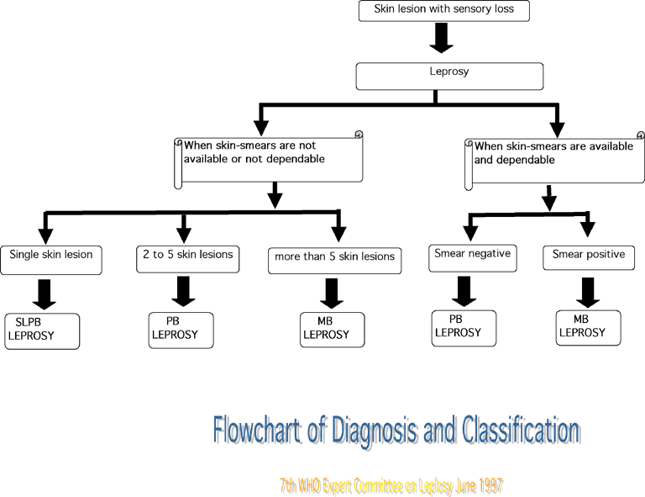

Slide 82
MDT
First recommended by a WHO expert committee- 1982.
Rapidly became the standard treatment of leprosy.
Supplied by WHO free of charge to all endemic countries since 1995.
WHO in collaboration with Novartis Pharma (Switzerland) supply MDT in “blister packs”

Slide 83
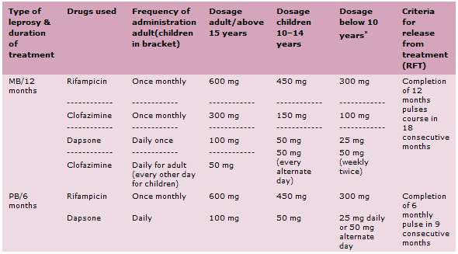
REGIMENS

Slide 84
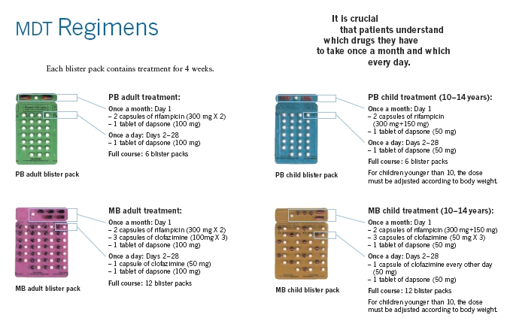

Slide 85
Blister packets for MDT
Easy to use, handy and of convenient size
Provide complete treatment
Improve clinical attendance
Drugs are better protected against moisture, heat and accidental damage
Ensures quicker dispensing of the drugs
Can be dispensed by non medical person

Slide 86
WHO starts its supply cycle in august of every year
Estimates the total global requirement of MDT for the following year
Patient is asked:
* To come to the leprosy center every month to collect his blister pack for that month.
* Swallow monthly supervised doses in front of the leprosy worker/doctor.
Explanation of self-administration of the rest of the drugs in the blister pack without interruption during leprosy reactions and pregnancy.
Invites all endemic countries to submit their annual official requests
Information on the current registered prevalence
The new case detection during the previous year
Current stock levels of MDT drugs.

Slide 87
ROM therapy :
Single lesion, no nerve, smear –ve
R -Rifampicin 600mg
O - Ofloxacin 400g
M - Minocycline 100mg

Slide 88
1. DAPSONE (4,4 DIAMINO DIPHENYL SULFONE)
A bacteriostatic and weakly bactericidal drug.
Dapsone monotherapy was the mainstay of treatment in early 1950s until MDT was introduced.

Slide 89
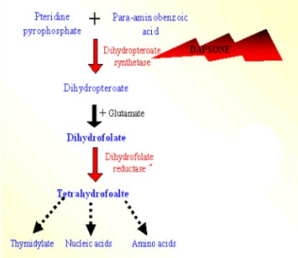
MECHANISM OF ACTION

Slide 90
Drug | Absorption | Metabolism | T1/2 | Excretion
Dapsone (100mg daily) | 99%, PSL are reached in 4–6 hours | Acetylation and N-hydroxylation in liver | 28 hours | Feces

Slide 91
CLINICAL AND MICROBIOLOGICAL EFFECTS
On dapsone monotherapy:
Clinical response is apparent= within 3–6 months of starting treatment.
Complete clinical regression= takes around 2–3 years.
In lepromatous patients:
Mucosal lesions= first to heal------- resulting in clearing of nasal passages-------
subsidence of epistaxis-----decrease in foul smell from the nose.
Healing of the oral and laryngeal lesions= return of normal voice.
Skin ulcers= heal early, often with scarring.

Slide 92
Regression of nodules and skin thickening= starts.
Nerve thickening, sensory/motor loss and trophic ulcers = respond very slowly and often incompletely.
A slow decline of 0.6–1 log unit per year in BI with the result that patients with a bacterial load of 5+ or more take up to 5–8 years to become smear negative.
Therefore, eyes and limbs need special care and protection from trauma and burns.
Killing of bacilli= completes in 3–6 months.
Clinical response in paucibacillary (TT and BT)= variable;
In about two-thirds= complete recovery within about 6 months
Remaining may take even more than a year to regress.

Slide 93
Serious side-effects of Dapsone include hemolytic anemia, agranulocytosis, methemoglobinemia, hepatitis and dapsone syndrome.

Slide 94
2. RIFAMPICIN
Semisynthetic derivative of rifamycin.
Antibiotic originally obtained from suspension of fungus, Streptomyces mediterranei.
Is bactericidal to M. Leprae.

Slide 95
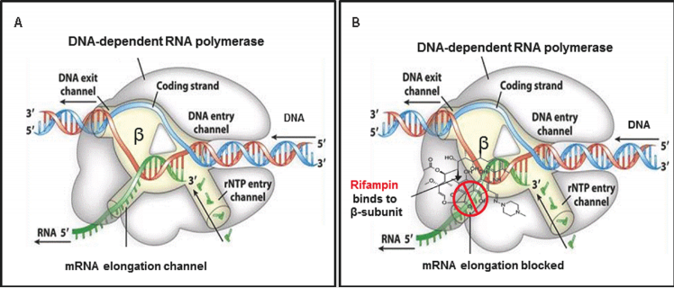
MECHANISM OF ACTION

Slide 96
Drug | Absorption | Metabolism | T1/2 | Excretion
Rifampicin (600mg once a month) | 90% better in empty stomach, PSL in 2–3 hours | De-acetylation and oxidation in liver | 12 hours | 35% in urine & 65% in feces

Slide 97
WHY IS RIFAMPICIN GIVEN ONLY ONCE A MONTH?
An exceptionally potent bactericidal agent against M. Leprae.
A single dose of 600 mg is capable of killing 99.99% or more of viable organisms.
Exerts a delayed antibiotic effect for several days, during which the organism is incapable of multiplying.
The high bactericidal activity of rifampicin makes:
Once a month application of the drug feasible
Cost-effective for leprosy control programs.

Slide 98
CLINICAL AND MICROBIOLOGICAL EFFECTS
Nasal symptoms= first to regress ,within 2–3 weeks
Beginning of clearance of skin lesions/infiltration= 2–3 months’ time
Complete regression of infiltration= takes long time
Nerve damage= most resistant.
Effective against dapsone-resistant organisms.
Rifampicin crosses the cell membranes------effective in killing intracellular organisms
Distributed throughout the body, including the CSF
Orange-red color to the urine, feces, saliva, sputum, tears, and sweat; patients should be so warned.

Slide 99
MI= comes to zero within 4–6 weeks of treatment.
BI= takes longer to decline.
A single dose of 1500 mg or 3–4 daily doses of 600 mg of the drug= kills over 99.99% of the viable M .Leprae

Slide 100
SIDE EFFECTS OF RIFAMPICIN
Most common side effect is a red coloration of urine due to excretion of the drug in urine
Daily dose | Intermittent dose | Once-monthly administration
Hepatotoxicity | Respiratory syndrome | No major Side effects
Loss of appetite | Flu like syndrome
Nausea | GI problems
Vomiting | Purpura
Pain in abdomen | Anaphylactic shock
Rise in serum enzymes (SGOT/SGPT) | Acute renal failure
Interstitial nephritis
Osteomalacia

Slide 101
3. CLOFAZIMINE
A brick red, fat-soluble crystalline dye.
Bacteriostatic and anti-inflammatory action.
For oral administration: its micronized crystals are suspended in an oil-wax base and encapsulated in soft gelatin.

Slide 102
MECHANISM OF ACTION
Blocks the template function of DNA by:
Increasing the lysosomal enzyme synthesis
Increasing phagocytic capacity of macrophages.
Binds preferentially to GC-rich region of mycobacterial DNA.
Stimulation of PGE 2 synthesis + inhibition of neutrophil motility + selective suppression of TH-1 subtype of T-helper cells= contribute to its role in type 2 reactions.
IL-2= a major cytokine in type 1 reaction
causes neuritis
production is stimulated by NFAT/NFKB.

Slide 103
Selectively block the KV1.3 potassium channel activity, perturbing the oscillation frequency of the calcium-release activated calcium channel, which in turn led to the inhibition of the calcineurin-NFAT signaling pathway.
Thus, it has an immunomodulatory effect also

Slide 104
Drug | Absorption | Metabolism | T1/2 | Excretion
Clofazimine (300 mg monthly supervised) (50 mg daily) | 30–50% | Kidney: one conjugated and two unconjugated metabolites. Hydrolytic dehalogenation Hydrolytic deamination followed by glucuronidation | 60 days | 1% in urine

Slide 105
WHY MONTHLY SUPERVISED DOSE OF CLOFAZIMINE IN ADDITION TO THE DAILY DOSE GIVEN?
Clofazimine:
A repository drug.
Stored in the body after monthly administration and is then slowly excreted.
Therefore, it is given as a loading dose of 300 mg once a month to ensure that the optimal amount of clofazimine is maintained in the body tissue, even if the patient occasionally misses his or her daily dose.

Slide 106
CLINICAL EFFECTS
Inhibition of multiplication of intracellular M. Leprae
In macrophages and cells of the reticuloendothelial system: drug is stored as needle like crystals
Discoloration of the organs and the skin
In the skin, subcutaneous fat, liver, lungs, adrenals, kidneys, lymph nodes, and gastrointestinal tract

Slide 107
Slowly excreted from the body= 6–12 months.
Hence, it takes more than 3 years for the patients to regain their normal coloration after stoppage of clofazimine.
Clofazimine is active against dapsone-resistant M. Leprae.
Drug should not be used alone nor it is a replacement for the cheaper and more effective drug dapsone.
Indicated in: patients with type 2 reactions
Anti-inflammatory action is very slow.
Has a special role in the prevention and management of patients with chronic ENL reactions.

Slide 108
Clofazimine s/e are mild & includes
skin discoloration,
ichthyosis and
mild GIT discomfort
Peripheral neuropathy

Slide 109
EFFECTIVENESS OF MDT
Most important indicator:
Rate of occurrence of relapse following successful completion of the scheduled course of treatment.
Relapse rate is very low (0.1% per year for PB and 0.06% per year for MB on the average).
Low frequency of side effects

Slide 110
MDT AND PREGNANCY
MDT is safe during pregnancy and lactation.
If given in the last trimester= increased risk of bleeding in the newborn.
Inj Vit K 0.5 ml I/M at the time of birth.
Dapsone and clofazimine= safe.
Clofazimine:
Crosses the placenta
Result in color of the newborn.

Slide 111
Excretion of the drug in milk of lactating mothers, on MDT:
Results in staining of the infants.
In women with leprosy (even apparently cured):
Run a serious risk of deterioration in nerve function as a part of type 2 reaction ⁻⁻⁻⁻⁻⁻⁻⁻⁻⁻⁻⁻⁻⁻⁻⁻⁻⁻ when they become pregnant
Type 1 reaction--------- in the postpartum period
Both requiring systemic corticosteroids
Thus endangering the fetus with:
Cleft lip/palate
Adrenal suppression in the newborn baby if steroid given in 1st and 3rd trimester respectively.

Slide 112
NEWER DRUGS - Rationale
For reducing the duration of MB-MDT
To circumvent the compliance issues of patients
With skin smears being the weakest link in the programs, a common regimen would be useful for both PB and MB cases
Special regimens needed for patients who cannot take clofazimine or rifampicin
Treatment of cases with bacilli resistant to one or more of the primary anti-leprosy drugs.

Slide 113
Ideal characteristics of a new anti-leprosy drugs :
Can be administered orally
It should be bactericidal and should not antagonize rifampicin in combination
It should not have debilitating side-effects
drugs should be first tested in the laboratory
bactericidal effects should be studied in clinical trials
Long-term relapse rates should be assessed.

Slide 114
New drugs :
Fluoroquinolones - Bactericidal drugs, e.g., pefloxacin, ofloxacin, sparfloxacin, moxifloxacin).
Quinolones inhibit the bacterial DNA gyrase or the topoisomerase II enzyme, thereby inhibiting the coiling and super-coiling of DNA.
Minocycline - a bacteriostatic drug. acts by binding to the 30s ribosomal subunits of bacteria, thereby inhibit- ing protein synthesis
Macrolides – Clarithromycin - A bactericidal drug that acts by inhibiting protein synthesis by binding to 50s ribosomal subunits.

Slide 115
ADVERSE DRUG REACTION (ADR)
Most common adr being hemolytic anemia
Most serious adr was agranulocytosis
Adr - more common during initial 2 months of mdt. Therefore, observant monitoring, with 2 weekly testing, is intiated in the first 2 months of therapy.

Slide 116
Prevention of Deformities
Adequate treatment of leprosy patient
Early detection of nerve damage
Prevention of nerve damage
Protection of anesthetic hands from injury
Care of hands with weakness/paralysis
Use of protective footwear
Adequate hydration of skin
Physiotherapy

Slide 117
Management of Deformities
Education of patient regarding prevention of injuries
Daily examination of hands and feet and prompt treatment for minor injuries
Using adapted tools and appliances after training
Reconstructive surgery
Rehabilitation

Slide 118
Physiotherapy
Oil massage/Wax Therapy-Uses
To make the skin soft and supple and loosen stiff joints
As a preliminary to exercises
To strengthen muscles and keep joints mobile
To reduce pain in acute neuritis
To stimulate innervated sweat glands to increase blood flow
Exercises : Active and assisted exercise : To increase the strength of muscles and retain their tone
.

Slide 119
Electric stimulation – Uses
To maintain the tone of denervated muscle
Helpful in breaking post operative adhesions
Before tendon surgery could be used as a means of documenting nerve damage and the progress of the nerve recovery with treatment

Slide 120
Splints
Indication
Acute neuritis
Mobile deformities(to prevent fixed deformities),
Fixed deformities(to correct the deformities).
Various splints
For radial neuritis-Static or dynamic wrist drop splint
For mobile deformity- Static or dynamic splint
For fixed deformity-Gutter splints, finger loops etc.
Splints for various deformities
Hand deformities : Gutter splints, finger loop splints, opponens splints and adductor bands
Foot deformity : “Y” strap with spring, single elastic strap

Slide 121
Prevention and Control of leprosy
Prevention of leprosy
Early detection through survey and initiation of treatment
Families of patients to be kept under surveillance
Immunoprophylaxis -Use of leprosy vaccines
Improvement in socio-economic conditions
Leprosy control
Three activities of a leprosy control unit
Case detection
Case holding, including treatment
Health education of public and patients

Slide 122
Prevention and Control of leprosy
Leprosy Organizations
UNICEF LEPRA, DANIDA, SIDA, CIDA, Leprosy mission, American leprosy mission (ALM), German leprosy relief association(GLRA), LEPRA, Netherland leprosy relief (NLR)
Leprosy control Programmes
National leprosy control programme (NLCP) 1954
Triad of Survey, Education and Treatment (S.E.T).
National leprosy eradication programme (NLEP) 1982

Slide 123
Prevention and Control of leprosy
National Leprosy Eradication Programme (NLEP), 1982
Eradicate leprosy from the country by 2000
‘Vertical’ health programme- In areas where prevalence of leprosy is more than 5 per 1000.
‘Horizontal’ programme- In areas where the prevalence rate is less than 5 per 1000
Three main units for programme operation :
Basic tier : Survey, education and treatment unit, leprosy control unit and urban leprosy control unit.
Second tier : District/zonal leprosy office
Third tier : Leprosy division of the state Directorate of the health services.

Slide 124
Rehabilitation in Leprosy
Rehabilitation :
  Physical and mental restoration of patients to normal activities, so that they are able to assume their place in the home, society and industry.
  Treatment of physical disability
  Education of patient, family and public
  Rehabilitation in special homes or institutional rehabilitation
  Community based rehabilitation

Slide 125
Thank you

