Slide 1
HIV/AIDS
Dr. Ashwin Charaniya
Assistant Professor (Skin & VD),
RMCH, Bareilly

Slide 2
Contents
History
HIV/AIDS scenario
Virology
Modes of transmission
Immunopathogenesis
Natural history and stages
Clinical features
Mucocutaneous manifestations
Laboratory diagnosis
Anti retroviral treatment
Immune reconstitution
Inflammatory syndrome
Post exposure prophylaxis
Prevention
MCQs
Photo quiz

Slide 3

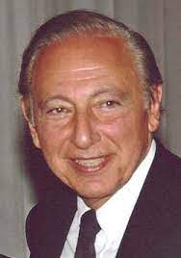
AIDS - History
1981 - First case diagnosed by Joel D. Weisman and Michael S. Gottlieb, in homosexuals in San Francisco, USA - presented with Kaposi’s sarcoma and Pneumocystis carinii pneumonia
1983 - Causative organism isolated and termed as lymphadenopathy associated virus (LAV) by Luc Montagnier, Pasteur laboratory, France
1984 - Robert Galo, USA coined the term human T- cell lymphotropic/lymphopathic virus (HTLV- III)
1986 - International committee on taxonomy named the virus as human immunodeficiency virus (HIV)
Luc Montagnier
Robert Galo

Slide 4
AIDS - History
1986 - First case in India
1987 - 1st anti-retroviral drug – Azidothymidine (AZT)
1989 - Compulsory testing of blood for HIV
1995 - Availability of protease inhibitors (PIs) - Beginning of highly active antiretroviral therapy (HAART)
2017 – Introduction of “test and treat policy” by national AIDS control organization – Initiation of anti retroviral therapy free of cost once the person is detected HIV positive

Slide 5
AIDS - Why is It a Hazard to Human Kind?
Major mode of HIV transmission is sexual
Urge for physical intimacy is fundamental in all human beings
Mother - to - child transmission:
Longer incubation period - A person with no knowledge of being infected can infect others unwillingly
Cure ??? - In anti-retroviral therapy (ART) era - Chronic manageable disease with lifelong medication posing many challenges
Prevention depends upon following a self-protective sexual behaviour code and one which protects others
It is very challenging to change human behaviour
Preventive vaccine not available

Slide 6
HIV/AIDS - Global Scenario
 | 2020
People living with HIV | 37.7 m
Adults and children newly infected with HIV | 1.5 m
AIDS – related deaths among adult and children | 0.68 m
People infected with HIV since the start of the epidemic | 79.3 million [55.9 million–110 million]
People died from AIDS-related illnesses since the start of the epidemic | 36.3 million [27.2 million–47.8 million]
People having access to ART | 26.5 million–27.7 million
Global report : United Nations AIDS Report on the global AIDS epidemic 2021

Slide 7
AIDS – Epidemic in India
Indicator | Value
Estimated people living with HIV at the end of 2019 | 23.48 lakhs
Estimated adult HIV prevalence in 2019 | 0.22%
Estimated people newly infected with HIV in 2019 | 69.22 Thousand
AIDS – related death (2019) | 58.90 Thousand
NACO Report 2019

Slide 8
Human Immunodeficiency Virus (HIV)
Family of retroviridae, genus lentivirus (a genus of slow viruses with long incubation period)
What is retrovirus?
  Though it is RNA virus, for its multiplication its RNA is converted into DNA with the help of enzyme reverse transcriptase
Origin of HIV: Scientists identified a type of chimpanzee in West Africa as the source of HIV infection in humans
  Chimpanzee version of the immunodeficiency virus (called simian immunodeficiency virus or SIV) most likely was transmitted to humans and mutated into HIV when humans hunted these chimpanzees for meat and came into contact with their infected blood

Slide 9

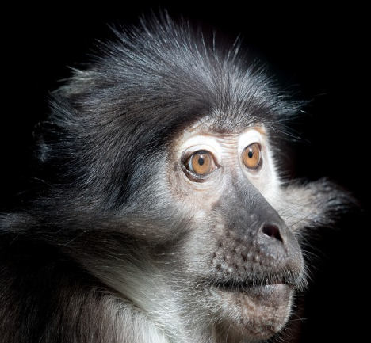
Human Immunodeficiency Virus (HIV)
Over decades, the virus has slowly spread across from Africa and later into other parts of the world
Chimpanzee
Sooty Mangabey

Slide 10
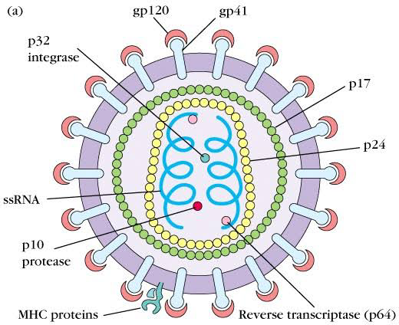
Human Immunodeficiency Virus (HIV)

Slide 11
Types of HIV
HIV has been subdivided into two types - HIV-1 and HIV-2
HIV-1 - Major cause of the disease all over the world
Eleven subtypes (A to K) and subtype ‘C’ is prevalent in India
HIV-1 subtype C is associated with sexual transmission and subtype D with intravenous drug users and homosexuals
HIV-2 - Restricted to certain geographic areas like West Africa
Transmissibility lesser, longer incubation period and better prognosis than the more virulent HIV-1
HIV-2 is intrinsically resistant to most NNRTIs
CRFs (circulating recombinant forms)- Occasionally, two viruses from different subtypes infect the same cell in an infected person and result in recombinant virus strains that may transmit within a population

Slide 12
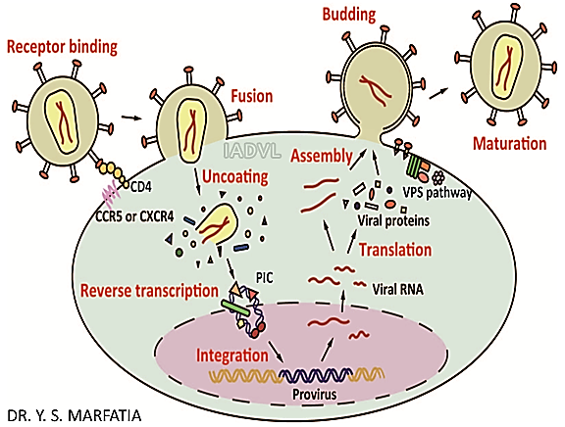
HIV Entry & Replication

Slide 13
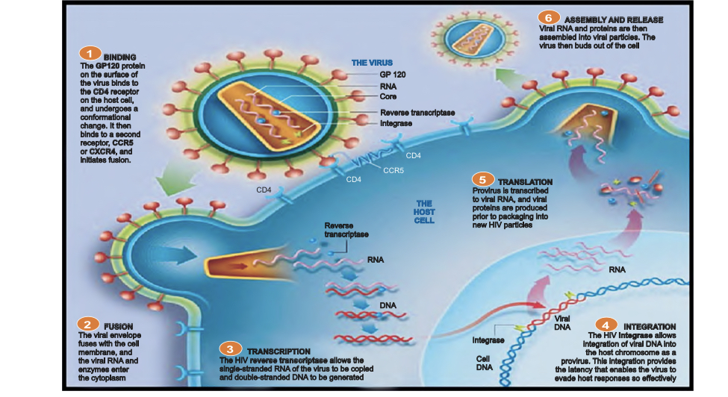

Slide 14
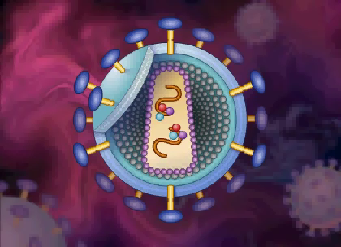

Slide 15
Peculiarities of HIV
Heterogenous and genetically diverse in variety of biologic, serologic and molecular features
Predominantly lymphotropic - to CD4+ T helper cells
Incurability: Most important characteristic - persists in sanctuary/ reservoir sites, a majority of them being the resting memory CD4+ T cells which have long half life and are unaffected by antiretroviral therapy (ART)
Evades immune response: Multiplies in presence of antibodies and continuous high level viral replication occurs even during clinical latency
HIV is also mutagenic and the replication is error prone leading to drug resistance and difficulty in preparation of vaccine

Slide 16
Body Fluids Containing HIV
Body fluids containing HIV |  | Body fluids with no/low concentration of HIV
Blood Semen Vaginal and cervical secretion -quantity less as compared to semen Breast milk | Amniotic fluid Cerebrospinal fluid (CSF) Pleural, pericardial, peritoneal fluids Any body fluid contaminated with blood | Following body fluids do not contain HIV, if not contaminated with blood
 |  | Saliva Tears Sweat | Urine Stool

Slide 17
Modes of Transmission
When HIV infected body fluids come in contact with uninfected person by different routes
  Sexual - From infected to normal partner by unprotected sexual act
  Through blood –
    Transfusion of blood/blood products
    Accidental transmission in health care setup from needle, syringe, instruments contaminated with infected blood
    Contaminated needle syringes used by IV drug abusers
  Parent to child transmission - A pregnant woman can transmit it before delivery, during delivery or after delivery through breastfeeding

Slide 18
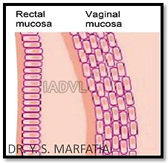
Dynamics of Sexual Transmission
Chances of male to female transmission is 5 to 6 times higher because female is the receptive partner with infected cells in the semen directly gaining entry in female genital tract
Reproductive tract infections are common in women which make the mucosa more susceptible to HIV transmission
Presence of STDs increases the risk of HIV by many times due to mucosal inflammation, micro-abrasions
Receptive anal intercourse - highest risk of
transmission as rectal mucosa is more fragile
and there are greater chances of injury

Slide 19
Route of Acquisition of HIV in India

Slide 20
Exposure Route Efficiency
Exposure route |  | Efficiency (%)
Blood transfusion (BT) |  | 90-95
Perinatal |  | 20-40
Sexual |  | 0.1-10
Vaginal |  | 0.05-0.1
Receptive vaginal intercourse |  | 0.1-10.0%
Insertive vaginal intercourse |  | 0.1-1.0%
Anogenital sex | Anogenital sex (total risk) | 0.065-0.5
 | Receptive anal intercourse | 1 to 30%
 | Insertive anal intercourse | 0.1 to 10.0%
Orogenital sex |  | 0.005-0.1
IV drugs use |  | 0.67
Needle stick exposure |  | 0.3
Mucous membrane splash to eye, oro-nasal area |  | 0.09

Slide 21
Immunopathogenesis
Immune system of human body comprises of cell mediated immunity mediated by T cells and humoral or antibody associated immunity by B cells
Two types of T cells important in the immunopathogenesis of HIV- helper (CD4+ T cells) and suppressor (CD8+ T cells)
T- helper (CD4+ cell) cell conducting the orchestration of immune system is the primary target of HIV, thereby deranging the whole immune system
Killing of CD4+ lymphocytes results in marked immunosuppression, leading to an increased chance of opportunistic infections by commensals, environmental contaminants and non- pathogens as well as malignancies associated with suppressed immunity

Slide 22
Cells Bearing CD4 Receptors & Thereby Susceptible to HIV
Skin | Neuronal cells | Hematopoietic cells | Others
Langerhans cells Fibroblast Megakaryocytes Basophils | Astrocytes Oligodendrocytes Capillary endothelium Microglial cells | B-lymphocytes T-lymphocytes NK cells Eosinophils Monocytes Macrophages Dendritic cells Promyelocytes Kupffer cells | Gut associated lymphoid tissue (GALT) Colon carcinoma cells Bowel epithelium Renal epithelium Thymic precursor cells Retinal cells Placental trophoblasts

Slide 23
Natural History of HIV Infection
Window period*
Antibodies start to appear
Antibodies
HIV load
CD4 cells
Entry of HIV
4-8 weeks
Up to 12 years
2-3 years
*No detectable antibodies

Slide 24
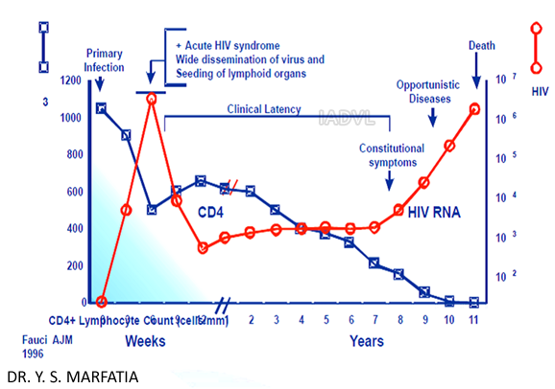
Natural History - Untreated HIV Infection

Slide 25
Stages of HIV Infection
Stage | CD4 count | Features
Primary HIV infection |  | Seroconversion illness
Clinical stage 1 | >500 | Asymptomatic Persistent generalized lymphadenopathy
Clinical stage 2 | 200-500 | Unexplained weight loss, HZ
Clinical stage 3 | below 200 | Unexplained weight loss, diarrhoea, fever
Clinical stage 4 | <50 | AIDS defining opportunistic infections and malignancies

Slide 26
Stages
Primary HIV infection/acute retroviral syndrome/seroconversion illness 2-4 weeks after the initial exposure 50-90% of patients experience seroconversion illness in form of an acute febrile illness, associated with lymphadenopathy, pharyngitis, maculopapular rash, orogenital ulcers and meningoencephalitis, due to rapid proliferation of HIV in blood and lymph nodes The HIV can be detected by HIV RNA/DNA tests; HIV antibody tests are negative (window period)
Clinical stage 1 - asymptomatic - lasts for 2-10 years (average 8 years) Asymptomatic Persistent generalized lymphadenopathy (PGL): Defined as enlarged lymph nodes (>1 cm) involving at least two non-contiguous sites, other than inguinal nodes, in the absence of an obvious cause
Adapted from - WHO

Slide 27
Stages
Clinical stage 2 - mild symptoms Moderate unexplained weight loss (<10% of presumed or measured body weight) Recurrent respiratory tract infections Skin: Herpes zoster, papular pruritic eruptions, seborrheic dermatitis Mucosa: Angular cheilitis, recurrent oral ulceration

Slide 28
Stages
Clinical stage 3 - Advanced symptoms - Characterized by advancing immunosuppression and opportunistic infections (OIs) Unexplained severe weight loss (>10% of presumed or measured body weight) Unexplained chronic diarrhoea for longer than one month Unexplained persistent fever (>37.6°C intermittent or constant, for longer than one month) Persistent oral candidiasis, oral hairy leukoplakia Pulmonary tuberculosis (current) Severe bacterial infections (pneumonia, pyomyositis, bone/joint infection, meningitis or bacteraemia) Acute necrotizing ulcerative stomatitis, gingivitis or periodontitis Unexplained anaemia (<8 g/dl), neutropenia (<0.5 × 109 per litre) or chronic thrombocytopenia (<50 × 109 per litre)

Slide 29
Stages
Clinical stage 4 - Severe symptoms HIV wasting syndrome TB: Extrapulmonary tuberculosis, disseminated non-tuberculous mycobacterial infection Pneumocystis jiroveci pneumonia, recurrent severe bacterial pneumonia Herpes simplex Chronic infection of >one month’s duration Candidiasis – Oro-oesophageal Kaposi’s sarcoma Cytomegalovirus infection (retinitis or infection of other organs) CNS: Toxoplasmosis, HIV encephalopathy, extrapulmonary cryptococcosis including meningitis, progressive multifocal leukoencephalopathy Chronic cryptosporidiosis (with diarrhoea), chronic isosporiasis Invasive cervical carcinoma

Slide 30
Opportunistic Infections
Infections in immunocompromised patients
Caused by micro-organisms usually not pathogenic to a normal immune system
Can be by
  Commensals
  Environmental contaminants
  Non- pathogens

Slide 31
HIV-related Infections Most Frequently Encountered in India
Causative organism | CNS | GIT | Lung | Mucocutaneous | Others
Bacterial | Tuberculosis Syphilis | Salmonella infection | Tuberculosis Bacterial respiratory infection M. avium complex | Bacillary angiomatosis Pyoderma in children | -
Viral | Cytomegalovirus (CMV) |  | CMV pneumonia | Herpes simplex virus Oral hairy leukoplakia Varicella zoster infections Molluscum virus Human papilloma virus infections | -

Slide 32
HIV-related Infections Most Frequently Encountered in India
Causative organism | CNS | GIT | Lung | Mucocutaneous | Others
Fungal | Cryptococcosis | Candidiasis (oesophageal) | Pneumocystis jiroveci Pneumonia | Candidiasis (oral) | Penicilliosis
Protozoal | Toxoplasmosis | CryptosporidiosisGiardiasis Stongyloides Microsporidiosis Isosporiasis Entamoeba histolytica | - | - | -

Slide 33
HIV-related Infections Most Frequently Encountered in India
Causative organism | CNS | GIT | Lung | Muco-cutaneous | Others
Other illnesses | AIDS dementia complex Progressive multifocal leucoencephalopathy (PML) | - | - | Non-Hodgkin’s lymphoma | Invasive cervical cancer

Slide 34
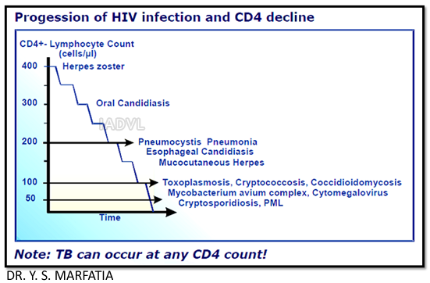
OIs at Various CD4

Slide 35
Mucocutaneous Manifestations of HIV Infection
Skin: Most commonly affected organ in patients with HIV/AIDS with more than 90% of HIV infected patients developing mucocutaneous signs and symptoms
Cutaneous manifestations can occur through all stages of HIV infection
Skin manifestations have diagnostic and prognostic significance as with different viral load and CD4 count, manifestations differ - helpful in situations where facilities for CD4 count and viral load are not easily available to monitor the progression
Skin, preputial skin and mucosa contain lot of CD4 receptor bearing cells like Langerhans cells and fibroblasts

Slide 36
Classification of Mucocutaneous Manifestations
Infectious
Non-infectious
Specific mucosal manifestation
Nail and hair
Cutaneous ADR due to ART: Morbilliform rash, urticaria/angioedema Stevens-Johnson syndrome/toxic epidermal necrolysis

Slide 37
Infections
Viral infection | Bacterial infection | Fungal infection | Parasitic infection
Acute Exanthema of HIV Herpes simplex virus/varicella zoster virus Epstein-Barr virus Human papilloma Molluscum contagiosum Kaposi sarcoma | Staphylococcus aureus Mycobacterial infection Bacillary angiomatosis | Dermatophytosis Candidiasis Malassezia furfur and trichosporosis Deep and systemic mycoses- cryptococcosis, histoplasmosis and penicilliosis | Arthropod infections-scabies and demodicidosis Protozoal infections-pneumocystosis, toxoplasmosis and leishmaniasis

Slide 38
Non–infectious Manifestations
Dryness and eczema
Seborrheic dermatitis
Psoriasis
Papular pruritic eruptions
Pruritus in HIV
Pigmentary disorder
Cutaneous adverse reactions
Neoplasms

Slide 39
Specific Mucosal Manifestations
Abnormal mucosal pigmentation
Oral ulceration
Viral infections
  Oral hairy leucoplakia
  Herpes simplex virus
  Herpes zoster virus
  Human papilloma virus
Fungal infections: Oral candidiasis
Malignancy: Kaposi sarcoma, non-Hodgkin’s lymphoma

Slide 40
Nail and Hair Manifestations
Nail manifestations
  Onychomycosis
  Yellow discoloration
  Melanotic bands
  Black pigmentation due to zidovudine
Hair manifestations
  Premature greying of hair
  Diffuse hair loss
  Male pattern alopecia
  Alopecia areata
  Long eyelashes

Slide 41
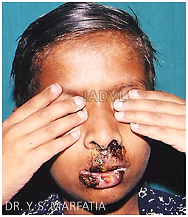
Herpes Simplex Virus (HSV)
The most common opportunistic infections in the HIV infected patients
HSV-1 causing orolabial erosions and HSV-2 causing genital lesions
HIV HSV double trouble- co-transmitters of each other
Acute outbreaks of HSV infection - accelerate HIV disease progression
Two fold ↑ risk of HIV acquisition in patients having genital herpes
HIV + cases with HSV infection shed more herpes simplex virus from genital mucosal tract even in the absence of clinical herpes
Extensive herpes labialis

Slide 42
HSV - Clinical Features
Chronic herpetic ulcers of more than one month duration is an AIDS defining condition
Tender, often painful and “giant” ulcerative lesions of genital region perianal area and lip are the hallmark of HSV in HIV infected patients
As the immunodeficiency progresses, HSV infection becomes chronic, persistent, progressive and recurrent, responding less promptly to oral antiviral therapy
Treatment: Early administration of 400 mg acyclovir 3 times a day till complete healing
Famciclovir - 250 thrice a day, valaciclovir - 1000 mg twice/day
Intravenous foscarnet is given for acyclovir resistant HSV

Slide 43
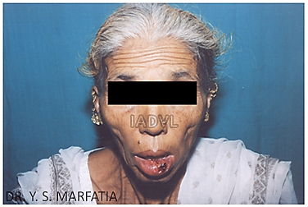
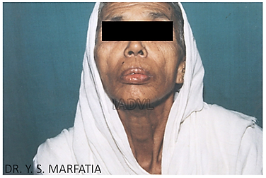
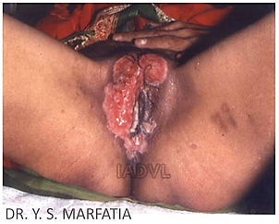
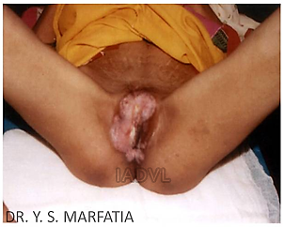
Herpes Labialis and Herpes Progenitalis
Herpes labialis
Herpes progenitalis
Pre-treatment
Post treatment

Slide 44
Herpes Zoster in HIV/AIDS
Caused by varicella zoster virus (VZV)
Since VZV causes varicella in normal children, HZ in young children should alert the physician to the possibility of HIV infection
In HIV positive cases with immunosuppression, it occurs in younger population, is recurring, haemorrhagic, disseminated and multi-dermatomal
Some cases develop herpes zoster ophthalmicus
Treatment: Oral acyclovir 800 mg 5 times a day till complete healing is the treatment of choice
Alternatively, famciclovir - 500 mg thrice/day
Valaciclovir – 1000 mg thrice/day
Preferably within 48-72 hours after the appearance of rash

Slide 45
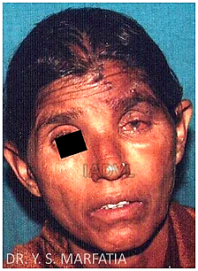
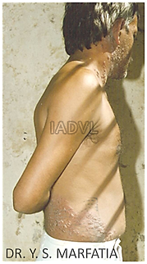
Herpes Zoster in HIV/AIDS
H. zoster ophthalmicus
Multidermatomal H. zoster

Slide 46
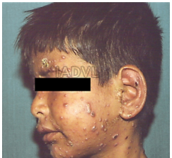
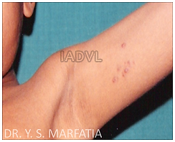
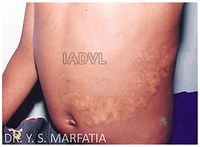
Severe chicken pox in HIV positive children
Herpes zoster in HIV positive children
Herpes zoster
Scar of H. zoster

Slide 47
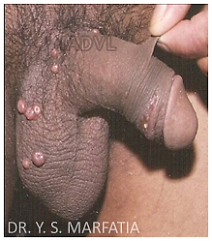
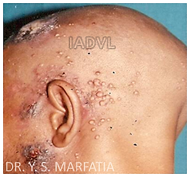
Molluscum Contagiosum Virus (MCV)
Aetiology: DNA virus - Poxviridae family
Clinical - Umbilicated pearly white papules
In HIV, the lesions tend to be numerous, widespread, may be nodular (giant molluscum) and disfiguring
Extragenital giant mollusca are a marker of AIDS
Treatment - ART - very effective, in addition to conventional methods like cryotherapy, electrodessication, gentle curettage etc.
For resistant cases, topical imiquimod 5% and topical or intravenous cidofovir can be used

Slide 48
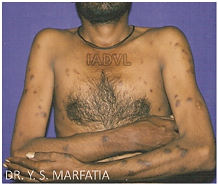
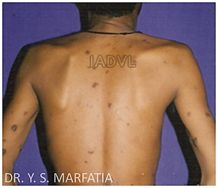
Kaposi’s Sarcoma (KS)
Aetiology: Human herpes virus 8 (HHV-8)
Mode of transmission: HHV-8 may be transmitted sexually, probably more by faeco-oral route or the ejaculate rather than blood in HIV + homosexual men
Clinical: The classical lesion is a purple patch, plaque or nodule, which may ulcerate
  Aggressive course in HIV, especially among homosexuals
Treatment: The response to ART is unpredictable, specific local or systemic therapy is often instituted as well

Slide 49
Human Papilloma Virus Infection (HPV)
Cutaneous and anogenital warts (Condyloma accuminata) caused by HPV infection - common during the course of HIV disease
  Can be extensive, numerous and resistant to therapy
HPV-16 and HPV- 18 - associated with carcinoma in situ cervix, vagina and rectum and high grade dysplasia
Invasive cervical cancer is aggressive in nature and is an AIDS defining condition
Treatment:
  Topical imiquimod, podophyllotoxin, liquid nitrogen and cidofovir
  ART can lead to decrease in their size
  Oral HPV can be treated with 1-3% cidofovir solution
Preventive vaccine for HPV related carcinoma - A recombinant quadrivalent vaccine and bivalent vaccine available

Slide 50
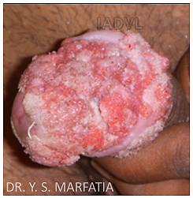
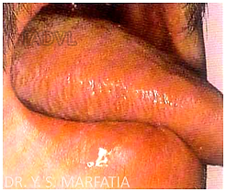
Giant Genital Wart
Etiology - HPV
Oral hairy leukoplakia
Corrugated appearance
Occurs with low CD4 count
Caused by Epstein-Barr virus (EBV)

Slide 51
Bacterial Infections
Staph. infection
Mycobacterial infection
Bacillary angiomatosis
T. pallidum infection
Others

Slide 52
Bacterial Infections
Staphylococcus aureus: Most common bacterial pathogen causing cutaneous and systemic infections in HIV
Up to 83% of patients with AIDS suffer from S. aureus infection and more in children
Primary staphylococcal infections in HIV
  Bullous impetigo
  Ecthyma
  Staphylococcal scalded skin syndrome (SSSS)
  Folliculitis
  Furuncles, carbuncles
  Cellulitis and hidradenitis

Slide 53
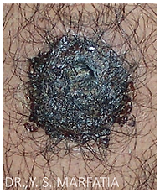
Bacillary Angiomatosis (BA)
Aetiology: Vascular proliferative response to infection with gram -ve, cat scratch disease organism, Bartonella henselae and Bartonella quintana
Usually occurs when CD4 count <200/µl
C/F: Solitary or multiple small, red, purple, pinpoint sized papules that increase in size to form nodules and tumours
Diagnosis: H&E Warthin–Starry staining
Drug of choice: Erythromycin (500 mg four times a day) is given or 3-4 weeks

Slide 54
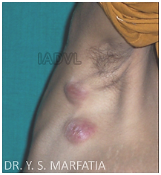
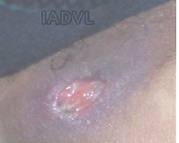
Cutaneous Tuberculosis (TB)
Although TB is common in HIV, exclusive cutaneous presentation is not common
Diverse clinical presentation:
  Scrofula
  Scattered violaceous papules
  Keratotic papules and nodules
  Tuberculids
Clinical appearance is not always characteristic
Response to ATT is confirmatory
TB lymph nodes
Always suspect TB in a non healing cutaneous ulcer, not responding to antibacterial or antiviral treatment
Tuberculous ulcer

Slide 55
Fungal Infections - Candidiasis
Oropharyngeal candidiasis: Most frequent opportunistic fungal infection affecting >90% of HIV patients at some point during progression of their disease
Candidiasis: Mucocutaneous candidiasis occurs in 3 forms in HIV:
  Oropharyngeal
  Oesophageal
  Vulvovaginal
Aetiology: Most common cause - Candida albicans
C/F: Cottage cheese like, creamy white exudative plaques on tongue, which can be easily removed and leaves an inflammatory erythematous surface
Treatment: Fluconazole 100 mg daily for 14 days
Oropharyngeal candidiasis is an aids defining illness

Slide 56
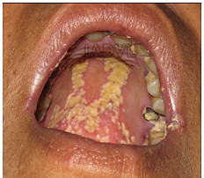
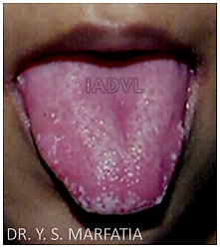
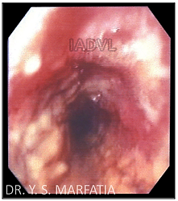
Candidiasis
(a) Oral candidiasis with angular cheilitis
(b) Cottage cheese like creamy white exudative plaques on the tongue
(c) Oesophageal candidiasis

Slide 57
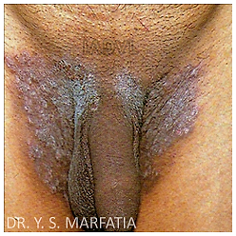
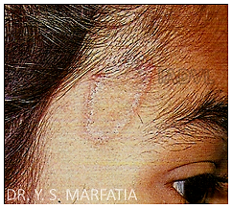
Dermatophytosis (Tinea)
Dermatophytosis in HIV patients is more varied, extensive and atypical than in immunocompetent individuals
Lesions may be atypical with lack of active edge and central scaling (anergic form)
Treatment: Systemic antifungal therapy with itraconazole, fluconazole, terbinafine with topical azoles like clotrimazole, sertaconazole, luliconazole

Slide 58
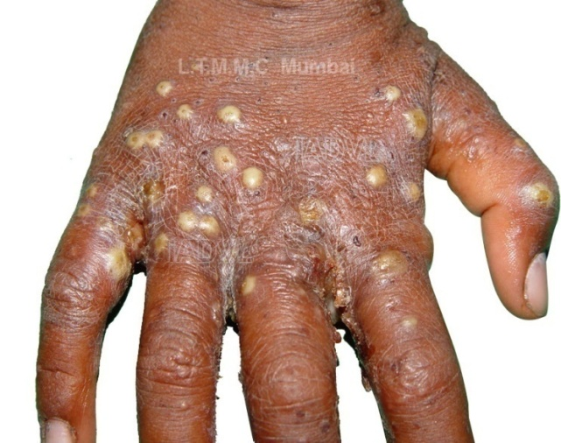
Parasitic Infestations
Scabies
  Occurs at any CD4 count, but manifestations more severe at lower CD4 counts
  C/F: Usually manifests as crusted (Norwegian) scabies, with patients infested with hundreds to thousands of adult female mites
  Treatment: Scabicides like 5% permethrin and 1% GBHC along with single dose oral Ivermectin (200 ug/kg single oral dose)

Slide 59
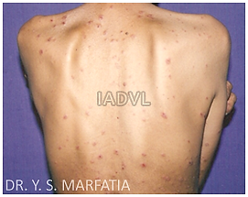
Non-infectious Dermatoses Papular and Follicular Eruptions
Papula: Transient (4-6 weeks)/ chronic (>6 weeks)
Chronic papulofollicular
Follicular:
  Staph. aureus folliculitis
  Eosinophilic folliculitis
Others:
  Pruritus
  Prurigo nodularis
  Insect bite reaction

Slide 60
Laboratory Diagnosis of HIV
Test | Window period | Comments
Specific antibody detection ELISA/EIA/rapid test Western blot (WB) | 3 weeks - 6 months | Rapid test recommended WB – Confirmatory test, high specificity
Specific antigen detection P24 antigen Reverse transcriptase assay | 7-10 days | Specificity high but sensitivity low
Fourth Generation ELISA | 16 days | 4th generation ELISA detects P24 antigen and antibody, reduce window period
Detection of viral nucleic acid Qualitative DNA/RNA PCR test, nucleic acid amplification test (NAAT) | 7-10 days | High specificity and sensitivity Useful in - Diagnosis of pediatric HIV (<18 months of age), detection of HIV during window period, recent BT, high risk sexual exposure and needle stick injury
Isolation/viral culture | Reports take time | Not feasible Used in research setting

Slide 61
Prerequisites for HIV Testing- 3 ‘C’s
Consent: Informed consent
Counselling: Pre-test counselling
Confidentiality
Post-test counselling
  If it is positive: Patient is referred to ART centre
  If negative: The subject is counselled regarding reduction of high risk sexual behaviour

Slide 62
Laboratory Monitoring for Immune Deterioration/Prognosis
CD4 lymphocyte count: Most important marker of immunological status of an HIV positive
  Level of CD4 correlates with occurrence of opportunistic infections
Plasma viral load (PVL): Plasma viral load detects exact quantity of virus in plasma
  Best measured by branched-DNA signal-amplification assay (bDNA)
  Other techniques: reverse transcription polymerase chain reaction (RT-PCR) and nucleic acid sequence based amplification
PVL and CD4 count - Most important predictors of progression to AIDS, and the prognostic markers of HIV and response to ART

Slide 63
Combination Anti-retroviral Therapy (cART) - Goals
Clinical goal
  Prolongation of life and improvement of quality of life
Virological goal
  Maximal and durable suppression of viral load (<50 copies/ml) so as to halt the disease progression
Immunological goals
  Preservation of immune system
Recovery of immune system
  Quantitative (normal CD4 count) and qualitative (pathogen specific immune response) immune reconstitution

Slide 64
Combination Anti-retroviral Therapy (cART) - Goals
Therapeutic goal
  Rational sequencing to maintain therapeutic options
  Relatively free of side effects
  Realistic in terms of adherence
Epidemiological goals
  To reduce HIV transmission
  Test and treat policy - This renders patient non infectious
  PVL becomes undetected within 6 months after starting ART
  If HIV PVL is undetectable, HIV is untransmissible

Slide 65
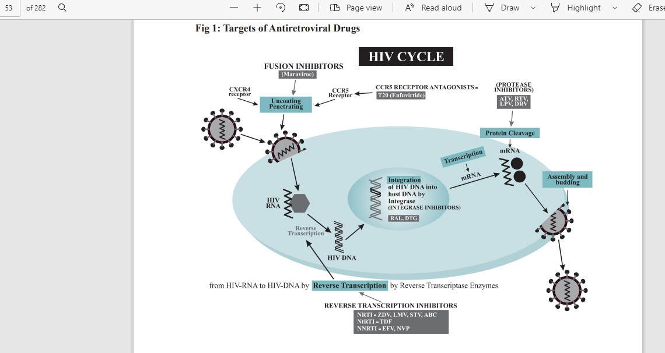
Mechanism of Action of Various ART
Adapted from : NACO guidelines October 2018

Slide 66
Table-8: Classes of Drugs Available
Nucleoside reverse transcriptase Inhibitors (NRTI) | Non-nucleoside reverse Transcriptase inhibitors (NNRTI) | Fusion inhibitors (FI)-(1)
Zidovudine (AZT/ZDV)* Lamivudine (3TC)* Abacavir (ABC)* Emtricitabine (FTC) | Nevirapine* (NVP) Efavirenz*(EFV) Delavirdine (DLV) Rilpivirine(RPV) Etravirine (ETV) | Enfuvirtide (T-20)
Nucleotide reverse transcriptase inhibitors (NtRTI) | Protease inhibitors (PI)
Tenofovir disoproxil fumarate Tenofovir alafenamide | Boosted PI -Lopinavir/ritonavir (LPV)* -Atazanavir/ritonavir Darunavir (DRV)
Integrase inhibitors-(3)
Raltegravir Elvitegravir Doultegravir
HIV (CCR5) entry inhibitor-(1)
Maraviroc

Slide 67
First Line ART Regimens
Adults and adolescents
  TDF + 3TC (or FTC) + EFV as a fixed-dose combination
  If it is contraindicated or not available, one of the following options is recommended:
    AZT + 3TC + EFV
    AZT + 3TC + NVP
    ABC + 3TC + EFV
    TDF + 3TC + Lopinavir/ritonavir
AZT can be considered only if Hb is >8gm/dl
If patient on AKT- Don’t give nevirapine

Slide 68
ADRs of Commonly Used Anti-retroviral Drugs
Drug | ADR
NRTI | Mitochondrial toxicity
Zidovudine (AZT) | Anemia, low leukocyte count, nausea, fatigue, headache, myopathy - (contraindicated if significant anemia or neutropenia) Dermatological: Nail and skin hyper pigmentation
Lamivudine (3TC) | Minimal toxicities, rash (though very rare)
Tenofovir | Renal toxicity, bone demineralization
Abacavir | Hypersensitivity reaction in 3 to 5% (can be fatal)
NNRTI | All can cause rash (NVP most common) Generally mild, self limited
Efavirenz (EFV) | CNS (nightmares, dizziness, other), rash (usually mild), hepatotoxicity, lipid abnormalities

Slide 69
ADRs of Commonly Used Anti-retroviral Drugs
Drug | ADR
Nevirapine (NVP) | Rash: Usually in first 2-8 weeks, higher in women, more if higher CD4 count, severe rash or SJ Syndrome Hepatotoxicity: Often mild to moderate but can be severe
Protease inhibitors | GI intolerance, altered taste, abnormal liver function test and bone disorder and All have been associated with metabolic abnormalities, such as hyperglycaemia, insulin resistance and increase in triglycerides, cholesterol and body fat distribution (lipodystrophy)

Slide 70
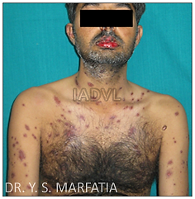
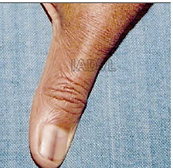
ADRs of Commonly Used Anti-retroviral Drugs
Zidovudine (AZT) induced longitudinal hyperpigmented band on thumb nail
Nevirapine induced SJ syndrome

Slide 71
IRIS - Immune Reconstitution Inflammatory Syndrome
Paradoxical deterioration in clinical status in patient on ART despite satisfactory control of viral replication and improvement of CD4 count
Inflammatory response towards previously diagnosed or incubating opportunistic pathogens as well as response towards other as yet unidentified antigen
Frequently occurring cutaneous IRIS events include TB, herpes simplex and herpes zoster
Appearance of OIs within a period of 8-12 weeks after initiation of ART should be identified as IRIS
Risk of development of IRIS - more if CD4% at time of initiation of ART is less than 15% and those who have a more rapid rise in CD4 count after initiation of ART

Slide 72
PEP (Post Occupational Exposure Prophylaxis)
Health care personnel can come in contact with blood or body fluids of HIV infected cases, thereby at potential risk of contracting HIV
Risk of HIV transmission due to occupational exposure
  Percutaneous injury (overall) - 0.18-0.3%
  Hollow bore needle - 0.18%
  Scalpel injury - 0.28%
  Mucous membrane - 0.09%
  Non-intact skin exposure - well below- 0.1%
  Intact skin - nil
  Risk of Hepatitis B virus transmission - 9-30%
  Risk of Hepatitis C virus transmission - 3-10%
PEP with ART initiated as early as possible (within 2 hrs and not after 72 hrs) can protect health care professionals

Slide 73
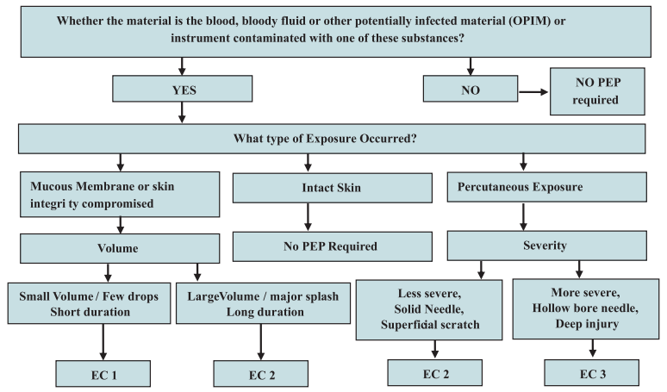
HIV Exposure Code (EC)

Slide 74
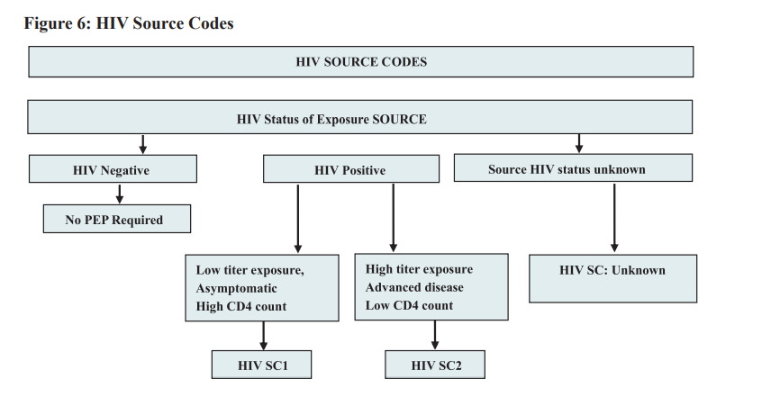
HIV Source Code (SC)

Slide 75
Exposure code | Source code | Recommendation for PEP | Duration
1 | 1 | Not warranted
1 | 2 | Recommended PEP | PEP is recommended for 28 days
2 | 1
2 | 2
3 | 1 or 2
2/3 | Unknown | Consider PEP if HIV prevalence is high in given population and risk categorization | 28 days

Slide 76
PEP Recommendation for Adults
TDF 300 mg + 3TC 300 mg one tab (FDC) once daily - One tab immediately within 2 hours of accidental exposure
Plus
Lopinavir (200 mg) + Ritonavir (50 mg) two tab (FDC) twice daily (2-BD) - Two tab immediately within 2 hours of accidental exposure
If LPV/r is not available/can not be used, Tenofovir (300 mg) + Lamivudine (300 mg) + Efavirenz (600 mg), one tab OD
All regimen to be continued for 4 weeks

Slide 77
Post & Pre-sexual Exposure Prophylaxis
Post sexual exposure prophylaxis
  The principle is same as occupational PEP
  It can be used in cases of sexual assault, unprotected sexual contact with known HIV positive partner
Pre-sexual exposure prophylaxis
  Administration of ART to an uninfected person before potential HIV exposure to reduce risk of infection and continued during risk
  Regimen – Tenofovir (300 mg) + Emtricitabine (200 mg)
  No consensus about initiation and duration
  It is effective if taken daily
  It does not offer protection against other STI
  It is not the option for standard protective measures

Slide 78
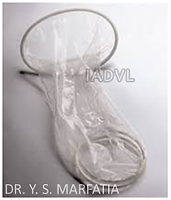
HIV Prevention - Safe Sex, Safe Blood &
Universal Precautions in Hospital Setup
Safe sex
  ABC of primary prevention of sexual transmission -
    A- Abstinence before marriage
    B- Be faithful- monogamous relationship with a single partner
    C- Condom use- correct and consistent use of condom
  There is resistance to use male condom
  Need of the hour is availability of female driven protective devices like female condoms and vaginal microbicides
  A female condom is a pre lubricated polyurethane sheath which covers introitus in toto and it is available

Slide 79
HIV Prevention - Safe Sex, Safe Blood &
Universal Precautions in Hospital Setup
Blood safety
  Blood donated from voluntary donor is ideal when needed
  It must be tested negative for HIV, hepatitis B, hepatitis C
Universal precautions at workplace
  Hand wash, barrier precautions e.g., use of latex gloves and if required goggles, impervious protective apparel
  Adaption of standard practices of sterilization and disinfections
  Use of time-tested disinfectants like ethanol, hypochlorite, glutaraldehyde, povidone iodine
  Proper disposal of hospital waste
Clean habits and common sense prevents HIV transmission
Only one person in the world can protect you from AIDS
“That’s you”

Slide 80
Moving Towards HIV Cure
Vaccine
Neutralizing antibodies
Stem cell transplantation

Slide 81
Moving Towards HIV Cure
Main barrier to a sterilizing cure is the presence of a “latent reservoir”:
  A population of HIV‑infected cells those persist for the lifetime despite ART, lack of HIV‑specific immune response
Eliminating the viral reservoir, make the latent virus susceptible for ART
Allogeneic hematopoietic stem cell transplantation from a donor homozygous for HIV‑resistant CCR5Δ32 mutation
Alteration of the host genome using genetic engineering techniques
Kick and kill (also known as “shock and kill”), altering the immune system for better clearance of the HIV‑infected targets
“Hit early and hit hard” (treatment in early stage of infection) are some of the strategies to be discussed

Slide 82
HIV Vaccine - Only Way to End HIV Epidemic
Innovative strategies to design vaccine immunogens capable of activating both arms of the adaptive immune response — antibodies and T cells
B cell immunogens - that stimulate B cells to generate broadly neutralizing antibodies (bnAbs) against the virus are now in clinical trials
T-cell immunogens - intended primarily to elicit broadly reactive, potent antiviral T-cell responses against the virus
Challenges - genetic variability of the virus, its ability to quickly establish a persistent lifelong infection

Slide 83
Innovative Vaccine Delivery Technologies
Recombinant VSV (vesicular stomatitis virus) vector that incorporates an HIV envelope gene
To use mRNA to direct cells to make proteins that will elicit immune response against HIV

Slide 84
MCQs
Q.1) Key target of HIV is
T helper cells
T suppressor cells
B lymphocyte
Macrophages
Q.2) All are true for HIV-2 except
HIV-2 is less transmissible
HIV-2 is less virulent
It is resistant to NRTI
It is resistant to NNRTI
Notes:
Ans : Q. 1 –A , Q. 2 – C

Slide 85
MCQs
Q.3) Most powerful route of HIV transmission is
Transfusion of blood
Unprotected sex
Mother to child transmission
Prick with HIV contaminated needle
Q.4) All are causes of opportunistic infections involving CNS except
Cryptococcosis
Cytomegalovirus
Toxoplasmosis
Cryptosporidiosis
Notes:
Ans : Q. 3 – A, Q. 4 – D

Slide 86
MCQs
Q.5) Which protease inhibitor boosts the pharmacological effect of other PIs
Ritonavir
Lopinavir
Atazanavir
Nelfinavir
Notes:
Ans : Q. 5 – A

Slide 87
Photo Quiz
Q. Identify the condition, name the causative organism and specify treatment
Notes:
Ans : Herpes Progenitalis, Tab Acyclovir

Slide 88
Photo Quiz
Q. Identify the condition and specify treatment
Notes:
Ans : Molluscum contagiosum-curettage, cryotherapy, electrodessication

Slide 89
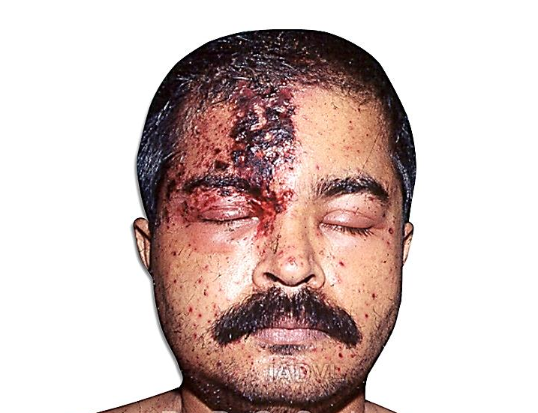
Photo Quiz
Q. Identify the condition, name the causative organism and specify treatment
Notes:
Ans : Herpes zoster ophthalmicus, Varicella Zoster virus, Tab Acyclovir 800 mg, 5 times a day for 7 days

Slide 90
Thank You

