Slide 1
HIV/AIDS
Dr. Akanksha Singh
Assistant Professor (Skin & VD),
RMCH, Bareilly

Slide 2
Human Immunodeficiency Virus (HIV)
Family of retroviridae, genus lentivirus (a genus of slow viruses with long incubation period)
What is retrovirus?
  Though it is RNA virus, for its multiplication its RNA is converted into DNA with the help of enzyme reverse transcriptase
Origin of HIV: Scientists identified a type of chimpanzee in West Africa as the source of HIV infection in humans
  Chimpanzee version of the immunodeficiency virus (called simian immunodeficiency virus or SIV) most likely was transmitted to humans and mutated into HIV when humans hunted these chimpanzees for meat and came into contact with their infected blood

Slide 3

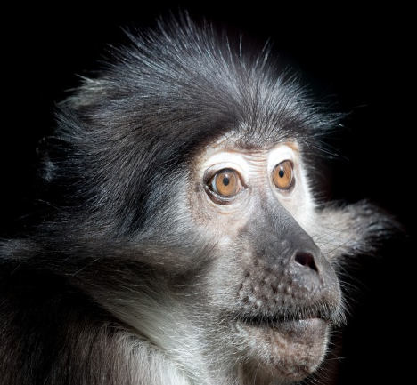
Human Immunodeficiency Virus (HIV)
Over decades, the virus has slowly spread across from Africa and later into other parts of the world
Chimpanzee
Sooty Mangabey

Slide 4
Types of HIV
HIV has been subdivided into two types - HIV-1 and HIV-2
HIV-1 - Major cause of the disease all over the world
Eleven subtypes (A to K) and subtype ‘C’ is prevalent in India
HIV-1 subtype C is associated with sexual transmission and subtype D with intravenous drug users and homosexuals
HIV-2 - Restricted to certain geographic areas like West Africa
Transmissibility lesser, longer incubation period and better prognosis than the more virulent HIV-1
HIV-2 is intrinsically resistant to most NNRTIs
CRFs (circulating recombinant forms)- Occasionally, two viruses from different subtypes infect the same cell in an infected person and result in recombinant virus strains that may transmit within a population

Slide 5
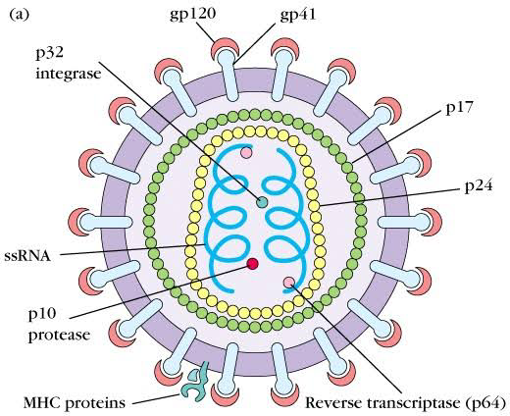
Human Immunodeficiency Virus (HIV)

Slide 6
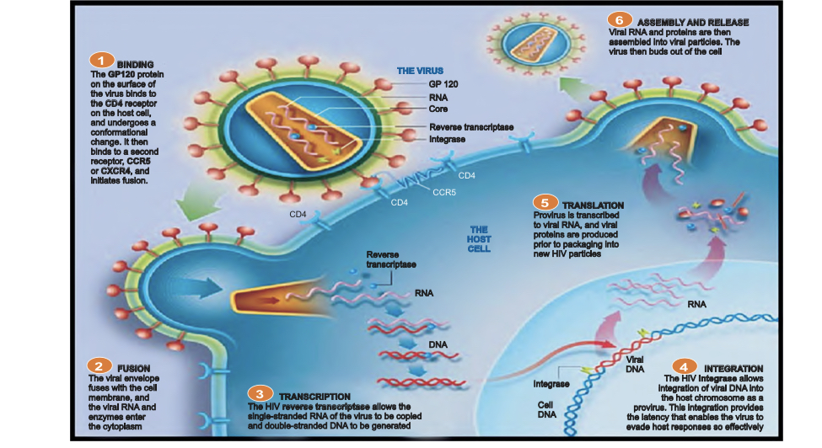

Slide 7
Body Fluids Containing HIV
Body fluids containing HIV |  | Body fluids with no/low concentration of HIV
Blood Semen Vaginal and cervical secretion -quantity less as compared to semen Breast milk | Amniotic fluid Cerebrospinal fluid (CSF) Pleural, pericardial, peritoneal fluids Any body fluid contaminated with blood | Following body fluids do not contain HIV, if not contaminated with blood
 |  | Saliva Tears Sweat | Urine Stool

Slide 8
Modes of Transmission
When HIV infected body fluids come in contact with uninfected person by different routes
  Sexual - From infected to normal partner by unprotected sexual act
  Through blood –
    Transfusion of blood/blood products
    Accidental transmission in health care setup from needle, syringe, instruments contaminated with infected blood
    Contaminated needle syringes used by IV drug abusers
  Parent to child transmission - A pregnant woman can transmit it before delivery, during delivery or after delivery through breastfeeding

Slide 9
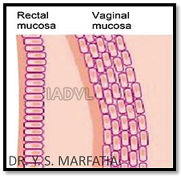
Dynamics of Sexual Transmission
Chances of male to female transmission is 5 to 6 times higher because female is the receptive partner with infected cells in the semen directly gaining entry in female genital tract
Reproductive tract infections are common in women which make the mucosa more susceptible to HIV transmission
Presence of STDs increases the risk of HIV by many times due to mucosal inflammation, micro-abrasions
Receptive anal intercourse - highest risk of
transmission as rectal mucosa is more fragile
and there are greater chances of injury

Slide 10
Route of Acquisition of HIV in India

Slide 11
Exposure Route Efficiency
Exposure route |  | Efficiency (%)
Blood transfusion (BT) |  | 90-95
Perinatal |  | 20-40
Sexual |  | 0.1-10
Vaginal |  | 0.05-0.1
Receptive vaginal intercourse |  | 0.1-10.0%
Insertive vaginal intercourse |  | 0.1-1.0%
Anogenital sex | Anogenital sex (total risk) | 0.065-0.5
 | Receptive anal intercourse | 1 to 30%
 | Insertive anal intercourse | 0.1 to 10.0%
Orogenital sex |  | 0.005-0.1
IV drugs use |  | 0.67
Needle stick exposure |  | 0.3
Mucous membrane splash to eye, oro-nasal area |  | 0.09

Slide 12
Immunopathogenesis
Immune system of human body comprises of cell mediated immunity mediated by T cells and humoral or antibody associated immunity by B cells
Two types of T cells important in the immunopathogenesis of HIV- helper (CD4+ T cells) and suppressor (CD8+ T cells)
T- helper (CD4+ cell) cell conducting the orchestration of immune system is the primary target of HIV, thereby deranging the whole immune system
Killing of CD4+ lymphocytes results in marked immunosuppression, leading to an increased chance of opportunistic infections by commensals, environmental contaminants and non- pathogens as well as malignancies associated with suppressed immunity

Slide 13
Cells Bearing CD4 Receptors & Thereby Susceptible to HIV
Skin | Neuronal cells | Hematopoietic cells | Others
Langerhans cells Fibroblast Megakaryocytes Basophils | Astrocytes Oligodendrocytes Capillary endothelium Microglial cells | B-lymphocytes T-lymphocytes NK cells Eosinophils Monocytes Macrophages Dendritic cells Promyelocytes Kupffer cells | Gut associated lymphoid tissue (GALT) Colon carcinoma cells Bowel epithelium Renal epithelium Thymic precursor cells Retinal cells Placental trophoblasts

Slide 14
Stages of HIV Infection
Stage | CD4 count | Features
Primary HIV infection |  | Seroconversion illness
Clinical stage 1 | >500 | Asymptomatic Persistent generalized lymphadenopathy
Clinical stage 2 | 200-500 | Unexplained weight loss, HZ
Clinical stage 3 | below 200 | Unexplained weight loss, diarrhoea, fever
Clinical stage 4 | <50 | AIDS defining opportunistic infections and malignancies

Slide 15
Stages
Primary HIV infection/acute retroviral syndrome/seroconversion illness 2-4 weeks after the initial exposure 50-90% of patients experience seroconversion illness in form of an acute febrile illness, associated with lymphadenopathy, pharyngitis, maculopapular rash, orogenital ulcers and meningoencephalitis, due to rapid proliferation of HIV in blood and lymph nodes The HIV can be detected by HIV RNA/DNA tests; HIV antibody tests are negative (window period)
Clinical stage 1 - asymptomatic - lasts for 2-10 years (average 8 years) Asymptomatic Persistent generalized lymphadenopathy (PGL): Defined as enlarged lymph nodes (>1 cm) involving at least two non-contiguous sites, other than inguinal nodes, in the absence of an obvious cause
Adapted from - WHO

Slide 16
Stages
Clinical stage 2 - mild symptoms Moderate unexplained weight loss (<10% of presumed or measured body weight) Recurrent respiratory tract infections Skin: Herpes zoster, papular pruritic eruptions, seborrheic dermatitis Mucosa: Angular cheilitis, recurrent oral ulceration

Slide 17
Stages
Clinical stage 3 - Advanced symptoms - Characterized by advancing immunosuppression and opportunistic infections (OIs) Unexplained severe weight loss (>10% of presumed or measured body weight) Unexplained chronic diarrhoea for longer than one month Unexplained persistent fever (>37.6°C intermittent or constant, for longer than one month) Persistent oral candidiasis, oral hairy leukoplakia Pulmonary tuberculosis (current) Severe bacterial infections (pneumonia, pyomyositis, bone/joint infection, meningitis or bacteraemia) Acute necrotizing ulcerative stomatitis, gingivitis or periodontitis Unexplained anaemia (<8 g/dl), neutropenia (<0.5 × 109 per litre) or chronic thrombocytopenia (<50 × 109 per litre)

Slide 18
Stages
Clinical stage 4 - Severe symptoms HIV wasting syndrome TB: Extrapulmonary tuberculosis, disseminated non-tuberculous mycobacterial infection Pneumocystis jiroveci pneumonia, recurrent severe bacterial pneumonia Herpes simplex Chronic infection of >one month’s duration Candidiasis – Oro-oesophageal Kaposi’s sarcoma Cytomegalovirus infection (retinitis or infection of other organs) CNS: Toxoplasmosis, HIV encephalopathy, extrapulmonary cryptococcosis including meningitis, progressive multifocal leukoencephalopathy Chronic cryptosporidiosis (with diarrhoea), chronic isosporiasis Invasive cervical carcinoma

Slide 19
Mucocutaneous Manifestations of HIV Infection
Skin: Most commonly affected organ in patients with HIV/AIDS with more than 90% of HIV infected patients developing mucocutaneous signs and symptoms
Cutaneous manifestations can occur through all stages of HIV infection
Skin manifestations have diagnostic and prognostic significance as with different viral load and CD4 count, manifestations differ - helpful in situations where facilities for CD4 count and viral load are not easily available to monitor the progression
Skin, preputial skin and mucosa contain lot of CD4 receptor bearing cells like Langerhans cells and fibroblasts

Slide 20
Classification of Mucocutaneous Manifestations
Infectious
Non-infectious
Specific mucosal manifestation
Nail and hair
Cutaneous ADR due to ART: Morbilliform rash, urticaria/angioedema Stevens-Johnson syndrome/toxic epidermal necrolysis

Slide 21
Infections
Viral infection | Bacterial infection | Fungal infection | Parasitic infection
Acute Exanthema of HIV Herpes simplex virus/varicella zoster virus Epstein-Barr virus Human papilloma Molluscum contagiosum Kaposi sarcoma | Staphylococcus aureus Mycobacterial infection Bacillary angiomatosis | Dermatophytosis Candidiasis Malassezia furfur and trichosporosis Deep and systemic mycoses- cryptococcosis, histoplasmosis and penicilliosis | Arthropod infections-scabies and demodicidosis Protozoal infections-pneumocystosis, toxoplasmosis and leishmaniasis

Slide 22
Non–infectious Manifestations
Dryness and eczema
Seborrheic dermatitis
Psoriasis
Papular pruritic eruptions
Pruritus in HIV
Pigmentary disorder
Cutaneous adverse reactions
Neoplasms

Slide 23
Specific Mucosal Manifestations
Abnormal mucosal pigmentation
Oral ulceration
Viral infections
  Oral hairy leucoplakia
  Herpes simplex virus
  Herpes zoster virus
  Human papilloma virus
Fungal infections: Oral candidiasis
Malignancy: Kaposi sarcoma, non-Hodgkin’s lymphoma

Slide 24
Nail and Hair Manifestations
Nail manifestations
  Onychomycosis
  Yellow discoloration
  Melanotic bands
  Black pigmentation due to zidovudine
Hair manifestations
  Premature greying of hair
  Diffuse hair loss
  Male pattern alopecia
  Alopecia areata
  Long eyelashes

Slide 25
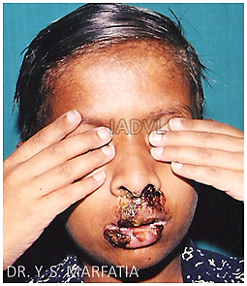
Herpes Simplex Virus (HSV)
The most common opportunistic infections in the HIV infected patients
HSV-1 causing orolabial erosions and HSV-2 causing genital lesions
HIV HSV double trouble- co-transmitters of each other
Acute outbreaks of HSV infection - accelerate HIV disease progression
Two fold ↑ risk of HIV acquisition in patients having genital herpes
HIV + cases with HSV infection shed more herpes simplex virus from genital mucosal tract even in the absence of clinical herpes
Extensive herpes labialis

Slide 26
HSV - Clinical Features
Chronic herpetic ulcers of more than one month duration is an AIDS defining condition
Tender, often painful and “giant” ulcerative lesions of genital region perianal area and lip are the hallmark of HSV in HIV infected patients
As the immunodeficiency progresses, HSV infection becomes chronic, persistent, progressive and recurrent, responding less promptly to oral antiviral therapy
Treatment: Early administration of 400 mg acyclovir 3 times a day till complete healing
Famciclovir - 250 thrice a day, valaciclovir - 1000 mg twice/day
Intravenous foscarnet is given for acyclovir resistant HSV

Slide 27
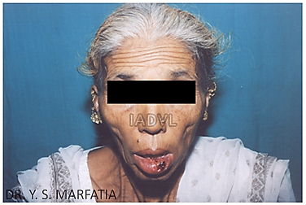
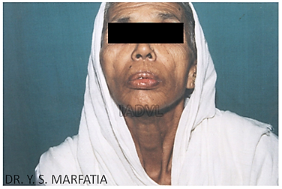
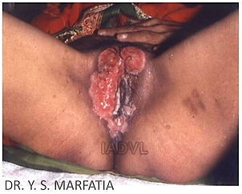
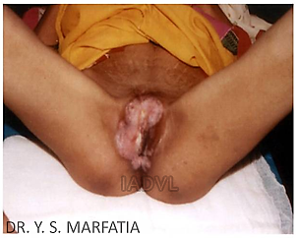
Herpes Labialis and Herpes Progenitalis
Herpes labialis
Herpes progenitalis
Pre-treatment
Post treatment

Slide 28
Herpes Zoster in HIV/AIDS
Caused by varicella zoster virus (VZV)
Since VZV causes varicella in normal children, HZ in young children should alert the physician to the possibility of HIV infection
In HIV positive cases with immunosuppression, it occurs in younger population, is recurring, haemorrhagic, disseminated and multi-dermatomal
Some cases develop herpes zoster ophthalmicus
Treatment: Oral acyclovir 800 mg 5 times a day till complete healing is the treatment of choice
Alternatively, famciclovir - 500 mg thrice/day
Valaciclovir – 1000 mg thrice/day
Preferably within 48-72 hours after the appearance of rash

Slide 29
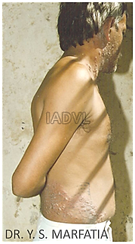
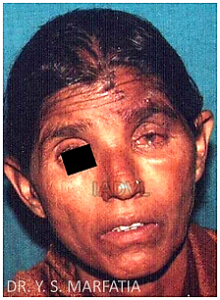
Herpes Zoster in HIV/AIDS
H. zoster ophthalmicus
Multidermatomal H. zoster

Slide 30
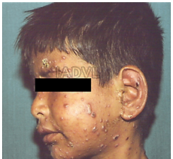
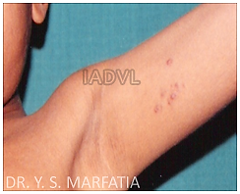
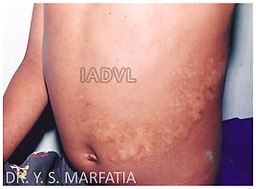
Severe chicken pox in HIV positive children
Herpes zoster in HIV positive children
Herpes zoster
Scar of H. zoster

Slide 31
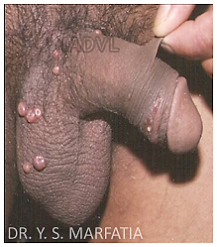
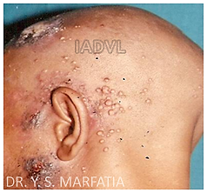
Molluscum Contagiosum Virus (MCV)
Aetiology: DNA virus - Poxviridae family
Clinical - Umbilicated pearly white papules
In HIV, the lesions tend to be numerous, widespread, may be nodular (giant molluscum) and disfiguring
Extragenital giant mollusca are a marker of AIDS
Treatment - ART - very effective, in addition to conventional methods like cryotherapy, electrodessication, gentle curettage etc.
For resistant cases, topical imiquimod 5% and topical or intravenous cidofovir can be used

Slide 32
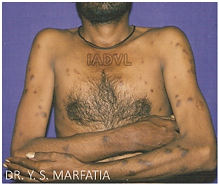
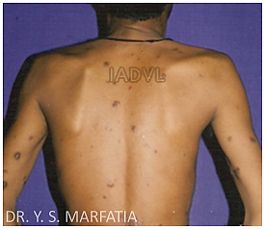
Kaposi’s Sarcoma (KS)
Aetiology: Human herpes virus 8 (HHV-8)
Mode of transmission: HHV-8 may be transmitted sexually, probably more by faeco-oral route or the ejaculate rather than blood in HIV + homosexual men
Clinical: The classical lesion is a purple patch, plaque or nodule, which may ulcerate
  Aggressive course in HIV, especially among homosexuals
Treatment: The response to ART is unpredictable, specific local or systemic therapy is often instituted as well

Slide 33
Human Papilloma Virus Infection (HPV)
Cutaneous and anogenital warts (Condyloma accuminata) caused by HPV infection - common during the course of HIV disease
  Can be extensive, numerous and resistant to therapy
HPV-16 and HPV- 18 - associated with carcinoma in situ cervix, vagina and rectum and high grade dysplasia
Invasive cervical cancer is aggressive in nature and is an AIDS defining condition
Treatment:
  Topical imiquimod, podophyllotoxin, liquid nitrogen and cidofovir
  ART can lead to decrease in their size
  Oral HPV can be treated with 1-3% cidofovir solution
Preventive vaccine for HPV related carcinoma - A recombinant quadrivalent vaccine and bivalent vaccine available

Slide 34
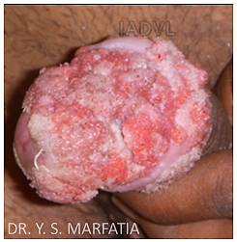
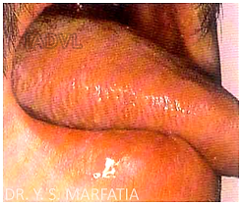
Giant Genital Wart
Etiology - HPV
Oral hairy leukoplakia
Corrugated appearance
Occurs with low CD4 count
Caused by Epstein-Barr virus (EBV)

Slide 35
Bacterial Infections
Staph. infection
Mycobacterial infection
Bacillary angiomatosis
T. pallidum infection
Others

Slide 36
Bacterial Infections
Staphylococcus aureus: Most common bacterial pathogen causing cutaneous and systemic infections in HIV
Up to 83% of patients with AIDS suffer from S. aureus infection and more in children
Primary staphylococcal infections in HIV
  Bullous impetigo
  Ecthyma
  Staphylococcal scalded skin syndrome (SSSS)
  Folliculitis
  Furuncles, carbuncles
  Cellulitis and hidradenitis

Slide 37
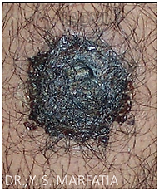
Bacillary Angiomatosis (BA)
Aetiology: Vascular proliferative response to infection with gram -ve, cat scratch disease organism, Bartonella henselae and Bartonella quintana
Usually occurs when CD4 count <200/µl
C/F: Solitary or multiple small, red, purple, pinpoint sized papules that increase in size to form nodules and tumours
Diagnosis: H&E Warthin–Starry staining
Drug of choice: Erythromycin (500 mg four times a day) is given or 3-4 weeks

Slide 38
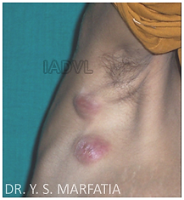
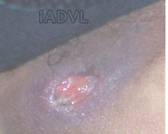
Cutaneous Tuberculosis (TB)
Although TB is common in HIV, exclusive cutaneous presentation is not common
Diverse clinical presentation:
  Scrofula
  Scattered violaceous papules
  Keratotic papules and nodules
  Tuberculids
Clinical appearance is not always characteristic
Response to ATT is confirmatory
TB lymph nodes
Always suspect TB in a non healing cutaneous ulcer, not responding to antibacterial or antiviral treatment
Tuberculous ulcer

Slide 39
Fungal Infections - Candidiasis
Oropharyngeal candidiasis: Most frequent opportunistic fungal infection affecting >90% of HIV patients at some point during progression of their disease
Candidiasis: Mucocutaneous candidiasis occurs in 3 forms in HIV:
  Oropharyngeal
  Oesophageal
  Vulvovaginal
Aetiology: Most common cause - Candida albicans
C/F: Cottage cheese like, creamy white exudative plaques on tongue, which can be easily removed and leaves an inflammatory erythematous surface
Treatment: Fluconazole 100 mg daily for 14 days
Oropharyngeal candidiasis is an aids defining illness

Slide 40
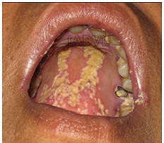
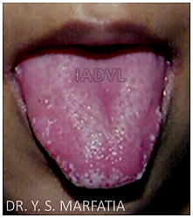
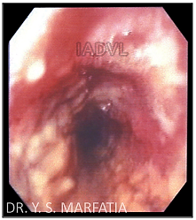
Candidiasis
(a) Oral candidiasis with angular cheilitis
(b) Cottage cheese like creamy white exudative plaques on the tongue
(c) Oesophageal candidiasis

Slide 41
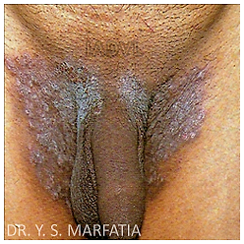
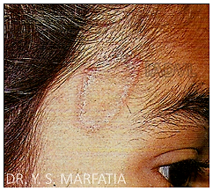
Dermatophytosis (Tinea)
Dermatophytosis in HIV patients is more varied, extensive and atypical than in immunocompetent individuals
Lesions may be atypical with lack of active edge and central scaling (anergic form)
Treatment: Systemic antifungal therapy with itraconazole, fluconazole, terbinafine with topical azoles like clotrimazole, sertaconazole, luliconazole

Slide 42
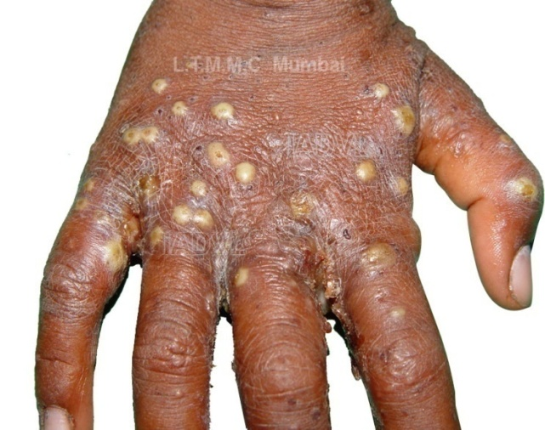
Parasitic Infestations
Scabies
  Occurs at any CD4 count, but manifestations more severe at lower CD4 counts
  C/F: Usually manifests as crusted (Norwegian) scabies, with patients infested with hundreds to thousands of adult female mites
  Treatment: Scabicides like 5% permethrin and 1% GBHC along with single dose oral Ivermectin (200 ug/kg single oral dose)

Slide 43
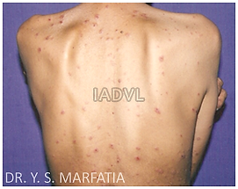
Non-infectious Dermatoses Papular and Follicular Eruptions
Papula: Transient (4-6 weeks)/ chronic (>6 weeks)
Chronic papulofollicular
Follicular:
  Staph. aureus folliculitis
  Eosinophilic folliculitis
Others:
  Pruritus
  Prurigo nodularis
  Insect bite reaction

Slide 44
Laboratory Monitoring for Immune Deterioration/Prognosis
CD4 lymphocyte count: Most important marker of immunological status of an HIV positive
  Level of CD4 correlates with occurrence of opportunistic infections
Plasma viral load (PVL): Plasma viral load detects exact quantity of virus in plasma
  Best measured by branched-DNA signal-amplification assay (bDNA)
  Other techniques: reverse transcription polymerase chain reaction (RT-PCR) and nucleic acid sequence based amplification
PVL and CD4 count - Most important predictors of progression to AIDS, and the prognostic markers of HIV and response to ART

Slide 45
Combination Anti-retroviral Therapy (cART) - Goals
Clinical goal
  Prolongation of life and improvement of quality of life
Virological goal
  Maximal and durable suppression of viral load (<50 copies/ml) so as to halt the disease progression
Immunological goals
  Preservation of immune system
Recovery of immune system
  Quantitative (normal CD4 count) and qualitative (pathogen specific immune response) immune reconstitution

Slide 46
Combination Anti-retroviral Therapy (cART) - Goals
Therapeutic goal
  Rational sequencing to maintain therapeutic options
  Relatively free of side effects
  Realistic in terms of adherence
Epidemiological goals
  To reduce HIV transmission
  Test and treat policy - This renders patient non infectious
  PVL becomes undetected within 6 months after starting ART
  If HIV PVL is undetectable, HIV is untransmissible

Slide 47
Table-8: Classes of Drugs Available
Nucleoside reverse transcriptase Inhibitors (NRTI) | Non-nucleoside reverse Transcriptase inhibitors (NNRTI) | Fusion inhibitors (FI)-(1)
Zidovudine (AZT/ZDV)* Lamivudine (3TC)* Abacavir (ABC)* Emtricitabine (FTC) | Nevirapine* (NVP) Efavirenz*(EFV) Delavirdine (DLV) Rilpivirine(RPV) Etravirine (ETV) | Enfuvirtide (T-20)
Nucleotide reverse transcriptase inhibitors (NtRTI) | Protease inhibitors (PI)
Tenofovir disoproxil fumarate Tenofovir alafenamide | Boosted PI -Lopinavir/ritonavir (LPV)* -Atazanavir/ritonavir Darunavir (DRV)
Integrase inhibitors-(3)
Raltegravir Elvitegravir Doultegravir
HIV (CCR5) entry inhibitor-(1)
Maraviroc

Slide 48
First Line ART Regimens
Adults and adolescents
  TDF + 3TC (or FTC) + EFV as a fixed-dose combination
  If it is contraindicated or not available, one of the following options is recommended:
    AZT + 3TC + EFV
    AZT + 3TC + NVP
    ABC + 3TC + EFV
    TDF + 3TC + Lopinavir/ritonavir
AZT can be considered only if Hb is >8gm/dl
If patient on AKT- Don’t give nevirapine

Slide 49
ADRs of Commonly Used Anti-retroviral Drugs
Drug | ADR
NRTI | Mitochondrial toxicity
Zidovudine (AZT) | Anemia, low leukocyte count, nausea, fatigue, headache, myopathy - (contraindicated if significant anemia or neutropenia) Dermatological: Nail and skin hyper pigmentation
Lamivudine (3TC) | Minimal toxicities, rash (though very rare)
Tenofovir | Renal toxicity, bone demineralization
Abacavir | Hypersensitivity reaction in 3 to 5% (can be fatal)
NNRTI | All can cause rash (NVP most common) Generally mild, self limited
Efavirenz (EFV) | CNS (nightmares, dizziness, other), rash (usually mild), hepatotoxicity, lipid abnormalities

Slide 50
ADRs of Commonly Used Anti-retroviral Drugs
Drug | ADR
Nevirapine (NVP) | Rash: Usually in first 2-8 weeks, higher in women, more if higher CD4 count, severe rash or SJ Syndrome Hepatotoxicity: Often mild to moderate but can be severe
Protease inhibitors | GI intolerance, altered taste, abnormal liver function test and bone disorder and All have been associated with metabolic abnormalities, such as hyperglycaemia, insulin resistance and increase in triglycerides, cholesterol and body fat distribution (lipodystrophy)

Slide 51
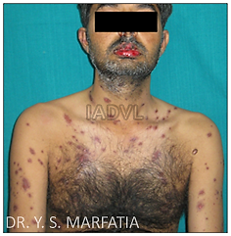
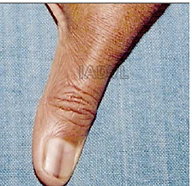
ADRs of Commonly Used Anti-retroviral Drugs
Zidovudine (AZT) induced longitudinal hyperpigmented band on thumb nail
Nevirapine induced SJ syndrome

Slide 52
PEP Recommendation for Adults
TDF 300 mg + 3TC 300 mg one tab (FDC) once daily - One tab immediately within 2 hours of accidental exposure
Plus
Lopinavir (200 mg) + Ritonavir (50 mg) two tab (FDC) twice daily (2-BD) - Two tab immediately within 2 hours of accidental exposure
If LPV/r is not available/can not be used, Tenofovir (300 mg) + Lamivudine (300 mg) + Efavirenz (600 mg), one tab OD
All regimen to be continued for 4 weeks

Slide 53
MCQs
Q.1) Key target of HIV is
T helper cells
T suppressor cells
B lymphocyte
Macrophages
Q.2) All are true for HIV-2 except
HIV-2 is less transmissible
HIV-2 is less virulent
It is resistant to NRTI
It is resistant to NNRTI
Notes:
Ans : Q. 1 –A , Q. 2 – C

Slide 54
MCQs
Q.3) Most powerful route of HIV transmission is
Transfusion of blood
Unprotected sex
Mother to child transmission
Prick with HIV contaminated needle
Q.4) All are causes of opportunistic infections involving CNS except
Cryptococcosis
Cytomegalovirus
Toxoplasmosis
Cryptosporidiosis
Notes:
Ans : Q. 3 – A, Q. 4 – D

Slide 55
Photo Quiz
Q. Identify the condition, name the causative organism and specify treatment
Notes:
Ans : Herpes Progenitalis, Tab Acyclovir

Slide 56
Photo Quiz
Q. Identify the condition and specify treatment
Notes:
Ans : Molluscum contagiosum-curettage, cryotherapy, electrodessication

Slide 57
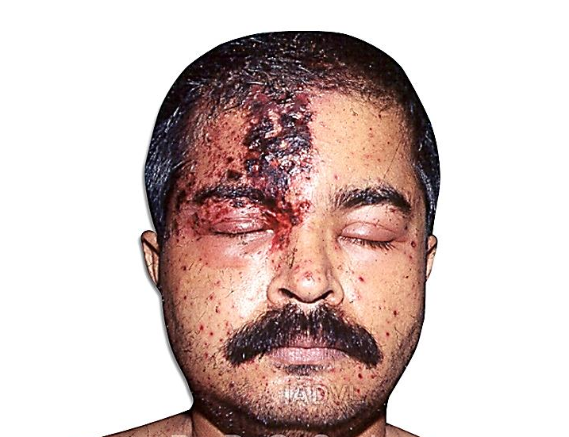
Photo Quiz
Q. Identify the condition, name the causative organism and specify treatment
Notes:
Ans : Herpes zoster ophthalmicus, Varicella Zoster virus, Tab Acyclovir 800 mg, 5 times a day for 7 days

Slide 58
Thank You

