Slide 1
Superficial fungal infection
Dr Ashwin charaniya
A.P dept of DVL
22/05/2024

Slide 2
Dermatophytes are fungi capable of causing skin changes of the type known as ringworm or dermatophytosis.
3 genera:
Microsporum,
Trichophyton and
Epidermophyton.

Slide 3
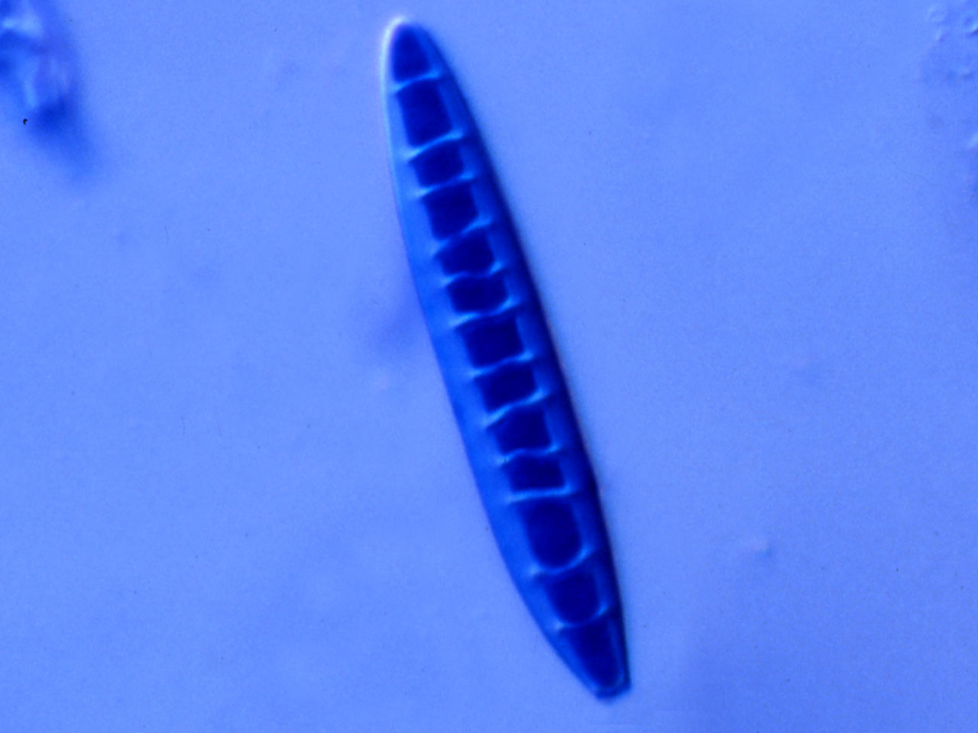
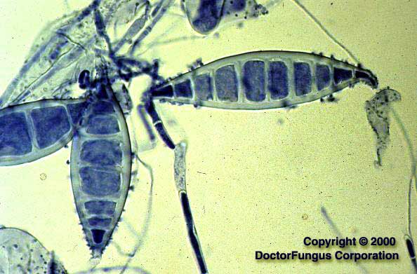
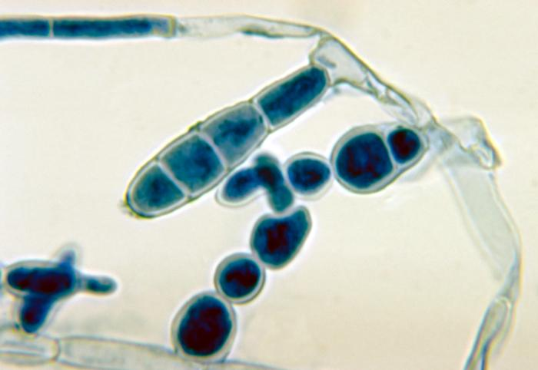
Epidermophyton
  Trichophyton
  Microsporum

Slide 4
Origin
Anthropophilic
Zoophilic
Geophilic

Slide 5
Dermatophytosis
These are fungal infections that invade and multiply within keratinised tissue- skin, hair & nails
Category | Mode of transmission | Typical clinical features | Etiological agents
Anthropophilic | Human to human | Mild to non-inflammatory, chronic | T. rubrum T. tonsurans T. concentricum T. mentagrophytes (var. interdigitale) Epidermophyton floccosum

Slide 6
Category | Mode of transmission | Typical clinical features | Etiological agents
Zoophilic | Animal to human | Intense inflammation (pustules and vesicles possible), acute | T. mentagrophytes (var.mentagrophytes) Microsporum canis T. Verrucosum
Geophilic | Soil to human or animal | Moderate inflammation | M. gypseum

Slide 7
Initial - contact with desquamated scale
adherence of fungal elements the skin attempts to slough it off with its continual shedding (desquamation)
Germination
invasion of stratum corneum, cell-mediated immune response
The fungus produces metabolic byproducts that are toxic and allergenic to the host
The inflammatory response increases cellular turnover of the stratum corneum in an attempt to shed the fungus from the skin

Slide 8
Pathogenesis
Contact
host factors
Adherence
Keratinases
Invasion of fungi in stratum corneum
Disease
Protease inhibitors,
β-globulins, Mannans
Inhibitory factors-sebum, ferritin

Slide 9
Dermatophytosis (Ringworm)
Terminology :
Head : Tinea capitis
Face : Tinea faciei
Beard : Tinea barbae
Trunk / body : Tinea corporis
Groin / gluteal folds : Tinea cruris
Palms : Tinea manuum
Soles : Tinea pedis
Nail : Tinea unguium

Slide 10
Tinea Corporis
Dermatophytosis of the trunk and extremities with the exclusion of the palms (tinea manuum), soles (tinea pedis) and groins (tinea cruris).
Incubation period- 1-3 weeks.
All species of dermatophytes can cause this.
Three most common causative organisms are
T.rubrum> T. mentagrophytes > M. canis.
In India, T. rubrum is most common.

Slide 11
Centrifugally spreading from point of skin invasion with centrally clearing, a typically annular lesion (ring like)
Morphological variants - arcuate, circinate & oval
Clinical variants
Tinea profunda
Majocchi’s granuloma
Tinea imbricata

Slide 12
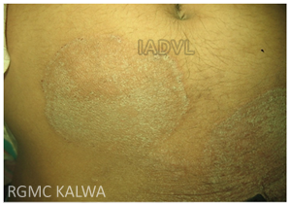
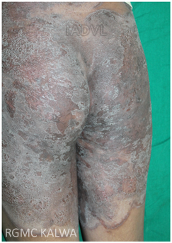
Recalcitrant and eczematized Tinea Corporis
Classical Tinea Corporis

Slide 13
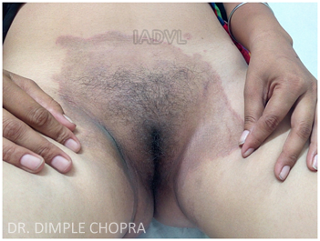
Tinea cruris
Dermatophyte infection of inguinal region
Area of erythema and pruritus in fold between scrotum & inner thigh
Characteristic sharply demarcated with raised, erythematous, scaly advancing border that may contain pustules and vesicles

Slide 14
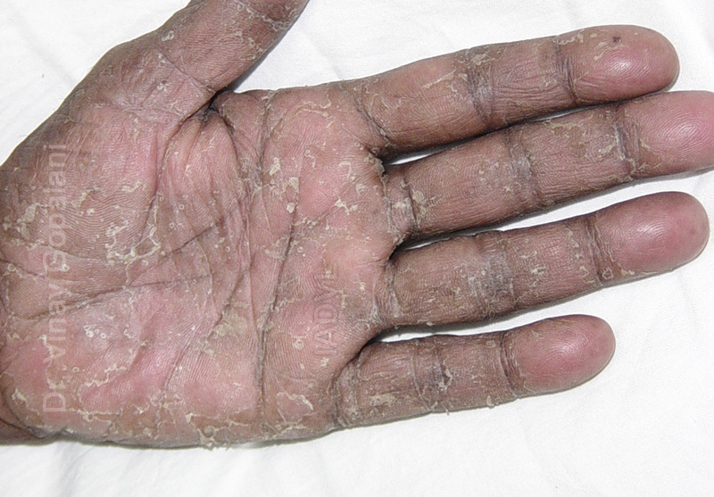
Tinea manuum
Dermatophytic infection of palm and interdigital space.
Reason for different clinical picture- related to lack of sebaceous glands on palm.
Two varieties :
Non inflammatory : Dry, scaly, mildly itchy
Inflammatory : Vesicular, itchy

Slide 15
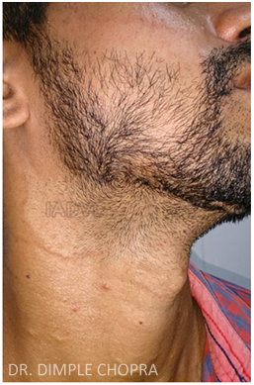
Tinea faciei
Erythematous scaly patches on the face
Annular or circinate lesions and induration with pustules on border
Itching, burning and exacerbation after sun exposure
Almost always associated with tinea of other body parts
Seen often in immuno-compromised adults

Slide 16
Tinea barbae
Dermatophytosis of the bearded areas of face and neck
Highly inflammatory, pustular folliculitis as caused by mainly zoophilic fungus
Hairs of the beard or moustache are surrounded by inflammatory papulo-pustules, usually with oozing or crusting, easily pluckable
Complications - abscesses, sinus tracts, bacterial super-infections , kerion like boggy swellings, alopecia
D/D - Sycosis barbae, Acne vulgaris, Pseudofolliculitis

Slide 17
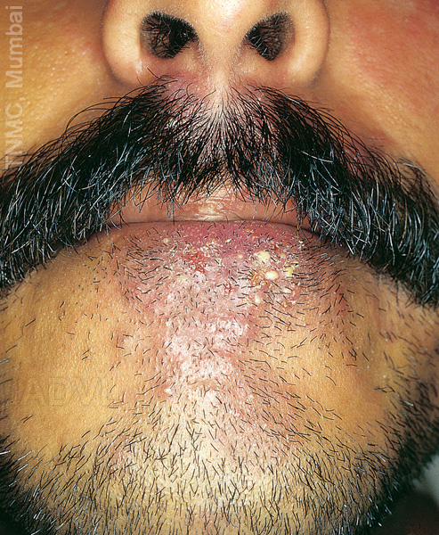
Tinea Barbae

Slide 18
Tinea capitis
Infection of the scalp and hair
Commonest mycosis observed in children
Caused by dermatophytes in the genera Microsporum and Trichophyton. Epidermophyton is not traditionally isolated
In North America T. tonsurans is most common while in Europe, M. canis is the most common agent
TYPES :
Non-inflammatory : Gray patch , Black dot
Inflammatory : Favus , Kerion

Slide 19
Tinea capitis
Three patterns of invasion exist;
Endothrix pattern - infection with anthropophillic fungi by non- fluorescent anthroconidia within hair shaft
T. tonsurans, T. violaceum
Ectothrix pattern- anthroconidia formed from fragmented hyphae outside the hair shaft, fluorescent or non fluorescent.
Favus - hyphae and air spaces within the hair shaft and a bluish-white fluorescence.

Slide 20
Grey patch
Ectothrix pattern of invasion
Patches of partial hair loss
Often circular in shape
Numerous “broken-off” hairs that are dull grey and lustreless due to the overcoating by arthrospores
Causes epidemics in schools
Etiologic Agent : Microsporum audouinii
Asymptomatic or complain of mild itching

Slide 21
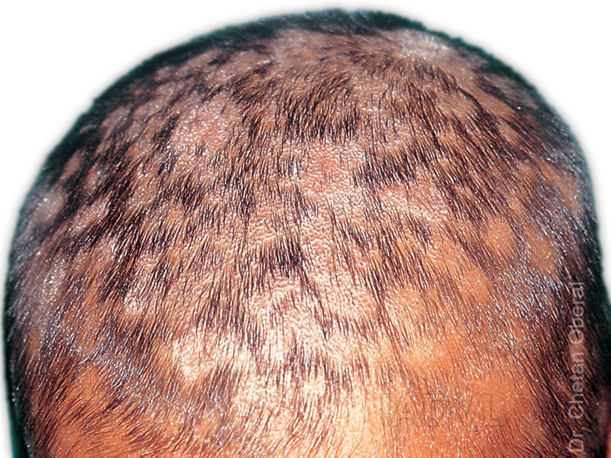
Tinea capitis

Slide 22
Black dot tinea capitis
Endothrix pattern of invasion.
Hair shaft is brittle and breaks at the level of the scalp, remnant of the hair left behind in the infected follicle appears as a black dot on clinical examination
Diffuse scaling with minimal hair loss or inflammation
Affected areas of hair loss are characteristically multiple and polygonal in outline with distinct finger like margins.
Commonly spare some hair within the areas of involvement

Slide 23
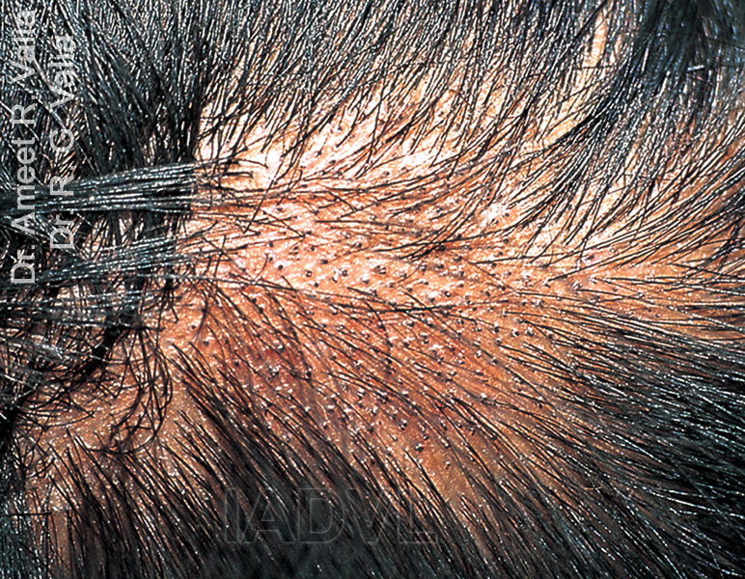
Black dot tinea capitis

Slide 24
Kerion
Mostly due to infection with T. verrucosum or T. mentagrophytes.
Inflammed boggy and indurated tender swelling that is studded with broken or unbroken hairs, vesicles and pustules.
Sinus formation and thick crusting with matting of adjacent hair
Lymphadenopathy and secondary bacterial infection
Heals with scarring & autoeczematisation(id eruption)

Slide 25
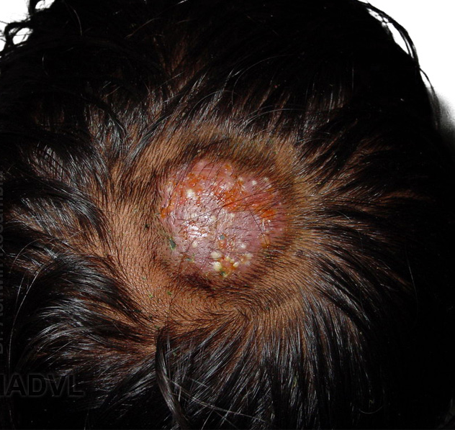
Kerion

Slide 26
Favus
A yellow cup shaped crust composed of a dense mat of mycelia and epithelial debris called scutulum (shaped like a shield)
The scutulae enlarge and merge to form prominent yellowish crusts.
Characteristic mousy odour
Borders of the infected lesions represent areas of advancing disease and are often polycyclic in shape & centre of the infected area gradually becomes extensively scarred and almost totally devoid of hair.
Later stage - cicatricial alopecia.
Commonest cause - T. schoenleinii

Slide 27
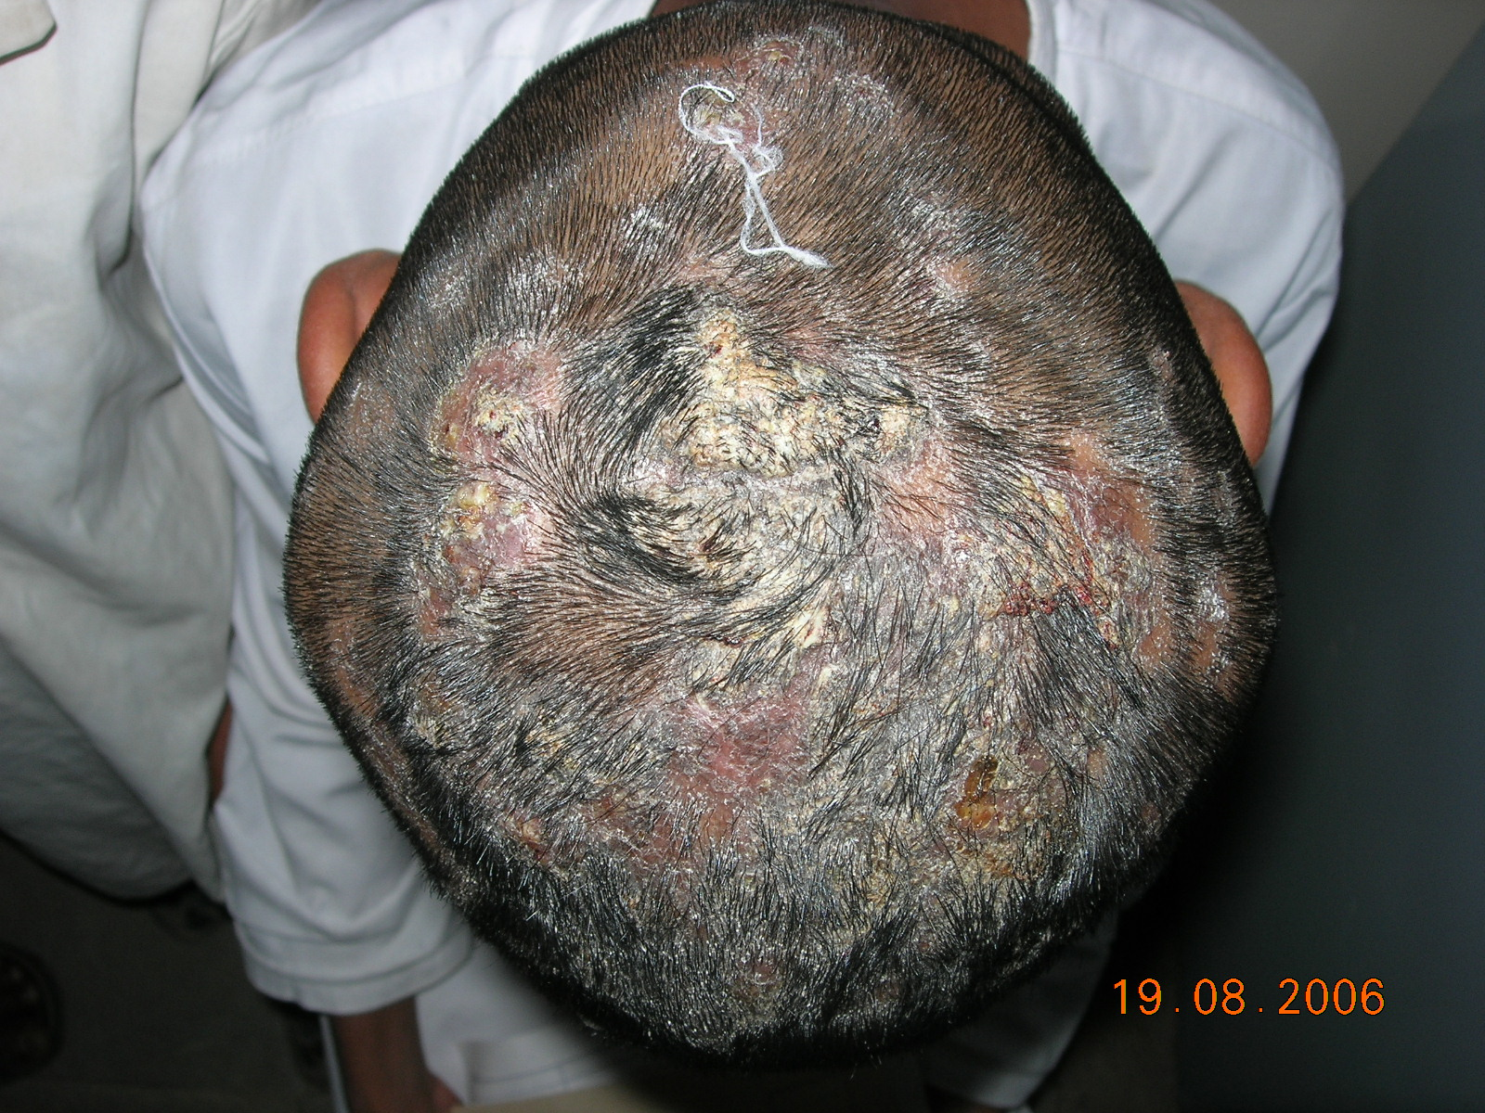

Slide 28
Tinea pedis
Type | Causative organism | Clinical features
Moccasin | T. rubrum E. floccosum | Diffuse hyperkeratosis, erythema, scaling and fissures on one or both plantar surfaces
Interdigital | T. mentagrophytes (var. interdigitale) T. rubrum E. floccosum | Most common type, erythema, scaling, fissures and maceration in web spaces, pruritus common, extend to dorsum and sole of foot

Slide 29
Tinea pedis
Type | Causative organism | Clinical features
Inflammatory (vesicular) | T. mentagrophytes (var. mentagrophytes) | Vesicles and bullae on medial foot; associated with dermatophytid reaction
Ulcerative | T. rubrum T. mentagrophytes E. floccosum | Exacerbation of interdigital tinea pedis; ulcers and erosions on web spaces; secondary infection with bacteria

Slide 30
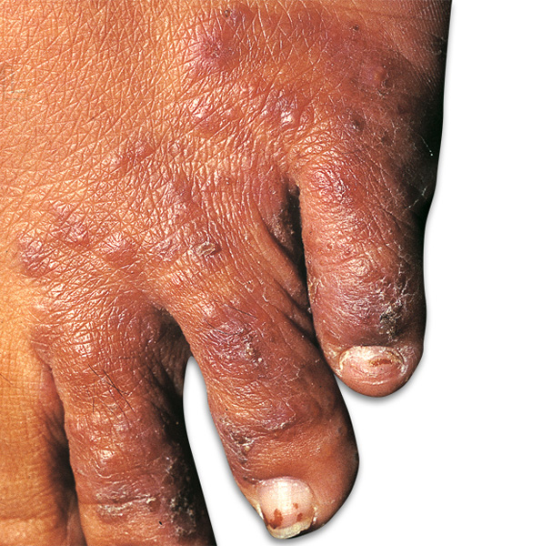
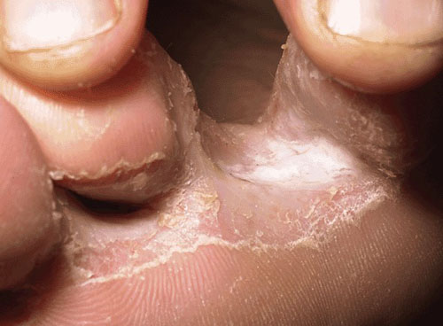
Tinea pedis

Slide 31
Tinea unguium
Onychomycosis - all fungal infections of nails including dermatophytes and non-dermatophytes.
Tinea unguium - Dermatophytic Onychomycosis
Dirty, dull, dry, pitted, ridged, split, discoloured, thick, uneven, nails with subungual hyperkeratosis.
Different types described depending on the site of nail involvement and its depth.
Distal and lateral onychomycosis
Proximal subungual onychomycosis
White superficial onychomycosis
Total dystrophic onychomycosis

Slide 32
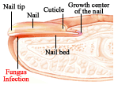

Slide 33
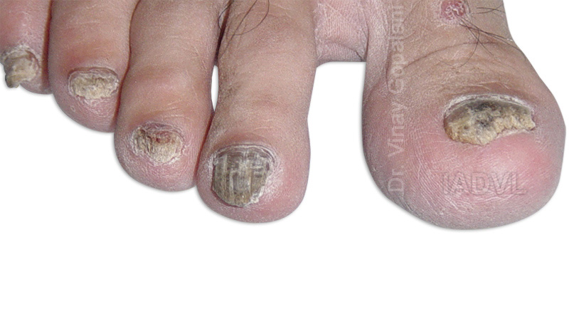
Tinea unguium
Toenail > Fingernail
Men > Women
Trauma - predisposing factor
Most common pathogens -
T. rubrum,
T. mentagrophytes
E. floccosum

Slide 34
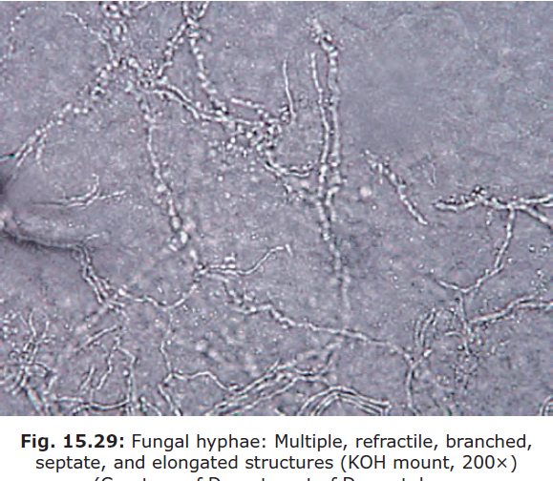

Slide 35
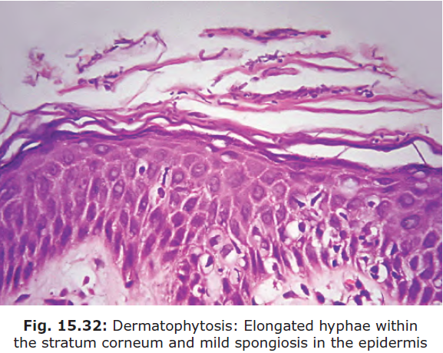

Slide 36
Antifungal

Slide 37
Classification of antifungal
Polyenes : Nystatin, Amphotericin B
Azoles :Imidazoles : Clotrimazole, Econazole, Ketoconazole, Miconazole, Oxiconazole
Triazole : Fluconazole, Itraconazole, Voriconazole
Allylamines : Terbinafine, Naftifine
Benzylamines : Butenafine
Echinocandines : Caspofungin, Micafungin
Hydroxypyridones: Ciclopirox Olamine
Heterocyclic Benzofuran : Griseofulvin

Slide 38
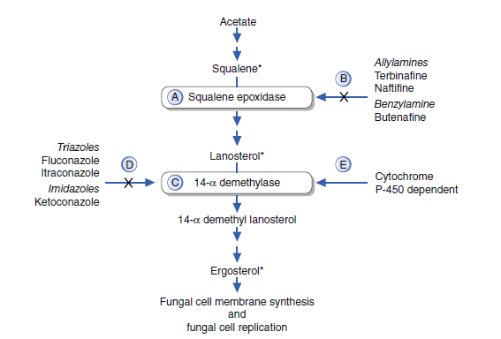

Slide 39
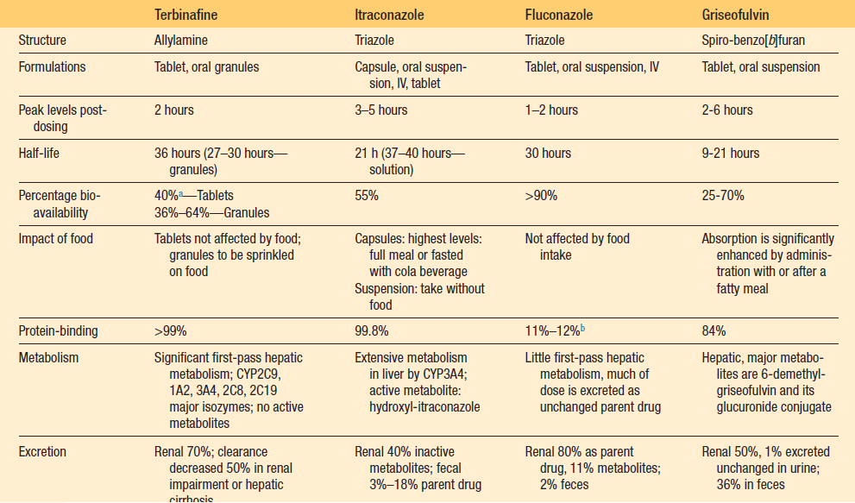

Slide 40
Class and Prototypes | Spectrum of action
Azoles Eg. Fluconazole, Ketoconazole, Sertaconazole, Eberconazole ,etc. (Fungistatic) | Dermatophytes, candida, pityrosporum, erythrasma, some action against staphylococcus
Allylamines Eg. Terbinafine, naftifine | Dermatophytes (fungicidal), Candida albicans (fungistatic)
Morpholines Eg. Amrolfine | Onychomycosis caused by dermatophytes, scytalidium spp.,Scopularis spp.,dimorphic fungi, C. Albicans, Cryptococcus neoformis, dematiaceous fungi.

Slide 41
Class and Prototypes | Spectrum of action
Benzylamines e.g. Butenafine | Dermatophyte (fungicidal), C. Albicans (fungistatic), P. versicolor
Polyenes Eg. Nystatin | Oral and Vaginal Candidiasis
Miscellaneous 1. Ciclopirox olamine | Dermatophytes, yeasts, molds e.g. Scytalidium spp. Scopulariopsis spp.
2. Zinc pyrithione 1% 3. Selenium disulfide 2.5% | P. Versicolor

Slide 42
Griseofulvin
This antifungal drug pregnancy category C was first isolated from Penicillium griseofulvum in 1939 by Oxford and colleagues, but its efficacy as an oral antifungal was first shown in 1958.
It is effective against dermatophytes only and has no action against bacteria or yeasts.
Griseofulvin is a fungistatic drug
The mode of action appears in part to be inhibition of formation of microtubules thus inhibiting fungal cell division.
It also inhibits nuclear acid synthesis.

Slide 43
The drug is poorly absorbed orally, varying between 25%–70% of an oral dose.
Peak plasma levels are attained approximately after 4 hours of ingestion.
Absorption is significantly enhanced by fatty meal.
The smaller microcrystalline and ultramicronized forms are better absorbed.
Simultaneous treatment with phenobarbitone reduces the blood levels of griseofulvin.
The anticoagulant effect of warfarin is decreased by griseofulvin.
Diminished alcohol intolerance has been reported in patients taking griseofulvin.
It may potentially cause loss of efficacy of oral contraceptives.

Slide 44
ADVERSE EFFECTS
Headache and stomach upset are common side effects.
Irritability, sleeplessness photosensitivity and exacerbation have been occasionally reported.
There is an effect on porphyrin metabolism; it precipitates an attack of acute intermittent porphyria, but porphyria cutanea tarda seems to be unaffected

Slide 45
Fluconazole
Fluconazole pregnancy category C
The drug is highly water soluble and is well absorbed via the oral route.
The drug penetrates well into tissues and body fluids.
The drug has a longer halflife thus permitting its single dose regimen
It readily penetrates the CSF and pharmacokinetic studies demonstrate that the concentration is approximately 10 times higher than the serum concentration after a single dose.
Fluconazole is predominantly excreted through the renal route and the dose should be adjusted according to the creatinine clearance.

Slide 46
ADVERSE EFFECTS
The common side effects are nausea, headache, pain abdomen and diarrhea.
Several cases of fluconazole induced Q–T prolongation with or without torsade de pointes have been reported.
Fluconazole is contraindicated in pregnancy and recent reports show that even a single dose taken by a pregnant woman can lead to birth defects in infants.
Rarely, fluconazole induced angioedema, Stevens–Johnson syndrome and toxic epidermal necrolysis have been described.

Slide 47
ITRACONAZOLE
Phenytoin, rifampicin and H2 blockers decrease the plasma concentration of itraconazole by interfering with cytochrome P-450.
Recent studies show that if it is given along with hypolipidemic agents, it can lead to rhabdomyolysis.
When given along with terfenadine, astemizole and cisapride, it causes torsades de pointes, and if given with nifedipine, peripheral edema.
Itraconazole enhances the anticoagulant effect of coumarin like drugs.
It may increase the concentration of cyclosporin if given together, thus enhancing renal toxicity

Slide 48
ADVERSE EFFECTS
The most frequently observed side effects are nausea, headache, abdominal pain and constipation.
Cutaneous side effects like skin rash, pruritus, urticaria, and Stevens–Johnson syndrome tend to occur more often in immunocompromised patients receiving immunosuppressants.
Long-term treatment for over a month can lead to increased liver enzyme levels.
A few cases of hypokalemia have been observed with long term therapy.
Itraconazole is contraindicated for the treatment of onychomycosis in patients with a history of congestive heart failure.

Slide 49
Terbinafine Adverse Effects
Overall, terbinafine is well tolerated.
Gastrointestinal disturbances and skin rash may occur. Rarely taste disturbance is noted.
The drug should be given cautiously in patients with deranged hepatic or renal function tests.
It can precipitate or exacerbate subacute cutaneous lupus erythematosus.
Cimetidine decreases its elimination, whereas rifampicin increases its elimination of drug; hence the dose should be regulated when given along with these drugs.

Slide 50
THANK YOU..

