Slide 1
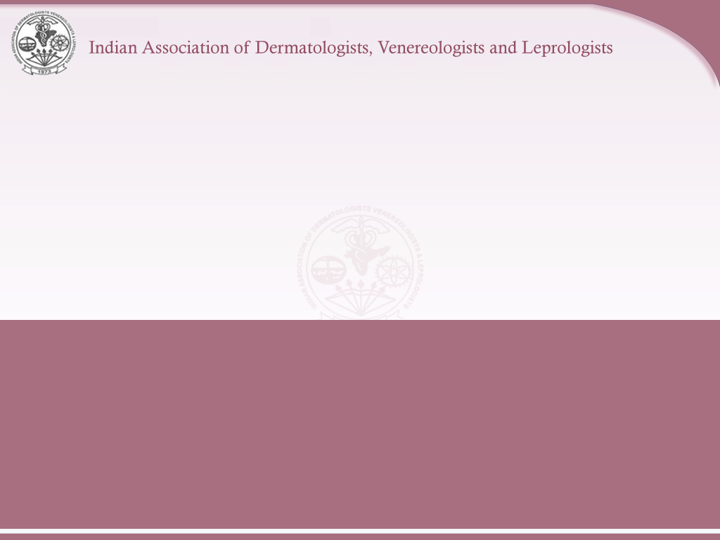
Eczema

Slide 2
Introduction
Dermatosis : Condition of the skin.
Dermatitis : Inflammation of the skin.
Eczema : Type of dermatitis.
'Ekze', in Greek means “to boil over”.
Definition : Eczema is type of dermatitis characterized by erythema, edema papulo-vesicles, oozing in acute stage, crusting and scaling in subacute & lichenification in the chronic stages and histologically characterized by spongiosis.
“All eczemas are dermatitis, but not all dermatitis are eczemas.”

Slide 3
Classification
Exogenous eczemas :
External cause for the eczema is identifiable.
Endogenous eczemas :
An internal cause or an inherent property of the skin is responsible.
Some types of eczema are precipitated by both external and internal factors. Eg: Xerotic eczema

Slide 4
Classification
Exogenous eczemas
Irritant dermatitis
Allergic contact
dermatitis
Photodermatitis
Endogenous eczemas
Atopic dermatitis
Pityriasis alba
Seborrhoeic dermatitis
Discoid eczema
Hand eczema
Asteatotic eczema
Gravitational eczema
Lichen simplex chronicus
Prurigo nodularis

Slide 5
Clinical stages
The inflammatory changes of eczema evolve through three stages :
Acute eczema
Subacute eczema
Chronic eczema
The skin changes vary in different stages.

Slide 6
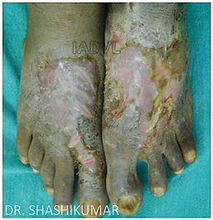
Acute eczema
Classical clinical features
Intense itching
Intense erythema
Oedema
Papulovesicles
Oozing

Slide 7
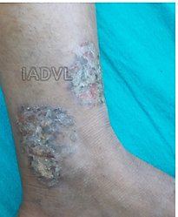
Subacute eczema
Classical clinical features
Erythema (lesser than in acute stage)
Crusting and scaling
Fissuring
Slight to moderate itching
Stinging and burning sensation

Slide 8
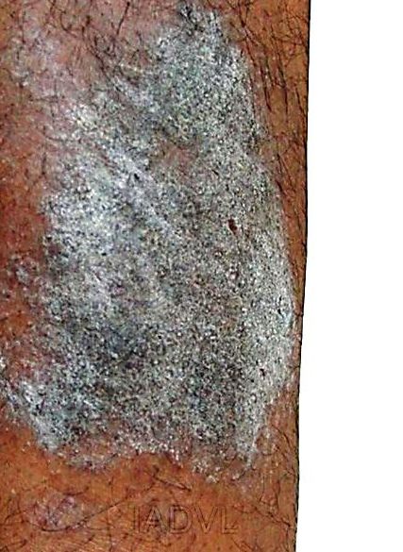
Chronic eczema
Classical clinical features
Dryness of skin
Excoriation
Fissuring
Lichenification - combination of thickening, hyperpigmentation & increased skin markings.

Slide 9
Exogenous Eczemas
Notes:
Contact dermatitis is a prototype of exogenous eczema. Types: Irritant contact reactions, Allergic contact dermatitis, Photocontact, phototoxic dermatitis, Immediate contact reactions, Non-eczematous reactions

Slide 10
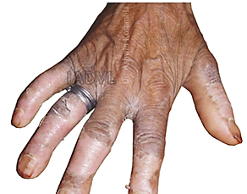
Irritant contact reaction
Non-immunologic inflammatory reaction of the skin due to an external agent.
Varied morphology.
Clinical types
Symptomatic (subjective)
irritant responses.
Chemical burns.
Acute irritant contact dermatitis.
Chronic irritant contact dermatitis.
Others
Notes:
Subjective or symptomatic irritant responses: Some persons complain of a subjective sensation of stinging, burning or smarting, but without any signs, as in from cosmetic intolerance.
Chemical Burns: Highly alkaline or acid substances. Burning sensation rather than itching. Large blister
Others: Non-immune contact urticaria, pigmentary , granulomatous, hyperkeratotic, acneiform, purpuric responses

Slide 11
Chronic irritant dermatitis
Common irritants
Water and wet work; sweating under occlusion.
Household agents: detergents; soaps; shampoos; disinfectants .
Industrial cleaning agents: solvents; abrasives.
Alkalis, including cement; acids.
Cutting oils; organic solvents.
Oxidizing agents, including sodium hypochlorite.
Reducing agents, including phenols; aldehydes
Certain plants, pesticides, raw food; animal enzymes and secretions
Desiccant powders; dust; soil
Miscellaneous chemicals
Contd…
Notes:
Syn: cumulative irritant contact dermatitis; wear and tear dermatitis
Develops as a result of a series of repeated and damaging insults to the skin

Slide 12
Chronic irritant dermatitis : Persons at risk
Persons in occupations of
Housewives
Dishwashers, bartenders
Hairdressing
Medical, dental, veterinary
Food preparation, catering, fishing
Printing and painting,
Metal work
Construction

Slide 13
Allergic contact dermatitis
Dermatitis resulting from delayed-type hypersensitivity reaction following contact of the skin with an allergen in a sensitized individual.
Develops within 12 to 48 hours of antigen exposure and persists for 3 to 4 weeks.

Slide 14
Allergic contact dermatitis
Clinical features
Acute inflammation
Well demarcated patches of erythema, edema, vesicles or bullae.
Linear, erosive and crusted lesions.
Chronic inflammation
Lichenification; scaling; or fissures.
Clinical features depend on location; duration of contact with allergen.
Intensity of the inflammation depends on the degree of sensitivity, concentration of antigen.

Slide 15
Allergic contact dermatitis
Allergens | Sources
Nickel, cobalt | Artificial jewellery
Chromium | Cement, Painting
Potassium dichromate | Leather, detergents
Epoxy resins, phenols | Plastics
Parthenium | Plants
Propylene glycol | Cosmetics, medicaments
PPD | Hair dyes
Neomycin, gentamycin | Topical medications

Slide 16
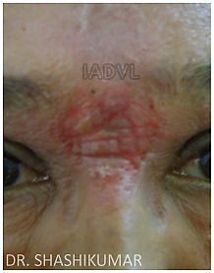
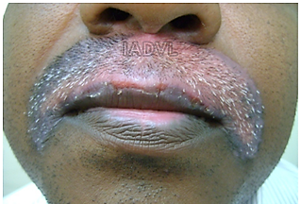
Allergic contact dermatitis
ACD to Hair dye
Bindi dermatitis

Slide 17
Photodermatitis
  An eczematous response of skin to sunlight
  Distribution typically on the light exposed areas of the skin
  Types of reactions to sunlight :
  Photo-toxic
  Photo-allergic
  Eczematous polymorphic light eruptions

Slide 18
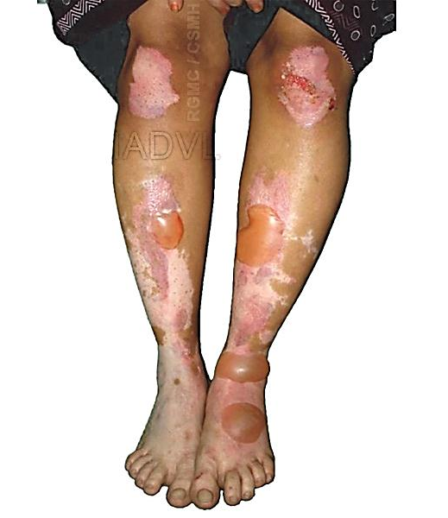
Phototoxic reactions : Inducing agents
Topical
Perfumes
Dyes
Psoralens
Tars
Plants (lime, celery)
Systemic
Psoralen
Tetracycline
Phenothiazine

Slide 19
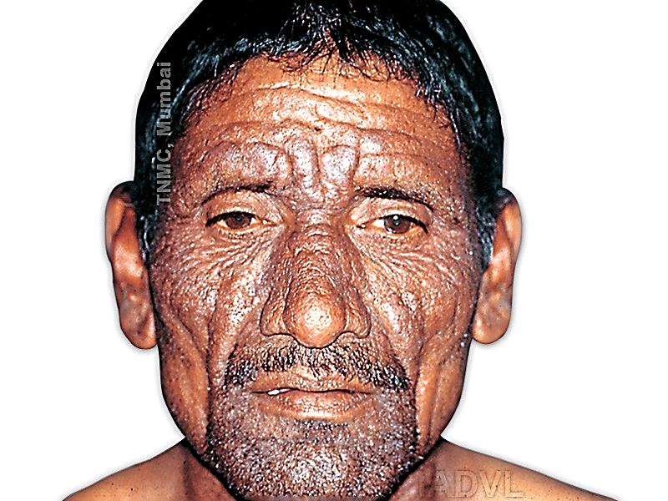
Photoallergic reactions : Inducing agents
Topical
Perfumes (soaps, aftershave)
Sunscreens (PABA)
Neomycin
Halogenated compounds
Parthenium (congress grass)
Systemic
NSAIDS
Phenothiazine
Thiazides
Parthenium

Slide 20
Photoallergic reactions
Parthenium induced photoallergic dermatitis
A type of hypersensitivity reaction aggravated by sunlight.
Commonly seen in people coming in contact with the pollen grains and other parts of the plant Parthenium hysterophorus.
Often occurs in farmers and people living in the vicinity of these plants.

Slide 21
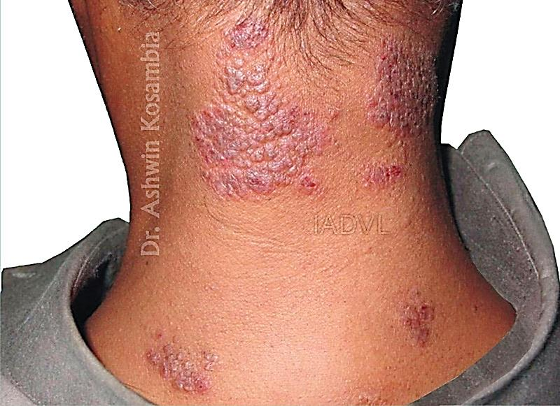
Polymorphic light eruption (PMLE)
Clinically characterized by an intermittent, delayed, and transient abnormal cutaneous reaction to UVR exposure.
The reaction consists of nonscarring, pruritic, erythematous papules, vesicles, or plaques on the light-exposed areas of the skin.

Slide 22
Hand eczema
Its is not a single disease and it is due to summation of many factors.
Commonly seen in dermatology practice; can be exogenous, endogenous or of combined aetiology.
Causes discomfort, embarrassment, interferes with normal daily activities.
Common in industrial occupation and threatens job security if infection is not controlled.
Womens are affected twice as often as men

Slide 23
Hand eczema
Morphological types
Irritant eczema
Allergic eczema
Recurrent focal palmar peeling
Hyperkeratotic palmar eczema
Fingertip eczema
Pompholyx (dyshidrotic eczema)
Id reaction

Slide 24
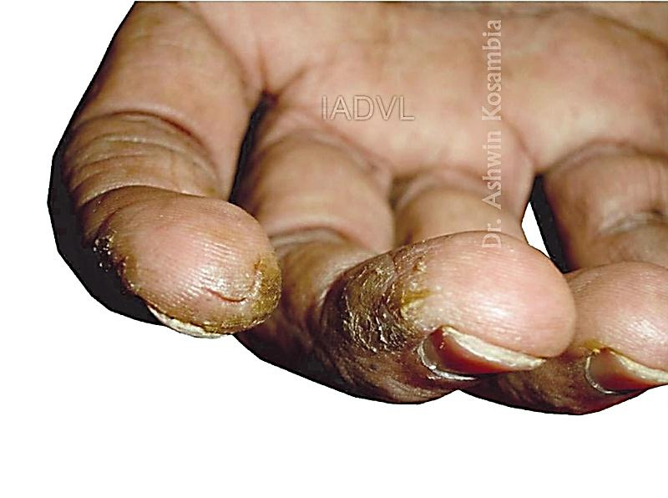
Fingertip eczema
Chronic eczema of the palmar surface of the fingertips, which may involve one or all fingertips.
The skin is dry, cracked, scaly and may break down into painful and tender fissures.
Resistant to treatment.
Advise patient to avoid irritants; use topical steroids and maintain lubrication of hands.

Slide 25
Pompholyx (Dyshidrotic eczema)
Chronic relapsing palmoplantar eczematous dermatitis characterized by firm, pruritic vesicles and bullae.
Deep-seated, symmetrical, pruritic, sago grain-like vesicles, preceded by moderate to severe itching.
Vesicles resolve gradually in 3 to 4 weeks, and may be followed by chronic eczematous changes.
Cause not known; not associated with any abnormality of the sweat glands.

Slide 26
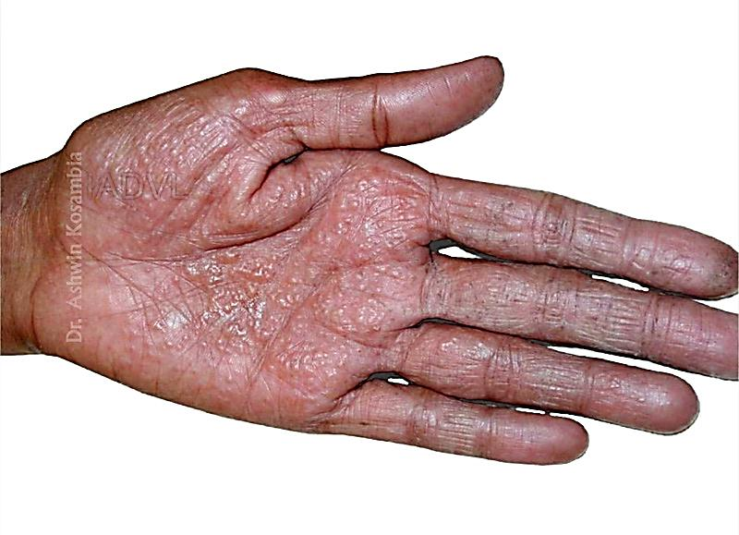
Pompholyx
Multiple deep-seated sago grain-like vesicles

Slide 27
Hand eczema
General instructions to patients
Only wash your hands when they are dirty.
Avoid use of harsh soaps and wash hands with mild synthetic detergents & lukewarm water.
Avoid direct contact with cleansers and detergents.
Avoid direct contact with and/or handling anything that causes burning or itching. E.g. wool; wet nappies; peeling potatoes; handling fresh fruits, vegetables, raw meat.
Preferably wear gloves while doing housework or work that involves contacting irritants.
Ensure frequent use of moisturizers and emollients.

Slide 28
Endogenous Eczemas

Slide 29
Atopic dermatitis
A chronic, immune-mediated, pruritic, inflammatory skin condition seen in atopic individuals.
Atopic
Dermatitis
Asthma
Allergic
Rhinitis
(Hay fever)
Atopic Triad

Slide 30
Atopic dermatitis
Marked by alternating periods of remission and flare-ups.
A result of complex interplay between environmental, immunologic, genetic and pharmacologic factors.
Aggravated by infection, psychological stress, seasonal changes, irritants, and allergens.

Slide 31
Atopic dermatitis
Diagnosis
It cannot be precisely defined as it does not have specific skin changes, histologic features or diagnostic laboratory test.
The diagnosis is usually arrived on the basis of clinical findings, comprising three or more major criteria and three or more minor criteria (Hanifin and Rajka, 1980).

Slide 32
Atopic dermatitis
Diagnostic criteria : Major features
Pruritus.
Typical morphology and distribution - Facial and extensor involvement in infants and children, flexural lichenification in adults.
Chronic or relapsing dermatitis.
Personal or family history of atopy (atopic dermatitis; asthma; allergic rhinitis).

Slide 33
Atopic dermatitis
Diagnostic criteria : Minor features
Xerosis
Ichthyosis, palmar hyperlinearity, or keratosis pilaris
Immediate (type 1) skin-test reactivity
Raised serum IgE
Early age of onset
Tendency toward cutaneous infections (especially S aureus and herpes simplex) or impaired cell-mediated immunity
Tendency toward non-specific hand or foot dermatitis
Nipple eczema
Cheilitis , Recurrent conjunctivitis
Dennie-Morgan- infraorbital fold

Slide 34
Atopic dermatitis
Diagnostic criteria : Minor features
Keratoconus
Anterior subcapsular cataracts
Orbital darkening
Facial pallor or facial erythema
Pityriasis alba
Anterior neck folds
Itch when sweating
Intolerance to wool and lipid solvents
Perifollicular accentuation
Food intolerance
Course influenced by environmental or emotional factors
White dermographism or delayed blanch

Slide 35
Atopic dermatitis
Clinical features
Age of onset typically during infancy (2 to 6 months); but may start at any age.
Clinical features vary at different phases of life; and comprise:
Itching
Macular erythema, papules or papulo-vesicles
Eczematous areas with crusting
Lichenification and excoriation
Dryness of the skin
Cutaneous reactivity
Secondary infection

Slide 36
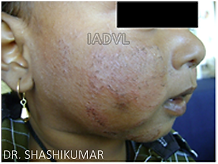
Atopic dermatitis
Infantile phase (2 months to 2 years)
Sites : cheeks, perioral area and scalp; extensors of feet and elbows.
Oozing lesions.
Teething, respiratory infections, emotional upsets and seasonal changes influence the disease course.
The disease often subsides by 18 months of age; but may progress to the childhood phase.

Slide 37
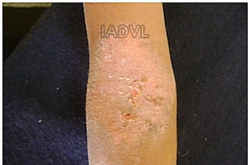
Atopic dermatitis
Childhood phase (2 to 12 years)
Characteristically involves elbow and knee flexures, sides of the neck, wrists and ankles.
Scratching and chronicity lead to lichenification.
Hands may often be involved with exudative lesions, sometimes with nail changes.
Secondary bacterial or viral infection may give rise to acute generalized or localized vesiculation.

Slide 38
Atopic dermatitis
Adult phase (12 years onwards)
Commonly involves flexural areas.
The disease may be diffuse or patchy.
May manifest only as chronic hand eczema.
Dermatitis of the upper eyelids and blepharitis.

Slide 39
Atopic dermatitis
Triggering factors
Anxiety; emotional stress
Temperature change and sweating
Decreased humidity
Excessive washing
Contact with irritants
Allergens
Foods
Microbial agents
Notes:
Anxiety and emotional stress have marked aggravating effect on the atopic dermatitis.
Atopic patients do not tolerate sudden changes in the temperature.
Decrease in the humidity, as in winter months, aggravates dryness of skin.
Repeated washing and drying remove water-binding lipids from the first layer of the skin.
Use of detergents, cosmetics, soaps, solvents, wool, household and industrial chemicals, cosmetics, perfumes, and some soaps.
House dust mite - Dermatophagoides pteronyssinus , pollens and allergens from pets, molds, or human dander
Food - eggs, peanuts, milk, fish, soy and wheat.
Staphylococcus aureus

Slide 40
Atopic dermatitis
Management
First-line treatment
Second-line treatment
Third-line treatment
Counselling; occupational advice

Slide 41
Atopic dermatitis
Management
First-line treatment
Second-line treatment
Third-line treatment
Counselling; occupational advice

Slide 42
Management of Atopic dermatitis
First-line treatment
Identify and control ‘flare factors’
Topical treatments
Bathing; Emollients; Humectants
Corticosteroids
Calcineurin inhibitors : Pimecrolimus; tacrolimus
Icthamol and tar
Notes:
General measures: Advise the patient to avoid frequent use of soaps; and to use soaps that are less alkaline (pH 5.5).
Advise the patients to avoid contact with wool, which irritates the skin
Advise measures to avoid exposure to house dust mites - regular cleaning of the premises; use of dust mite proof encasings on pillows, mattresses;
weekly washing of the bedding in hot water; removal of bedroom carpets and maintaining indoor humidity levels with air conditioning. Advise patients also to avoid keeping pets.
Identify the offending food agents and advise patients to avoid the same.
Inform patients about the aggravating effect of the herpes simplex infection on the AD
Advise patient to avoid extremes of temperature.
Advise patients to avoid stress

Slide 43
Management of Atopic dermatitis
First-line treatment
Oral treatment
  Antihistamines
  Sedative antihistamines preferred
  Promethazine; trimeperazine; hydroxyzine
  Antibiotics
  Systemic steriods (in severe cases)

Slide 44
Management of Atopic dermatitis
Second-line treatment
Intensive topical therapy- step up to potent steroid
Wet wrap technique
Allergy management
  Food
  Inhalants
  Contact allergy
Notes:
Wet wrap techniques - This technique is employed for controlling severe AD or acute flare-ups. The rationale is to keep the skin moist when the topical steroids are applied so as to enhance their skin penetration. A low-potency topical steroid is applied to the affected skin. Then two layers of absorbent bandage are applied over it. The inner layer is pre-soaked in warm water and the outer layer is dry. The dressings can be used overnight or changed every 12 hr.
Encourage mothers for prolonged breast-feeding. Avoid eggs, milk, peanuts, soy and wheat.
Aggressive eradication of the house dust mites

Slide 45
Management of Atopic dermatitis
Third-line treatment
Phototherapy
Oral immunosuppresants
  Cyclosporine
  Azathriopine
  Thymopentine
  α- Interferon
  Desensitization
Notes:
NBUVB – preferred in children.
Desensitization plays a limited role.
Counseling and occupational advice Counseling about the nature of the atopic dermatitis, the trigger factors, the fluctuant course of the disease, and the treatment benefits and limitations play a major role.

Slide 46
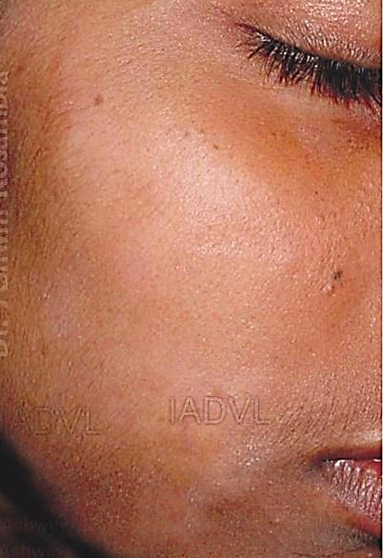
Pityriasis alba
A common disorder characterized by asymptomatic, ill-defined, hypopigmented, scaly macules and patches.
Low grade eczematous disrupts melanosomes transfer from melanocytes to keratinocytes.
Primarily seen on the face of children and adolescents.
Infrequently involves lateral aspect of the upper arm; and thighs.
Notes:
It commonly affects children between age of 3 and 16 years, and disappears in early adulthood. It often occurs during winter and frequently involves the face, particularly area around the mouth, chin and cheeks.

Slide 47
Pityriasis alba
Minor feature of atopic dermatitis.
Hypopigmentation appears prominent in dark skinned patients and during summer as it stands out against the tanned skin.
DD :
PIH, tinea versicolor, Indeterminate hansens, previtiligo.
Management :
Reassurance : self-limiting condition; hypopigmentation is not due to vitiligo.
Emollients to control scaling.
Sunscreens.
Short course of a topical steroid for actively inflammed lesions.

Slide 48
Seborrhoeic dermatitis
A common, chronic, inflammatory papulosquamous disease, which characteristically involves areas rich in sebaceous glands with high sebum production and large body folds.
Lesions favor the scalp, ears, face, central chest and intertriginous areas.
Lesions comprise erythema, greasy and scaly papules and red, coalescing plaques, leading to eczematous changes.
2 forms - Infantile and adults forms.

Slide 49
Aetiology
Exact causes not known, several factors implicated :
Pityrosporum ovale
Defective cell-mediated immune response to P. Ovale
Increased P. Ovale in dandruff and affected skin areas
Overactive sebaceous glands with overproduction of sebum or alterered sebum composition.
Immunocompetent persons with family history.
May be associated with psoriasis; Parkinson’s disease.
May be a marker of HIV infection.
Aggravated by emotional stress.

Slide 50
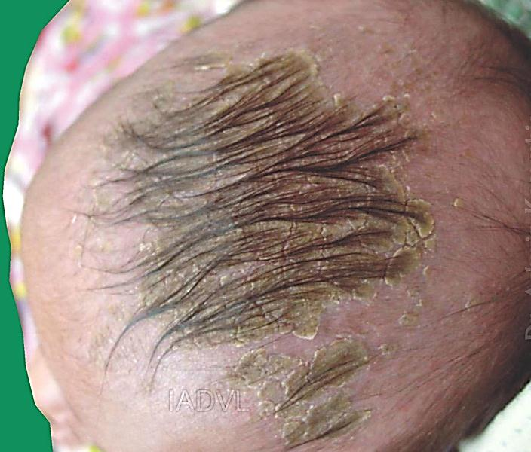
Clinical features (Infants)
Commonly affects within first 3 months of life; rare after 6 months of age; affects both sexes equally.
Usually starts in 1st week after birth.
Affects the scalp (vertex and frontal areas; the ‘cradle-cap’ area), diaper area, face (forehead, eyebrows, eyelids, nasolabial folds, temples), retroauricular folds, neck and the axillae.
Lesions comprise tiny papules covered with yellow, greasy scales; and redness in the diaper area and axillae.

Slide 51
Clinical features (Adults)
Affects hairy areas; mostly men (30 to 60 years).
Scalp : Earliest sign is dandruff; later followed by greasy scales and retroauricular fissuring. Inflammation and itching are associted with dandruff in seborrheic dermatitis.
Face : Scaling & erythema of forehead, medial portion of eyebrows, eyelids, nasolabial folds, lateral part of nose and retroauricular region.
Trunk : Papules, greasy scales, petaloid pattern.
Flexural areas : erythema, greasy scaling and secondary infection.

Slide 52
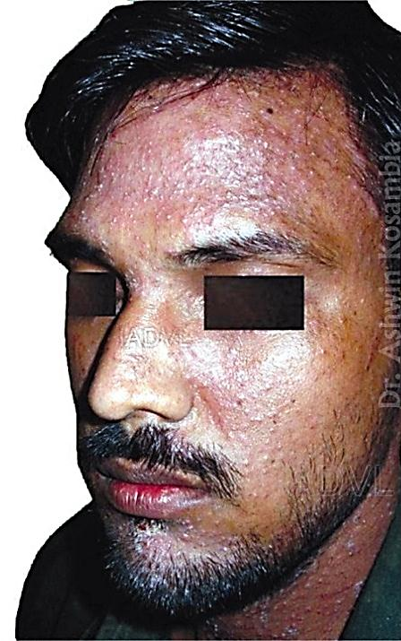
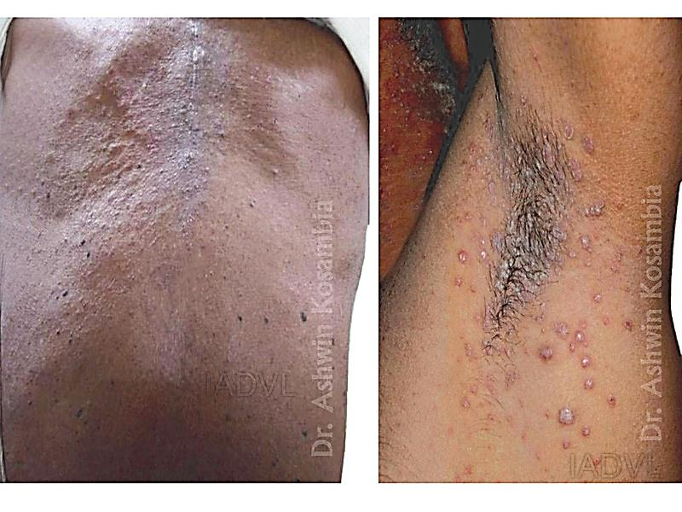
Seborrhoeic dermatitis

Slide 53
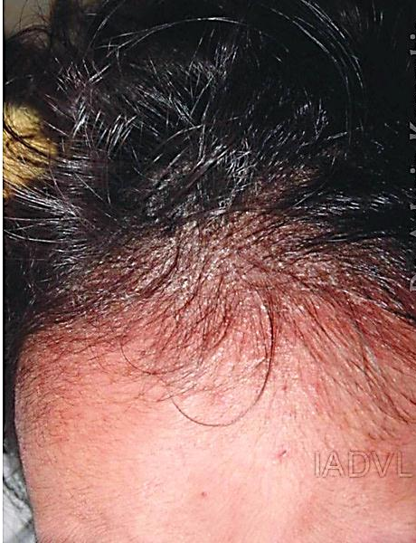
Seborrhoeic dermatitis
Aims of Management
Loosening and removal of scales by shampoos and keratolytic agents.
Inhibit colonization by the yeast
P. ovale.
Reduction of itching and redness.
Educate patient about chronic, recurrent nature of the disease.

Slide 54
Seborrhoeic dermatitis
Management
Medicated shampoos : selenium sulphide or ketaconazole, ciclopirox olamine, tar and salicylic lotions.
Mild topical steroid or antifungals for lesions on face and trunk.
Short course of systemic steroids or antifungals, UVB therapy, for recalcitrant disease.

Slide 55
Asteatotic eczema
(Eczema craquele, winter eczema)
Eczema associated with a decrease in the skin surface lipids; excessive dryness of the skin precedes eczema.
Elderly and atopics affected;
Starts over shins later may spread to thighs, proximal extremities and trunk. Face, palms & soles spared.
Common during winter, low humidity.
Dry, scaly skin (xerosis); dry, cracked finger pulps; thin, long, horizontal and vertical superficial fissures on the legs (cracked porcelain or ‘crazy paving’ pattern, dried riverbed).
Erythema, eczematous changes, haemorrhagic and purulent fissures in severe cases.

Slide 56
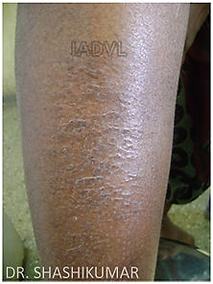
Asteatotic eczema

Slide 57
Asteatotic eczema
Management
Advise to live in a warm room; avoid exposure to cold winds.
Wear woollen clothing over the cottons, avoid direct contact with wool.
Short bath with lukewarm water; and avoid harsh soaps and detergents.
Application of emollient, immediately after bathing frequently thereafter to keep the skin moisturized.
Lanolin and paraffin based creams; weak topical corticosteroids, in urea base, which encourages hydration.

Slide 58
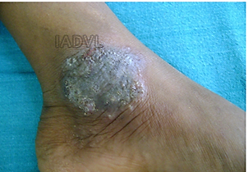
Discoid eczema (Nummular eczema)
Chronic eczema of unknown cause, characterized by coin-shaped plaques with well-defined margins; lesions may be annular or ring-shaped.
Predominantly affects the middle-aged and elderly persons with dry skin; rare in children; aggravates in winter.
Commonly affects extensor surfaces of the limbs, trunk, dorsa of the hands.

Slide 59
Discoid eczema
Management
Frequent use of emollients
Avoid known irritants and allergens.
Topical corticosteroids
Systemic steroids in extensive disease.
Sedative antihistamines
Broad-spectrum systemic antibiotics in exudative lesions.

Slide 60
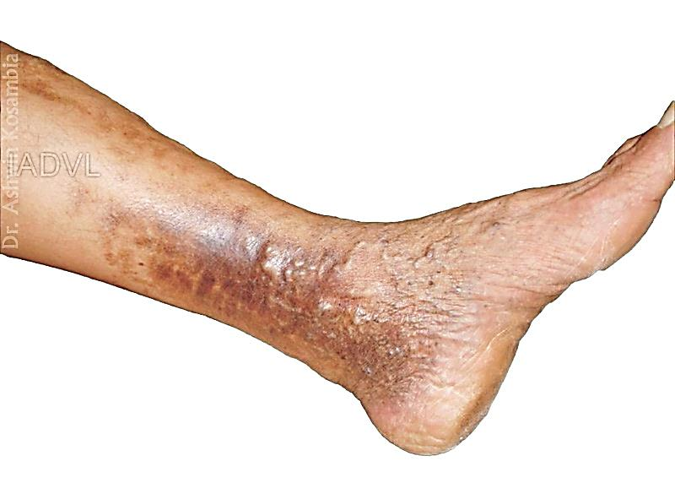
Gravitational eczema
(Venous eczema; Stasis dermatitis)
It is a common component of the clinical spectrum of chronic venous insufficiency of the lower extremities.
Commonly occurs in persons who require to stand for long hours.
Sites: medial aspect of the lower leg.
Chronic inflammation and microangiopathy asdsociated with chronic venous insufficiency is responsible.
Also contact sensitization & irritant dermatitis due to stasis ulcer secretion have a role.
May present as acute, subacute or chronic eczema.

Slide 61
Gravitational eczema
Associated features of venous hypertension :
Oedema of the legs
Dilated superficial veins; varicose veins
Purpura, brownish discolouration due to haemosiderosis
Erosion; ulceration
White atrophic telangiectatic scarring (atrophie blanche)
Elephantiasis nostra (papillomatosis) in chronically congested limbs
Elevated homocysteinemia.
Notes:
Pitting edema of medial aspect of leg is the initial sign of chronic venous insufficiency which is more in the evening. Later redness (pseudoerysipelas), lipodermatosclerosic changes.
Vesiculation may be secondary to contact sensitization may lead to secondary dissemination.

Slide 62
Gravitational eczema
Management :
Management of chronic venous hypertension is the mainstay
Leg elevation; weight reduction in obese patients
Adequate compression bandage or stockings
Surgery for chronic venous insufficiency
Sedative antihistamines
Topical steroids
Systemic antibiotics for secondary bacterial infection

Slide 63
Lichen simplex chronicus
(Circumscribed neurodermatitis)
Result of persistent itching and scratching.
Commonly affects adults (30 to 50 years); often in atopics.
Presents multiple, intensely pruritic, circumscribed, localized, lichenified skin plaques.
Involves easily accessible areas: scalp, nape and sides of the neck, wrists, extensor surface of the arms, ankles, upper thighs, perineum, vulva and scrotum.
Psychological factors may play a role.

Slide 64
The “Itch / Scratch” Cycle
Itch
Scratch
Scratch
Itch

Slide 65
Prurigo nodularis
Chronic condition characterized by intensely itchy, small, firm, reddish papules & nodules.
Idiopathic, papular or nodular form of lichen simplex chronicus.
Commonly affects individuals (20 to 60 years); both sexes equally; emotional stress may contribute.
Usually involves extensor surface of limbs; may also occur on the face, trunk and the palms.

Slide 66
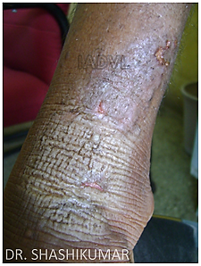
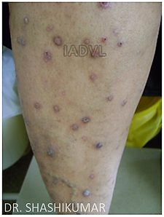
Lichen simplex chronicus
Prurigo nodularis

Slide 67
Lichen simplex chronicus / Prurigo nodularis
Management
Educate about the role of stress in causing itching and scratching.
Counsel to relieve the tension and anxiety.
High potency steroids, under occlusion. Intralesional steroids for circumscribed chronic lesions.
Topical capsaicin; doxepin; sedative antihistamines.
Topical vitamin D3 in steroid-resistant prurigo.
Psychotropic drugs : relieve anxiety and depression.

Slide 68
MCQ’S
  Q.1) Mother brought her 5 year old child with a complaint of white patch over the face. Had similar history lesions 3 months back. On examination ill-defined scaly macule was seen and sensation was normal. The most probable diagnosis is
  Indeterminate Hansens
  Pityriasis alba
  Pityriasis versicolor
  Post inflammatory hypopigmentation
Notes:
Ans : Q. 1 - B

Slide 69
MCQ’S
  Q.2) The following are endogenous eczema except
  Atopic dermatitis
  Nummular eczema
  Diaper dermatitis
  Stasis eczema
  Q.3) White dermographism is associated with?
Infective eczema
Atopic dermatitis
Asteatotic eczema
Idyshidrotic eczema
Notes:
Ans : Q. 2 - C, Q. 3 - B

Slide 70
MCQ’S
Q.4) A topical antibiotic causing frequent allergic contact dermatitis
Nadifloxacin
Fusidic acid
Dapsone
Neomycin
Q.5) Among the metals, the most commonest cause of allergy is
Nickel
Cobalt
Chromium
Silver
Notes:
Ans : Q. 4 - D, Q. 5 - A

Slide 71
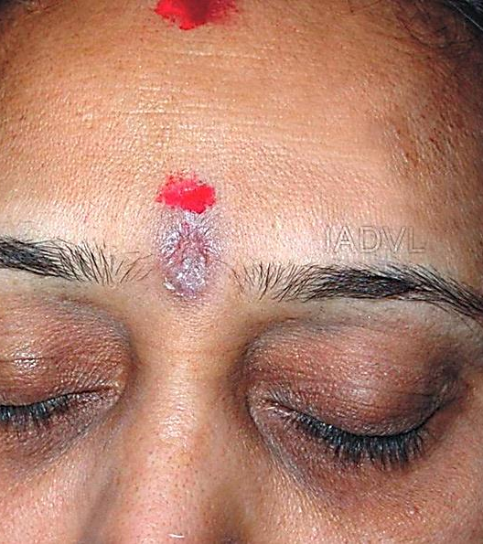
Photo Quiz
Q. Identify the condition?
Notes:
Ans : Bindi dermatitis

Slide 72
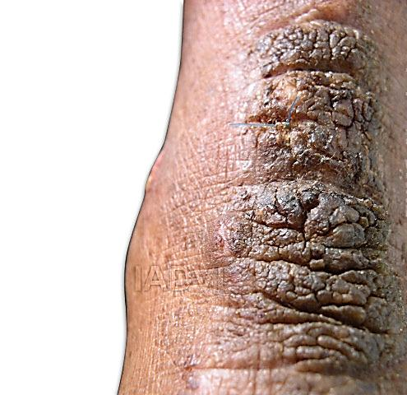
Photo Quiz
Q. Identify the condition?
Notes:
Ans : Lichen Simplex Chronicus

Slide 73
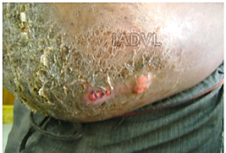
Photo Quiz
Q. Identify the variant of eczema
Notes:
Ans : Infective eczema

Slide 74
Thank You!

