Slide 1
Immunization

Slide 2
Contents:
Introduction
Vaccine preventable disease
Types of vaccines
National Immunization schedule
Adverse reaction & contraindications
Immunization programme

Slide 3
Immunization
Def:-
“Immunization is the administration of all or part of a pathogen or preformed antibodies to elicit an immunological response that protects from disease.”
Considered one of the most cost effective health interventions of all times.

Slide 4
VPDs?

Slide 5
Vaccine Preventable Diseases:
Vaccine | Disease
BCG | Tuberculosis
OPV | Poliomyelitis
Hepatitis | Hepatitis-B
Rota viruse | Rota virus diarrhoea
Pentavalent | Diphtheria, Tetanus, Pertusis. Hepatitis-B, Influenza
Measles-Rubella | Measles-Rubella
Japanese encephalitis | Japanese encephalitis
Vitamin - A | Night Blindness
Tuberculosis

Slide 6
Types of vaccines
Types | Vaccine
Live attenuated vaccine | BCG, OPV, Measles, MMR, Rotavirus,
Killed or inactivated vaccine | IPV, Rabies, Hepatitis A, Influenza
Sub-unit (purified antigen) | Hepatitis-B, Hib (Haemophillus influenzae type-B), Pnumococcal
Toxoid | Tetnus toxoid, Diphtheria toxoid

Slide 7
National Immunization Schedule

Slide 8
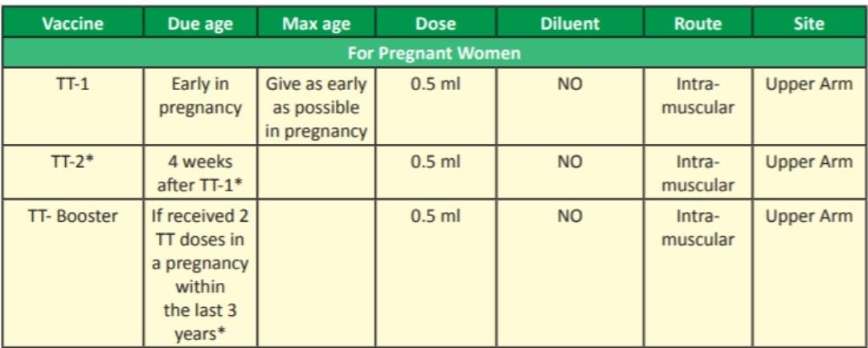
National Immunization Schedule. For pregnant women

Slide 9
NIS. for Infants
Vaccine | Due age | Max age | Dose | Diluent | Route | Site
BCG | At birth | Till one year | (0.05ml until 1 month) 0.1ml beyond 1 month | Nacl | Intra-dermal | Upper left arm
Hepatitis-B | At birth | Within 24 hours | 0.5ml | No | Intra muscular | Anto-lateral side of mid thigh
OPV-0 | At birth | Within first 15 days | 2 drops | - | Oral | Oral
OPV 1,2,3 | At 6, 10, 14 weeks | Till 5 years of age | 2 drops | - | Oral | Oral
Pentavalent 1, 2, 3 | At 6, 10, 14 weeks | Till 1 years of age | 0.5ml | No | Intra muscular | Anto-lateral side of mid thigh
Rotaviruse | At 6, 10, 14 weeks | Till 1 years of age | 5drops | No | Oral | Oral
IPV | At 6, 14 weeks | Till 1 years of age | 0.1ml | No | Intra-dermal | Upper arm Right

Slide 10
NIS. for Infants cont..
Vaccine | Due age | Max age | Dose | Diluent | Route | Site
Measles/ MR-1st dose | At 9-12 month | 5 years of age | 0.5ml | Sterile water | Sub-cutaneous | Upper arm right
Japnese encephalitis | At 9-12 month | 15 years of age | 0.5ml | Phosphate buffer solution | Sub-cutaneous | Upper arm left
Vit-A | At 9 months | 5 years of age | 1ml | - | Oral | Oral

Slide 11
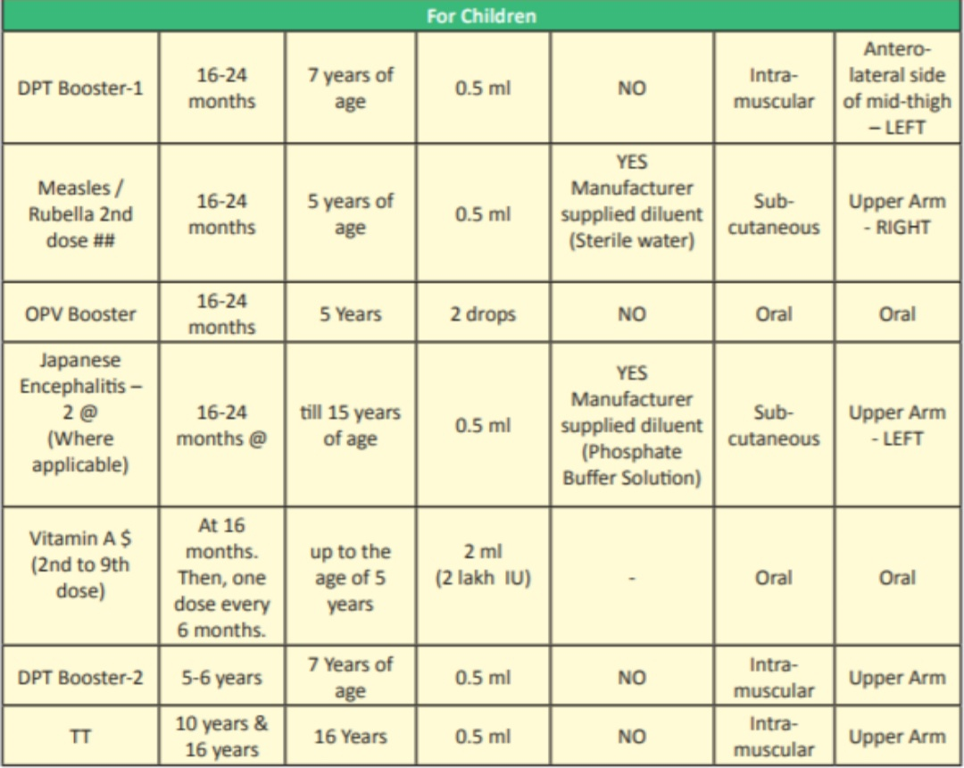
NIS. for children cont..

Slide 12
Adverse reactions
&
Contraindication

Slide 13
Bacillus Calmette Guerin (BCG) vaccine
Adverse reactions | Local ulceration or discharging sinus; axillary lymphadenitis; disseminated infection, osteomyeltis (in immunodeficient recipient)
Contraindication | Cellular immunodeficiency; symptomatic HIV
Storage | 2-8°C; sensitive to heat and light; discard unused vaccine after 4 hr

Slide 14
Oral poliovirus (OPV) vaccine
Adverse reactions | Vaccine derived poliovirus; vaccine associated paralytic poliomyeltis
Contraindication | Inherited or acquired immunodeficiency; symptomatic HIV
Storage | Storage 2-8°C; sensitive to heat; use vaccine vial monitor

Slide 15
Pentavalent vaccine
Adverse reactions | Local pain, swelling, fever
Contraindication | (i) Progressive neurological disease (administer DT or dT instead); (ii) anaphylaxis after previous dose; (iii) encephalopathy within 7 days of previous dose
Storage | 2-8°C; sensitive to light

Slide 16
Measles Vaccine
Adverse reactions | Fever, transient macular rash ('measles like' illness) 5-10 days later
Contraindication | (i) Immunosuppressive therapy (e.g. high dose corticosteroids); (ii) malignancy; (iii) severe immunodeficiency (iv) untreated tuberculosis
Storage | 2-8°C; sensitive to heat and light; use within 4-6 hrs of reconstitution

Slide 17
Rotavirus vaccine
Adverse reactions | Intussusception (rare)
Contraindication | Past history of intussusception; severe immunodeficiency
Storage | 2-8°C; do not freeze; protect from light; use immediately after reconstitution or opening

Slide 18
Immunization Programme

Slide 19
Mission Indradhanush
To strengthen and re-energize the immunization programme and achieve full coverage at rapid pace, The Govt. of India launched ‘Mission -Indradhanush’ in December 2014.
It aims to immunize all children under the age of 2 years, as well as all pregnant women, against seven vaccine preventable diseases.

Slide 20
7 colours of Indradhanush represents prevention against 7 diseases i.e.
S.no | Disease
1 | Diphtheria
2 | Tetanus
3 | Pertusis
4 | Polio
5 | Tuberculosis
6 | Measles
7 | Hep-B

Slide 21
Newer vaccines added in Mission Indradhanush are:
IPV
Rota viruse
Japanese encephalitis
Pnuemococcal vaccine
Haemophilus influenzae type B

Slide 22
Intensified Mission-Indradhanush
To further intensify immunization programme, Govt. of India launched ‘Intensified Mission-Indradhanush’ in 2017. Which aims to reach each every child upto 2 years of age and all those pregnant women who have been left uncovered under routine immunization programme.

Slide 23
End

