Slide 1
STD
(Chancroid,Donovanosis, LGV)
Dr Ashwin charaniya
a.P dept of dvl
12/06/2024

Slide 2
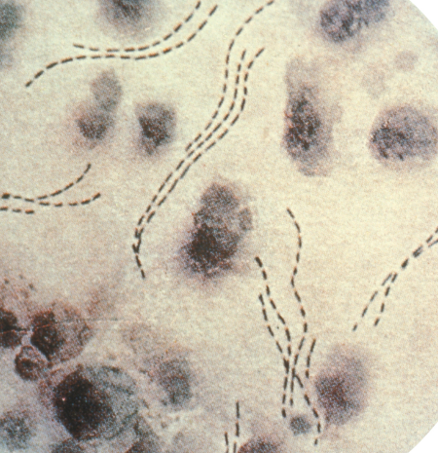
Chancroid
Also known as soft chancre.
Acute, autoinoculable, STI caused by Hemophilus ducreyi.
Males affected more commonly.
Etiology : Hemophilus ducreyi
Pleomorphic gram negative facultative, anaerobic bacillus.
“School of fish” or “rail road track” appearance (gram stain).
Growth is best in Mueller Hinton agar supplemented with chocolate horse blood.

Slide 3
Epidemiology
10% of patients are co-infected with either HSV or T. pallidum.
Males >> females.
Occurs in sustained, urban outbreaks.

Slide 4
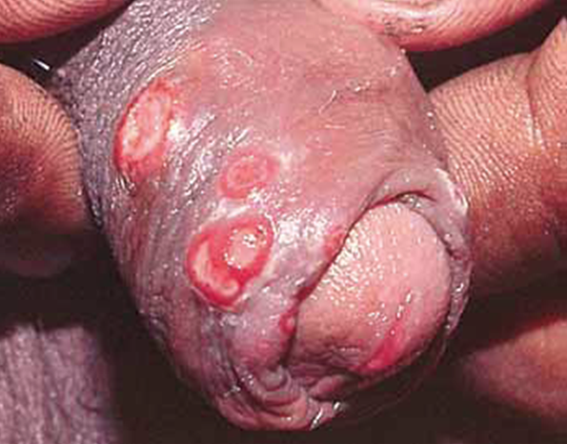
Clinical features
Incubation period : 3-7 days
Sites : Frenulum, prepuce, coronal sulcus in male and vulva, vestibule in females.
Painful genital ulcers
Non-indurated (Soft chancre)
Bleed on touch, undermined edges,
Yellow-grey necrotic slough
Yellow ragged edges
Edema of prepuce

Slide 5
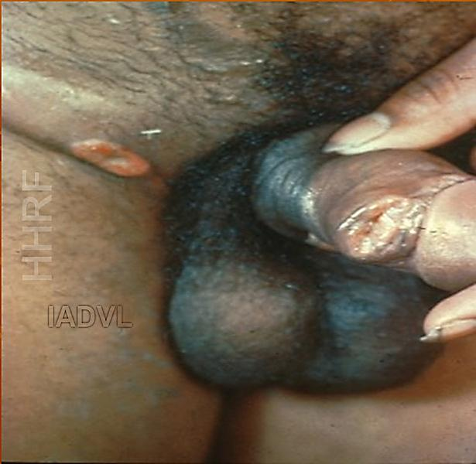
Tender sometimes suppurative
inguinal lymphadenopathy (BUBO)
(unilateral in majority).
Suppurative, unilocular , discrete, rupture of abscess . Ulcer , single sinus formation.
Gram staining & culture of the pus can be done

Slide 6
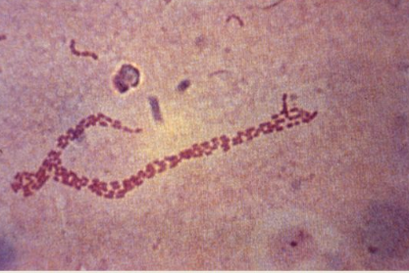
Investigations and Treatment
Microscopy:
Gram stain : Pleomorphic GNB, short chains, pairs, or schools of fish appearence, rail road track appearance, thumb print appearence
  Culture: Mueller-Hinton agar base with 5% chocolated horse blood (MH-HB)
Histopathology: not done routienly,
The lesion consists of three vertical zones with characteristic vascular changes.
Ulcer is narrow and consists of neutrophils, fibrin, erythrocytes, and necrotic tissue.
The middle zone - wide and newly formed blood vessels with proliferation of their endothelial cells, thrombosis.
Deep zone is composed of a dense infiltrate of plasma cells and lymphoid cells

Slide 7
Serology : ELISA, Immuno dot technique
Molecular techniques – PCR
Treatment (NACO)
Azithromycin 1 gm orally single dose
or
Ceftriaxone 250 mg IM in a single dose
or
Ciprofloxacin 500 mg twice daily x 3 days

Slide 8
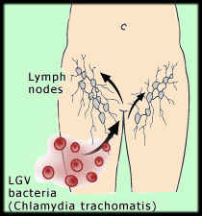
Lymphogranuloma Venereum (LGV)
Sexually transmitted Chlamydial disease that primarily involves Lymphatics
A,B ,Ba ,C – TRACHOMA
D- K – INCLUSION CONJUCTIVITIS
L1,L2,L3 - LGV
Lymphogranuloma venereum is caused by Chlamydia trachomatis serovars L1, L2 & L3.

Slide 9
Etiopathogenesis
Chlamydia enters minute skin disruptions during intercourse
Lymphotropic causing lymphangitis
Lymph node necrosis and abscess formation
Fistulae and sinus tracts

Slide 10
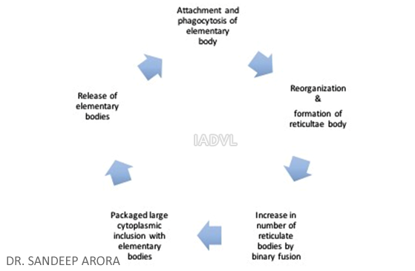
Life cycle
Infection

Slide 11
Infection occurs through metabollically inactive elementary body
Conversion to metabolically active reticulate body occurs within the cells

Slide 12
Clinical features
Primary
Incubation Period : 3-12 days.
Superficial ulceration, which looks like herpes, is temporary and heals without scarring.
It is usually transient and passes unnoticed.

Slide 13
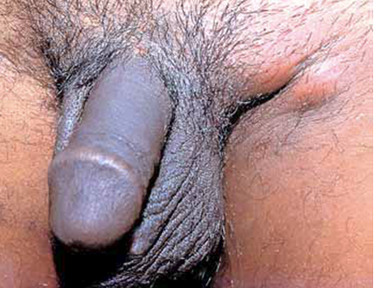
Clinical features
Inguinal syndrome
Incubation period = 10-30 days
More common in males
MC - Bubo – Inguinal lymphadenopathy
Swelling in groin; unilateral in majority
Groove sign of Greenblatt - both inguinal and femoral lymph nodes separated by the inguinal ligament
Rupture to form Multiple sinuses
Associated with Constitutional features

Slide 14
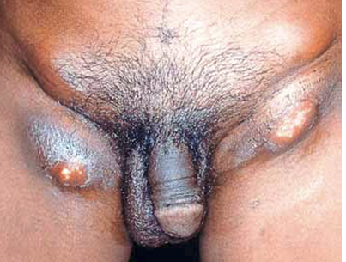
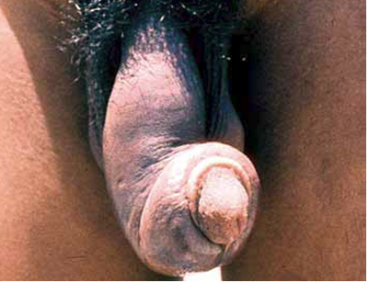
Genital syndrome
Inguinal ulcerations/ Sinuses
Penile and scrotal elephantiasis.
Ram-rod penis.(Saxophone)
Doughy tender swellings along dorsal lymphatics of penis : bubonuli.
Females-elephantiasis of the vulva and clitoris. (esthiomene)

Slide 15
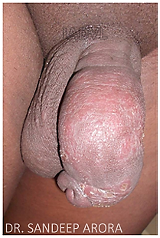
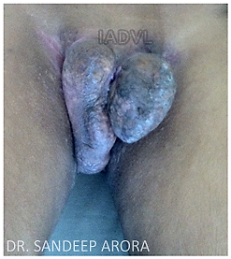
Penile Elephantiasis
Vulval Elephantiasis - Esthiomene

Slide 16
Anorectal syndrome
Rectal strictures, Anal fissures
Edematous rectal mucosa
On proctoscopy - friable and bleeding rectal mucosa

Slide 17
Investigations and Treatment
Microscopy:
Giemsa stain for inclusion bodies
Direct immunofluorescence staining
ELISA rapid assays
Serology:
Complement fixation test
Immunofluorescent antibody test
LGV (NACO)
Recommended regimen : Doxycycline 100 mg twice daily for 15 days.
Alternative regimen : Erythromycin base 500 mg four times daily for 15 days.

Slide 18
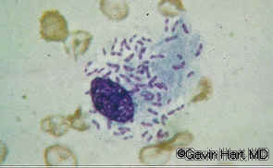
Donovanosis
A chronic, destructive mildly contagious, granulomatous STI caused by Klebsiella(Calymmatobacterium) granulomatis.
Incubation period : 8 - 80 days.
The organism occurs inside large
vacuolated histiocytes in the form of
“closed safety pin”.
Pathogenesis : Sites of trauma –
nodular lesion ‘lumps under the skin’.

Slide 19
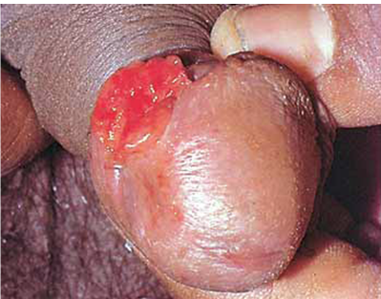
(1)Ulcerogranulomatous—Classical or Fleshy exuberant type:
MC, nontender, fleshy, exuberant, single or multiple, beefy-red ulcers that bleeds on touch

Slide 20
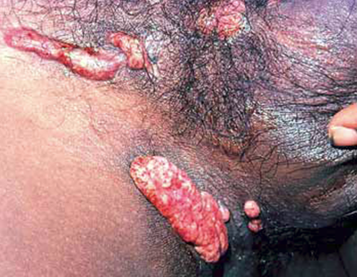
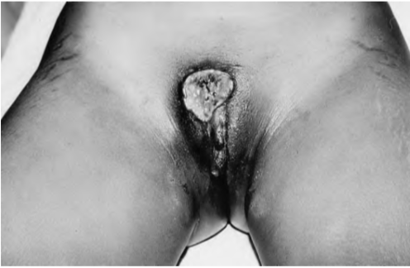
(2) hypertrophic or verrucous type
(3) necrotic type

Slide 21
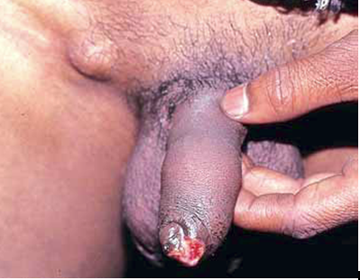
(4) Sclerotic or Cicatricial type:
extensive formation of fibrous and scar tissue
“Pseudobubo”-
Inguinal swelling in donovanosis
due to granuloma

Slide 22
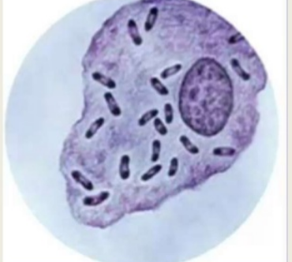
Investigations
Microscopy
Giemsa or Leishman’s stain
(crush smear) for Donovan bodies.
Histopathology.
Wright-Giemsa stain - demonstrates clusters of blue-to-black organisms that resemble safety pins within the vacuoles of enlarged macrophages.

Slide 23
Treatment
Doxycycline 100 mg twice daily
or
Erythromycin base / stearate 500 mg QDS for 14 days
or
Azithromycin 500 mg BD for 14 days

Slide 24
Treatment (CDC)
Recommended Regimen
Azithromycin 1 g orally once per week or 500 mg daily for at least 3 weeks and until all lesions have completely healed.
Alternative Regimens
Doxycycline 100 mg orally twice a day for at least 3 weeks and until all lesions have completely healed OR
Erythromycin base 500 mg orally four times a day for at least 3 weeks and until all lesions have completely healed.

