Slide 1
BACTERIAL INFECTIONS OF SKIN
  DR. ASHWIN CHARANIYA
  Assistant Professor
  DEPT OF DVL
  RMCH
  DATE: 24/04/2024

Slide 2
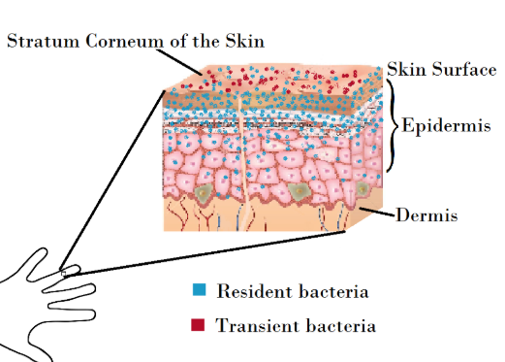
Bacterial flora of normal skin
Bacteria that are found regularly on skin constitute the normal flora
Varies quantitatively from one individual to another, but qualitative variations are relatively less.
The normal flora has been classified into:
  Resident flora
  Transient flora

Slide 3
Bacterial flora of normal skin
Bacterial flora
Resident flora
Transient flora
> Bacteria that grow on skin
> Stable in number
> Undergo multiplication
> No exogenous source
> Lie free on the skin surface without attachment
> Derived from exogenous sources.
> Unable to multiply
> Disappear from the skin within a short time.

Slide 4
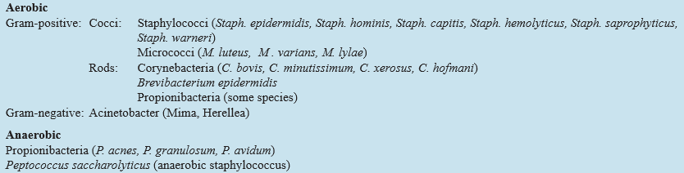
Bacterial flora of normal skin

Slide 5
Introduction
Pyoderma (literal meaning- has pus)
Bacterial infections of skin.
Caused by mainly 2 Gram positive organisms:
    Staphylococcus aureus : Intact skin
    Group A beta-hemolytic Streptococci : Traumatic skin
Other bacteria:
    Corynebacteria
    Micrococcus
    Pseudomonas

Slide 6
Classification of pyoderma
PRIMARY (occur without any predisposing conditions)
  Superficial :
    Follicular : Superficial folliculitis
    Follicular impetigo
    Non-follicular : Impetigo
  Deep :
    Follicular : Sycosis barbae, Furuncle, Carbuncle
    Non-follicular : Ecthyma, Cellulitis, Erysipelas, Paronychia, Necrotising fasciitis
SECONDARY (occur secondary to pre-existing dermatoses)
  Infected eczemas, Infected ulcers, etc

Slide 7
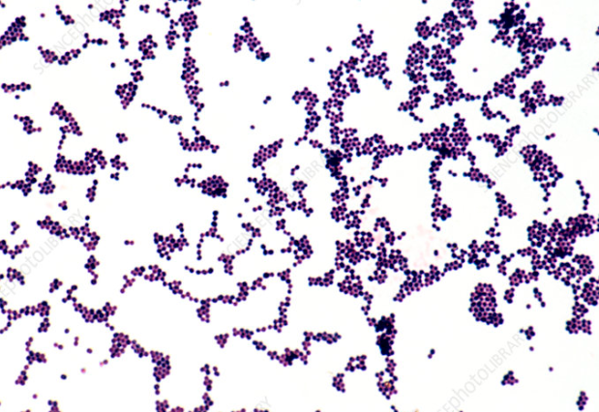
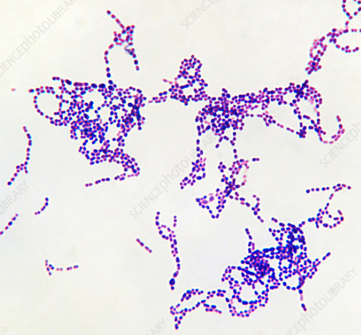
Speaking about infections caused by staphylococcus & streptococcus
Staphylococcus Streptococcus

Slide 8
Staphylococcus Aureus | Streptococcus
Affects intact skin & involves superficially | Affects traumatized skin & extend deep till subcutaneous tissue bcoz secretes a enzyme hyaluronidase
Disease can also result from S. aureus toxin production Eg- SSSS, TEN | Disease are caused because of circulating toxin Eg- scarlet fever, TEN
Causes- Impetigo Ecthyma Folliculitis | Causes- Cellulitis Erysipelas
Toxins- Exfoliatin A & B Enterotoxin Toxic shock syndrome toxin 1 | Toxins- Hemolysin (streptolysin O & S) Erythrogenic toxin Pyrogenic exotoxin

Slide 9
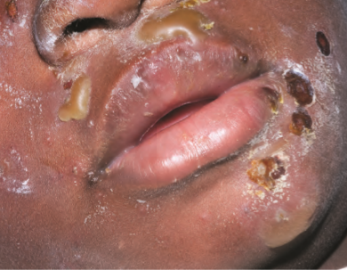
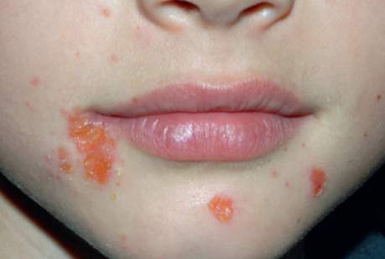
Impetigo
Impetigo is a superficial epidermal highly communicable infection
Commonly seen in pre-school children.
Caused either by staphylococcus aureus or group a beta hemolytic streptococci.
There are 2 types of Impetigo
  Bullous Impetigo
  Non bullous Impetigo/ impetigo contagiosa

Slide 10
Impetigo
The predisposing factors which may lead to impetigo are- close contact, atopic dermatitis, warmth, poor hygiene, minor trauma etc.
There may be associated pruritus, fever, lymphadenopathy- but these may or may not be present.

Slide 11

Bullous Impetigo
Most common in childhood
When it occurs in neonates it may be widespread (erroneously called pemphigus neonatorum in the past).
Overcrowding and poor standards of hygiene are predisposing factors.

Slide 12
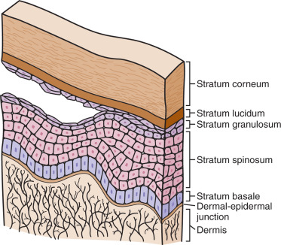
Bullous Impetigo
PATHOGENESIS
Bullous impetigo is caused by an Epidermolytic Toxin.
Produced at the site of infection by Staphylococcus aureus.
Causing intra-epidermal cleavage, clinically manifesting as - Bullae.

Slide 13
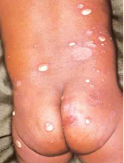
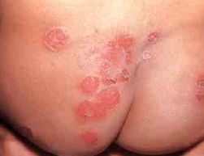
Bullous Impetigo
Clinical Features
The lesions are relatively thick walled superficial bullae surrounding erythema
Ruptures & form very thin varnish-like yellow crust
Common site is face, but any part of the body including mucous membranes, palms and soles can be affected.

Slide 14
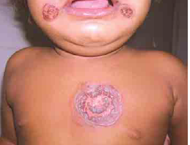
Bullous Impetigo
Occasionally the bullae spread peripherally with central clearing, producing annular lesions (impetigo circinata)
Regional lymphadenitis rarely occurs.

Slide 15
Non Bullous impetigo
Also known as impetigo contagiosa.
Nasal carriage of staphylococci may be an important factor.
The bacteria can be transmitted through fomites and by insects.
The disease occurs mainly in hot and humid climates.

Slide 16
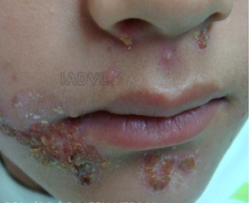
Non Bullous impetigo
CLINICAL FEATURES
Initially begins a erythematous macule
Thin-roofed vesiculopustule (fluid, clear in the beginning, becomes turbid in less than a day)
Ruptures forming a loosely adherent, honey or straw-coloured or golden yellow, granular crust, which appears ‘stuck on’
Heals with scarring

Slide 17
FEATURES | BULLOUS IMPETIGO | NON-BULLOUS IMPETIGO
Bullae | Thick-walled; lasts for 2 to 3 days | Thin-walled and transient with honey comb crusting
Base | Very little or no erythema | Erythematous
Extension | May extend peripherally with central clearing | May extend peripherally but without central clearing

Slide 18
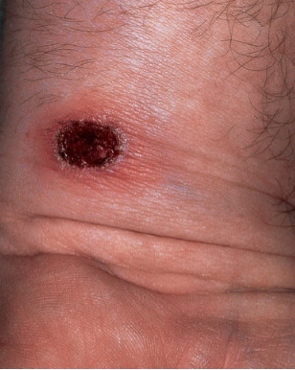
Ecthyma
Ecthyma is a deeper variant of Impetigo, having a similar etiology.
Factors which predispose to ecthyma are - diabetes and other immune-compromised states.
Legs & buttocks are the most commonly involved sites.

Slide 19
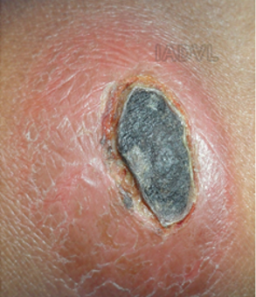
Ecthyma
It clinically manifests as a lesion with a thick, chocolate-coloured, adherent crust, with a rim of erythema.
Crust when removed, results in a punched-out ulcer, which heals with scarring.

Slide 20
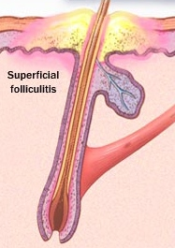
Superficial Folliculitis
This is the result of inflammation of the terminal part or ostium of the hair follicle of infective or noninfective origin.
Noninfective causes include:
  Contact with mineral oil as an occupational hazard
  Iatrogenically due to occlusive dressings, adhesive tapes,
  or after use of coal tar preparations in the treatment of psoriasis
Infective cause is staph. Aureus.

Slide 21
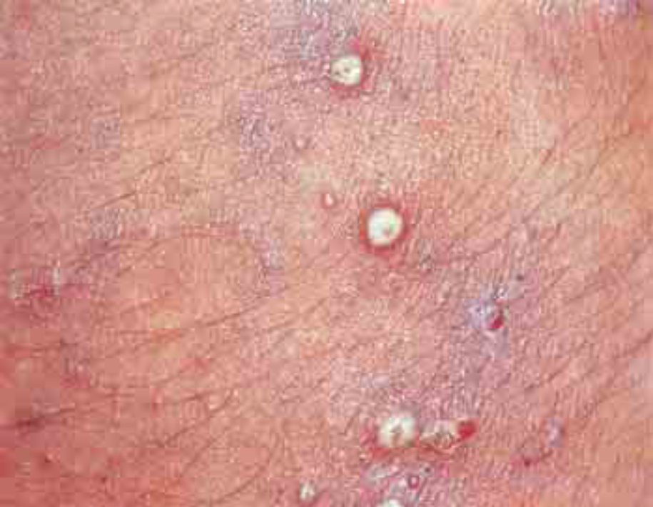
Superficial Folliculitis
Lesions are characterized by dome-shaped pustules or papules with a crusted surface, a hair or follicular orifice in the centre, and sometimes surrounding erythema
Pustules of superficial folliculitis

Slide 22
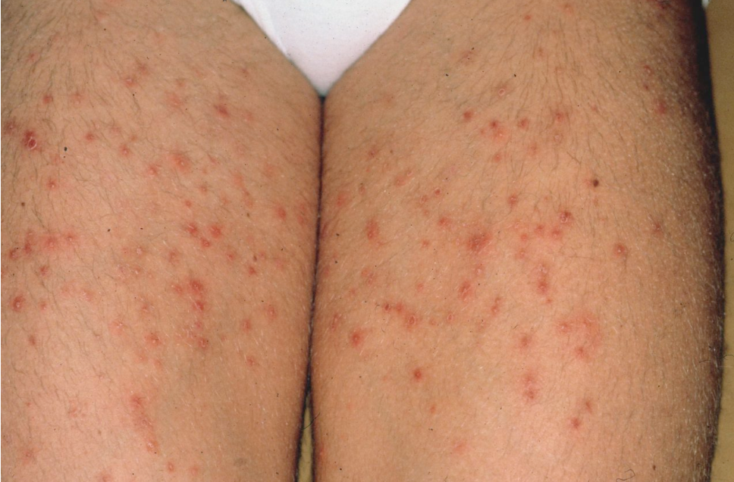
Variants of Superficial Folliculitis
BOCKHART’S IMPETIGO
Children are commonly affected.
Pustules developing in crops involve the scalp, the hair margin, and often the extremities.
They heal in about a week.

Slide 23
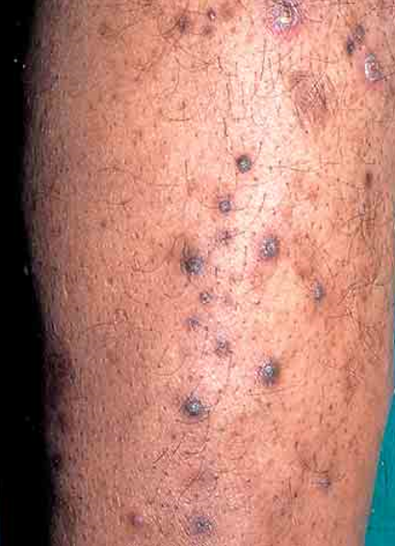
Variants of Superficial Folliculitis
CHRONIC FOLLICULITIS OF THE LEGS
DCPA (Dermatitis Cruris Pustulosa et Atrophicans)
Is a chronic, recalcitrant, folliculitis, affecting young Indian males, lasting for several years.
Site- anterior aspect of the lower legs bilaterally which may extend up to the thighs

Slide 24
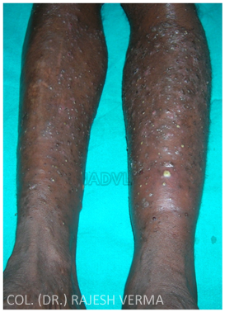
Variants of Superficial Folliculitis
Disease course - remitting and relapsing, with appearance of crops of itchy follicular pustules, each healing with scars.
The disease process arrests, when no more unaffected hair follicles are left in the pre-disposed sites.
Usually clears after development of atrophy

Slide 25
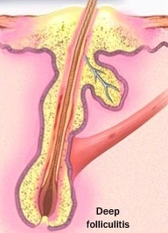
Deep Folliculitis
This is a deeper variant of folliculitis, involving the whole depth of the hair follicle
Site- Beard area (sycosis barbae)
Nape of neck (sycosis nuchae).
The term sycosis is derived from Latin meaning ‘small fig’.

Slide 26
Deep Folliculitis
Occurs in males 20 to 40 years of age.
It is caused by Staph. aureus.
Predisposing factors - Seborrheic dermatitis, trauma produced by shaving, and emotional stress.

Slide 27
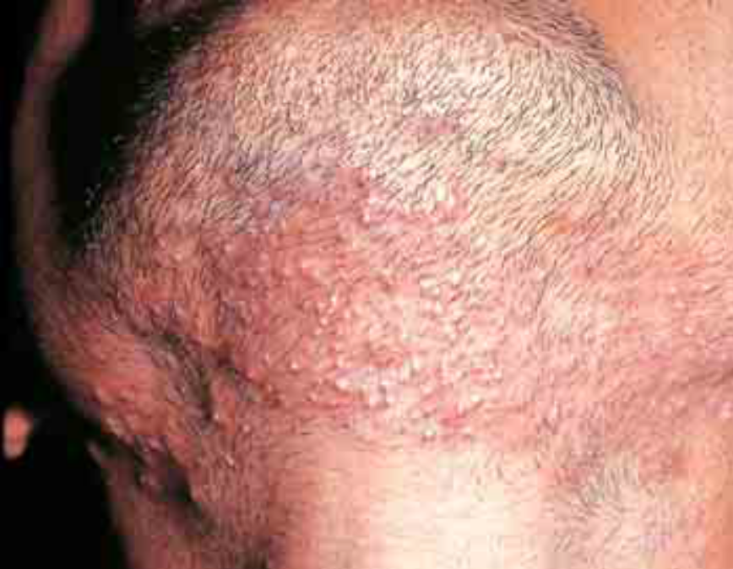
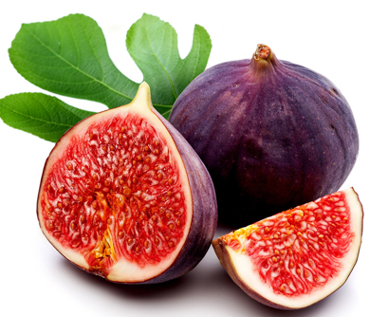
Deep Folliculitis
      Erythematous follicular
      discrete papules or pustules
Coalesce
Raised plaque,
studded with pustules.
“Fig like” appearance

Slide 28
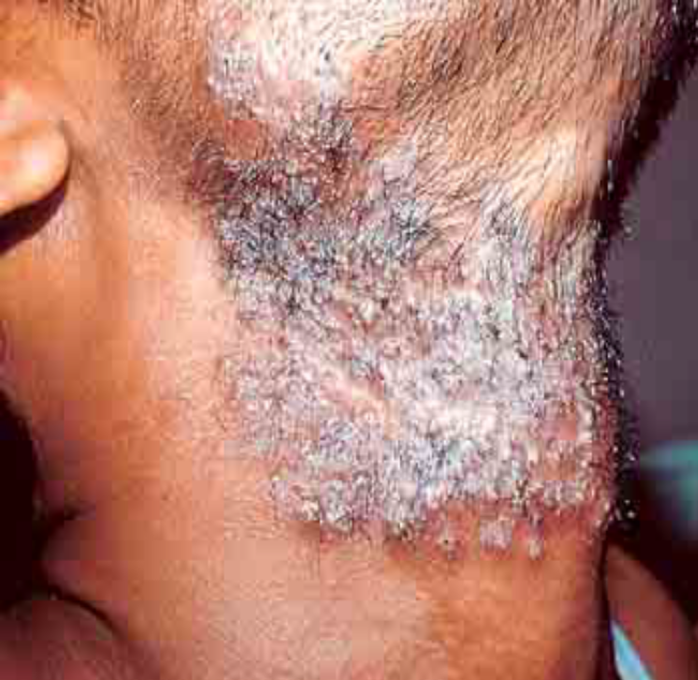
Deep Folliculitis
A variant of deep folliculitis which destroys hair follicles and produces extensive scarring is called lupoid sycosis
The papulopustules are present at the borders of scarred areas.

Slide 29
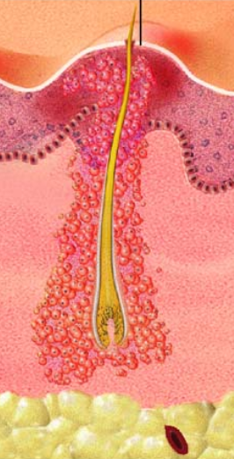
Furunculosis (Syn. Boils)
This term is derived from the Latin word meaning ‘petty thief’.
The word ‘boil’ has been derived from German and refers to ‘a swelling’.
In this condition, there is extended involvement of the hair follicle including the perifollicular region in the dermis subcutaneous tissue, i.e. there is folliculitis as well as perifolliculitis.

Slide 30
Furunculosis (Syn. Boils)
It is caused by Staph. aureus.
Common during adolescence and early adult age.
Furuncles may appear as isolated lesions or multiple ones.
Generally the subjects are healthy but have poor hygiene or are carriers of Staph. aureus.
Factors like DM, intake of systemic steroids may be responsible for their increased frequency and greater severity.

Slide 31
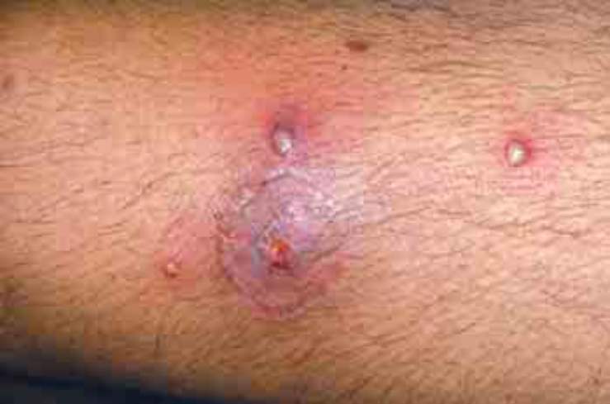
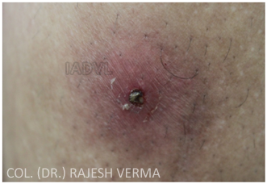
Furunculosis (Syn. Boils)
Begins as a tender area which rapidly develops into an inflammatory indurated nodule 2 to 3 cm in diameter
Within the next few days the area becomes necrotic and discharges pus from a point at the follicular opening.
Those which do not discharge on the surface are called ‘blind boils’.

Slide 32
Furunculosis (Syn. Boils)
There is usually mild fever and constitutional symptoms.
Complications - cavernous sinus thrombosis (Due to lesion over lips and cheek) but rare

Slide 33
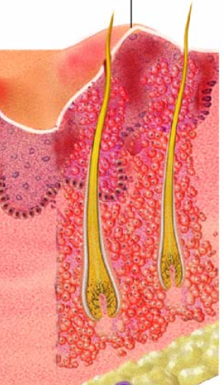
Carbuncle
This term is derived from a Latin word meaning ‘a small piece of coal’
A carbuncle is a group of boils which show deep infection of contiguous follicles with Staph. aureus.
The infection spreads from one follicle to the other not usually via the surface but through the subcutaneous tissue.
Notes:
because the necrotic swelling with high local
temperature and pain suggested a glowing piece of coal.

Slide 34
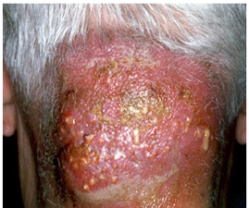
Carbuncle
It is associated with uncontrolled diabetes mellitus, prolonged steroid therapy or any other immunocompromised state.
The lesion starts as a painful, tender, firm to hard indurated lump
Pus is discharged from multiple sites giving sieve like appearance

Slide 35
Carbuncle
It is associated with intense inflammatory changes in the surrounding and underlying tissues.
Common sites are the back of the neck, shoulders, hips and thighs.
Constitutional disturbances are present.
Heals with scarring
Notes:
because the necrotic swelling with high local
temperature and pain suggested a glowing piece of coal.

Slide 36
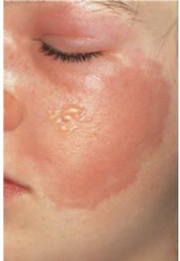
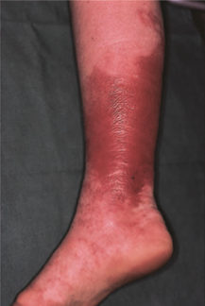
Cellulitis
An acute, subacute or chronic infection of the deeper subcutaneous tissue,
Caused by Strep. pyogenes, and rarely by Staph. aureus or Gram-negative rods.
Deeper variant of erysipelas.
Occult diabetes may be an important factor in the development of
cellulitis

Slide 37
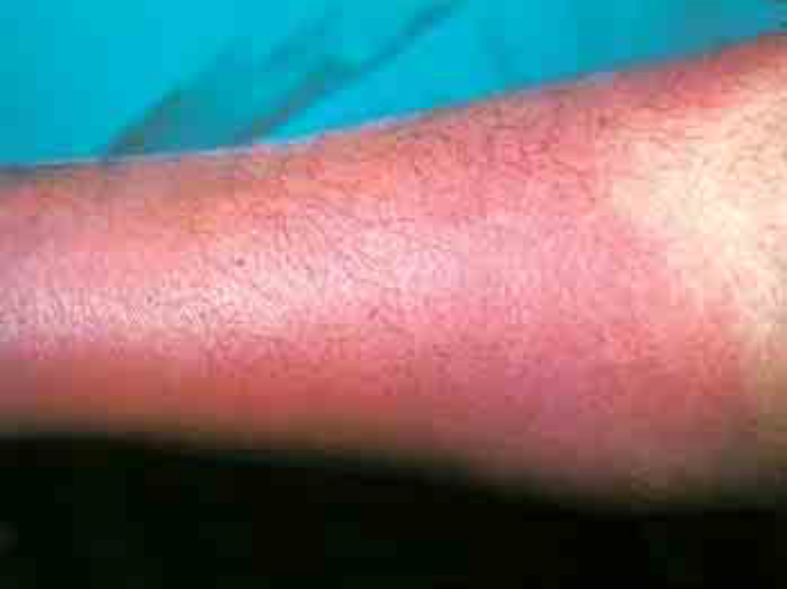
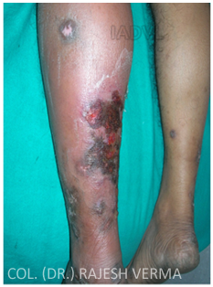
Cellulitis
Clinically, it presents as an area of diffuse erythema of the involved skin, which is tender and warm to touch.
The surface may show focus of pus and necrosis, which may give way to form an ulcer.
Associated with systemic symptoms of malaise and fever.
If untreated – necrosis can be developed

Slide 38
Staphylococcal Scalded Skin Syndrome (SSSS)
A disease affecting the neonates, infants and young children.
Causative agent- staph. Aureus group II phage type 71
The disease is caused by a diffusible exotoxin (known as epidermolytic toxin, exfoliatin, or epidermolysin) elaborated by the bacteria.
Toxin is carried to the skin via the circulation

Slide 39
Staphylococcal Scalded Skin Syndrome (SSSS)
Foci of infection of Staphylococcus aureus (nasopharynx, conjunctiva, middle ear)
Epidermolytic toxin
Acts on intra-epidermal desmosome complex
Fragile, tense bullae and vesicles
Erosions

Slide 40
Staphylococcal Scalded Skin Syndrome (SSSS)
The eruption appears suddenly, following an upper respiratory tract infection or purulent conjunctivitis.
The skin becomes intensely erythematous and tender, especially on the face and proximal flexures, but the process soon generalizes
Affected infants are febrile and irritable
Flaccid blisters appear one to two days later, especially in areas of mechanical stress including flexural areas, buttocks, hands, and feet.

Slide 41
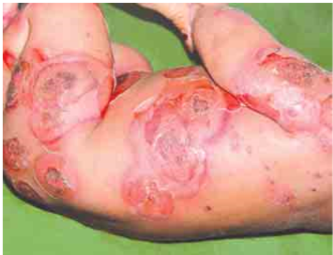
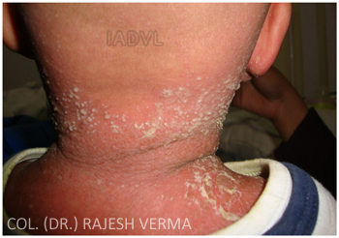
Staphylococcal Scalded Skin Syndrome (SSSS)
Gentle pressure applied to the skin results in separation of the upper epidermis and wrinkling of the skin (pseudo Nikolsky's sign).
Painful erosions appear when the erythematous sheets of skin shrink and fall (“potato-chip” desquamation) or when the blisters rupture
Mucous membranes other than the lips are usually spared

Slide 42
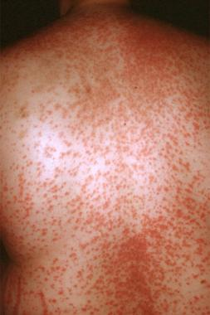
Toxic Shock Syndrome
Toxic shock syndrome is acute febrile multisystem disease, mediated by TSST-1(Toxic Shock Syndrome Toxin-1) secreted by Staphylococcus aureus
Two forms of the disease,
  Menstrual - occurs in those young women who often use highly absorbent tampons.
  Non menstrual - occur in either sex and at any age

Slide 43
Toxic Shock Syndrome
Staphylococci presumably gain entry during insertion of the tampon and find conditions favorable to their growth in the vagina.
The toxins are elaborated and enter the circulation.
Staphylococcal infection can be present at the sites of surgical wounds, skin and soft tissue, or as postpartum or post-abortion infection.

Slide 44
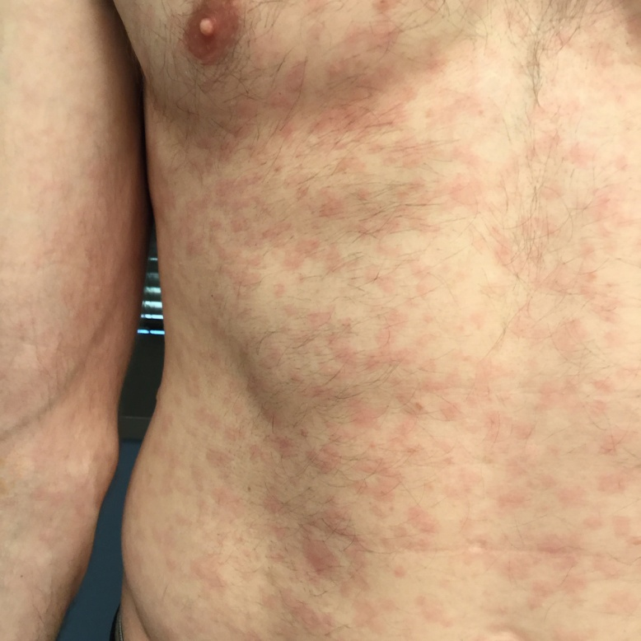
Toxic Shock Syndrome
Clinical features of both forms are similar and may be mild to severe.
The onset is acute and the patient has fever, hypotension and extensive macular erythema.
This rash appears on the first day.
It may occasionally be maculopapular or papulopustular.

Slide 45
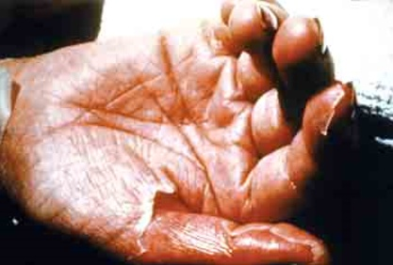
Toxic Shock Syndrome
Desquamation occurs after 1 to 2 weeks and may be localized to the palms and soles
The gastrointestinal tract, liver, kidneys, central nervous system, and muscles may be affected.
Hematological and metabolic abnormalities may occur
Mortality rate is 7%.

Slide 46
Gram staining.
This is the most important staining method in bacteriology.
It is named after the Danish bacteriologist Hans Christian Gram(1853-1938) who originally devised it in 1882 to discriminate between pneumococci and Klebshiella pneumoniae in the lung tissue.
It is the first and usually the only method employed for the diagnostic identification of bacteria in clinical specimens.

Slide 47
It is a differential staining method of differentiating bacterial species into large groups into gram positive(staining dark purple) and gram negative(staining light red) based on the physical and chemical properties of their cell walls.

Slide 48
Components.
The Gram procedure requires the application of 4 reagents in the following order.
1. A basic pararosaniline (triphenyl methane) violet dye, namely crystal violet, methyl violet or gentian violet(mixture)
3. A decolourizing solvent, eg. Acetone, alcohol or aniline.
4. A light red or pink counterstain, eg. Basic fuschin, neutral red or safranine.
2. An aqueous solution of iodine.
1.Primary stain.
2.Mordant
3.Decolourizer
4.Counterstain.

Slide 49
In the original staining technique used by gram the primary stain used was aniline gentian violet.
Mordant was lugols iodine(iodine potassium iodide in water)
Decolourizer was absolute alcohol and
Bismark brown was the counterstain.

Slide 50
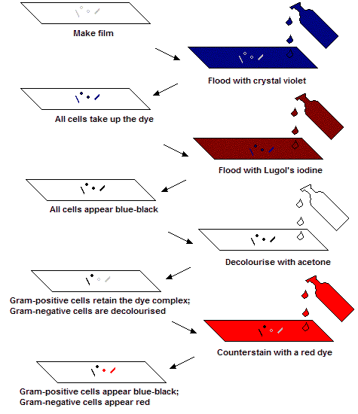
Procedure.

Slide 51
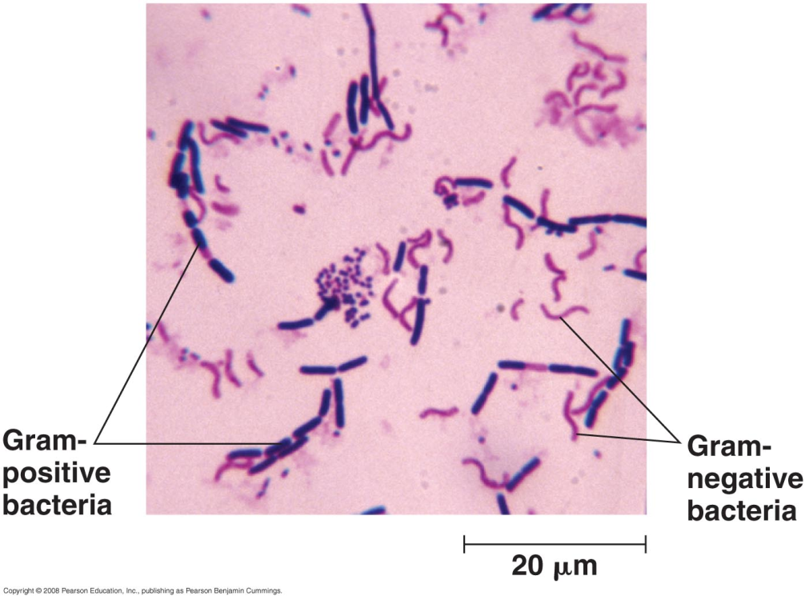
And those that get decolourised and subsequently take up the counterstain are called as gram negative.
Those bacteria that hold on to the primary dye iodine complex and remain violet are called as gram positive .

Slide 52
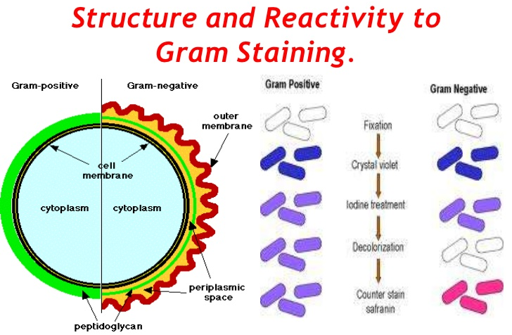

Slide 53
Limitations of gram staining.
Some gram positive bacteria may lose the stain easily and appear as a mixture of gram positive and gram negative(gram-variable).
Gram reaction also depends on the age of the cell. Old cultures of gram positive bacteria where the cell walls may be weakened may readily get decolourized.
Certain group of bacteria can demonstrate variable response to the stain which can be due to growth stress e.g unsuitable nutrients,temperature, ph or electrolytes.
Loss of cell wall in gram negative bacteria may render them gram negative.(L-forms)

Slide 54
Modifications of gram stain.
Kopeloff and beermans modification.
primary stain solution consists of freshly constituted methyl violet with sodium bicarbonate in distilled water.
mordant consists of iodine dissolved in 4%NaOH solution.
Decolourizer is either acetone alone or a mixture of acetone and alcohol
Counterstain is basic fuchsin.

Slide 55
Applications of gram staining.
1) differentiation of bacteria into gram positive and gram negative.
2)First step towards the identification of bacteria in cultures.
3)Observation of bacteria in clinical specimens provides a vital clue in the diagnoses of infectious diseases.
4)Useful in estimation of the total count of bacteria.
5)Empirical choice of antibiotics can be made on the grams staining report.
6)Choice of culture media for innoculation can be empirically made on grams staining report.

Slide 56
Miscellaneous.
Although Gram stain is useful in staining bacteria, certain fungi such as Candida and Cryptococcus are observed as Gram positive yeasts.
•Half-Gram stain refers to modified staining technique, where the smear is neither decolorized nor counterstained. It is useful to stain a known Gram positive bacterium.
•Rapid Gram stain refers to quickened technique where the smear is exposed to only 30 seconds instead of one minute.
•In specimen such as sputum, capsulated bacteria may stand out as clear spaces between the bacterium and the pink (mucus) background.
•The spores may stand out as clear, unstained region in sporing bacteria.

Slide 57
Management
GENERAL PRINCIPLES
Improvement of local hygiene is primary.
Identification and elimination of immunocompromising factors
Wounds, both accidental and surgical, should be properly cared for by use of appropriate topical antibacterials.

Slide 58
Management
In crusted lesions, the crusts must be removed. This serves two purposes: first, it exposes the affected part to air, resulting in desiccation and secondly, topical medication can reach the target site more effectively.
Local application of heat is beneficial in cases of boils – relieves discomfort, softens the boil, helps in localization of infection and promotes drainage.

Slide 59
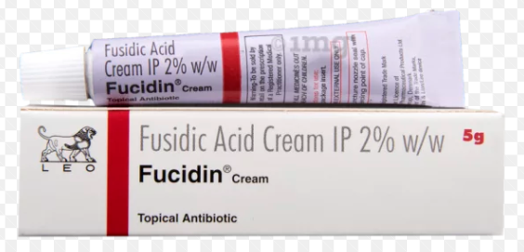
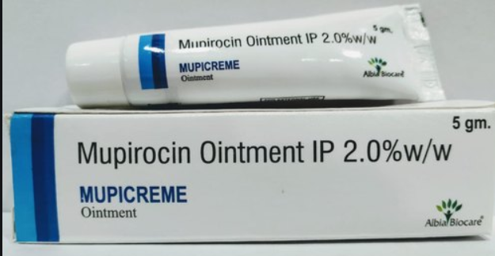
Management
TOPICAL TREATMENT
Topical antibacterials like 2% sodium fusidate and 1% framycetin
In case of rural clinics and for patients who cannot afford these , 1% gentian violet lotion may be used
Lately, mupirocin 2% (pseudomonic acid A), a potent topical antimicrobial, has been developed from pseudomonas fluorescens.
Applied to the affected area 2 times a day
Notes:
It inhibits bacterial protein synthesis by binding
to isoleucyl transfer RNA synthetase, thus preventing the
incorporation of isoleucine into protein chains

Slide 60
Management
SYSTEMIC TREATMENT
Systemic antibiotics are needed for all but the most localized infections.
The major problem is Staph. aureus that has developed resistance to many antimicrobials.
The most common type of resistance is due to penicillinase production.
Penicillinase stable penicillins are very effective.
Other useful drugs include erythromycin, cotrimoxazole and the cephalosporins (penicillin hypersensitivity)

Slide 61
Management
Cloxacillin resistance among Staph. aureus is rare
Hence it is reasonable to start first
Dose of cloxacillin in adults is 0.25–0.50 g q6h and in children 12.5 mg/kg q6h
If no response, cephalosporins can be started
The dose of cephalexin in adults is 0.25–1 g q6h, and in children 6.25–12.5 mg/kg q6h

Slide 62
Management
RECURRENT FURUNCULOSIS
Recurrent furunculosis is generally defined as three or more attacks within a 12 month period
Rifampicin 600 mg daily on an empty stomach with one of the quinolones like ciprofloxacin for 10 days, followed by cloxacillin or cotrimoxazole for 1 to 2 months.
Regular application of an antistaphylococcal cream in the anterior nares twice a day for a few months helps.

Slide 63
THANK YOU

