Slide 1
ACNE VULGARIS

Slide 2
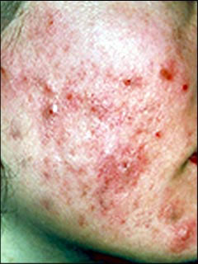
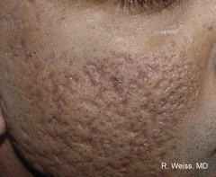
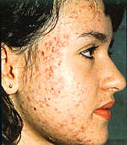

Slide 3
Acne vulgaris, a very common malady of adolescents, is well known and easily recognized.
It is common enough to be called a physiological process but is better regarded as a disease due to its inflammatory component and the disfigurement it produces on the face, which is socially and psychologically the most important body region.

Slide 4
Definition
A precise definition of acne vulgaris is difficult to frame.
It can be defined as a chronic, self-limiting, inflammatory disease of pilosebaceous unit, manifesting generally in adolescence with pleomorphic lesions like comedones, papules, nodules, and cysts.
Extensive scarring can occur.

Slide 5
Epidemiology
The disease occurs in all races worldwide, affecting 90% of people sometime or the other in their life.
Few racial differences are known. The Japanese population is said to be affected less than Americans and cystic acne is more common in whites.

Slide 6
The age of onset is at puberty or a few months earlier. The peak incidence is between 14 to 17 years in women and 16 to 19 years in men.
Usually the incidence decreases after teens, but sometimes it may persist even in the thirties.
Sudden and profuse lesions erupting at a later age calls for investigations of the pituitary, adrenal cortex, and gonads.

Slide 7
Acne is more common and more severe in males than in females, relating it to androgen activity.
Neonatal lesions related to circulating maternal hormones are known.
Acne was found to be more common in urban boys than in their rural counterparts.

Slide 8
Genetic factors influence the susceptibility to acne.
Children with acne have one or both parents with acne in many cases.
Racial predisposition and similarity of lesions in monozygotic twins are also due to genetic factors.

Slide 9
Etiology and Pathogenesis
Acne vulgaris is multifactorial in origin and several factors affect the severity.
The following etiological factors are important:
1. Alteration in the pattern of keratinization within the sebaceous follicle.
2. Level of circulating sex hormones, especially androgens.
3. Quantity and quality of sebum secretion.
4. Colonization by follicular microbial flora.
5. Immunological factors.
6. Environmental factors.

Slide 10
Alteration in the Pattern of Keratinization within the
Sebaceous Follicles
Ductal hypercornification is seen histologically as microcomedones, which are the initial lesions of acne.
These later become visible clinically as blackheads or whiteheads.
Comedones are due to abnormalities in the proliferation and differentiation of ductal keratinocytes.
Normally, keratinous material is loosely arranged in sebaceous follicles
but in acne, it becomes dense.
Increased production of keratinocytes and their increased adhesion due to persistence of desmosomes, leads to “retention hyperkeratosis”.
These initialchanges occur in the follicular infundibulum, leading to the formation of micro-comedones, thereby initiating the process of acne formation.

Slide 11
Circulating Sex Hormones
A spurt in the level of hormones during puberty correlates well with the onset of acne vulgaris.
Androgens increase sebum secretion and also cause sebaceous gland hyperplasia.
Estrogens, on the other hand, suppress sebaceous gland activity.
Acne results from hormonal imbalance increasing in severity with an increase in the androgen–estrogen ratio.

Slide 12
Quality and Quantity of Sebum Secretion
Excess sebum secretion, sebaceous gland hypertrophy, andhyperplasia usually occur in patients of acne, more so in severe acne.
Sebum is acnegenic and when injected into the skin, causes inflammation.

Slide 13
Follicular Microbial Flora
Resident bacterial flora in sebaceous follicles, namely P. acnes, P. granulosum (both anaerobic pleomorphic diphtheroids), Pityrosporum ovale, and Staphylococcus epidermidis, play an important role in the production of acne.
In patients of acne, the levels of P. acnes per sq. cm. were found to be significantly higher than in those without acne

Slide 14
Environmental Factors
A hot and humid climate aggravate acne, due to increased sweating causing ductal hydration. Many occupations(e.g. soldiers wearing a uniform for long; cooks; people working with oils or chemicals like halogenated hydrocarbons) provide a conducive atmosphere for the development or aggravation of acne.
Emotional stress and strains of various types play a significant role in the aggravation of pre-existing acne.
External application of oils, pomades, and other comedogenic chemicals cause acneiform eruptions.

Slide 15
The diet, especially chocolate, fat-rich diets, and ice cream,has been commonly blamed for acne, and this is generally debunked by dermatologists.
Now some studies suggest that diet could play a role in the pathogenesis of acne.
A high-glycemic load carbohydrate diet induces hyperinsulinemia which results in androgen synthesis, similar to what is seen in polycystic ovarian disease (PCOD).

Slide 16
Sequence of Events
The microcomedo is the first subclinical lesion. It is caused by blockage of the sebaceous canal due to altered keratinization, leading to retention of sebum and initiation of an inflammatory response.
An increase in the microbial flora increases inflammation (papule and pustule formation).
Further, retention of sebum and release of enzymes cause rupture of the sebaceous gland.
The resultant spread of sebum in the dermis adds to the inflammatory cell collection in the dermis (resulting in nodule formation).
Confluence of the affected glands results in the accumulation of large areas containing pus, fluid, and glandular debris (cyst formation).
A scar results when such inflamed lesions and cysts heal after rupture or absorption of fluid.
The pattern and size of the scar would depend on the size and pattern of lesion, as well as on individual susceptibility.
The disfigurement so produced is dreaded by the both the patient and physician alike.

Slide 17
Clinical Features
Lesions of acne vulgaris are seen on the sebaceous-rich body regions, mainly the face, mid chest, back ,shoulders, and upper arms.
It is interesting that the groins and pubic region, although rich in sebaceous glands, are usually not affected.
One probable reason for this is the fact that acne lesions generally occur in sebaceous glands connected with the vellus hair.
Those connected with a terminal hair have a large pilary canal and are not blocked.

Slide 18
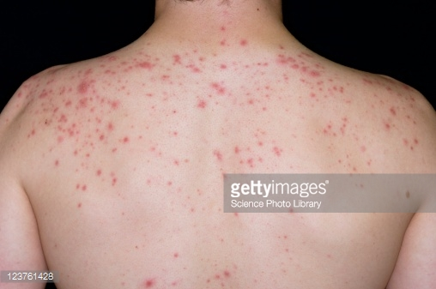
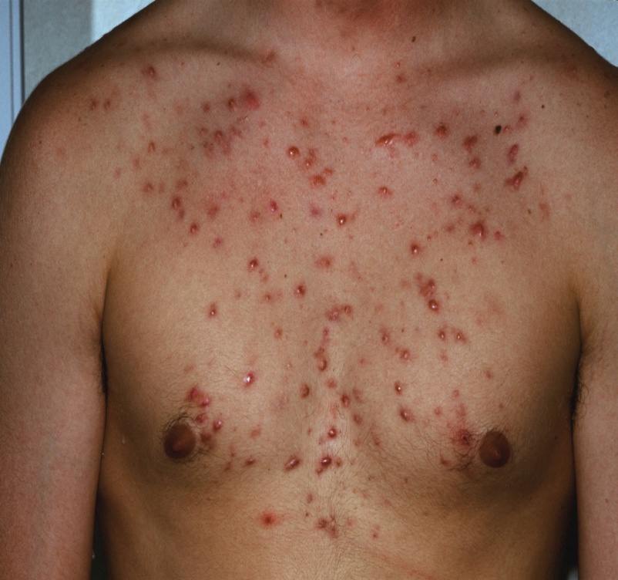
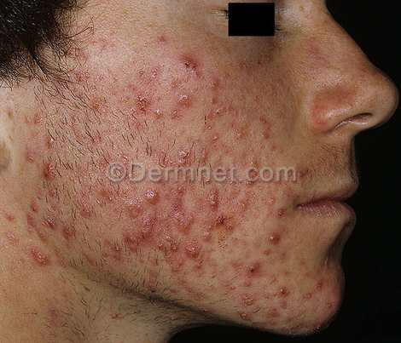

Slide 19
Comedones are characteristic early lesions of acne. A comedo (plural, comedones) is a plug of sebaceous and keratinous material lodged in the opening of a hair follicle.
Initially,obstruction within the follicle is microscopic and cannot be perceived clinically; such lesions are termed as microcomedones.
As comedones enlarge, they become apparent as open comedones (blackheads) or closed comedones(whiteheads).

Slide 20
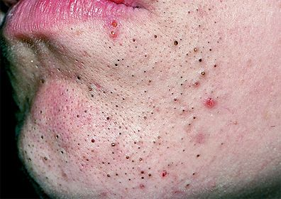
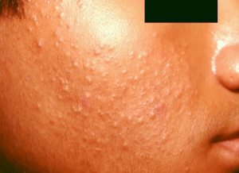

Slide 21
Open comedones (which are 1–2 mm in diameter on the skin surface) represent follicles with a widely dilated orifice.
The black color characteristic of these lesions does not represent dirt; rather, it may be the result of oxidation of melanin, interference in transmission of light through compacted epithelial cells, or the presence of certain lipids in the sebum

Slide 22
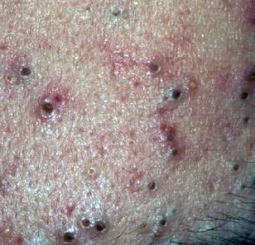
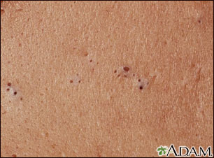

Slide 23
Closed comedones (which are 1 to 3 mm in diameter) are macular or papular lesions without surrounding erythema.
They represent follicles that have become dilated with cellular and lipid debris, but possess only a microscopic opening to the skin surface. These lesions remain undetected unless the skin is stretched between the fingers to reveal it.

Slide 24
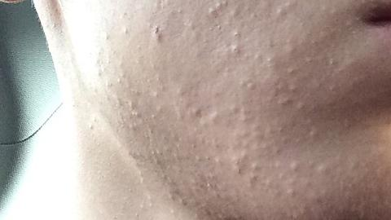

Slide 25
The inflammatory lesions, namely papules, pustules, nodules, and cysts, indicate the severity of the disease. The severity of the acne can be graded on clinical grounds as under:
Grade I (Mild): Comedones, occasional papules
Grade II (Moderate): Comedones, many papules, few pustules
Grade III (Severe): Predominantly pustules, nodules and abscesses
Grade IV (Cystic): Mainly cysts or abscesses, widespread scarring

Slide 26
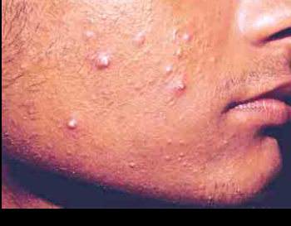

Slide 27
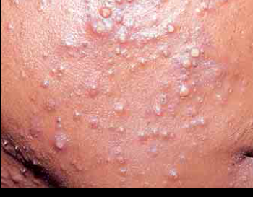

Slide 28
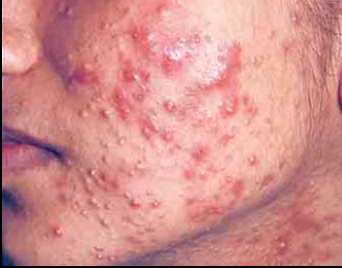

Slide 29
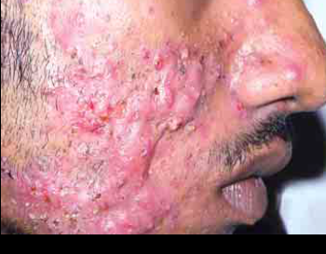

Slide 30
Acne ‘cysts’ are not true cysts because they are not lined by epithelium; hence, it is more appropriate to call them nodules or abscesses.
Nodules are more frequently seen in males and may be disfiguring, if deep and hemorrhagic.
Nodules may lead to abscess and sinus formation with devastating results.
These lesions can be very painful and tender.

Slide 31
Sequelae include hyperpigmentation and scarring following deep inflammatory lesions .
Up to 90% of patients of acne develop some scarring but about 22% suffer from significant scarring.
Various types of scars are formed following acne vulgaris.
Characteristic ice-pick scars, atrophic macules, and perifollicular elastolysis occur due to loss of collagen.
On the other hand, increased collagen causes hypertrophic scars and keloids.

Slide 32
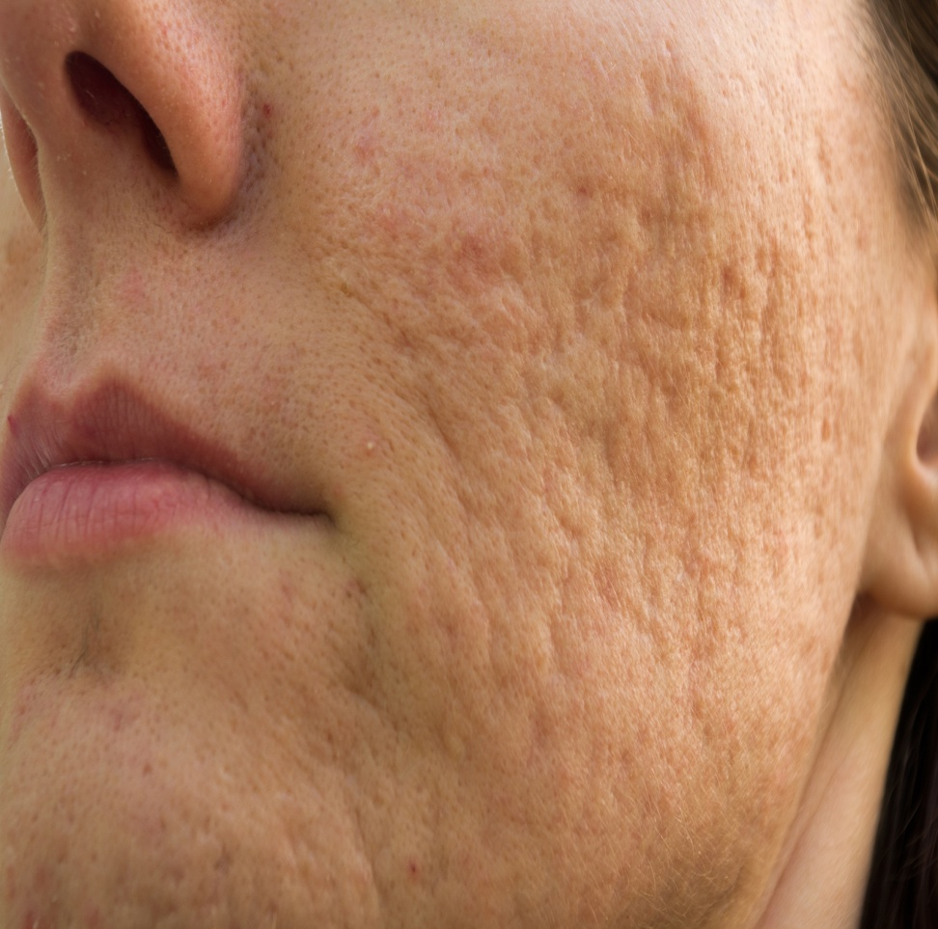
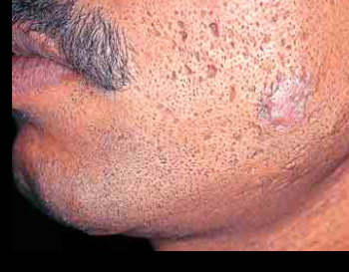

Slide 33
Psychosocial Impact of Acne
Acne is associated with a greater psychological burden than a variety of other chronic diseases.
Patients with severe acne and scarring have demonstrated a wide range of psychological abnormalities including depression, suicidal ideation, anxiety, psychosomatic symptoms (pain and discomfort), embarrassment, body dysmorphic disorder, and social inhibition.
Prompt and effective treatment of acne is essential to improve self-esteem, obsessive-compulsiveness, shame, embarrassment, body image, social assertiveness, and last but not the least, self-confidence.

Slide 34
Course
The disease usually runs a self-limiting course, remitting in the late twenties or early thirties. During the period of activity too, the course is variable with spontaneous flare-ups and remissions.
The appearance of acne in the older age group or persistence of acne lesions beyond the thirties calls for investigations of the endocrine system.

Slide 35
Aims of Treatment
The aims of treatment are:
1. To reduce the follicular bacterial population, and to reducelipases,
2. To remove the follicular obstruction,
3. To reduce inflammation, and
4. To decrease the sebaceous gland activity by blocking androgen stimulation.

Slide 36
Selection of the Treatment Modality
The severity and grading of acne, the extent of disease and scarring, psychological effects of acne, the patient’s choice, cost, and response to previous therapy are factors that should be considered before chalking out the treatment strategy for a patient.
Classifying acne severity is important to finally choose from a number of options for therapy.

Slide 37
Mild involvement (few to many comedones, no inflammatory lesions):
a. Benzoyl peroxide gel has a potent bacteriostatic effect, with a reduction in lesion count as early as after 4 days of application. It also reduces the size and number of comedones present and inhibits sebum secretion.
b. Salicylic acid penetrates into the sebaceous gland and has comedolytic and anti-inflammatory effects. It can be used as adjunctive therapy and is used in cleansers, toners, masks, and peels.
c. Azelaic acid has antimicrobial, anti-inflammatory and comedolytic activity and it is relatively non-irritating.

Slide 38
2. Mild or moderate involvement (few to many comedones, some papules and/or pustules):
a. Benzoyl peroxide gel OR
b. Topical retinoids may be used for correcting abnormal follicular keratinization leading to microcomedones. They include:
i. Tretinoin not only corrects follicular keratinization but also thins the stratum corneum, which may potentiate the penetration of other topical agents. It can be irritating to the skin but this can be minimized by the correct method of application.
ii. Adapalene is non-photodegradable and nonphototoxic and can be used simultaneously with benzoyl peroxide due to its milder irritation potential.
iii. Tazarotene 0.05% gel has a higher potential for irritation that can be minimized when applied as short contact therapy. It is suitable for individuals with oily skin.

Slide 39
3. Moderate or severe involvement (many inflammatory papules, pustules, 1–2 nodules and/or scarring):
a.Oral antibiotics like doxycycline, minocycline, and azithromycin have antibacterial and anti-inflammatory actions. However, if there is no response after adequate antibacterial therapy or if recurrence is prompt andtroublesome after stoppage, sebostatic agents may be used.
b. Sebostatic agents:
i. Hormonal therapy may be used in unresponsive young women not desiring conception.
ii. Isotretinoin is also sebostatic and is usually used in men but can be administered to women if adequate care is taken to prevent pregnancy.

Slide 40
4. Cystic acne: (more than two nodules, cysts, abscesses, bridging scars):
a. Aspiration of the cyst and intralesional steroid injections AND
b. Systemic antibiotics AND
c. Dapsone or sebostatic agents as described above

Slide 41
5. Adjunctive therapy:
a. Comedo expression, chemical peels, microdermabrasion.
b. Laser and light therapies: Blue light or photodynamic therapy, nonablative lasers, pulsed dye lasers, ultraviolet light
c. Acne surgery: Draining of cysts and for scars, punch grafts, skin resurfacing with laser, cryosurgery, dermabrasion, fillers.

Slide 42
Acne Surgery
Removal of comedones is done physically by a comedone extractor. Removal of closed comedones is more difficult than that of open comedones due to their narrow orifice, which requires prior opening with a small bore needle.
Dermabrasion
Collagen Implants
Laser Therapy

Slide 43
THANKYOU!

