Slide 1
SCHIZOPHRENIA
Presenter: Dr. Arpit Jaiswal
Assistant Professor
Deptt.of Psychiatry

Slide 2
A married man, age 38, with a history of dependable, conscientious work as a bookkeeper, became sleepless, anxious, and unable to concentrate. He developed the belief that his vision was failing because of poisons secretly placed in his food by former neighbors. He found a misprint in a newspaper that he felt was placed there by the editor to shame him publicly.

Slide 3
Admitted to the psychiatric service of a general hospital, he said that cars passing up and down the street contained agents who were spying on him. He believed that the electric light bulbs in his room were emanating a purifying radiation to counteract syphilitic germs, which he was supposedly breathing into the atmosphere, although a physical examination was negative for syphilis.

Slide 4

History
Epidemiology
Etiopathogenesis
Diagnosis
Clinical features Mangement

Slide 5
Schizophrenia is a clinical syndrome of variable, but profoundly disruptive, psychopathology that involves cognition, emotion, perception, and other aspects of behavior.
It is an illness in which episodes of florid disturbance are usually set against a background of sustained disability

Slide 6
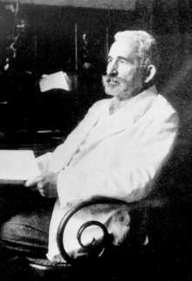
History
Kraepelin -
dementia precox, a term that emphasized the change in cognition (dementia) and early onset (precox) of the disorder.
(paranoia, grandiose delusions, auditory hallucinations, abnormal emotional reg., bizarre thoughts)—partly genetic

Slide 7
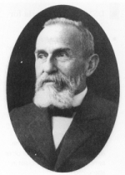
Bleuler coined the term schizophrenia, which replaced dementia precox in the literature.
He chose the term to express the presence of schisms between thought, emotion, and behavior in patients with the disorder.
Loosening of associations
Flattening of affect
Autism
Ambivalence

Slide 8
Epidemiology
Schizophrenia is found in all societies and geographical areas, and incidence and prevalence rates are roughly equal worldwide.
the lifetime prevalence of schizophrenia is about 1 percent, which means that about 1 person in 100 will develop schizophrenia during their lifetime.
The Epidemiologic Catchment Area study sponsored by the National Institute of Mental Health reported a lifetime prevalence of 0.6 to 1.9 percent. According to DSM-IV-TR, the annual incidence of schizophrenia ranges from 0.5 to 5.0 per 10,000.

Slide 9
Schizophrenia is equally prevalent in men and women.
The peak ages of onset mid twenties. Unlike men, women display a bimodal age distribution, with a second peak occurring in middle age.

Slide 10
Genetic factor: Genetic factors account for the majority of liability to schizophrenia.
Heritability estimates range from 60-80%
One affected parent 10%risk in child

Slide 11
Prevalence of Schizophrenia in Specific Populations
 | Prevalence (%)
General population | 1
Non-twin sibling of a schizophrenia patient | 8
Child with one parent with schizophrenia | 12
Dizygotic twin of a schizophrenia patient | 12
Child of two parents with schizophrenia | 40
Monozygotic twin of a schizophrenia patient | 47

Slide 12
Environmental factors:
-Complications of pregnancy
- neurodevelopmental difficulties
-Disturbed childhood behaviour
-Maternal influenza in pregnancy and winter births
-Degree of urbanisation at birth

Slide 13
Substance Abuse in Schizophrenia
Nicotine : Up to 90 % patients may be dependent on nicotine. Apart from smoking-associated mortality, nicotine decreases the blood concentrations of some antipsychotics.
Those reporting high levels of cannabis use (more than 50 occasions) were at sixfold increased risk of schizophrenia compared to nonusers.
Comorbid Alcohol abuse is high.

Slide 14
Etiopathogenesis
Schizophrenia is a misregulation of information in the brain
  Many different NT pathways are hypothesized to be involved in the biological basis of the disorder
  Genetics may be an important role
  The environment/ stress triggers a possible genetic predisposition

Slide 15
Genes
Genes scattered across 1q, 5q, 6p, 6q, 8p, 10p, 13q, 15q, and 22q
Susceptible genes
  Neuregulin 1: NMDA, GABA, & Ach receptors
  Dysbindin: synaptic plasticity
  Catechol-O-methyl transferase: DA metabol.
  G72: regulates glutamatergic activity
  Others: myelination, glial function

Slide 16
Neurotransmitters
DOPAMINE :
Original theory proposed that an over activation of DA led to schizophrenic symptoms
More recently it has been hypothesized that
  Positive symptoms are caused by an over activation of specific DA pathways
  Negative symptoms arise from and under activation of different DA pathways

Slide 17
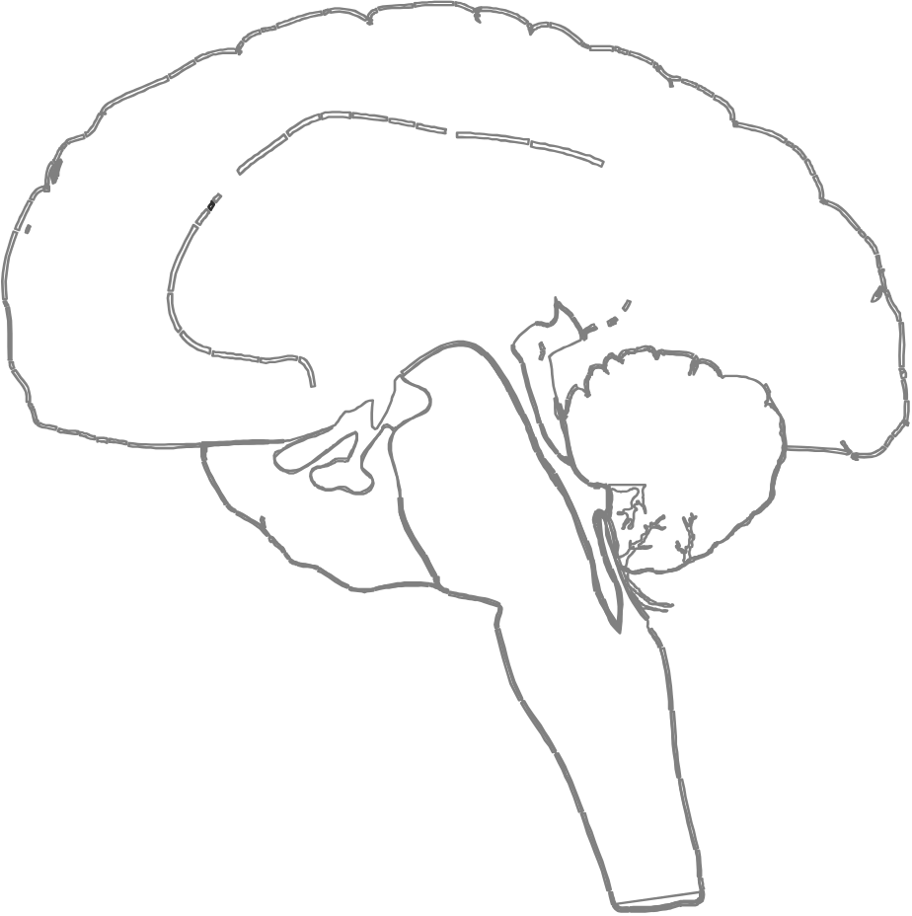
Dopamine Pathway In Brain
Mesocortical pathway
Nigrostriatal pathway (part of EP system)
Hypoactivity:
negative symptoms
Mesolimbic pathway
Hyperactivity:
positive symptoms
Tuberoinfundibular pathway
(inhibits prolactin release)
*
Notes:
This slide is animated.
Based on the pioneering work of Dr. Arvid Carlsson and a growing body of evidence,
the predominant hypothesis regarding the pathophysiology of schizophrenia is that
it is associated with impaired dopamine neurotransmission in the brain.¹⁻³ Four major
dopaminergic pathways have been described:
• The mesolimbic pathway originates from the midbrain ventral tegmental area and innervates the ventral striatum (nucleus accumbens), olfactory tubercle, and parts of the limbic system.
• The mesocortical pathway also originates from the midbrain ventral tegmental area and innervates areas of the frontal cortex. It has been implicated in aspects of learning and memory.
• The nigrostriatal pathway is involved in control of movement.
• The tuberoinfundibular pathway projects from the hypothalamus to the anterior pituitary gland and controls prolactin secretion.
Overactivity of the mesolimbic pathway has been implicated in development of positive symptoms of schizophrenia.
The negative and some cognitive symptoms of schizophrenia have been associated with a reduction of dopamine activity in the mesocortical pathways.
The overall goal of treatment is to reduce the activity of hyperactive pathways mediating psychosis and to increase the activity of hypoactive pathways that seem to mediate negative and cognitive symptoms, while simultaneously preserving the activity of those pathways that regulate motor movement and prolactin secretion.
1. Carlsson A. The dopamine theory revisited. In: Hirsch SR, Weiberger DR, eds. Schizophrenia. Oxford, UK: Blackwell Science;1995;379.
2. Laruelle M, Abi-Dargham A. Dopamine as the wind of the psychotic fire: new evidence from brain imaging studies. J Psychopharmacol. 1999;13:358.
3. Seeman P. Antipsychotic drugs, dopamine receptors, and schizophrenia. Clin Neurosci Res. 2001;1:53.

Slide 18
Serotonin
Serotonin excess - cause of both positive and negative symptoms in schizophrenia.
Robust serotonin antagonist activity of clozapine and other second-generation antipsychotics.
Studies show a possibility of serotonin-glutamate interaction
  Drug-induced serotonin blocking limits glutamate release

Slide 19
Glutamate
Glutamate induced hyperactivity, hypoactivity, and glutamate-induced neuro-toxicity have been implicated in the pathogenesis of Schizophrenia.
Role of GABA , Norepinephrine, Acetylcholine and various neuropeptides in the pathogenesis of schizophrenia.

Slide 20
Structural changes in brain
Computed tomography (CT) scans of patients with schizophrenia have consistently shown lateral and third ventricular enlargement and some reduction in cortical volume.
Reduction in temporal lobe volume
Bio –psycho –social model.

Slide 21
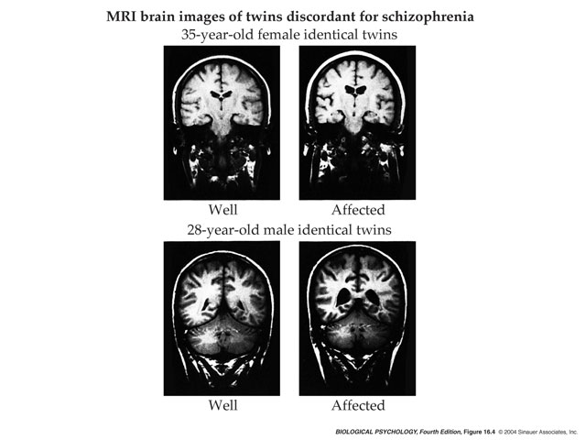

Slide 22
Studies of PM brain samples from schizophrenic patients have shown a decrease in the size of the amygdala, the hippocampus, and the parahippocampal gyrus.

Slide 23
Neuropathology
Loss of brain volume occurs in schizophrenic brains, this results from reduced density of the axons, dendrites, and synapses that mediate associative functions of the brain.
Schizophrenia results from excessive pruning of synapses during adolescence.

Slide 24
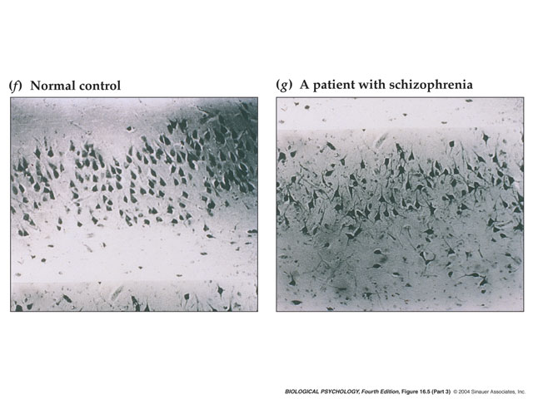

Slide 25
Social theories
In the 1960s
e.g. schizophrenogenic mother, marital skew and schism
They are now of historical interest only
. Expressed Emotion: Parents or other caregivers may behave with overt criticism, hostility, and overinvolvement toward a person with schizophrenia
Many studies have indicated that in families with high levels of expressed emotion, the relapse rate for schizophrenia is high.

Slide 26
Diagnosis
Kurt Schneider Criteria for Schizophrenia
First-rank symptoms Audible thoughts Voices arguing or discussing or both Voices commenting Somatic passivity experiences Thought withdrawal and other experiences of influenced thought Thought broadcasting Delusional perceptions All other experiences involving volition made affects, and made impulses

Slide 27
ICD-10 criteria schizophrenia F20
1. At least one of the following:
Thought echo, insertion, withdrawal, or broadcasting.
Delusions of control, influence, or passivity; clearly referred to body or limb movements or specific thoughts, actions, or sensations; and delusional perception.
Hallucinatory voices giving a running commentary on the patient's behaviour or discussing him/her between themselves, or other types of hallucinatory voices coming from some part of the body.
Persistent delusions of other kinds that are culturally inappropriate or implausible, (e.g. religious/political identity, superhuman powers and ability).

Slide 28
2. Or, at least two of the following:
Persistent hallucinations in any modality, when accompanied by fleeting or half-formed delusions without clear affective content, persistent over-valued ideas, or occurring every day for weeks or months on end.
Breaks of interpolations in the train of thought, resulting in incoherence or irrelevant speech or neologisms.
Catatonic behaviour such as excitement, posturing, or waxy flexibility, negativism, mutism, and stupor.
Negative symptoms such as marked apathy, paucity of speech, and blunting or incongruity of emotional responses.
A significant and consistent change in the overall quality of some aspects of personal behaviour, manifest as loss of interest, aimlessness, idleness, a self-absorbed attitude, and social withdrawal.
3. Duration of atleast1 mth.

Slide 29
The symptoms of schizophrenia are conventionally divided into positive (new symptoms or signs) and negative (loss of a previous function):
Positive symptoms
Delusions (commonly persecutory, thought interference, or passivity) and Hallucinations (usually auditory hallucinations commenting on the subject or referring to them in third person).

Slide 30
Negative symptoms
Loss of the normal level of motivation or drive, loss of awareness of socially appropriate behaviour, flattening of mood, and difficulty in abstract thinking.
Other symptoms
Formal thought disorder (a loss of the normal flow of thinking usually shown in the subject's speech or writing), agitation, depression, poor concentration, poor sleep, soft( non-localising neurological signs), cognitive impairment.

Slide 31
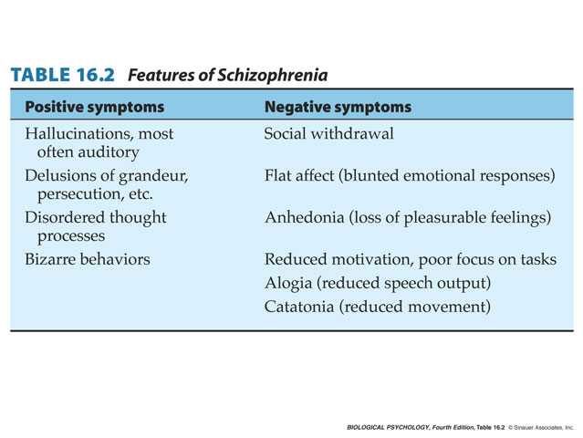

Slide 32
ICD-10 | DSM-IV | Key symptoms
Paranoid schizophrenia | Paranoid Type | Delusions and hallucinations
Hebephrenic schizophrenia | Disorganised type | Disorganised speech behaviour (often silly/shallow) and flat or inappropriate affect
Catatonic schizphrenia | Catatonic type | Psychomotor disturbance
Undifferentiated schizophrenia | Undifferentiated type | Meeting general criteria, but no specific symptom subtype predominates

Slide 33
Post-schizophrenic depression |  | Some residual symptoms, but depressive picture predominates
Residual schizophrenia | Residual type | Previous ˜positive symptoms less marked; prominent negative symptoms
Simple schizophrenia |  | No delusions or hallucinations deficit state (negative symptoms) gradually arises without an acute episode.

Slide 34
A spouse or relative noticing withdrawn or bizarre behaviour.
Not achieving educational potential
Complaining to GP about various symptoms.
Presentation to criminal justice system.
Deliberate self harm.
Complaining to council/police etc. on basis of delusional symptoms (e.g. hearing voices of neighbours throughout the night).

Slide 35
Differential diagnosis
: Acute/transient psychotic disorder, delusional disorder, paranoid personality disorder, bipolar disorder, depressive episode with psychotic symptoms, manic episode with psychotic symptoms, drug-induced psychosis, alcohol withdrawal.
Negative symptoms may also be mimicked by the effects of medication (extrapyramidal side-effects, sedation) or by depression coexisting or following an acute episode of illness

Slide 36
Investigations
Blood tests Routine: U + E, LFT, calcium, FBC, glucose.
When suggested by history/examination: VDRLs, TFTs, PTH, cortisol, tumour markers.
Radiological CT or MRI only in the presence of suggested neurological abnormality or persistent cognitive impairment.
CXR only where examination/history suggests comorbid respiratory/cardiovascular condition.

Slide 37
Urine drugs screen (particularly stimulants and cannabis), microscopy and culture (where history suggestive).
Other EEG rarely necessary unless history of seizure or symptoms suggest TLE.
Special investigations 24hr collection for cortisol (if Cushing's disease suggested from history/examination).
24hr catecholamine/5-HIAA collection for suspected phaeochromocytoma/carcinoid syndrome respectively.

Slide 38
TREATMENT :
Pharmacological
Psychosocial

Slide 39
Before treatment
Involve patients and their relatives in decisions about medical care.
Undertake a comprehensive assessment of medical, social, and psychological needs.
Provide patients and carers with clear verbal and, if necessary, written information.
Obtaining consent from the patient for any procedures or treatments.

Slide 40
Acute psychotic symptoms require immediate attention. Treatment during the acute phase focuses on alleviating the most severe psychotic symptoms. This phase usually lasts from 4 to 8 weeks

Slide 41
Medications
Commence atypical antipsychotic risperidone, olanzapine, quetiapine,aripiprazole ) at an effective dose in Ist episode psychosis .
Use benzodiazepines (e.g. lorazepam ) to control non-acute anxiety/behavioural disturbance.

Slide 42
Relapse prevention
Continue antipsychotic medication at minimum necessary dose. Atypical or a preferably non-sedating, conventional antipsychotic (e.g. trifluoperazine, flupenthixol, haloperidol).
Depot antipsychotic medication, particularly where use of oral medication has resulted in relapse due to non-compliance.

Slide 43
Psychological
Family therapy and psychoeducation are effective in reducing relapse.
Evidence also exists for CBT.
Social skills Training
Role in ensuring compliance and Relapse Prevention.

Slide 44
Course and Prognosis
The classic course of schizophrenia is one of exacerbations and remissions.
This failure to return to baseline functioning after each relapse is the major distinction between schizophrenia and the mood disorders.

Slide 45
The schizophrenia patient's vulnerability to stress is usually lifelong. Positive symptoms tend to become less severe with time, but the socially debilitating negative or deficit symptoms may increase.
¼ have good outcome,1/3 have chronic course remainder are somewhat functioning with relapses.
Suicide in 1:10 patients
Maximum relapse first 2 yrs. Medication reduces the relapse rate.

Slide 46
Thank You

