Slide 1
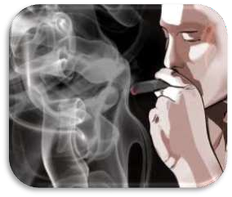

Substance Use Disorder
Dr. Vishal Nagar
Department of Psychiatry

Slide 2
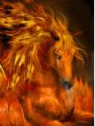





Slide 3
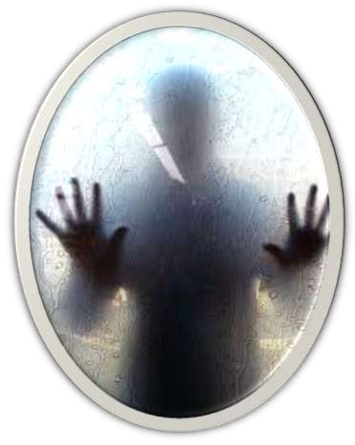
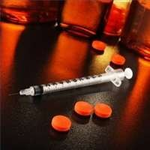
world wide distribution.
affects both genders and all races.
Pattern and type of substance use depends on several factors.

Slide 4
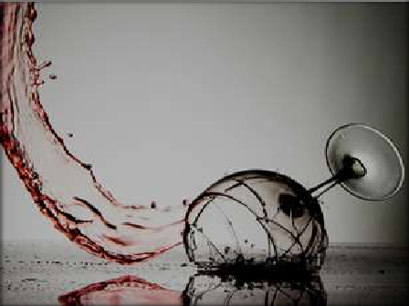
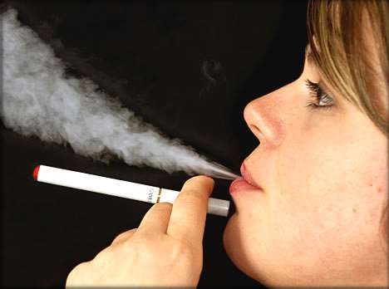

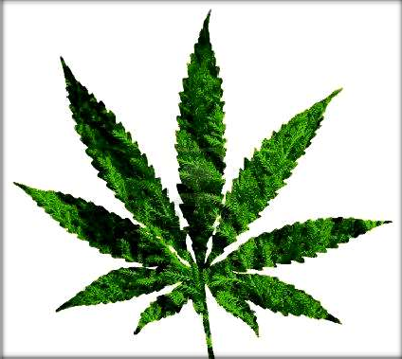

Slide 5
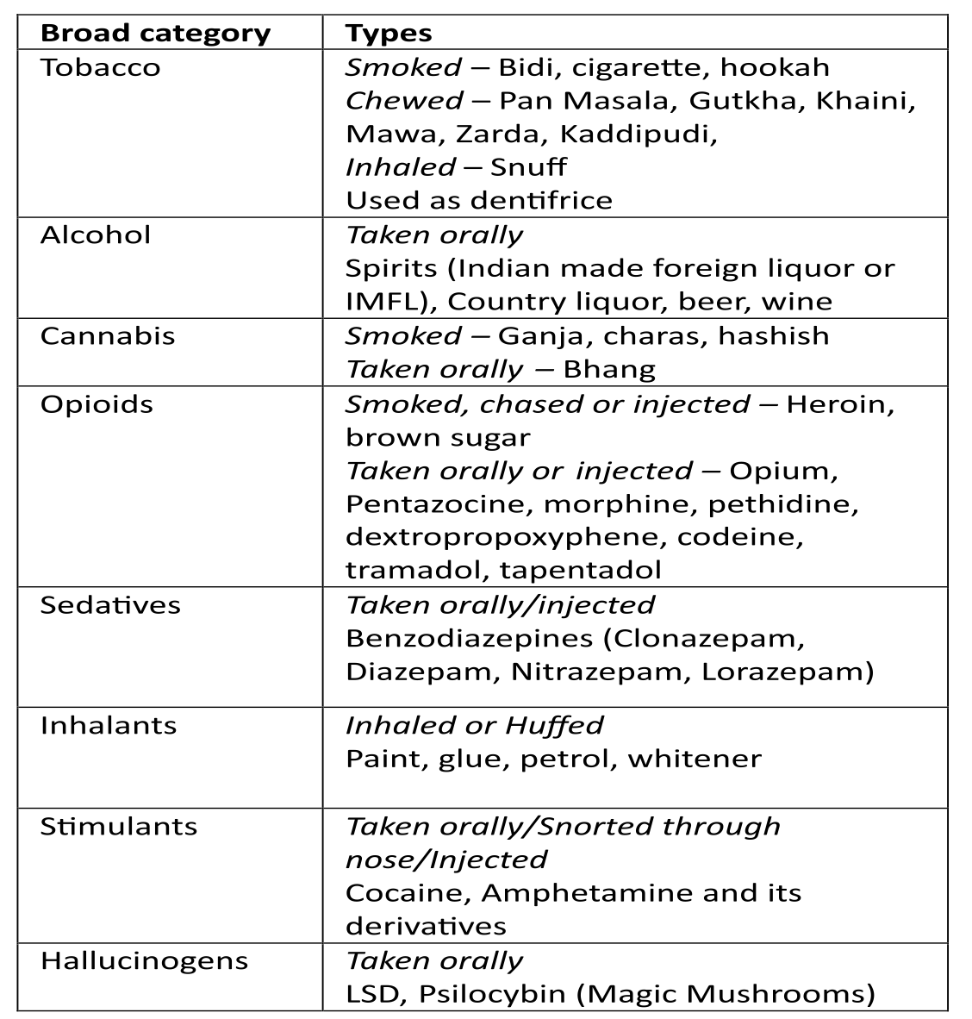
Major Substances

Slide 6

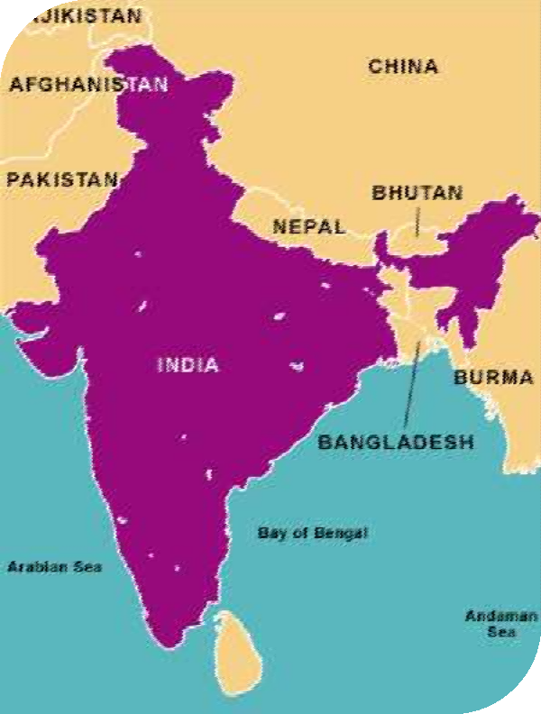
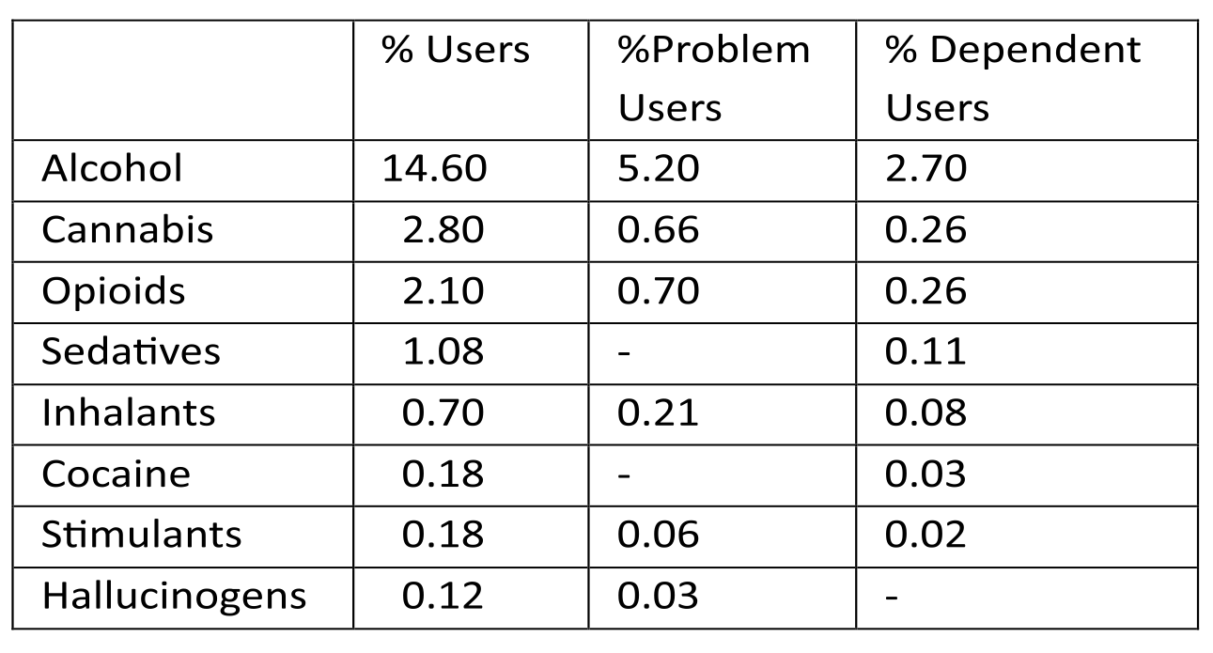
Epidemiology

Slide 7
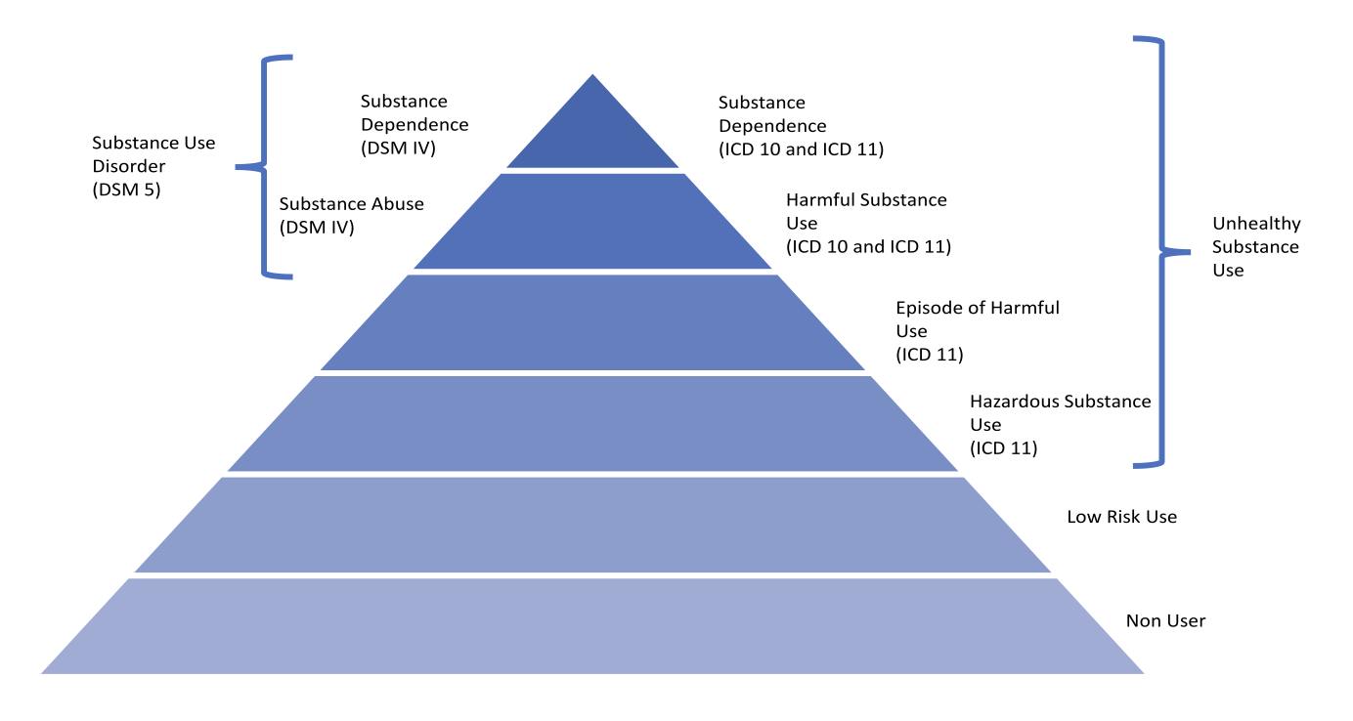
Diagnosis of Substance Use Disorders

Slide 8

a strong desire or sense of compulsion to take the substance;
difficulties in controlling substance-taking behaviour
(c) a physiological withdrawal state
(d) evidence of tolerance,
(e) progressive neglect of alternative pleasures or interests
(f) persisting with substance use despite clear evidence of overtly harmful consequences
Dependence syndrome

Slide 9
Causes of substance use
Psychological – rewarding expectations
Stress
Environmental - social, religious Biological – genetic (60%)
Personality characteristics
Psychiatric illnesses

Slide 10
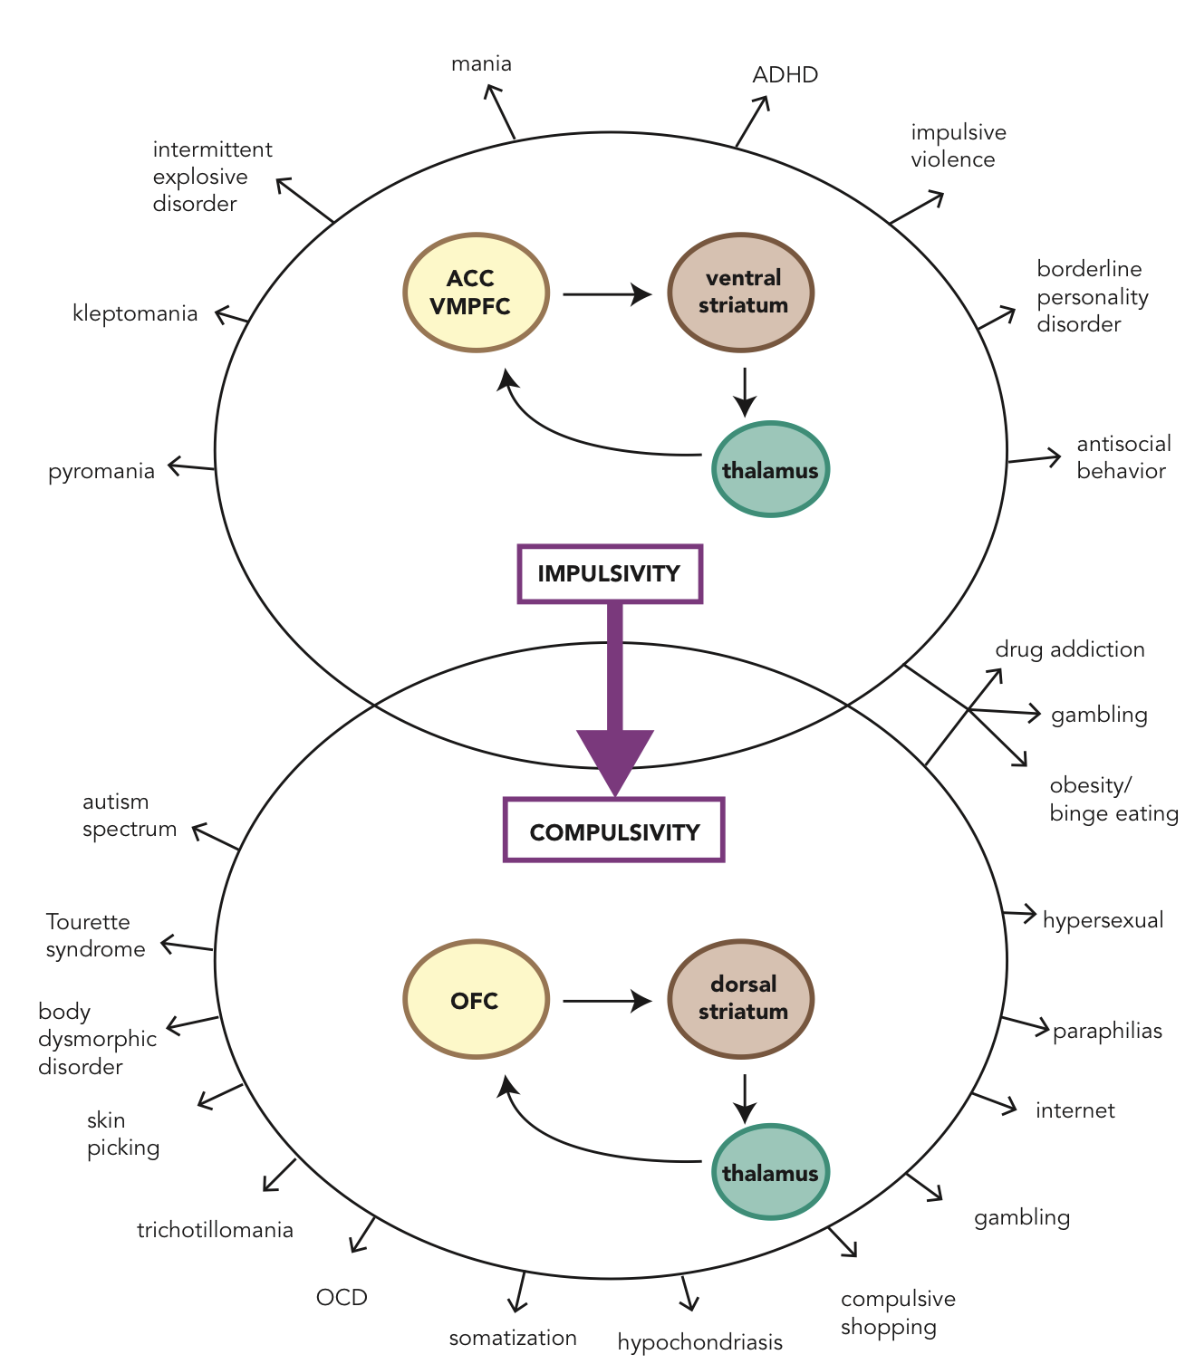

Slide 11
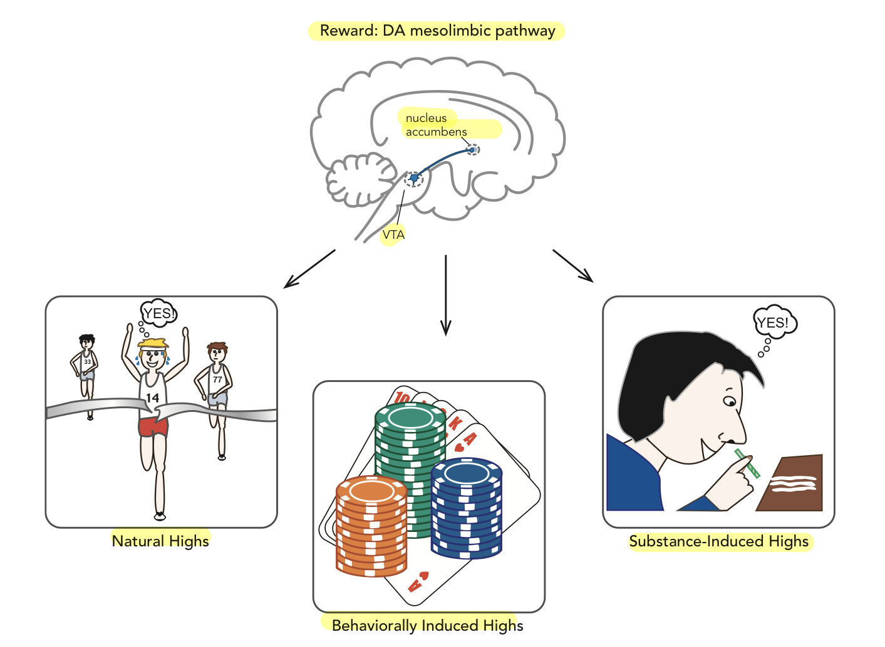

Slide 12
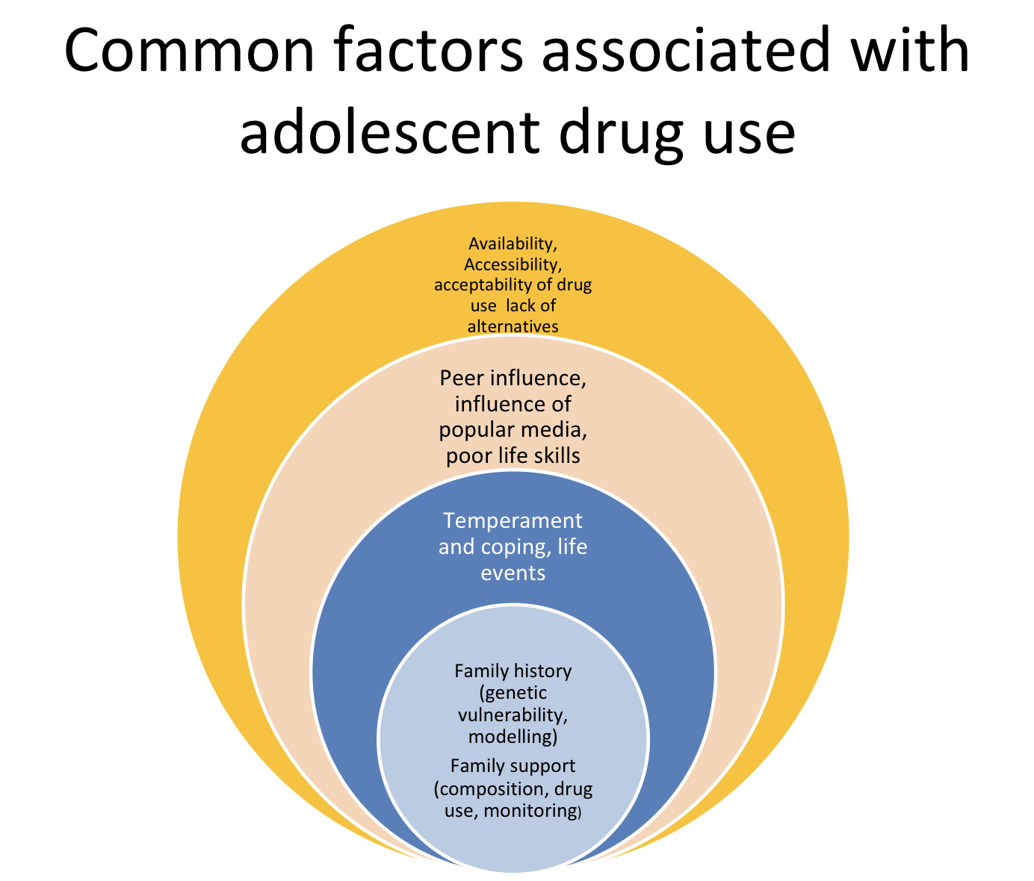

Slide 13
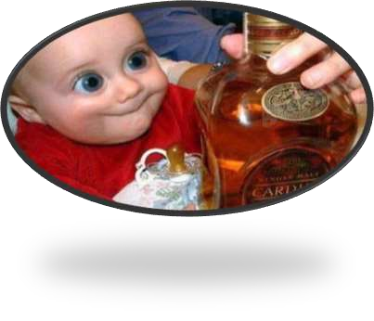
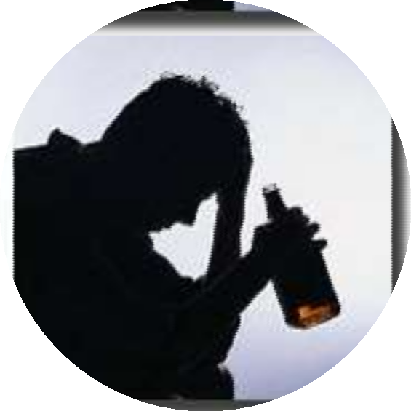
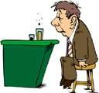
Alcohol use disorders

Slide 14

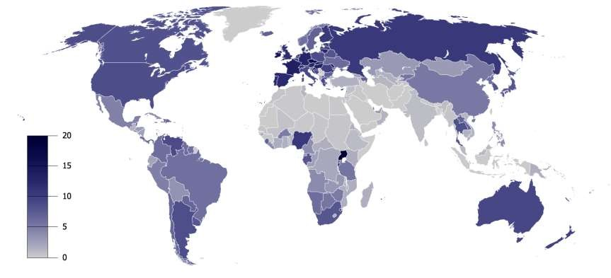
Country wise consumption of alcohol
Alcohol consumption per capita (age 15 or older), per year, by country, in liters of pure alcohol

Slide 15

Scenario
Alcohol contributes to 1.8 million deaths each year (worldwide).
In US 22,000 deaths and 2 million non-fatal injuries each year are due to alcohol.
In US 90% of population drink alcohol at sometime during their life.

Slide 16



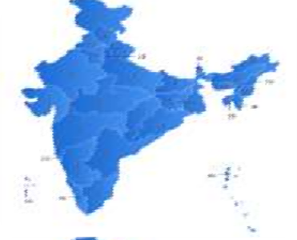

In India the data available is just tip of the ice berg.
After nicotine, most commonly psychotropic substance of use in India
National House Hold Survey (NHS)- Prevalence in general population (above 15 yrs) 21.4% (National survey, 2004)
Drug Abuse Monitoring Survey (DAMS)- Prevalence in treatment seekers 43.9% (National survey, 2004)

Slide 17
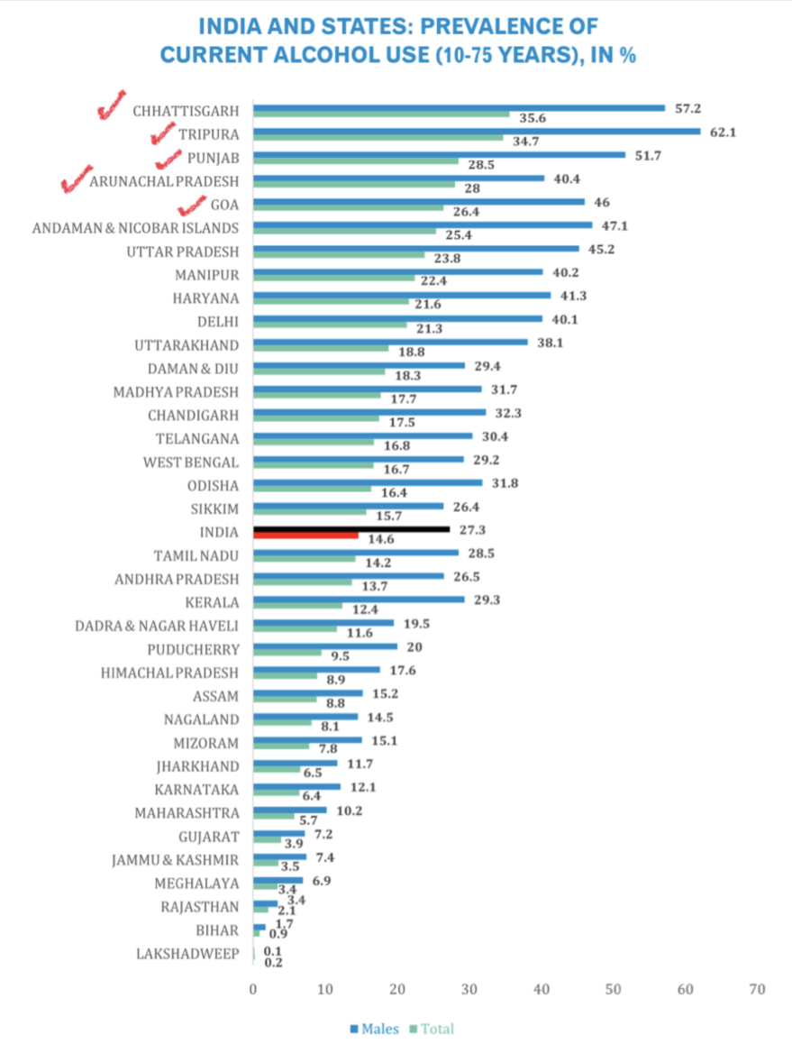

Slide 18


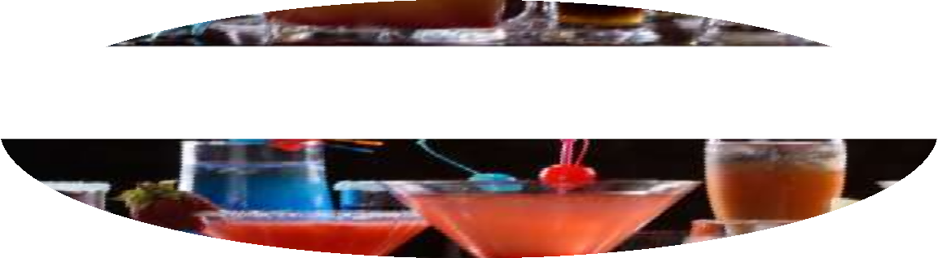

Alcoholic beverages
Alcohol beverages with lower concentration of alcohol ( Beers/ Wines) are produced by fermentation of sugar or starch where as that with higher concentration of alcohol are produced by fermentation followed by distillation.

Slide 19
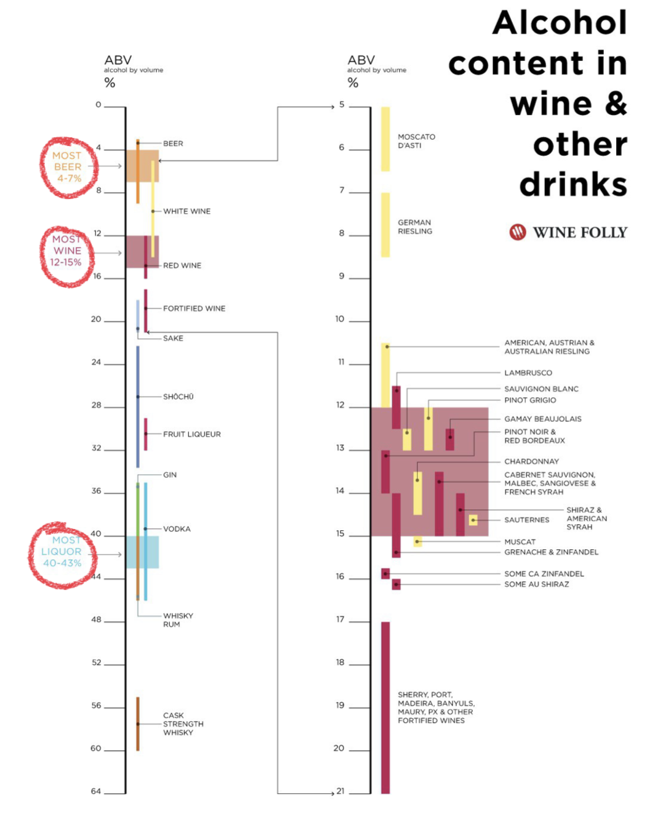

Slide 20
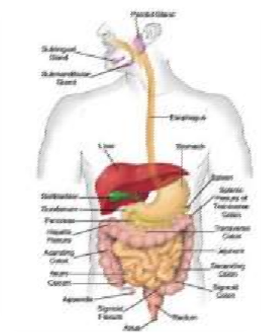
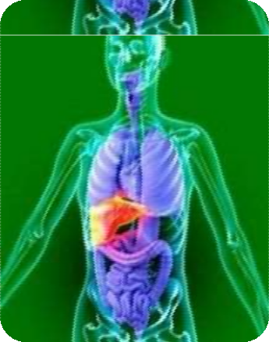
PROPERTIES OF ALCOHOL
Ethanol is well absorbed through the mucosal lining of the digestive tract in the mouth, esophagus, stomach and intestine.
The most common site of absorption is in the proximal small intestine, which is also the site of absorption of many of the B vitamins.

Slide 21
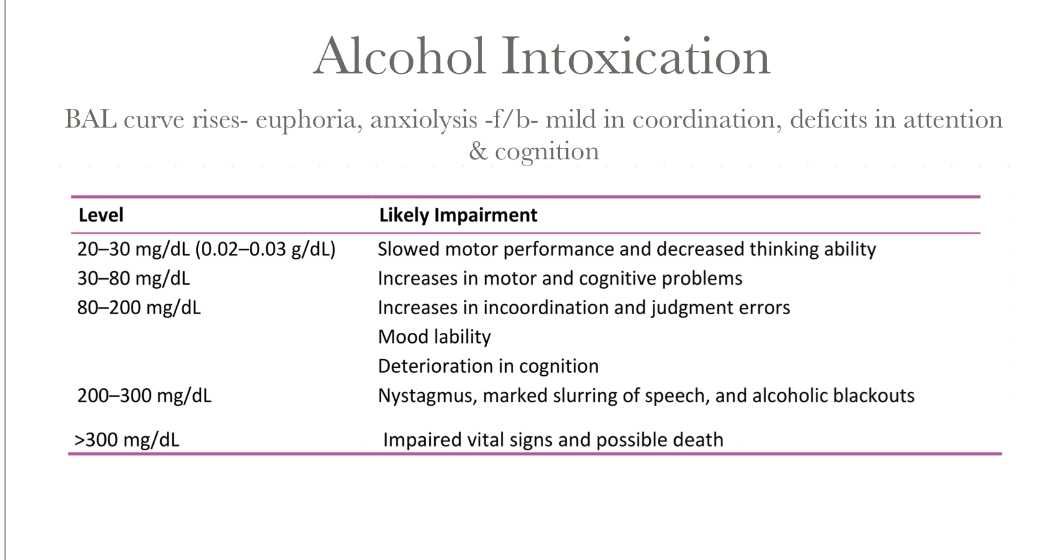

Slide 22
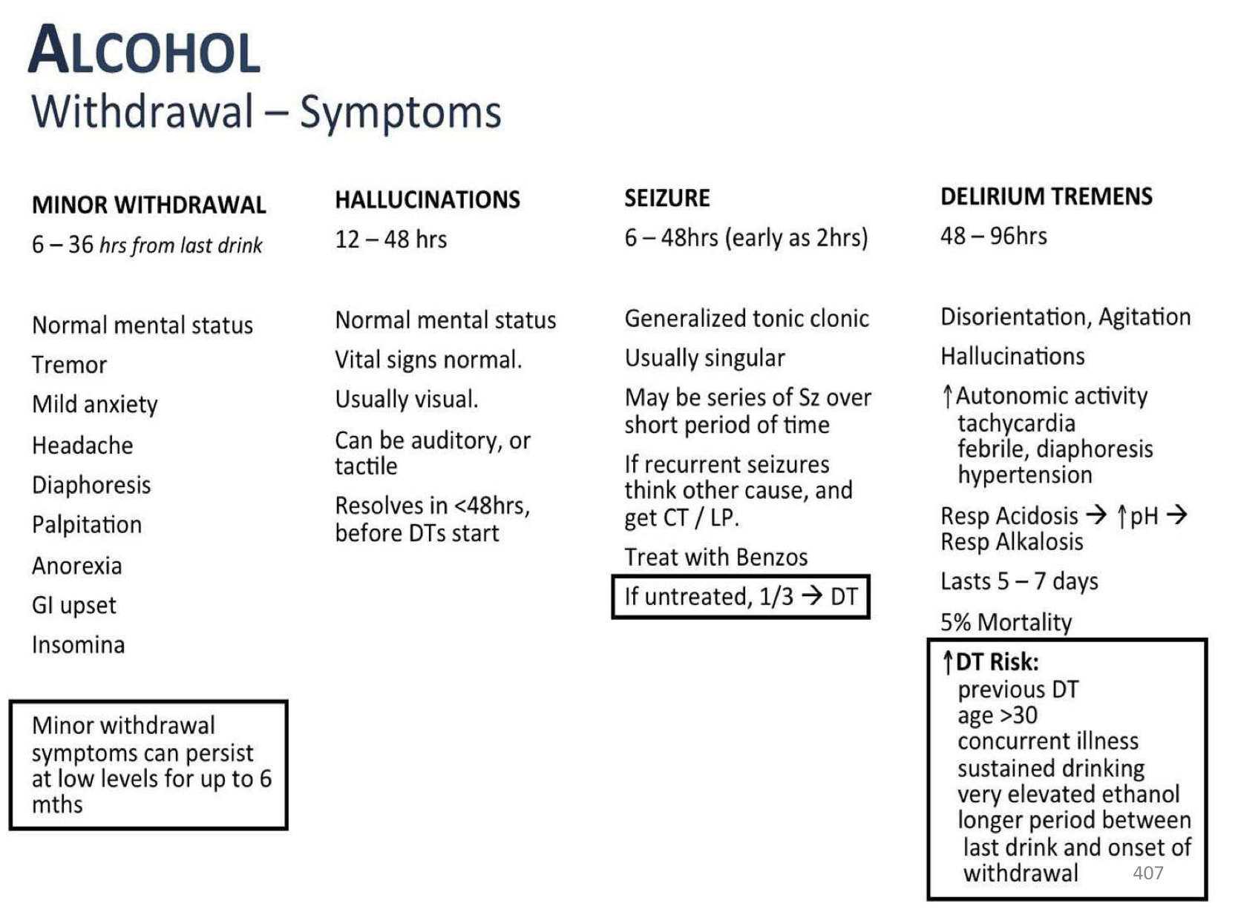

Slide 23
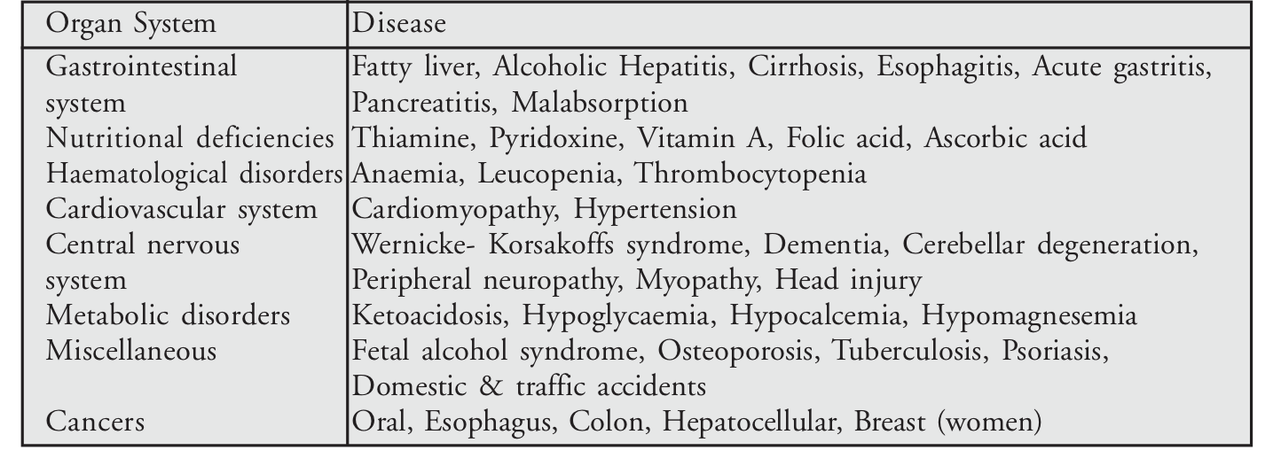
Diseases associated with alcohol use
D

Slide 24
Conclusion
Substance use a growing global and national concern
Not just health related problems
Changing scenarios

Slide 25
Thank You

