Slide 1
STRESS and related disorders
Dr Abhinav Kuchhal
Asst. Professor
Department of Psychiatry

Slide 2
Introduction- Stress the new normal??
The modern world which is said to be a world of achievement is also a world of stress and has been called the – Age of Anxiety and Stress
Stress has been dubbed as the “Health Epidemic of the 21st century’’ by the World Health Organization

Slide 3
How is Stress defined ?
WHO defines stress as “the reaction people may have when presented with demands and pressures that are not matched to their knowledge and abilities and which challenge their ability to cope”
Stress is the body’s nonspecific response to a demand placed on it. (Hans Selye)

Slide 4
Worldwide, about 500 million people are believed to be suffering from neurotic, stress related and psychological problems
India, is also not left unaffected, due to change in the life style the number of person suffering from stress is increasing every day especially in cities, with a few surveys on mental morbidity in various parts of the country suggesting a prevalence rate of 18-20 per 1000

Slide 5
MODEL OF STRESS
Stress model developed by Carson and Kuipers (1998).
The model proposes three levels of the stress process
The first level of the stress process suggests that there are STRESSORS, which come from external sources.
These include specific occupational stressors, everyday ‘hassles’ or ‘uplifts’, which can be cumulative and the stress associated with major life events.
The second level of the stress process are the ‘MODERATORS’.
Carson and Kuipers (1998) identified several factors, which can buffer against the negative effects of stress on individuals.
These are high levels of self-esteem, good social support networks, hardiness and good coping skills, mastery and personal control, emotional stability and good physiological release mechanisms.
The final level of the stress model is the STRESS OUTCOMES.
Outcomes of stress can be both positive and negative.
Positive outcomes include mental and physical well being and high levels of job satisfaction.
Negative outcomes include ill health, burnout and low job satisfaction

Slide 6
MAJOR sources OF STRESS
Daily Life Hassles
Major Life Events
Internal Stressors

Slide 7
Daily Life Hassles
They are the minor stressors which are short-term or less severe such as events or problems including traffic hassles, peer/work relations, time pressures.
They can cause feelings of sickness, and lack of sleep and concentration

Slide 8
Major Life Events
They are either positive or negative, which create major emotional changes or require tremendous amounts of adjustments.
They include personal crisis (health issues, death in family, divorce, financial problems)
Major age related transitions such as marriage, child birth, career or retirement

Slide 9
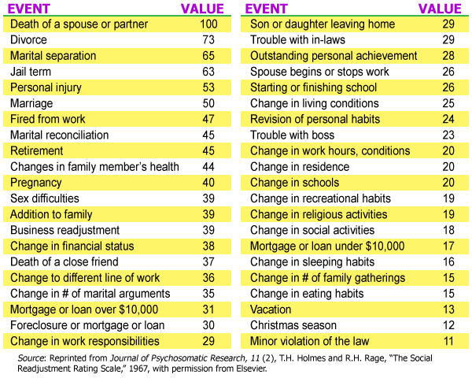
Life event scale for stress

Slide 10
Internal Stressors - Self Generated Stress
Lifestyle choices: Caffeine, Lack of sleep, Overloaded schedule
Negative self: Pessimistic thinking, Over analysing
Mind traps: Unrealistic expectations, All or nothing thinking
Personality traits: Perfectionists, Workaholics, Type A personality

Slide 11
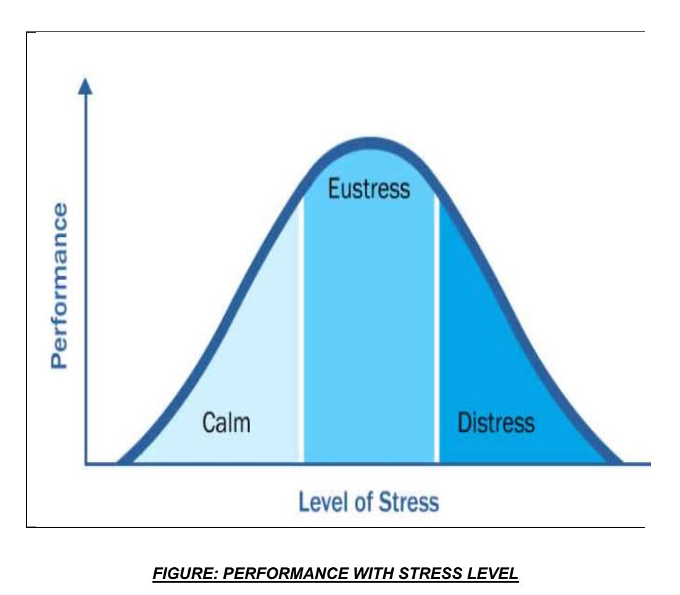
Can stress be good ??
The Yerkes–Dodson law1 dictates that performance
increases with physiological or mental arousal, but only
up to a point.

Slide 12
College life - The best years of your life?
THE CHALLENGES IN COLLEGE
Even positive change is stressful
Greater academic demands
Unstructured time
Decreased adult availability
Being on your own in a new environment
Sleep
Food
Balancing Academic and Extracurricular
Roommates and FRIENDS
Alcohol and other drugs

Slide 13
Stress in medical colleges
A meta-analysis of the American JAMA magazine suggested depressive symptoms in 21 % to 43 % of all medical students including, interns and residents
Medical students have mean anxiety scores one standard deviation above those of non-patients, and their depression levels increase significantly

Slide 14
Stress in MBBS
Level of stress increases as the course of MBBS progresses.
Final year students found to be more stressful than third and second year.
Lengthy syllabus and busy schedule are the two important causative factors for stress in different years of MBBS students.
All these findings raises an alarm related to stress in medical students and insists for introducing early interventional programs to reduce the stress

Slide 15
Impact of stress

Slide 16
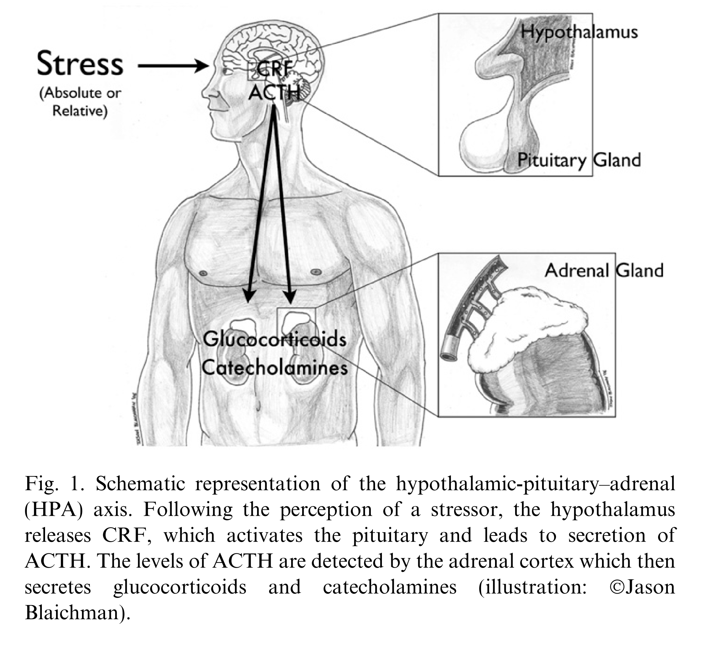
The neuroendocrine response to stress

Slide 17
Impact of stress
STRESS
Behavioral
Physiological
Biochemical
Emotional
Sleep disturbance
Use of alcohol/drugs
Absenteeism
Aggression
Accident prone
Eating disorders
Depression/anxiety
Low self esteem
Irritability
Crying
Suicide
Loss of humor
Worrying
Lack of concentration
Negative thoughts
Poor Memory
Impaired Judgement
Indecisiveness
Nightmares
Cognitive
Increased metabolic rate
Altered hormone levels
Altered endorphin levels
Higher blood pressure
Rapid breathing
Increased heart rate
Dilation of pupils
Muscle tension
Dry mouth
Headache
Frequent infections(poor immunity)

Slide 18
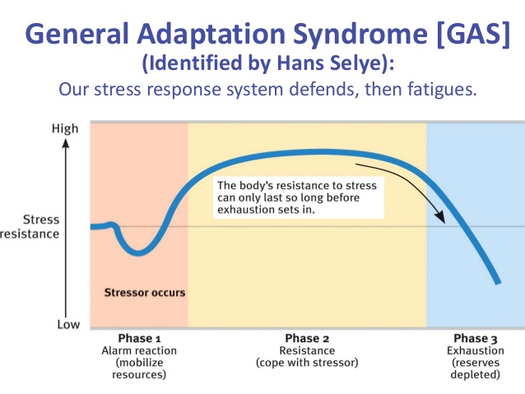
The General Adaptation System

Slide 19
Stress Related illness
Stress is not the same as ill-health, but has been related to such illnesses as;
Cardiovascular disease
Asthma
Diabetes
Ulcers
Skin complaints - psoriasis
Headaches and migraines

Slide 20
Chronic sadness or depression
Chronic mental and physical fatigue
Chronic stress related illnesses (headache, stomach ache, bowel problems, etc.)
Isolation, withdrawal, self-destructive thoughts
BURNOUT

Slide 21
DSM 5, classification of trauma and stressor related disorders.
Reactive Attachment Disorder
Disinhibited Social Engagement Disorder
Posttraumatic Stress Disorder (includes Posttraumatic Stress Disorder for Children 6 Years and Younger)
Acute Stress Disorder
Adjustment Disorders
Other Specified Trauma- and Stressor-Related Disorder
Unspecified Trauma- and Stressor-Related Disorder

Slide 22
Trauma and stressor related disorders include disorders in which exposure to a traumatic or stressful event is listed explicitly as a diagnostic criterion.
Trauma is our minds reaction to terrible events. That severely hurt or frighten us. While we all have built-in resilience to such kinds of pain, in anguish systems can overwhelm us if an event is too much to bear, anyone can experience trauma.
A world, mental health. Survey found that up to 70% of adults have faced trauma inducing happenings in their lifetimes, the older we get, the more the odds go up.
Traumatic events can range from serious accidents, deaths in the family, Surviving a natural disaster, physical or verbal abuse, being a victim of a crime, military Deployments even divorce. There's no shortage of the things that can induce trauma.

Slide 23
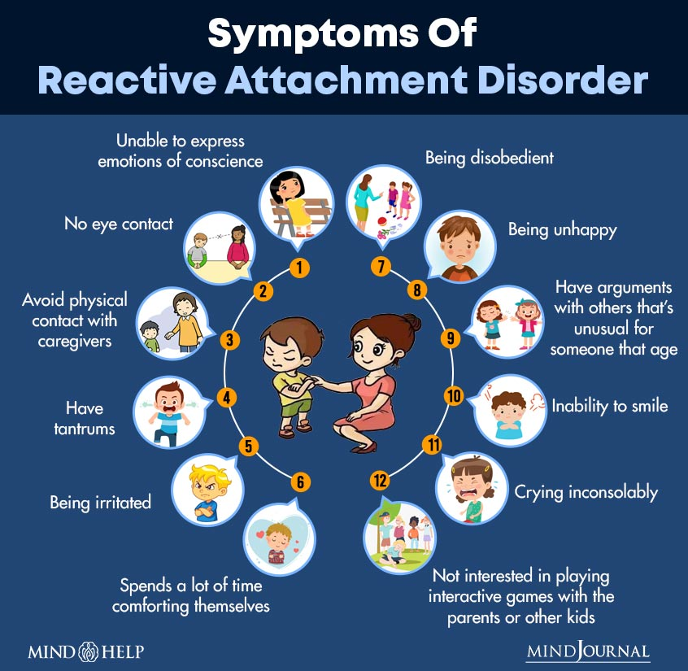
Reactive Attachment Disorder
Reactive attachment disorder (RAD) occurs when a baby or young kid fails to build a strong, healthy emotional link with his or her primary caregivers (parental figures). Children with RAD frequently struggle with emotion management. They have difficulty making genuine connections with others.

Slide 24
Disinhibited Social Engagement Disorder
Disinhibited social engagement disorder (DSED) is a type of both behavior and attachment disorder. To put this disorder simply, it’s when your child is not really attached to anyone and at the same time is over friendly with other people, even with strangers.
‌DSED can occur in children for the following reasons:‌
Absence of a caregiver or parent in the first few years of childhood
Lack of love, care, or emotional support while growing up
Neglect or abandonment by caregivers
Lack of a constant caregiver or repeated changing of caregivers
Negative experiences like childhood trauma or sexual abuse
Growing up in foster care or orphanages

Slide 25
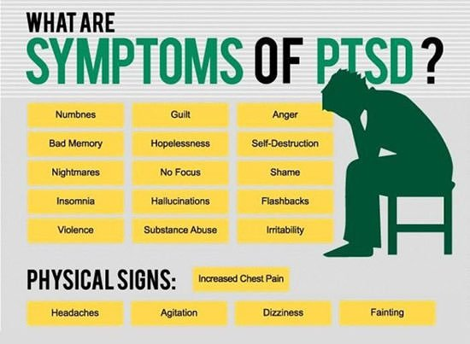
Posttraumatic Stress Disorder

Slide 26
Acute Stress Disorder

Slide 27
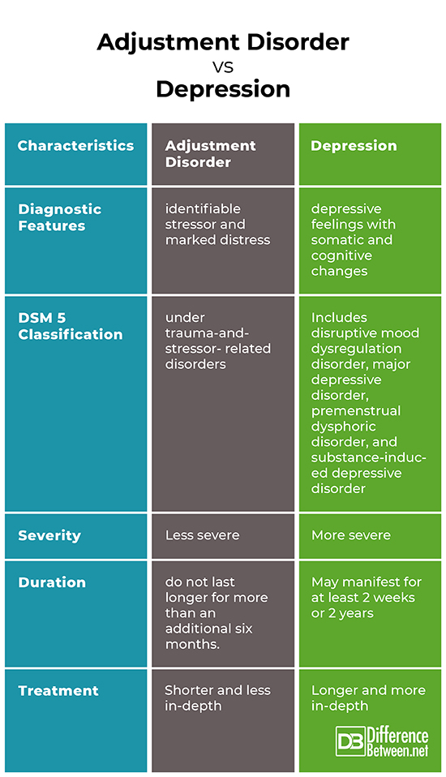

Slide 28
Stress management
Everything can be taken away from man but one thing—the last human freedom, to choose one’s
attitude in any given set of circumstances.

Slide 30
Stress Management
Stress management involves controlling and reducing the tension that occurs in stressful situations by making emotional, behavioral and physical changes.
Every person has a unique response to stress, so there is no one fixed solution to managing it.
No single method works for everyone or in every situation, so experiment and focus on what makes you feel calm and in control

Slide 31
Coping - Definition
Coping refers to voluntary, controlled responses to stress.
Coping has been defined as the constantly changing cognitive and behavioral efforts to manage specific external and/or internal demands that are appraised as taxing or exceeding the resources of the person

Slide 32
Cognitive Appraisal of Stressors
Cognitive appraisal of stressors reflects an individual’s overall perception or evaluation of a stressor.
Primary Appraisal determining whether a stressor is irrelevant, positive, or stressful.
Secondary Appraisal assessing what might and can be done to reduce stress.

Slide 33
RECOGNIZE WHAT YOU CAN CHANGE
Can you change your stressors by avoiding or eliminating them ?
Can you reduce their intensity (manage them over time instead of immediately)?
Can you shorten your exposure to stress (take a break, leave)?
Can you devote the time necessary to make a change in yourself?

Slide 34
Stress Management Techniques
There are 3 ways to manage stress:
  Change your thinking
  Change your behavior
  Change your lifestyle

Slide 35
Change Your Thinking
A person can change his thinking through:
  Re-framing
  Positive thinking

Slide 36
Reframing:
Re-framing is a technique to change the way a person looks at things in order to feel better about them.
There are many ways to interpret a certain situation. So, pick the one you like
Re-framing does not change the external reality, but helps you view things in a different light and less stressfully.
Challenge your Beliefs & put it in right perspectives

Slide 37
Positive Thinking
Forget powerlessness, dejection, despair, failure
Stress leaves us vulnerable to negative suggestion so focus on positives
Focus on your strengths

Slide 38
Change Your Behavior
Be assertive – Say No if you can’t cope with others demands
Get organized
Ventilation
Humor
Diversion and distraction

Slide 39
Change Your Lifestyle
Diet : Light Diet
Smoking & Alcohol: Reduce or quit
Exercise: Do it regularly
Sleep: Have enough sleep
Leisure: Have time for yourself
Relaxation: Daily for at least 5-10 Minutes self talk

Slide 40
Strategies To Reduce Stress
Expect some frustrations, failures and sorrows.
Take control
  Manage your time instead of letting it manage you. Use a to-do list, follow a written plan, set goals and follow through
Avoid procrastination, make realistic goals
  A major cause of stress. Make a realistic list of things you need to do each day. Do the most important things first. That way, even if you don’t finish the list, you get the most important things done
Join the crowd
  Even though you may think you are the only person in the world who is experiencing stress, the fact is that everyone experiences it sometime
Talk to someone
  Find someone you trust, discuss the problems and look for solutions.

Slide 41
Involve yourself in extracurricular activities
  Share your talents to better the lives of others as well as your sense of well-being
Resource management
  Practice better time and money management
Enjoy life's simple pleasures
  like dancing, music, and social outings, curl up with a good book, watch a comedy, spend time in nature
Use it
  A little stress is a good thing. Athletes use it to increase performance. If you are experiencing a small amount of anxiety, it can help to keep you active and alert. Use it to increase your performance
Forgive others,
  Do not hold grudges and be tolerant; not everyone is capable as you. Understand things from the other person point of view
Gain perspective on things
  Is the issue really that important??

Slide 42
Zest for life
  each day is a gift, smile and be thankful that you‘re the part of the bigger picture
Develop mutually supportive friendships/relationships.
  Relationships can be a source of stress as well as your buffer against stress
Always be kind and gentle with yourself
  Be a friend to yourself, decrease negative self talk, don’t be a perfectionist, spare time for yousrelf
Get professional help
  If all of this not helping, consult a mental health professional who can help you learn how to manage stress effectively and guide others who need to help

Slide 43
Relaxation techniques

Slide 44
Relaxation techniques
Relaxation technique (also known as relaxation training) is any method, process, procedure, or activity that helps a person to relax; to attain a state of increased calmness; or otherwise reduce levels of anxiety, stress or anger.
Can decrease muscle tension, lower the blood pressure and slow heart and breath rates, among other health benefits.

Slide 45
Meditation and mindfulness
Meditation is a practice of increased concentration that leads to increased awareness; a solitary practice of reﬂection on internal rather than external stimuli
Mindfulness is the art of living in the present moment through the eyes of non-judgment (turning off the voice of the ego)

Slide 46
Yoga
Yoga is a Sanskrit word meaning “union,” which is accomplished through meditation.
More specifically, it refers to the union of mind, body, and spirit.
It includes various asanas
The practice of yoga relaxation has been found to reduce tension and anxiety. The autonomic symptoms of high anxiety such as headache, giddiness, chest pain, palpitations, sweating, abdominal pain respond well

Slide 47
deep breathing/ Pranayam
Diaphragmatic breathing, abdominal breathing, belly breathing, deep breathing or costal breathing is the act of breathing deep into one's lungs by flexing one's diaphragm rather than breathing shallowly by flexing one's rib cage.
This deep breathing is marked by expansion of the abdomen rather than the chest when breathing
It decreases resting heart rate, promotes feelings of relaxation, decreases muscle tension, improves mental clarity, increases oxygen capacity in lungs, helps deal with stress overload

Slide 48
Mental Imagery and Visualization
Mental imagery describes the ability of the unconscious mind to generate images that have a calming, healing effect on the body.

Slide 49
Music therapy
It is the systematic application of music by the music therapist to bring about helpful changes in the emotional or physical health of the client, and the ability to experience an altered state of physical arousal and subsequent mood by processing a progression of musical notes of varying tone, rhythm, and instrumentation for a pleasing effect.

Slide 50
Massage therapy
It is the manipulation of skin, muscles, ligaments, and connective tissue for the purpose of decreasing muscle tension and increasing physical comfort in musculature and surrounding joints.

Slide 51
Progressive muscular relaxation (PMR)
Muscle tension is the most common symptom of stress
A relaxation technique comprising of tensing and then relaxing the body’s muscle groups in a systematic and progressive fashion to decrease muscle tension
There are different methods of PMR
Either start from toe and work your way up to your neck and head or start with your head and neck and work down to your toes. Tense your muscles for about 5 seconds and then relax for 30 seconds, then repeat

Slide 52
Physical exercise
Physical exercise is a form of stress: the enactment of all the physiological systems that the fight-or-ﬂight response triggers for physical survival.
The positive effects of physical exercise are lowering resting heart rate, resting blood pressure, and muscle tension, higher levels of self-esteem and lower incidences of depression and anxiety and other benefits

Slide 53
Diet and Nutrition
Although the primary purpose of food is as a source of nutrients, many people use food as a means to fill an emotional void created by stress.
A malnourished diet—one that is deficient in essential amino acids, essential fats, vitamins, and minerals—is itself a stressor on the body.
Excess amounts of sugar, caffeine, salt, and foods poor in vitamins and minerals weaken the body’s resistance to the stress response and may ultimately make a person more vulnerable to disease and illness.
The concept of spiritual nutrition suggests eating a wide variety of fruits, vegetables, and grains that nurture the health of the seven primary chakras.

Slide 54
Stress in times of covid-19 PANDEMIC

Slide 55
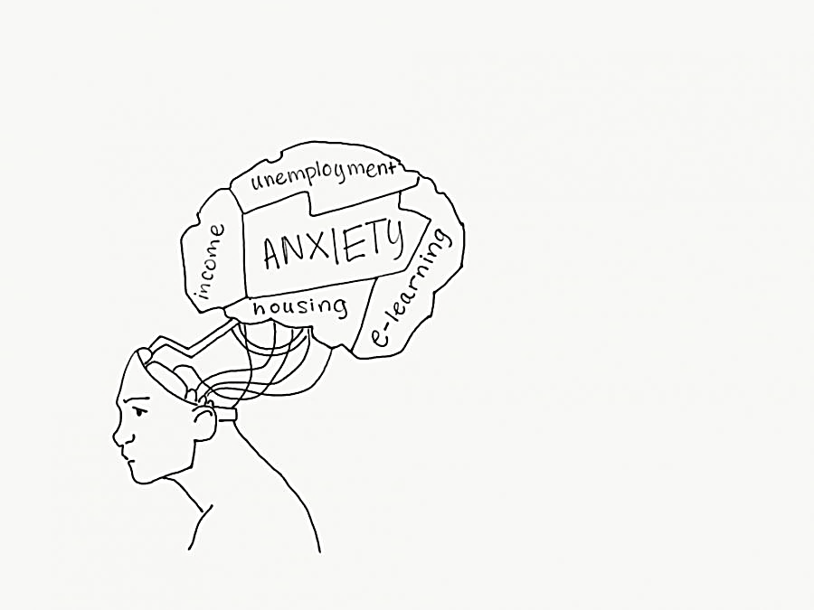
How COVID-19 leads to psychological problems
COVID -19
Uncertain prognoses, high risk of getting infected, fear for and loss of loved ones
Growing financial losses, loss of jobs, insecurities, inadequate supplies, uncertainties about future
Conflicting messages from authorities, difficulty securing medical care and medications
Unfamiliar public health measures that infringe on personal freedoms – quarantine, social distancing and self isolation
Shortage of resources for testing and treatment & for protecting first responders and health care providers
Widespread emotional distress, despair and increased risk for psychiatric illnesses associated with COVID-19, unhealthy behavior and non-compliance

Slide 56
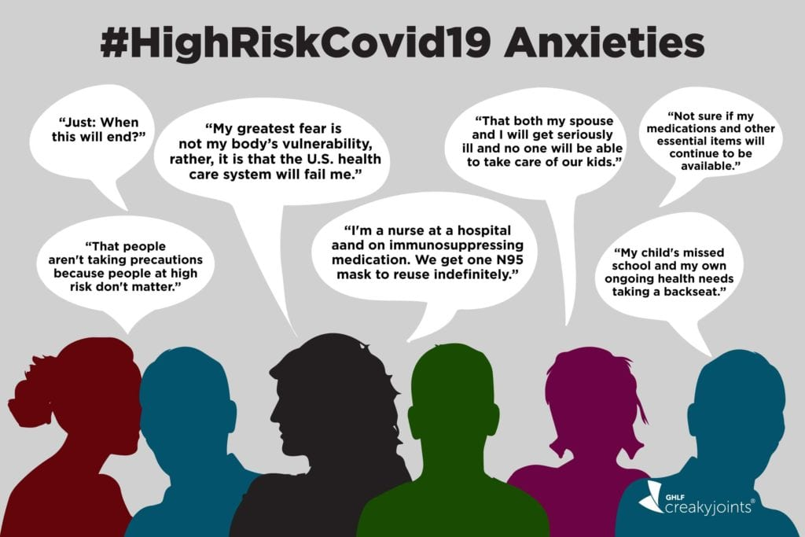

Slide 57
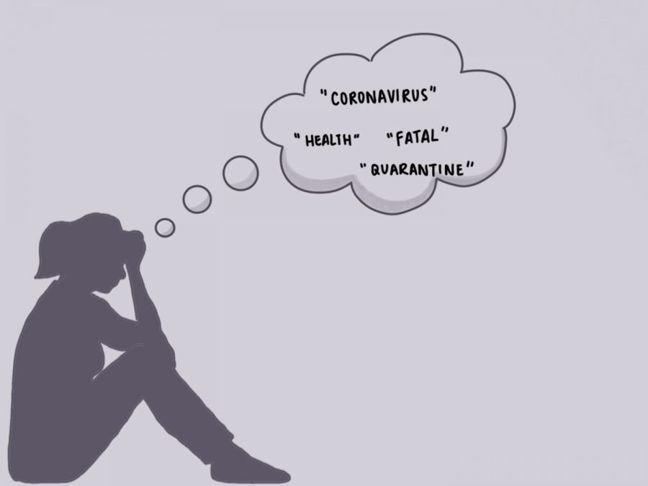
Psychological sequelae of COVID and related issues
Stress
Anxiety
Panic attacks
Obsessive Compulsive disorders
Depression
Psychosis
Phobias
Irritability
Insomnia
Fear
Suicidal ideation
Confusion
Anger
Frustration
Boredom
Shame, guilt, stigma associated with quarantine
Stress and Trauma-related disorders (PTSD)
May persist for much longer…..
Brooks SK, Webster RK, Smith LE, et al. The psychological impact of quarantine and how to reduce it: rapid review of the evidence. Lancet 2020;395:912-20

Slide 58
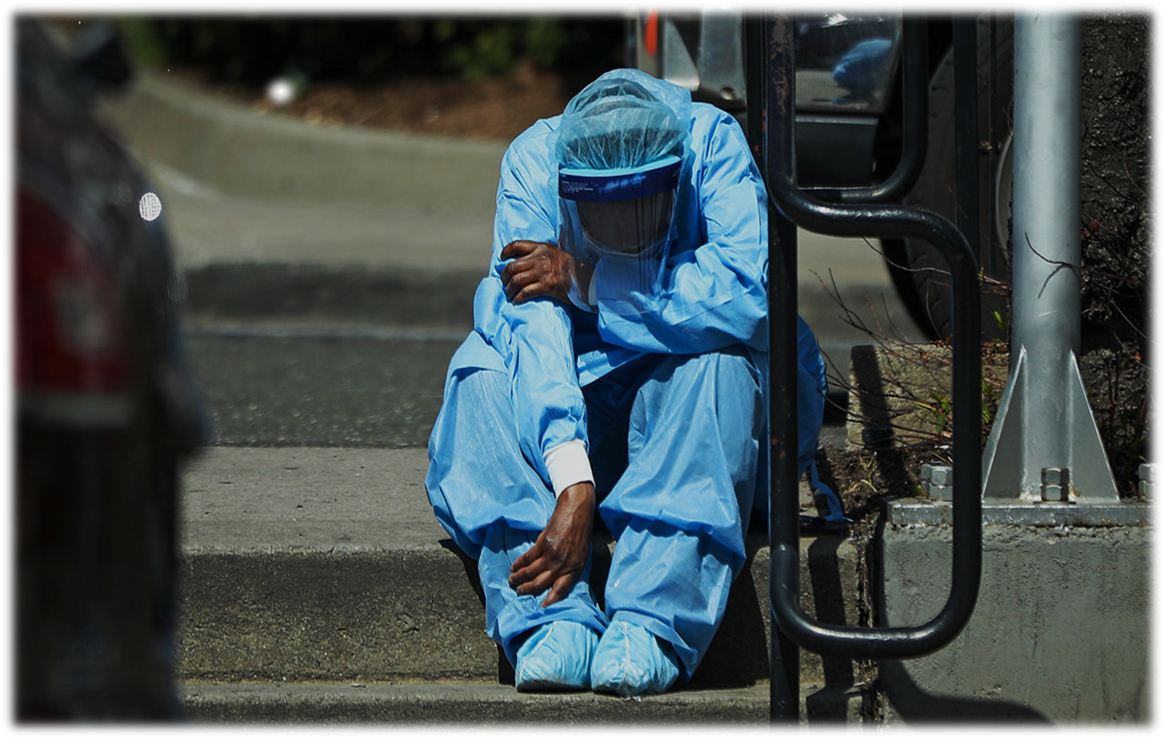
Who are at higher risk for psychological problems
Health care workers
Children, women and elderly - social isolation, abandonment, financial insecurities, violence and abuse
People with COVID-19, contacts, survivors, family members
People with preexisting medical, psychiatric or substance use problems
Betty Pfefferbaum and Carol S. North. Mental Health and the Covid-19 Pandemic. The New England Journal of Medicine
Notes:
The balance between professional duty, altruism and personal fear for oneself and others can often cause conflict and dissonance in many HCWs.

Slide 59
Stressors and concerns of health care workers during COVID-19 pandemic
Expanding workload - More and longer shifts, lesser quarantine and rest periods
Shortages of PPEs and lack of clarity around indications for its use
Lack of effective treatments
Witnessing co-workers becoming ill
Postgraduate students denied education and training in their own branches
Salary cuts, unpaid dues, punishments, denied leaves, no incentives, no acknowledgements
Hostility and aggression
Not able to meet familial and other obligations
Fear of transmitting the virus to family and others
Intense scrutiny of national and international media and fake news
Dealing with patients who are unwilling to be quarantined
Isolation from family and other supports

Slide 60
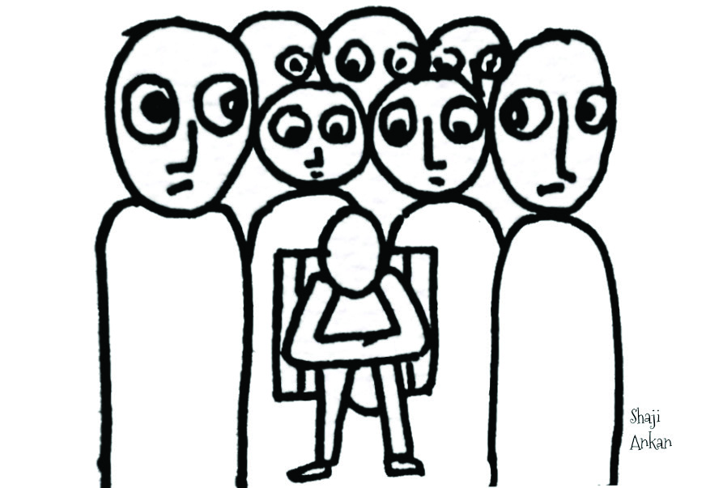
Psychosocial issues for health care workers
Quarantine
Social stigma
Life and death decisions
Moral injury
Burnout

Slide 61
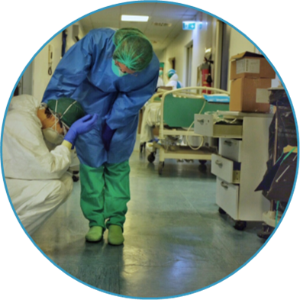
Tips for a positive mental health
Do's
Positive thinking and Self compassion
Don'ts
Ruminations
Routine, Balanced diet and Exercise
Communication and Socialization
Xenophobia
Substance use
Excessive media consumption
Believing and spreading fake news
Stay updated with latest scientific information
Appreciate the ‘honour’ and ‘noble calling’ of our profession
Meet your basic needs
Professional help, if needed

Slide 62
Relaxation techniques
Mediation and Mindfulness
Yoga
Deep breathing/ pranayama
Mental imagery and visualisation
Autogenic training
Biofeedback
Progressive muscle relaxation
Music therapy

Slide 63
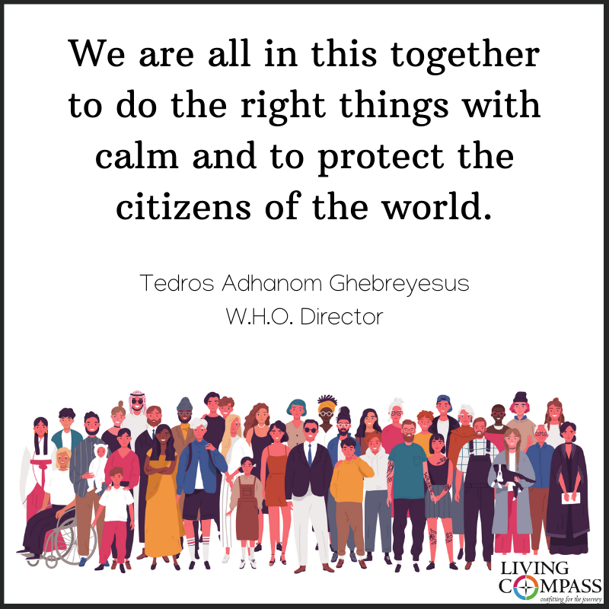
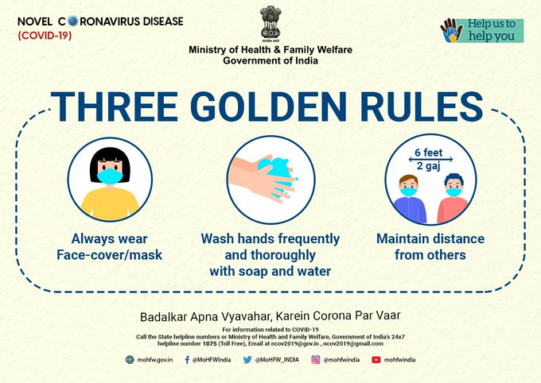
Thank you..

Slide 64
Thank you

