Slide 1

Treatment approach to somatoform disorders
Dr. Ramjan Ali
Professor
Deptt. of Psychiatry

Slide 2
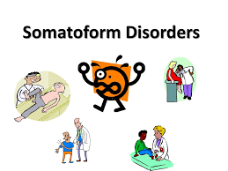
Introduction to Somatoform Disorders
The term is from Greek, “soma” for body.
According to DSM-5, the key characteristic of somatoform disorder is the presence of or preoccupation with physical symptoms that suggest a medical condition but cannot be satisfactorily explained by any medical condition, affect of substance or any other psychiatric disorder.

Slide 3
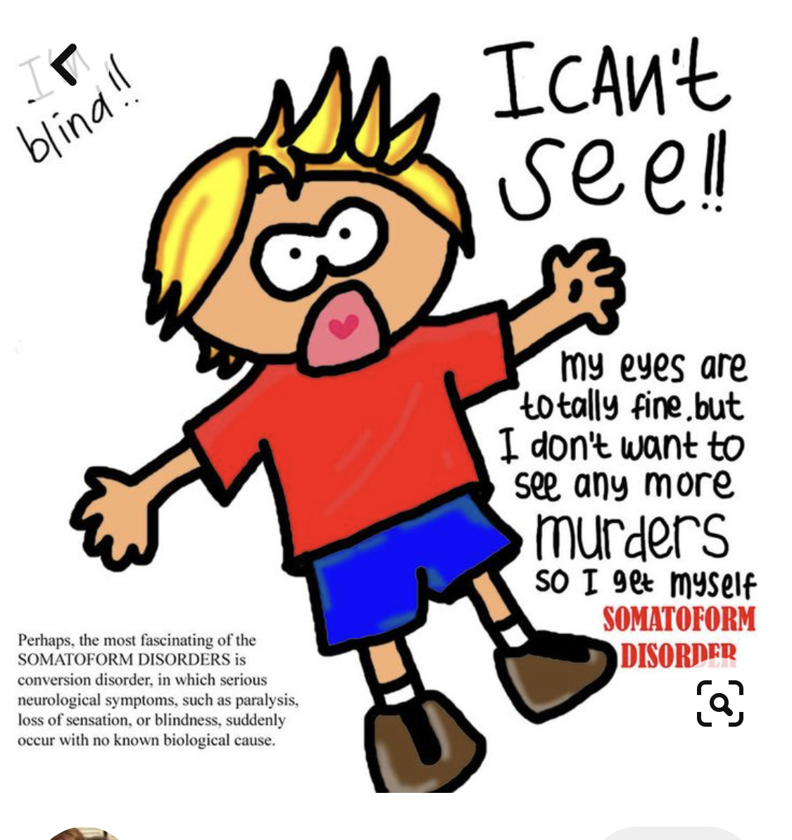
Somatoform disorder includes:
Hypochondriasis
Body dysmorphic disorder
Somatization disorder
Conversion disorder
Somatoform pain disorder

Slide 4
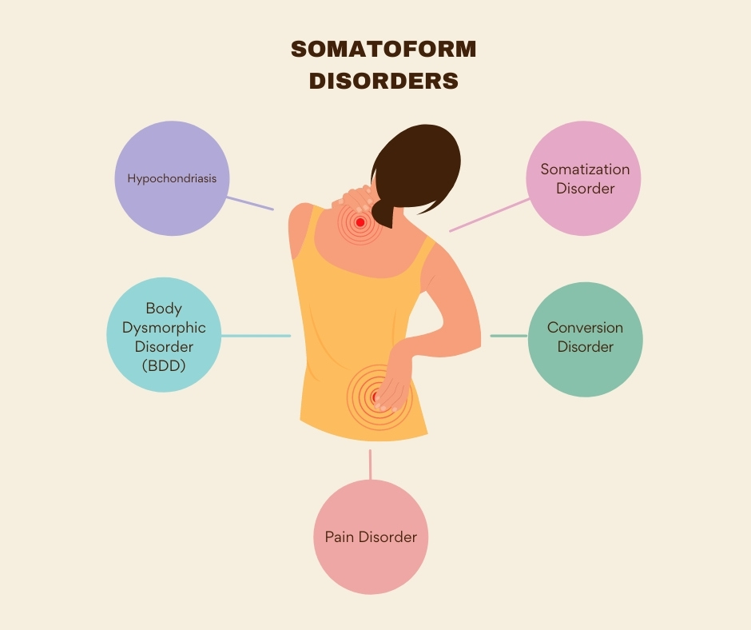
Pharmacotherapy of Somatoform Disorders
Fallon (Pharmacotherapy of Somatoform Disorders;JPR)
Obsessional/cognitive cluster.
  Hypochondriasis
  BDD
Somatic/sensory cluster.
  Somatization
  Pain disorders.
Stressor at onset.
  Conversion.

Slide 5
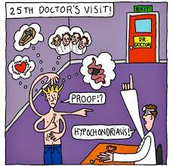
Pharmacotherapy of hypochondriasis
Hypochondriasis may emerge as a secondary feature of other primary psychiatric disorders, such as panic disorder or ‘‘masked’’ major depression, and that treatment of the underlying disorder will lead to a resolution of the hypochondriacal preoccupation.
Kellner et al. demonstrated that about one-third of patients with melancholic depression (who had scores on a hypochondriasis scale) when treated with amitriptyline, the hypochondriacal features resolved along with the depression.
Similarly, Noyes et al. reported that hypochondriasis scores among patients with panic disorder declined in parallel with the resolution of the panic attacks as a result of pharmacotherapy.

Slide 6
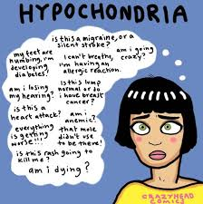
The clinical impression until the late 1980s was that pharmacotherapy would not benefit those with primary hypochondriasis.
The pharmacologic revolution in the early 1990s shattered this pessimism as clinicians and researchers became aware that clomipramine and Serotonin reuptake inhibitors [SRIs] were helpful for patients with obsessional disorders.
Over the last 10 years, case reports and clinical case series suggested that these agents might be helpful for hypochondriasis: clomipramine, fluvoxamine, fluoxetine, and citalopram.
Patients with hypochondriasis who fail to respond to one SRI may experience benefit from an alternative SRI. In one case report, a patient who showed no benefit to 80 mg/day of fluoxetine for 12 weeks subsequently responded very well to 300 mg/day of fluvoxamine.

Slide 7
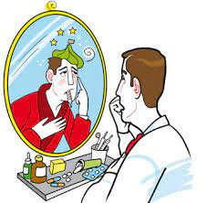
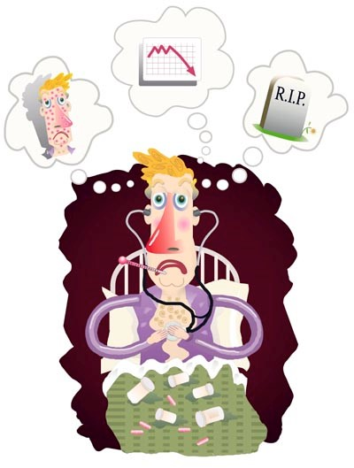
Uncontrolled open-label series have suggested efficacy associated with fluoxetine, fluvoxamine, paroxetine, nefazadone, and imipramine.
Studies showing efficacy with SSRI (Fallon et al)
  Fluoxetine(started on 20 mg/day and had dose increases as needed to 80 mg/day)
  Fluvoxamine (starting at 50 mg/day and increasing weekly by 50 mg to the target dose of 300 mg/day)
  Paroxetine(max 60mg/day)
  Nefazodone(mean dose 432mg/day)
  Imipramine (max 150mg/day)
  SSRI>TCA: In open-label trials, the percentage of patients considered virtually symptom free was greater among patients given serotonin reuptake inhibitors (range: 28.6 – 55.6%) than among patients given the tricylic imipramine (12.5%)

Slide 8
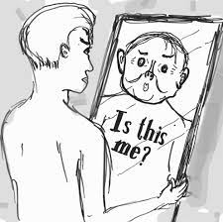
Pharmacotherapy of BDD
Case series and open label clinical trials suggest that SRIs may be particularly effective .
In one retrospective review of 130 patients who received a total of 316 medication trials, Phillips et al. noted the percentages of trials that resulted in clinical improvement in BDD were :
SSRI (42% of 65 trials )
Monoamine oxidase inhibitors (MAOIs) (30% of 23 trials )
Tricyclic Anti-depressant (15% of 48 trials)
Neuroleptics (3%)

Slide 9


Clomipramine>desipramine: In a 16-week double-blind, crossover design study of clomipramine and desipramine, clomipramine was found to be superior to desipramine in the acute treatment of BDD symptoms.
Phillips et al. randomly assigned 67 patients with BDD to either fluoxetine or placebo for 12 weeks. Fluoxetine was significantly more effective than placebo, the responder rate was 53% for fluoxetine and 18% for placebo.

Slide 10
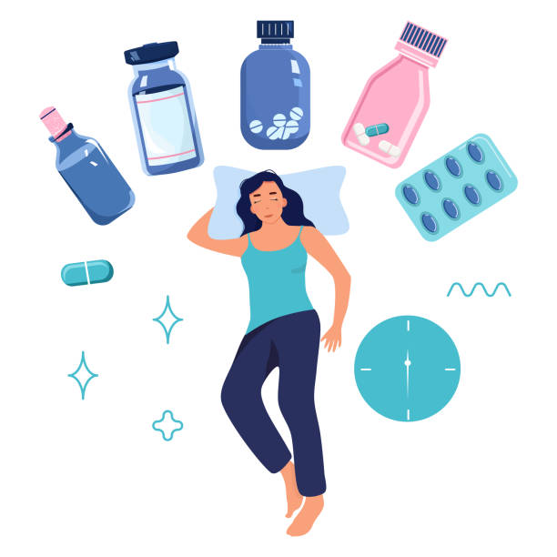
Pharmacotherapy of pain disorders
In a placebo-controlled study of abnormal cardiac pain perception, Imipramine at 50 mg/day resulted in significantly fewer pain episodes.
In a placebo-controlled study of mixed pain/depression syndromes, phenelzine (median dose 75 mg/day) was more effective than imipramine (median dose 150 mg/ day) and placebo.
In a 1992 meta-analysis of 39 placebo-controlled studies on chronic pain, greater analgesia was associated with:
tricyclic drugs (imipramine, amitryiptyline, doxepin, clomipramine) rather than tetracyclic drugs (mianserin, maprotiline, trazodone). TCA>tetracyclics
medicines with a mixed serotonergic and noradrenergic profile (amitriptyline, imipramine) rather than medicines that are either primarily serotonergic or noradrenergic

Slide 11
Other agents -
Venlafaxine, a serotonergic and noradrenergic reuptake inhibitors, has been shown to be as effective as imipramine in a placebo-controlled trial for the treatment of painful polyneuropathy
Buproprion SR, a weak dopamine- and norepinephrine-reuptake inhibitor, has been shown, in a double-blind placebo-controlled study, to be effective for neuropathic pain
Anticonvulsants also have an important role in pain management-
Carbamazepine is clearly beneficial in treating trigeminal neuralgia
Gabapentin is particularly useful in painful diabetic neuropathy and postherpetic neuralgia
Lamotrigene, topiramate, and levetiracetam may also have pain-reducing effects

Slide 12
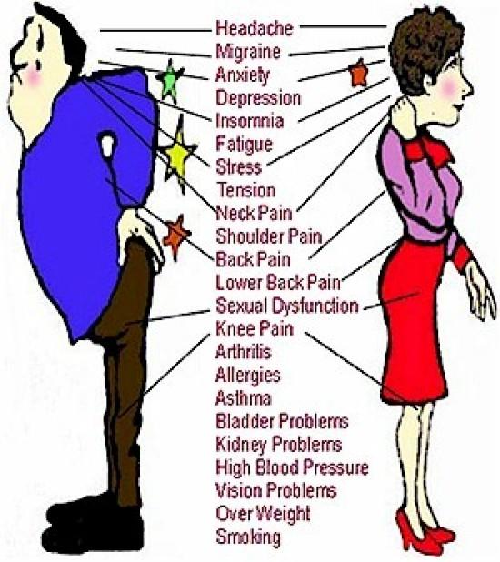
Pharmacotherapy of Somatization Disorder
Treat co-existing mood disorders/anxiety disorders.
TCA.
  Most effective.
  But have More side effects.
SSRI/SNRI.
  First choice.
  Dose titration
Avoid BZDs.
St. John’s Wort (Hypericum Perforatum)

Slide 13
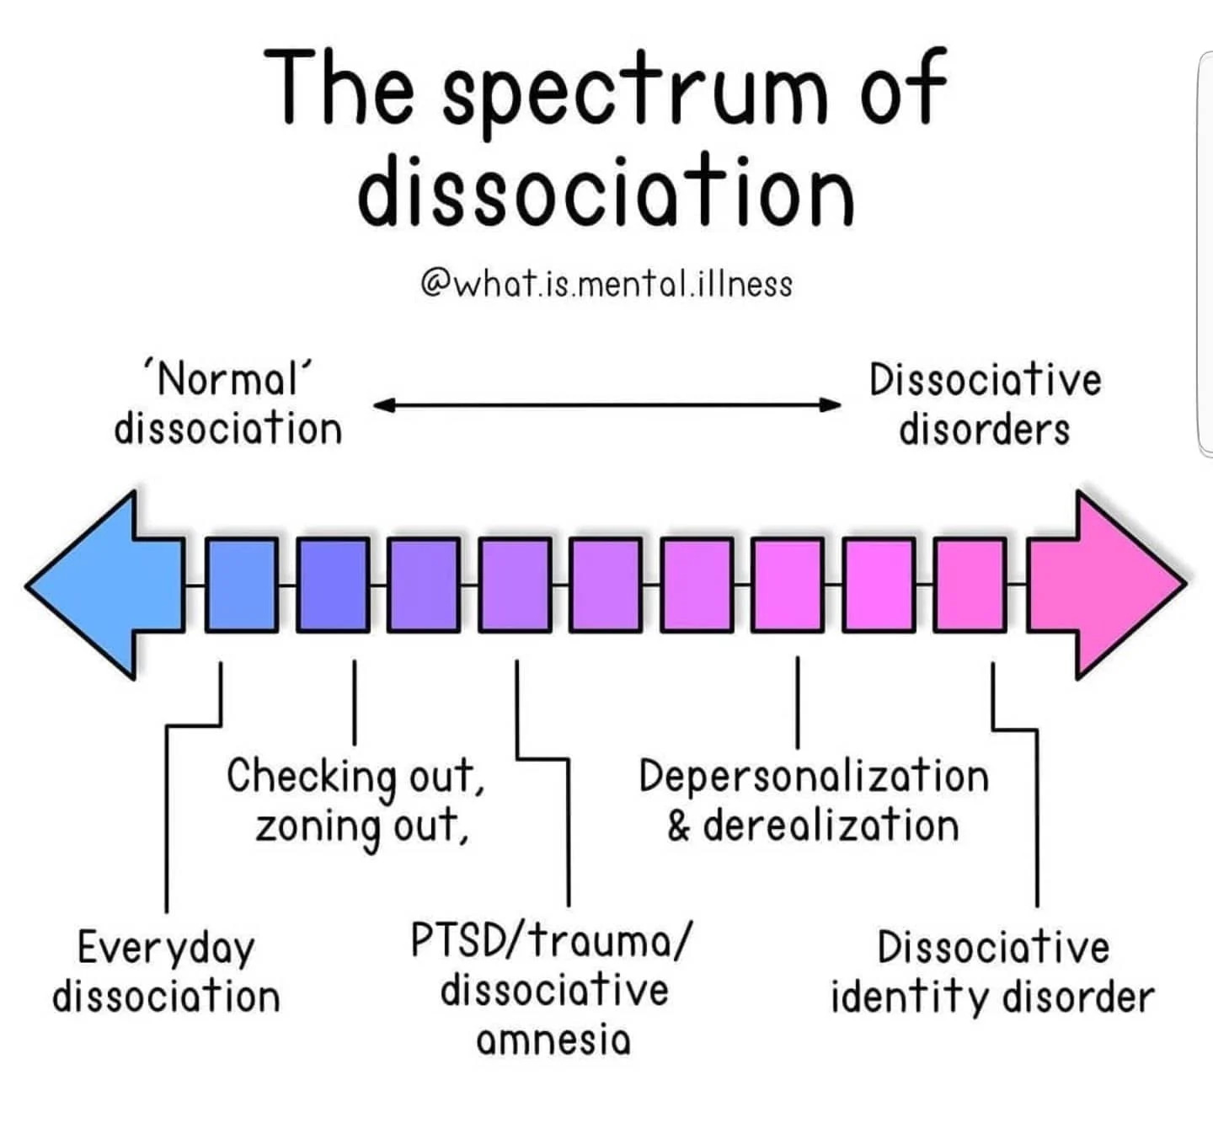
Dissociative AND CONVERSION Disorder
Wide spectrum of dissociative disorders includes:
Dissociative Amnesia
Dissociative Fugue
Dissociative Identity Disorder
Dissociative convulsion
Dissociative Motor Disorder
Trance- Possession disorder and
Depersonalisation-Derealisation Disorder

Slide 14
Pharmacotherapy of dissociative disorders
There are hardly any targeted pharmacological approaches for DD unlike other psychiatric disorders (Somer et al., 2013).
Utility of psychodynamic therapies to address core unconscious conflicts in addition to cognitive and supportive psychotherapy had been a standard treatment in most of the institutes across India as well as in the west (LaFrance et al., 2014).
Frequently utilised treatment options for DD (Gentile et al., 2014) include:
Selective serotonin Reuptake Inhibitors (SSRI)
Serotonin Norepinephrine Reuptake inhibitors (SNRI)
Antiepileptic drugs
Benzodiazepines (BZD)

Slide 15
The limited data from this meta-analysis reflects insufficient information on the use of pharmacotherapy in specific subtypes of DD.
In an open label trial of Venlafaxine in panic disorder with and without dissociative symptoms, good response to treatment was observed in patients without dissociative symptoms (Ural et al., 2015).
In Two open label trial of Naltrexone in patients with BPD and depersonalization disorder respectively shown significant improvement in dissociative symptoms suggesting involvement of opioid system in symptom manifestation (Bohus et al., 1999, Simeon and Knutelska, 2005).
In a placebo controlled RCT, Fluoxetine was studied in the context of response to childhood trauma and dissociative experience in bulimic patients and treatment response was found to be nonspecific (McCarthy et al., 1994).

Slide 16
In a 16 week double blind crossover trial for depersonalization disorder, Clomipramine was found to be marginally better than Desipramine (Simeon et al., 1998).
Sertaline was found to be ineffective against CBT in psychogenic nonepileptic seizures.
Another 2 RCTs reflected Amitriptyline to be ineffective while modified banxia houpu decoction (Chinese herb) effective in Globus Pharyngeus symptoms (Deary and Wilson, 1994; Bo et al., 2010)
The results of the meta-analysis show heterogeneous and surprisingly insufficient literature on RCTs on various subtypes of DD. This meta-analysis generates some evidence for the use of pharmacotherapy in depersonalization subtype of dissociative disorders but the results of single pharmacological agent in a specific DD needs to be replicated in larger RCTs

Slide 17

Treatment of Dissociative Amnesia
Cognitive Therapy –
- identifying the specific cognitive distortions (trauma) may provide an entry into autobiographical memory for which patient experiences amnesia .
Hypnosis
- used to contain, modulate and titrate intensity of symptoms
- facilitate controlled recall of dissociated memories
- provide support and ego strengthening
- promote working through and integration of dissociated material

Slide 18
Somatic Therapy –
- no known pharmacotherapy available
- pharmacologically facilitated interviews , with sodium amobarbital, thiopental, oral benzodiazepines and amphetamines
- material uncovered in the interview needs to be processed by patient in his usual conscious state.
Group psychotherapy –
- helpful in PTSD and in childhood abuse
- supportive interventions by the group members , may facilitate integration and mastery of the dissociated material .

Slide 19

Treatment of Dissociative Fugue
Treated with an eclectic, psychodynamically oriented psychotherapy that focuses on helping the patient recover memory for identity and recent experience.
Hypnotherapy and pharmacologically facilitated interviews are necessary. Medical treatment for injuries sustained during fugue.
Hospitalization indicated for patients with suicidal ideation or self-destructive ideas and impulses.
Family therapy and social interventions to resolve difficulties in family, sexual, occupational and legal situations. When dissociative fugue involves assumption of new identity, it is useful to conceptualize this entity as psychologically vital to protecting the person.
- The therapeutic goal in such cases is neither suppression of the new identity nor fascinated explication of all its attributes

Slide 20

Treatment of
Depersonalization/Derealisation disorder
Pharmacotherapy with SSRIs may be helpful
Psychotherapy –
- psychodynamic, cognitive, cognitive –behavioral, hypnotherapeutic and supportive therapy.
Others-
- stress management strategies
- distraction techniques
- reduction of sensory stimulation
- relaxation training
- physical exercise

Slide 21
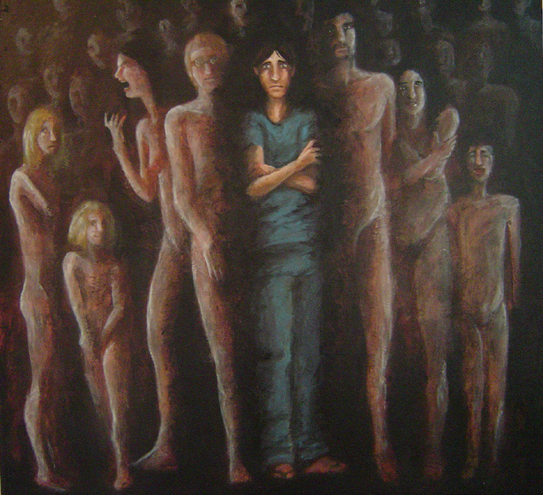
Treatment of Dissociative Identity Disorder
Psychotherapy
- psychoanalytical psychotherapy
- cognitive therapy
- behavioral therapy
- hypnotherapy
ECT--- can also be helpful in some cases.
Psychopharmacology
- SSRIs for OCD symptoms
- mood stabilizers (more useful for PTSD and anxiety than mood swings)
- sleep problem – mirtazapine, trazodone,
benzodiazepines

Slide 22
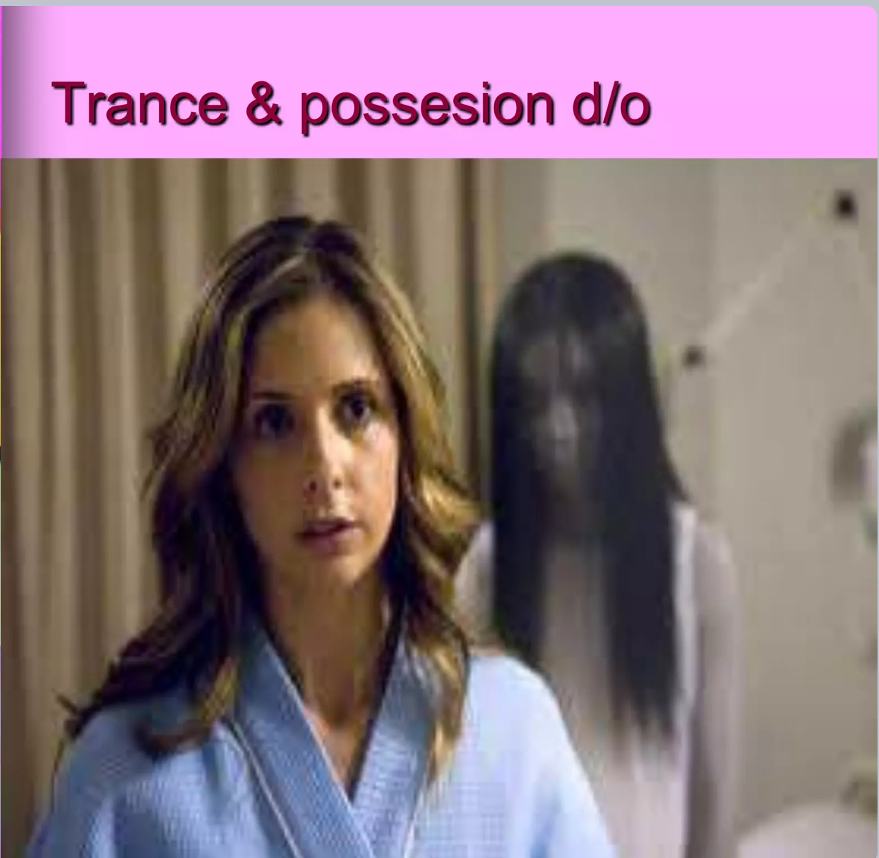
Other Specified or Unspecified Dissociative Disorder
Includes-
Dissociative Trance Disorder
Ganser syndrome
Brainwashing
Recovered Memory Syndrome

Slide 23
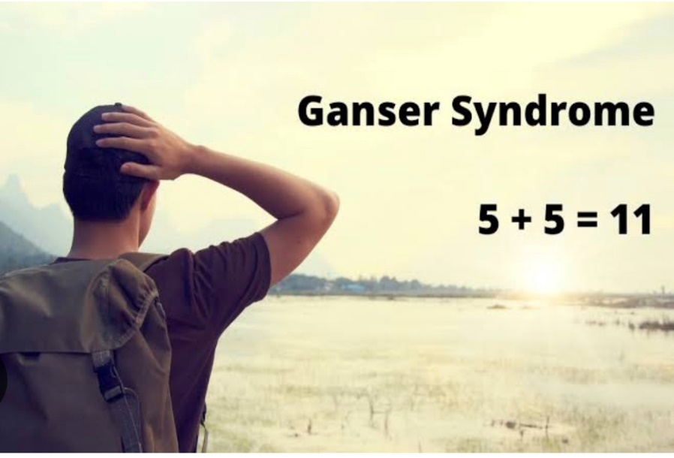
Ganser syndrome:
No systematic treatment studies have been conducted.
Exploration of possible stressors
Hypnosis and amobarbital narcosynthesis, to reveal underlying stressor
Low dose antipsychotics.
Brainwashing:
Treatment depends on the background and circumstances involved .
exploration of preexisting psychopathology and vulnerabilities
general techniques used in treating posttraumatic and dissociative states.
Family intervention and therapy may be required.
Recovered Memory Syndrome:
Attention should be directed towards helping patients in limiting their role as victims and transcend their past traumas

Slide 24
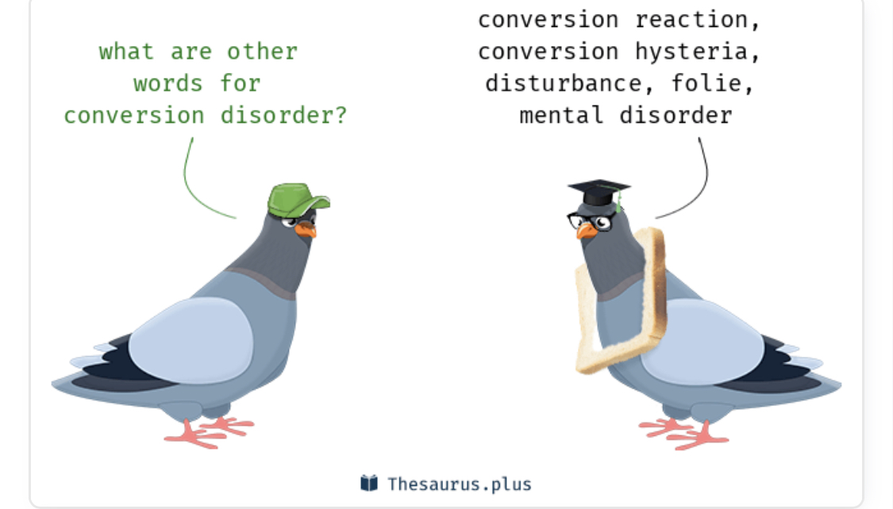

Slide 25
Treatment of Functional Neurological Symptom Disorder (Conversion Disorder)
Resolution is spontaneous, facilitated by insight-oriented supportive or behavior therapy
Hypnosis, anxiolytics and behavioral relaxation exercise are effective in some cases.
Parental amobarbital or lorazepam may be helpful in obtaining additional historic information .
Psychodynamic approaches include psychoanalysis and insight-oriented psychotherapy .

Slide 26

MOLECULAR
BASIS
OF
MANAGEMENT

Slide 27
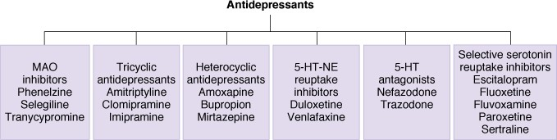
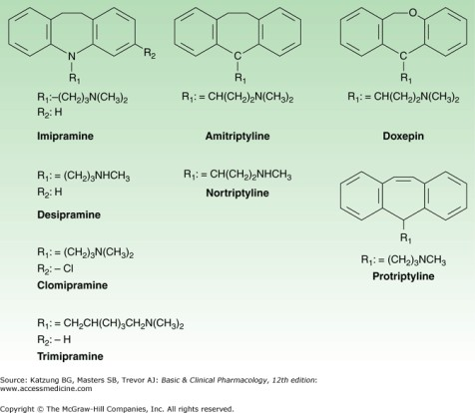
Antidepressant Drugs-Classification
Tricyclic Agents
  Imipramine/Desipramine/ Clomipramine/ Amitriptyline/Nortriptyline/ Protriptyline/Doxepin/ Nordoxepin

Slide 28
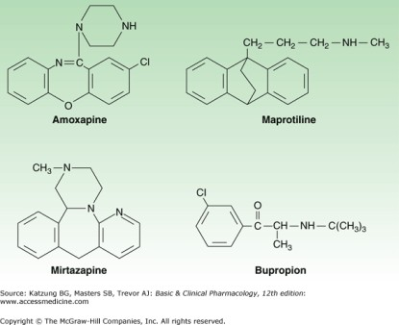

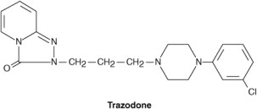
Antidepressant Drugs-Classification (contd.)
Heterocyclic Agents
  Unicyclic
    Bupropion
  Tetracyclic
    Amoxapine(N-desmethyl
loxapine)/Maprotilene/ Mirtazapine
5-HT₂ Antagonists
  Nefazodone/Trazodone

Slide 29
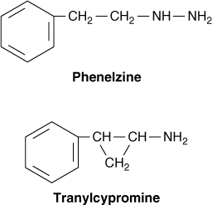
Antidepressant Drugs-Classification (contd.)
Mono-Amine-Oxidase-A Isozyme Inhibitors (MAO-AI’s)
  Hydrazine group
    Isocarboxazid/Phenelzine
  Nonhydrazine group
    Nialamide/Tranylcypromine/Clorgyline/Pargyline/ Moclobemide/Brofaromine/Cimoxatone/
    Toloxatone

Slide 30
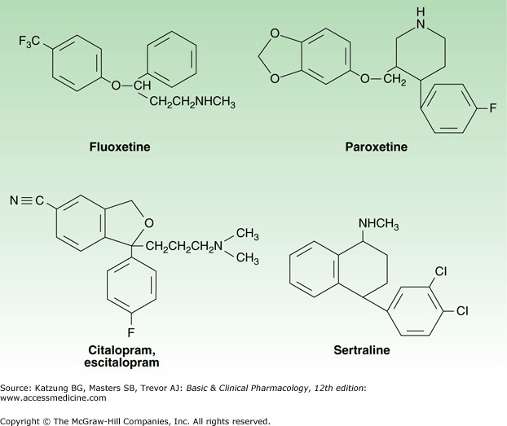
Selective Serotonin Reuptake Inhibitors (SSRI’s)
Selective Serotonin Reuptake Inhibitors (SSRI’s)
◻Citalopram/ Escitalopram/ Fluoxetine/ Paroxetine/ Sertraline/ Fluvoxamine

Slide 31
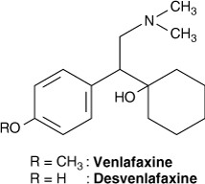
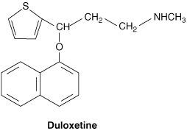
Serotonin NE Reuptake Inhibitors (SNRI’s)
Serotonin Norepinephrine Reuptake Inhibitors (SNRI’s)
◻Duloxetine
◻Venlafaxine
◻Desvenlafaxine

Slide 32
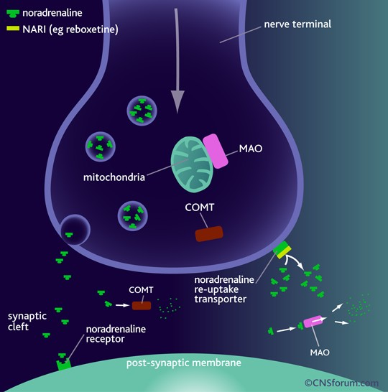
Postulated Mode of Action of Tricyclic Antidepressant Drugs
TCA’s→↓NE/↓5-HT reuptake (↓NET/ ↓ SERT) →
↑monoaminergic neurotransmission
→Antidepressant action

Slide 33
Tricyclic Antidepressants(TCA’s)- Pharmacological Actions
CNS Actions
  Mood elevation in depressed patients
  Latency period : 2-4 weeks
  Can cause EPS/Ataxia/Seizures/Coma
CVS Actions
  Orthostatic hypotension→↑HR
ANS Actions
  Anticholinergic effects
  Most potent anticholinergic action(Amitriptyline)

Slide 34
Tricyclic Antidepressants(TCA’s)- Pharmacokinetics
Absorption
  Well absorbed orally
Distribution
  ↑Lipophilic→↑V_{d}→↑T(1/2)
Metabolism & Excretion
  Hepatic microsomal N-demethylation/ oxidation/glucuronidation→Renal Elimination

Slide 35
Tricyclic Antidepressants(TCA’s)-Adverse Effects
Excessive sedation/Lassitude/Fatigue/Confusion
Sympathomimetic effects(Tachycardia/Agitation/Sweating/ Insomnia)
Anticholinergic(‘Atropine-like”) effects
Orthostatic hypotension/ECG abnormalities/Cardiomyopathies
Tremor/Paresthesias/EPS

Slide 36
Tricyclic Antidepressants(TCA’s)-Adverse Effects
Weight gain
Overdosage(extremely hazardous): Remember 3C’s
  Agitation/Delirium/Neuromuscular irritability/Convulsions/Coma
  Respiratory depression/Circulatory collapse
  Hyperpyrexia
  Cardiotoxicity(Cardiac conduction defects/Severe arrhythmias)

Slide 37
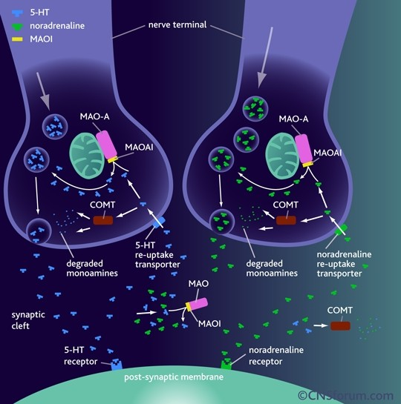
Postulated Mode of Action of MAO-A Inhibitor Drugs
MAO-AI’s→↓MAO-A isozyme → ↓ monoamine metabolism→
↑monoaminergic neurotransmission
→Antidepressant action

Slide 38
MAO-AI’s-Pharmacological Actions
CNS Actions
◻Mood elevation
◻Latency period: 2-3 weeks
◻Tranylcypromine→Amphetamine- like→causes NE release in CNS→ antidepressant action(48 h)
◻MAOI’s→↓REM sleep/↓Narcolepsy

Slide 39
MAO-AI’s-Pharmacological Actions (contd.)
CVS Actions
◻Postural hypotension
◻Beer/Cheese/Chicken Liver→↑Tyramine content/↓Tyramine metabolism→
↑↑catecholamine release(nerve terminals) →Hypertensive Crisis(Cheese Reaction)

Slide 40
MAOI Interaction with Tyramine
(‘Cheese Reaction’)
OH
CH₂CH ₂NH ₂
CH₂CH NH
2 2
HO
HO
Tyramine
Noradrenaline
OH
Tyramine is normally metabolized by MAO in gut and liver
If unmetabolized, tyramine enters sympathetic nerve terminals where it displaces NE from vesicles into cytosol

Slide 41
MAOI Interaction with Tyramine
(‘Cheese Reaction’)(contd.)
OH
CH₂CH ₂NH ₂
CH₂CH NH
2 2
HO
HO
Tyramine
Noradrenaline
OH
Because MAO in the nerve terminals is inhibited there is a massive ‘non-physiological’ release of NE from sympathetic nerve terminals which can lead to fatal hemorrhage
Patients prescribed an MAOI are warned not to eat/ drink certain substances (substances that contain tyramine etc.) e.g. beer, wine, cheese, marmite

Slide 42
MAO-AI’s-Pharmacological Actions (contd.)
Hepatic Actions
◻Cause hepatotoxicity
◻Interference with drug detoxification

Slide 43
MAO-AI’s-Pharmacokinetics
MAO inhibitors are taken orally
They are ‘hit & run’ drugs i.e., their effects greatly outlast their detectable presence in the body because they inhibit the enzyme irreversibly & termination of effect is dependent on synthesis of fresh enzyme(which takes weeks)
The hydrazine group is acetylated(like INH) & the population is divided into slow & fast acetylators

Slide 44
MAO-AI’s-Adverse Effects & Drug Interactions
Adverse Effects
  Headache/Drowsiness/Dry mouth/Weight gain/ Orthostatic hypotension/Impotence/Cheese Reaction
Drug Interactions
  MAOI’s + SSRI’s→ Serotonin Syndrome(lethal)
  TCA’s + CNS Depressants→ ↑↑ CNS depression
  TCA’s + MAOI’s→ Hyperpyrexia/Convulsions/ Coma

Slide 45
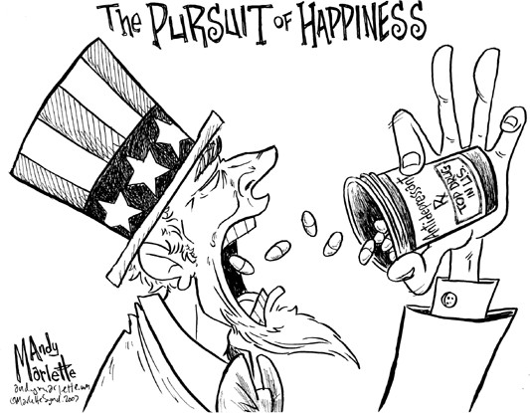
Selective Serotonin Reuptake Inhibitors (SSRI’s)

Slide 46
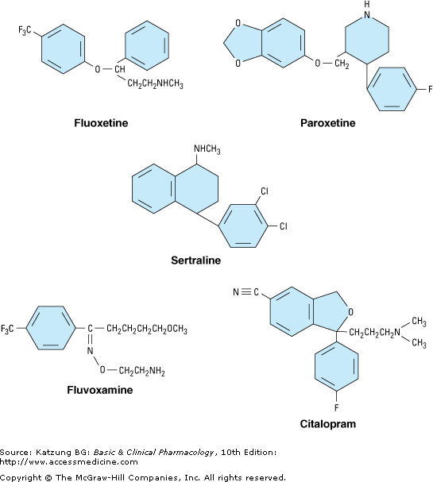
Selective Serotonin Reuptake Inhibitors (SSRI’s)
Structurally distinct from the tricyclic molecules
Have fewer adverse effects than the tricyclics and have become popular

Slide 47
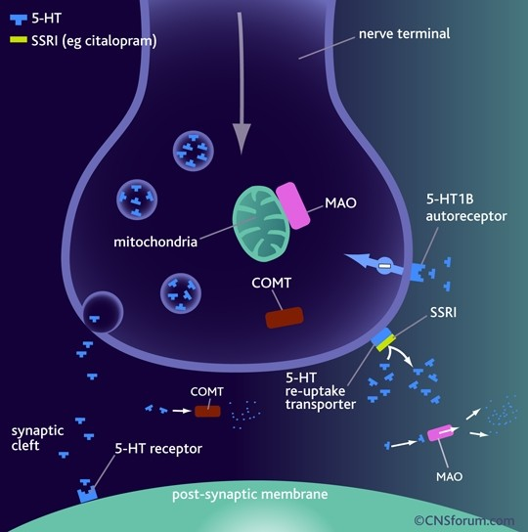
SSRI’s-Mechanism of Action
SSRI’s→ selective
↓5-HT reuptake (↓ SERT) →
↑monoaminergic (serotonergic) neurotransmission
→Antidepressant action

Slide 48
Selective Serotonin Reuptake Inhibitors(SSRI’s)-Pharmacokinetics
Absorption
  Well-absorbed orally
Metabolism
  Fluoxetine→Norfluoxetine
Excretion
  Renal elimination
  Elimination T(1/2)= 1-3 d(Fluoxetine)/ 7-15 d(Norfluoxetine)

Slide 49
Selective Serotonin Reuptake Inhibitors(SSRI’s)- Adverse Effects
“Less serious”
Anorexia/Nausea
Hypomania/Mania/Nervousness/Headache/Insomnia/ Dizziness/EPS
QT Prolongation(Citalopram)
Hyponatremia(5-HT 5-HT_{1C} & 5-HT₂ Receptors
  Citalopram/Fluoxetine/Fluvoxamine/Paroxetine/Sertraline
Sexual dysfunction
Serotonin syndrome
ADH release)

Slide 50
Selective Serotonin Reuptake Inhibitors(SSRI’s)- Drug-Drug Interactions
SSRI | Significant PK Interactions(↑ Plasma Levels & Potential Adverse Effects )
Sertraline | Clozapine Unlikely to cause other clinically significant pharmacokinetic drug interactions

Slide 51
Selective Serotonin Reuptake Inhibitors(SSRI’s)- Drug-Drug Interactions
SSRI | Significant PK Interactions(↑ Plasma Levels & Potential Adverse Effects )
Citalopram/ Escitalopram | Unlikely to cause clinically significant pharmacokinetic drug interactions but contra-indicated with other drugs which can prolong QT interval

Slide 52
Selective Serotonin Reuptake Inhibitors(SSRI’s)- Drug-Drug Interactions
SSRI | Significant PD Interactions
Sertraline/ Citalopram/ Escitalopram | Potential Serotonin Syndrome when combined with: Other Antidepressants(5-HT-enhancing) Buspirone/Fentanyl/Linezolid/Lithium/Ondansetron/St. John’s Wort/Tramadol Increased risk of bleeding (particularly upper GI bleed) with: NSAIDs/Warfarin and other anticoagulants/Antiplatelets Other PD interactions to consider: Other drugs which can also cause sexual dysfunction(antipsychotics), GI effects(acetylcholinesterase inhibitors) or hyponatremia (thiazide diuretics)

Slide 53
Serotonin Syndrome
Potentially life-threatening condition caused by excessive serotonergic activity in CNS
Characterized by:
  Mental status changes
  Autonomic instability, &
  Neuromuscular hyperactivity
Most cases reported in patients:
  Using multiple serotonergic drugs or
  Who have had considerable exposure to a single serotonin- augmenting drug
Diagnostic Criteria: Dursun/Hunter/Radomski/Sternbach

Slide 54
Serotonin Syndrome
Diagnosis is made using the Hunter Serotonin Toxicity Criteria
Require the presence of ONE of the following classical features or groups of features:
  Spontaneous clonus
  Inducible clonus + [agitation OR diaphoresis]
  Ocular clonus + [agitation OR diaphoresis]
  Tremor + hyperreflexia
  Hypertonia + Temperature > 100.4^{O}F(38^{O}C) +[ocular clonus OR inducible clonus]
[Ables AZ, Nagubilli R. Prevention, recognition and management of serotonin syndrome. Am Fam Physician 2010; 81(9): 1139-42.]

Slide 55
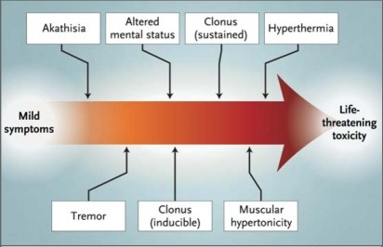
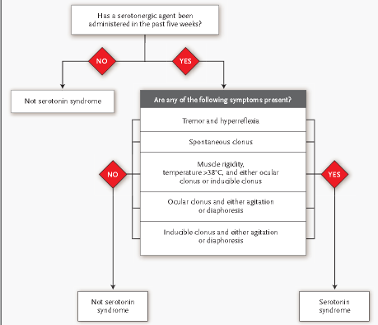
Serotonin Syndrome
Most cases of SS are mild
Treated by
  Withdrawal of the offending agent +
  Supportive care
Benzodiazepines used to treat agitation + tremor
Cyproheptadine used as an antidote
Patients with moderate or severe cases of SS require hospitalization
Critically ill patients may require:
  Neuromuscular paralysis
  Sedation, &
  Intubation

Slide 56
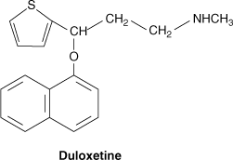
Serotonin NE Reuptake Inhibitors(SNRI’s)
Bind to transporters for both serotonin and NE(NET + SERT)
Enhance actions of both neurotransmitters
SNRIs differ from the TCAs in lacking significant blocking effects on peripheral receptors including
  Histamine(H₁)/Muscarinic/ α-adrenergic receptors

Slide 57
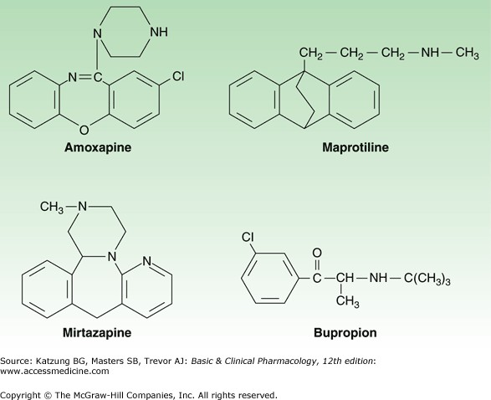
Heterocyclics
Bupropion
  Mechanism of antidepressant action unknown
  Drug has no effect on 5-HT or NE receptors nor on amine transporters
Mirtazapine
  Increases amine release from nerve endings by antagonism of presynaptic α₂ adrenoceptors involved in feedback inhibition
  Is also an antagonist at serotonin 5-HT₂ receptors

Slide 58
Heterocyclics
Amoxapine/Maprotiline
  Are potent NET inhibitors + less potent SERT inhibitors
  Both possess anticholinergic properties

Slide 59
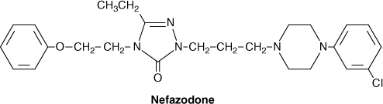

5-HT₂ Antagonists
5-HT₂ Antagonists
  Major antidepressant actions result from block of the 5-HT _{2A} receptor
  G-protein–coupled receptor located in several CNS regions including the neocortex
  Antagonism of this receptor is equated with both the antianxiety + antidepressant actions of these drugs

Slide 60
References
Oxford shorter textbook of psychiatry 6th edition.
Kaplan and Sadocks synopsis of psychiatry 11th edition.
I.C.D 10
Kaplan and Sadock’s Comprehensive textbook of psychiatry 10 edition.
Fallon BA. Pharmacotherapy of somatoform disorders. J Psychosom Res. 2004 Apr;56(4):455-60. doi: 10.1016/S0022-3999(03)00631-7. PMID: 15094032.
Gentile JP, Dillon KS, Gillig PM. Psychotherapy and pharmacotherapy for patients with dissociative identity disorder. Innov Clin Neurosci. 2013 Feb;10(2):22-9. PMID: 23556139; PMCID: PMC3615506.
Sutar R, Sahu S. Pharmacotherapy for dissociative disorders: A systematic review. Psychiatry Res. 2019 Nov;281:112529. doi: 10.1016/j.psychres.2019.112529. Epub 2019 Aug 23. PMID: 31470213.

Slide 61


