Slide 1
Mental Health
By - Dr. Vishal Nagar
Dept. of Psychiatry

Slide 2


Slide 3
“we are all but a heartbeat away from disaster.”

Slide 4
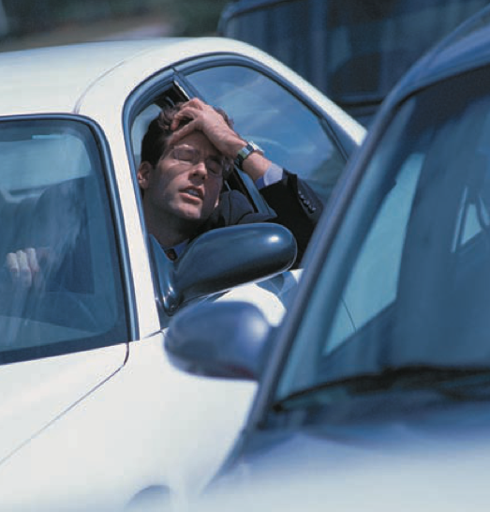

Slide 5
Introduction
Prior to the 1930s, the term “stress” - simply referred to the physical strain on a material object.
Any circumstances that threaten or perceived to threaten one’s well being
The term stress was coined by Hans Selye. adrenocortical system as the crucial responder to stressful stimulation.
Walter Cannon - the sympathetic nervous system

Slide 6
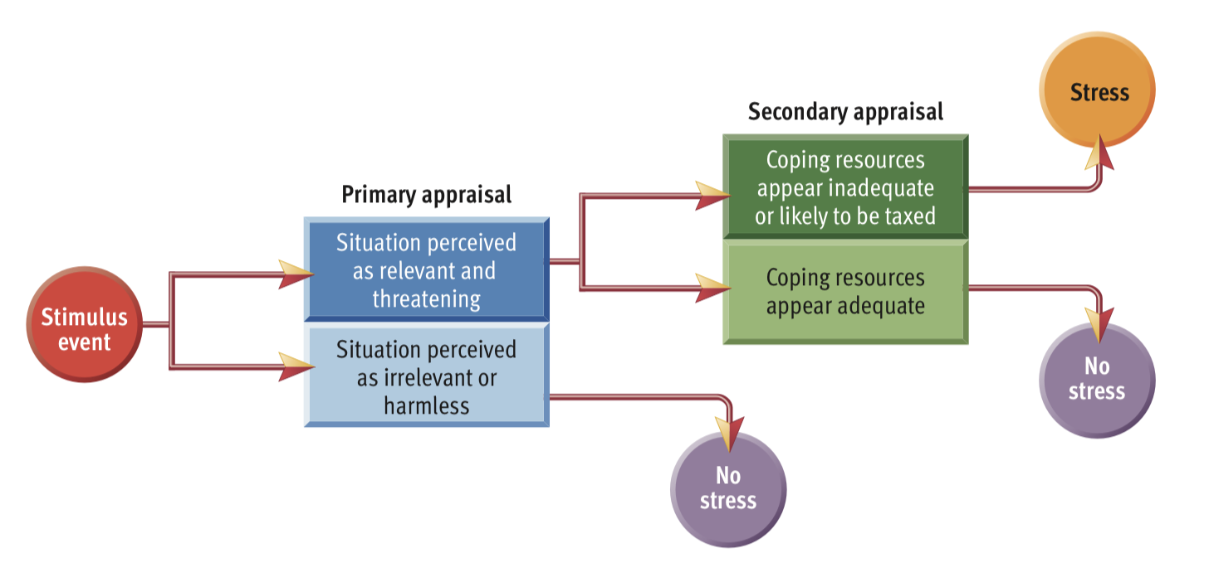

Slide 7
TYPES OF STRESS
Frustration
Conflict
Change
Pressure

Slide 8
VULNERABILITY AND RESILIENCE
individuals’ defensive behaviors, information- seeking behaviors, affiliative behaviors, and all-round problem-solving behaviors - coping behavior.
Genetic and environmental factors
epigenetic mechanisms
stress or mood disorders in mothers - risk factors for psychiatric disorders in offspring.

Slide 9
PHYSIOLOGICAL RESPONSES TO STRESSORS
The body’s reaction to a stressor (be it real, symbolic, or imagined) is to initiate a set of responses that seek to diminish the impact of the stressor.
Much is known about the physiological response to acute stress, and considerably less is known about the response to chronic stress.
release of catecholamines
Chronic stress - enduring effects on neuronal firing and gene activation.
HPA axis
immune system - role in stress physiology

Slide 10
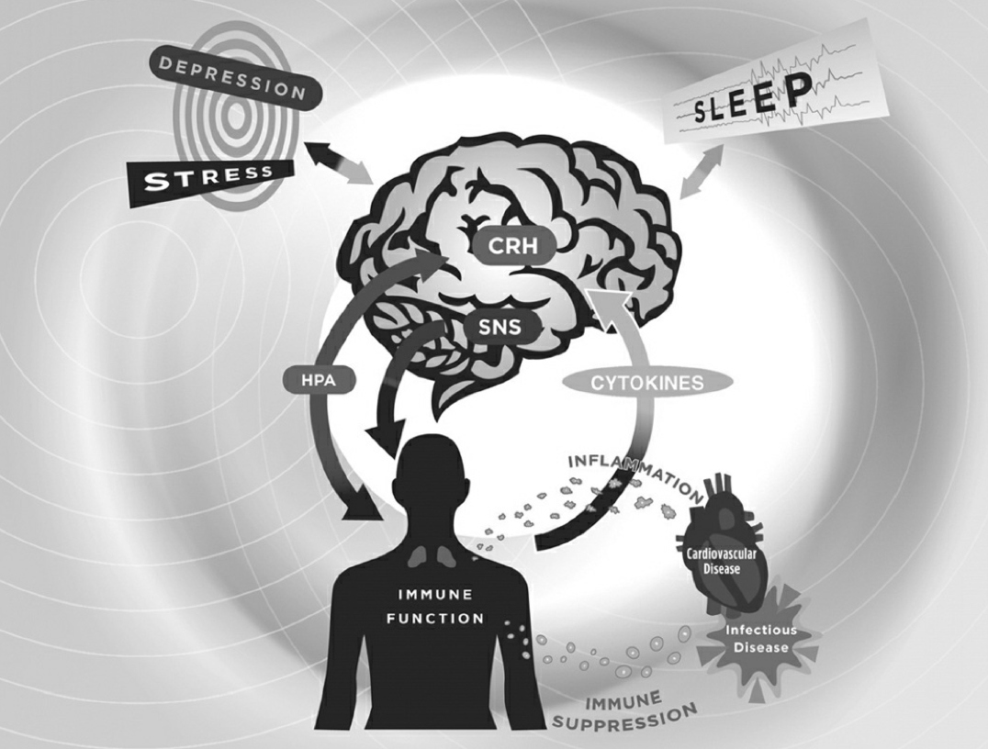
bidirectional interactions between the brain and the immune system, and the clinical implications of immune alterations due to stress, depression, or sleep disturbance.

Slide 11
Stress Management Training
Self- observation,
cognitive restructuring,
relaxation training,
time management,
problem solving.

Slide 12
Self-Observation
A daily diary - to keep a record of how they responded to challenging or stressful events that occurred each day.
Entries three columns: antecedents, behaviors, and consequences.
smartphones/ apps

Slide 13
Cognitive Restructuring
underlying cognitions are major determinants of emotional responding.
excessive or prolonged emotional reactions - result of distorted cognition
monitoring and analyzing dysfunctional thoughts.

Slide 14
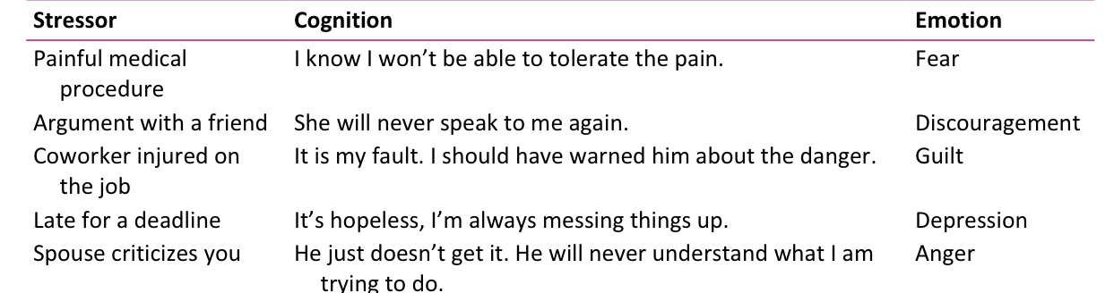
Stress-Related Negative Thoughts

Slide 15
Key Questions for Challenging Negative Automatic Thoughts
Is there an alternative explanation?
What is the evidence that this thought is true?
What will be the effect of continuing to think this way?
What is the best outcome, worst outcome, and most realistic outcome? What is the likelihood that this will happen?

Slide 16
Relaxation Training
Progressive relaxation training - a series of structured exercises involving slowly tensing and relaxing major muscle groups.
to generalize their skills in relaxation from home practice sessions to stressful and demanding daily life events.
differential relaxation
mini-practice

Slide 17
Time Management
first step - enhance awareness of current patterns of time use.
second step - set priorities. (urgency and importance)
urgent-not-important quadrant or the not-urgent-not-important quadrant - much time
little or no time engaging in activities in the not-urgent-but-important quadrant (exercising, resting, relaxing, or doing volunteer work)

Slide 18
Goal setting
Goal setting focuses on specific behavior change targets that fit with an individual’s long-term priorities.
First Step - identify a goal to be accomplished in the next week
Second step- critically analyze the goal to ensure that is reasonable, specific, and personally meaningful.
Third step - reconfirm a time frame (e.g., 1 week) in which they will meet the goal (important in reducing procrastination)
Successful completion of a goal that has been long neglected can be very rewarding.

Slide 19
Problem Solving
identify the key problematic aspects of a stressful event
generate a wide range of alternative problem solutions
evaluating the alternatives and selecting the best solution
try to apply the best solution in the problem situation

Slide 20
THANK YOU

