Slide 1
PERSONALITY DISORDERS
BY- Dr. VISHAL NAGAR
Department of Psychiatry

Slide 2
Normal personality can be defined as, “the characteristic pattern of behaviors or modes of thinking that determine a person’s adjustment to environment”.
It includes the factors such as intellectual abilities, attitude, beliefs, moral values, emotional reactivity.

Slide 3
Most definition of normal personality includes some or all of the following features,
Present since adolescence.
Stable overtime despite fluctuations in mood.
Manifest in different environment.
Recognizable to friends and acquaintance.

Slide 4
DEFINE PERSONALITY DISORDER
According to WHO abnormal personality can be defined as “deeply ingrained maladaptive pattern of behavior, continuing throughout the most of adult life, although often becoming less obvious in middle or old age

Slide 5
Maladaptive behavior results in loneliness, suspiciousness and withdrawn behavior.
Personality disorders falls somewhere within the maladaptive range. The degree of maladaptiveness depends on the type of disorder and its severity of symptoms.

Slide 6
CHARACTERISTIC OF PERSONALITY DISORDER
It is not a mental illness.
It is a maladaptive behavior.
It is long lasting, most of time lifelong problems.
It causes significant impairement in social and occupational functioning.
It produces distress to the individual and to others.

Slide 7
Personality disorder is different from mental illness. Whereas the symptoms of personality
disorder are continuous and adolescence or even before.
These patients are odd but no mad.
start from

Slide 8
ETIOLOGY
Biological factors.
Developmental factors.
Social cultural factors.
Psychological stressors.

Slide 9
1. Biological factors:
Genetic
Low level of serotonin.
Those with family history of alcoholism or other psychiatric problems.
Especially among the people with a cluster A.

Slide 10
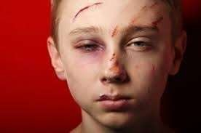
2. Developmental factors:
Early traumatic experience
Losses suffered by the attachment figure.
Childhood abuse.
Sexual abuse.
Lack of parental care.

Slide 11
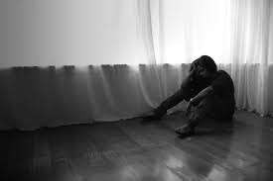
3.Socio cultural factors:
Isolation
Long term psychiatric problems.
Chronic institutionalization
Immigration.
Lack of close family ties which promotes loneliness.

Slide 12
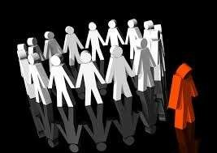
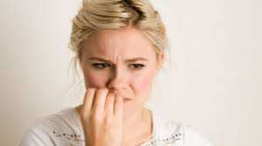
4.Psychodynamic factors:
Anxiety
Increased autonomy
Separation
Lack of coping
Abandonment
Dependency, etc

Slide 13
CLASSIFICATION OF PERSONALITY DISORDER
Personality disorder are coded on axis
II and have been divided into three clusters,
Cluster A (odd and eccentric)
Cluster B (dramatic, emotional, erratic)
Cluster C (anxious and fearful)

Slide 14
Cluster A (odd and eccentric)
  Paranoid personality disorder.
  Schizoid personality disorder.
  Schizotypal personality disorder.

Slide 15
Cluster B (dramatic, emotional, erratic)
  Antisocial personality disorder.
  Histrionic personality disorder.
  Narcissistic personality disorder.
  Borderline personality disorder.

Slide 16
Cluster C (anxious and fearful)
  Avoidant personality disorder
  Dependent personality disorder
  Obsessive compulsive personality disorder

Slide 17
Cluster A (odd and eccentric)
a. Paranoid personality disorder:
Paranoid personality disorder is more
prevalent in male then females.
This disorder is marked by a distrust of other people and a constant unwarranted suspicion that others have sinister motive.

Slide 18


Person with this disorder search for hidden
meanings and hostile intention in everything others say or do.

Slide 19
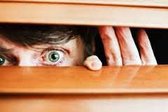

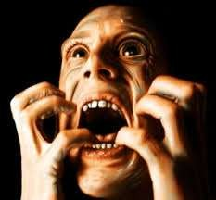
SIGNS AND SYMPTOMS:
Suspicious.
Mistrustful.
Argumentative.
Stubborn.
Self-importance.
Hypersensitive.
Jealous and
Irritable.

Slide 20
b.Schizoid personality disorder:
Schizoid personality disorder is characteristic by detachment and social withdrawal.
People with this disorder are commonly described as loners, with solitary interest and occupations and no close friends.

Slide 21
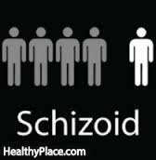
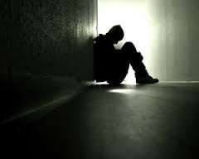
Typically they maintain a social distance even
from family members and seem unconcerned about others

Slide 22
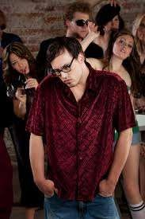
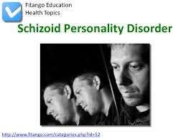
SIGNS AND SYMPTOMS:
Emotionally cold.
Humorless.
Aloof.
Introspective.
No desire for enjoyment of close relationship.
Inability to experience pleasure.

Slide 23
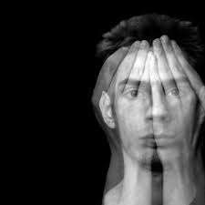
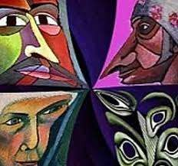
c. Schizotypal disorder:
This disorder is marked by odd thinking and behavior, a pervasive pattern of social and interpersonal deficits and acute discomfort with others

Slide 24
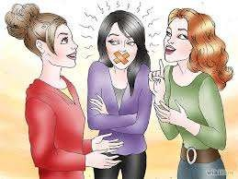
SIGN AND SYMPTOMS
Inappropriate affect.
Odd believes or magical thinking.
Social withdrawal.
Odd, eccentric or peculiar behavior.
Lack of close relationship.
Social isolation.
Not fitting easily with others.

Slide 25
Cluster B (dramatic, emotional, erratic)
a. Antisocial personality disorder.
Antisocial personality disorder is characterized by chronic antisocial behavior that violates other rights or social norms which predisposes the affected person to the criminal behavior

Slide 26
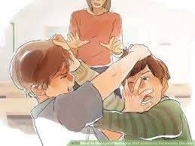
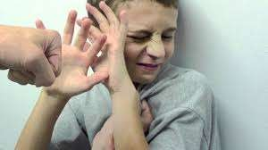
The person is unable to maintain the consistent, responsible functioning at work, school or as a parent.

Slide 27

SIGN AND SYMPTOMS
Failure to sustain the relationship.
Impulsive actions.
Low tolerance to frustration.
Tendency to cause violence.
Lack of guilt
Inability to maintain close personal or sexual relationship

Slide 28
b. Histrionic personality disorder.
Patient with this disorder is characteristically have a pervasive pattern of excessive emotionality and attention seeking behavior and are drawn to momentary excitement and fleeting adventure.

Slide 29

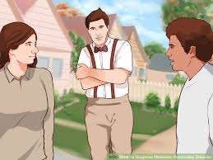
This disorder is most common in female.
People with this disorder need to be the center of attention at all time

Slide 30
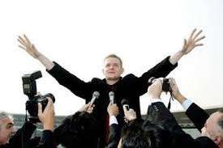
SIGN AND SYMPTOMS
Dramatic emotionality (emotional blackmail, angry scenes, demonstrative suicide attempts.)
Attention seeking behavior.
Lack of considerations for other
Self-dramatization.

Slide 31
c. Narcissistic personality disorder.
Patient with Narcissistic personality disorder is self-centered, self-absorbed and lacking in empathy for others.
He typically takes advantages of people to achieve his own ends, and uses them without regards to their feelings.

Slide 32
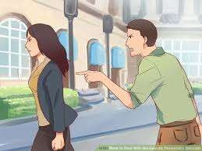
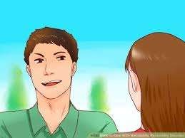
SIGN AND SYMPTOMS:
Attention seeking
Dramatic behavior
Unable to face criticism.
Lack of empathy.
Arrogances.
Exploitative behavior

Slide 33

d. Borderline personality disorder
Borderline personality disorder is marked by a pattern of instability in interpersonal relationship, mood, behavior, and self-image.

Slide 34
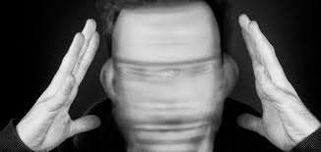
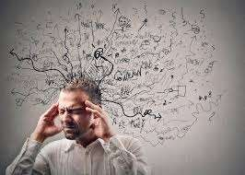
The 4 main categories of SIGN AND SYMPTOMS are,
Unstable relationship.
Unstable self-image
Unstable emotions
Impulsivity.

Slide 35


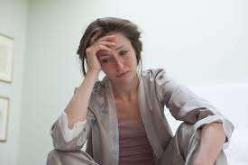
Other S/S includes,
Lack of control of anger.
Recurrent suicidal threats or behavior.
Uncertainty about personal identity.
Chronic feeling of emptiness

Slide 36

3. Cluster C (anxious and fearful)
a. Avoidant personality disorder
People with this disorder have low self-esteem, and poor self-confident, they will be negative and have a difficulty in viewing situation and interactions objectively.

Slide 37


SIGNS AND SYMPTOMS
Fear of disapproval or rejection.
Unwillingness to become involved with people.
Shyness.
Insecurity.

Slide 38
The persons having this disorder also have other psychiatric disorder like – social phobia, anxiety disorder, OCD, depressive disorder, somatoform disorder, etc.

Slide 39
b. Dependent personality disorder
This disorder is characterized by an extreme need to be taken care of, which leads to submissive and fear of separation or rejection.
People with this disorder, let other make important discussion for them and have a strong need for constant reassurance and support

Slide 40
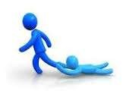
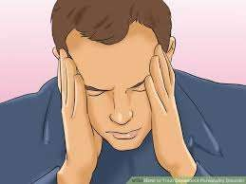
SIGN AND SYMPTOMS:
Feeling uncomfortable and helplessness.
Inability to make decisions.
Low self-esteem and lack of self-confidence.
Hypersensitivity.

Slide 41
c. Obsessive compulsive personality disorder:
The individual places a great deal of pressure on himself and other not to make a mistake.
Believes his way of doing something is the only correct way, may force himself and others to follow right moral principles.

Slide 42
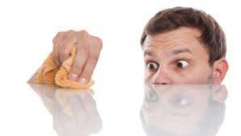


SIGN AND SYMPTOMS
Feeling of excessive doubt and caution.
Perfectionism.
High standards

Slide 43
TREATMENT
ANXIOLYTIC DRUGS:
  To treat severe stress,
Alprazolam
Ativan
Librium
Diazepam, etc

Slide 44
NEUROLEPTIC DRUGS: ANTIPSYCHOTIC
  It can be useful in case of paranoid and schizotypal personality disorder.
Olanzapine
Haloperidol
Droperidol

Slide 45

3. PSYCHODYNAMIC TREATMENT:
It’s also known as the insight oriented therapy, focuses on unconscious processes as they are manifested in a person’s present behavior.

Slide 46

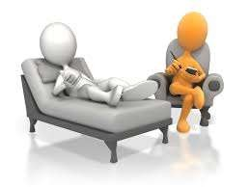
The goal of psychodynamic therapy is a client’s self-awareness and understanding of the influence of the past on present behavior

Slide 47
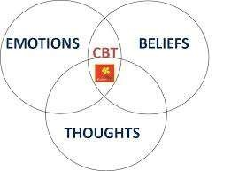
4. COGNITIVE AND BEHAVIOUR TEHRAPY
Most cognitive behavioral approaches address specific aspects of thought, feelings, behavior, or attitude and do not claim to treat the entire personality disorder of the person.

Slide 48
CONCLUSION:
abnormal personality can be “deeply ingrained maladaptive
defined as pattern of
behavior, continuing throughout the most of adult life, although often becoming less obvious in middle or old age

Slide 49
Personality disorder illness. Whereas the
is different from mental symptoms of personality
disorder are continuous and start from adolescence or even before.
It is not a mental illness.
It is a maladaptive behavior.
It is long lasting, most of time lifelong problems.
It produces distress to the individual and to others.

Slide 50
Thank you….

