Slide 1

Mood Disorders
Dr Abhinav Kuchhal
Asst. Professor
Department Of Psychiatry

Slide 2

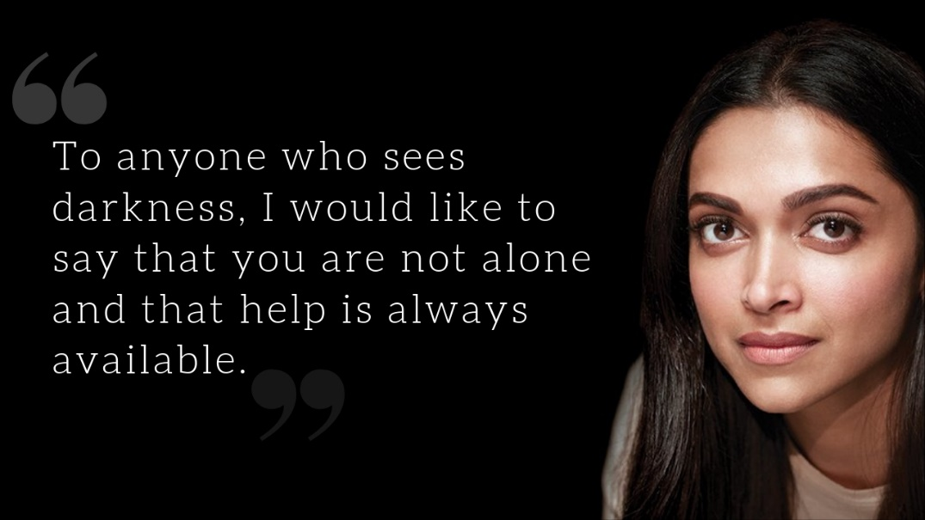


What these Celebs have in Common..?
Mood Disorder

Slide 3
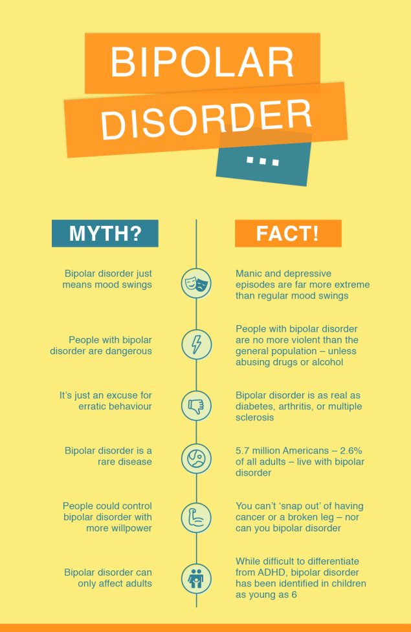

Slide 6
The term ‘mood disorders’ groups together a number of clinical conditions whose common and essential feature is a disturbance of mood, accompanied by related cognitive, psychomotor, psychophysiological, and interpersonal difficulties.

Slide 7
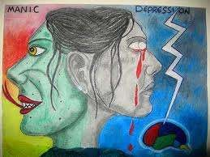
History
Definitions
Types of Mood disorders
Epidemiology
Etiology

Slide 8

History
About 400 BC, Hippocrates told - alignment of the planets caused the spleen to secrete black bile, which then darkened the mood = melancholia.
Around 30 AD, the Roman physician Celsus : described melancholia
as a depression caused by black bile.
In 1882, the German psychiatrist Karl Kahlbaum - described cyclothymia, mania and depression as stages of the same illness.
In 1899, Emil Kraepelin : identified mania and depression as an illness characterized by severe mood swings that are relatively independent of social and psychological forces and termed these as
“MANIC DEPRESSIVE PSYCHOSIS”

Slide 9
Definitions
Mood :
  Pervasive and sustained
  Feeling tone
  that is expressed internally
  That influences a person’s behavoir and perception of the world
  Distinguished from affect – the external
expression of mood

Slide 10
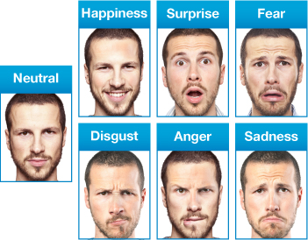
1
2
3
4
5
6

Slide 11
Mood disorders - Person’s having mood disorder, general emotional state or mood is distorted or inconsistent with his circumstances and interferes with his ability to function. He may be extremely sad, empty or irritable (depressed), or he may have periods of depression alternating with being excessively happy (mania).
Anxiety disorders can also affect his mood and often occur along with depression. Mood disorders increase his risk of suicide.
Elevated mood | Depressed mood | Others
Expansiveness | Lack of energy /interest | Change in activity level
Flight of ideas | Feelings of guilt | Change in Cognitive abilities
Decreased sleep | Difficulty in concentration | Change in speech
Grandiose ideas | Loss of appetite | Change in biological functions
 | Thoughts of death /suicide

Slide 12
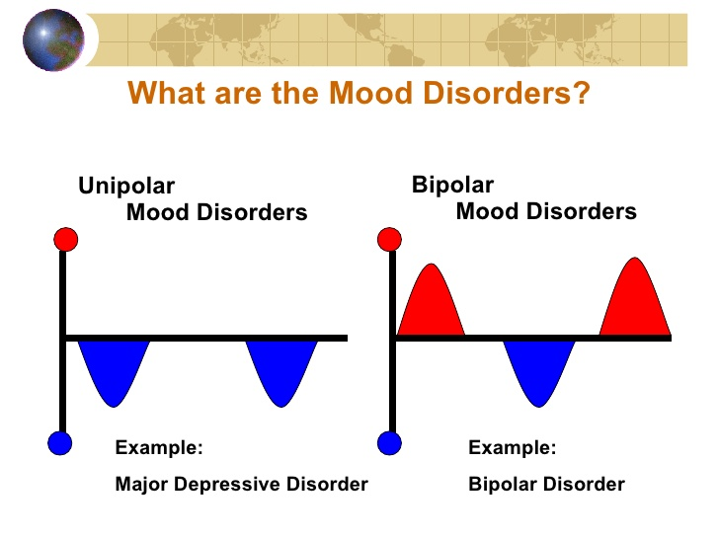

Slide 13
Types of Mood disorders
Patients afflicted with only major depressive episodes = major
depressive disorder or unipolar depression.
Patients with both manic and depressive episodes or patients with manic episodes alone =bipolar disorder.
Patients who are bipolar, but who do not have depressive episodes=
unipolar mania• and pure mania (sometimes used)
Three additional categories of mood disorders
  Hypomania - an episode of manic symptoms that does not meet the DSM-V criteria for manic episode
  Cyclothymia - disorder that represent less severe forms of bipolar disorder
  Dysthymia - disorder that represent less severe forms of major depression

Slide 14
Classification of Mood Disorder
According to the ICD 10, the mood disorder are classified as follows:
F30-F39 Mood [affective] disorders
F30 Manic episode
F31 Bipolar affective disorder
F32 Depressive episode
F33 Recurrent depressive disorder
F34 Persistent mood [affective] disorders (including cyclothymia and
dysthymia)
F38 Other mood [affective] disorders
F39 Unspecified mood [affective] disorder

Slide 15
What are the symptoms of Depression..??

Slide 16
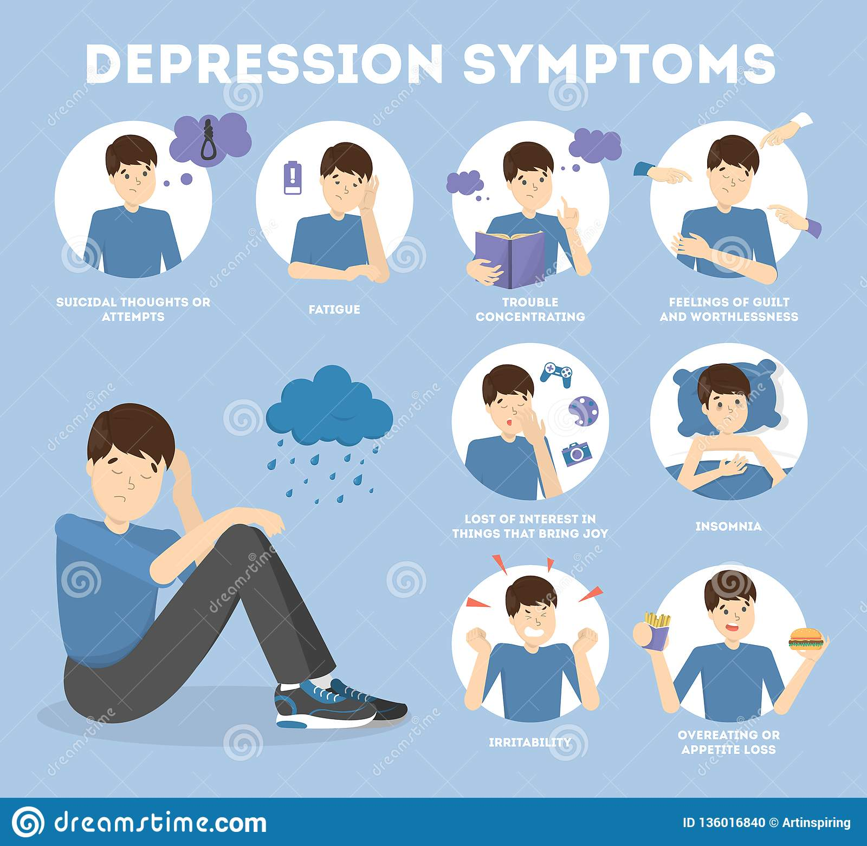

Slide 17
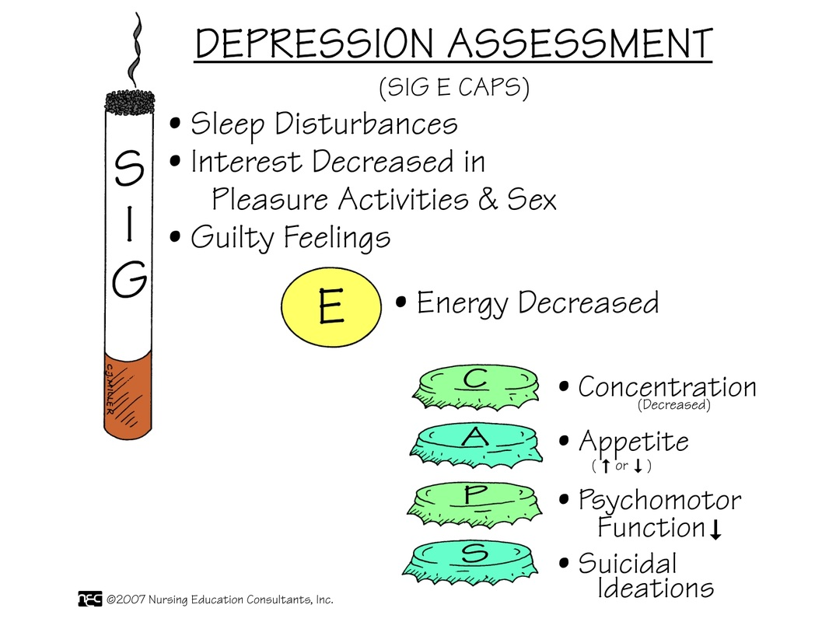

Slide 18
Criteria for Depressive episode
The individual usually suffers from
Depressed mood, to a degree that is definitely abnormal for the individual present for most of the day and almost everyday, largely uninfluenced by circumstances and sustained for at least 2 weeks.
Loss of interest and enjoyment, and
Reduced energy leading to increased fatiguability and diminished activity.
Other common symptoms are:
(a)reduced concentration and attention;
(b)reduced self-esteem and self-confidence;
(c)ideas of guilt and unworthiness (even in a mild type of episode);
(d)bleak and pessimistic views of the future;
(e)ideas or acts of self-harm or suicide;
(f)disturbed sleep
(g)diminished appetite.

Slide 19
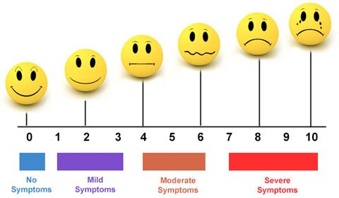

Slide 20

Mania
A manic episode:
  is a distinct period
  of an abnormally and persistently elevated, expansive, or irritable mood
  lasting for at least 1 week, (or less - if a patient must be hospitalized )
A hypomanic episode:
  lasts at least 4 days
  similar to a manic episode
  except that it is not sufficiently severe to cause impairment in social or occupational
functioning
  no psychotic features are present.
Both are associated with
  inflated self-esteem,
  decreased need for sleep,
  distractibility,
  great physical and mental activity,
  overinvolvement in pleasurable behavior.

Slide 21
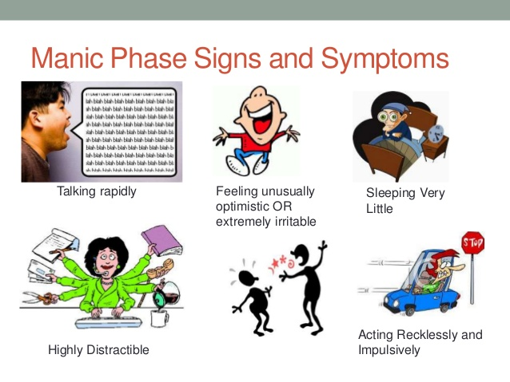

Slide 22
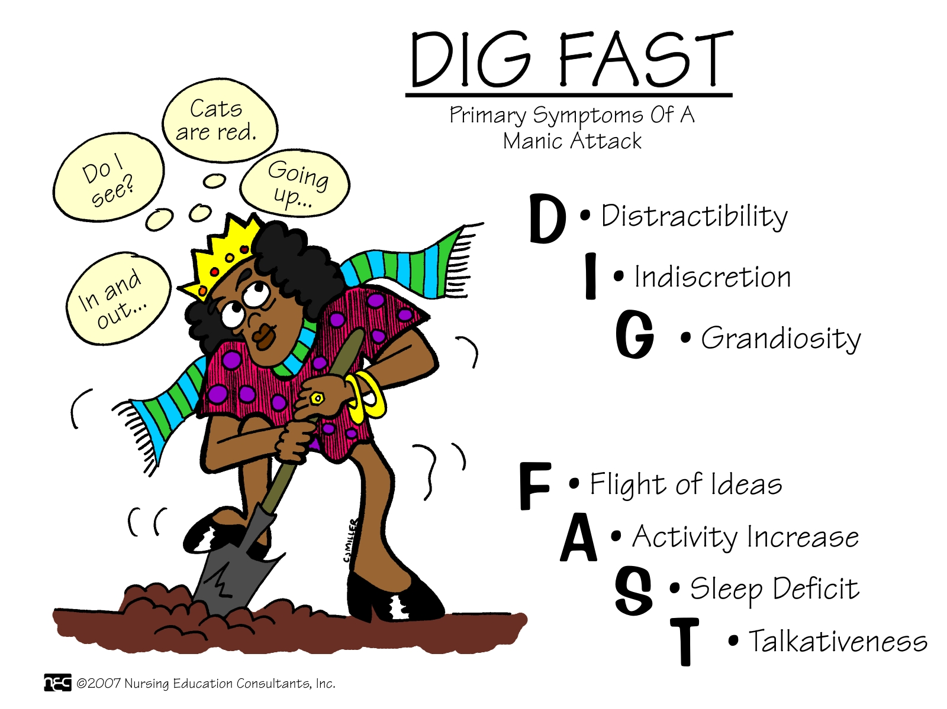

Slide 23
Criteria for Manic episode
A mood which is predominantly elevated, expansive or irritable and definitely abnormal for the individual concerned. This mood change must be prominent and sustained for at least a week (unless it is severe enough to require hospital admission).
B. At least three of the following must be present (four if the mood is merely irritable), leading to severe interference with personal functioning in daily living:
(1) Increased activity or physical restlessness
(2) Increased talkativeness ('pressure of speech’);
(3) Flight of ideas or the subjective experience of thoughts racing;
(4) Loss of normal social inhibitions resulting in behaviour which is inappropriate to the circumstances;

Slide 24
(5) Decreased need for sleep;
(6) Inflated self-esteem or grandiosity;
(7) Distractibility or constant changes in activity or plans;
(8) Behaviour which is foolhardy or reckless and whose risks the subject does not recognize e.g. spending sprees, foolish enterprises, reckless driving;
(9) Marked sexual energy or sexual indiscretions.

Slide 25
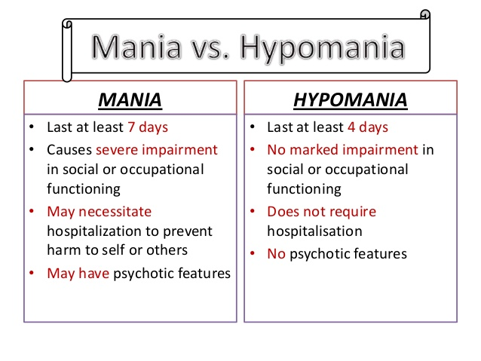
Mania vs Hypomania

Slide 26
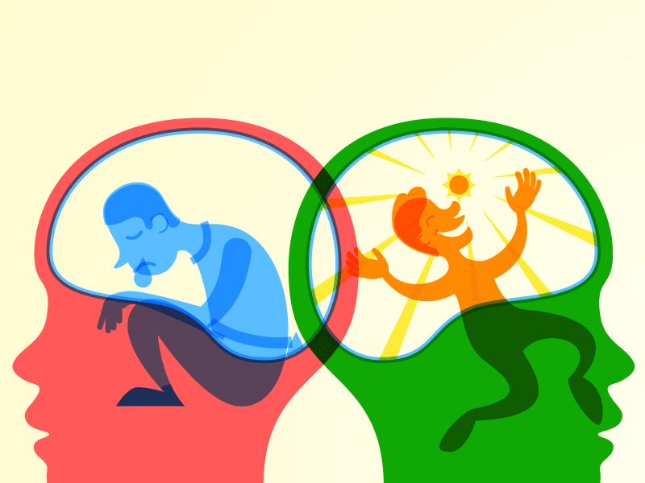
Mania
Bipolar I disorder
  a clinical course of one or more manic episodes and, sometimes, major depressive episodes.
Bipolar II disorder
  A variant of bipolar disorder
  episodes of major depression and hypomania (rather than
mania)

Slide 27
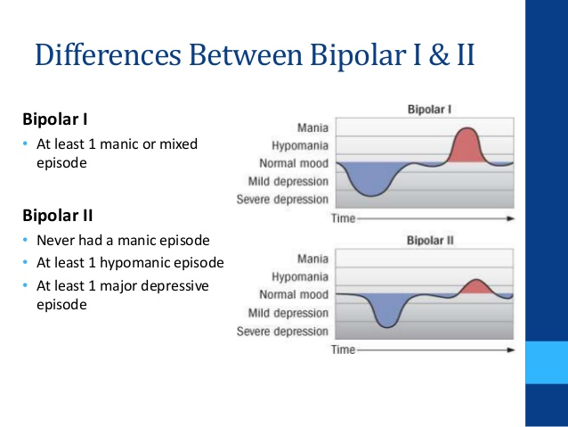

Slide 28
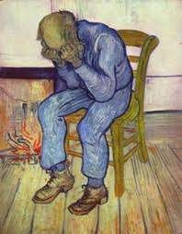
Dysthymia and Cyclothymia
Dysthymic disorder
  at least 2 years of depressed mood
  not sufficiently severe to fit the diagnosis of major depressive episode.
Cyclothymic disorder
  at least 2 years of frequently occurring
    hypomanic symptoms cannot fit the diagnosis of manic episode
    depressive symptoms that cannot fit the diagnosis of major depressive episode.

Slide 29
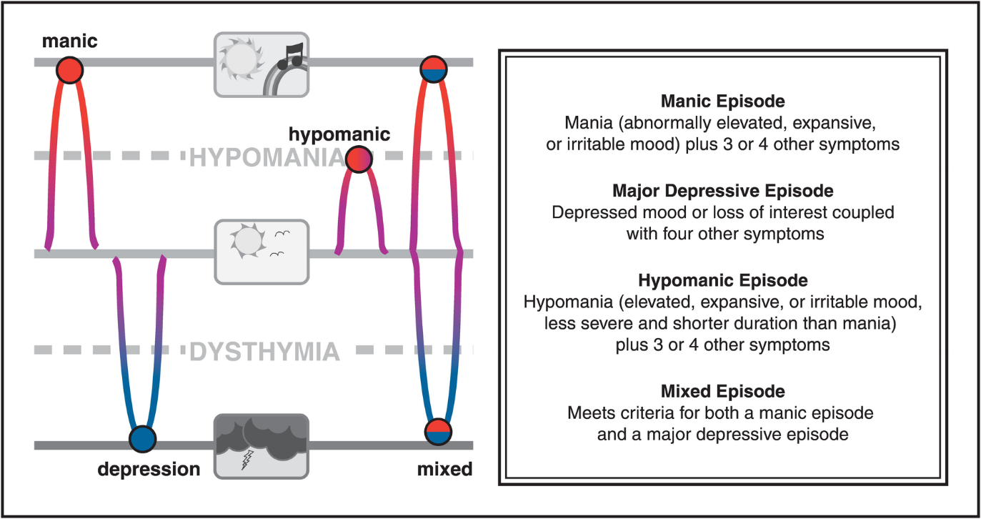

Slide 30
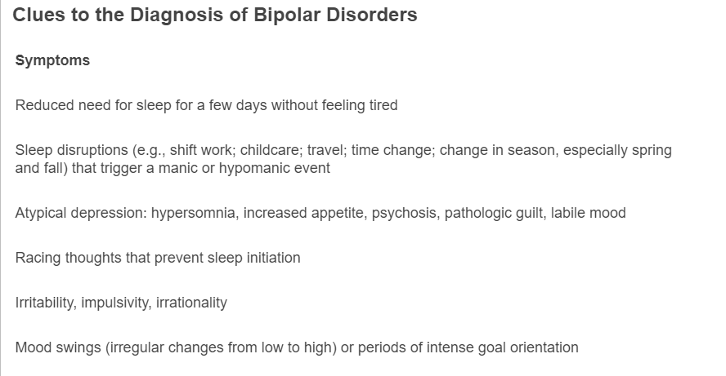
Diagnostic clues

Slide 31
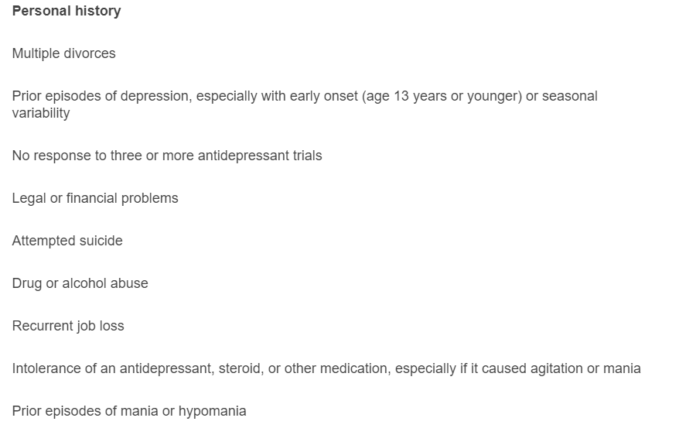
Diagnostic clues : contd

Slide 32
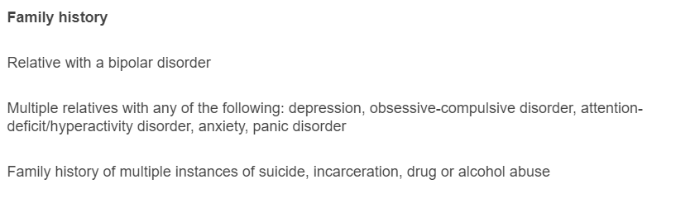
Diagnostic clues : contd

Slide 33
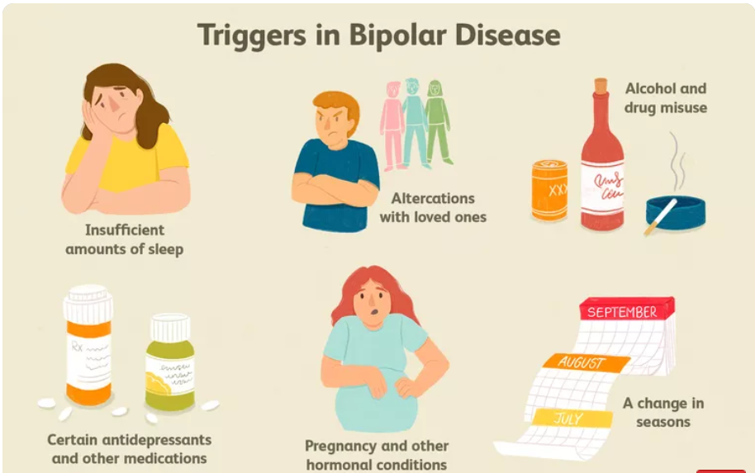
Triggers in BPD

Slide 34
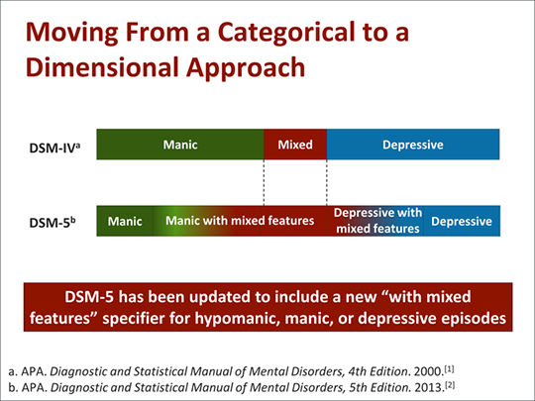
DSM 5 : “Mixed features” specifier added

Slide 35
Epidemiology
Incidence and Prevalence:
  MDD - highest lifetime prevalence (almost 17 percent) of any psychiatric disorder.
Sex:
– Women : Men = 2:1. (MDD) ; 1:1(BPD1)
  The hypothesis reasoning it :
    hormonal differences,
    the effects of childbirth,
    differing psychosocial stressors
    behavioral models of learned helplessness.
  Manic episodes are more common in men, and depressive episodes are more common in women.
  Women,
    more likely than men to present a mixed picture
    higher rate of being rapid cyclers, defined as having four or more manic episodes in a 1-year period.
Age:
  The mean age of onset for bipolar I disorder = 30yrs.
  The mean age of onset for major depressive disorder = 40 years (50 % between 20-50yrs)
  Recent trend: Incidence of MDD - increasing in <20 years of age – (alcohol and drugs of abuse)

Slide 36
Epidemiology
Marital Status
  Poor interpersonal relationships
  Divorced or separated
Socioeconomic and Cultural Factors
  No correlation for MDD
  BPD 1 : upper socioeconomic group
Comorbidity
  MDD : increased risk of having one or more additional comorbid Axis I disorders.
    Alcohol abuse or dependence,
    Panic disorder,
    Obsessive compulsive disorder (OCD),
    Social anxiety disorder.
  worsen the prognosis and increase - risk of suicide

Slide 37
Etiology
Biogenic Amines
Norepinephrine↓
  Downregulation or decreased sensitivity of beta-adrenergic receptors = clinical antidepressant responses
  Presynaptic beta-receptors activation = decrease norepinephrine release
  Presynaptic beta-receptors (also) on serotonergic neurons = regulate serotonin release.
  Example, Venlafaxine(SNRI) - supports a role for NE

Slide 38
Etiology
Serotonin ↓
  SSRIs showed - serotonin = m.c NT
  Multiple serotonin receptor subtypes – increased excitement for more specific treatments
  Depletion of serotonin = precipitate depression, ( suicidal impulses : CSF - serotonin metabolites and less serotonin uptake sites on platelets)
Dopamine ↓
  Reduced in depression and increased in mania.
  Drug effects:
    reserpine and diseases that reduce dopamine concentrations (e.g.,PD)
    In contrast, drugs that increase dopamine concentrations, (tyrosine, amphetamine, and bupropion)
  Two recent theories
    mesolimbic dopamine pathway may be dysfunctional in depression
    dopamine D₁ receptor may be hypoactive in depression.

Slide 39
Etiology
Other Neurotransmitter Disturbances
Acetylcholine (ACh) ↑ in depression
  reciprocal or interactive relationships with all three monoamine systems.
  Abnormal levels of choline at autopsy
  Cholinergic agonist
    can ↑ symptoms in depression, and can ↓ symptoms in mania but not sufficient -
Rx
    can induce changes in HPA activity and sleep ≈ depression.
Gamma-Aminobutyric acid (GABA) ↓in depression
  has an inhibitory effect on mesocortical and mesolimbic systems.
  ↓ plasma, CSF, and brain GABA levels in depression.
The amino acids glutamate and glycine are the major excitatory and inhibitory neurotransmitters in the CNS.
  Glutamate with hypercortisolemia = deleterious neurocognitive effects of severe recurrent depression.
  NMDA receptors antagonists have antidepressant effects.

Slide 40
B. Alterations of Hormonal Regulation
Activity of the gene coding for the neurokinin brain-derived neurotrophic growth factor (BDNF) is decreased after chronic stress, as is the process of neurogenesis.
history of early trauma
  increased HPA activity – hallmark : Hypercortisolema in depression
  structural changes (i.e., atrophy)
  These tests of feedback inhibition (dexamethasone suppression test ) are not used as a diagnostic test
    mania,
    schizophrenia,
    Dementia,
    psychiatric disorders.
Thyroid Axis Activity
  5 to 10 % : undetected thyroid dysfunction, (TSH)
  hormone replacement therapy
  unlike the dexamethasone suppression test (DST), blunted TSH response to TRH does not usually normalize with effective treatment.

Slide 41
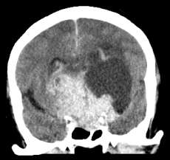
C. Immunological Disturbance
– Depressive disorders are associated with several immunological abnormalities, including decreased lymphocyte proliferation
D Structural and Functional Brain Imaging
  CT and MRI Brain
    abn hyperintensities in subcortical regions,
      periventricular regions,
      basal ganglia,
      thalamus.
    M.ost common in bipolar I disorder
    hyperintensities = deleterious neurodegenerative effects of recurrent
affective episodes.
  PET
    decreased anterior brain metabolism,
      greater left hemisphere reductions are seen in depression
      greater right hemisphere reductions in mania.
    reduced cerebral blood flow or metabolism, or both, in the dopaminergically
innervated tracts of the mesocortical and mesolimbic systems in depression.
•

Slide 42
E. Neuroanatomical Considerations
four brain regions in the regulation of normal emotions:
  the prefrontal cortex (PFC) : representations of goals and appropriate responses to obtain these goals = multiple, conflicting behavioral responses
  the anterior cingulate: integration of attentional and emotional inputs = facilitates control of emotional arousal, particularly when goal attainment has been thwarted or when novel problems have been encountered
  the hippocampus : learning and memory
  the amygdala : station for processing novel stimuli

Slide 43
F. Genetic Factors
– More common in monozygotic twin ,Recently, the primary focus of genetic studies is identifying specific susceptibility genes
G. Family Studies
  if one parent = 10 - 25 percent for mood disorder.
  If both parents = this risk roughly doubles.
H. Twin Studies
  concordance rate for mood disorder in the monozygotic (MZ) twins of 70 to 90 percent compared with the same-sex dizygotic (DZ) twins of 16 to 35 percent.
I. Linkage Studies
  DNA markers are segments of DNA = track the segregation of specific chromosomal regions within families affected with a disorder.
  Chromosomes 18q and 22q are the two regions with strongest evidence for linkage to bipolar disorder.

Slide 44
Psychosocial Factors
J. Life Events and Environmental Stress
  One theory : stress = long-lasting changes in the brain's biology = alter the functional states of various neurotransmitter and intraneuronal signaling systems = loss of neurons and an excessive reduction in synaptic contacts.
    high risk of undergoing subsequent episodes even without an external stressor.
      losing a parent before age 11,
      loss of a spouse
      Unemployment

Slide 45
K Personality Factors
Persons with certain personality disorders may be at greater risk for depression
  OCD,
  histrionic,
  Borderline
antisocial or paranoid personality disorder can use projection and other externalizing defense mechanisms to protect themselves from their inner rage.
Recent stressful events are the most powerful predictors of the onset of a depressive episode.

Slide 46
L. Other Formulations of Depression
Cognitive Theory
  Aaron Beck postulated a cognitive triad of depression that consists of
    views about the self negative self-precept;
    about the environment tendency to experience the world as hostile and demanding,
    about the future the expectation of suffering and failure.

Slide 47
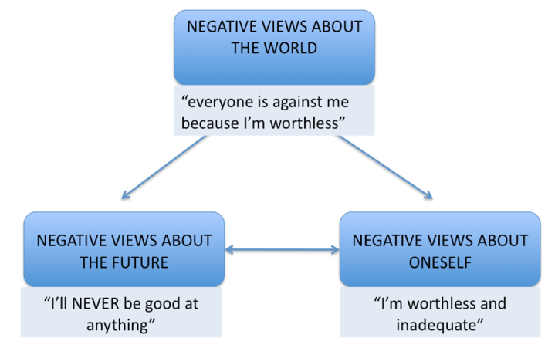

Slide 48
MANAGEMENT

Slide 49





· There are NO specific tests.
Investigations focus on exclusion of treatable causes or other secondary problems.
Standard tests:
Complete blood picture
ESR
3 .B12/folate
4. Liver function test
Thyroid function test
Glucose level
Calcium level

Slide 50
Hospitalization is mandatory If there is:
Serious risk of suicide
Significant self –neglect (impaired nutrition & social interactions)
Severe depressive symptoms
Severe psychotic symptoms
Lack of
Social support
Initiation of ECT (Treatment resistant depression)
A need to address comorbid conditions

Slide 51




First line of treatment: Anti-depressant
effective in 65-75% of patients.
The decision of choosing anti-depressant depends on:
Patient factor: age, sex, comorbid illness, previous response to antidepressants.
Symptomatology: sleep problem, hypersomnia , OCD symptoms , risk of suicide

Slide 52
TRICYCLIC ANTIDEPRESSANTS (TCA)
Action: reuptake inhibition of norepinephrine(NE) and serotonin (5-HT), increasing both in synaptic cleft
Examples : Imioramine (Tofranil) , Clomipramide (Anafranil) , Amitryptptiline (Tryptizol)
TCA are cheap drugs but have many side effects.
Selective Serotonin Reuptake Inhibitors (SSRI)
Action: more selective inhibitory effect on reuptake of serotonin.
Lesser side effects than TCA
Examples: 1. Fluoxetine
2 Sertaline
Paroxetine
Fluvoxamine

Slide 53
Second line of treatment:
1 When the first line treatment fail.
2 Unacceptable side effects from 1st line drug.
Change of antidepressant to different class or the same class with different side effect.

Slide 54

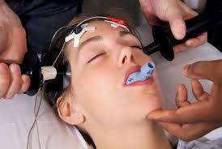
Electro convulsive therapy
ECT is used mainly to treat severe depression, but is also indicated for patients with bipolar disorder & schizoaffective disorder
There is no question about the efficacy and safety of ECT, which is practiced widely in INDIA and the rest of the world. But it remains controversial and stigmatized because of misinformation and outmoded perceptions about how the treatment is performed.

Slide 55
GOOD PROGNOSTIC FACTORS
Abrupt or acute onset
Severe depression
Typical clinical features
Well-adjusted pre-morbid personality
Good response to treatment

Slide 56
BAD PROGNOSTIC FACTORS
Double depression
Co-morbid physical disease,
Personality disorders
Alcohol dependence
Chronic ongoing stress
Poor drug compliance
Marked hypochondriacal features or mood incongruent features

Slide 57
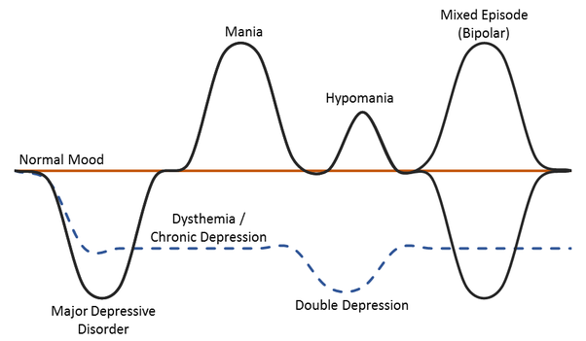
BAD PROGNOSTIC FACTORS
Double depression
Co-morbid physical disease,
Personality disorders
Alcohol dependence
Chronic ongoing stress
Poor drug compliance
Marked hypochondriacal features or mood incongruent features

Slide 58




1. Hospitalization-
Due to High Risk for Injury and violence
Pharmacotherapy
-Mood stabilizers
-Antipsychotics
Electroconvulsive Therapy (ECT)
The patient is continue treatment for 4-6 months after resolution of the symptoms then preventive treatment considered.

Slide 59
Prevention of relapses
  Prophylaxis
  Therapeutic alliance
  Family education
6. Psychotherapy
Some psychotherapy treatments used to treat bipolar disorder include:
•
•
•
Cognitive behavioral therapy (CBT)
Family-focused therapy
Interpersonal and social rhythm therapy
•
Psychoeducation

Slide 60
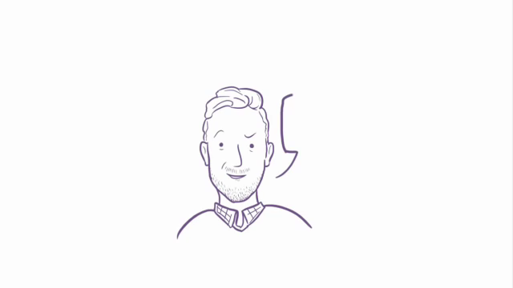

Slide 61
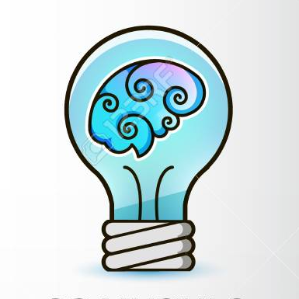
THANK YOU !
Any Questions ?
You can contact me at
dr.abhinavkuchhal@gmail.com
9897547922

