Slide 1
PHARMACOLOGIC BASIS AND SIDE EFFECTS OF DRUGS USED IN PSYCHIATRIC DISORDERS
DR. RAMJAN ALI

Slide 2
INTRODUCTION
Psychiatric medication is a licensed psychoactive drug taken to exert an effect on the chemical makeup of the brain and nervous system. Thus, these medications are used to treat mental illnesses.
Also referred to as Psychotropics or Psychotherapeutic medications
Since the mid-20th century, such medications have been leading treatments for a broad range of mental disorders and have decreased the need for long-term hospitalization .

Slide 3
Psychopharmacology
Psychopharmacology is the study of the effects of drugs on affect, cognition, and behavior
Efficacy refers to the maximal therapeutic that a drug can achieve.
Potency describe the amount of the drug needed to achieve the maximum effect.
Half life is the time taken for half of the drug to be removed from the blood stream.
Agonist a drug that binds to and activates a receptor
Antagonist a drug that binds to but does not activate (block) a receptor

Slide 4
PSYCHOTROPIC MEDICATIONS CLASSIFICATION
ANTIPSYCHOTICS
(NEUROLEPTICS)
MOOD STABILIZERS
ANTIDEPRESSANTS
ANXIOLYTICS
SEDATIVES
HYPNOTICS
PSYCHOSTIMULANTS
ANTIHISTAMINICS,
ANTIMUSCARINICS
DOPAMINE AGONISTS

Slide 5
ANTI-PSYCHOTIC DRUGS

Slide 6
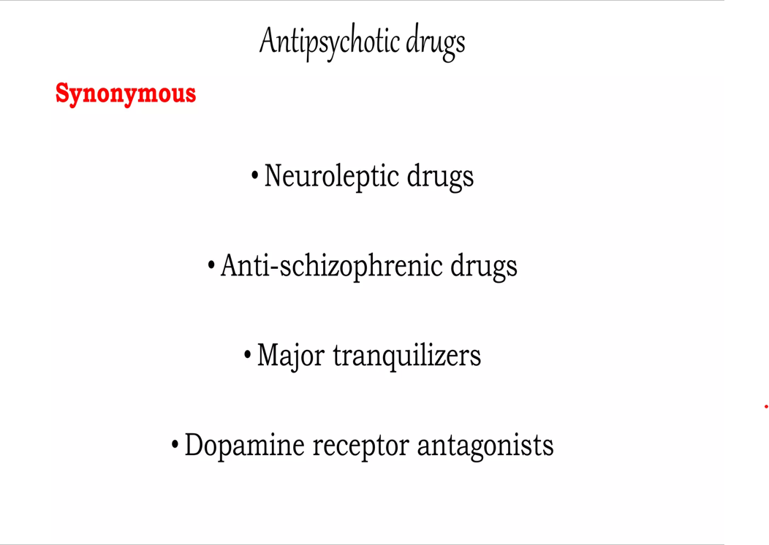

Slide 7
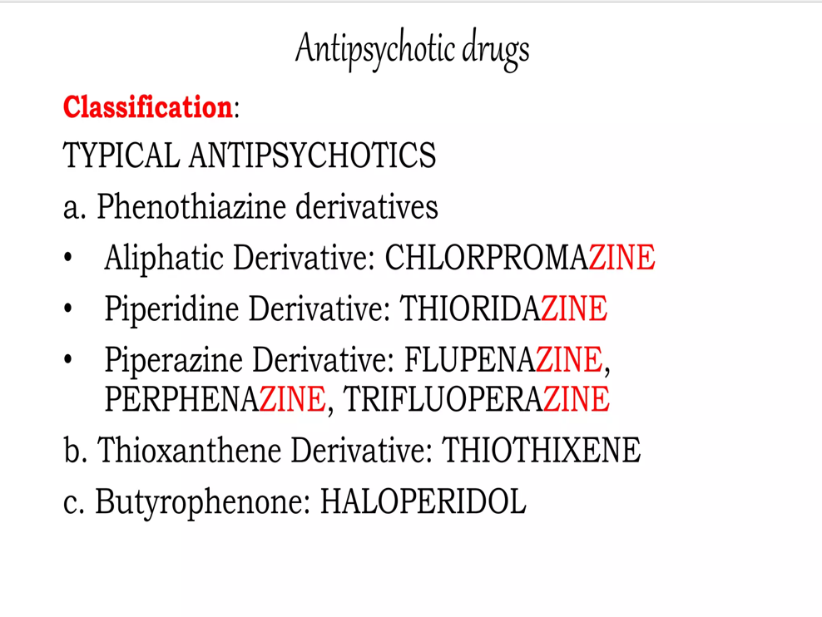

Slide 8
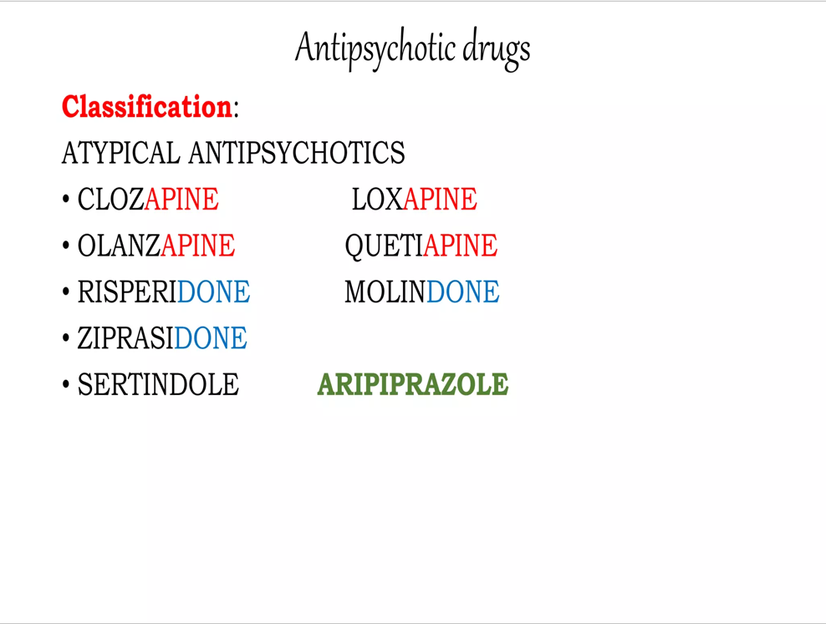

Slide 9
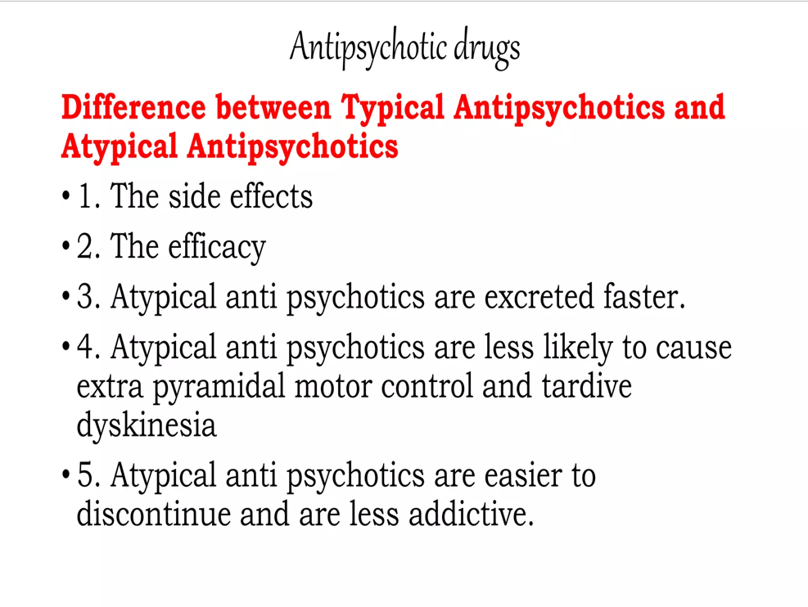

Slide 10
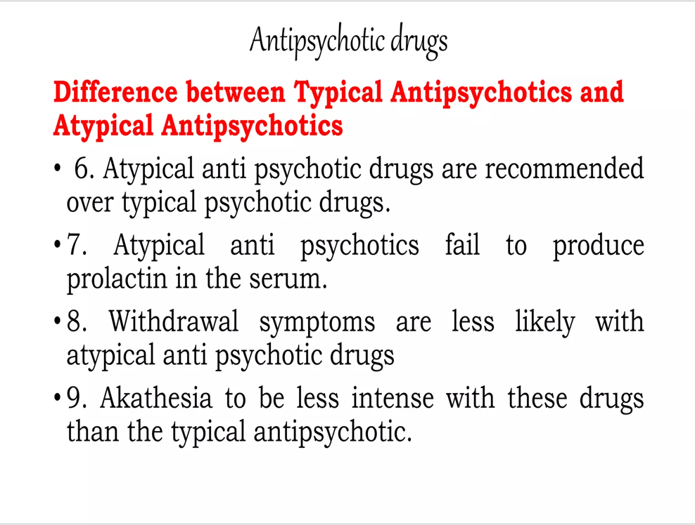

Slide 11
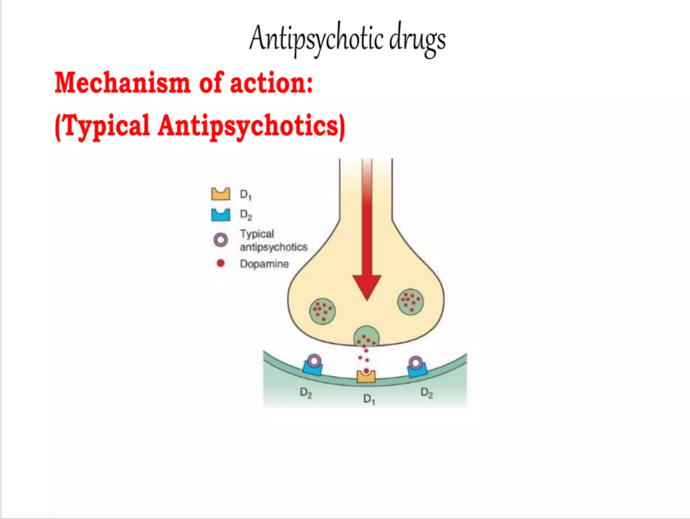

Slide 12
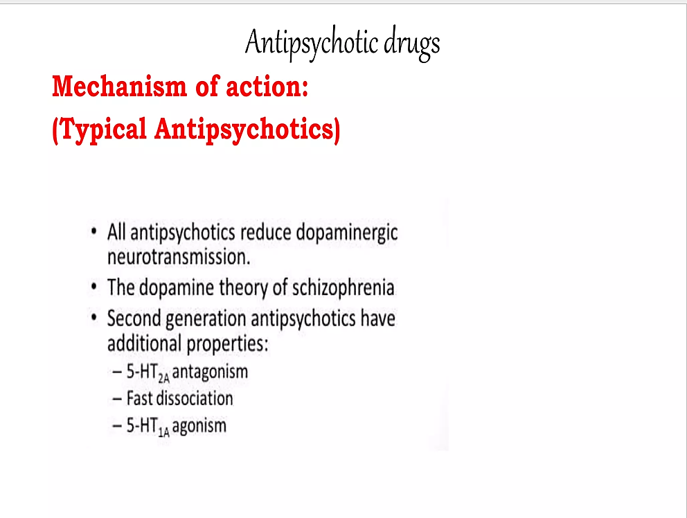

Slide 13
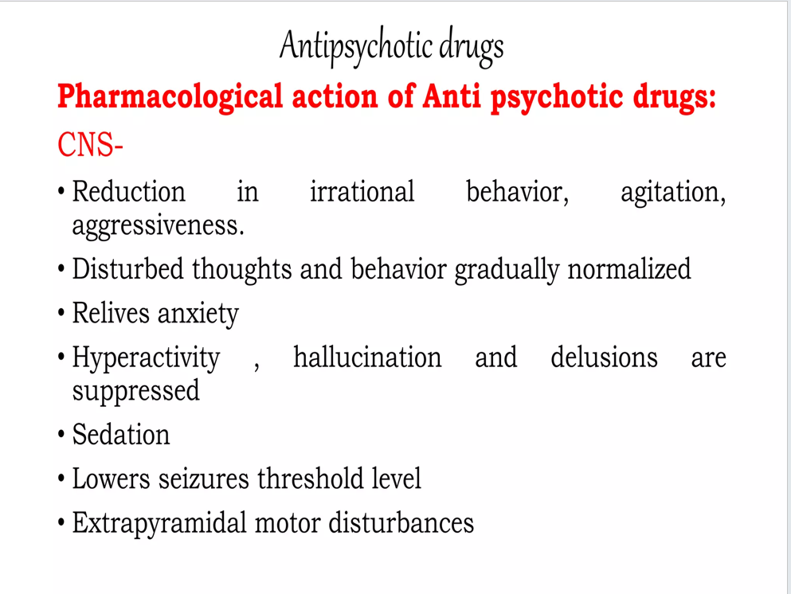

Slide 14
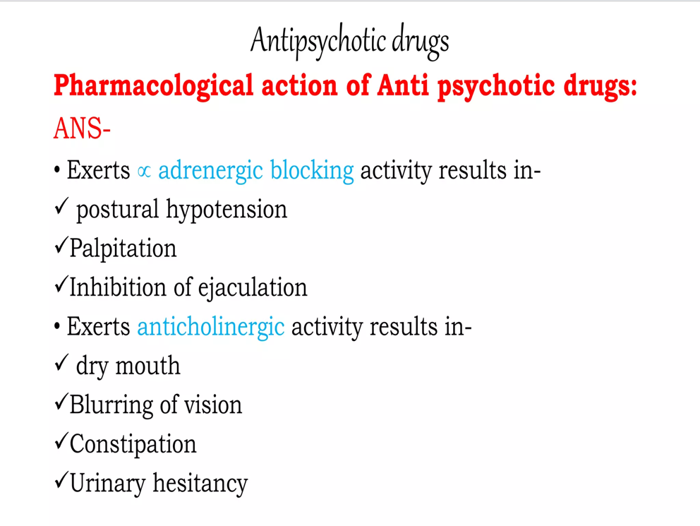

Slide 15
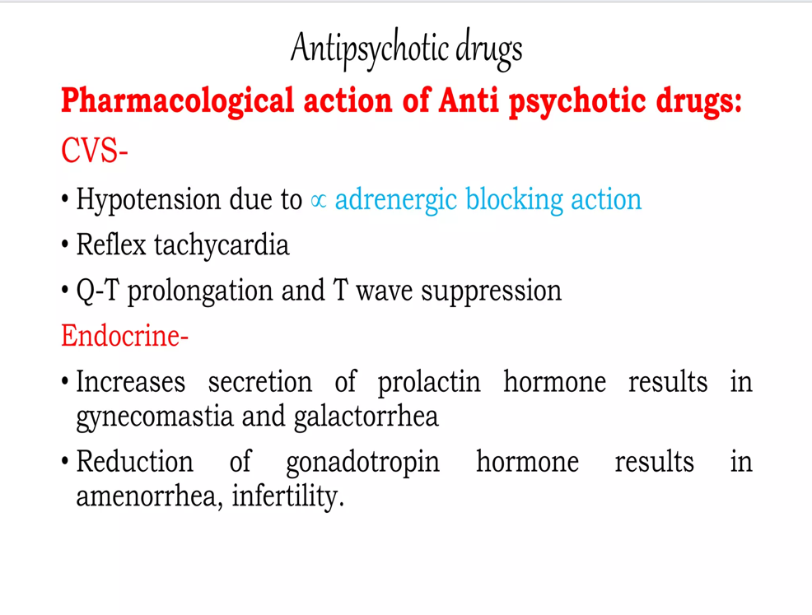

Slide 16
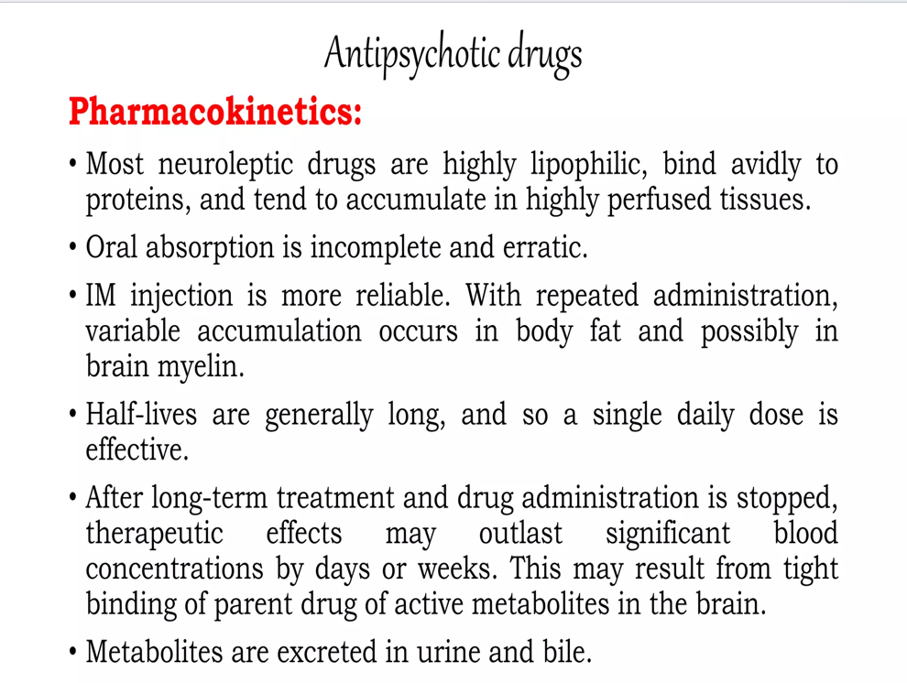

Slide 17
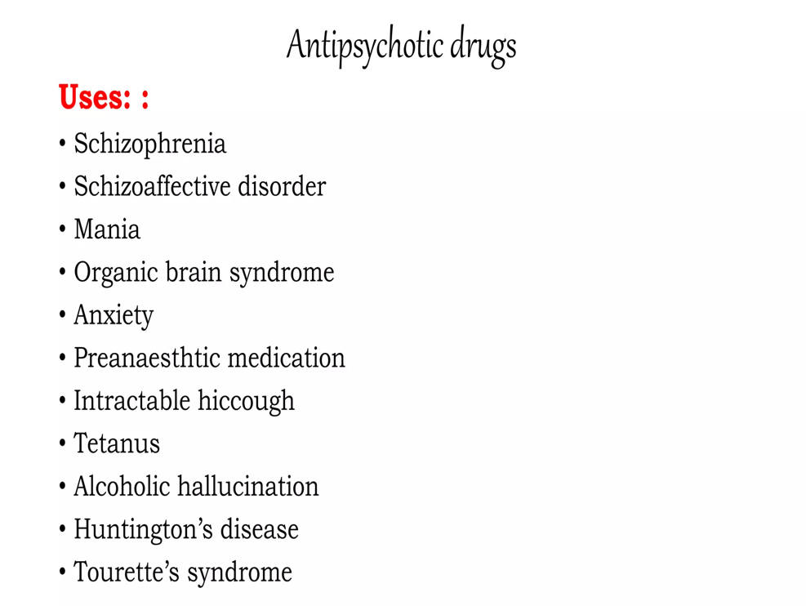

Slide 18
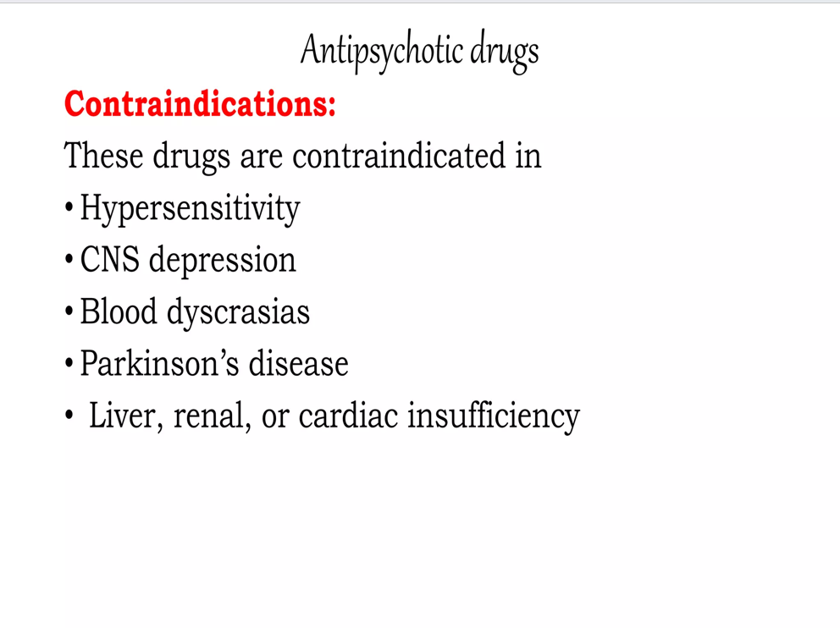

Slide 19
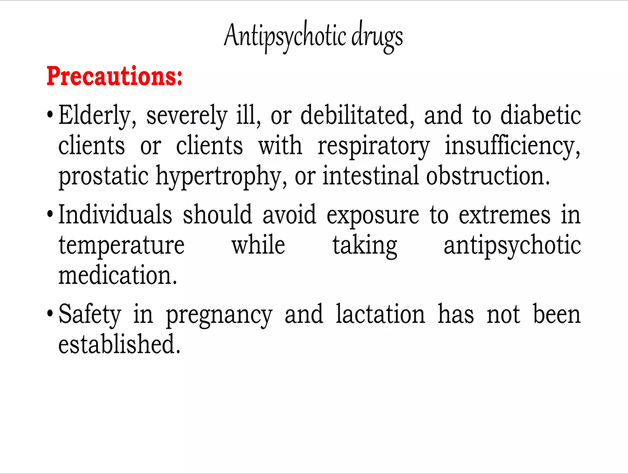

Slide 20
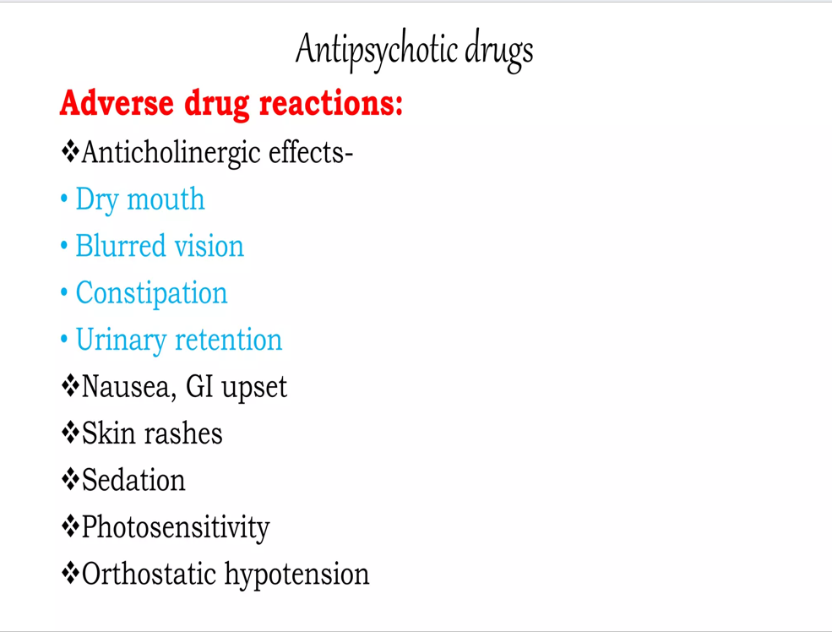

Slide 21
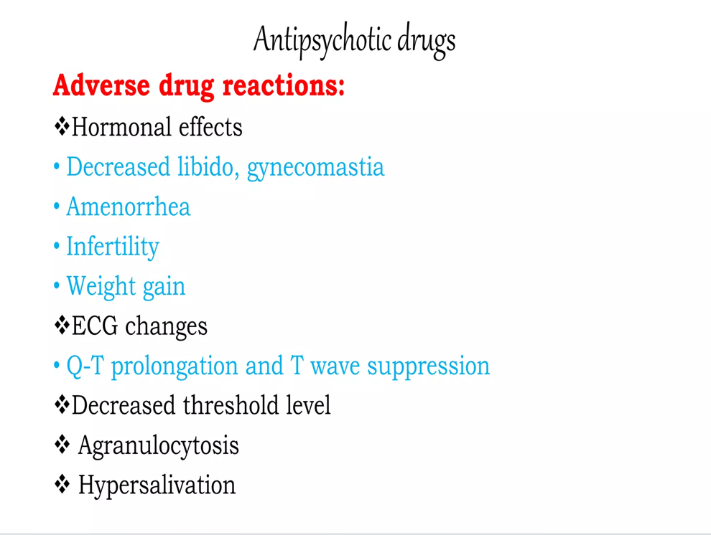

Slide 22
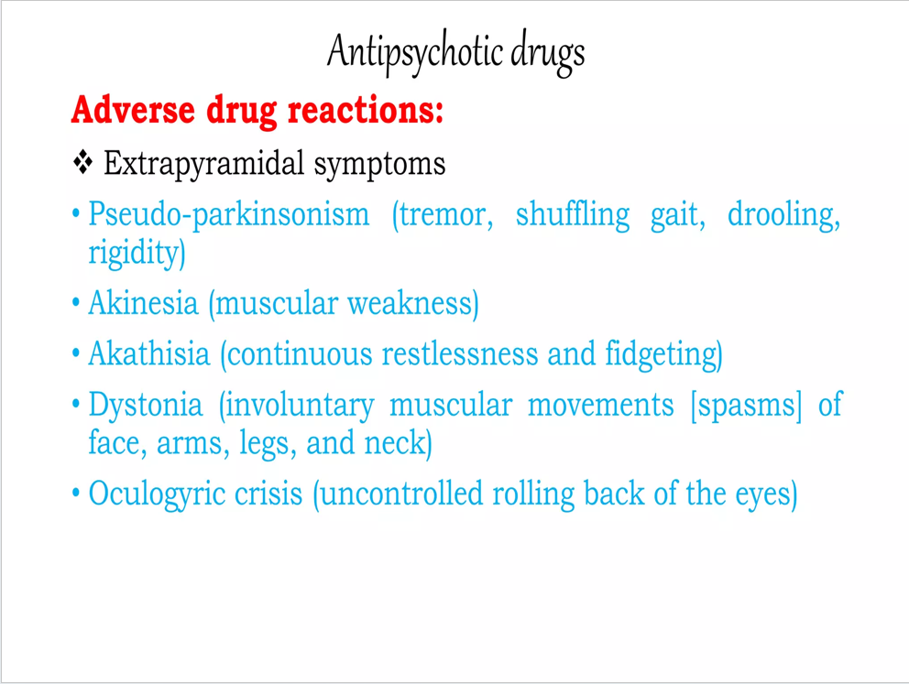

Slide 23
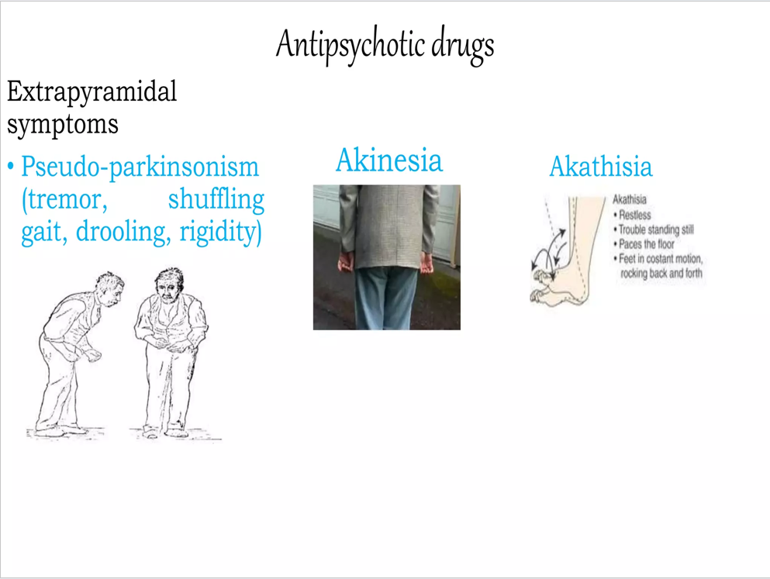

Slide 24
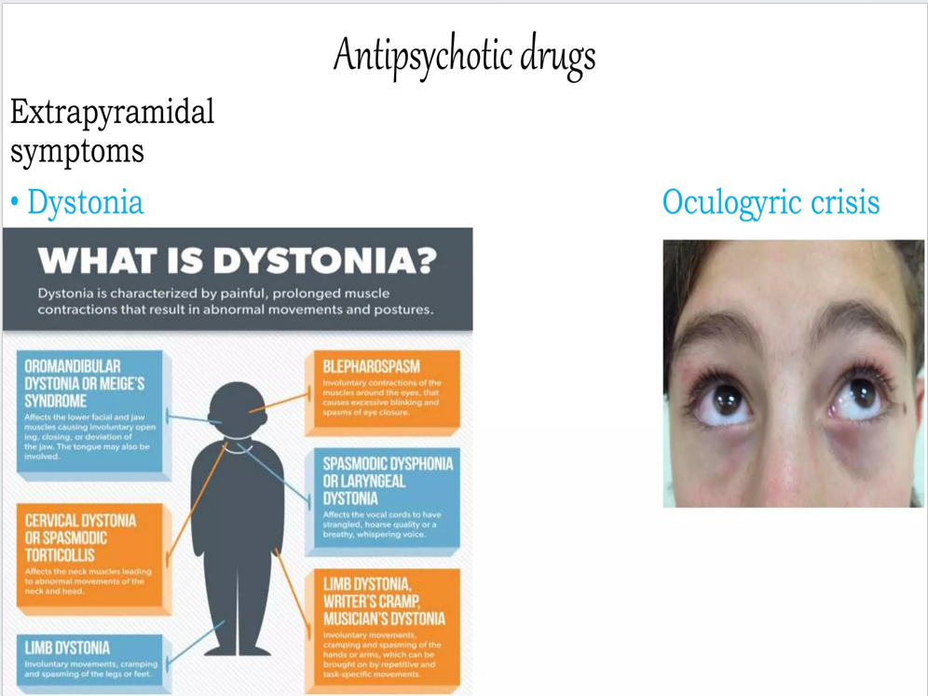

Slide 25
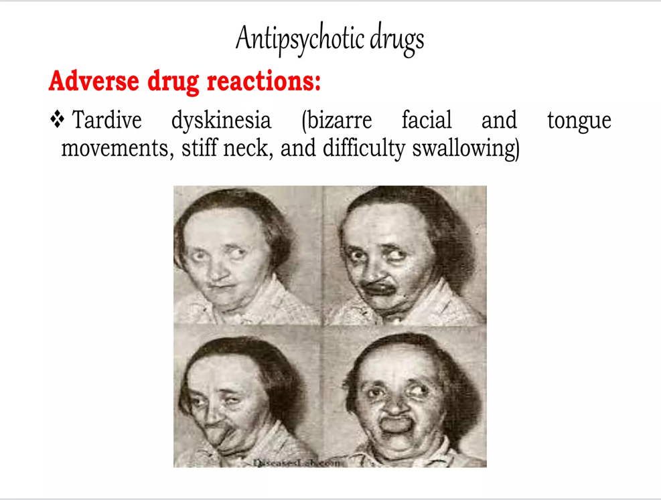

Slide 26
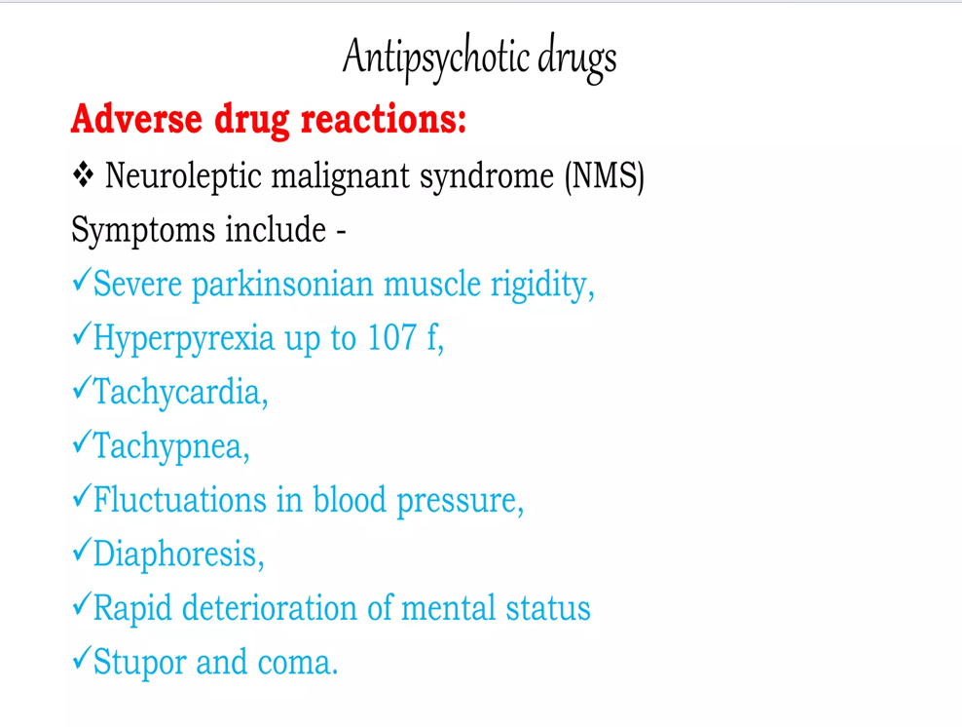

Slide 27
ANTI-DEPRESSANT DRUGS

Slide 28
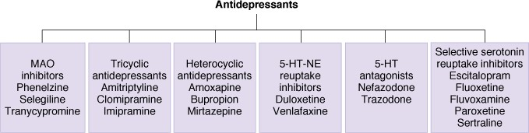
Antidepressant Drugs - Classification

Slide 29
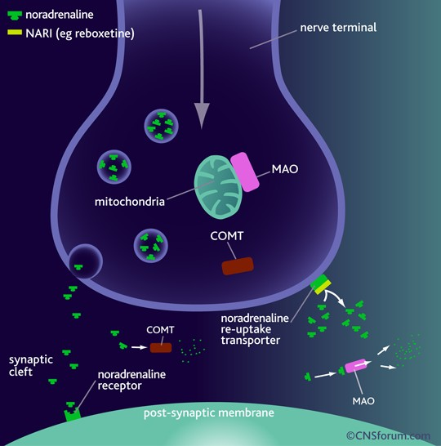
Postulated Mode of Action of Tricyclic Antidepressant Drugs
TCA’s→ ↓NE/↓5-HT reuptake (↓NET/ ↓ SERT) →
↑monoaminergic neurotransmission
→Antidepressant action

Slide 30
Tricyclic Antidepressants (TCA’s) - Pharmacological Actions
CNS Actions
  Mood elevation in depressed patients
  Latency period : 2-4 weeks
  Can cause EPS/Ataxia/Seizures/Coma
CVS Actions
  Orthostatic hypotension→↑HR
ANS Actions
  Anticholinergic effects
  Most potent anticholinergic action(Amitriptyline)

Slide 31
Tricyclic Antidepressants(TCA’s)- Pharmacokinetics
Absorption
  Well absorbed orally
Distribution
  ↑Lipophilic→↑V_{d}→↑T(1/2)
Metabolism & Excretion
  Hepatic microsomal N-demethylation/ oxidation/glucuronidation→Renal Elimination

Slide 32
Tricyclic Antidepressants(TCA’s)-Adverse Effects
Excessive sedation/Lassitude/Fatigue/Confusion
Sympathomimetic effects(Tachycardia/Agitation/Sweating/ Insomnia)
Anticholinergic(‘Atropine-like”) effects
Orthostatic hypotension/ECG abnormalities/Cardiomyopathies
Tremor/Paresthesias/EPS

Slide 33
Tricyclic Antidepressants(TCA’s)-Adverse Effects
Weight gain
Overdosage(extremely hazardous): Remember 3C’s
  Agitation/Delirium/Neuromuscular irritability/Convulsions/Coma
  Respiratory depression/Circulatory collapse
  Hyperpyrexia
  Cardiotoxicity(Cardiac conduction defects/Severe arrhythmias)

Slide 34
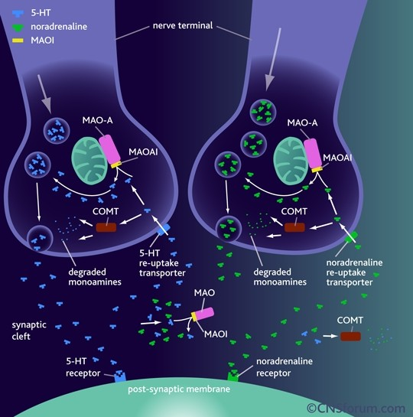
Postulated Mode of Action of MAO-A Inhibitor Drugs
MAO-AI’s→ ↓MAO-A isozyme →
↓ monoamine metabolism →
↑ monoaminergic neurotransmission
→Antidepressant action

Slide 35
MAO-AI’s-Pharmacological Actions
CNS Actions
Mood elevation
Latency period: 2-3 weeks
Tranylcypromine→Amphetamine- like→causes NE release in CNS→ antidepressant action(48 h)
MAOI’s→↓REM sleep/↓Narcolepsy

Slide 36
Hepatic Actions
Cause hepatotoxicity
Interference with drug detoxification
CVS Actions
Postural hypotension
Beer/Cheese/Chicken Liver→↑Tyramine content/↓Tyramine metabolism→
↑↑catecholamine release(nerve terminals) →Hypertensive Crisis(Cheese Reaction)

Slide 37
MAOI Interaction with Tyramine
(‘Cheese Reaction’)
OH
CH₂CH ₂NH ₂
CH₂CH NH
2 2
HO
HO
Tyramine
Noradrenaline
OH
Tyramine is normally metabolized by MAO in gut and liver
If unmetabolized, tyramine enters sympathetic nerve terminals where it displaces NE from vesicles into cytosol

Slide 38
Because MAO in the nerve terminals is inhibited there is a massive ‘non-physiological’ release of NE from sympathetic nerve terminals which can lead to fatal hemorrhage.
Patients prescribed an MAOI are warned not to eat/ drink certain substances (substances that contain tyramine etc.) e.g. beer, wine, cheese, marmite

Slide 39
MAO-AI’s-Pharmacokinetics
MAO inhibitors are taken orally
They are ‘hit & run’ drugs i.e., their effects greatly outlast their detectable presence in the body because they inhibit the enzyme irreversibly & termination of effect is dependent on synthesis of fresh enzyme(which takes weeks)
The hydrazine group is acetylated(like INH) & the population is divided into slow & fast acetylators

Slide 40
MAO-AI’s-Adverse Effects & Drug Interactions
Adverse Effects
  Headache/Drowsiness/Dry mouth/Weight gain/ Orthostatic hypotension/Impotence/Cheese Reaction
Drug Interactions
  MAOI’s + SSRI’s→ Serotonin Syndrome(lethal)
  TCA’s + CNS Depressants→ ↑↑ CNS depression
  TCA’s + MAOI’s→ Hyperpyrexia/Convulsions/ Coma

Slide 41
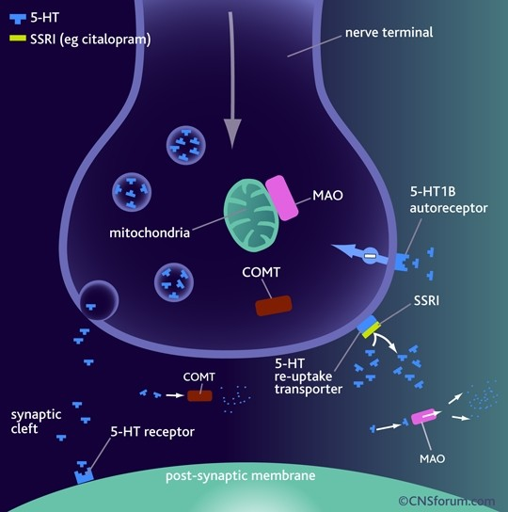
SSRI’s-Mechanism of Action
SSRI’s→ selective
↓5-HT reuptake (↓ SERT) →
↑monoaminergic (serotonergic) neurotransmission
→Antidepressant action

Slide 42
Selective Serotonin Reuptake Inhibitors(SSRI’s)-Pharmacokinetics
Absorption
  Well-absorbed orally
Metabolism
  Fluoxetine→Norfluoxetine
Excretion
  Renal elimination
  Elimination T(1/2)= 1-3 d(Fluoxetine)/ 7-15 d(Norfluoxetine)

Slide 43
Selective Serotonin Reuptake Inhibitors(SSRI’s)- Adverse Effects
“Less serious”
Anorexia/Nausea
Hypomania/Mania/Nervousness/Headache/Insomnia/ Dizziness/EPS
QT Prolongation(Citalopram)
Hyponatremia(5-HT 5-HT_{1C} & 5-HT₂ Receptors
  Citalopram/Fluoxetine/Fluvoxamine/Paroxetine/Sertraline
Sexual dysfunction
Serotonin syndrome
ADH release)

Slide 44
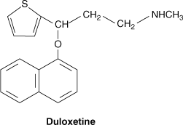
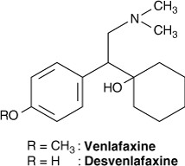
Serotonin NE Reuptake Inhibitors(SNRI’s)
Bind to transporters for both serotonin and NE(NET + SERT)
Enhance actions of both neurotransmitters
SNRIs differ from the TCAs in lacking significant blocking effects on peripheral receptors including
  Histamine(H₁)/Muscarinic/ α-adrenergic receptors

Slide 45
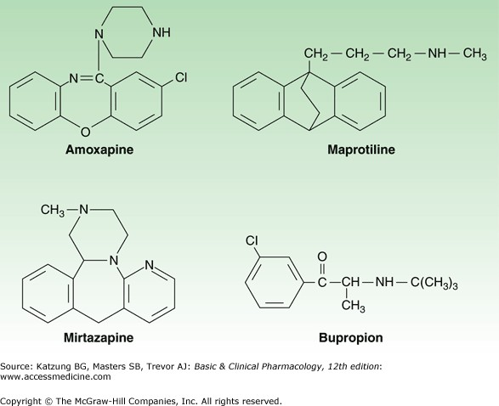
Heterocyclics
Bupropion
  Mechanism of antidepressant action unknown
  Drug has no effect on 5-HT or NE receptors nor on amine transporters
Mirtazapine
  Increases amine release from nerve endings by antagonism of presynaptic α₂ adrenoceptors involved in feedback inhibition
  Is also an antagonist at serotonin 5-HT₂ receptors

Slide 46
Heterocyclics
Amoxapine/Maprotiline
  Are potent NET inhibitors + less potent SERT inhibitors
  Both possess anticholinergic properties

Slide 47
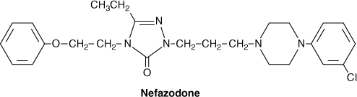
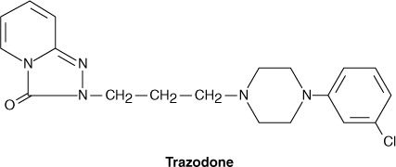
5-HT₂ Antagonists
5-HT₂ Antagonists
  Major antidepressant actions result from block of the 5-HT _{2A} receptor
  G-protein–coupled receptor located in several CNS regions including the neocortex
  Antagonism of this receptor is equated with both the antianxiety + antidepressant actions of these drugs

Slide 48
ANTI-PARKINSONIAN DRUGS

Slide 49
CLASSIFICATION OF ANTI-PARKINSONIAN DRUGS
Drugs acting on dopaminergic system:
• Dopamine precursors - Levodopa (1-dopa)
• Peripheral decarboxylase inhibitors - carbidopa and benserazide
• Dopaminergic agonists: Bromocriptine, Ropinirole and Pramipexole
• MAO-B inhibitors - Selegiline, Rasagiline
• Dopamine facilitator - Amantadine
Drugs acting on cholinergic system:
• Central anticholinergics - Trihexyphenidyl (Benzhexol), Procyclidine, Biperiden
• Antihistaminics - Orphenadrine, Promethazine

Slide 50
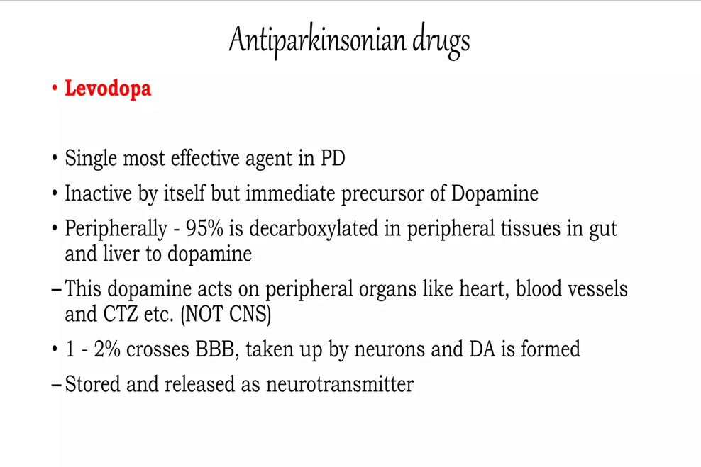

Slide 51
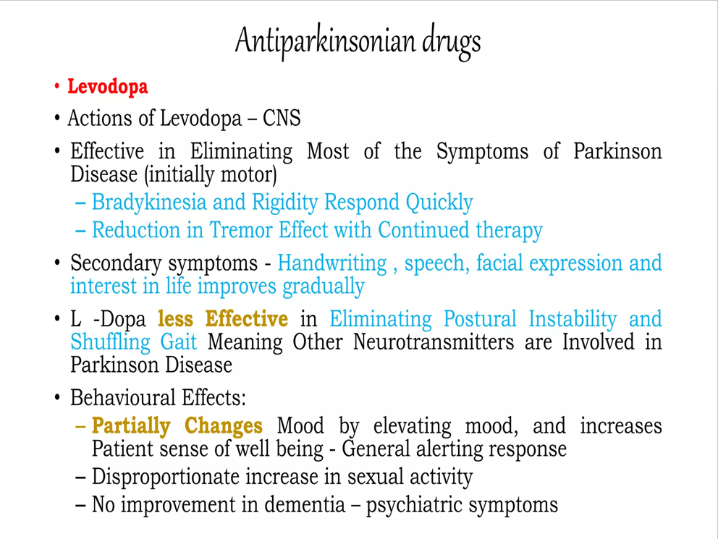

Slide 52
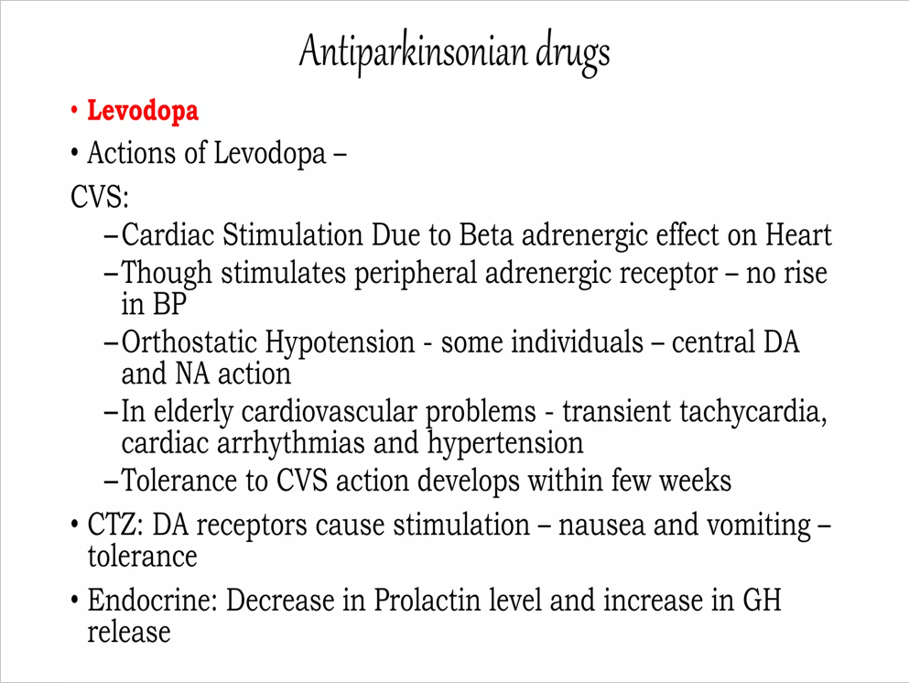

Slide 53
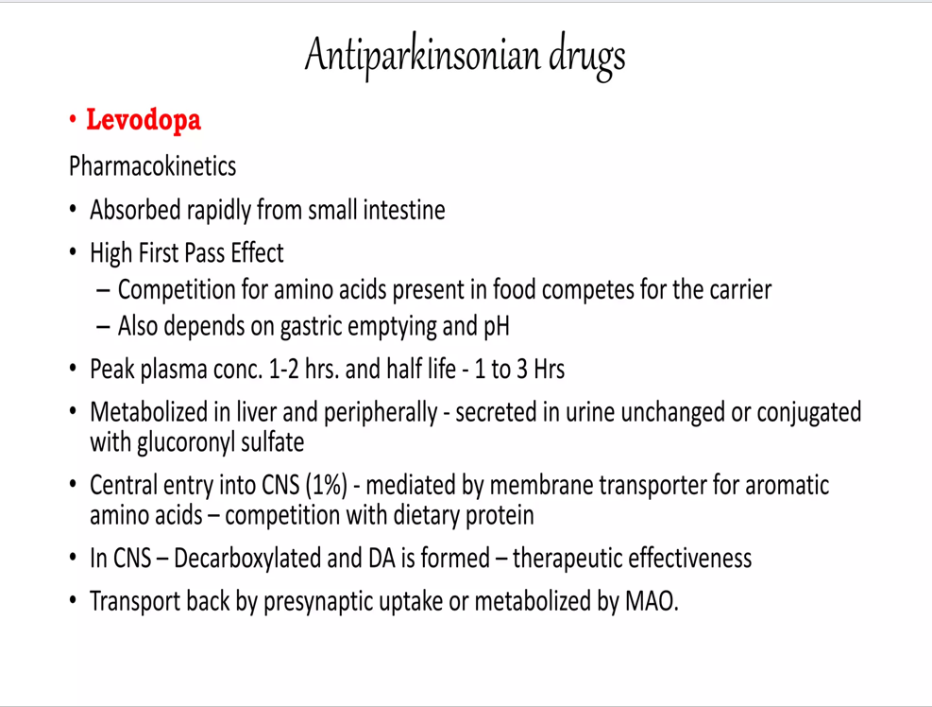

Slide 54
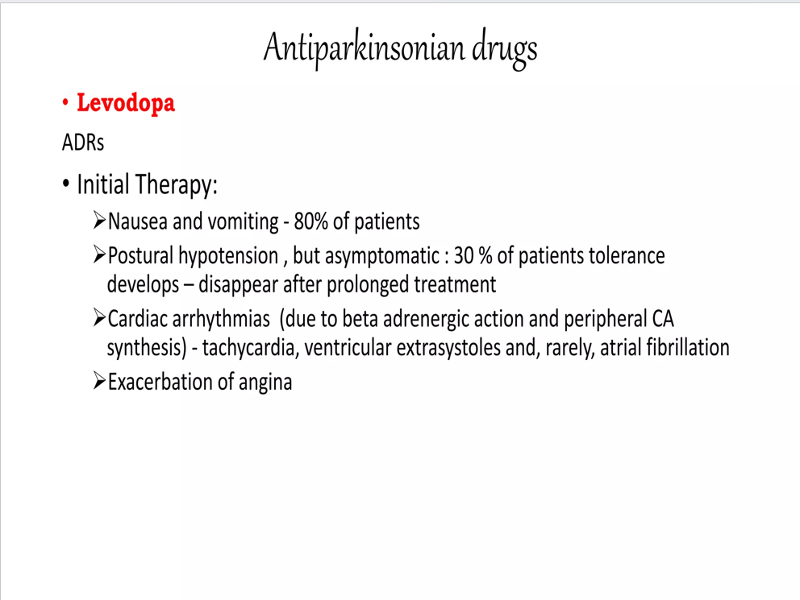

Slide 55
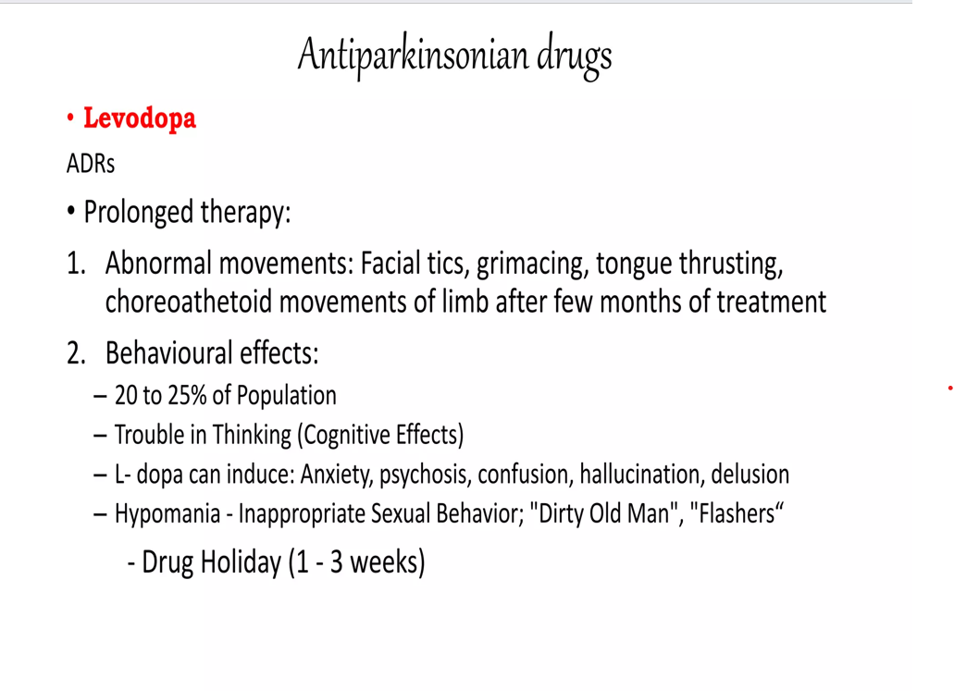

Slide 56
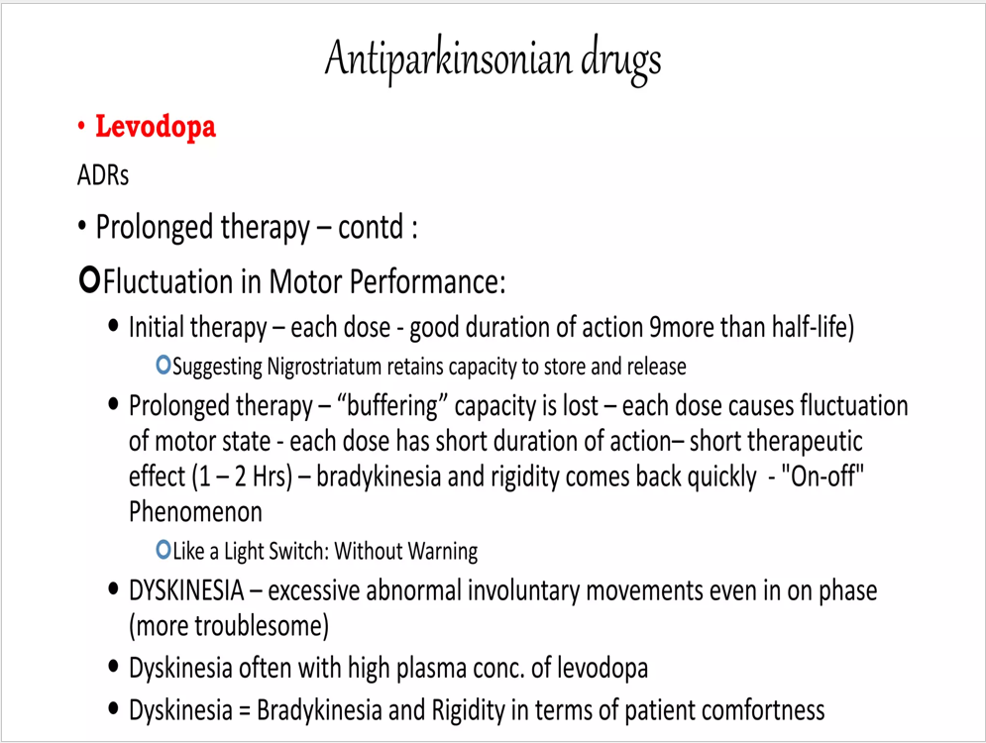

Slide 57
ANTI-ANXIETY DRUGS

Slide 58
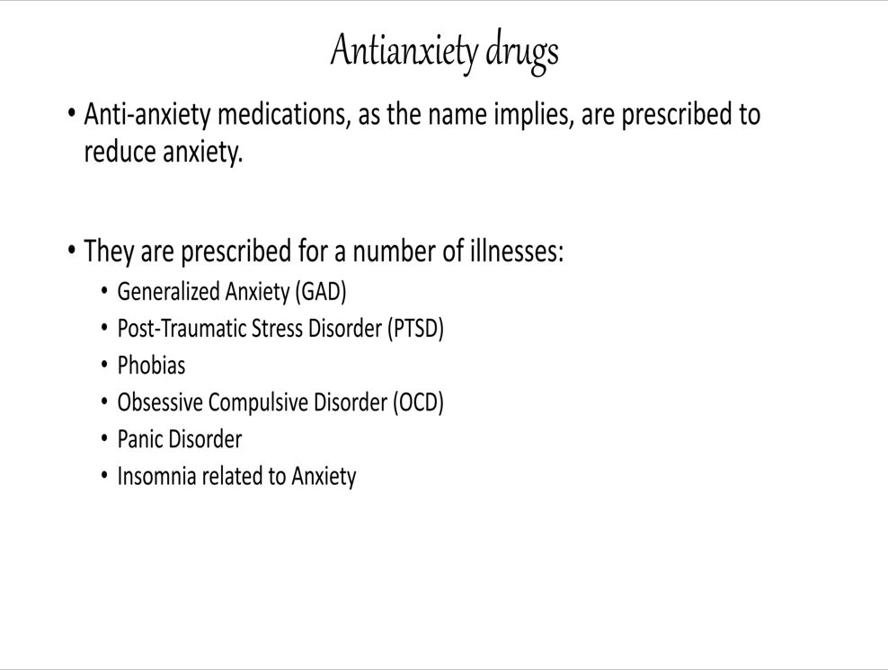

Slide 59
Classification of anti-anxiety medications
Benzodiazepines
Barbiturates
Non benzodiazepines and non barbiturates

Slide 60
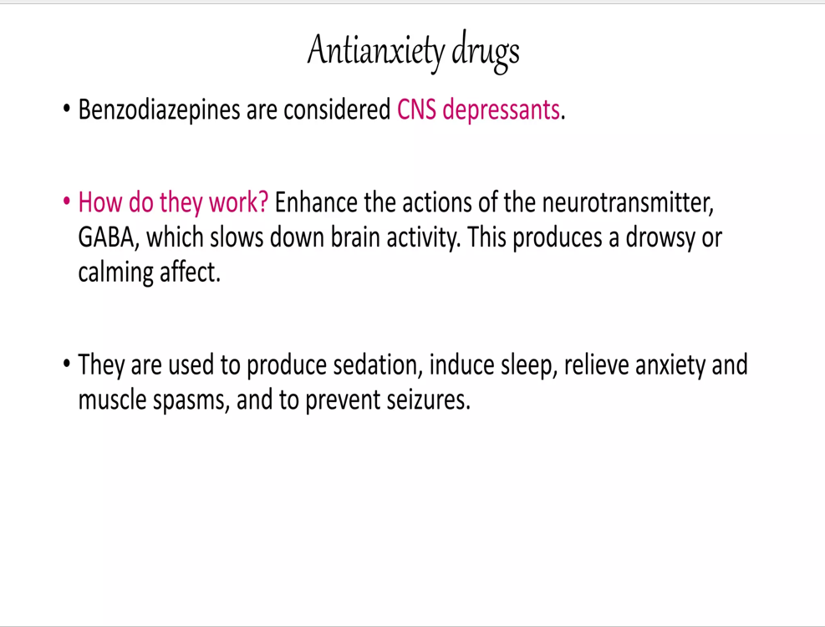

Slide 61
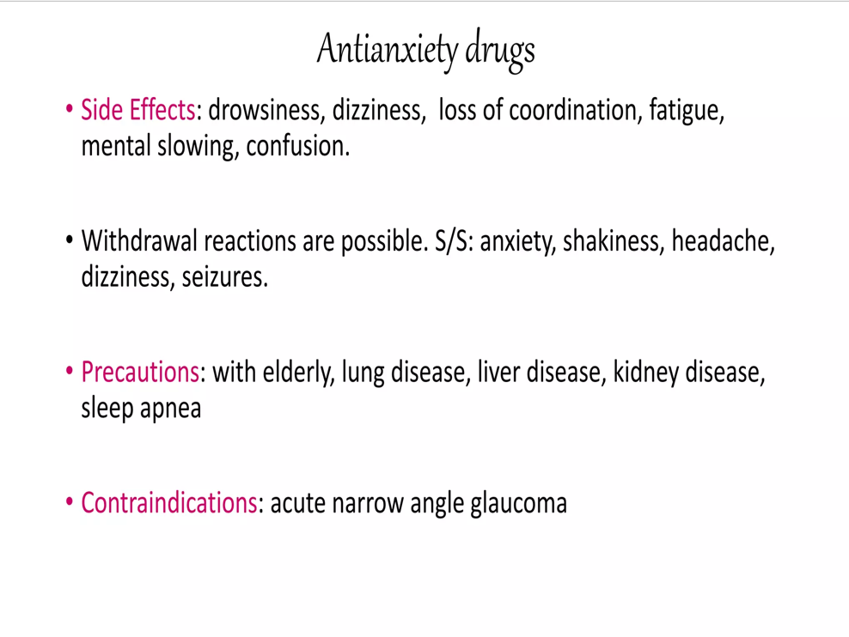

Slide 62
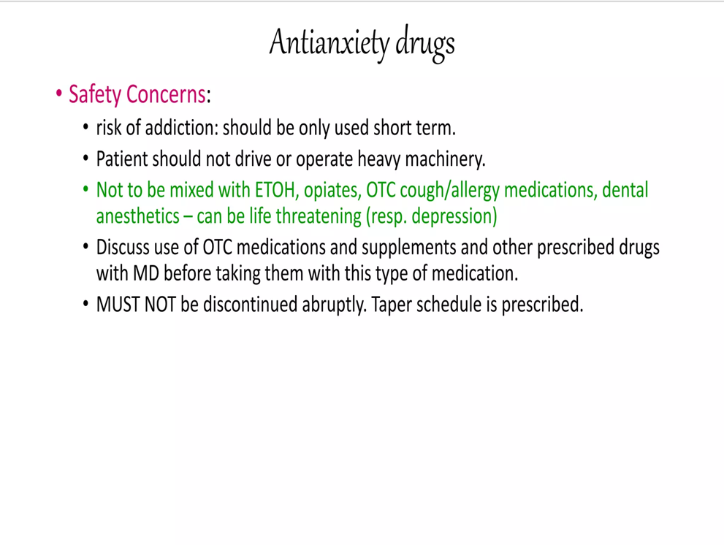

Slide 63
THANK YOU

