Slide 1

Doctor- Patient Relationship
Presented By:- Dr Arpit Jaiswal
Assistant Professor
Psychiatry Department RMCH

Slide 2
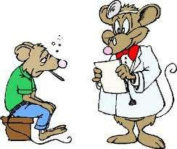
Doctor Patient relationship
The nature of the relationship
determines the success of the
treatment/intervention
PARSONS was one of the earliest
sociologist to examine doctor
patient relationship
He regarded illness as a form of
social deviance (impairs normal role performance, affects smooth functioning of the society)
The amount of illness is controlled by socially prescribed roles for doctors & patients

Slide 3
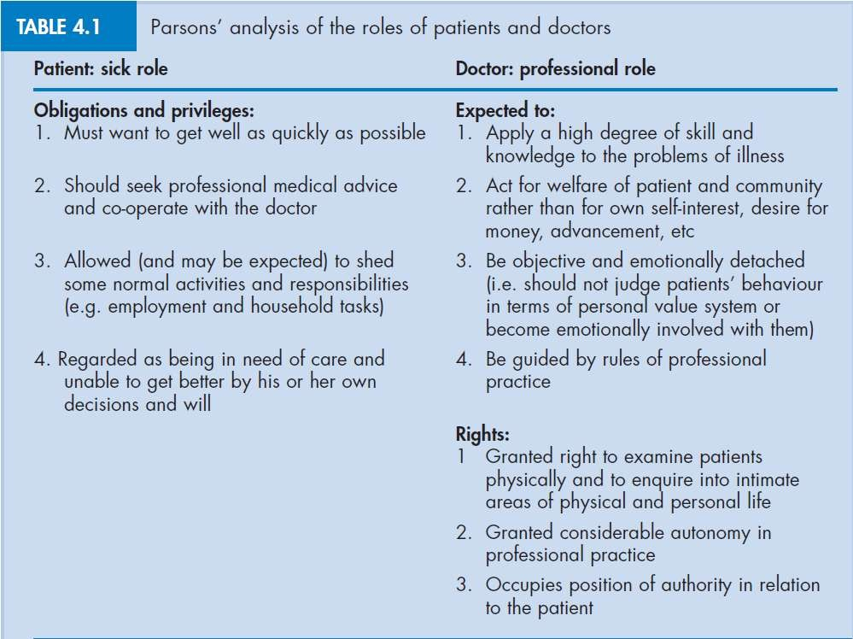
Parsons Social roles of doctors & patients

Slide 4
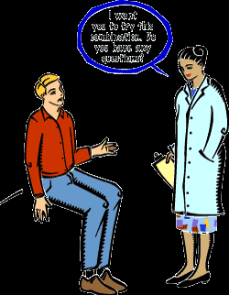
Other models
Szasz & hollender
Seriously ill patient –
activity passivity model
Acute ( infectious diseases)
– guidance cooperation
model
Chronic diseases – mutual participation model

Slide 5
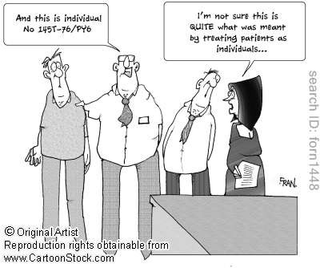
Conflicts in doctors role
Doctors own values patients
vs. AIDS,
(abortion,
homosexuality)
Interest of the patient vs.
state (sick note, notification)
Interest of individual patients
vs. wider population
(rationing of resources)
Confidentiality

Slide 6
Outcomes
Clinical
Satisfaction
  Doctor
    Failure to elicit patients worries & interpretation of symptoms lead to believe that patients have consulted inappropriately & their time & skills are wasted
  Patient
    Perception of the doctors interpersonal & clinical skills
    Patients satisfaction with the initial consultation
    Information & advice given

Slide 7
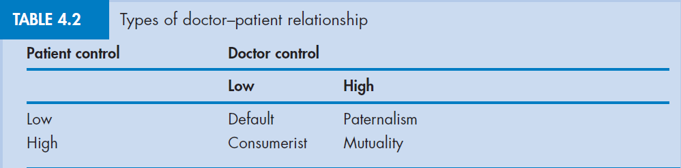
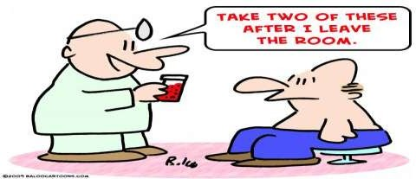
Types of doctor patient relationship

Slide 8
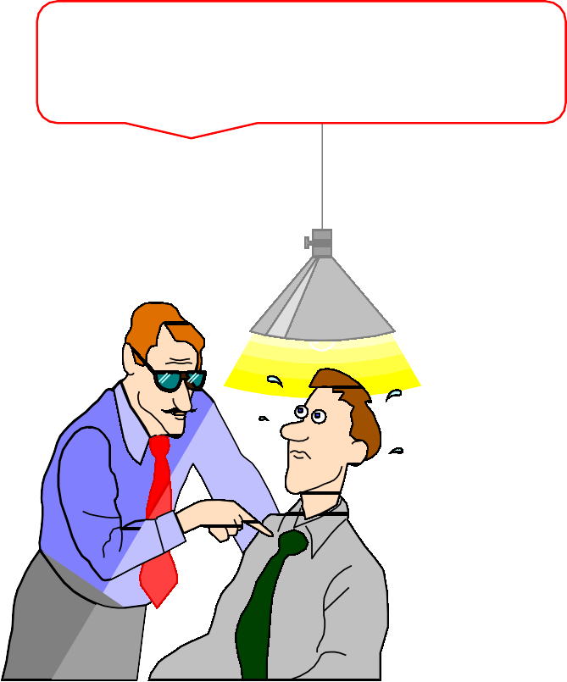
Types of doctor patient relationship
Paternalistic
The traditional D-P relationship
If I’ve told you once I told you 1,000 times, stop smoking!!”
Doctor Takes on role of “parent”
Patient submissive
Shift towards Mutuality

Slide 9
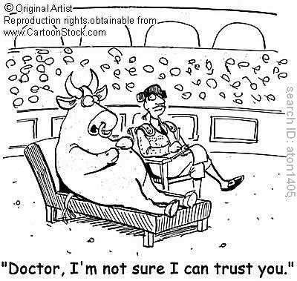
Types of doctor patient relationship
Mutuality
Equal partners
Meeting between experts
Joint venture
Exchange of ideas

Slide 10
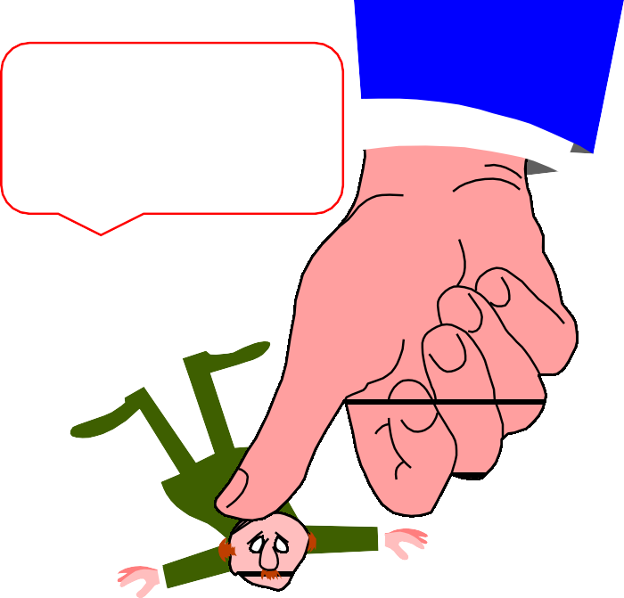
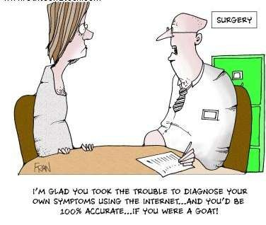
Types of doctor patient relationship
Consumerist
Doctor: passive
You’re paid to
Patient : active role
Second opinion, referral to hospital, sick note
do what I tell you!!”

Slide 11
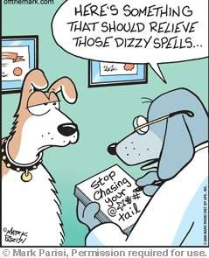
Types of doctor patient relationship
Default
Patient adopts a passive role
Doctor reduces his control
If patient is not aware of alternatives to passive patient role/ timid in adopting a participative relationship

Slide 12
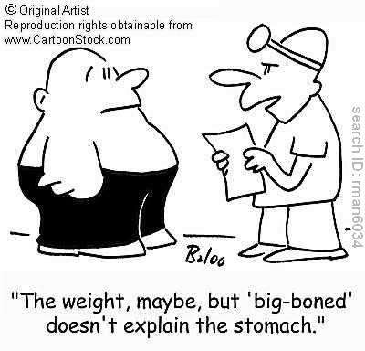
Influences on doctor patient relationship
- Consultation style
Doctor centered
Paternalistic - doctor is the expert
and patient expected to cooperate
Tightly controlled interviewing style
aimed at reaching an organic
diagnosis.
Closed questions
‘voice of medicine’- focus on biomedical diagnosis and treatment as quickly as possible

Slide 13
Influences on doctor patient relationship
- Consultation style
Patient centered
Mutuality
Less authoritarian - encourages patient to their own feelings and concerns
Open questioning, interested in psycho-social aspect of illness
Voice of the patient- communication of patients beliefs feelings & psychosocial context (bio psychosocial)

Slide 14

Influences on doctor patient relationship
- Time
Average 6 minutes
Pressures of time- doctor centered
consultation
However, doctors own style & approach influences than the time available
Patient centric approach needs more time but overall reduces the number of return visits & thus the total consultation time

Slide 15
Influences on doctor patient relationship
- Patient
The patient’s ability to exercise and control depends on a
number of factors:
Age
Social and educational level
Sex
Different languages
Membership of an ethnic minority

Slide 16
Influences on doctor patient relationship
– structural context
General practice
Hospital situation
Ward

Slide 17
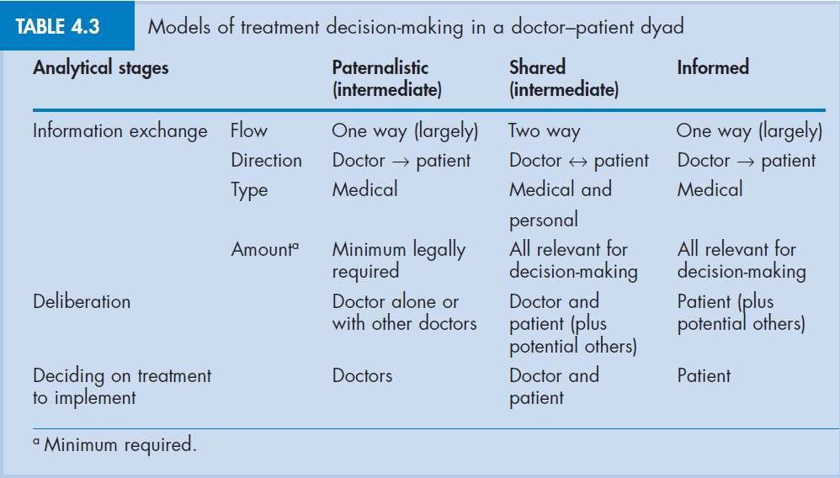
Models of decision making

Slide 18
Shared decision making -impetus
Increased medical knowledge among patients
Prevailing social values- individual autonomy, responsibility
Chronic illness
To make choices and to balance risks & benefits
Doctors make inaccurate guesses about patients concerns & their preferences and treatment choices differ

Slide 19
Shared decision making –impetus Compliance
It is the extent to which a patient follows the instructions of the physician.
clinical
Research confirms that the doctor-patient relationship is the best predictor of whether the patient will follow the doctor’s instructions and advice.
Examples of compliance include:
Taking medications on schedule.
Keeping appointments.
Following directions for changes in behavior or diet.
Approximately 1/3 of patients are compliant with treatment.
1/3 complies some of the time; and 1/3 don't comply with treatment at all.

Slide 20
Shared decision making –impetus Compliance
Factors associated with decreased patient's compliance:
Perception of the physician as rejecting and unfriendly.
Physician failure to explain the diagnosis or causes of symptoms.
Increased complexity of treatment regimen i.e. more
than three types of medication taken more than four times a day
Increased number of required behavioral changes.
Verbal instructions for taking medication.
Visual problems reading prescription labels (particularly in the elderly).

Slide 21
Shared decision making –impetus Compliance
Factors associated with increased patient's compliance
Good doctor-patient relationship.
Written instructions for taking medication.
Patient's subjective feelings of distress or illness.
Doctor's awareness of and sensitivity to the patient's belief system.
Physician enthusiasm, permissiveness, time spent talking with the patient.
Physician experience and older physician age. Short waiting room time.
Patient knowledge of the expected positive treatment outcome. Patient knowledge of the names and effects of prescribed drugs.
•
•
•
•

Slide 22
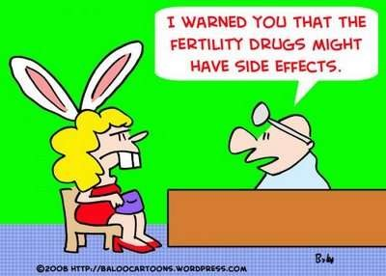
Communication skills
Patients perception of inadequacies of
communication arise from
Content skills – what doctors say, e.g., the
substance of the questions asked, the answers received, the information given, the
differential diagnosis list, and the doctors
medical knowledge base
Process skills – how doctors say it, e.g., how
the doctor asks questions, how well he
and
listens, how he sets up explanation
planning with the patient, how he structures his interaction and makes that structure visible to the patient through signposting or transitions &how he build relationships with patients

Slide 23
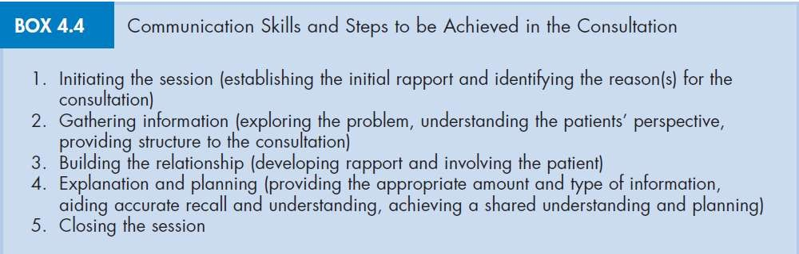
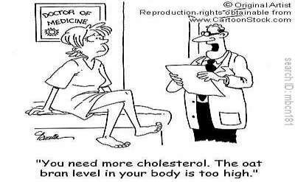
Communication skills

Slide 24
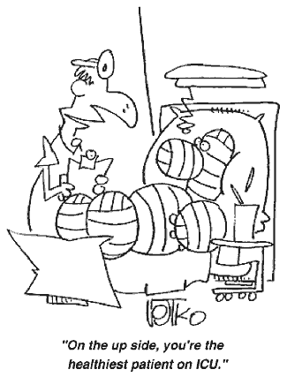
Communication and Treatment
Advice, reassurance and support from the doctor can have a significant effect on recovery
The placebo effect

Slide 25
Thank you
“We have not lost faith, but we have transferred it from God to the medical profession.” - George Bernard Shaw

