Slide 1
DEPRESSION
By - Dr. Vishal Nagar
Dept of Psychiatry

Slide 2
INTRODUCTION
MDD (unipolar depression) is the most common mood disorder.
may manifest as a single episode or as recurrent episode.
Hippocrates (460 to 357 BCE) described melancholia (“black bile”) as a state of “aversion to food, despondency, sleeplessness, irritability, and restlessness.”
Adolf Meyer - coined the term psychobiology.

Slide 3
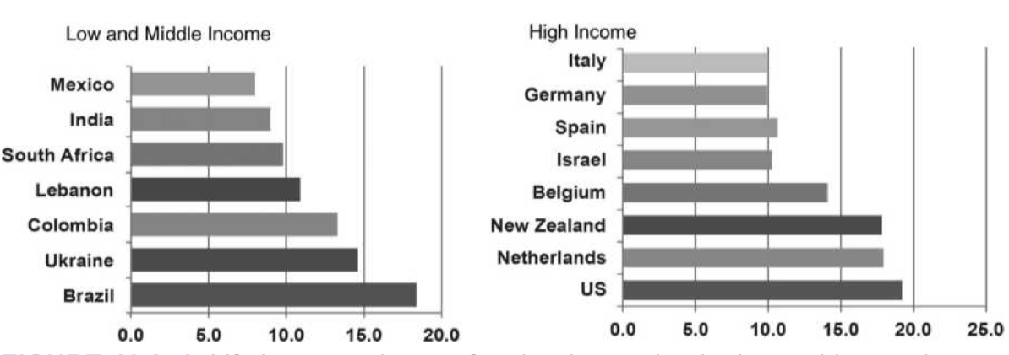
EPIDEMIOLOGY
The lifetime prevalence estimates average 11.1 in low and 14.6 in high-income countries.
the 12-month prevalence rates average 5.5 in high and 5.9 in low- income countries.
prevalence of MDD increases significantly across adolescence, more marked among females than males. -world mental health surveys

Slide 4
Sexual orientation (lesbians, gay people, bisexual, and transgender [LGBT]) - potential risk factor
The average age of onset of recurrent MDE falls between the ages of 30 and 35 years
postpartum period - increased risk
rates of mood disorders are lower in blacks and Hispanic than in whites.
spring and fall are the peak times for depression

Slide 5
Comorbidities
alcohol abuse or dependence,
panic disorder,
obsessive- compulsive disorder (OCD), and
social anxiety disorder.

Slide 6
Impact
high economic impact on ill workers, their employers, and society.
psychiatric and neurologic disorders will account for 15% of the total burden of all diseases.
MDD is the leading cause of disability among those age 5 and over, and
the second leading source of disease burden surpassing cardiovascular diseases, dementia, lung cancer, and diabetes.
2.5% of the total proportion of DALYs was attributable to MDD
24.5% was attributable to MDD (Among neuropsychiatric conditions)
Major Depression was associated with a nearly threefold increase in mortality

Slide 7
ETIOLOGY
Genetic factors - upto 30% cases hereditary, genes like 5HTT-LPR, BDNF, CRF receptor gene
Biological factors- Trimonoamine depletion (Serotonin, NE, Dopamine), Excitotoxicity by increased glutamate
Neuroimaging findings - ventricular enlargement, cortical atrophy, reduced hippocampus, reduced amygdala, enlarged pituitary
Stress Diathesis model - Excess HPA axis activity (DST)
Inflammatory theory- increased pro inflammatory cytokines, increased prevalence of depression in inflammatory medical disorders, Thyroid axis dysfunction

Slide 8
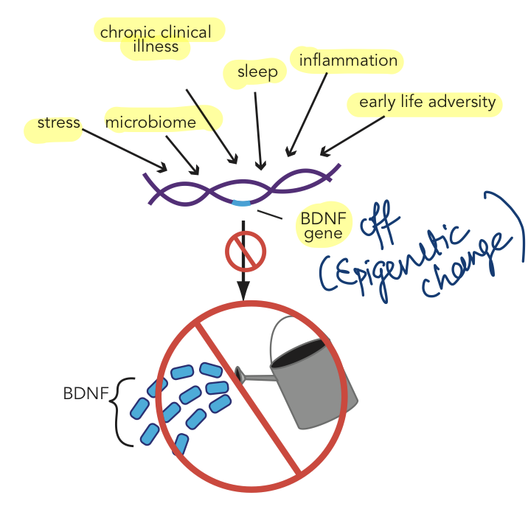
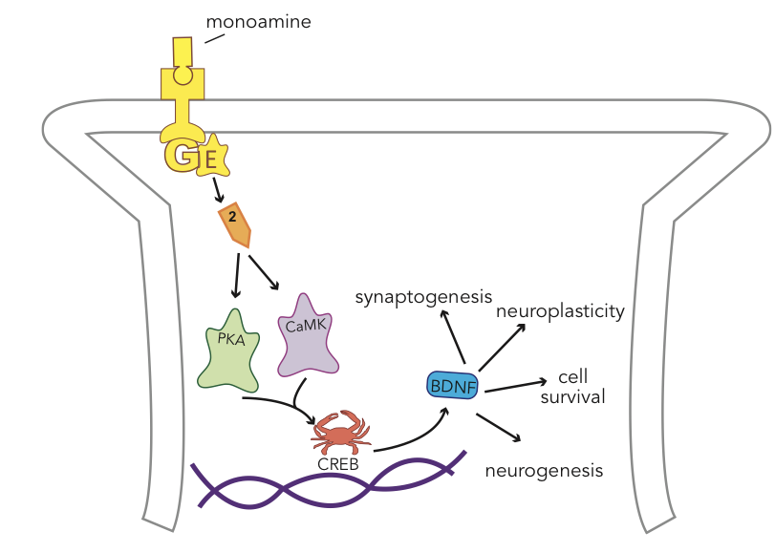

Slide 9
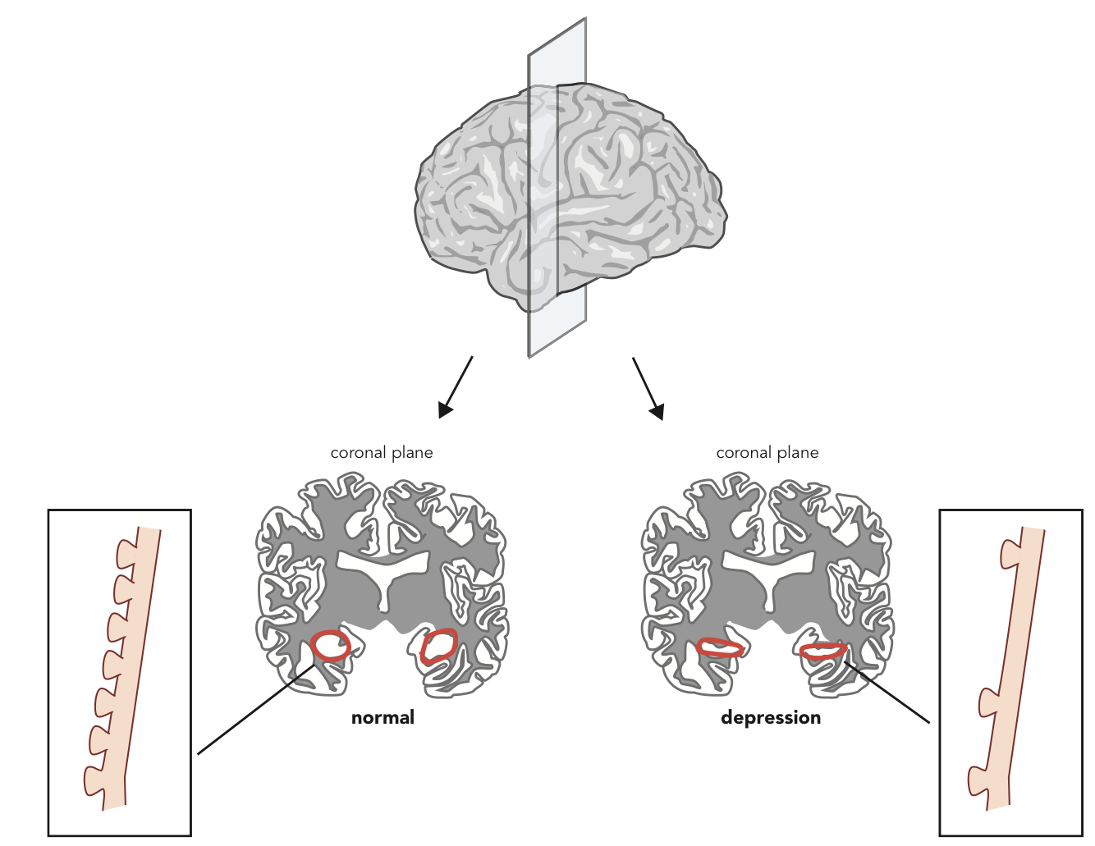

Slide 10
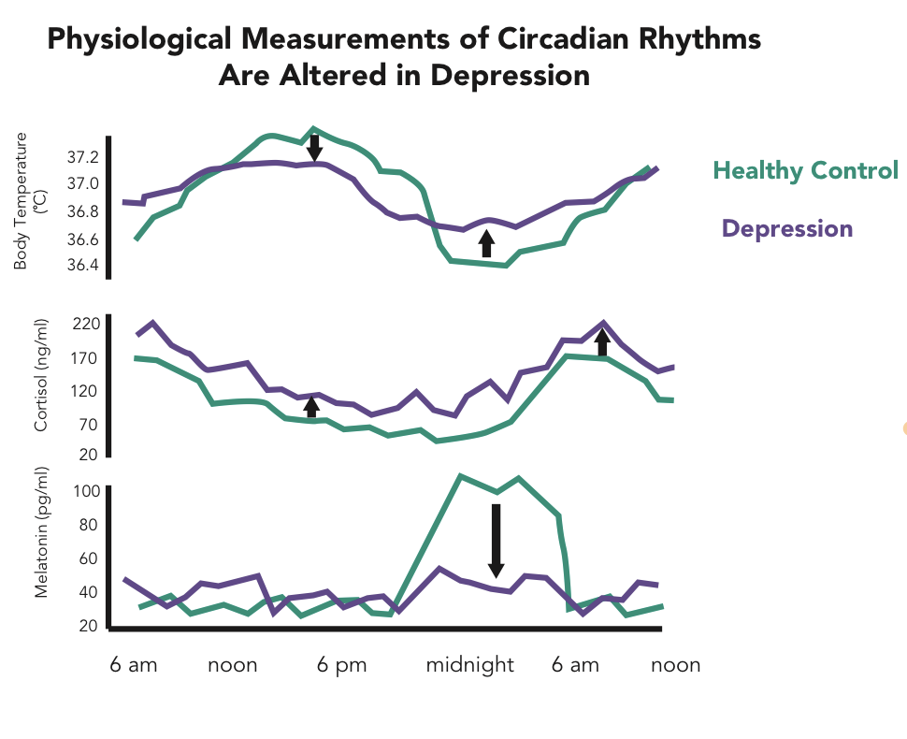

Slide 11
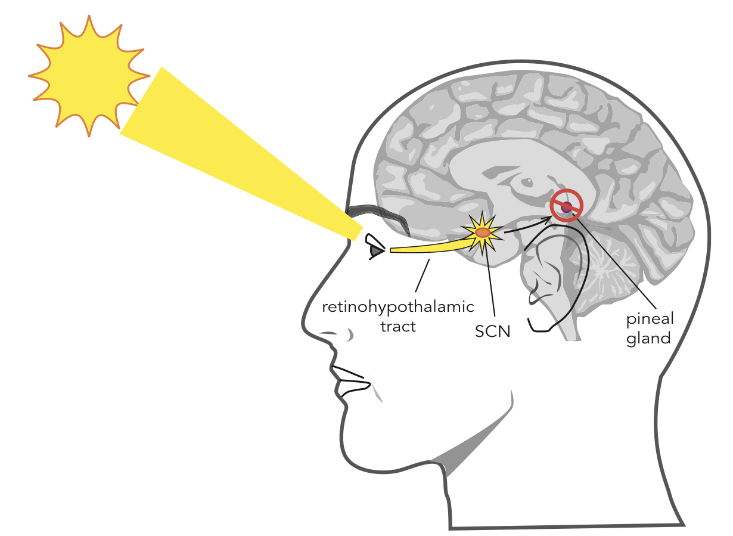

Slide 12
Cognitive theory
Cognitive triad, cognitive distortions - By Aaron T. Beck
Cognitive triad - negative view of self, future, environment
Cognitive distortions (maladaptive assumptions) - overgeneralisation, dichotomous thinking, magnifications/minifications, selective abstraction
Learned helplessness model - By Metin Seligmann

Slide 13
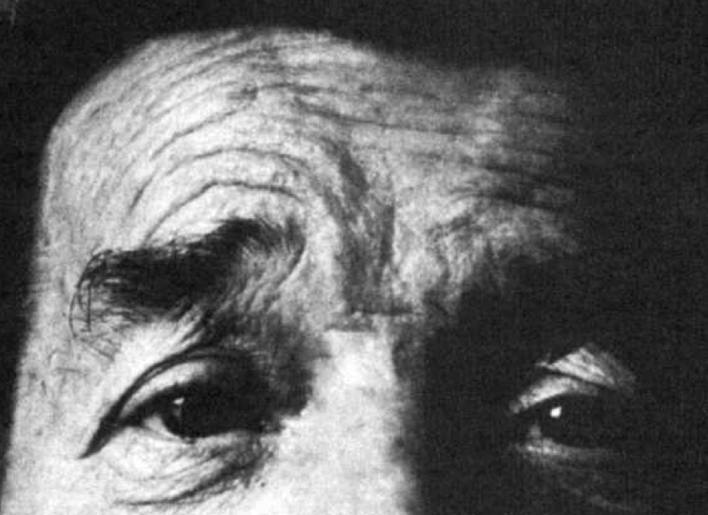
CLINICAL FEATURES
DEPRESSED MOOD
ANHEDONIA AND LOSS OF INTEREST
Psychomotor Disturbances - AGITATION/RETARDATION/STUPOR
Cognitive Disturbances- negative evaluations of the self, the world, and the future (the negative triad)

Slide 14
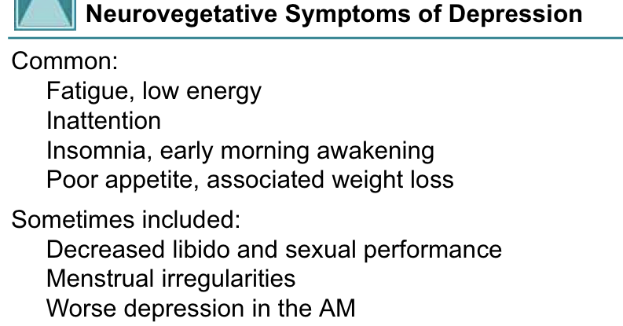
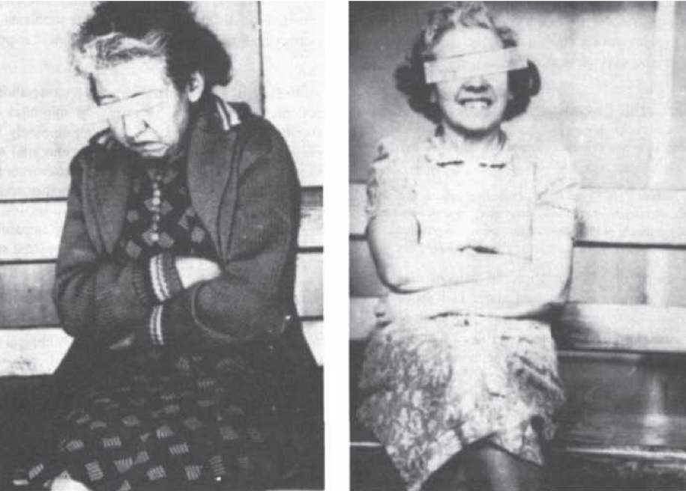
MOOD-CONGRUENT PSYCHOTIC FEATURES
HOPELESSNESS AND SUICIDE

Slide 15
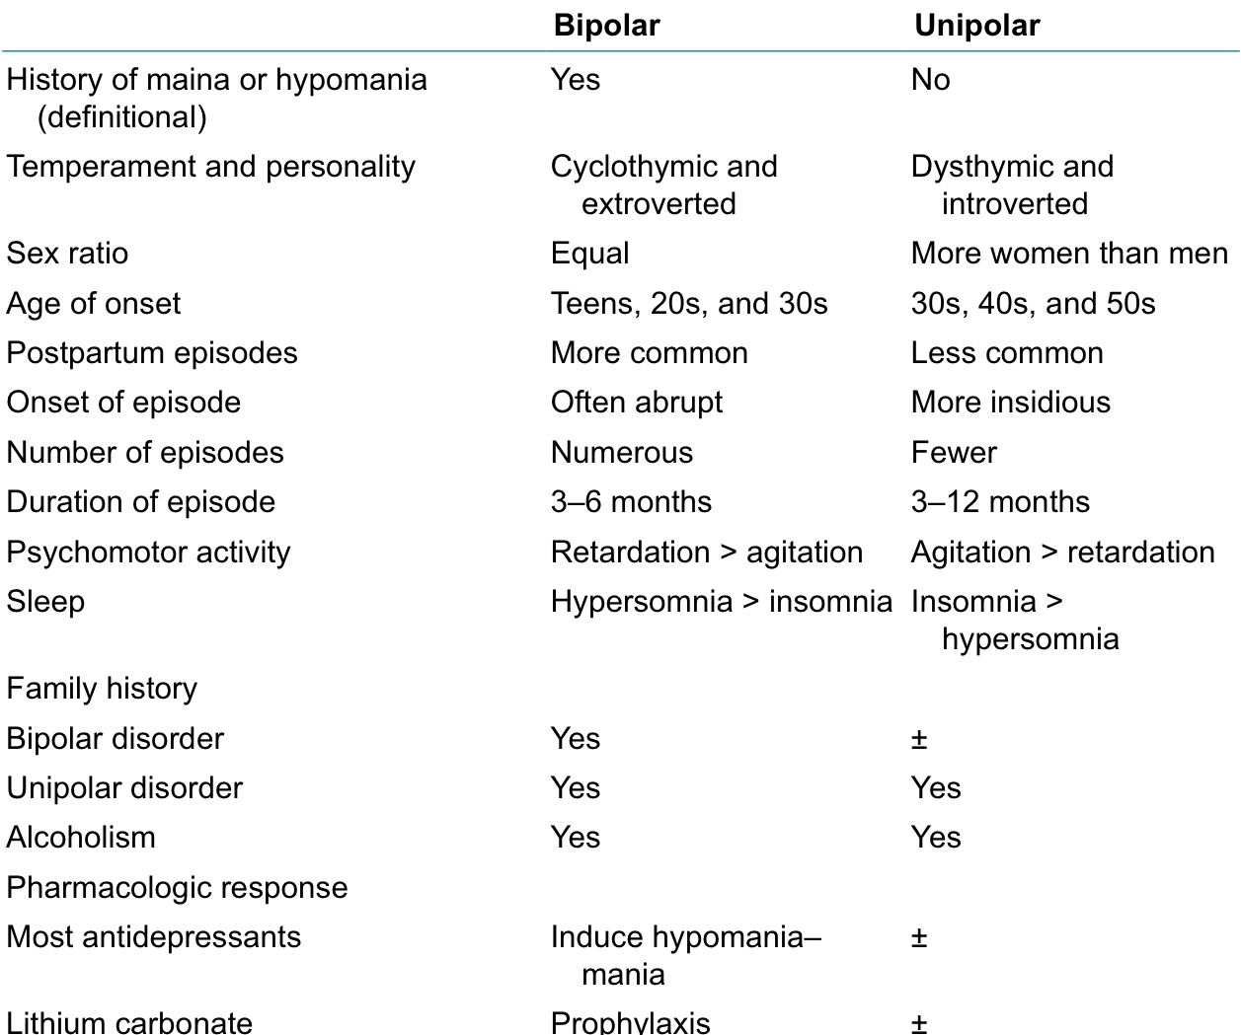
Bipolar vs Unipolar Depression

Slide 16
DIAGNOSIS
DSM 5
At least 2 weeks, 5 out of these symptoms (at least one from first two)
Dysphoria or feeling depressed
Anhedonia
↑or↓weight-or appetite
↑or↓sleep
↑ or ↓ activity
↓ energy
Depressing thoughts: worthlessness, guilt
↓ concentration
Suicidal ideation/plan

Slide 17
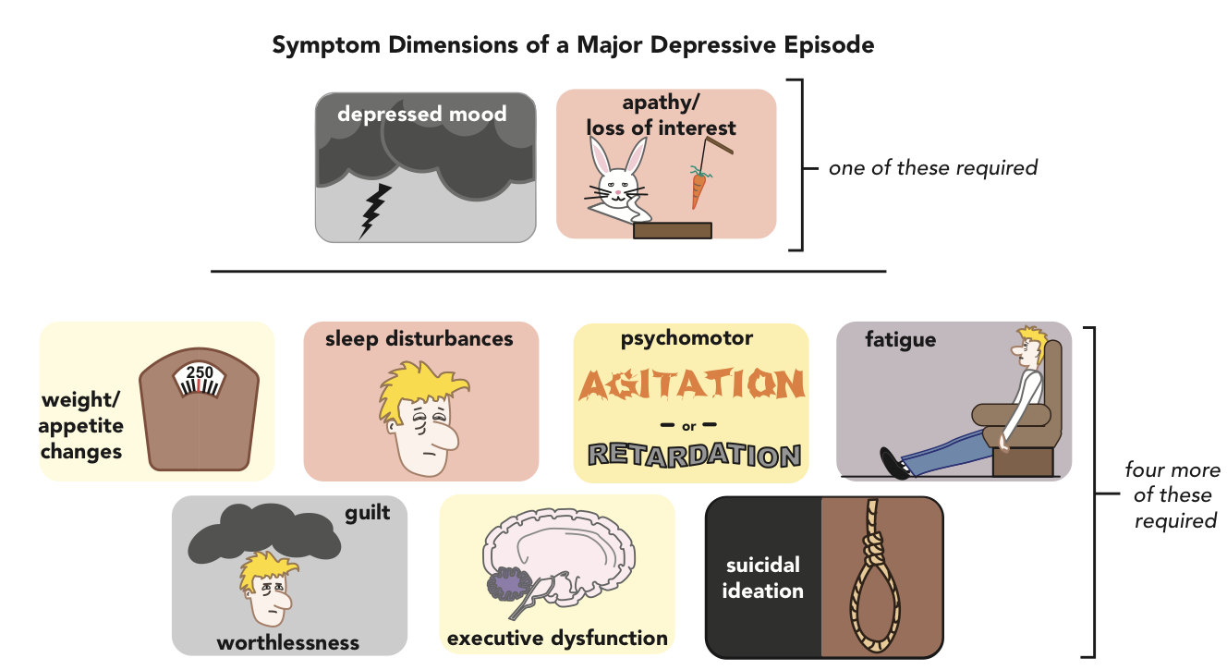

Slide 18
ICD-10
Most typical symptoms- depressed mood, loss of interest and enjoyment, and reduced energy leading to increased fatiguability and diminished activity.
Other symptoms- (a) reduced concentration and attention;
(b) reduced self-esteem and self-confidence;
(c) ideas of guilt and unworthiness (even in a mild type of episode); (d) bleak and pessimistic views of the future;
(e) ideas or acts of self-harm or suicide;
(f) disturbed sleep;
(g) diminished appetite.

Slide 19
ICD 11
a period of almost daily depressed mood or diminished interest in activities lasting at least two weeks accompanied by other symptoms

Slide 20
MANAGEMENT
Pharmacotherapy - SSRIs, SNRIs, others (Mirtazapine, Bupropion, Vortioxetine, Agomelatine)
NOVEL PHARMACOLOGIC AGENTS - Ketamine, Esketamine, Brexanolone
Others - Vagal Nerve Stimulation, TMS, Phototherapy, Sleep deprivation
Psychosocial therapies - Cognitive theory, Interpersonal therapy, Behaviour therapy, Family therapy

Slide 21
PHARMACOLOGICAL TREATMENT
Selective Serotonin reuptake Inhibitors (SSrIs)
Fluoxetine
Sertraline
Paroxetine
Fluvoxamine
Citalopram
Escitalopram

Slide 22
Side effects
GI effects
Sexual Dysfunction
Sweating
Discontinuation Syndrome
Bleeding
Hyponatremia
Cardiovascular Effects
Weight Gain

Slide 23
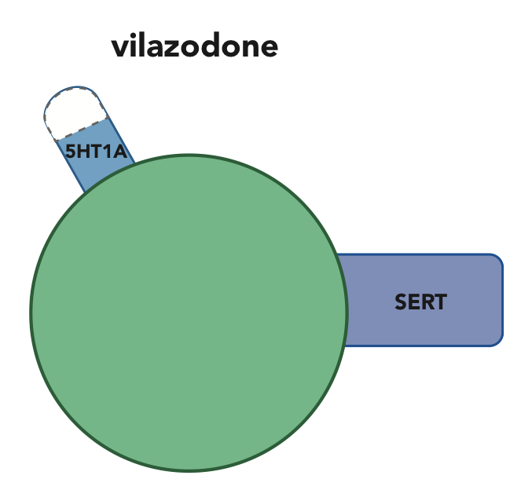
Serotonin Partial Agonist reuptake Inhibitors (SPArIs)
Vilazodone

Slide 24
Serotonin–Norepinephrine reuptake Inhibitors (SNrIs)
Venlafaxine
Desvenlafaxine
Duloxetine
Milnacipran
Levomilnacipran

Slide 25
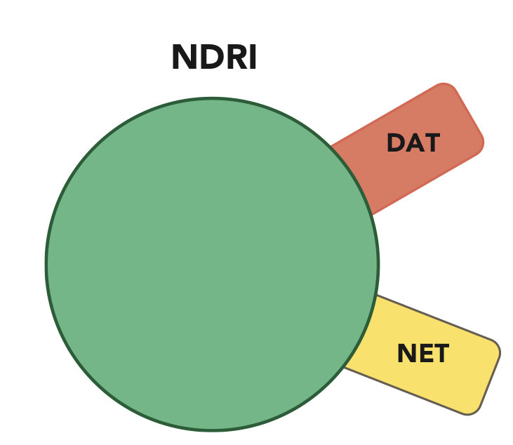
Norepinephrine–Dopamine reuptake Inhibitors (NDRIs)
Bupropion

Slide 26
Agomelatine
Mirtazapine (NaSSA) - noradrenergic and specific serotonergic antidepressant.
Trazodone (SARI) - Serotonin Antagonist/reuptake Inhibitors
Vortioxetine - Vortioxetine is a serotonin reuptake inhibitor and also has actions at several serotonin receptors, including 5HT1A, 5HT1B, 5HT1D, 5HT3, and 5HT7.
Brexanolone - Neuroactive Steroids
Ketamine -

Slide 27
Tricyclic Antidepressants
Clomipramine
Imipramine
Amitriptyline
Nortriptyline
Protriptyline
Maprotiline
Amoxapine
Doxepin
Desipramine
Trimipramine
Dothiepin
Lofepramine
Tianeptine

Slide 28
Monoamine Oxidase Inhibitors (MAOIs
Iproniazid
Isocarboxazid
Phenelzine
Tranylcypromine
Moclobemide

Slide 29
THANK YOU

