Slide 1
Management of bipolar affective disorder
Dr. (col) Siddharth dixit
Professor and head
Department of psychiatry

Slide 2

Yo yo Honey singh

Slide 3

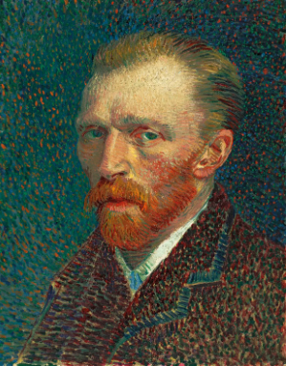
marilyn monroe
vincent van gogh

Slide 4
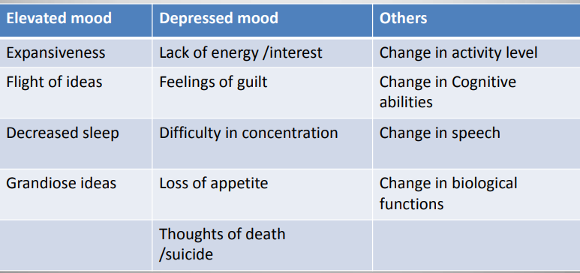
Bipolar affective disorder also known as manic depressive illness is a disorder that causes unsual shift in mood , energy , activity levels , and the ability to carry out day to day tasks.

Slide 5
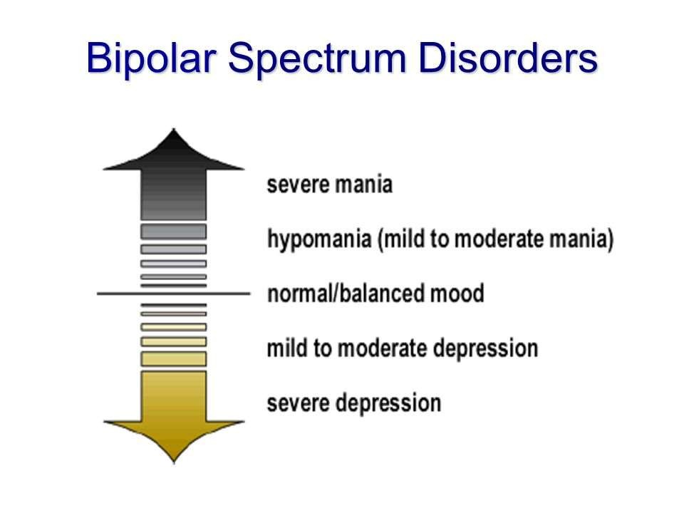

Slide 6

Mania-Clinical symptoms
Inflated self-esteem or grandiosity.
Decreased need for sleep
More talkative than usual
Flight of ideas or subjective experience that
thoughts are racing.
Distractibility
Increase in goal-directed activity or
psychomotor agitation.
Excessive involvement in pleasurable activities that have a high potential for painful consequences

Slide 7

Depression- Clinical symptoms
Depressed mood
Diminished interest or pleasure in all, or almost all, activities
Decreased or increased appetite
Significant weight loss or gain
Insomnia or hypersomnia
Psychomotor agitation or retardation
Fatigue or loss of energy
Feelings of worthlessness or excessive or inappropriate guilt
Diminished ability to think or concentrate
Recurrent thoughts of death
Recurrent suicidal ideation or attempts

Slide 8
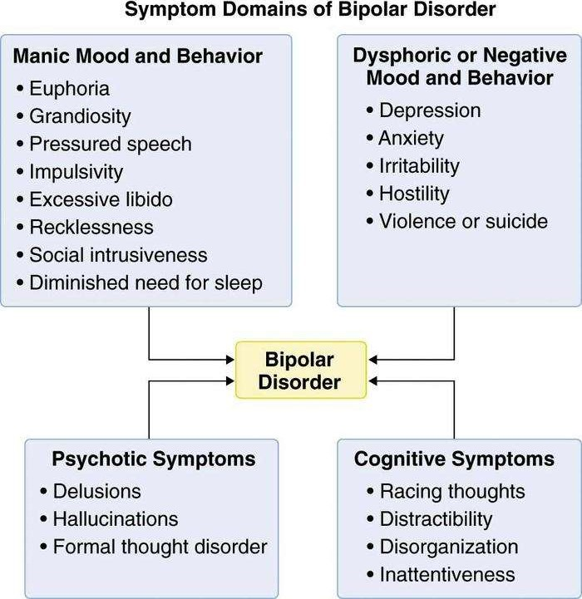

Slide 9
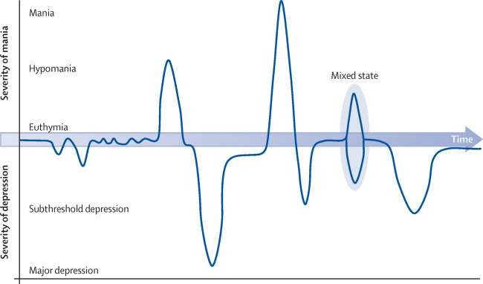

Slide 10
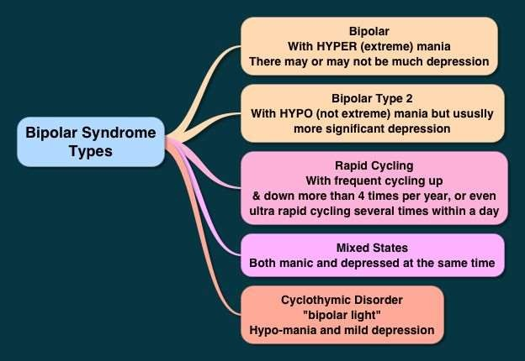

Slide 11
Assessment and management

Slide 12
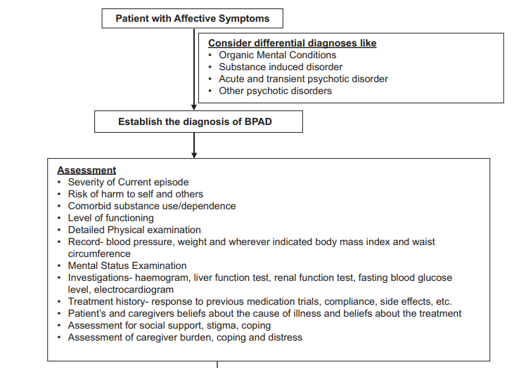

Slide 13
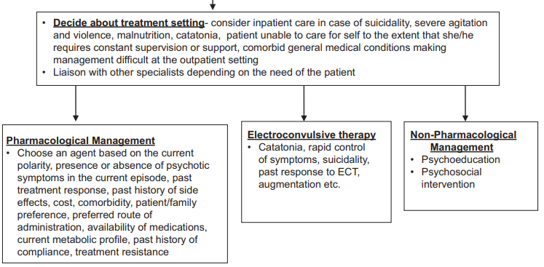

Slide 14
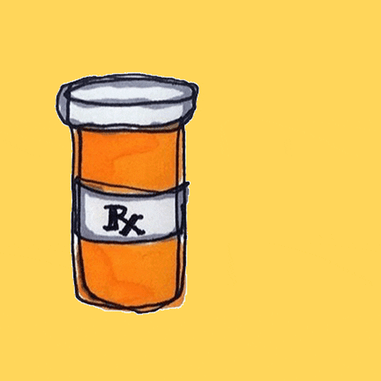
Pharmacological treatment
Mood Stabilisers :
Lithium
Divalproex/valproate
Carbamazepine/Oxcarbazepine
Lamotrigine
Topiramate
Gabapentin

Slide 15
Antidepressants :
Tricyclic Antidepressants-(imipramine,clomipramine,amitriptyline)
Selective serotonin reuptake inhibitors-(fluoxetine,paroxetine,escitalopram)
Serotonin and nor‑epinephrine reuptake inhibitors-(venlafaxine,duloxetine)
Bupropion, mirtazapine, etc.

Slide 16
Antipsychotic medications :
First‑generation antipsychotic medications (Oral/parenteral/depot or long acting- preparations)
Second‑generation antipsychotic medications (Oral/parenteral/depot or long acting- preparations)

Slide 17
Adjunctive medications :
Anticholinergic
Benzodiazepines
Hypnotic-sedatives
Anticonvulsants

Slide 18
Lithium
Lithium is the oldest mood stabilizer used in the management of BPAD.
. It has been found to be efficacious in management of acute episode of either polarity and has been found to be efficacious in prevention or relapse of episodes of either polarity.
It has been shown to have a role in prevention of suicide in patients with BPAD.
Prior to starting lithium, patients need to be educated :

Slide 19
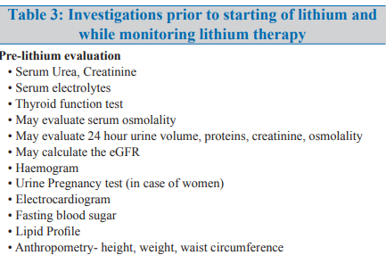

Slide 20
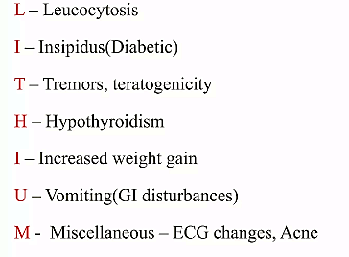
SIDE EFFECTS

Slide 21
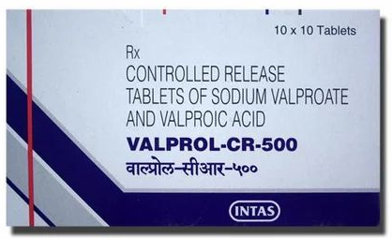
valproate
Efficacious in management of acute mania and mixed episodes.
Prior to starting valproate, clinicians need to review the medical history for presence of any hepatic, haematological and bleeding problems.
In young women, last menstrual periods need to be ascertained and if required urine pregnancy test need to be done to rule out pregnancy.

Slide 22
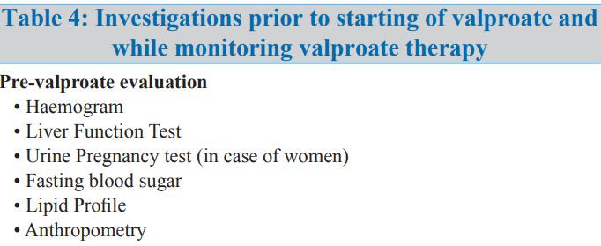
Valproate is associated with weight gain and metabolic abnormalities therefore evaluate the lipid profile, fasting blood glucose levels and anthropometry.
Valproate is started in low doses- 15- 30 mg/kg (250 mg BD or 250 mg TID and titrated upwards).

Slide 23
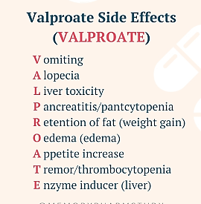

Slide 24

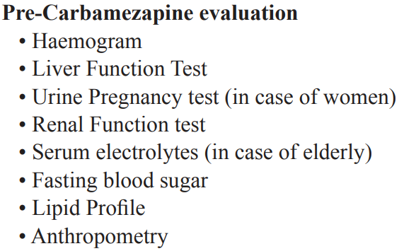
carbamezapine
Efficacious in the management of acute bipolar mania and prevention of relapse.
Usual starting dose of carbamazepine is 200 mg/day given in divided doses and titrated upward slowly.

Slide 25
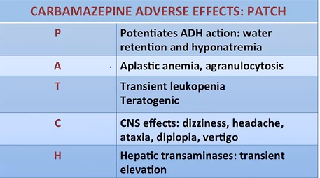
SIDE EFFECTS OF CARBAMEZAPINE

Slide 26
lamotrigine
Efficacious in management of bipolar depression and prevention of relapse of depression
Most dreaded side effect of lamotrigine includes skin rash, including stevens - johnson syndrome and toxic epidermal necrolysis.

Slide 27
antipsychotics
Antipsychotics like olanzapine, quetiapine, aripiprazole, risperidone, paliperidone and ziprasidone are effective in the management of acute mania.
A. There is evidence for use of quetiapine monotherapy, and olanzapine and fluoxetine combination in the management of bipolar depression.
There is evidence for lurasidone in the management of acute episode of bipolar depression.

Slide 28
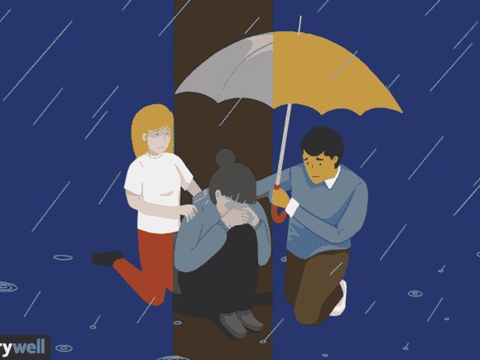
Non Pharmacological Management

Slide 29
Psychosocial management as an adjunct to pharmacotherapy has shown to be of significant benefit during the management of acute phase of bipolar depression and maintenance phase of illness.
The psychosocial interventions have shown to be associated with reduced risk of relapses, better functioning and better treatment adherence.
Basic components of all these programs involve:
Informing the patients about their illness
Identifying the early signs of relapse
Handling stress,

Slide 30
Maintaining social rhythms
Addressing the interpersonal issues and expressed emotions
Problem solving
Enhancing medication and treatment adherence.
Psychosocial interventions include:
Psychoeducation (individual and group)
Interpersonal and social rhythm therapy (IPSRT)
Cognitive behaviour therapy and
Family focused intervention.

Slide 31
Treatment adherence counselling
Explain when and how often to take medicines .
Preferably give once a day dosing .
Prescribe minimum number of tablets and medications .
Always ask the patient about kind of formulation (e.g. tablet, capsule etc) which they would prefer to take .
Check the whole prescription to avoid duplication of medication .

Slide 32
Explain the patient/family that the beneficial effect will be seen only after days to weeks of intake of medications. Explain the patient the need to take medication even after feeling better .
Explanation of side effects‑ If patients ask about the side effects, explain the patient about the same.
Explain the patient as to what to do‑ if they encounter side effects .
Encourage the patient to report side effects and the need to consult with psychiatrist before discontinuing medications on their own.

Slide 33
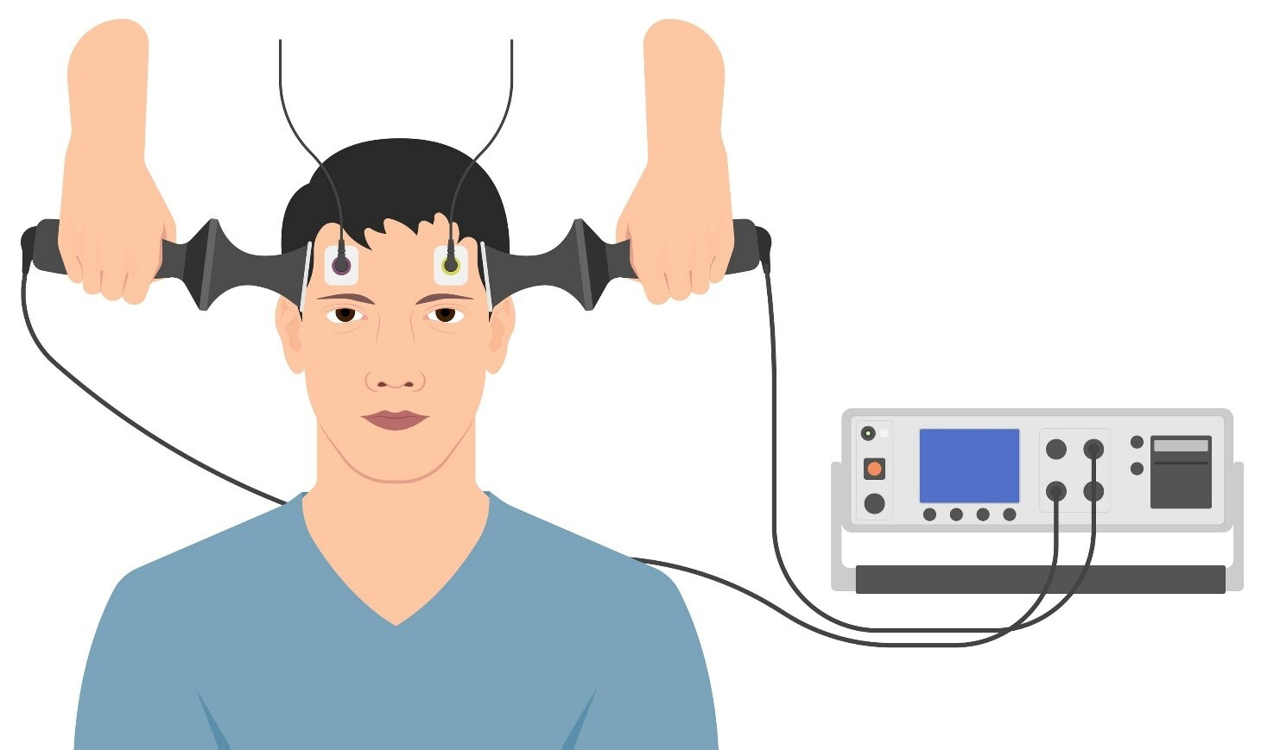
Indications of ECT
Bipolar depression not responding to adequate pharmacotherapy
Bipolar mania not responding to adequate pharmacotherapy
Catatonic symptoms
Need for rapid control of symptoms
Presence of suicidal behaviour which puts the life of the patient at risk
Presence of severe agitation or violence which puts the life of others at risk
Refusal to eat which puts the life of patient at risk

Slide 34
History of good response in the past
Augmentation of partial response to pharmacotherapy
Not able to tolerate pharmacotherapy
Treatment resistant illness
Episodes of severe depression or mania during pregnancy

Slide 35

thank
you

