Slide 1
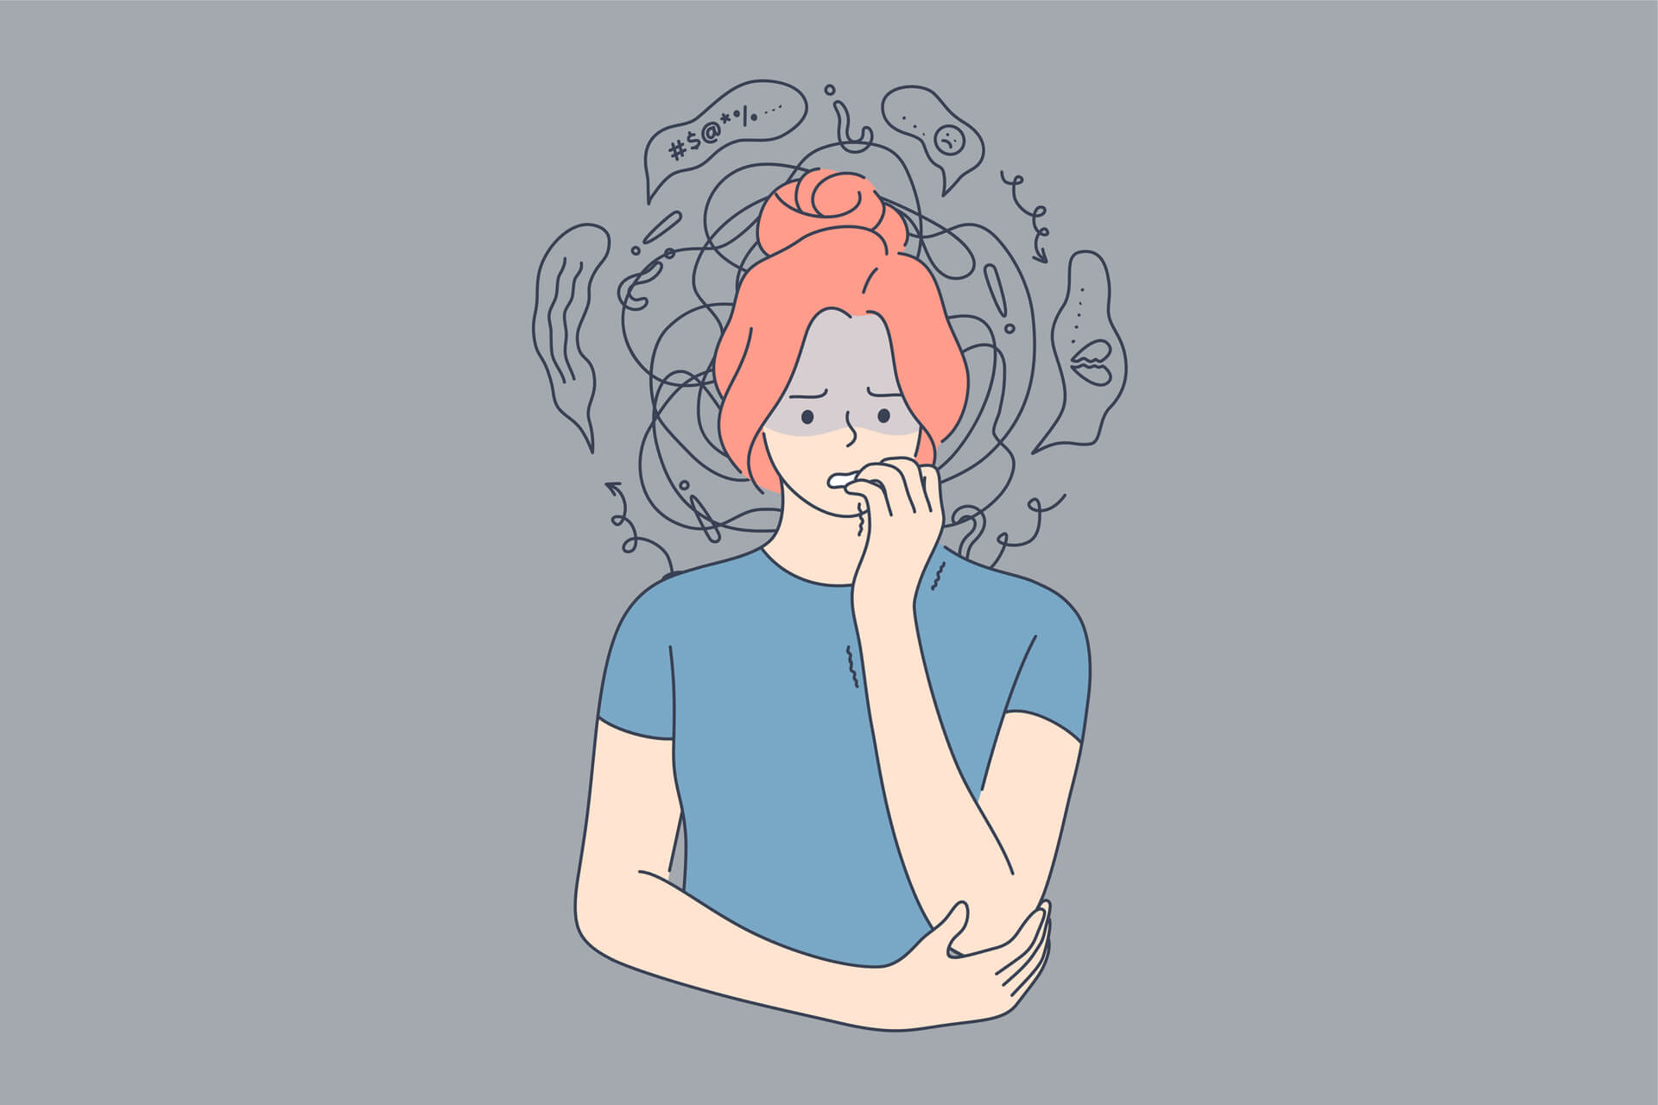
BIOLOGICAL BASIS OF ANXIETY
Dr. Ramjan Ali
Professor,
Dept of Psychiatry

Slide 2
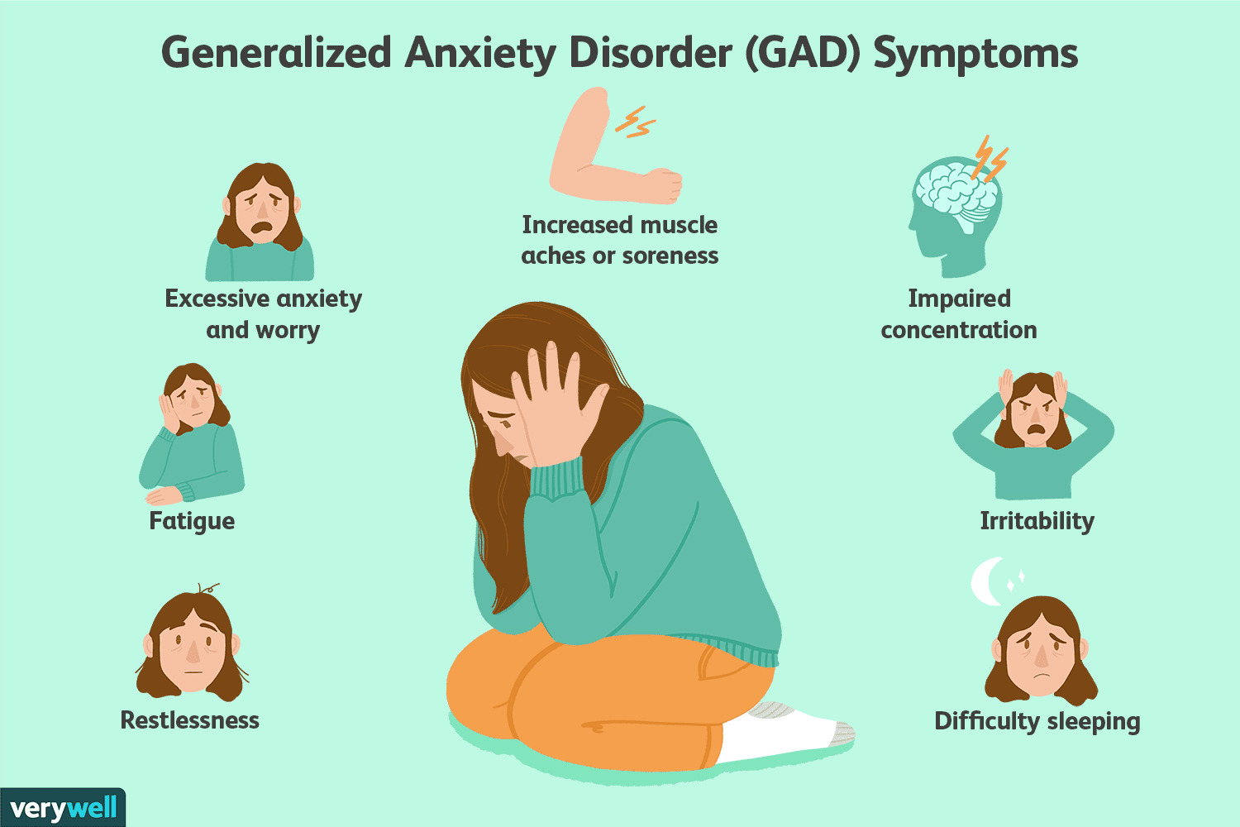
CONTENTS
What is Anxiety?
Anxiety vs. Fear
Prevalence
Psychological aspect
Look through various experiments and Animal models
Studies of Inheritance Patterns
Environmental influences
Functional Anatomy
Neurochemical and hormonal Systems Involved
Neuroimaging Findings

Slide 3

What is Anxiety?
The word anxiety derives from the Latin substantive angor and the corresponding verb ango (to constrict). A cognate word is angustus (narrow).
Anxiety- Feeling of apprehension caused by anticipation of danger, which may be internal or external.
Anxiety is a psychological, physiological, and behavioural state induced in animals and humans by a threat to wellbeing or survival, either actual or potential.
It is characterized by increased arousal, expectancy, autonomic and neuroendocrine activation, and specific behaviour patterns.

Slide 4
Pathological anxiety interferes with the ability to cope successfully with life challenges.
Psychopathology appears to be a consequence of predisposing factors (or traits), which result from numerous gene–environment interactions during development (particularly during the perinatal period) and experience (life events).
Nearly one-fifth (17 percent) of adults report a lifetime history of one of the major anxiety disorders, and 1 in 10 suffer from a current anxiety disorder.
Despite their high burden, anxiety disorders have the lowest proportion of professional treatment of all the classes of mental disorders.
In this review, the biology of fear and anxiety will be examined from systemic (brain–behaviour relationships, neuronal circuitry, and functional neuroanatomy) and cellular/molecular (neurotransmitters, hormones, and other biochemical factors) points of view.

Slide 5
Fear-Unpleasurable emotional state consisting of psychophysiological changes in response to a realistic threat or danger.
Phobia-Persistent, pathological, unrealistic, intense fear of an object or situation
Panic attack - abrupt surge of intense fear or intense discomfort that reaches a peak within minutes, and during which time physical and cognitive symptoms occur.

Slide 6
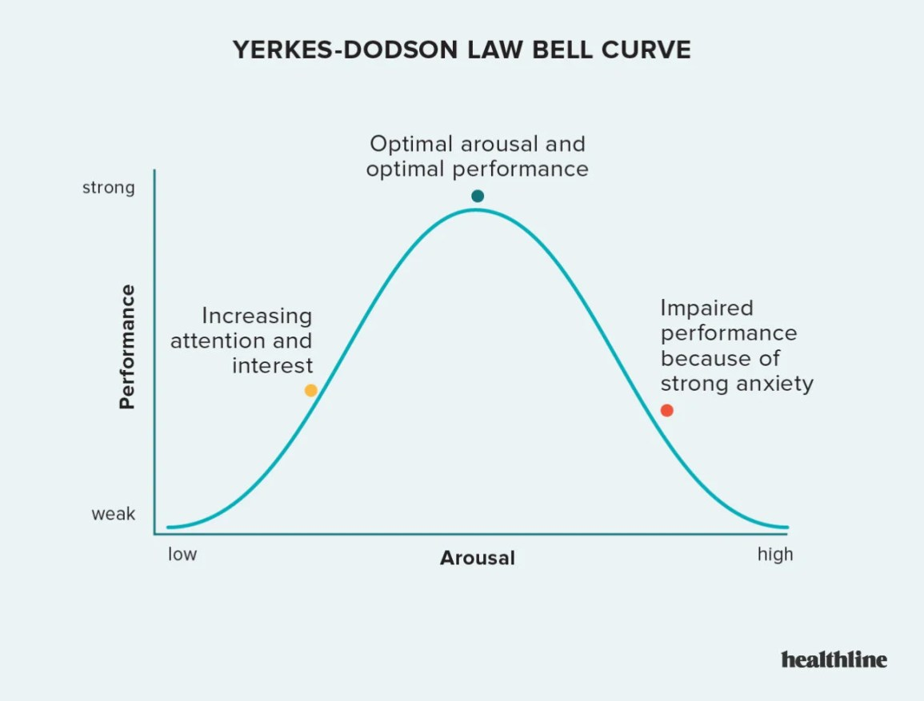
Anxiety vs. Fear
Anxiety- Apprehension about a future threat
Fear-Response to an immediate threat
Both involve
  physiological arousal of Sympathetic nervous system
  can be adaptive
Fear triggers “fight or flight”
  May save life
Anxiety increases preparedness
  “U-shaped” curve (Yerkes & Dodson, 1908)
Notes:
Absence of anxiety interferes with performance
Moderate levels of anxiety improve performance
High levels of anxiety are detrimental to performance

Slide 7
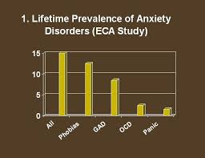
Prevalence
The current weighted prevalence of total Anxiety Disorders was 2.57% among the adult general population in the present survey.
Among Anxiety Disorders, agoraphobia was most common (1.6%), followed by GAD (0.57%).

Slide 8
Psychological aspect

Slide 9
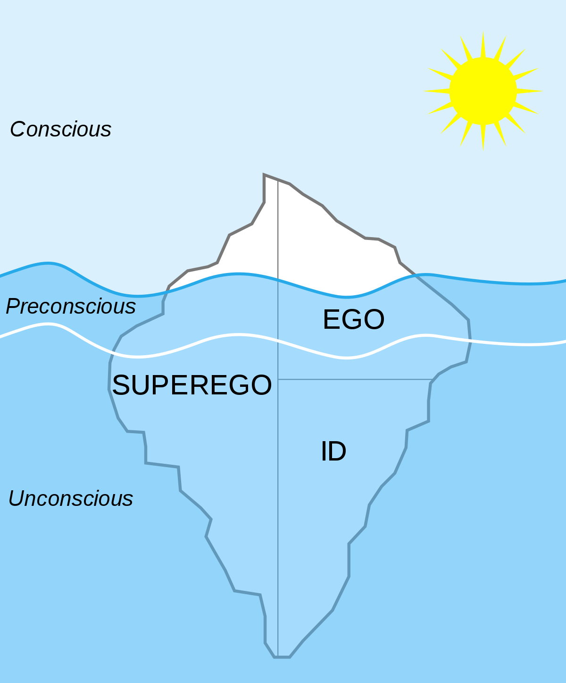
Psychoanalytic Theory:
Freud's psychoanalytic theory anxiety is the result of inability of the ego defense mechanism to resolve the conflict between ID and superego.
Cognitive Behavior Theory:
Anxiety is the result of faulty cognitions (cognitive distortions) of an individual. Patients suffering from anxiety disorder tend to overestimate the degree of danger in a given situation and underestimate their capacity to cope with that situation.
Behaviour Theory:
Anxiety is a conditioned or learned response to a specific environmental stimulus, (vicarious learning).

Slide 10
Various experiments

Slide 11
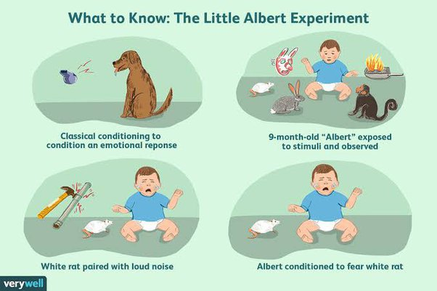
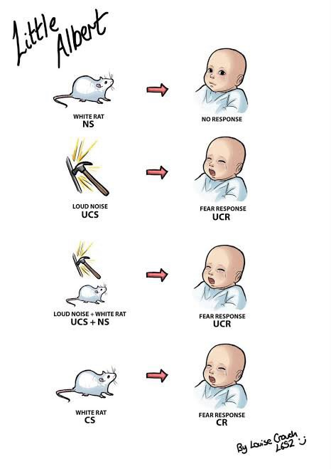
Notes:
Neutral Stimulus: White Rat
Unconditioned Stimulus: Hammer hitting sound
Unconditioned response: Fear
Conditioned stimulus: White follow
Conditioned response: Fear
The participant in the experiment was a child that Watson and Rayner called "Albert B." but is known popularly today as Little Albert. When Little Albert was 9 months old, Watson and Rayner exposed him to a series of stimuli including a white rat, a rabbit, a monkey, masks, and burning newspapers and observed the boy's reactions.
The boy initially showed no fear of any of the objects he was shown.
The next time Albert was exposed to the rat, Watson made a loud noise by hitting a metal pipe with a hammer. Naturally, the child began to cry after hearing the loud noise. After repeatedly pairing the white rat with the loud noise, Albert began to expect a frightening noise whenever he saw the white rate. Soon, Albert began to cry simply after seeing the rat.
After conditioning, Albert feared not just the white rat, but a wide variety of similar white objects as well. His fear included other furry objects including Raynor's fur coat and Watson wearing a Santa Claus beard.

Slide 12
Response to sodium lactate infusions has been proposed as an experimental model and a biologic marker for panic attacks. Several authors have claimed that patients suffering from panic attacks, but not normal controls, "panic" in response to lactate.¹
Sodium lactate infusions induce panic attacks in patients with panic disorder, but not in normal controls, by an unknown mechanism. plasma cortisol response to infusion of O.5 mol/L of sodium lactate in 103 patients with panic disorder or agoraphobia with panic attacks, and 32 normal controls. ²

Slide 13
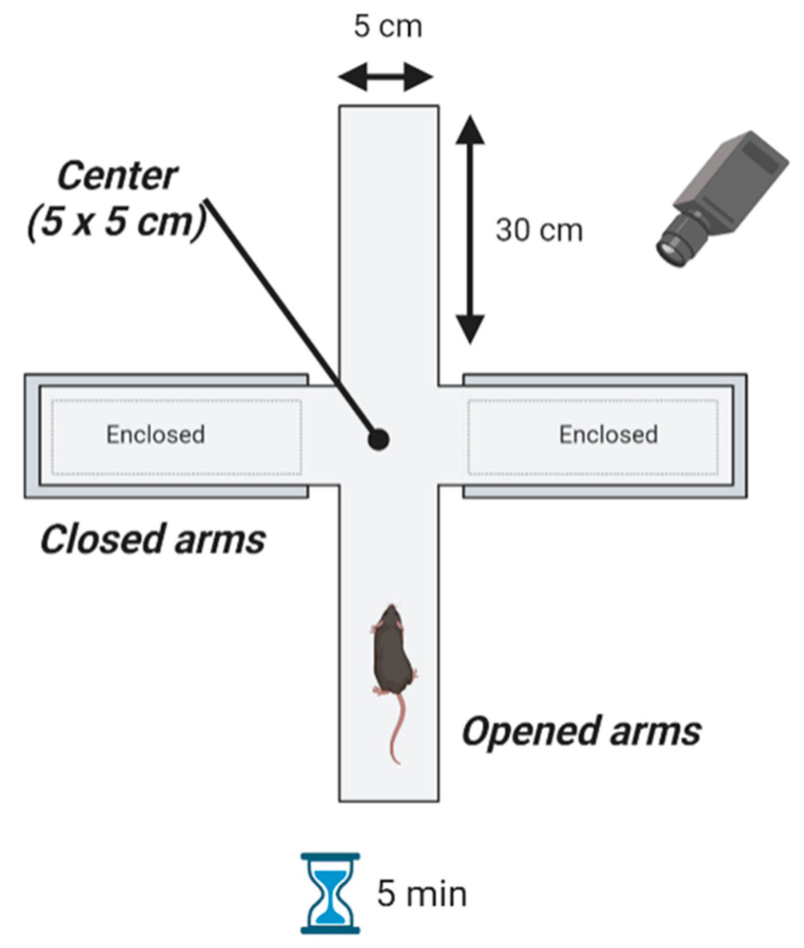
Animal models
mostly are based on the use of mammalian species, particularly rats, hamsters and mice.
state anxiety models - animals are confronted with situations that generate an anxious state . It can be either conditioned (eg, conditioned fear, avoidance, and punishment-induced conflict tests, Vogel conflict test, Fear-potentiated startle ) or unconditioned (eg, aversive and ethological conflict tests, Elevated plus maze , Cat exposure test, Light-dark box ). ³
trait or “pathological” anxiety: genetic manipulations (transgenic or “knockout” animals) or selective breeding creates lines of rats or mice that permanently express an increased or decreased level of anxiety.

Slide 14
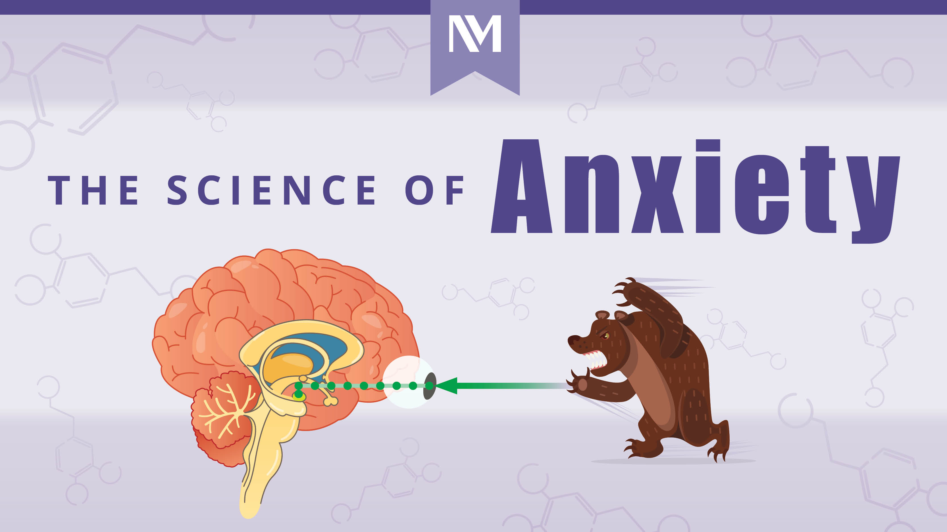
BIOLOGICAL BASIS
FUNCTIONAL NEUROANATOMY
NEUROCHEMICAL CORELATES
GENITIC AND ENVIRONMENTAL FACTORS
NORADRENERGIC SYSTEM
SERITONERGIC SYSTEM
GABAnergic
system
NEUROSTEROIDS
HORMONES OF HPA AXIS
OTHER PEPTIDES

Slide 15
Studies of Inheritance Patterns.
A relatively large number of family studies have supported the familial aggregation of the major anxiety disorders, including panic disorder, generalized anxiety disorder, phobias, and agoraphobia. For panic disorder, the familial risk was highest for early- onset panic disorder. In the case of social anxiety disorder, it was strongest for the generalized subtype.
Several large twin studies have demonstrated higher inheritance for monozygotic than dizygotic twins, suggesting a genetic component. The genetic contribution appears to be about 30 percent or more, perhaps as high as 60 percent for the phobias.

Slide 16
Environmental influences
Naturally occurring variations in maternal care can also alter the regulation of genes controlling the behavioral and neuroendocrine responses to stress, as well as hippocampal synaptic development. These effects are responsible for stable, individual differences in stress reactivity, as well as the maternal behavior of female offspring.
They could constitute the basis of a nongenetic mechanism for the transmission of individual differences in stress reactivity and coping styles across generations.
In 1958, Levine reported that rats handled for the first 21 days of life exhibit reduced fearfulness compared with nonhandled controls.

Slide 17
Since then, several studies have shown the beneficial effects of neonatal handling and a progressive habituation to stress on adults’ stress responses and anxiety-related behaviors. Neonatal handling can even reverse the behavioral abnormalities induced by prenatal stress.These effects appear to be mediated essentially by the CRF/HPA axis system, although the serotonergic and catecholaminergic systems could be also involved.
A study has shown that neonatal handling increases the expression of the peripheral benzodiazepine receptor (PBR), which has been implicated in the synthesis of endogenous, natural anxiolytic agents such as the neurosteroids, in rat adrenals, kidney, and gonads.⁴

Slide 18
Functional Anatomy
Symptoms of mood and anxiety disorders are thought to result in part from disruption in the balance of activity in the emotional centers of the brain rather than in the higher cognitive center .
The locus ceruleus and arousal- the ascending noradrenergic system originating from the locus ceruleus (LC) is the core around which feelings of anxiety are organized. The LC contains a large proportion of the noradrenaline (NA) cell bodies found in the brain . It is highly responsive to alerting/stressful stimuli.
In rats, cats, and monkeys, increased LC neuronal firing rate is associated with alertness, selective attention to meaningful and/or novel stimuli, and vigilance.

Slide 19
In cats, confrontation with a novel, but nonthreatening stimulus, such as a mouse, does not cause a specific increase in LC firing, whereas confrontation with a threatening stimulus (eg, a dog) causes a marked increase in LC firing. Thus, novelty by itself is not sufficient to activate the LC/NA system, but stimuli that signal reward, as those that signal danger, may activate the system
Some LC neurons project to the paraventricular nucleus (PVN) in the hypothalamus and activate the HPA axis, triggering or facilitating the stress response associated with increased anxiety.
The LC is therefore in a key position to integrate both external sensory and internal visceral stimuli and influence stress- and fear-related neuroanatomical structures, including cortical areas

Slide 20
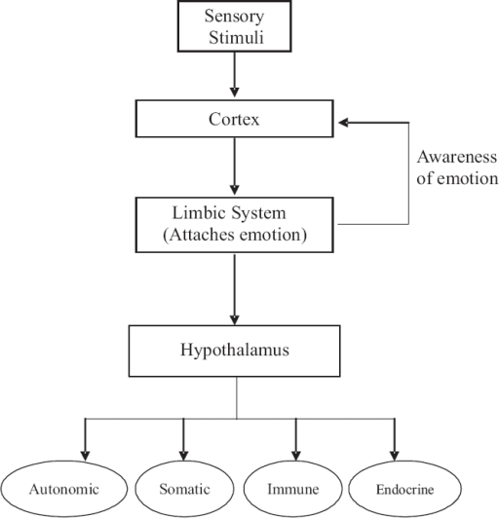

Slide 21
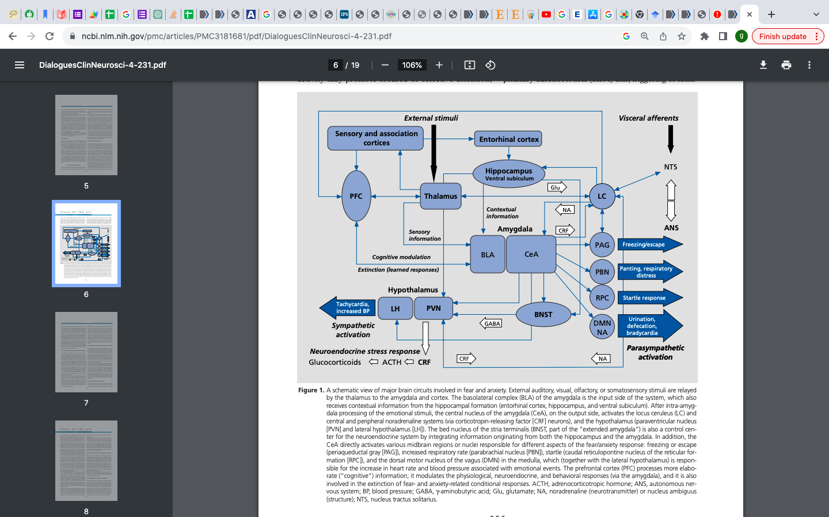

Slide 22
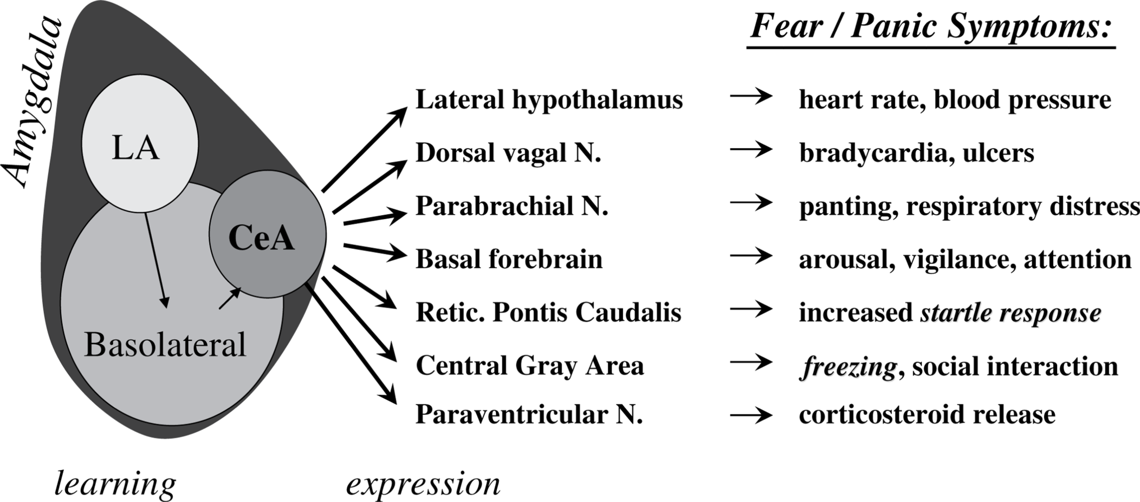

Slide 23
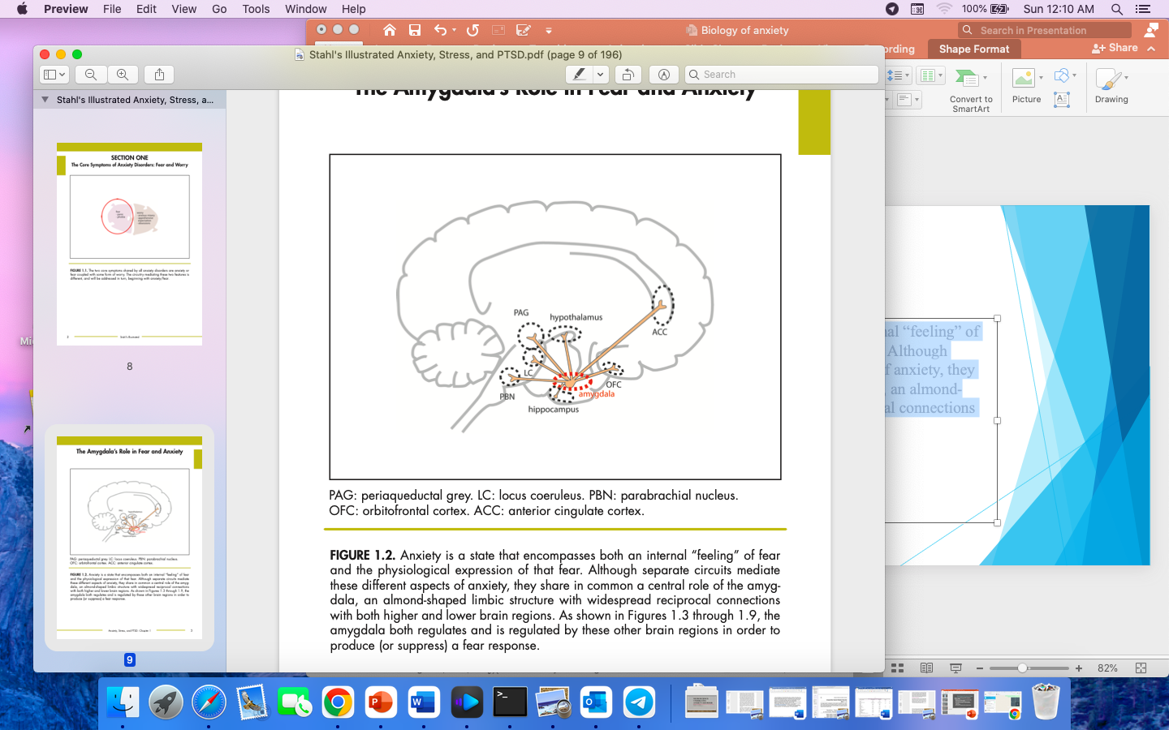
The Amygdala’s Role in Fear and Anxiety
an almond-shaped limbic structure with widespread reciprocal connections with both higher and lower brain regions
Notes:
Anxiety is a state that encompasses both an internal “feeling” of fear and the physiological expression of that fear. Although separate circuits mediate these different aspects of anxiety, they share in common a central role of the amygdala,

Slide 24
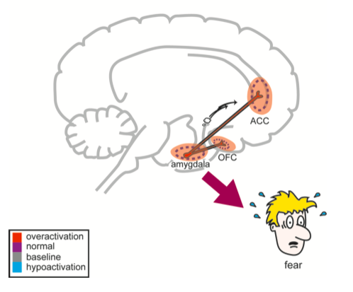
The Amygdala and the Feeling of Fear
The emotional aspect of fear is regulated by connections between the amygdala and key areas of the prefrontal cortex, specifically the orbitofrontal cortex (OFC) and the anterior cingulate cortex (ACC).

Slide 25
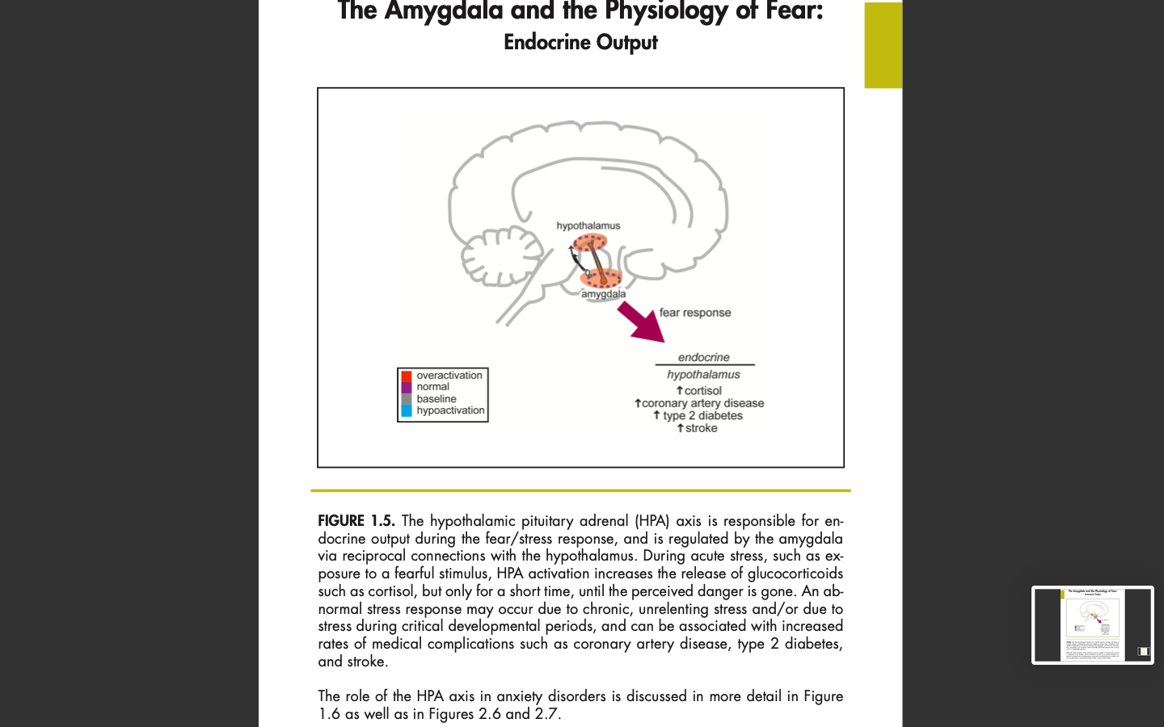
The Amygdala and the Physiology of Fear: Endocrine Output
The (HPA) axis is responsible for endocrine output during the fear/stress response, and is regulated by the amygdala via reciprocal connections with the hypothalamus.
During acute stress, such as exposure to a fearful stimulus, HPA activation increases the release of glucocorticoids such as cortisol, but only for a short time, until the perceived danger is gone.

Slide 26
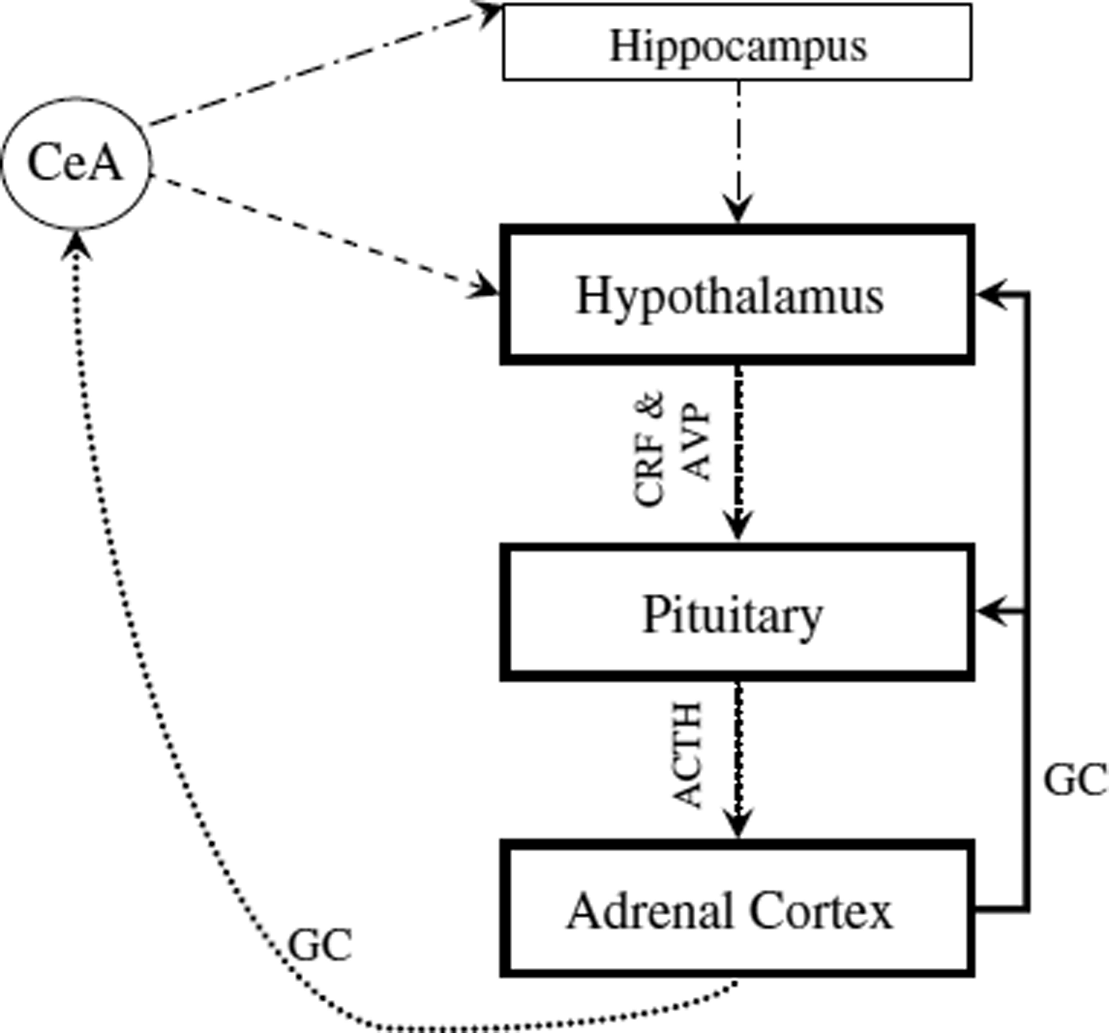
In situations of chronic stress, excessive glucocorticoid release may eventually lead to hippocampal atrophy, thus preventing it from inhibiting the HPA axis . This could contribute to chronic activation of the HPA axis and increase risk for an anxiety disorder.
Fig. 3.
The HPA axis. Black line- Suppression connection; dotted line- Facilitory connection; dots and dashes line- Suppression connection indirect pathway (via BNST and other limbic regions); and dashed lines- Facilitory connection indirect pathway (via BNST and other limbic regions).

Slide 27
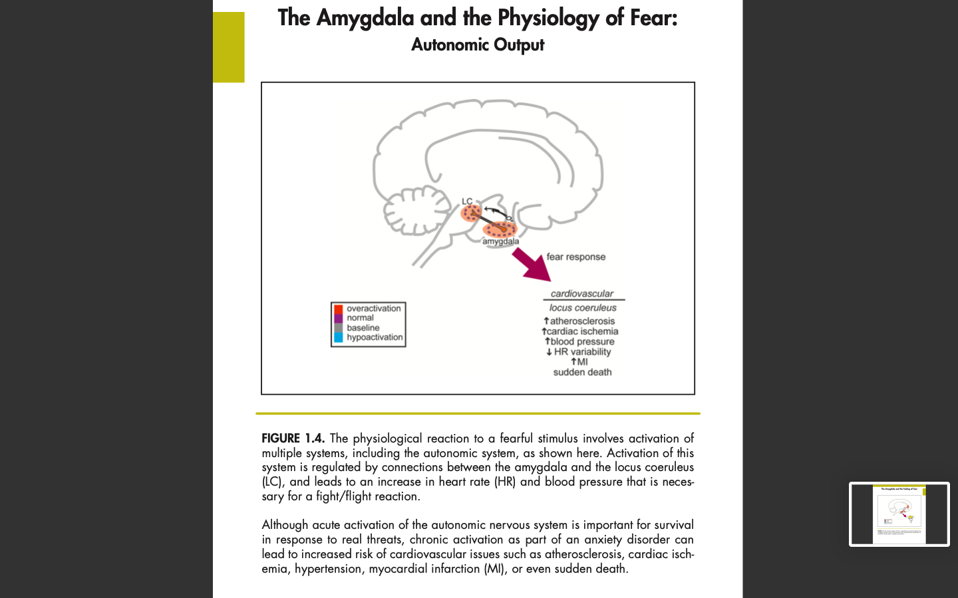
The Amygdala and the Physiology of Fear: Autonomic Output
The physiological reaction to a fearful stimulus involves activation of multiple systems, including the autonomic system, which is regulated by connections between the amygdala and the locus coeruleus (LC), and leads to an increase in heart rate (HR) and blood pressure that is necessary for a fight/flight reaction.
Although acute activation of the autonomic nervous system is important for survival in response to real threats, chronic activation as part of an anxiety disorder can lead to increased risk of cardiovascular issues such as atherosclerosis, cardiac ischemia, hypertension, myocardial infarction (MI), or even sudden death.

Slide 28
The amygdala and social behavior and phobia
The amygdala may play an important role in regulating social behavior. Thus, in adult macaque monkeys, selective bilateral lesions of the amygdala result in a lack of fear response to inanimate objects and a “socially uninhibited” pattern of behavior.
may function as a protective “brake” during evaluation of a potential threat, and it has been suggested that social anxiety may involve a dysregulation or hyperactivity of the amygdala evaluative process. Studies in rats also suggest that the basolateral nucleus of the amygdala may play a crucial role in the consolidation of information that leads to the formation of a specific phobia.

Slide 29
The septohippocampal system and behavioral inhibition- The primary function of the BIS is to compare actual with expected stimuli. If there is a discrepancy between the actual and expected stimuli (ie, “novelty” or “uncertainty”), or if the predicted stimuli are aversive, the BIS is activated, arousal and attention to novel environmental stimuli is increased, and ongoing behaviors are inhibited.
Thus, according to Gray, anticipatory anxiety reflects a central state mediated by BIS activation, which is elicited by threats of punishment or failure, and by novelty or uncertainty.⁵
NA system is involved in the initial alarm reaction, whereas freezing promoted by septohippocampal inhibition may help regulate the intensity and duration of fear. However, according to Panksepp, the amygdala-central gray axis plays an essential role in creating the emotional state associated with fear and anxiety.⁶

Slide 30
Neurochemical and hormonal Systems

Slide 31
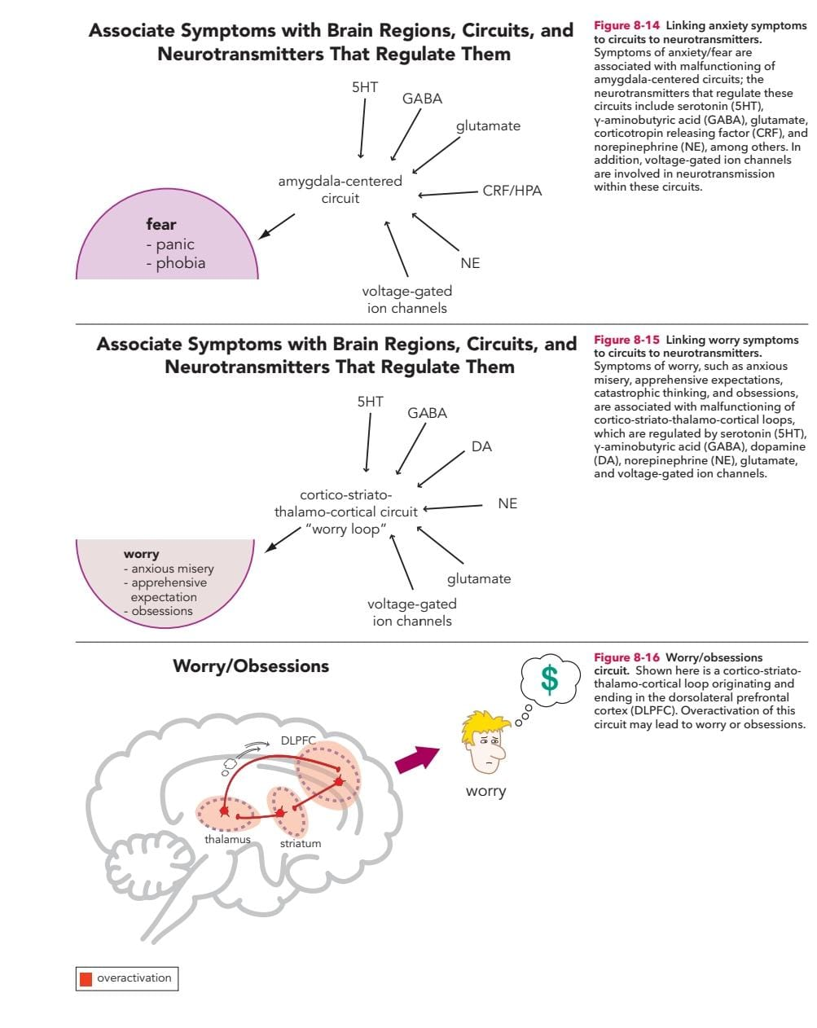

Slide 32
Neurochemical Systems Involved in Anxiety Disorders
Neurochemical | Brain Regions | Association with Anxiety Disorders
Neurosteroids | Hippocampus, amygdala, cortex | Abnormal peripheral levels of neurosteroids in PD; possibly also in GAD and SAD (inconsistent findings)
Arginine vasopressin (AVP) | Paraventricular nucleus of hypothalamus, septum, hippocampus, cortex | Single nucleotide polymorphism in AVP V1b receptor gene linked to PD
Dopaminergic system | Amygdala, nucleus accumbens, prefrontal cortex | Excessive mesocortical dopamine release, persistently high levels of dopamine in prefrontal cortex

Slide 33
Neurochemical | Brain Regions | Association with Anxiety Disorders
Serotonergic system | Dorsal raphe nuclei, amygdala, hippocampus, prefrontal cortex | Low activity of postsynaptic 5- HT1A receptors in PD and SAD
γ-amino butyric acid (GABA) | Substantia nigra, globus pallidus, hypothalamus, periaqueductal gray matter, hippocampus, amygdala, anterior cingulate | Reduced GABA-A and benzodiazepine binding in PD Reduced GABA levels in PD, possible imbalance between GABAergic inhibition and glutamate-mediated excitation
Glutamate | Amygdala, hippocampus, frontal and cingulate cortices | Possible imbalance between GABAergic inhibition and glutamate- mediated and excitation in PD

Slide 34
Neurochemical | Brain Regions | Association with Anxiety Disorders
Neuropeptide Y (NPY) | Amygdala, hippocampus, brainstem, nucleus accumbens, locus coeruleus, hypothalamus | Low NPY levels in PTSD, less well studied in anxiety disorders
Galanin | Prefrontal cortex, amygdala, hippocampus, locus coeruleus | Very few studies in patients with anxiety disorders Galanin gene polymorphism associated with PD, only in women
Cholecystokinin (CCK) | Cerebral cortex, hippocampus, amygdala, caudate, putamen, thalamus, hypothalamus | Lower CSF levels of CCK in PD

Slide 35
Neurochemical | Brain Regions | Association with Anxiety Disorders
Oxytocin | Hypothalamus, ventral tegmental area, amygdala | Oxytocin gene receptor polymorphism associated with increased risk for anxiety in individuals with early life stress
Endocannabinoid system | Prefrontal cortex, hypothalamus, amygdala, hippocampus | Dysregulation of endocannabinoid signaling

Slide 36
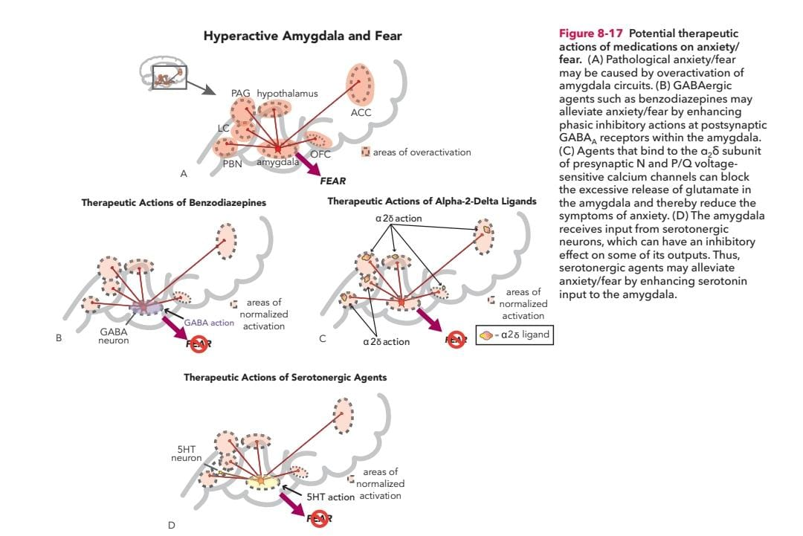

Slide 37
Noradrenergic system | Locus coeruleus, amygdala, hippocampus, hypothalamus, prefrontal cortex | Unrestrained, excessive system activation
Hypothalamic– pituitary–adrenal (HPA) axis | Hippocampus, amygdala, hypothalamus, prefrontal cortex | Dysregulated HPA axis function (excessive cortisol release, abnormal feedback) in some studies
Corticotropin- releasing hormone (CRH) | Prefrontal and cingulate cortices ,amygdala, hippocampus, hypothalamus, bed nucleus of stria terminalis, nucleus accumbens , periaqueductal gray matter, locus coeruleus, dorsal raphe nuclei | Persistently increased CRH concentration

Slide 38
Neuroimaging Findings

Slide 39
Neuroimaging Findings in Patients who Have Generalized Anxiety Disorder
Structural imaging studies have shown high ratios of gray matter to white matter in the upper temporal lobe of pediatric patients of (GAD) and increased amygdala volume, which may correspond to the stress-induced amygdalar hypertrophy observed in laboratory animal studies
In functional imaging studies of adolescent patients who have GAD, resting vlPFC activity is elevated relative to healthy control subjects. Because the vlPFC activity correlates negatively with symptom severity, the elevation in vlPFC metabolism is interpreted as a compensatory response rather than an underlying cause of GAD.

Slide 40
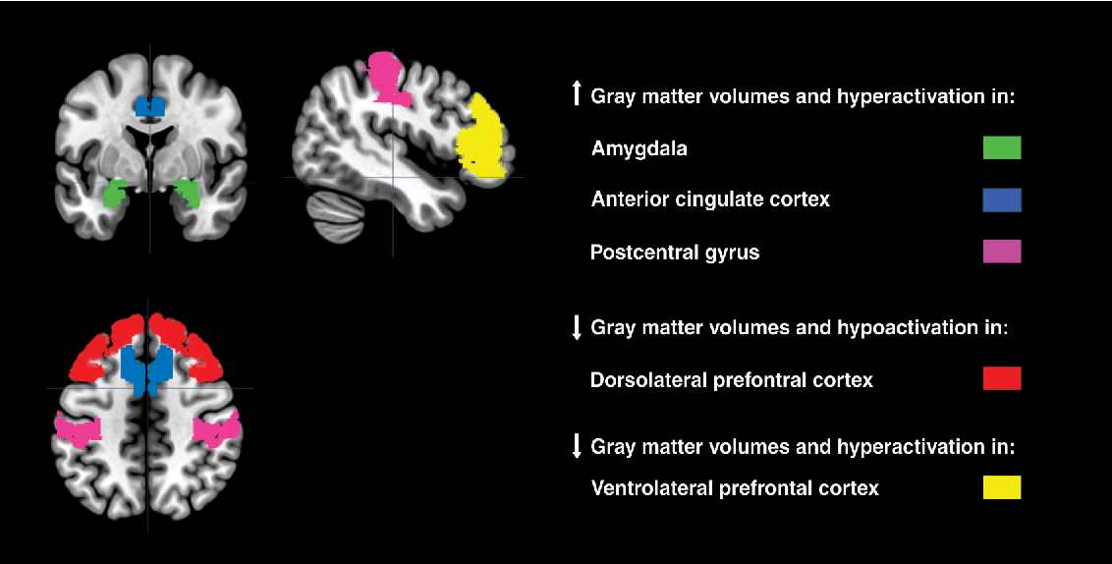
In response to viewing angry faces, adolescent patients who had GAD exhibited an elevated right amygdala response; this activation correlated positively with symptom severity. The overactivity in the right amygdala also was correlated negatively with activity in the right VLPFC.

Slide 41
Because of observed hypermetabolism in the PFC of patients who have GAD, neuronal viability has been assessed in this region as measured by the ratio of N-acetylasparate to creatine using proton MRS, neuronal viability was increased in the right dorsolateral PFC in those without early-life stress but was decreased in those who self-reported early-life trauma
Functional brain imaging results obtained under resting conditions in patients who have GAD have tended to be inconsistent; provocative anxiety-inducing tasks have produced more robust and interpretable FMRI results.
Many imaging studies of patients who have GAD show elevated amygdala and insula activation during negative emotional processing .

Slide 42
Functional anatomy of normal and pathological anxiety
Anatomic Area | Normal and Pathological Anxiety
Insular cortex | Acute anxiety activates ventral insula
Cingulate cortex | Acute anxiety has no effect on ACC but deactivates the PCC
Amygdala | Not overactive at rest Overactive during symptom provocation Right amygdala most relevant to anxiety

Slide 43
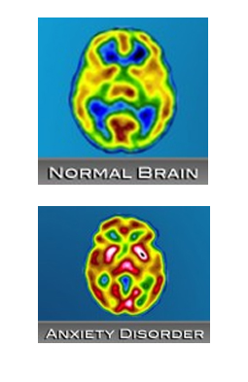
SPECT identified lower metabolism in the left inferior parietal lobe and overall decreased bilateral cerebral blood flow (CBF) in patients who had PD as compared with control subjects, and this decrease corresponded with symptom severity.
Other studies, however, have demonstrated elevated glucose uptake in the amygdala, hippocampus, thalamus, midbrain, caudal pons, medulla, and cerebellum as measured by PET.
These elevations normalize after successful pharmacological or behavioral therapy, suggesting that the increased glucose uptake in these regions is state dependent.
Patients who had PD had decreased frontal activity bilaterally but increased activity in the right medial and superior frontal lobe in SPECT studies. Interestingly, the CBF asymmetry and shift to the right hemisphere correlated with disorder severity in individual patients.

Slide 44
SUMMARY
The biological bases of fear and anxiety are now recognized, and the major brain structures and neuronal circuits involved in emotional information processing and behavior are delineated.
Emotional and cognitive processes cannot be dissociated, even when considering such a basic emotion as fear.

Slide 45
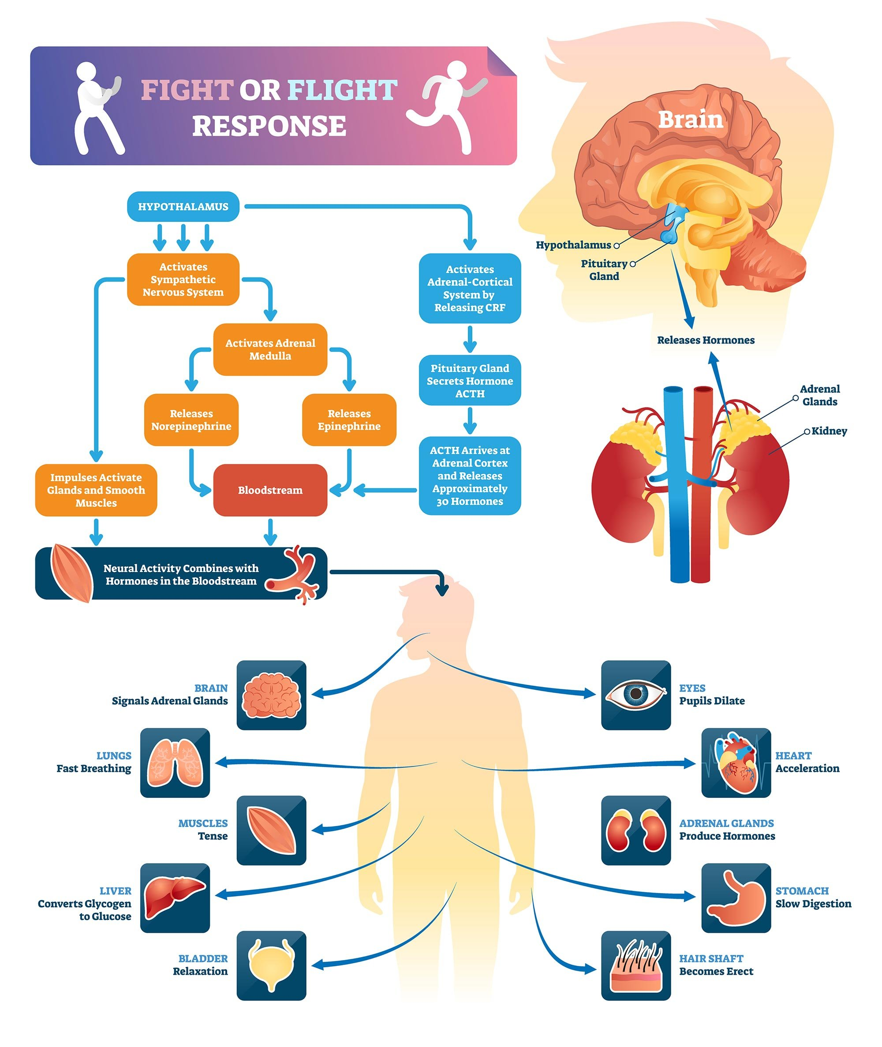

Slide 46
REFERENCES
Hollander E, Liebowitz MR, Gorman JM, Cohen B, Fyer A, Klein DF. Cortisol and Sodium Lactate—Induced Panic. Arch Gen Psychiatry. 1989;46(2):135–140.
Margraf J, Ehlers A, Roth WT. Sodium lactate infusions and panic attacks: a review and critique. Psychosom Med. 1986 Jan-Feb;48(1-2):23-51.
Campos AC, Fogaça MV, Aguiar DC, Guimaraes FS. Animal models of anxiety disorders and stress. Brazilian Journal of Psychiatry. 2013;35:S101-11.
Steimer T. The biology of fear-and anxiety-related behaviors. Dialogues in clinical neuroscience. 2002 Sep 30;4(3):231-49.
Gray JA. The Neuropsychology of Anxiety. An Enquiry into the Functions of the Septo-hippocampal System. Oxford, UK: Clarendon Press; 1987.

Slide 47
Martin EI, Ressler KJ, Binder E, Nemeroff CB. The neurobiology of anxiety disorders: brain imaging, genetics, and psychoneuroendocrinology. Psychiatric Clinics. 2009 Sep 1;32(3):549-75.
Kaplan and sadocks Comprehensive textbook of Psychiatry:10th edition vol 1,New York:Lippincott and Williams.
Sadock BJ, Sadock VA. Kaplan and Sadock’s Synopsis of Psychiatry. 10th ed. New York: Lippincott and Williams; 2007.
Stahl SM, Grady MM. Stahl's illustrated anxiety, stress, and PTSD. Cambridge University Press; 2010 May 7,chapter 1 page 1-23

Slide 48

THANK YOU

