Slide 1
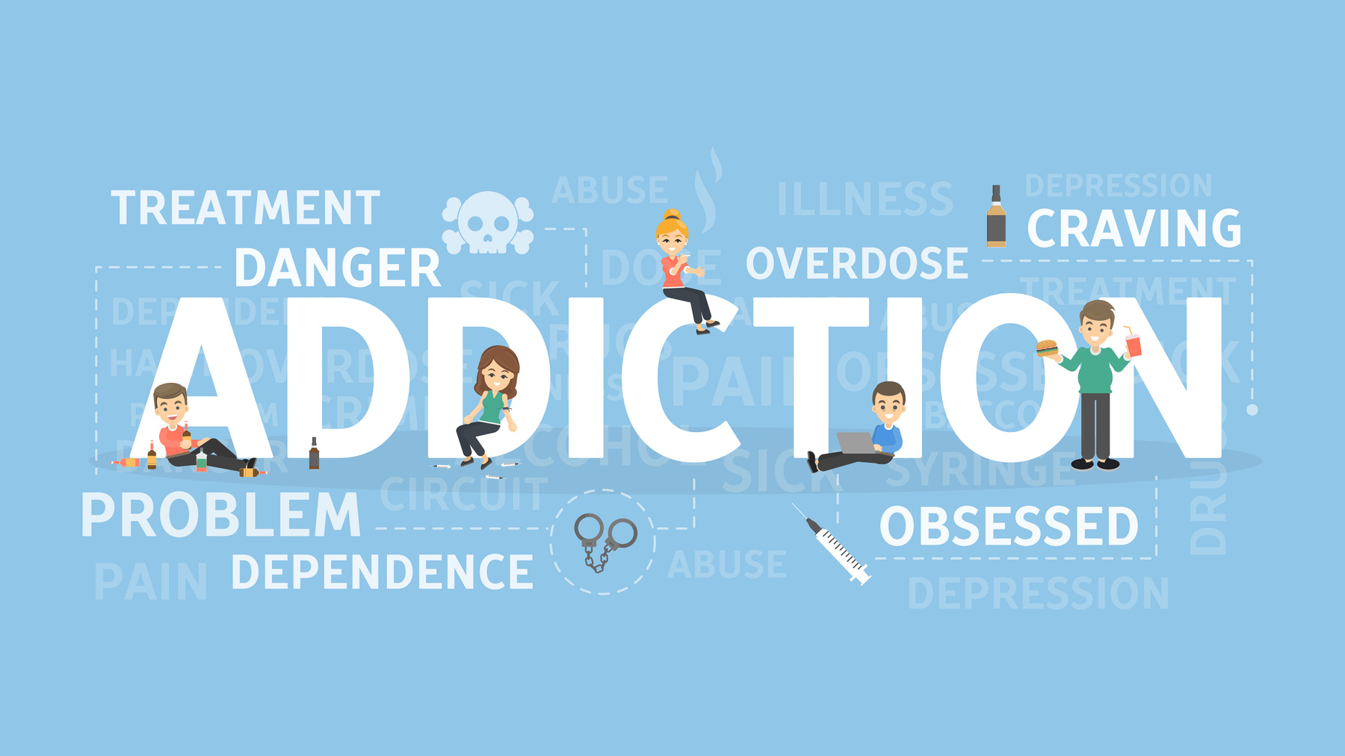
ALCOHOL RELATED PROBLEMS AND THEIR MANAGEMENT
BY - DR ABHINAV KUCHHAL

Slide 2


INTRODUCTION
Alcohol is one of the most widely used psychoactive substance.
Alcohol related disorders impact all aspects of health care delivery system, specially psychiatry.
At least 20% of the patients in mental health setting have alcohol abuse or dependence.

Slide 3
MAJOR DRUGS OF ABUSE IN INDIA
DRUG TYPE | NHS (CURRENT PREVALENCE, %) | DAMS (% AMONG TREATMENT SEEKERS)
Alcohol | 21.4% | 43.9%
Cannabis | 3.0% | 11.6%
Heroin | 0.2% | 11.1%
Opium | 0.4% | 8.6%
Other Opiates | 0.1% | 6.3%
SOURCE: RAY R, NATIONAL SURVEY 2004

Slide 4
ESTIMATES OF NUMBER OF USERS OF SELECT DRUG TYPE
DRUG TYPE | CURRENT USE (in millions)
Tobacco | 162.86
Alcohol | 62.46
Cannabis | 8.75
Opiates | 2.04
Sedative/ Hypnotics | 0.29
SOURCE: RAY R, NATIONAL SURVEY 2004
BETWEEN 17% AND 26% OF CURRENT USERS OF VARIOUS SUBSTANCES WERE DEPENDENT USERS

Slide 5


EPIDEMIOLOGY
Age group of 15-24 years has emerged as critical period for the initiation of substance use habit.
More than half of the alcohol abusers use alcohol for the first time at this age.
More common in males.
Reported from different occupational categories.
Risk of alcoholism is much higher among the first degree family members of an alcoholic.

Slide 6
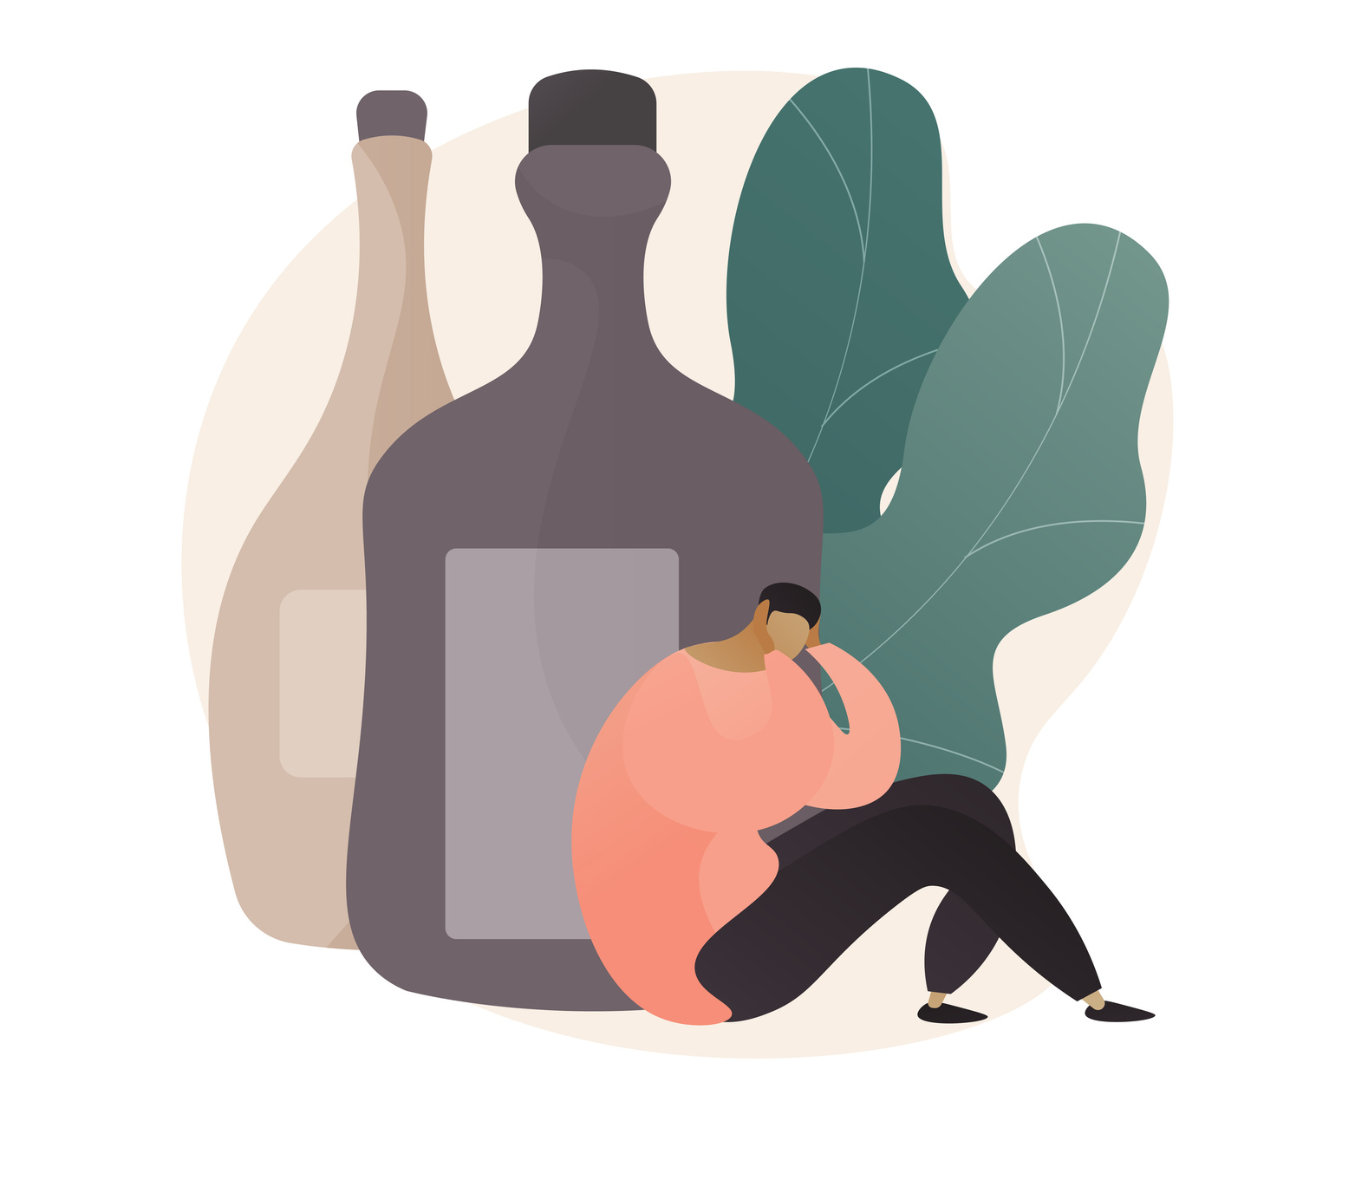
SOCIO-CULTURAL RISK FACTORS
  Male
  Lower education
  Lower income
  Marital breakdown
  Certain occupation
  Idleness
  Social stress

Slide 7
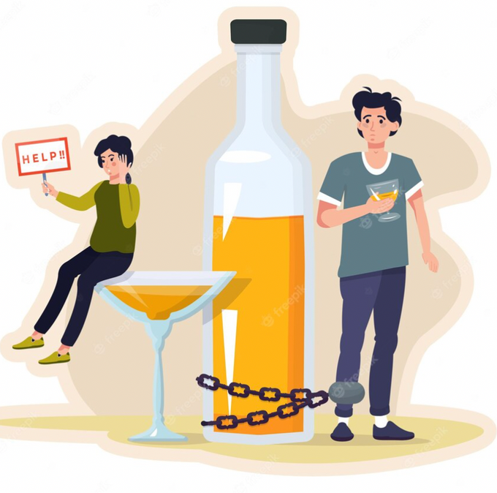
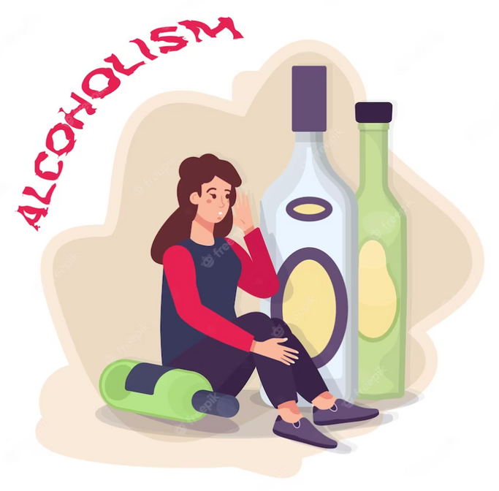

ACUTE INTOXICATION
A transient condition closely related to blood level of alcohol.
In healthy persons without alcohol tolerance.
Mild intoxication-BAC<=100mg%
Moderate intoxication- BAC 100-200 mg%
Severe intoxication - BAC >200mg%

Slide 8
ACUTE EFFECTS THAT COMMONLY OCCUR WITH INCREASING BAC
BAC mg/dl | Effects
<80 | Euphoria, feeling of relaxation and talking freely, clumsy movements of hands and legs, reduced alertness but believes himself to be alert
>80 | Noisy, moody, impaired judgement, impaired driving ability
100-200 | Electroencephalographic changes begin to appear, Blurred vision, unsteady gait, gross motor in-coordination, slurred speech, aggressive, quarrelsome, talking loudly.
200-300 | Amnesia for the experience – blackout
300-350 | Coma
350-600 | May cause or contribute to death

Slide 9
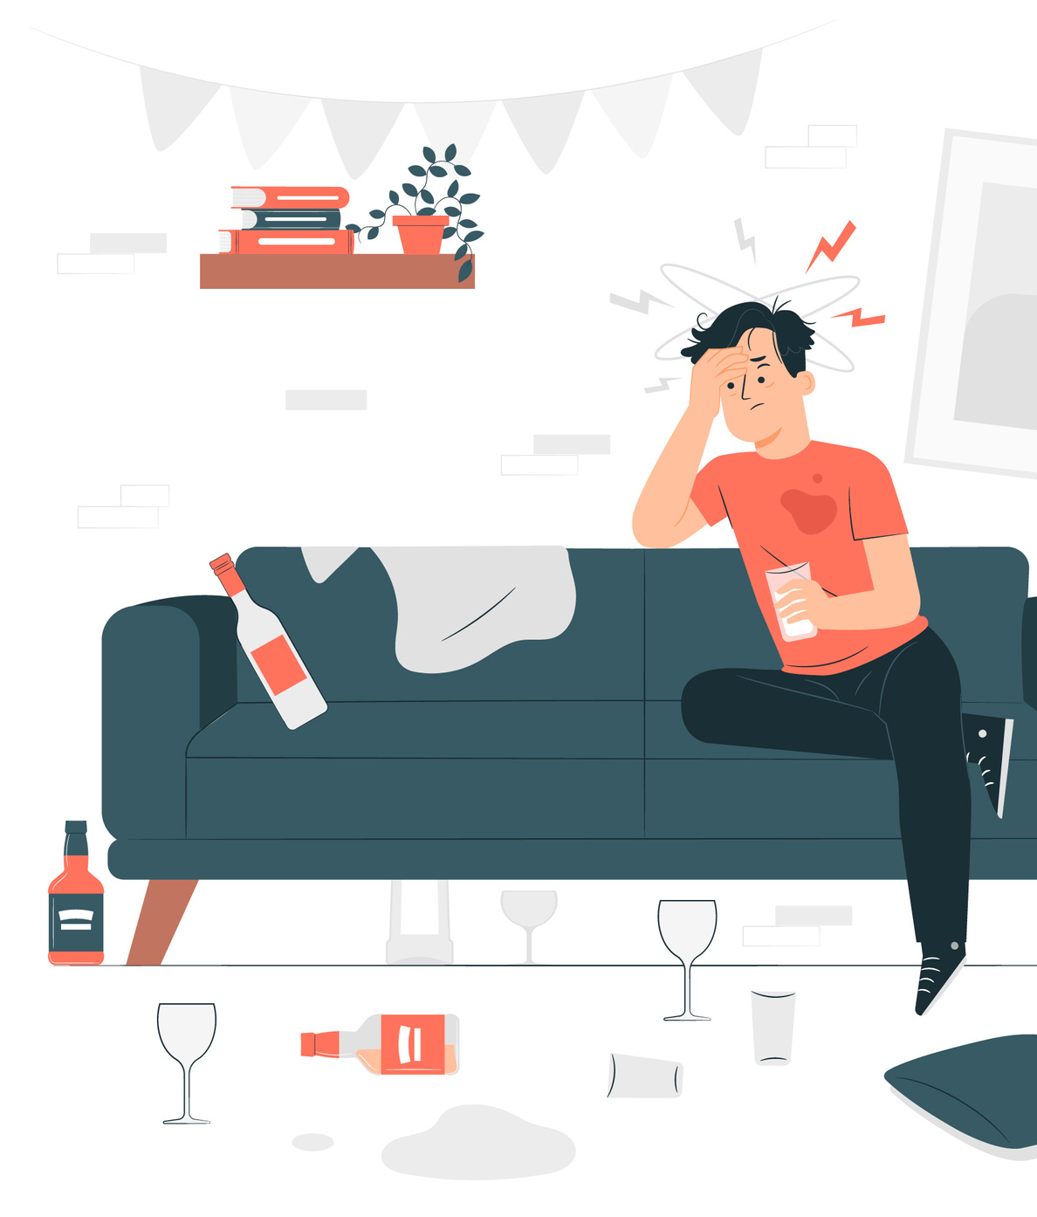
DEPENDENCE SYNDROME
It is a cluster of physiological, behavioural and cognitive phenomenon in which the use of alcohol takes on much higher priority for a given individual than other behaviours that once had greater values.

Slide 10
ICD-10 CRITERIA FOR THE ALCOHOL DEPENDENCE SYNDROME
  A strong desire or sense of compulsion to consume alcohol; impaired capacity to control drinking in terms of its onset, termination, or levels of use, as evidenced by:
  alcohol being often taken in larger amounts or over a longer period than intended; or
  by a persistent desire to or unsuccessful efforts to reduce or control alcohol use;
2. A physiological withdrawal state when alcohol is reduced or ceased, as evidenced by:
  the characteristic withdrawal syndrome for alcohol, or
  by use of the same (or closely related) substance with the intention of relieving or avoiding withdrawal symptoms;

Slide 11
ICD-10 CRITERIA FOR THE ALCOHOL DEPENDENCE SYNDROME
3. Evidence of tolerance to the effects of alcohol, such that:
  there is a need for significantly increased amounts of alcohol to achieve intoxication or
  the desired effect, or a markedly diminished effect with continued use of the same amount of alcohol;
4. Preoccupation with alcohol, as manifested by:
  important alternative pleasures or interests being given up or reduced because of drinking; or
  a great deal of time being spent in activities necessary to obtain, take, or recover from the effects of alcohol;
5. Persistent alcohol use despite clear evidence of harmful consequences, as evidenced by continued use when the individual is actually aware, or may be expected to be aware, of the nature and extent of harm.

Slide 12
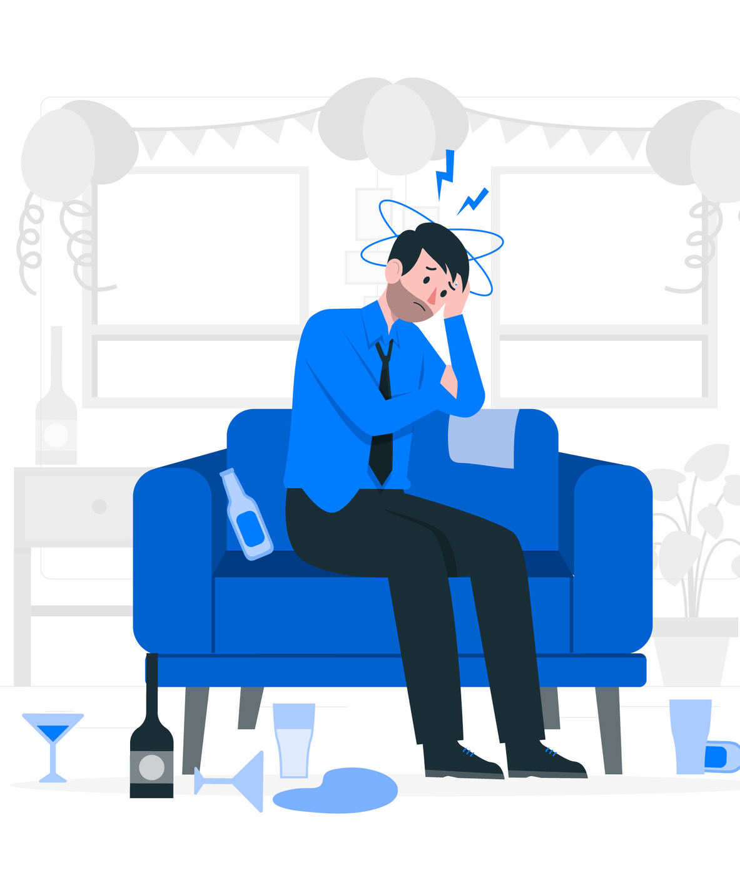
WITHDRAWAL SYNDROME
Due to chronic alcohol abuse, there is gradual up regulation of N-methyl D aspartate receptors.
When concentration of alcohol is suddenly lowered the brain is left in a hyperactive and hyper excited state causing withdrawal syndrome.
There is autonomic hyperactivity resulting in hand tremor, sweating, tachycardia, systolic hypertension.
There is insomnia and anxiety.
Occurs 6-12 hours of last consumption of alcohol.
May last up to 4-5 days depending upon severity

Slide 13

WITHDRAWAL SYNDROME
Withdrawal with perceptual disturbance
  During withdrawal there may be transient visual, tactile, auditory hallucinations or illusion
  Reality testing is still intact
Withdrawal with grand mal seizure (Rum fit)
  Typical grand mal seizures occur in 30% cases
  EEG is abnormal only at the time of fits

Slide 14
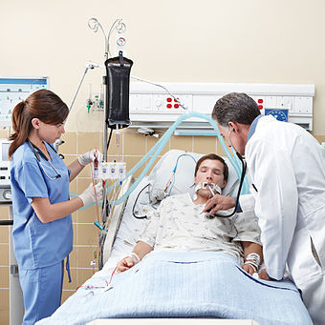
DELIRIUM TREMENS
Starts 3-4 days after abstinence from alcohol and lasts for 2-7 days.
Mortality 5%
  Reduced level of consciousness
  Disorientation of time, place and person
  Impairment of recent memory
  Insomnia
  Perceptual disturbances
  Autonomic hyperactivity
  Tremor ataxia
  Mild pyrexia

Slide 15

ALCOHOL INDUCED AMNESIA
Transient state of amnesia after drinking excess alcohol.
The memory gap usually lasts for hours, but may be as long as a day or more.
In extreme cases patients find themselves in strange places with no recollection of how they got there

Slide 16
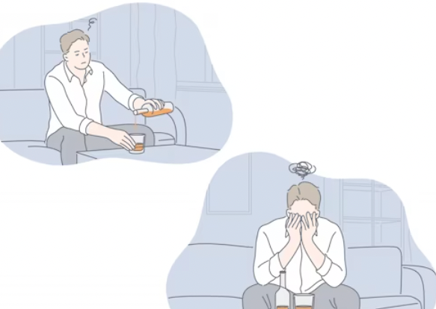
ASSOCIATED PSYCHIATRIC DISORDERS
  Mood disorders
  Anxiety disorders
  Suicidal behaviour
  Personality deterioration
  Impaired psychosexual function
  Pathological jealousy
  Alcoholic hallucination

Slide 17

HALLUCINOSIS
It is a rare condition in which auditory hallucinations are present in clear consciousness and without autonomic over activity.
Starts with simple noise, gradually replaced with voices that threaten, abuse or speak to person.
Third person hallucinations may be present.
It should be differentiated from auditory hallucinations during withdrawal and delirium tremens.

Slide 18
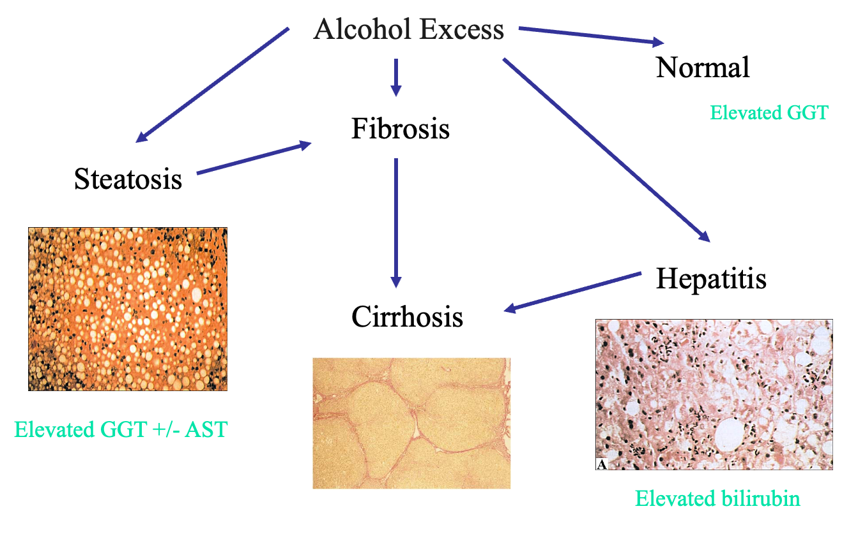
PHYSICAL DISEASES ASSOCIATED WITH ALCOHOL USE
High PT and low albumin

Slide 19
ALCOHOLIC LIVER DISEASE
  Alcoholic liver disease - Fatty Liver
Fatty Liver | Clinical Features
Symptoms | Often asymptomatic
Signs | Hepatomegaly
Investigations | Elevated AST, ALT, Bilirubin
Treatment | Abstinence
Prognosis | Completely reversible withabstinence

Slide 20
ALCOHOLIC HEPATITIS
  May be initial presentation of liver disease
  Presents with jaundice
  Liver function tests mixed pattern (ALP 450 (250) + ALT 100 (50)
  Cirrhosis usually present (+ complications)
  High mortality
  20-50%
  1-6 months resolution

Slide 21
ALCOHOLIC HEPATITIS
Symptoms | Anorexia, nausea, vomiting,pain abdomen, fever
Signs | Icterus, tender hepatomegaly
Investigations | Elevated AST, ALT & bilirubin,prolonged prothombin time
Complication | Fulminant hepatic failure,ascites, encephalopathy,gastrointestinal bleed,coagulopathy
Prognosis | In the absence ofcomplications reversiblewith abstinence

Slide 22
LIVER CIRRHOSIS
Symptoms | Anorexia, weight loss, abdominal discomfort, distension of abdomen
Signs | Jaundice, spider naevi, clubbing, parotid enlargement, palmar erythema, gynaecomastia, testicular atrophy, Dupyutren’s contracture, distended veins over abdomen, hepatomegaly or shrunken liver, splenomegaly, ascites
Complications | Ascites, variceal bleed, hepatic encephalopathy, spontaneous bacterial peritionitis, hepatic failure, renal failure

Slide 23
HEPATIC ENCEPHALOPATHY
Symptoms | Agitation, mood swings, confusion, disorientation, disturbed sleep, altered sensorium, coma
Signs | Flapping tremor, Hyper-reflexia, coma
Precipitating factors | G.I. bleed, infection, increased protein intake, use of sedatives, Electrolyte imbalance
Investigations | Elevated levels of serum ammonia, abnormal liver function tests, prolonged PT, abnormal EEG

Slide 24
WERNICKE'S ENCEPHALOPATHY
Due to chronic alcohol abuse, there is gradual up regulation of N-methyl D aspartate receptors.
When concentration of alcohol is suddenly lowered the brain is left in a hyperactive and hyper excited state causing withdrawal syndrome.
There is autonomic hyperactivity resulting in hand tremor, sweating, tachycardia, systolic hypertension.
There is insomnia and anxiety.
Wernicke's encephalopathy onsets acutely, and usually presents with nystagmus, gaze palsies, ophthalmoplegia (especially of the abducens nerve, CN VI), gait ataxia, confusion, and short-term memory loss.

Slide 25
WERNICKE'S ENCEPHALOPATHY
The classic triad for this disease is encephalopathy, ophthalmoplegia and ataxia.
Untreated, this condition may progress to coma.
The pathological changes in Wernicke's encephalopathy are concentrated in the mammillary bodies cranial nerve nuclei III, IV, VI and VIII, as well as the thalamus, hypothalamus, periaquiductal grey, cerebellar vermis and the dorsal nucleus of the vagus nerve.
The ataxia and ophthalmoparesis relate to lesions in the oculomotor (ie IIIrd, IVth, and VIth nerves) and vestibular (ie VIIIth nerve) nuclei.
Treatment includes an intravenous (IV) or intramuscular (IM) injection of thiamine, as well as the active exclusion of central nervous system (CNS) diseases or other metabolic disturbances.

Slide 26
WERNICKE'S ENCEPHALOPATHY
Patients are usually dehydrated, and so rehydration to restore blood volume should be started. If the condition is treated early, recovery may be rapid and complete.
Even if the patient is hypoglycemic (common in alcoholism), a glucose infusion should be avoided. Glucose depletes thiamine stores in the brain, acutely worsening Wernicke's encephalopathy.

Slide 27
KORSAKOFF'S SYNDROME
Korsakoff's syndrome (Korsakoff's psychosis, amnesic-confabulatory syndrome), is a degenerative brain disorder caused by the lack of thiamine (vitamin B1) in the brain
Individuals diagnosed with Korsakoff's syndrome usually have symptoms of anterograde and retrograde amnesia, or severe memory loss, as well as confabulation, that is, invented memories which are then taken as true due to gaps in memory sometimes associated with blackouts.
These symptoms are caused by damage to mammillary bodies (nodes on the underside of the brain associated with memory) and other brain regions due to deficiency of thiamine (vitamin B1).
When Wernicke's encephalopathy accompanies Korsakoff's syndrome, the combination is called the Wernicke-Korsakoff syndrome.

Slide 28
KORSAKOFF'S SYNDROME
Korsakoff's syndrome (Korsakoff's psychosis, amnesic-confabulatory syndrome), is a degenerative brain disorder caused by the lack of thiamine (vitamin B1) in the brain
Individuals diagnosed with Korsakoff's syndrome usually have symptoms of anterograde and retrograde amnesia, or severe memory loss, as well as confabulation, that is, invented memories which are then taken as true due to gaps in memory sometimes associated with blackouts.
These symptoms are caused by damage to mammillary bodies (nodes on the underside of the brain associated with memory) and other brain regions due to deficiency of thiamine (vitamin B1).
When Wernicke's encephalopathy accompanies Korsakoff's syndrome, the combination is called the Wernicke-Korsakoff syndrome.

Slide 29
KORSAKOFF'S SYNDROME
Korsakoff's is a continuum of Wernicke's encephalopathy, though a recognized episode of Wernicke's is not always obvious.
The disease involves neuronal loss that is, damage to nerve cell transmitters; gliosis which is damage to cells in the Central Nervous System; and hemorrhage or bleeding in mammillary bodies. Damage to the dorsomedial nucleus of the thalamus is also associated with this disorder.
Treatment involves replacing the thiamine by Intravenous (IV) or intramuscular (IM) injection, and providing proper nutrition and hydration
Amnesia and brain damage caused by the disease does not respond to thiamine replacement therapy.

Slide 30
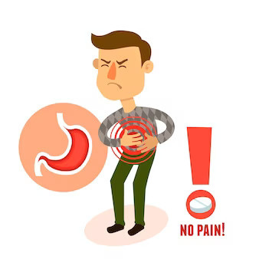
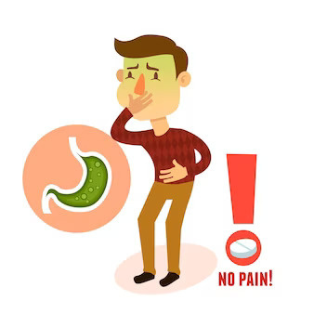
REMEMBER THE OTHER ORGANS
Pancreas
  Acute pancreatitis
  Chronic pancreatitis
Nerves
Heart
Bones
  Peripheral sensory neuropathy
  Cerebellar atrophy
  AF
  Dilated cardiomyopathy
  Fractures

Slide 31
POPULATION SCREENING INSTRUMENTS
CAGE - Cut Down Annoyed Guilt Eye Opener
  Have you ever felt you should Cut down on your drink?
  Have people Annoyed you by criticizing your drinking?
  Have you ever felt Guilt about your drinking?
  Have you ever needed Eye opener drink?
MAST - Michigan Alcohol Screening Test
  Widely used screening test
  It is a 25 items list of common signs and symptoms of alcoholism
  Score of 5 or more represents the cut off point
AUDIT - Alcohol Use Disorders Identification Test
  Developed by WHO in 1992
  It is a 10 item questionnaire
  Has clinical questions and laboratory parameters to suggest harmful use and alcohol dependence

Slide 32

ASSESSMENT OF SEVERITY OF WITHDRAWAL
Clinical institute withdrawal assessment for alcohol-revised version (CIWA-Ar)
  It is a 10 item scale that can monitor the clinical course of alcohol withdrawal
  Nausea and vomiting
  Tremor
  Paroxysmal sweat
  Anxiety
  Agitation
  Tactile disturbances
  Auditory disturbances
  Visual disturbances
  Headache and fullness in head
  Orientation and clouding of sensorium

Slide 33
ASSESSMENT OF SEVERITY OF WITHDRAWAL
Short alcohol withdrawal scale (SAWS)
It is a self completion questionnaire
It covers symptoms of previous 24 hours

Slide 34
SHORT ALCOHOL WITHDRAWAL SCALE (SAWS)
 | NONE 0 | MILD 1 | MODERATE 2 | SEVERE 3
Anxious
Sleep disturbance
Problem with memory
Nausea
Restless
Tremor
Feeling confused
Sweating
Miserable
Heart pounding

Slide 35
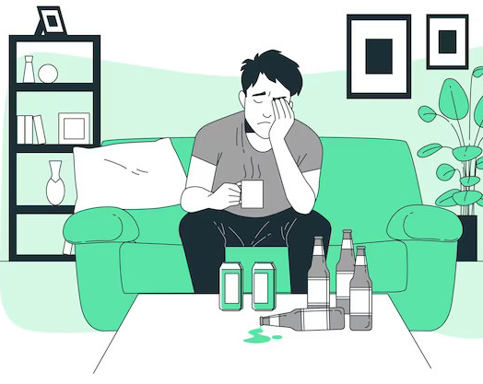
MANAGEMENT OF ALCOHOL RELATED PROBLEMS

Slide 36
LAB TESTS FOR ALCOHOL DEPENDENCE
Gamma glutamyl transpeptidase
  It is raised in 80% of alcohol-dependent individuals
  Returns to normal within 48 hours of abstinence
Mean corpuscular volume
  Raised in 60% of alcoholics
  Strongly suggestive of drinking (rule out other causes)
Carbohydrate deficient transferrin
  Levels increased in heavy drinking
  More specific then GGT
Blood alcohol conc. and breath analyser

Slide 37
TREATMENT AND REHABILITATION
INTERVENTION
  Break through feelings of denial
  Help patient recognize adverse consequences
  Maximize motivation for t/t and continued abstinence
  Counselling of the family (not to protect patient from problems caused by alcohol)
DETOXIFICATION
REHABILITATION
  Continued motivation
  Readjustment of life style
  Relapse prevention

Slide 38
TREATMENT OF INTOXICATION
  Take vitals
  Assess and maintain airway, respiration & circulation
  Physical examination regarding consciousness, trauma, sequelae of drug use ( pupil size, alcohol on breath)
  Monitor intake and output
  Lab investigations
  Objective signs of intoxication
  loss of inhibition
  stupor or coma

Slide 39
TREATMENT OF INTOXICATION
  Gastric lavage if recently ingested
  In chronic alcoholics predisposed to hypoglycaemia and thiamine deficiency give 50% dextrose with thiamine 100mg i.v

Slide 40
DETOXIFICATION
Benzodiazepines
  Decreases hyper-autonomic state by facilitating GABA receptor transmission
  M/C Chlordiazepoxide 40-120 mg/day
  Diazepam 40-60mg/day
Beta blockers
  Improves vital signs
  Reduce craving
Carbamazepine
  Decreases severity of withdrawal
  Prevents seizures
Vitamin Thiamine

Slide 41
PHARMACOLOGICAL TREATMENT TO HELP MAINTENANCE OF ABSTINENCE
Disulfiram
  Consumption of alcohol will cause
  Flushing
  Headache
  Pounding in chest/head
  Tightness in chest
  Nausea/vomiting
  Hypotension
Acamprosate
  Suppresses urge to drink
Naltrexone

Slide 42
Newer avenues
  Sodium oxybate is the sodium salt of gamma-hydroxybutyric acid (GHB). It is used for both acute alcohol withdrawal and medium to long-term detoxification.
  This drug enhances GABA neurotransmission and reduces glutamate levels. It is used in Italy in small amounts under the trade name Alcover.
  Baclofen has been shown in animal studies and in small human studies to enhance detoxification.
  This drug acts as a GABA B receptor agonist and this may be beneficial.

Slide 43
PSYCHOSOCIAL TREATMENT
Can enhance pharmacological treatment by increasing compliance, retention in treatment.
GOALS
  Short term- strengthening pharmacological efficacy
  Long term- abstinence, maintenance, change in life style

Slide 44
MODALITIES OF PSYCHOSOCIAL INTERVENTION
Brief intervention
  1-4 sessIons
  early stage problems
  increase the motivation
Extended interventions
  5-12 sessions
  explain and discuss concept of substance use, adverse health and social consequences, psychological problems, identifying high risk situation.
Self help groups- e.g. Alcohol Anonymous

Slide 45
“The efforts to achieve and maintain a sober lifestyle are not a game in which all benefits are lost with the first sip. Rather recovery is a process of trial and error; patient use slips that occur to identify high risk situations and to develop more appropriate coping techniques”

Slide 46
THANK YOU!

