Slide 1
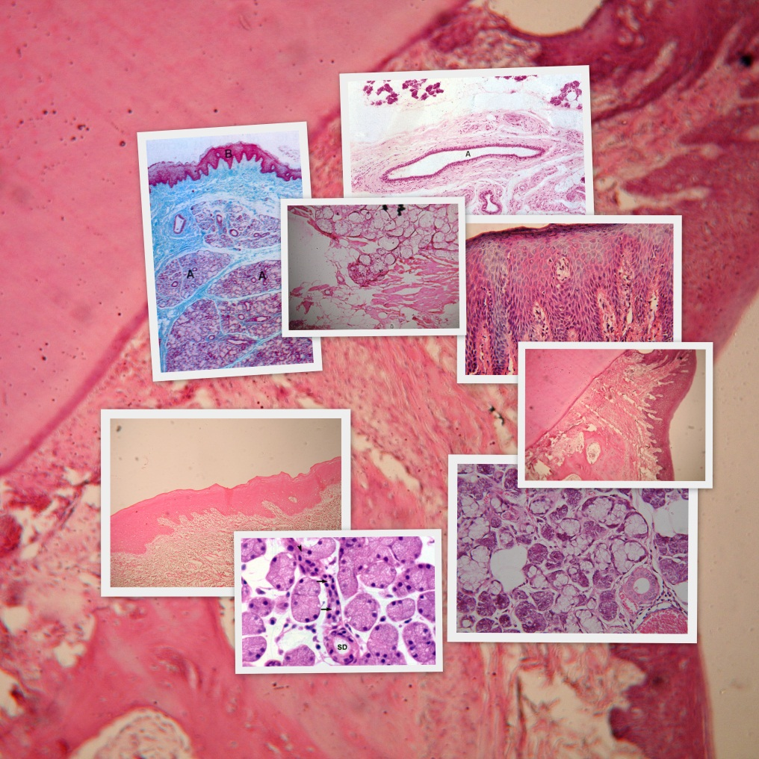
GENERAL HISTOLOGY
Department of Oral and Maxillofacial Pathology
Institute of Dental Sciences
Bareilly
Dr. --------------------

