Slide 1


Slide 2
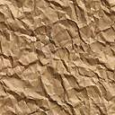
CYSTS OF JAW
Part - I

Slide 3
DEFINITION
‘A pathological cavity having fluid, semifluid or gaseous contents and which is not created by the accumulation of pus’. Most cysts, but not all, are lined by epithelium.
  (KRAMER in 1974)
Not lined by epithelium : Mucous extravasation cyst of salivary glands, Aneurysmal bone cyst & Solitary bone cyst - ‘PSEUDOCYSTS’
Reichart and Philipsen (2004) - ‘Cavities’

Slide 4
CLASSIFICATION
3 TYPES
Cysts of the jaws
Epithelial lined
Non epithelial lined
Cysts associated with Maxillary Antrum
Cysts of the soft tissues of the mouth, face neck and salivary glands
Developmental origin
Inflammatory origin
ODONTOGENIC
NON ODONTOGENIC
Radicular cyst
Residual cyst
Inflammatory collateral cyst
Paradental cyst
Solitary bone cyst
Aneurysmal bone cyst
According To Shear
Textbook on Cysts of the oral regions; Mervyn Shear; 4th edition

Slide 5
Odontogenic
Midpalatal raphe cyst of infants
Non odontogenic
Calcifying odontogenic cyst
Gingival cyst of infants
Odontogenic keratocyst
Dentigerous cyst
Eruption cyst
Gingival cyst of adults
Developmental lateral
Periodontal cyst
Botryoid odontogenic cyst
Glandular odontogenic cyst
Nasolabial cyst
Nasopalatine duct cyst
Developmental Cysts
Notes:
Odontogenic, meaning arising from odontogenic Tissues (b) Non-odontogenic, meaning cysts arising from ectoderm
involved in the development of the facial tissues

Slide 6
Mucocele
Retention cyst
Pseudocyst
Postoperative maxillary cyst
Cysts associated with Maxillary Antrum

Slide 7
Cysts of soft tissues of Mouth, Face & Neck
Dermoid and epidermoid cysts
Lymphoepithelial (Branchial) cyst
Thyroglossal duct cyst
Anterior median lingual cyst (intralingual cyst of foregut origin)
Oral cysts with gastric or intestinal epithelium (oral alimentary tract cyst)
Cystic hygroma
Nasopharyngeal cyst
Thymic cyst
Cysts of the salivary glands: Mucous extravasation cyst; mucous retention cyst; ranula; polycystic (dysgenetic) disease of the parotid
Parasitic cysts: hydatid cyst; Cysticercus cellulosae; trichinosis

Slide 8
CLASSIFICATION BY TISSUE OF ORIGIN
RESTS OF MALASSEZ
Periapical Cyst
Residual Cyst
Paradental Cyst
REDUCED ENAMEL EPITHELIUM
Dentigerous Cyst
Eruption Cyst
DENTAL LAMINA
Odontogenic Kerato Cyst
Gingival Cyst Of New Born
Gingival Cyst Of Adult
Lateral Periodontal Cyst
Glandular Odontogenic Cyst
Notes:
SOURCE: WEBSITE DATA; MARQUETTE UNIVERSITY SCHOOL OF DENTISTRY, 2001.

Slide 9
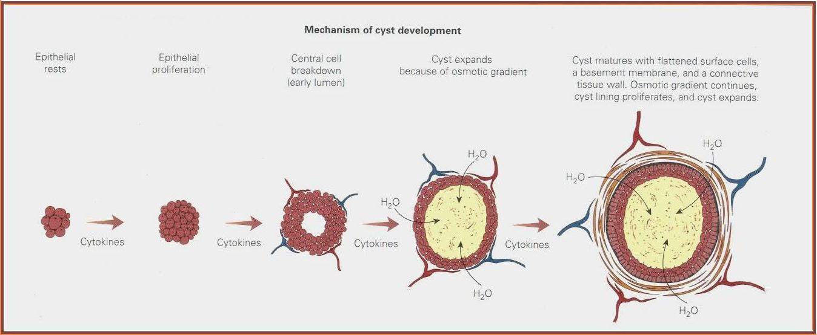
Mechanism of cyst development
Notes:
The common behavioral feature of all cysts is the stimulation of residual developmental epithelial cells, leading to proliferation but not invasion of adjacent tissues. The epithelial rests proliferate into a solid mass of epithelial cells. As the mass enlarges, the epithelial cells in the center become positioned further from the blood supply at the periphery of the mass. At some point, usually 180 to 200 um (0.18 to 0.20 mm), the cells at the center become too far removed from the nearest blood vessel to survive by nutritional diffusion. They die, creating a lumen. Their intracellular products make the lumen hypertonic, which transudates fluid into the lumen. This in turn creates a hydrostatic pressure, producing bone resorption, clinical expansion, and sometimes mild paresthesia or pain. As additional epithelial cells die off and are sloughed into the lumen, their contents perpetuate the hypertonic state and the hydrostatic pressure. The cell membranes and nuclear membranes of these sloughed cells are high in cholesterol, hence the common finding of cholesterol clefts in the lumen or even in the walls of many cysts. As the cyst enlarges, it compresses surrounding connective tissue into a connective tissue wall. The epithelial lining matures and develops a basement membrane. The cyst lining continues to proliferate, thus causing the cyst to enlarge until (1) it is removed (enucleation), (2) the proliferating cells are communicated into the oral cavity or an external surface so as to break the proliferation‐hydrostatic pressure cycle (marsupialization), or (3) the inciting cytokines are removed (via tooth removal or root canal therapy in radicular cysts)
Cyst development begins and continues by cytokine stimulation of epithelial rests and is added to by the central cellular breakdown products, which create a hypertonic intraluminal solution that transudates fluid for further cyst expansion

Slide 10
GROWTH FACTORS IN CYSTS ENLARGE MENT
Mechanism governing enlargement of the cysts - same irrespective of type
BONE RESORBING FACTOR (BRF)
HYDROSTATIC ENLARGEMENT
MURAL GROWTH
Peripheral cell division
Secretion
Transudation and exudation
Dialysis
Accumulation of cellular contents

Slide 11
INCIDENCE RATES OF ODONTOGENIC CYSTS
Ahlforn E, et.al. in 1984: out of 5914 cases
      Radicular –58.2%
      Juxta radicular-0.5%
      Residual-12%
      Kerato cyst- 5.4%
      Follicular- 18.6%
      Lateral periodontal cyst-0.8%
      Unspecified- 0.1%

Slide 12
INFLAMMATORY CYSTS

Slide 13
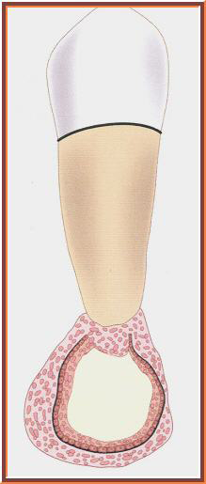
RADICULAR CYST
SYNONYMS:
Periapical cyst
Root end cyst
Apical periodontal cyst
Dental cyst

Slide 14
Types
Apical cyst 75%
Residual cyst 20%: which has remained in the jaw following extraction of involved tooth
Lateral cyst: rare, arises as a result of extension of inflammation from pulp into lateral peridontium along a lateral root canal
Soames & Southm 4th ed.

Slide 15
Etiology
Caries involving pulp
Trauma
Previous restoration
Failure of RCT

Slide 16
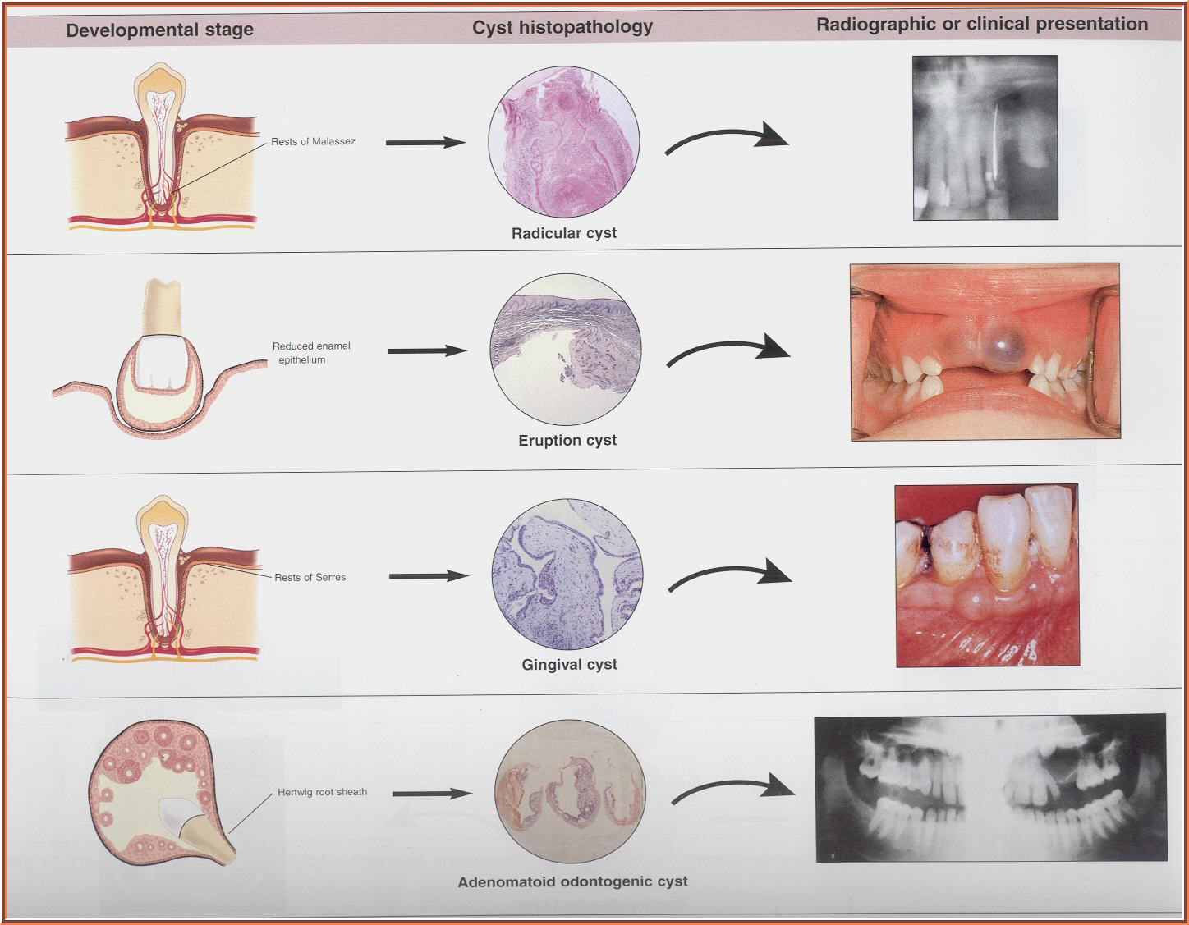
PATHOGENESIS
Develops - proliferation of subsequent cystic degeneration of ‘epithelial cell rests of malassez” - periapical region - Non Vital tooth.
The entire process of cyst development occurs in different phases:
  Phase of Initiation
  Phase of Proliferation
  Phase of Cystification
  Phase of Enlargement

Slide 17
Phase of initiation
Bacterial infection of dental pulp / direct inflammatory effect of necrotic pulpal tissue in a Non-vital Tooth  stimulation -cell rests of malassez
Phase of proliferation
Excessive and exuberent proliferation of cells  formation - large mass / island of immature proliferating epithelial cells at periapical region of affected tooth.
Phase of cystification
Centrally located cells - deprived -nutritional supply
Ischemic liquifactive necrosis, peripheral cells survive
Formation:cavity - hollow space/ lumen : mass proliferating cell rest of malassez & peripheral lining of epithelial cells
Notes:
induce bone resorption through the elaboration of interleukin‐1 and osteoclast‐activating factors.
lipids in cyst walls and fluids, Suzuki (1984) suggested that jaw cyst enlargement was related to lipo-peroxide and prostaglandin-like substances produced by lipid peroxidation of the cyst wall and fluid.

Slide 18
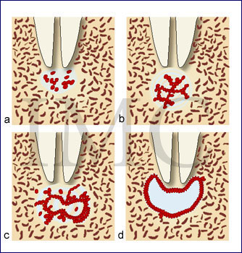
ENLARGEMENT
  Epithelial proliferation in lining
  Hydrostatic pressure generated in cyst lumen from hyperosmolarity created by cellular breakdown & sloughing of cells into lumen
  Osmotic gradient favors transudation of fluid into lumen, maintains its hydrostatic pressure , causes further resorption of surrounding bone
  Suzuki (1984) - jaw cyst enlargement - lipo-peroxide and prostaglandin-like substances produced by lipid peroxidation of cyst wall and fluid.
Notes:
Tay et al (2004) provided evidence for osteoclast recruitment and differentiation in the walls of radicular cysts.
RANK L within the fibrous wall of radicular cysts and that it was involved in osteoclast recruitment.
Bone resorption is a complex process involving highly coordinated interactions between osteoblasts and osteoclasts
that are modulated by the RANKL/RANK/OPG system. Receptor activator of nuclear κB ligand (RANKL) is secreted primarily by activated T cells and binds a cell surface receptor (RANK) to promote osteoclast differentiation and activation. Tay et al. (2004) showed immunostaining for RANKL within the fibrous wall of radicular cysts. That RANKL was involved in osteoclast recruitment was confirmed by the demonstration of tartrate-resistant acid phosphatase (TRAP) and calcitonin- receptor positive osteoclasts adjacent to the RANKL positive cells.
Collagenases also contribute to breakdown of the connective tissues and collagenolytic activity has been demonstrated in the walls of radicular cyst and it has been suggested that this might influence its expansion. Expression of MMPs in radicular cysts, including the gelatinases (MMP-2 and MMP-9) (Teronen et al., 1995a), interstitial collagenase (MMP-1) (Teronen et al., 1995b) and collagenases MMP-8 and MMP-13 (Wahlgren et al., 2001), suggesting a role for these enzymes in cyst growth and development. Inflammation in radicular cysts is also associated with increased expression of plasminogen activator (Tsai et al., 2004) which indirectly forms plasmin which may also activate MMPs

Slide 19
CLINICAL FEATURES
Most common cyst
Incidence: > 50% all jaw cyst
3rd-5th decade
M>F
Maxilla> Mandible

Slide 20
Clinical presentation
Symptomless
Pain if infected
Larger cyst can cause swelling.
Initially bony hard→crackling sound→ rubbery and fluctuant.
.

Slide 21
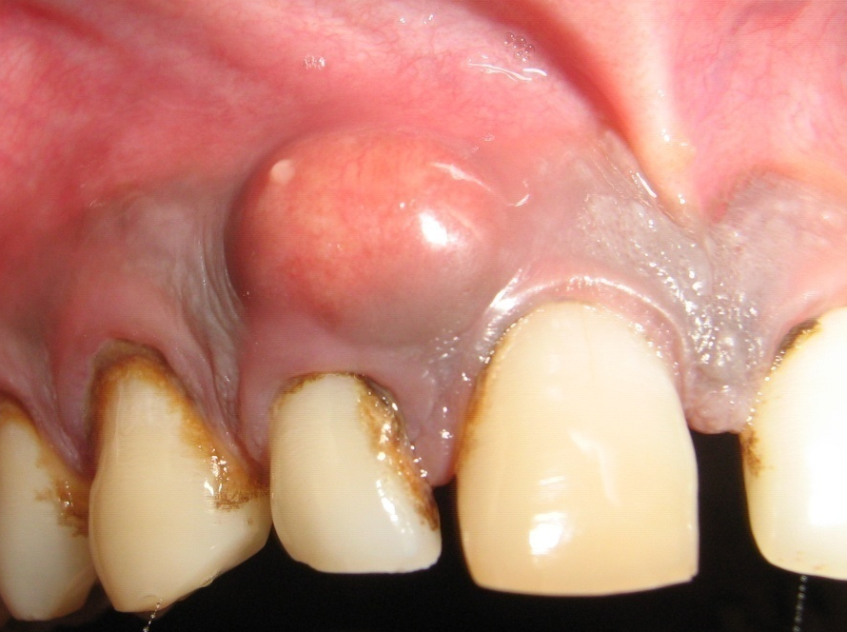
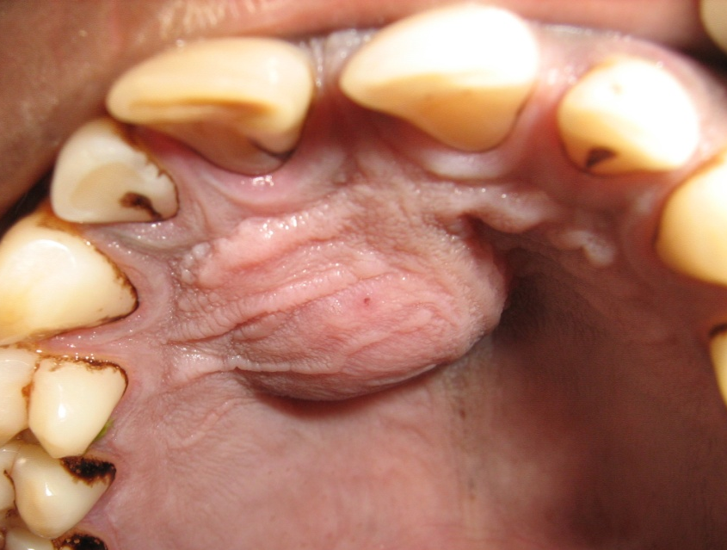
In maxilla → buccal or palatal enlargement
In mandible→ usually labial or buccal enlargement
Lingual expansion is rare in mandible.
Associated with non vital tooth.

Slide 22
Rare in deciduous teeth. 0.5% ( Lustman and Shear 1985)
Mervyn Shear 4th ed.

Slide 23
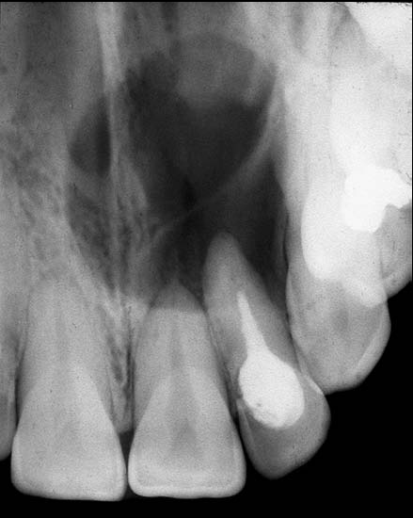
Radiologic features
Location: apex of nonvital tooth
60% in maxilla esp. around incisor and canine .
Periphery and shape: well defined cortical border
Outline is curved or circular
Internal structure:radiolucent
Dystrophic calcification → in long standing cyst

Slide 24
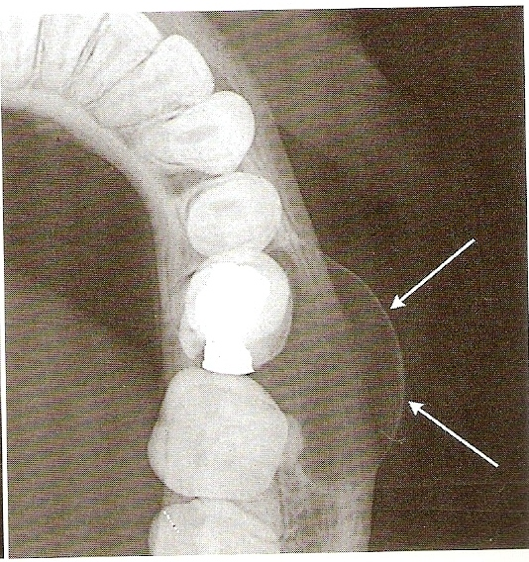
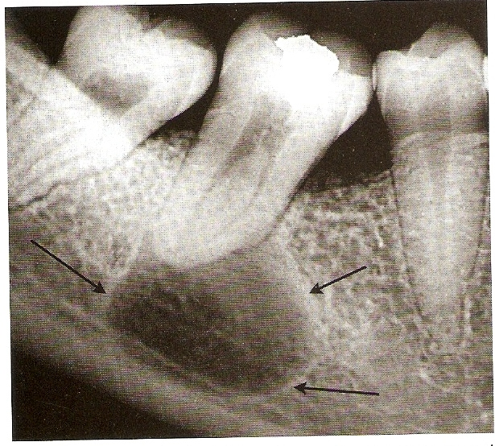
Effects on sorrounding structure:
If large displacement and resoption of root of adjacent teeth.
Resoption pattern may have a curved outline.
In rare cases resoption of involved nonvital tooth
Expansion of outer cortical plate in a curved or circular shape
Displacement of inferior alveolar canal.

Slide 25
Differential diagnosis
Apical granuloma
Periapical surgical defect
Radiolucent apical scar
Lateral periodontal cyst

Slide 26
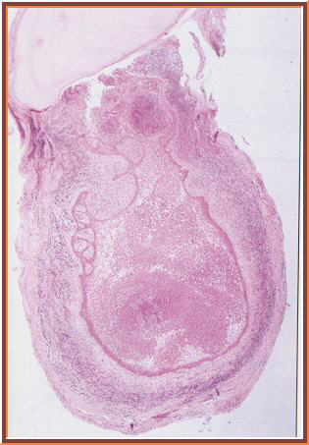
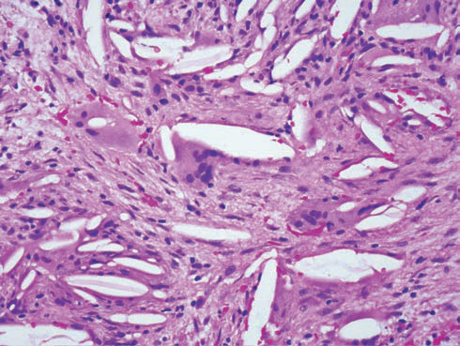
HISTOLOGICAL FEATURES
Multinucleate foreign body giant cells on surface of cholesterol clefts in wall
Lined by a nonkeratinizing stratified squamous epithelium
Russell bodies (round eosinophilic globules) within or outside plasma cell , result of very active immunoglobulin synthesis
Cellular destruction - Cholesterol -liberated , found within macrophages as foamy histiocytes
Rushton bodies, hyaline structures - eosinophilic & brittle in consistency 1st - Dewey in 1918
Notes:
Dystrophic calcifications may also be seen, and at the periphery, reactive osteophytic bone is often noted.
Browne postulated that the main source of cholesterol was from disintegrating red blood cells in a form that readily crystallizes in the tissues. Cholesterol from the above source and also from serum accumulates in the tissues because of the relative inaccessibility of normal lymphatic drainage
circulating plasma lipids were a further source of cholesterol in cysts . supported by Skaug who assayed cyst fluids for lipoproteins and cholesterol
Rushton Bodies were a secretory product of odontogenic epithelial cells formed in the same way as the secondary enamel cuticle, an opinion also held by Takeda (1985). Sedano and Gorlin (1968) believed that hyaline bodies were of haematogenous origin, and were derived from thrombi in venules of the connective tissue that had become varicose and strangled by epithelial cuffs which encircled them; recent studies :- product of the epithelium
Once the cholesterol crystals have been deposited in the fibrous capsules of the cysts, they behave as foreign bodies and excite a foreign body, giant cell reaction. In histological sections, the cholesterol crystals are dissolved out and clefts are seen surrounded by dense aggregations of multinucleate giant cells. The cholesterol masses are extruded from the fibrous wall by the foreign body reaction. Invariably, the path of least resistance is into the cyst cavity as the external surface of the cyst may consist of dense fibrous tissue, bone and mucosa. When the reaction reaches the epithelial lining, this ulcerates.

Slide 27
DIAGNOSIS
Periapical radiographs
Pulp tests
Ultrasonography - ECHO present (better than radiographs)
Fluid Aspiration
  YELLOW BROWN from the breakdown products of blood
  Cholesterol crystals –Shimmering gold /Straw color
  Protein estimation: 6.3-7.5g/100ml rich in gama globulin high molecular weight substance enters via altered permeability (implies are inflammatory exudates)

Slide 28
treatment
Conservative endodontic therapy( Bhaskar)
Decompressed through reduction of intracystic pressure
84% Success Rate ( Shah 1988)
Root resection
Enucleation
marsupilization

Slide 29
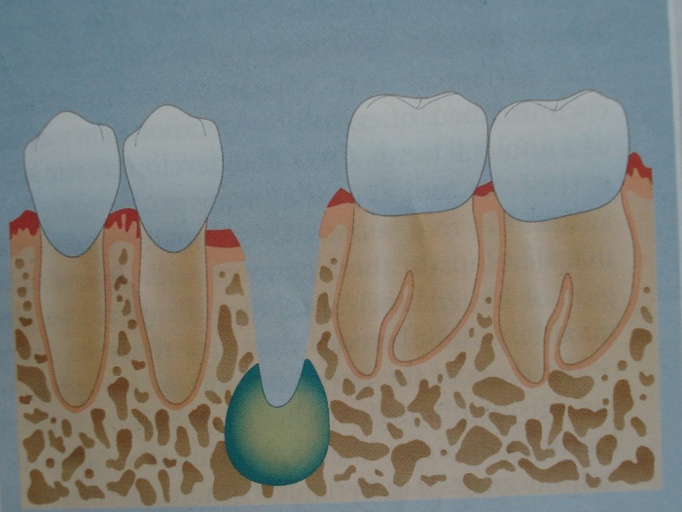
Residual Cyst
Inflammatory cyst of jaws that fails to involute after root canal therapy / tooth removal
Age: older age group
Sex: Male>Female
Site: Maxilla>Mandible
Asymptomatic
Rarely >5 to 10 mm in diameter

Slide 30
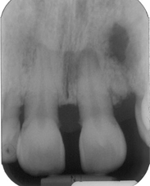
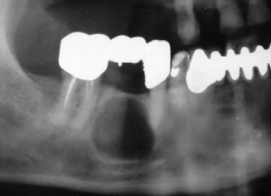
RADIOGRAPHIC FINDINGS
Residual cysts -enlarging darkening radiolucency
Will not show much bony expansion
Most are small, 1 to 3 cm, sizes > 6 cm may be seen

Slide 31
DIFFERENTIAL DIAGNOSIS
Periapical cemento‐osseous dysplasia or a sublingual salivary gland depression - anterior mandible
Idiopathic bone cavity - Remained static or enlarged only slowly

Slide 32
DIAGNOSIS AND TREATMENT
Pulp testing of adjacent teeth to rule out the possibility of a source for another radicular cyst
Exploration and enucleation of the residual cyst
Exploration and removal of any inflammatory focus, such as residual roots or root canal filling

Slide 33
INFLAMMATORY COLLATERAL CYST
SYNONYMNS
Paradental cysts/ Inflammatory paradental cyst
Mandibular infected Buccal cyst
Inflammatorypocket cyst
Eruption pocket cysts
Slater(2003)
3 -4% of all cysts
Inflammatory origin
Odontogenic epithelium
(Craig 1976)
Cell rests of Malassez
Reduced enamel epithelium
Clinical variant - Dentigerous cyst
Notes:
They named this entity the mandibular infected buccal cyst to emphasise its origin in inflamed periodontal tissues of partially or fully erupted molars

Slide 34
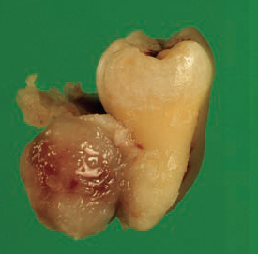
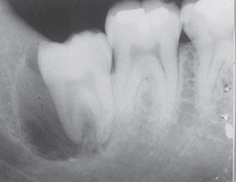
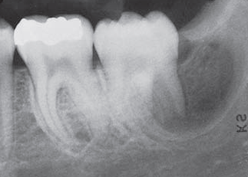
Male predominance
Age:- 10 - 39 , 2/3rd in -3rd decade
Arises - partially erupted 3rd molar (rarely, other teeth)
Partially erupted tooth displaces cyst buccally - lies against buccal roots or bifurcation
Unilocular, Well demarcated, radiolucency distal to partially erupted tooth, often buccal superimposition.
Intact Periodontal Ligament space, TOOTH VITAL
1st – 2nd molars - Juvenile Paradental Cyst
Swelling and pain not prominent features
Notes:
The tooth is always vital, which allows a lateral radicular cyst to be excluded. The diagnostic features
are the young age of the patients, the mandibular molar site, the buccal periostitis, the usually vital pulp and the radiographic preservation of the continuity of the apical lamina dura. The cyst is always situated on the buccal
surface of a mandibular molar, most frequently the first permanent molar, after partial or complete eruption. The
associated tooth is usually tilted so that the apices are adjacent to the lingual cortex, a feature that is demonstrable
in occlusal radiographs.

Slide 35
TREATMENT
Colgan et al. (2002) -food impaction- plays role- occlusion of the opening of the pocket – currettage done
Paradental cysts associated with third molars - removed along with offending tooth
Juvenile lesions enucleation of cyst without removal of associated tooth

Slide 37
Developmental
Odontogenic Cysts
Odontogenic keratocyst
Periodontal cyst
Dentigerous cyst
Calcifying odontogenic cyst
Developmental lateral
Eruption cyst
Glandular odontogenic cyst
Gingival cyst of adults
Gingival cyst of infants
Botryoid odontogenic cyst

Slide 38
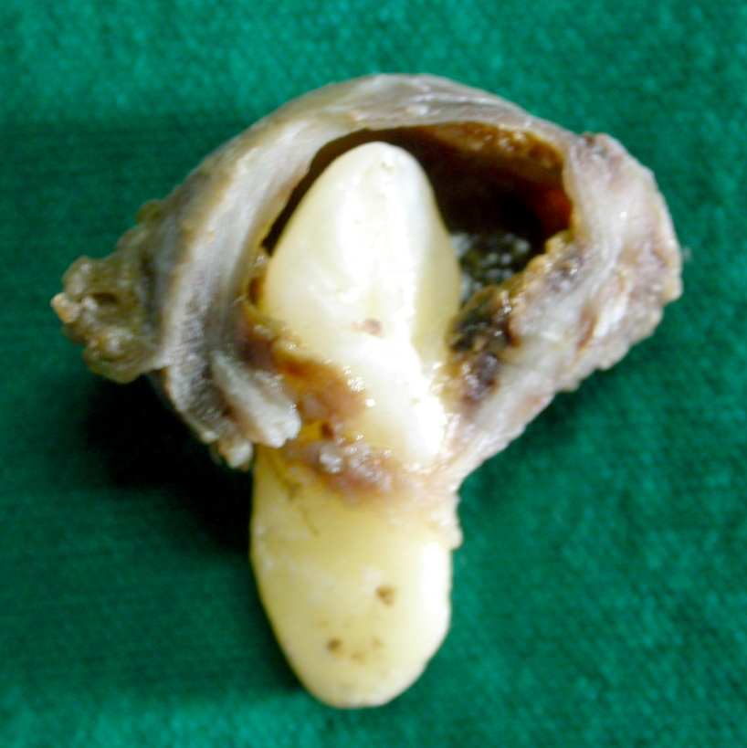
DEntigerous cyst (follicular cyst)
Dentigerous cyst is one which encloses the crown of an un-erupted tooth by expansion of its follicle & is attached to the neck.
Mervyn Shear

Slide 39
SYNONYM
FOLLICULAR CYST
PERICORONAL CYST

Slide 40
Second most common type of cyst in the jaws
Forms about 16% of oral cyst
dentigerous cyst is one of the most common jaw bone cyst (15.7%), Mourshed(4) and Daley et al.,
Asymptomatic
Follicular spaces >5mm (normal 2-3 mm) should be closely followed for potential development of dentigerous cysts.
OOO 2008;105:139-43

Slide 41
associated with unerupted teeth and seemingly attached to the amelocemental junction.
British Dental Journal 2002; 192: 75–76

Slide 42
Clinical features
Age – 10 -30 years
Sex – M > F (2: 1)
Race – Whites > Blacks
Site –
    Mandibular 3rd molar,
    Maxillary permanent canines,
    Mandibular premolars &
    Maxillary 3rd molars
Langlais and langland

Slide 43
Rarely with supernumerary teeth and odontomas (5 to 6%). Lustman and Bodner (1988).

Slide 44
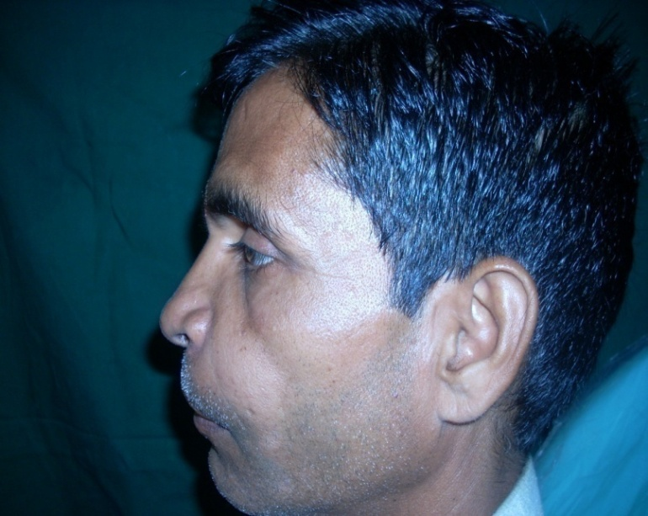
Can attain a size of 10-15 cm.
Bony expansion and facial fullness.
Painless unless secondarily infected.
Larger cyst can cause pathological fracture.
Can resorb one or both cortices.
MARX & STERN

Slide 45
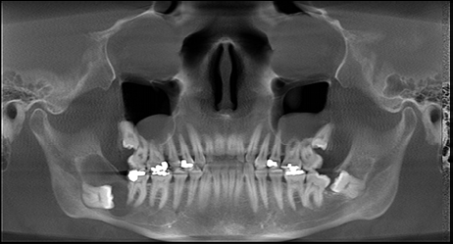
RADIOGRAPHIC FEATURES
Unilocular lucency asso. with crown of un-erupted tooth
Well defined sclerotic border
Root resorption ( 55%)
Either resorbs or displaces the adjacent teeth.

Slide 46
Can displace the tooth into inferior border of the mandible, ramus of the mandible, nasal floor, and maxillary sinus .
Expansion of the outer cortex

Slide 47
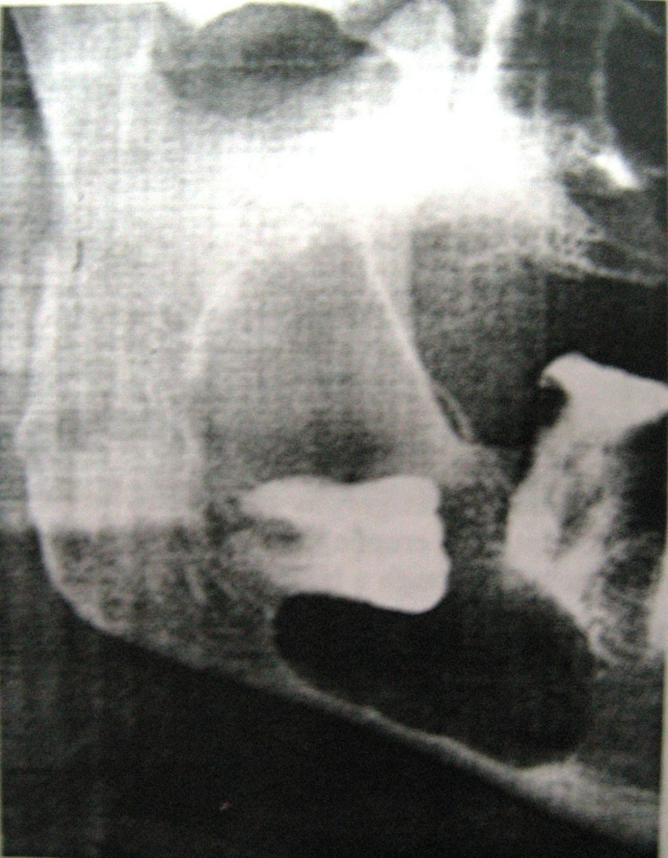
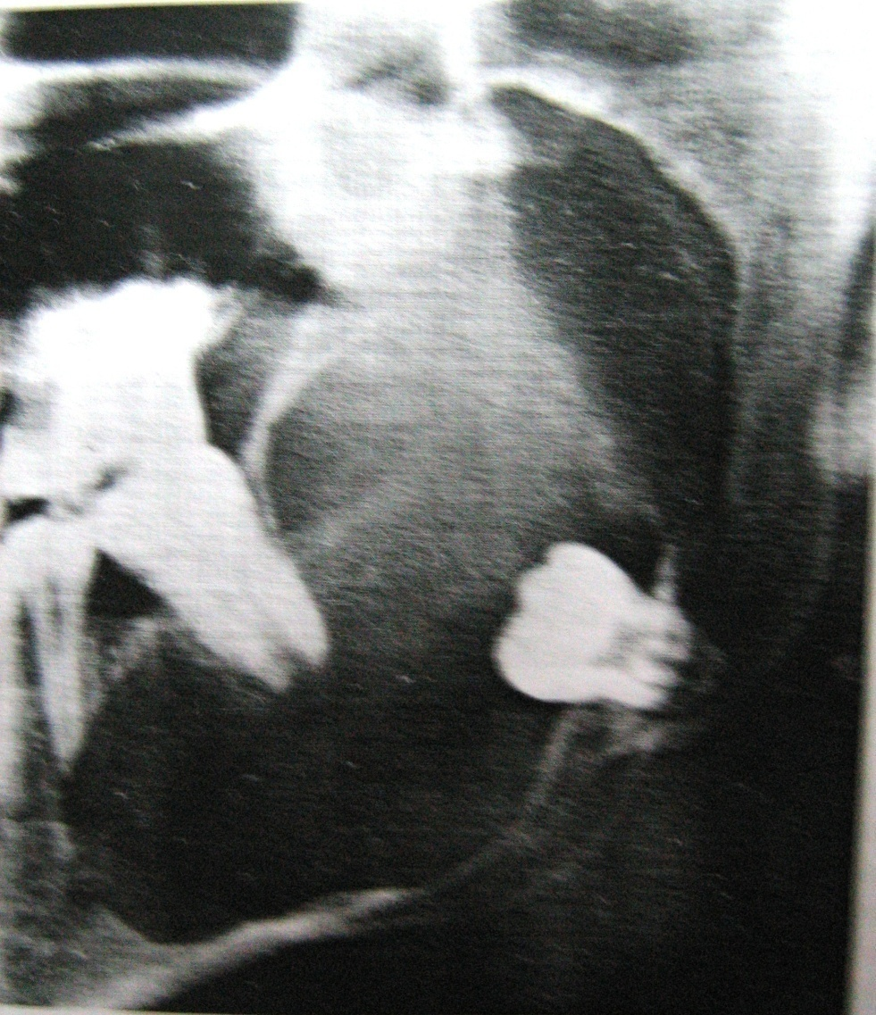
Displacement of 3rd molar, scalloping at margin in ramus
Displacement of 3rd molar and resoption of apex of 2nd premolar

Slide 48
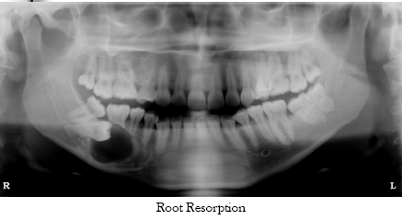


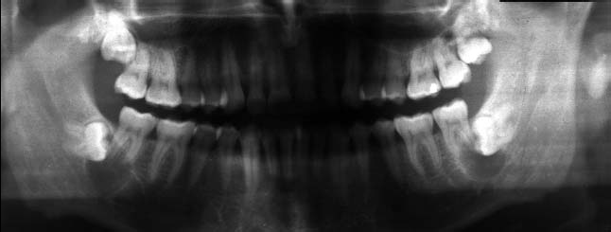
Radiolucencies asso. With both impacted 3rd molar

Slide 49
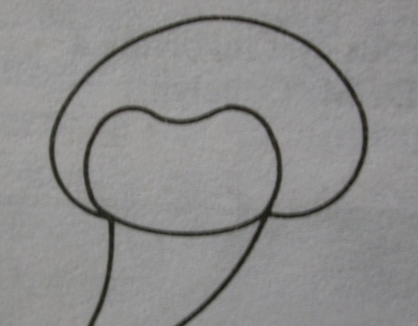
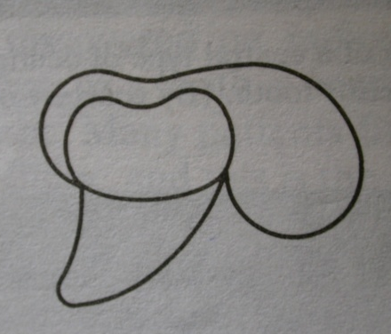
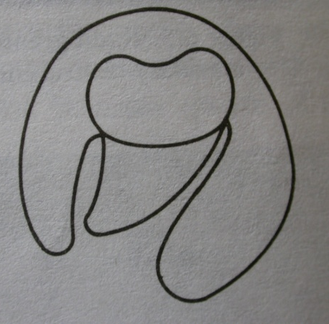
Radiological types
Central
Lateral
Circumferential

Slide 50
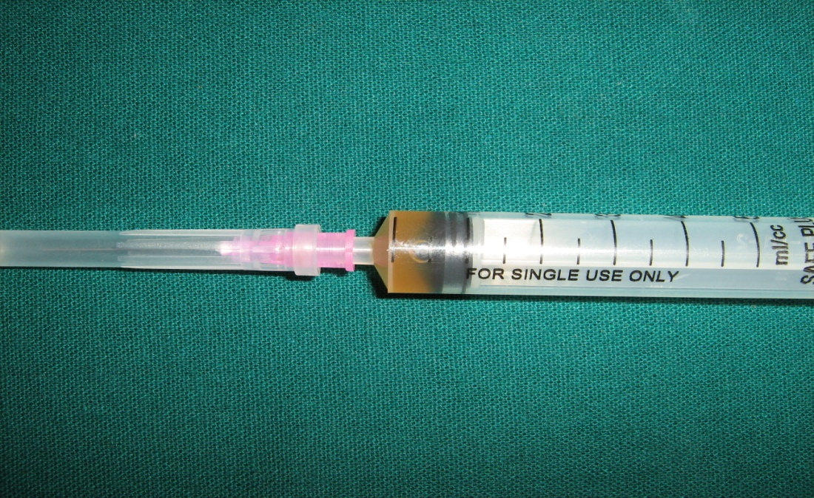
Diagnostic work-up
Aspiration : straw colored fluid
cholestrol crystals

Slide 51
INVESTIGATIONS
Clinical examination
Tooth vitality tests
Fine needle aspiration cytology (FNAC)
Radiographs
Biopsy
Ultrasound

Slide 52
Differential diagnosis
Hyperplastic follicle
Odontogenic keratocyst (OKC)
Adenomatoid odontogenic tumor (AOT)
Calcified epithelium odontogenic cyst (CEOC)
Ameloblastic fibroma or Cystic ameloblastoma
Radicular cyst

Slide 53
TREATMENT
Enucleation
Marupilization in some cases

Slide 54
ODONTOGENIC KERATOCYST
‘Odontogenic Keratocyst’ introduced by (Philipsen 1956).
‘Keratocystic Odontogenic Tumour’ (Philipsen, 2005)

Slide 55
CLINICAL FEATURES
3-11% of all odontogenic cysts
Most aggressive and Recurrent
Characteristics resembling : a cyst and a benign tumor
Age: infancy to older age : Peak:2nd - 3rd decade
Sex: Males>Females.(1.7:1) { in syndrome F>M }
Mandible posterior– 50% Ramus and 3rd molar area >Maxilla tuberosity area >Anterior cuspid.
Bimodal age distribution - second peak -5th decade

Slide 56
Pain, swelling or discharge
Paraesthesia of lower lip or teeth
Pathological fractures
Resorption of bone - cortex and inferior border.
  Extends further anteroposteriorly than buccolingually
  Clinically observable expansion of bone occurs late
Resorb roots of adjacent teeth -smooth and regular pattern
Enlarge to produce deflection of roots of teeth

Slide 57
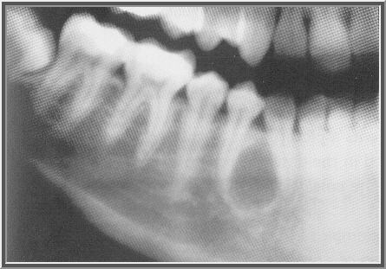
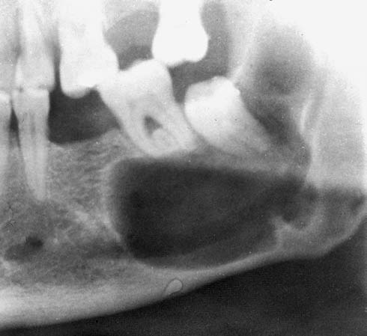
RADIOLOGICAL FEATURES
Small, round or ovoid, radiolucent areas
Well demarcated - distinct sclerotic margins
Smooth periphery mostly
Scalloped margins - suggest unequal growth activity in different parts of cyst lining
Notes:
Sclerotic margins –in slowly enlarging lesions, but part of the border may be diffuse.

Slide 58
Main (1970)
  OKC- embraces an adjacent unerupted tooth ‘Envelopmental’
  Formed in place of a normal tooth ‘Replacement’
  Those in ascending ramus away from teeth ‘Extraneous’
  Adjacent to roots of teeth - mandibular premolar region, indistinguishable radiologically from lateral periodontal - ‘Collateral’

Slide 59
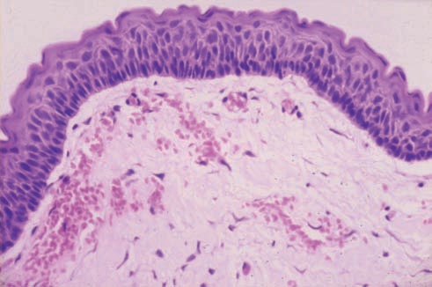
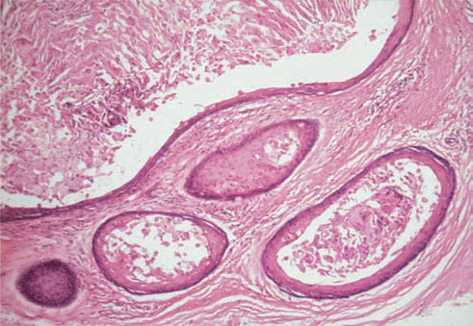
HISTOLOGY
Lined by a regular, narrow, keratinised, stratified, squamous epithelium, about 5–8 cell layers thick and without rete ridges
Orthokeratinised OKCs have a substantially lower recurrence rate than parakeratinised
Satellite microcysts in wall of OKC.
Notes:
fibrous capsule of the OKC is usually thin with relatively few cells widely separated by a stroma which is often rich in mucopolysaccharide and resembles mesenchymal connective tissue

Slide 60
PREOPERATIVE DIAGNOSIS
Fluids from keratinising cysts –
  Soluble protein levels < 3.5g/100mL (mean 2.2g/100mL)
  Whereas Non-keratinising cysts : 5.0–11.0g /100mL (mean - 7.1g per 100mL)
Notes:
Fully keratinised linings were impervious to all proteins whereas the usual type of radicular or dentigerous cyst wall would at least slowly transmit the smaller proteins

Slide 61
Computerised tomography - Voorsmit (1984) 1st to use
Magnetic resonance imaging - Minami et al. (1996)
Histopathology
Transmission electron microscopy
Immunohistochemistry
Notes:
CT images revealed features such as areas of thinning, perforation and cortical loculation.
T2 relaxation times of the cyst components were significantly shorter in the OKCs than in the ameloblastomas. On what are termed T1-weighted images, OKCs imparted hypointense to isointense signals to muscle. Epithelial linings with increased signal intensity on T1- weighted images proved to be infected cysts. On T2- weighted images, small crevices could be visualised, as could small daughter cysts.

Slide 62
DIFFERENTIAL DIAGNOSIS
Ameloblastoma; older age, multilocular, amber colored fluid.
Dentigerous cyst : impacted tooth, thin straw colored fluid,
Aneurysmal bone cyst ; under 20yrs age, trauma, soap bubble\honeycomb, multinucleated giant cells.

Slide 63
Odontogenic Myxoma ; 10-30yrs, mandible, premolar & molar, missing teeth, tennis racket, rarely show root resorption
Lateral periodontal cyst ; mandibular bicuspid & canine
Browns tumor of hyper pararthyroidism ; serum chemistry
CEOT (calcifying epithelial odontogenic tumor)
Cherubism ; younger age and bilateral involvement

Slide 64
TREATMENT
marginal excision - resection
resection of involved bone followed by primary or secondary reconstruction plates stainless steel titanium and bone grafting procedures with iliac crest grafts.
In recurrent lesion resection is treatment of choice

Slide 65
Carnoys Solution : Stoelinga & Vanhoelst (1981) - treatment with enucleation, excision of the overlying mucosa and or/ muscle, if attachment existed to eliminate epithelial rests and or microcysts and care full cauterization of the bony defect with carnoys solution.
  Composition Of Carnoys Solution:
  Ethyl Alcohol - 60ml
  Glacial Acetic Acid - 10ml
  Chloroform - 30 ml

Slide 66
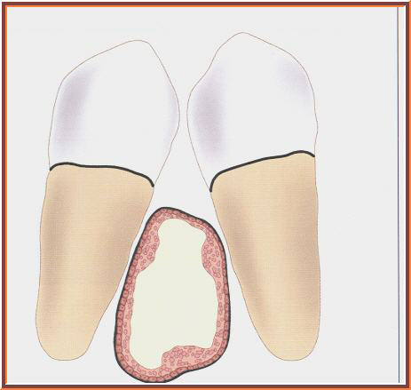
LATERAL PERIODONTAL CYST
Arises from dental lamina rests that lie within the interradicular crestal or midroot‐level bone ; develops between teeth

Slide 67
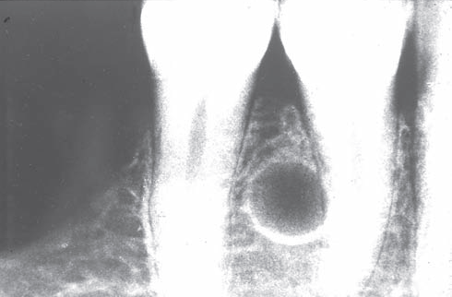
Age – 22-85 yrs (mean -50 yrs)
Equal gender distribution (males slightly ⬆)
Mandibular premolar followed by maxillary premolar region
May be symptomless
Associated teeth – vital, nonmobile
May show root divergence
No soft tissue swelling
No root resorption
Radiographs - round or oval well circumscribed radiolucent area, usually with a sclerotic margin.
Notes:
The margins are well corticated, indicative of slow enlargement

Slide 68
DIFFERENTIAL DIAGNOSIS
Mental foramen
Botryoid odontogenic cyst – a variant – differs histologic features, ↑ recurrence
Odontogenic keratocyst
Early ameloblastoma
Idiopathic bone cavities

Slide 69
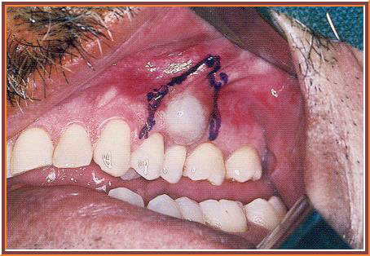
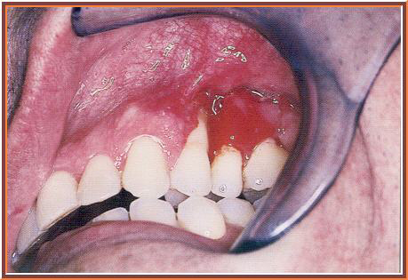
TREATMENT
Treated by surgical enucleation- mucoperiosteal flap
Paradental cyst

Slide 70
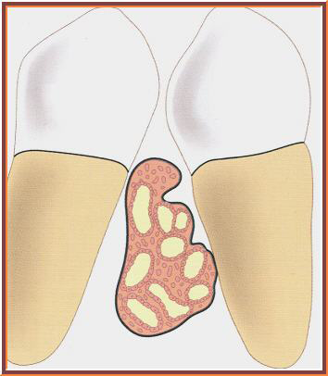
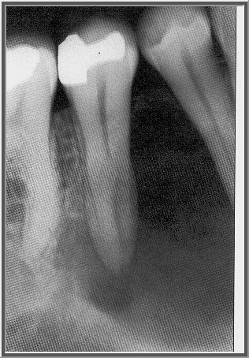
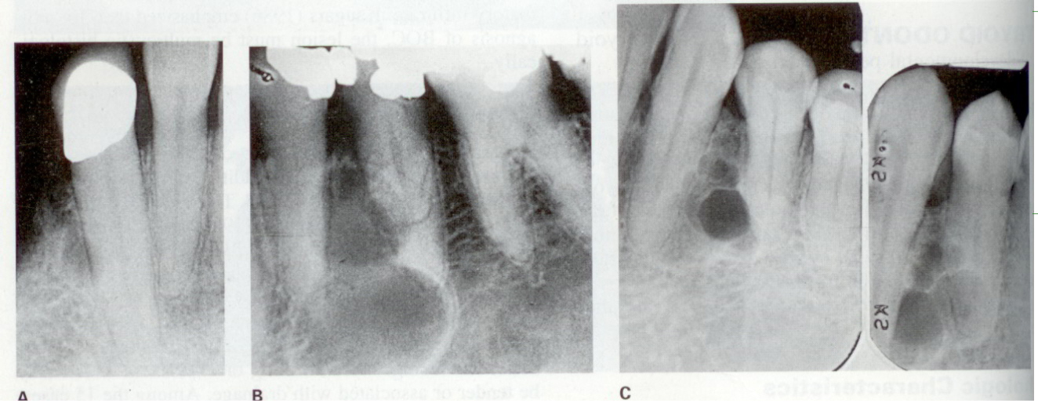
BOTRYOID ODONTOGENIC CYST
Creates - Multilocular radiolucency between teeth resemble a grape cluster (botryoid)
Notes:
Which corresponds to a cyst lining with numerous lobulations and thickened epithelial tufts again resembling a grape cluster. These numerous loculations impart an added degree of difficulty in the removal of a botryoid odontogenic cyst. Therefore, the probability of an incomplete removal is greater, causing a higher recurrence potential.

Slide 71
5th- 7th decade
Mandible> Maxilla ( more in anterior region)
Mostly asymptomatic, sometimes- pain, swelling, paresthesia, discharge may be present

Slide 72
CALCIFYING ODONTOGENIC CYST
0.9% of all cysts
Majid Sanatkhani, Hosein Hoseini Zarch, Atessa Pakfetrat, FarnazFalaki Odontogenic Cysts: a Clinical and Radiographic Study of 58 Cases. Australian Journal of Basic and Applied Sciences, 5(5): 329-333, 2011
Notes:
Synonyms for the dentinogenic ghost cell tumour have been listed as ‘calcifying ghost cell odontogenic tumour’, ‘odontogenic ghost cell tumour’ and ‘dentinoameloblastoma’, while the dentinogenic ghost cell tumour is considered a solid variant of the calcifying odontogenic cyst

Slide 73
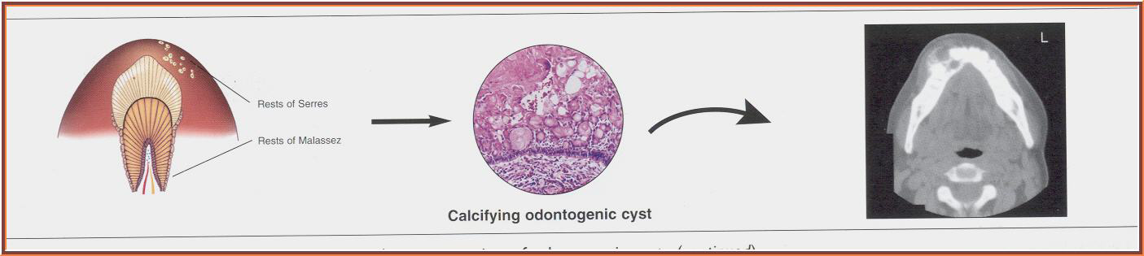
Age – 1-82 yrs (peak : 2nd decade)
Equal gender distribution
Maxilla> Mandible (anterior region)
Swelling present
Intra-osseous lesions - hard bony expansion
Extraosseous lesions -pink to red, circumscribed elevated masses measuring up to 4cm in diameter

Slide 74
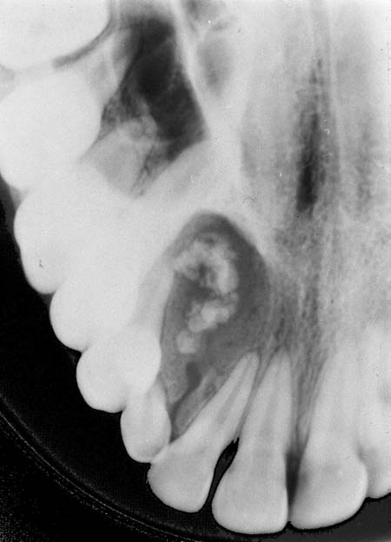
RADIOLOGICAL FEATURES
Regular/ irregular outline- ill defined or well demarcated margins
Irregular calcified bodies of varying size and opacity may be seen in the radiolucent area
Displacement of teeth
Resorption of roots

Slide 75
5 Radiologic Signs :-
Radiopaque foci- clustered around occlusal or incisalmsurface of impacted tooth
Radiopaque material – clustered towards edge of lesion
Radiopaque foci resemble- compound / complex odontome
Impacted tooth- not a permanent molar
Expanded bone appears perforated

Slide 76
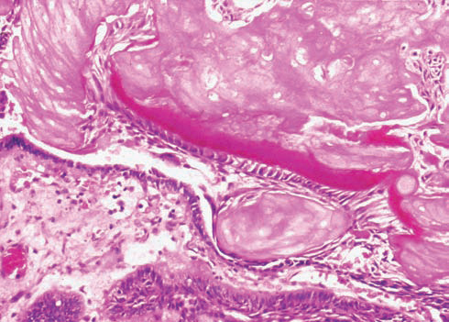
HISTOLOGIC FEATURES
WHO 1992
‘A cystic lesion - epithelial lining shows well-defined basal layer of columnar cells, an overlying layer - many cells thick and may resemble stellate reticulum, and masses of “ghost” epithelial cell that may be in in the epithelial lining or in the fibrous capsule
“Ghost” epithelial cells may become calcified.
Ghost cells - enlarged, ballooned, ovoid or elongated elliptoid epithelial cells represent an abnormal type of keratinisation & have affinity for calcification
Sheets of ghost cells
Notes:
Dysplastic dentine may be laid down adjacent to the basal layer of the epithelium and in some instances the cyst is associated with an area of more extensive dental hard tissue formation resembling that of a complex or compound odontoma
calcifying odontogenic cyst was a unicystic process that developed from reduced enamel epithelium or remnants of odontogenic epithelium in the follicle, gingival tissue or bone. The ghost cells are found in groups, particularly in the thicker areas of the epithelial lining. The ghost cells may be in contact with the connective tissue wall of the cyst where they may then evoke a foreign body reaction with the formation of multinucleate giant cells.

Slide 77
Eruption cyst
Occurs as tooth is erupting
Compressible expansion of soft tissue ridge smooth swelling - either the colour of normal gingiva or blue
Radiograph shows signs of eruption.
No radiolucency, but soft tissue thickness seen.

Slide 78
History of about 3–4weeks duration
Enlarge to: 1–1.5 cm
Treated by Marsupialisation

Slide 79
Gingival cyst of adults
0.6% of all odontogenic cysts
Age -4th-6th decade
F>M (65:35)
Mandible > Maxilla - Premolar–canine region

Slide 80
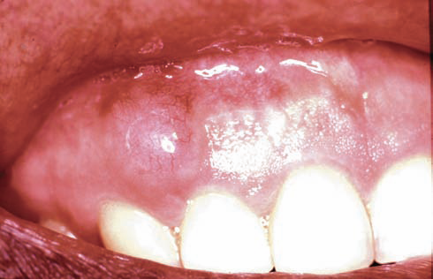
History :- Slowly enlarging, painless swelling.
Round to oval, well circumscribed , < 1cm
Attached gingiva / interdental papilla, on facial aspect
Surface - smooth ; Colour of normal gingiva or bluish
Soft & fluctuant
Adjacent teeth - usually VITAL

Slide 81
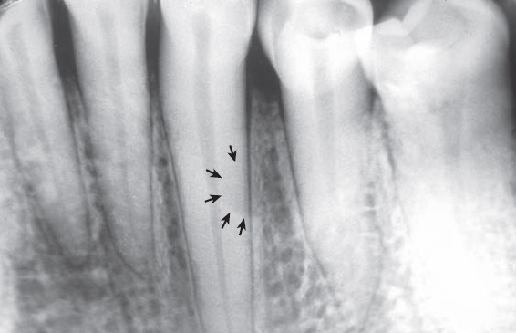
Radiographic – faint round shadow indicates superficial bone erosion

Slide 82
Treatment
Local surgical excision
No tendency for recurrence

Slide 83
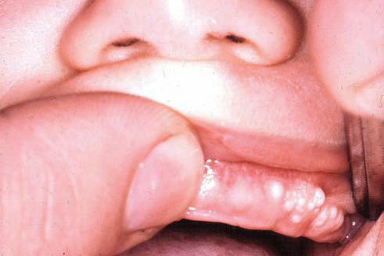
Gingival cysts of infants
Small & white /cream coloured - arise from dental lamina
According to Fromm, found only on crests of maxillary and mandibular dental ridges
Rarely seen after 3 months age
Undergo involution and disappear, or rupture through surface epithelium & exfoliate

Slide 84
Glandular odontogenic cyst
Rare- 0.2%; more recurrence
Age- peak – 6th decade (30-80 yrs)
M>F(55:45)
Mandible>Maxilla (mostly anterior region)
Painless, swelling
Peripheral ostectomy + enucleation reduce recurrences

Slide 85
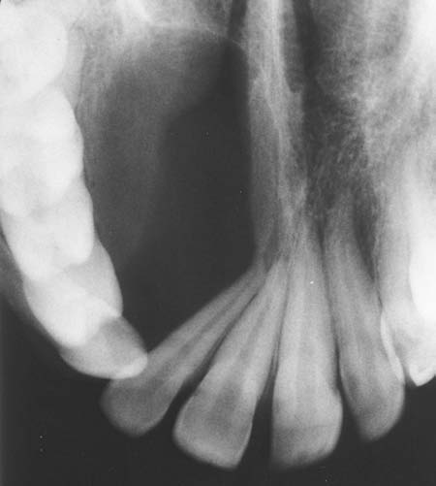
RADIOGRAPHIC FEATURES
Unilocular / multilocular : with or without well-defined margins
Tooth displacement
Root resorption
large unilocular radiolucent area with a
smooth corticated margin

Slide 86
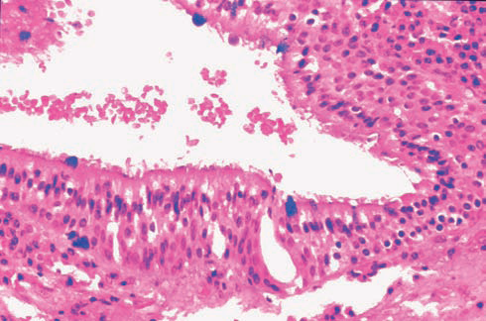
HISTOLOGIC FEATURES
Superficial layer of epithelial lining consists of columnar or cuboidal cells
Intra-epithelial crypts or microcysts or pools lined by cells

Slide 87
TREATMENT
Enucleation – complete cystic lining

Slide 88
Cyst Type | Site - tooth relationship | Sex M:F | Age Range | Radiographic Features
Radicular periodontal | At apex of non vital tooth | 3:2 | 20-50yrs | Unilocular
Residual cyst | Causative tooth is extracted | Equal | >50yrs | Unilocular
Paradental cyst | Related to inflammed third molar follicle | 4:1 | 20-29 | Unilocular over roots of third molar
Dentigerous cyst | Upper 3s and lower 8s | 2;1 | 10-40 | Unilocular containing crown of unerupted tooth
OKC parakeratinized | Molar region, impacted tooth | 2:1 | 40+ | Multilocular
OKC Orthokeratinized | Molar region | 3:2 | 20-40 to 60+ | Unilocular
Calcifying odontogenic cyst | Canine and incisor region | 1:3 | 20-30 | Unilocular with calcifications Vital teeth Associated with odontomas

Slide 89
Cysts of Orofacial Region

Slide 90
Mid palatal raphae cyst of infants
Nasopalatine duct cysts
Nasolabial cysts
Non Odontogenic

Slide 91
Midpalatal Raphé Cyst Of Infants
Arise from epithelial inclusions at line of fusion of palatine shelves and nasal processes
Small and white or cream coloured
Rarely seen after 3months of age
Undergo involution and disappear, or rupture through surface epithelium & exfoliate
Notes:
Epstein’s pearls are those that occur along the midpalatine raphé and are not of odontogenic origin, whereas Bohn’s nodules are found on the buccal or lingual aspects of the dental ridges

Slide 92
Nasopalatine duct cyst
Incisive canal cyst

Slide 93
Soft tissue swelling of palatal midline
Smaller cysts - swelling behind maxillary central incisors
Larger cysts -labial expansion , midpalatal expansion often compressible - palatal bone resorbed beneath mucosa
drainage - salty or unpleasant taste
M>F (2:1 ratio)
Age range : 30‐ 60 years

Slide 94
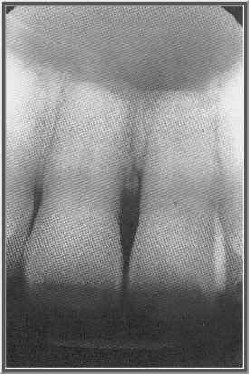
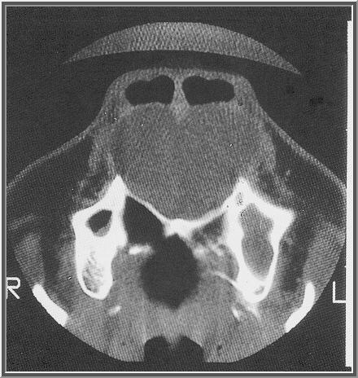
Radiographic findings
Large lesions revealing a midline, heart‐shaped, unilocular radiolucency
Create a smooth, regular resorption of incisor roots

Slide 95
Differential diagnosis
Periapical granuloma
Radicular cyst
Primordial cyst related to supernumerary tooth
Notes:
Chondrosarcoma is reasonable to consider since this is one of the preferred locations for this rare tumor of the jaws

Slide 96
Diagnosis & Treatment
Pulp testing
Plain radiographs
Aspiration provide strong evidence of its cystic nature
Enucleated from bony cavity and separated from palatal periosteum by direct vision.
Palatal approach is best

Slide 97

Nasolabial cyst
Very rare cyst limited to soft tissue
Because no bone is involved, its former name, nasoalveolar cyst, inappropriate

Slide 98

Middle‐aged adults
4:1 predilection for women
Painless round mass within skin adjacent to ala of nose around uppermost portion of nasolabial crease
Doughy and sometimes compressible
Location - subcutaneous & external to facial musculature, may cause oral mucosa to bulge

Slide 99
Differential Diagnosis
Canine space abscess from an odontogenic infection
Sebaceous cyst or an implanted epidermal inclusion cyst (stratified squamous cells) ; nasolabial cyst (pseudostratified columnar cells)
Notes:
sebaceous cyst or an implanted epidermal inclusion cyst clinically and histologically resemble a nasolabial cyst. In such cases, a thorough histopathologic review of the epithelial lining is necessary to distinguish them. In the nasolabial cyst, the majority of its lining is pseudostratified columnar cells rather than stratified squamous cells as are found in the other two

Slide 100
Diagnosis & Treatment
Pulp testing of maxillary teeth in the affected area - to rule out odontogenic infection
Surgical pericapsular excision

Slide 101
Non-Epithelial-lined Cysts
Solitary Bone Cyst
Aneurysmal Bone Cyst

Slide 102

Aneurysmal bone cyst
1st - Jaffe and Lichtenstein (1942) -characteristic ‘blown-out’ contour of bone seen in radiographs
1st report involving craniofacial skeleton - Bernier and Bhaskar (1958)
Its cavities or spaces - lined with young fibroblasts rather than epithelium.
Notes:
Significant hemorrhage can arise , since all central giant cell tumors have a venous pressure bleeding quality, and those with larger blood‐filled spaces will exhibit a greater bleeding tendency

Slide 103
Clinical Features
Age- 1st 3 decades (peak- 2nd decade)
Gender- F>M
Site - mandible - ( molar region, ramus) rare- anterior
Firm swellings – painful
Relatively rapid – onset
H/o- recent displacement of teeth – vital
Lesion perforates cortex , covered by periosteum / only a thin shell of bone - springiness or egg-shell crackling
Not pulsatile, bruits are not heard

Slide 104


Radiological Features
‘Ballooning’ growth pattern -radiolucent area - elevation of periosteum  ovoid or fusiform expansion of bone with the typical ‘blown-out’ cortical expansion
Unilocular
Longer-standing lesions -‘soap-bubble’ appearance
May become progressively calcified (Kransdorf and Sweet, 1995).
ballooning expansion of the cortex

Slide 105
Treatment
Curettage
19% recurrence rate

Slide 106


