Slide 1
Orthodontic intrusion:
A contemporary review
Nabil M. Al-Zubair
journal of orthodontic research
DOI:
10.4103/2321-3825.140625

Slide 2
Contents
Introduction
Type of intrusion
Clinical observation and tissue reaction
Biomechanical methods

Slide 3
Introduction
Nikolai defined it as “a translational form of the tooth movement directed apically and parallel to the long axis”,
Burstone defined it as “apical movement of the geometric center of the root in respect to the occlusal plane or a plane based on the long axis of the tooth.”

Slide 4
Labial tipping of an incisor around its center of resistance produces pseudointrusion, which can also correct the deep bite.
Orthopedic intrusion referring to superior displacement or, even better, to inhibition of inferior movement of the maxillary complex, and it is achieved with the use of functional appliances or high pull headgear with or without a functional appliance

Slide 5
Types of Intrusion
Relative intrusion
Absolute intrusion

Slide 6
Relative intrusion
It is achieved by preventing eruption of the incisors while growth provides vertical space into which the posterior teeth erupt
Can be achieved with continuous archwires by placing a reverse curve of Spee in the mandibular arch wire, and an exaggerated curve of Spee in the maxillary arch wire

Slide 7
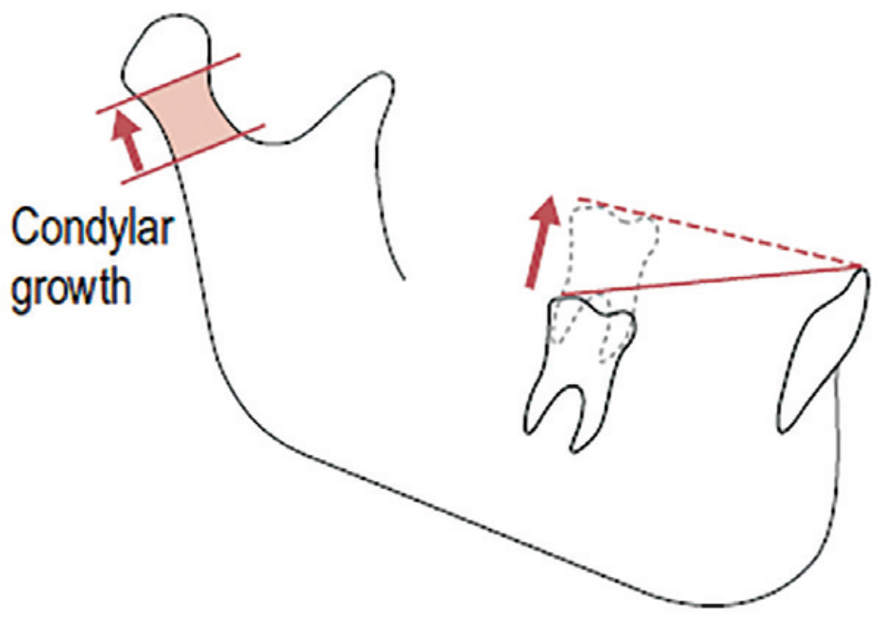
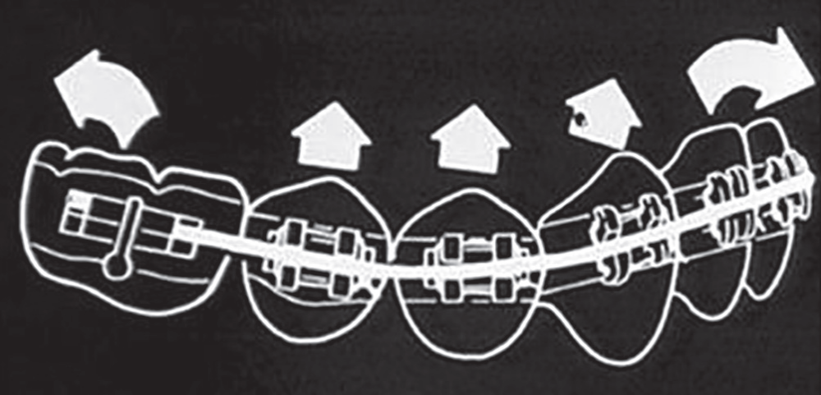
Notes:
Relative intrusion of the incisors is accomplished by labial tipping of the incisors and extrusion of other teeth in the arch, without any actual intrusion, as the diagram shows. Therefore, in the leveling phase any wire can relatively intrude teeth. However, an intrusion wire, is used when there is a necessity for absolute intrusion of teeth, where tipping and extrusion of other teeth is not in demand

Slide 8
Absolute intrusion
There is pure intrusion of the incisors without extrusion of the posterior teeth
Teeth being apically pushed into supporting bone, it requires a mechanical arrangement other than a continuous archwire attached to each tooth.
Light continuous force directed toward the tooth apex is the key to successful intrusion

Slide 9
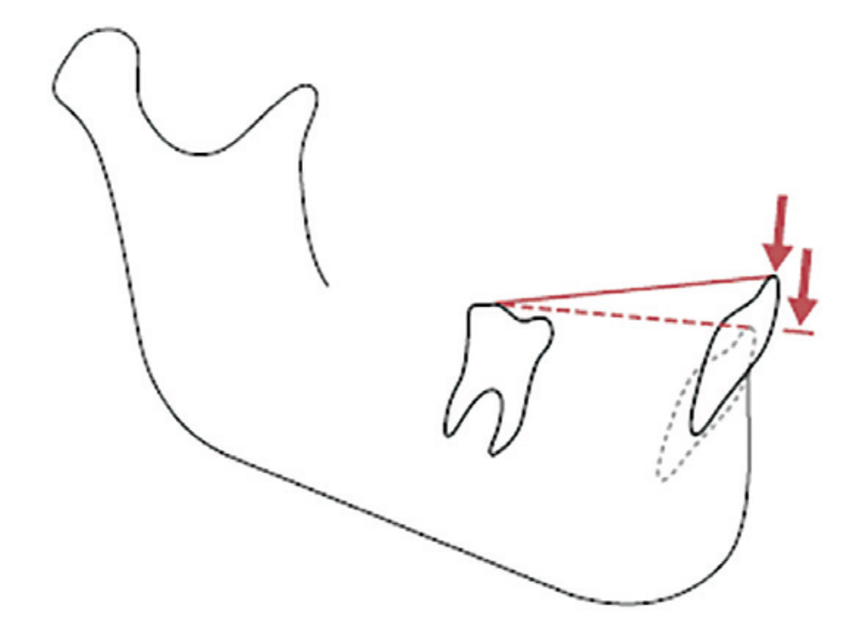
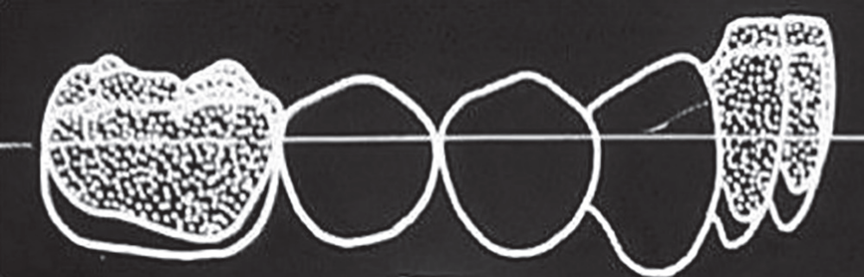
Notes:
Incisors being intruded, using the molars as anchorage as the diagram shows. There is an equal and opposite extruding force occurring on the molars, as with every force in orthodontics. Pure absolute intrusion is preferable accomplished with the use of mini-implants

Slide 10
Methods of intrusion
Relative intrusion
Anterior bite plates contacting the anterior dentition while allowing posterior eruption
Twin-blocks, where differential molar eruption can occur by trimming the posterior blocks
Anterior bite turbos
Reverse curve of spee

Slide 11
Methods of absolute intrusion
J-Hook headgear
Bypass and segmental mechanics
Temporary skeletal anchorage (micro implants)

Slide 12
Clinical Observations and the Tissue
Reactions
Intrusion of the tooth involves resorption of the bone, particularly around the apex of the tooth .
In this movement, the whole of supporting structures are under pressure with virtually no areas of tension.
Bone of the apical region is fairly compact as it is in some adults, a light interrupted force may be preferable to provide time for cell proliferation

Slide 13
Biomechanical Methods of
Orthodontic Intrusion
Continuous light forces of 15-30 g per tooth seem to be ideal
Important factor for successful incisor intrusion is the anatomical position of tooth roots in relation to the cortical plate

Slide 14
Begg technique
Accomplished more rapidly due to the cervically located bracket-wire point contact in combination with the use of special pins for wire ligation in the Begg bracket, leading to lower friction
With the Begg technique, there is less relaxation of the stress applied by the ligating means

Slide 15
2. Bioprogressive technique
Using the segmented rectangular utility arch, made of cobalt chromium alloy, which is not as hard as stainless steel, incorporates intrusion with low forces in the initial treatment stages, taking advantage of the force systems developed by the activated wire
Correction includes incisor intrusion in combination with tipping or extrusion of the molars; therefore, the force system is not predictable

Slide 16
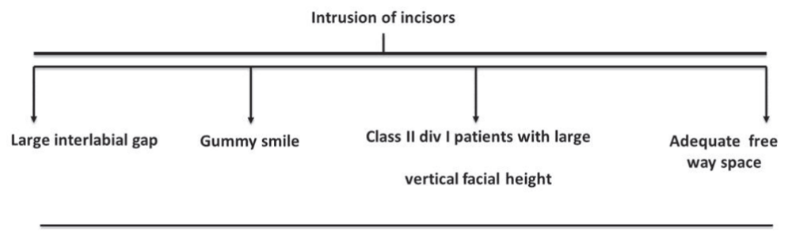
Indications and Contraindications

Slide 17
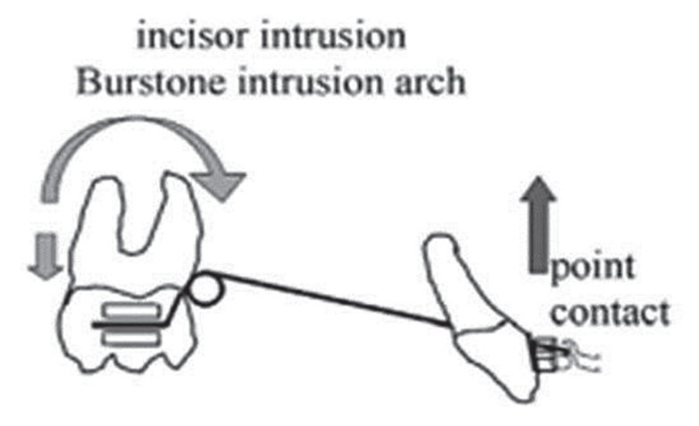
Intrusion of Anterior Teeth in Gummy Smile
Burstone intrusion arch
The single anterior point contact allows for precise calculation of the force delivery and it can be applied at the desired level relative to the position of the center of resistance of the anterior segment

Slide 18
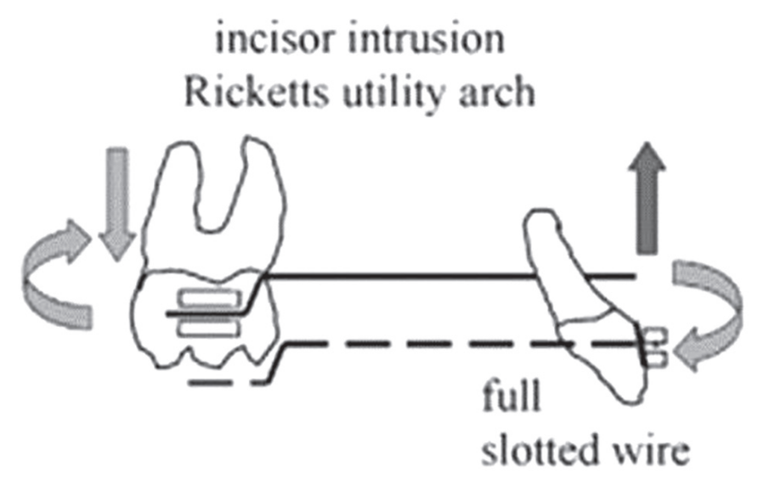
2. Ricketts Utility arch
Large buccal root torque moment is felt at the incisors, and depends on the wire/bracket relationship

Slide 19
Deep Bite and Reduced Lower Facial Height
Outcome of orthodontic eruption is not stable because of strong masticatory system and rectangular face
Minimal exposure of incisors at smiling, correction should include careful intrusion of lower incisors
Depending on the degree of deep bite, posterior orthodontic eruption with the use of an anterior biteplate

Slide 20
Deep Bite and Increased Lower Facial Height
Incisor intrusion is also necessary in cases of extrusion of maxillary but, especially mandibular incisors often observed in Class II, division 2 malocclusion.
During intrusion of lower incisors with lingual tipping, using a utility arch without tie back, the incisor crown follows an arch and moves labially, while being vertically displaced.

Slide 21
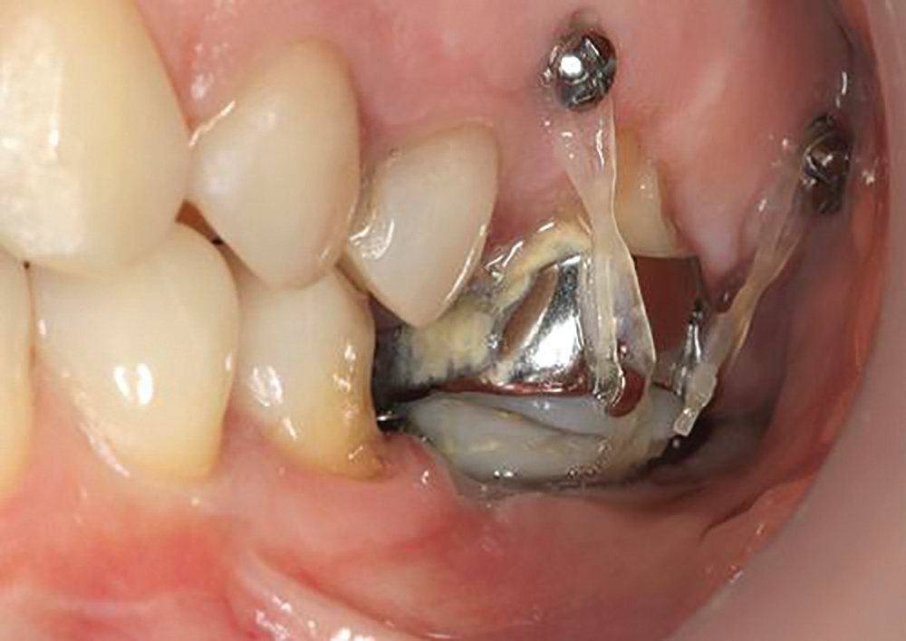
Intrusion of Posterior Teeth
Posterior intrusion is one of the most difficult tooth movements in orthodontics, because of the multiple molar roots.

Slide 22
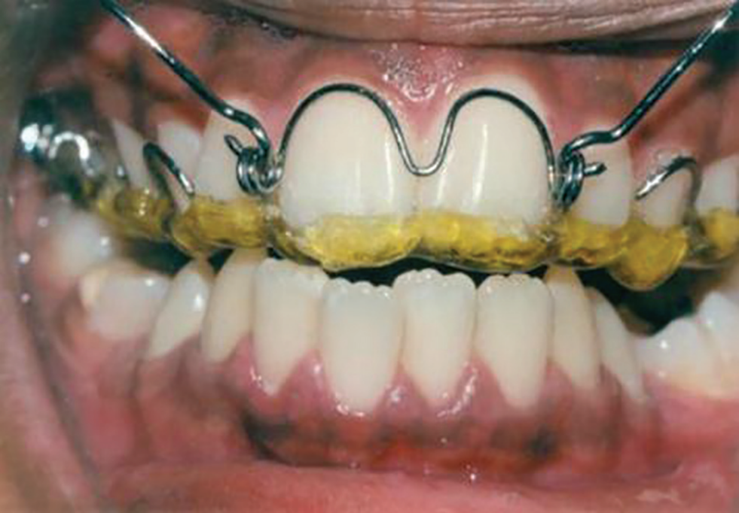
The Fixed and Removable appliances Used for Intrusion accomplishment
Acrylic intrusion splint with occlusal an incisal coverage in combination with very high, almost vertical pull headgear
Notes:
method corrects the position of anterior teeth sagitally and vertically and is indicated in Class II, division 1 cases where both incisor intrusion and reduction of increased overjet are required

Slide 23
Magnets
When magnets are placed in the oral environment, saliva acts as an electrolyte creating small currents that stimulate tissues.
electromagnetic field created increases vascularity and stimulates bone metabolism
samarium-cobalt (SmCo5, Sm2Co17) and neodymium-iron-boron (Nd2Fe14B)

Slide 24
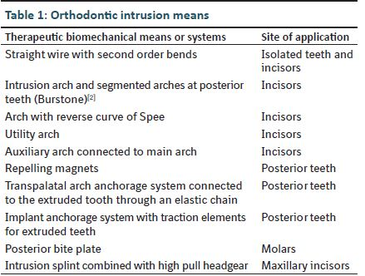
Summary

