Slide 1
JOURNAL CLUB PRESENTATION
Guides:
Dr A K Chandna
Dr. D K Agarwal
Dr. Preeti Bhattacharya
Dr. Ankur Agarwal
Dr. Shivani Singh
Presenter
Dr.Priyanshi Trivedi
Jr2

Slide 2
FIXED FUNCTION APPLIANCES: AN OVERVIEW
Dr Prateek et al
International journal o current research
Vol9 ,issue 3,march 2017

Slide 3

CONTENTS
INTRODUCTION
INDICATIONS
CLASSIFICATION
CONSIDERATIONS
MODE OF ACTION
EFFECTS ,COMPLICATIONS
CONCLUSION

Slide 4
INTRODUCTION
Growth modification is the best way to correct a jaw discrepancy as it allows the patients to grow out of the skeletal disharmony.
Functional appliances refer to a variety of appliances designed to alter the arrangement of various muscle groups that influence the function and position of the mandible in order to transmit forces to dentition and basal bone
The ideal time for treatment with fixed functional appliance is permanent dentition (to ensure a stable intercuspation of teeth post treatment) and after the pubertal growth spurt
(Kragt and Herman S Duterloo, 1982

Slide 5
INDICATIONS
1) The correction of skeletal abnormality in young growing individuals.
a) In skeletal class II patients with retrognathic mandible.
b) In skeletal class III patients with retrusive maxilla.
2) Making use of the residual growth left in neglected post adolescent patients who have passed the maximal pubertal growth and are too old for removable functional appliances.
3) In adults patients
a. Can be used to distalize the maxillary molars in correction of dental class II molar relationship.
b. Can be used to enhance anchorage.

Slide 6
c. Can be used as an mandibular anterior repositioning splint in patients having temporomandibular joint disorders.
d. Presurgical muscle conditioning of patients with class II malocclusion.
e. Post surgical stabilization of class II / class III malocclusion.
4. Correction of functional midline shifts by using the appliance unilaterally.

Slide 7
CLASSIFICATION
A} Rigid Fixed Functional Appliances (RFFA ) | B} Flexible Fixed Functional Appliances (FFFA) | C} Hybrid Fixed Functional Appliances (HFFA)
1. The Herbst Appliance and its modifications. | 1.The Jasper Jumper | 1. Eureka Spring
2. The Mandibular Protraction Appliance (MPA) | 2. The Adjustable Bite Corrector | 2. FORSUS- Fatigue Resistant Devices
3. The Mandibular Anterior Repositioning Appliance (MARA) | 3. The Churro Jumper. | 3. The Twin Force Bite Corrector.
4. The Ritto Appliance | 4. The Amoric Torsion Coils. | 4. Alpern Class II Closers
5.The IST-Appliance | 5. The Scandee Tubular Jumper | 5. The Calibrated Force Module
 | 6. The Klapper Super Spring
 | 7. The Bite Fixer

Slide 8
CONSIDERATIONS
1)Age factor
2)Growth considerations
3)Esthetic considerations
4)Compliance

Slide 9
MODE OF ACTION
Mechanism of mandibular repositioning similar to removable appliance
The appliance is tooth borne and exerts its effects via teeth to the underlying bone by transmitting the forces developed as a result of the continuous forward posturing of the lower jaw.

Slide 10
The general mode of action is one or combination of the following.
Mandibular growth induction
Maxillary growth restriction
Dento-alveolar changes
Glenoid fossa relocation
Changes in neuromuscular anatomy and function.

Slide 11
Functional appliance
Increased contractile activity of lateral pterygoid muscle
Intensification of retrodiscal pad by repetitive activity (bilaminar zone)
Increase in growth stimulating factors
a) Enhancement of local mediators
b) Reduction of local regulating factors
Additional growth of condylar cartilage and subperiosteal ossification of posterior border of ramus
Supplementary lengthening of mandible

Slide 12
Biomechanical Effects of Fixed Functional Appliance on Craniofacial Structures
1) Fixed functional appliances move the entire mandible anteroinferiorly, with maximum displacement observed in the parasymphyseal and midsymphyseal regions.
2) The displacement was more pronounced in the dentoalveolar region as compared to the skeletal displacement.
3) All dentoalveolar structures experience tensile stresses, except for anterior nasal spine and the maxillary posterior teeth.
4) Maximum tensile stress occurred in the condylar neck and head. (Panigrahi and vineeth, 2009)

Slide 13
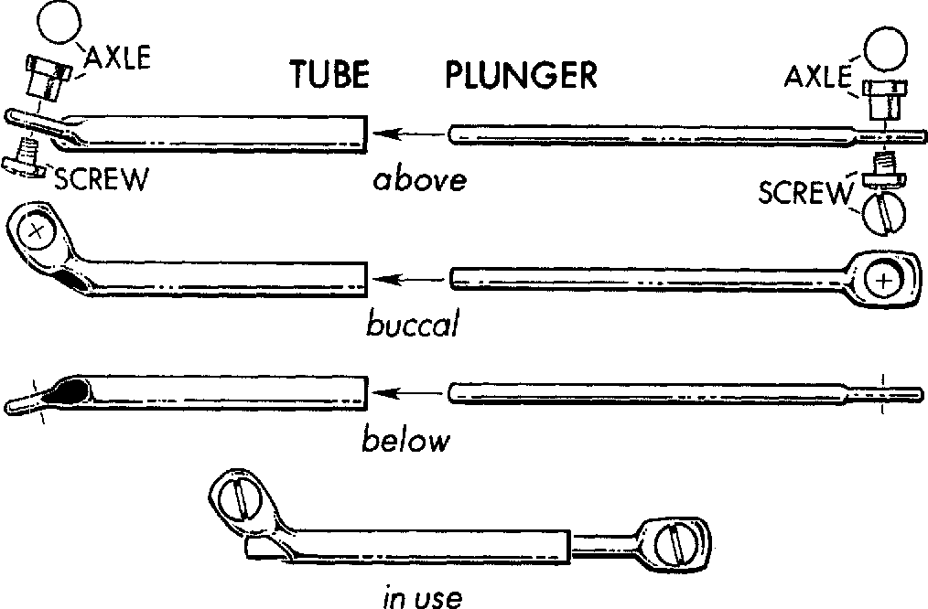
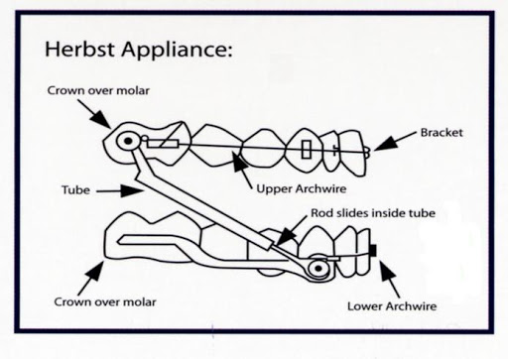
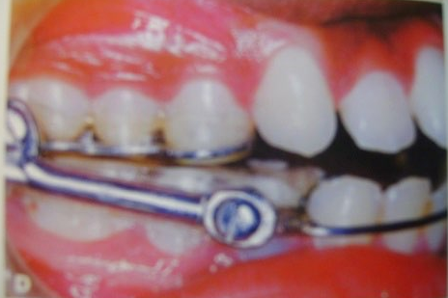
Herbst appliance
The Herbst appliance is an artificial joint between maxilla and mandible. A telescope mechanism on either side of the jaw, attached to orthodontic bands, keep the mandible continuously in an anterior jumped position during all mandibular functions.
The telescopic tube was attached to the maxillary permanent first molar band and the telescope plunger to the mandibular first premolar band

Slide 14
Modifications
Bonded Herbst appliance
Acrylic splint Herbst appliance
Integrated Herbst appliance
Mandibular advancement locking unit(MALU)Herbst
Flip locked Herbst appliance

Slide 15
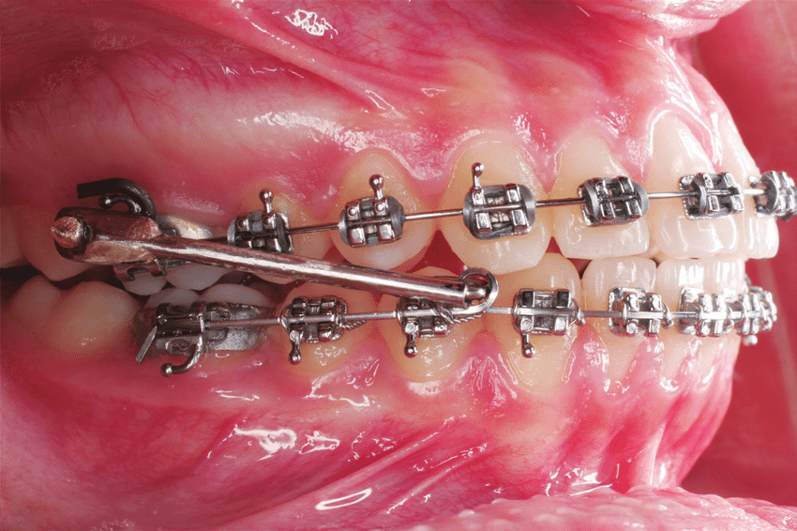
MANDIBULAR PROTRACTION APPLIANCE(MPA)
There are four types of MPA (I - IV).
It is used for the treatment of skeletal class II deformity. Sufficient overjet reduction has been seen in period as short as 4 months.
The result may be due to mandibular growth promotion and dentoalveolar changes. Dentoalveolar changes include distalization of maxillary molars, retraction of maxillary anteriors, mesialization of mandibular molars without retraction of mandibular anteriors.
This appliance was developed to overcome the costly laboratory procedures associated with the herbst appliance and the jasdper jumper.

Slide 16
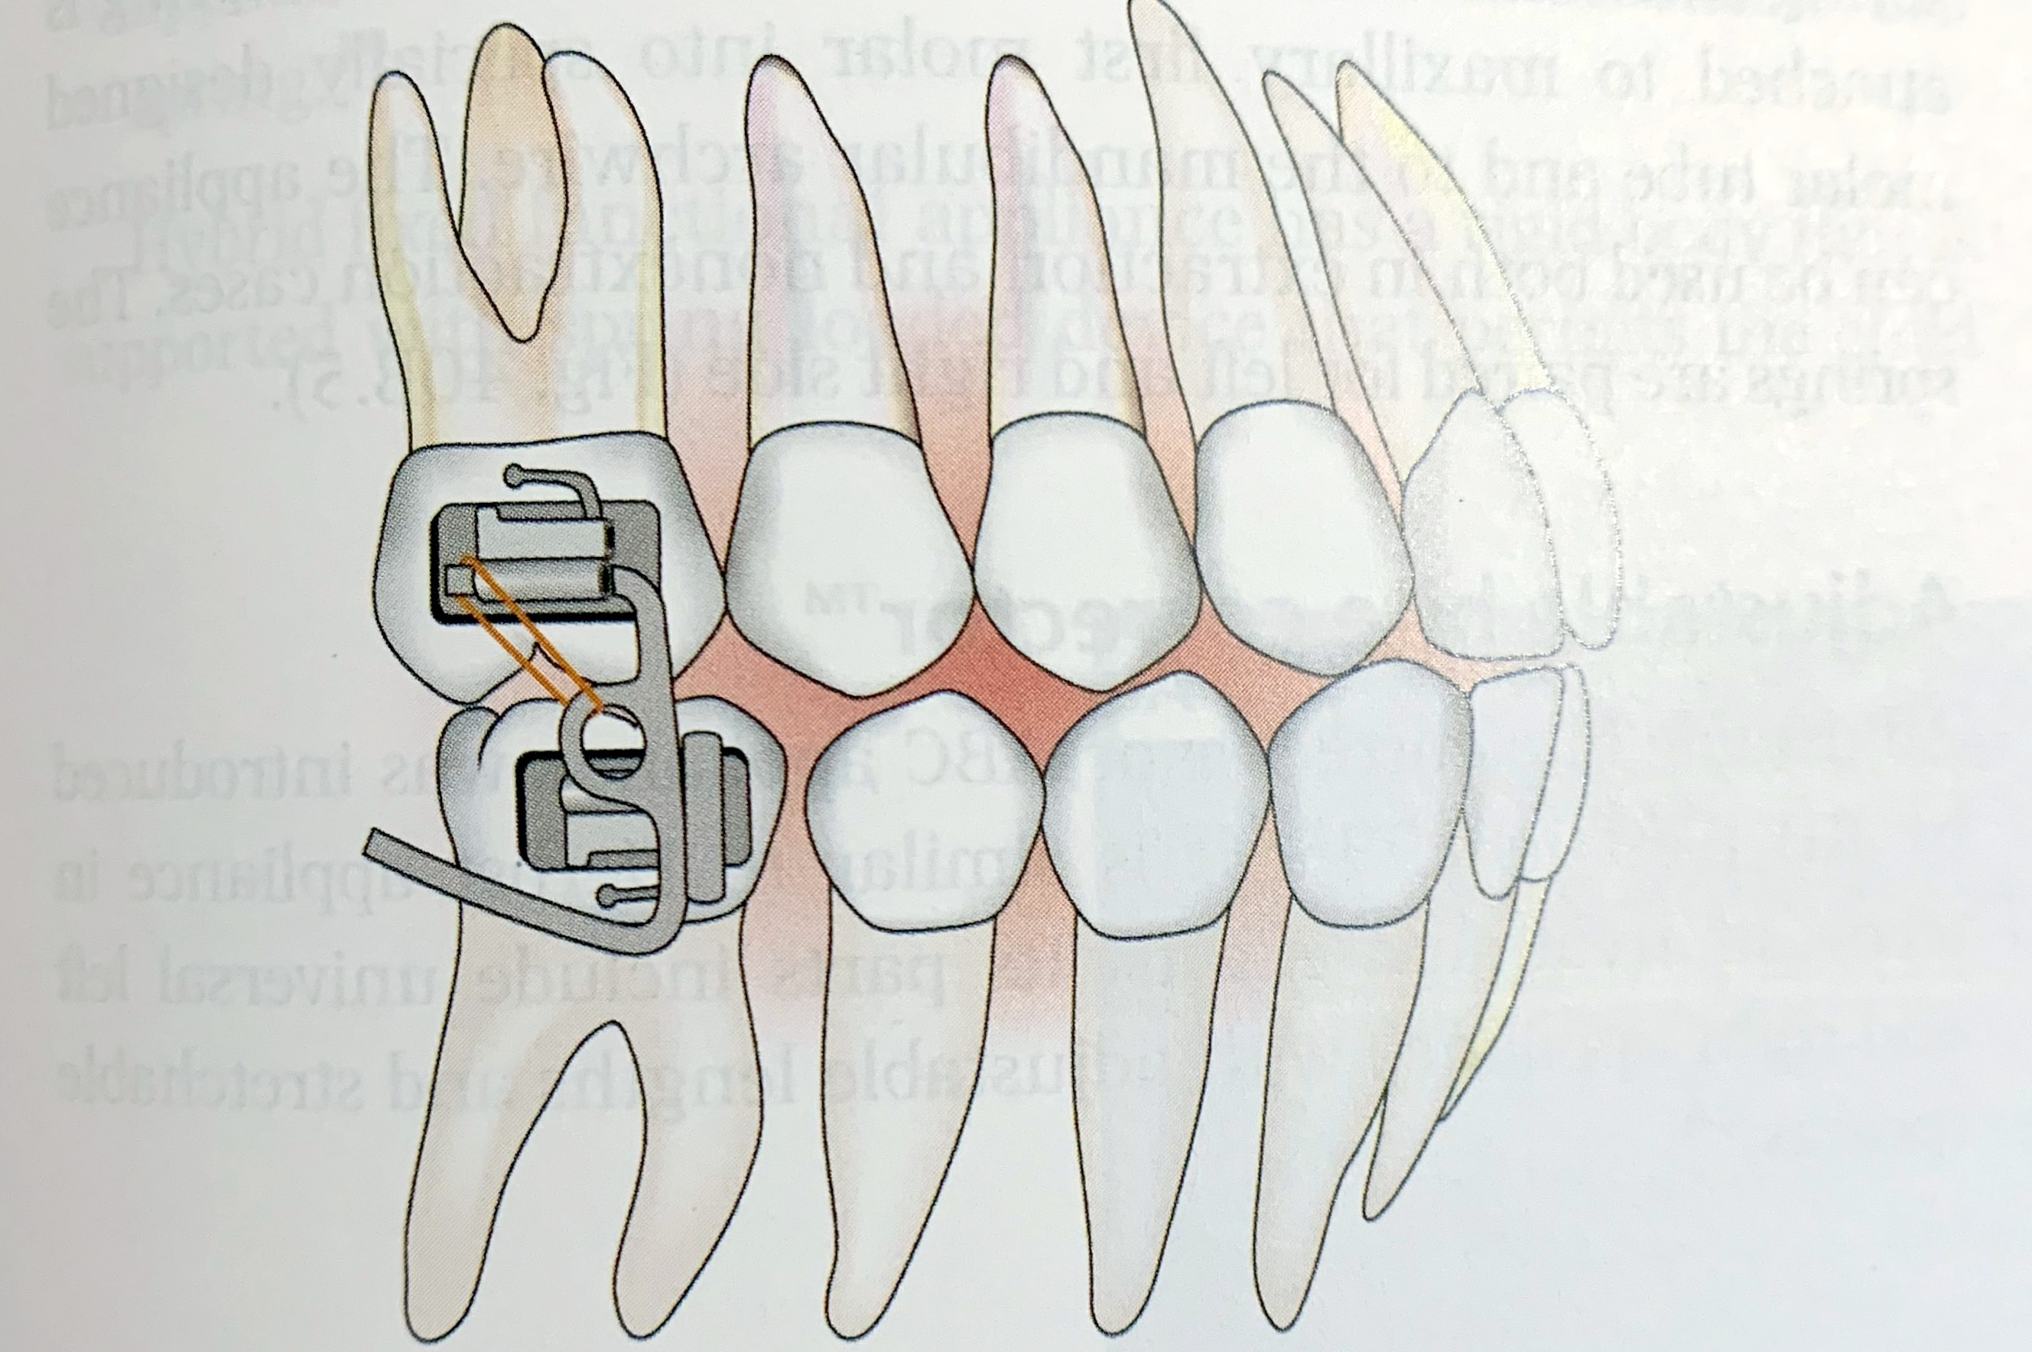
MANDIBULAR ANTERIOR REPOSITIONING APPLIANCE
It postures the lower jaw in the forward position
It is a miniatured rigid fixed functional appliance primarily attached to upper first molars on either sides

Slide 17
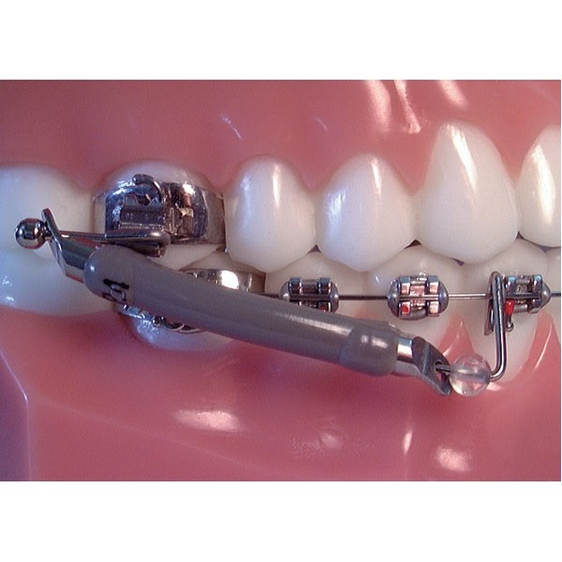
JASPER JUMPER
In an attempt to overcome the rigidity problem of the Herbst Appliance, James Jasper developed a new pushing device that is flexible. It is termed as Jasper Jumper.
It can be attached between the maxillary and mandibular arches to produce both sagital and intrusive forces which may be either "head-gear like", “activator like forces" or combination of both.

Slide 18
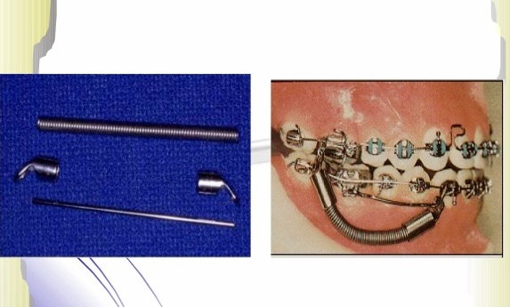
ADJUSTABLE BITE CORRECTOR
The appliance is similar to Jasper Jumper but incorporates several useful features.
It consists of a stretchable closed-coil spring with internally threaded endcaps at both ends. This allows additional range of opening with no risk of breaking the appliance or accidentally changing its length.

Slide 19
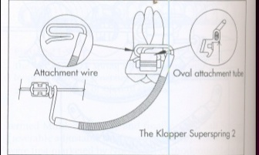
SUPER SPRING II
The super spring II is a flexible spring that attaches between the maxillary molar and mandibular canine. It is designed to rest in the vestibule, making it impervious to occlusal damage and allowing for good hygiene
Uses: The spring can be used in entire range of class II cases, from vertical facial patterns with shallow overbites to brachyfacial patterns with deep overbites. It can be used with fully bracketed appliance.

Slide 20
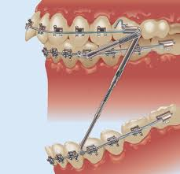
EUREKA SPRING
This is also a fixed intermaxillary force delivery system similar to fixed Herbst appliance
Advantages of eureka spring are that minimal patient co-operation is required.
Because of its small size and lack of protruberances into the buccal vestibule it is almost invisible. Hence its esthetic acceptability is high.
it is Resistant to breakage.
And causes minimal tissue irritation.

Slide 21
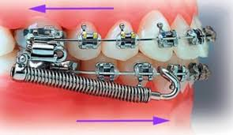
Forsus (Fatigue resistant device)
The Forsus (also known as the Forsus Fatigue Resistant Device [FRD]) is a semirigid telescoping system incorporating a superelastic nickel-titanium coil spring that can be assembled chair-side, and it can be used in conjunction with complete fixed orthodontic appliances.
The Forsus (FRD) can be used instead of Class II elastics in mild cases and instead of Herbst appliances in severe cases. Forsus springs work best in patients with convex profiles, but they are indicated in any Class II patients except those with normal mandibles and protrusive maxillae, or with protrusive or overly large mandibles relative to the other cranial structures

Slide 22
COMPLICATIONS
Sanden et al. (2004) described the complications during fixed functional appliance treatment.
The types of complications most commonly seen,
1. Breakage of bands or splints.
2. Breakage of telescoping mechanisms.
3. Loosening of bands or splints.
4. Trauma to buccal mucosa

Slide 23
CONCLUSION
Removable functional appliances are effective but rely heavily at the mercy of patient cooperation for achieving predictable results in a reasonable time frame. Patient cooperation is variable and is not always forth coming, with appliances such as headgear or removable functional appliances.
Thus fixed functional appliances have an added advantage over them but a correct diagnosis is paramount for successful treatment

Slide 24
THANK YOU

