Slide 1
Two different antibiotic protocols as adjuncts to one-stage full-mouth ultrasonic debridement to treat generalized aggressive periodontitis: A pilot randomized controlled clinical trial
SHREYA MAHESHWARI
PG 2ND YEAR
DEPT. OF PERIODONTICS

Slide 2
WHY I CHOSE THIS ARTICLE ?

Slide 3
PROLOGUE
AGGRESSIVE PERIODONTITIS
“a disease of the periodontium occurring in an otherwise healthy adolescent which is characterized by a rapid loss of alveolar bone about more than one tooth of the permanent dentition. The amount of destruction manifested is not commensurate with the amount of local irritants.”
Baer, 1971

Slide 4
1923 Gottlieb
called “diffuse atrophy of the alveolar bone.”
1928 Gottlieb
He then termed the disease deep cementopathia and hypothesized that this was a “disease of eruption” and that cementum initiated a foreign body response.
1938 Wannenmacher
described incisor–first molar involvement and called the disease parodontitis marginalis progressiva
H
I
S
T
O
R
Y
1999, World Workshop in Periodontics
several rapidly progressing periodontitis forms were united under the term aggressive
periodontitis.
The European Federation of Periodontology and the American Academy of Periodontology for November 2017 grouped “chronic” and “aggressive” periodontitis
under the same category, “periodontitis”, and established
a staging and grading scheme.
1966, the World Workshop in Periodontics
concluded that the concept of “periodontosis”
as a degenerative entity was unsubstantiated and that the term should be eliminated from periodontal nomenclature

Slide 5
Aggressive Periodontitis
The following characteristics are common to patients with aggressive periodontitis:
• Otherwise clinically healthy patient (note the distinction with periodontitis as a manifestation of systemic disease)
• Rapid attachment loss and bone destruction
• Familial aggregation of diseased individuals
The following characteristics are common but not universal:
• Amount of microbial deposits inconsistent with disease severity
• Increased levels of Actinobacillus actinomycetemcomitans
• Abnormalities in phagocyte function
• Hyper-responsive macrophages, producing increased prostaglandin E2 (PGE2) and interleukin-1 (IL-1)
• In some cases, self-arresting disease progression

Slide 6
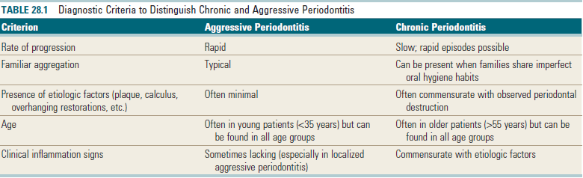
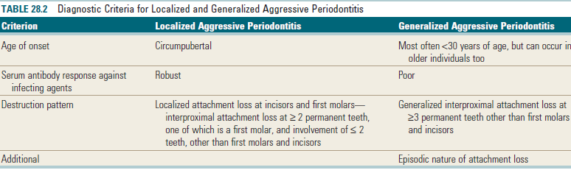

Slide 7
SOURCE OF THE ARTICLE
Name of Journal: Journal of Periodontology
Year : 2019 Month : february
Page numbers : 1-10
Volume 89 Issue 10
Section of the journal under which the article is published : Original Research
Accepted for publication – February 2019.

Slide 8
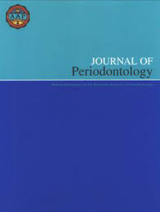
ABOUT THE JOURNAL
The aim of journal of periodontology is to
publish original papers of the highest
scientific quality to support the practice,
education, & research in the dental speciality
of periodontics.

Slide 9
METRICS OF THE ARTICLE
Current impact factor - 3.392
5-year impact - 2.90
Cited half-life - 9.20
Immediacy index - 0.32
Eigen factor - 0.02
Article influence - 0.83

Slide 10
ISSN : 0022-3492 (Print)
1943-3670 (Electronic)
0022-3492 (Linking)
OCLC no. : 2105859
NLM ID : 8000345 [Serial]
Other ID : (DNLM)J34160000(s)
(0CoLC)02105859
Publisher : American academy of periodontology

Slide 11
NLM Title Abbreviation : J Periodontol
ISO Abbreviation : J Periodontol
Editor-in-Chief : Kenneth S. Kornman, DDS PhD
Waltham, Massachusetts
Associate Editors : Anna Dongari
Thomas W
David W

Slide 12
Publication Start Year: 2018
Frequency: Monthly
Publication Type: Journals
Country of Publication: United States
Publisher: (Chicago) American academy of periodontology-
Latest Publisher: American academy of periodontology- Michigan Ave
Acid-Free: No
Current Indexing Status: Currently indexed for MEDLINE

Slide 13
TITLE
Two different antibiotic protocols as adjuncts to one-stage full-mouth ultrasonic debridement to treat generalized aggressive periodontitis: A pilot randomized controlled clinical trial

Slide 14
AUTHORS
Division of Periodontics, Institute of Science and Technology, São Paulo State University, São Paulo, Brazil
Cássia F. Araujo
Naira M.R.B. Andere
Nídia C. Castro dos Santos
Department of Prosthodontics and Periodontics, Division of Periodontics, University of Campinas ,Brazil
Aurélio A. Reis
Renato C.V. Casarin
Ingrid F. Mathias-Santamaria
Luciane D. de Oliveira
Maria A.N. Jardini Mauro P. Santamaria

Slide 15
INTRODUCTION
The initial treatment of this disease aims to disrupt the biofilm and reduce the bacterial load of periodontal pockets by root instrumentation using hand-driven or power-driven instruments.
However, the use of adjunctive antimicrobial agents is usually required in the treatment of generalized aggressive periodontitis (GAgP).
Due to the capability of disease-related pathogens, mostly Aggregatibacter actinomycetemcomitans and Porphyromonas gingivalis, to attach to periodontal pocket epithelium, invade the periodontal connective tissue, and thereby escape from host defenses.

Slide 16
Effectiveness of the amoxicillin (AMX) and metronidazole (MET) combination.
This association promotes greater gain in the clinical attachment level (CAL), as well as greater reduction in periodontopathogenic microorganisms and in the levels of inflammatory cytokines when compared with mechanical treatment alone.
Hypersensibility reaction to AMX, requiring another drug.
CLM, has its higher concentration in inflamed gingival tissue when compared with health.
It may reach increased concentration levels in gingiva than in plasma and accumulate within fibroblasts and epithelial cells.
These characteristics may favor its action on intracellular microorganisms that can invade periodontal tissue and may facilitate the elimination of pathogens. CLM may enhance the treatment outcomes of AgP.

Slide 17
AIM
To assess the clinical and microbiological responses of the AMX + MET association versus CLM combined with one-stage full-mouth ultrasonic debridement (FMUD) in the treatment of patients with GAgP.

Slide 18
MATERIAL AND METHODS

Slide 19
1) diagnosis of GAgP,
2) presence of ≥20 teeth, excluding third molars and teeth indicated for extraction;
3) Presence of ≥6 sites presenting PD ≥5 mm with bleeding on probing (BOP) and ≥2 sites with PD ≥7 mm (including incisors and first molars, in addition to three other non-contiguous teeth between them);
4) good general health;
5) at least 18 years old; and
6) agree to participate in the study and sign a written consent.
1) were pregnant or nursing;
2) were suffering from any other systemic disease (e.g., cardiovascular, diabetes, blood dyscrasias, immunodeficiency, etc.);
3) received antimicrobials or anti-inflammatory drugs in the previous 6 months;
4) received a course of periodontal treatment within the last 12 months;
5) smoked ≥10 cigarettes/day;
6) reported an allergy to AMX , MET, or CLM;
7) Required antibiotic prophylaxis; or
8) were currently using medication that could interfere with periodontal response were excluded

Slide 20
Pre treatment protocol

Slide 21
Randomization and allocation concealment

Slide 22
TREATMENT
AMX+MET group (n=23):
FMUD associated withAMX (500 mg, 8/8 hours) plus MET (400 mg, 8/8 hours), both for 7 days.
CLM group (n=23):
FMUD associated with CLM (500 mg, 12/12 hours for 7 days).
Administration of the first antibiotic dose began immediately before the periodontal debridement session.
After the treatment, patients returned monthly for oral prophylaxis.

Slide 23
Clinical measurements
(1) PD: distance from the bottom of sulcus/pocket to gingival margin;
(2) CAL: distance from the bottom of sulcus/pocket to cemento-enamel junction (CEJ);
(3) gingival recession (GR): distance from gingival margin to CEJ;
(4) full-mouth plaque index (FMPI); and
(5) full-mouth BOP.
The clinical measures were assessed using a manual probe.
PD, CAL, and GR measurements were done at six sites per tooth (mesiobuccal, buccal, disto-buccal, distolingual, lingual, and mesiolingual)

Slide 24
Microbiological evaluation
Subgingival plaque samples were taken from one random non-molar pocket with baseline PD ≥5 mm, CAL ≥5 mm, and BOP.
Supragingival biofilm was carefully removed with the aid of curets, and two #35 sterile paper points were inserted into the sites for 30 seconds.
The samples were stored in sterile microtubes and kept in a −20ºC freezer until the time of analysis by quantitative polymerase chain reaction§ (qPCR).
The DNA counts of Aggregatibacter actinomycetemcomitans, Porphyromonas gingivalis, Tannerella forsythia, and Fusobacterium nucleatum were rated using specific primers.

Slide 25
Adverse effects and compliance
The questionnaire was based on six specific reactions (malaise, dizziness, drowsiness, diarrhea, itching, and rash).
In the delivery of the drugs, the patients were cleared to pay attention to these symptoms.

Slide 26
Statistical analysis
Clinical and microbiological data were submitted to the analysis of variance (ANOVA) two way repeated-measures/Tukey test for inter- and intragroup comparison.
Friedman test was applied to detect intragroup differences, and Mann-Whitney U test was applied to detect intergroup differences from variables that did not present normality.
Chi-squared was used to evaluate the differences between groups.
The significance level adopted was 5%.

Slide 27
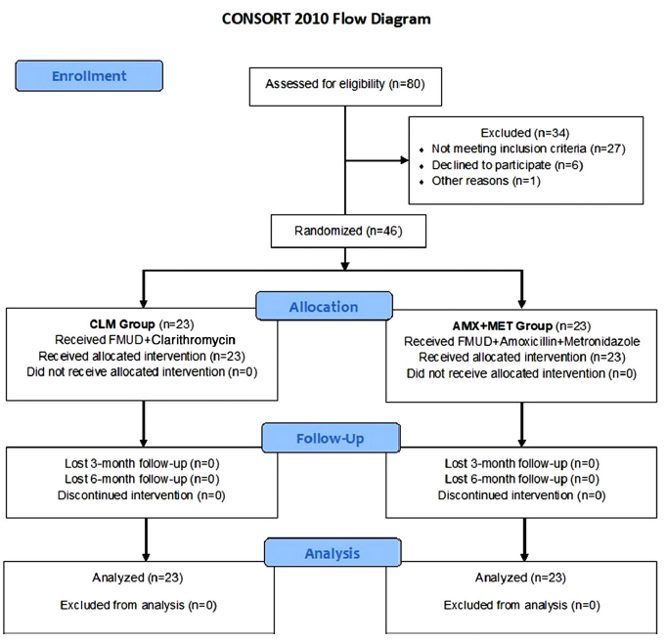

Slide 28
RESULTS

Slide 29
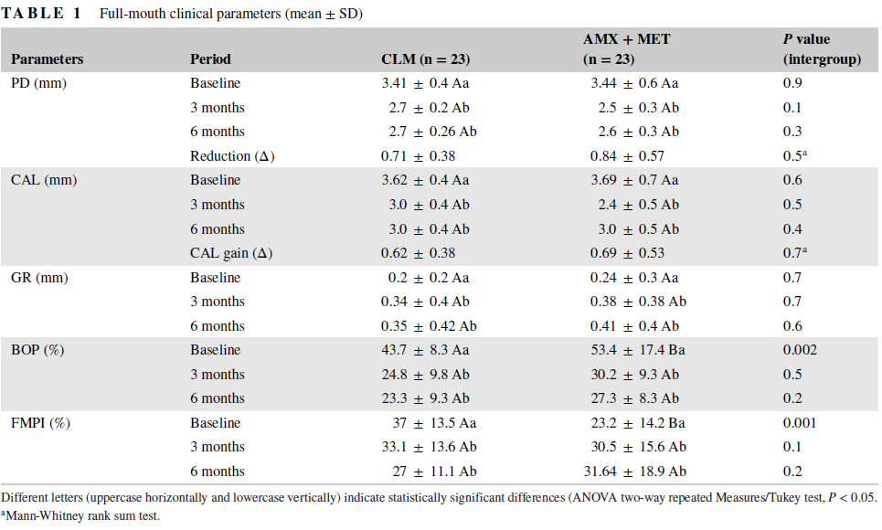

Slide 30
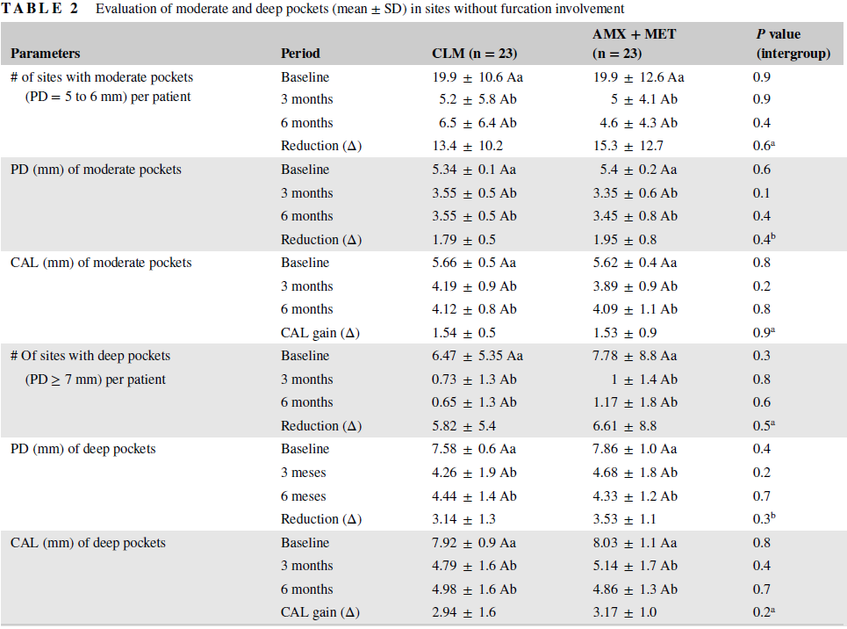

Slide 31
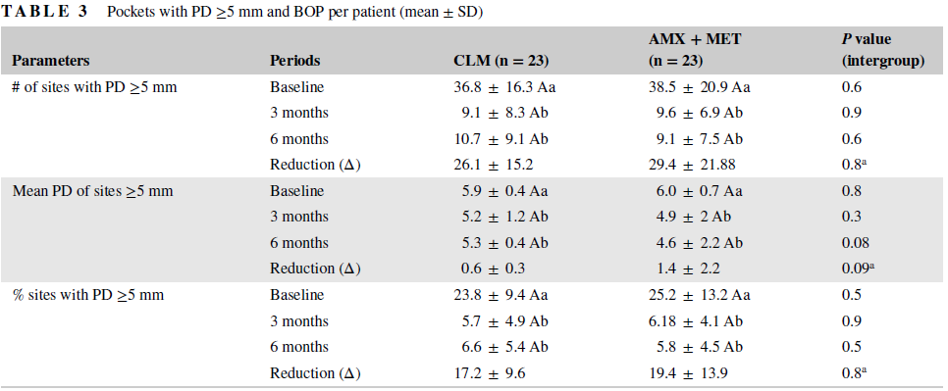

Slide 32
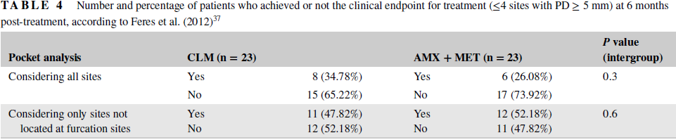
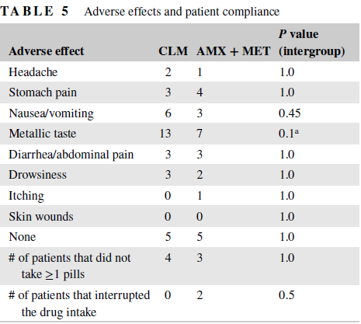

Slide 33
Microbiologic outcomes
Microbiologic analysis showed statistically significant reduction in the counting (Log10) of A. actinomycetemcomitans and P. gingivalis at 3 and 6 months post-treatment, in both groups (P > 0.05).
It also revealed statistically significant decrease in the frequency of detection of A. actinomycetemcomitans at 6 months, with no intergroup difference.
There was statistically significant reduction in T. forsythia at 6 months, favoring the CLM group.
The amount of F. nucleatum was not modified by any antibiotic protocol.

Slide 34
DISCUSSION
The present pilot study showed that CLM for 7 days as an adjunct to one-stage full-mouth ultrasonic periodontal debridement in the treatment of GAgP did not produce superior results compared with the use of AMX+MET.
The differences in CAL gain and PD reduction of deep pockets and the percentage of patients achieving the treatment end point were not statistically significant between the two treatment protocols.
Guerrero et al. - evaluated the adjunct effect of the AMX + MET combination. 41 patients received 500 mg AMX and 500 mg MET, both three times a day, for 7 days and the outcomes of this study is in accordance with the present study.

Slide 35
Alternatives to the AMX+MET association, Andere et al. performed the first randomized placebo controlled clinical trial evaluating the effect of the adjunctive use of CLM for 3 days in the nonsurgical treatment of GAgP.
In this study, 40 patients with GAgP were selected. In addition to ultrasonic periodontal debridement, the test group received 500 mg CLM, 12/12 hours, for 3 days. The results demonstrated that CLM provides greater reduction of deep pockets compared with the placebo group.
Statistically significant intergroup difference was observed only in PD reduction at 6 months, which was favorable to the group that received CLM.

Slide 36
This study also evaluated microbiological outcomes. As reported by previous studies in which the AMX+MET association was used, the counts of A. actinomycetemcomitans and P. gingivalis were significantly reduced.
In the present study, CLM promoted a decrease in T. forsythia at 6 months, which may help to prevent the persistence of T. forsythia in pockets after non-surgical therapy and to promote post-treatment stability.
Pradeep and Kathariya also reported significant reductions in A. actinomycetemcomitans and P. gingivalis counts but not in T. forsythia.
Previous reports demonstrated that the persistence of A. actinomycetemcomitans, P. gingivalis, and T. forsythia may be related to the unsuccess of the therapy. The amount of F. nucleatum was not modified by any antibiotic protocol

Slide 37
In both groups, 78.26% of the patients reported the occurrence of at least one adverse effect.
Despite both groups have shown similar occurrence of adverse effects patients in CLM group seem to report more tolerable symptoms.
a systematic review that evaluated AMX + MET as adjunct to periodontal treatment recommended that the highest dose should be used for the shortest period to minimize the risk of antibiotic resistance, supporting the regimen adopted in the present study.
Cosgarea et al. concluded that the use of AMX + MET for 3 or 7 days brings clinical improvements compared with placebo after 12 months.
Borges et al. showed that 14 days of AMX+MET is more effective than the 7-day regimen in the treatment of patients with severe chronic periodontitis.

Slide 38
LIMITATIONS

Slide 39
CONCLUSION
Within the limits of this pilot study, the results suggest that CLM is not superior to AMX+MET in the treatment of GAgP.
However, this antibiotic led to good clinical outcomes and may be a possible alternative to AMX+MET in the treatment of severe periodontitis in young patients.

Slide 40
REFERENCES
Carranza 9th and 13th edition
KD Tripathi 7th edition
Guerrero A, Griffiths GS, Nibali L, et al. Adjunctive benefits of systemic amoxicillin and metronidazole in non-surgical treatment of generalized aggressive periodontitis: a randomized placebo controlled clinical trial. J Clin Periodontol. 2005;32:1096-1107.
Feres M, Soares GM, Mendes JA, et al. Metronidazole alone or with amoxicillin as adjuncts to non-surgical treatment of chronic periodontitis: a 1-year double-blinded, placebo-controlled, randomized clinical trial. J Clin Periodontol. 2012;39:1149- 1158
Martys CR. Monitoring adverse reactions to antibiotics in general practice. J Epidemiol Community Health. 1982;36:224-227.
Pavicić MJ, van Winkelhoff AJ, Pavicić-Temming YA, Graaff J. Amoxycillin causes an enhanced uptake of metronidazole in Actinobacillus actinomycetemcomitans: a mechanism of synergy. J Antimicrob Chemother. 1994;34:1047-1050.

Slide 41
`
THANK YOU

